Slide 1
Solution Framework Low Code TestAutomation Generation
Tooling for the Continuous Testing Life Cycle

Slide 2
High-Level Architecture

Slide 3
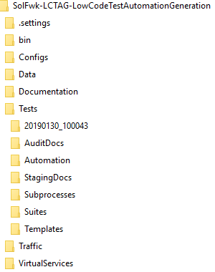
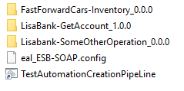
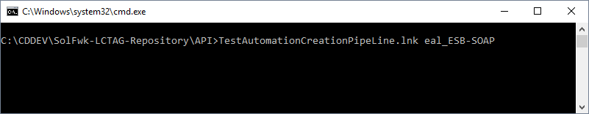
High-Level Architecture
Version Controlled
DevTest project
File-based API Test Repository
Functional grouping of API Test Specifications in direcories
Contains:
Config files for controlling functional features of the generated tests
Shortcut to TestAutomationCreationPipeLine.bat
Timestamped directory
Contains generated test for a TestAutomationCreationPipeLine run
Test Generation Run

Slide 4
Procedure 1/? - Add API Test
Add a Transaction aka Interaction
Add the Actual Request
Add the Minimal Expected Response
Optional – Add a specific, complete, correct Response
Rinse, repeat
Or Correct an existing Transaction aka Interaction

Slide 5
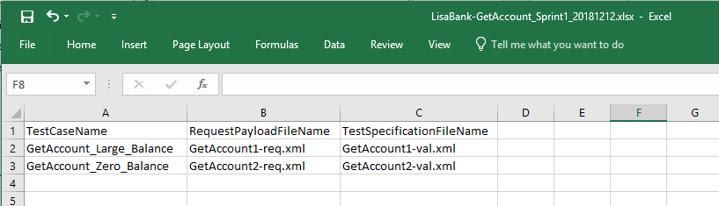
Procedure 2/? - Define Commit Scope for current API Test Design iteration
List up created and/or corrected tests into an Excel file
Commit to Source Control Management (software version control)
Run TestAutomationCreationPipeLine
Commit to Artifact Repository (Nexus, Artifactory, ...)
Deliverable
API Test Specification aka Contract Specification aka API Test Source Code under version control
API Test “Executable” under version control

Slide 6
Backup Slides

Slide 7
LisaBank-GetAccount_Sprint1_20181212.xlsx - Excel

Slide 8
CA-DevTest-Solution-Patterns

Slide 9
bin

Slide 10
API

Slide 11
C:\Windows\system32\cmd.exe

Slide 12
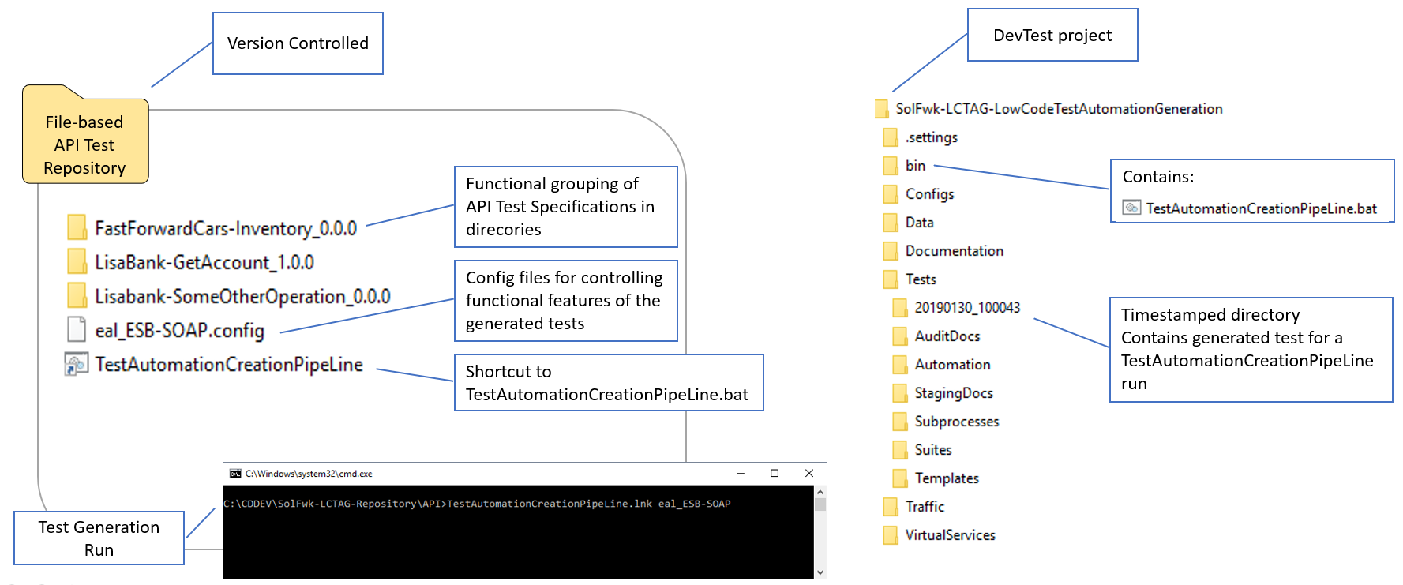
PowerPoint Slide Show - SolFwk-LowCodeTestAutomationGeneration.pptx

Slide 13
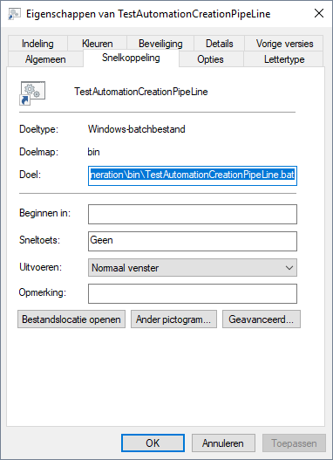
Eigenschappen van TestAutomationCreationPipeLine

Slide 14
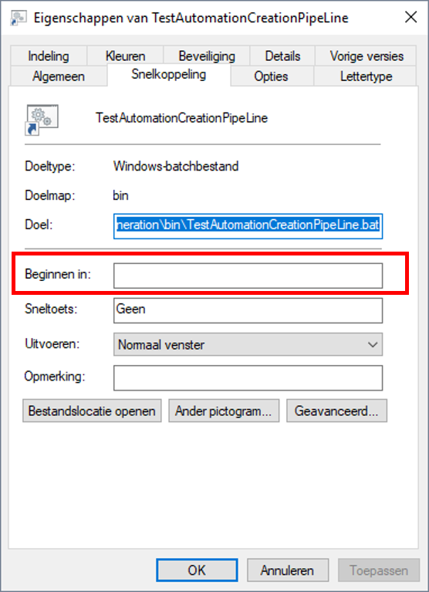
PowerPoint Slide Show - SolFwk-LowCodeTestAutomationGeneration.pptx

Slide 15
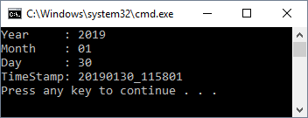
C:\Windows\system32\cmd.exe

Slide 16
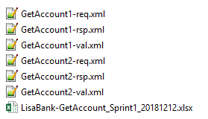
LisaBank-GetAccount_1.0.0

Slide 17
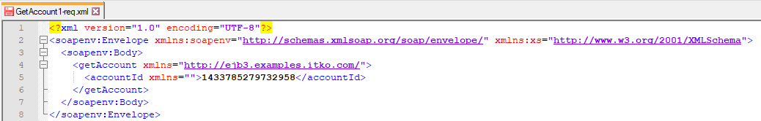
C:\CDDEV\SolFwk-LCTAG-Repository\API\LisaBank-GetAccount_1.0.0\GetAccount1-req.xml - Notepad++

Slide 18
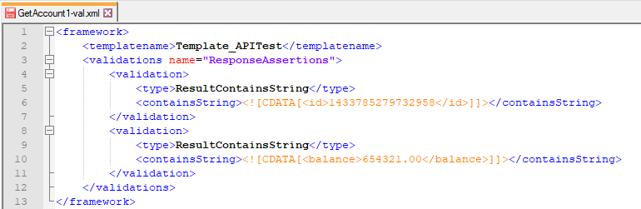
C:\CDDEV\SolFwk-LCTAG-Repository\API\LisaBank-GetAccount_1.0.0\GetAccount1-val.xml - Notepad++

Slide 19



C:\CDDEV\SolFwk-LCTAG-Repository\VirtualServiceValidation\LisaBank-GetAccount_1.0.0\GetAccount1-val.xml - Notepad++

Slide 20
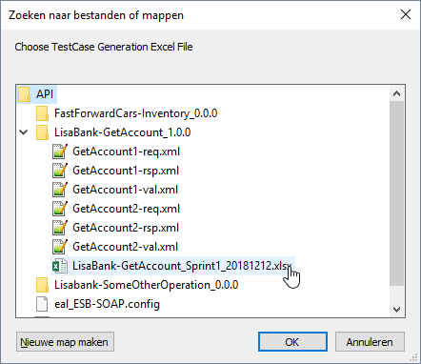
Zoeken naar bestanden of mappen

Slide 21
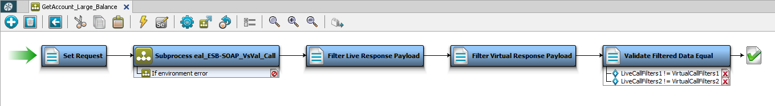
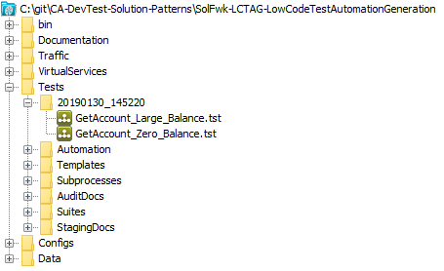
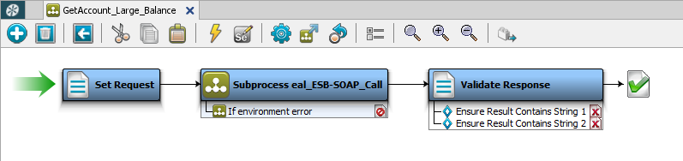
DevTest Solutions v10.3.0 (10.3.0.297) : DevTest Workstation (User: admin)

