Slide 1
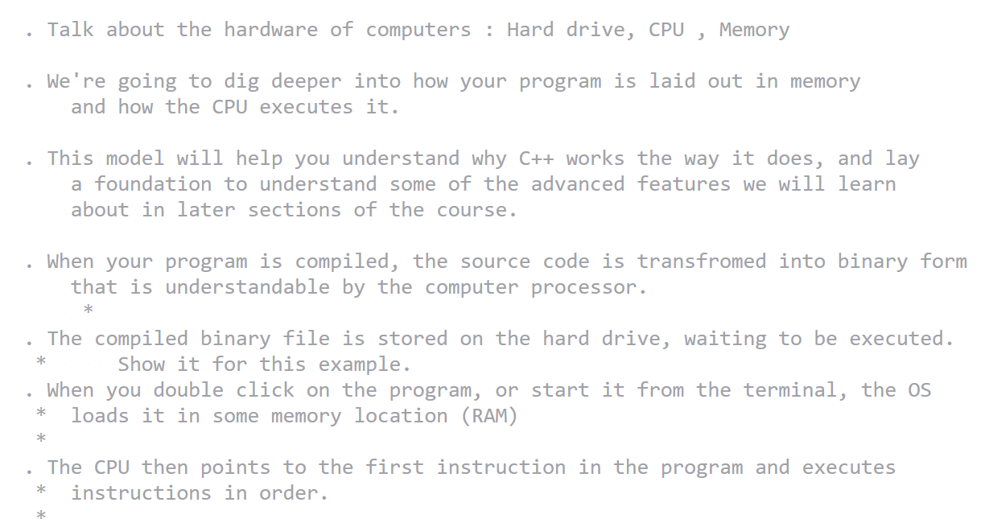
Notes to self

Slide 2
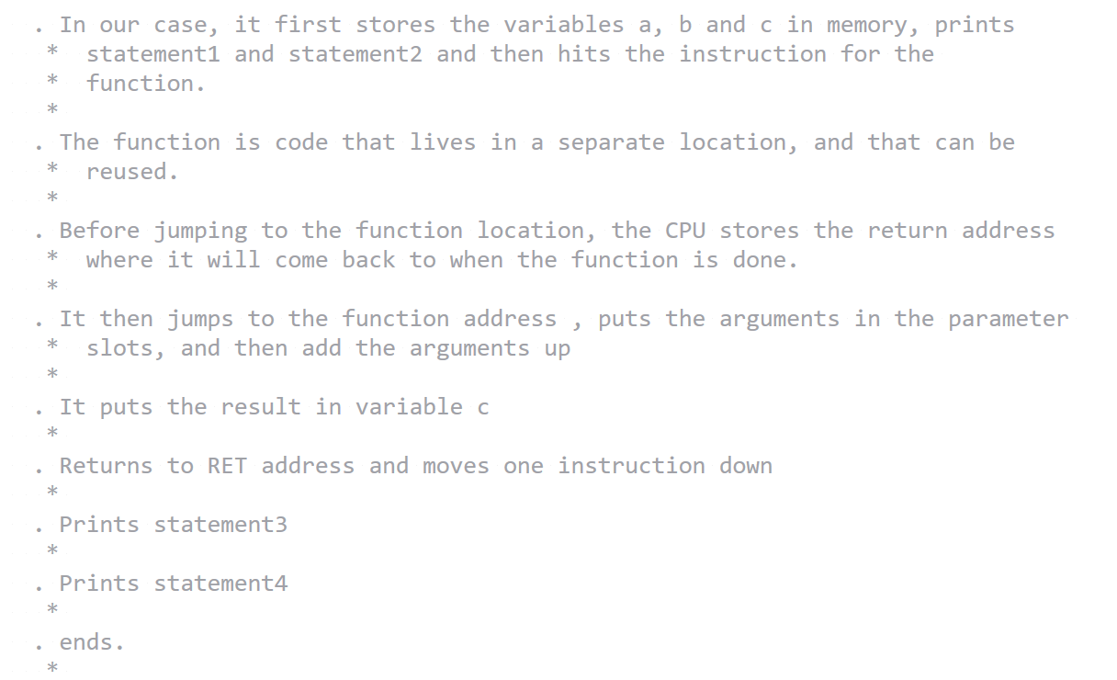
Notes to self

Slide 3
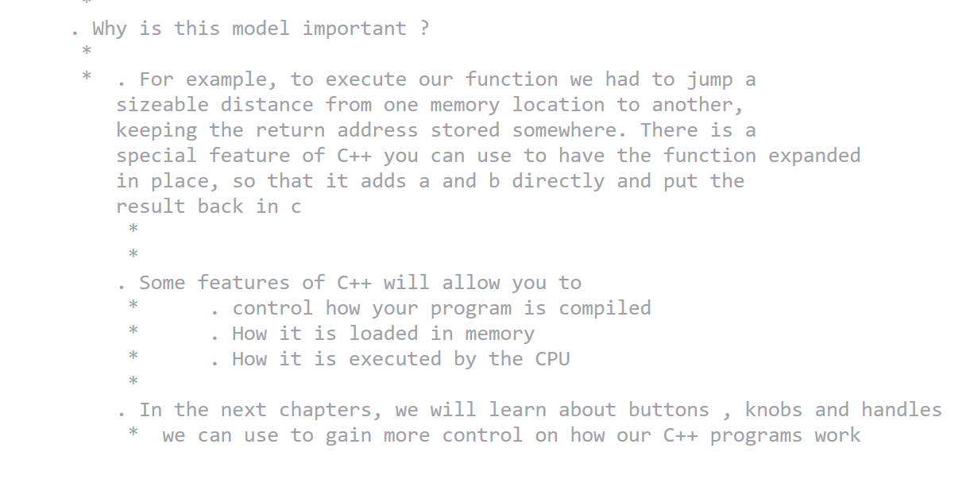
Notes to self

Slide 4
C++ Program Execution Model & Memory Model

Slide 5
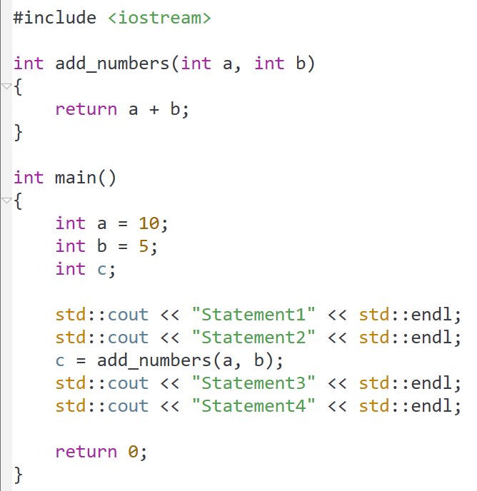

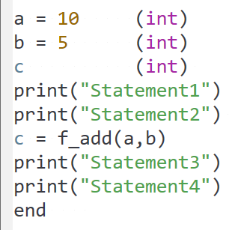

Compiler

Slide 6
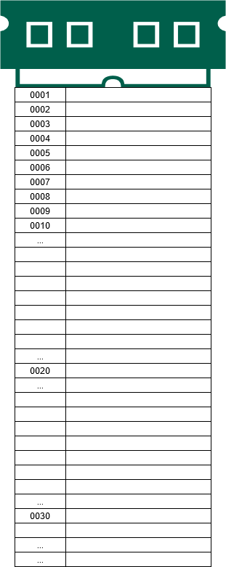

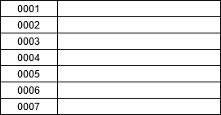

CPU
Program area
Hard Drive

Slide 7
CPU
Program area
a= 10 (int)
b = 5 (int)
c (int)
print(“Statement1”)
print(“Statement2”)
c = f_add(a,b)
print(“Statement3”)
print(“Statement4”)
end
Hard Drive
param1
param2
Param1 + param2

Slide 8
CPU
Program area
a= 10 (int)
b = 5 (int)
c (int)
print(“Statement1”)
print(“Statement2”)
c = f_add(a,b)
print(“Statement3”)
print(“Statement4”)
end
Hard Drive
param1
param2
Param1 + param2

Slide 9
CPU
Program area
a= 10 (int)
b = 5 (int)
c (int)
print(“Statement1”)
print(“Statement2”)
c = f_add(a,b)
print(“Statement3”)
print(“Statement4”)
end
Hard Drive
a
param1
param2
Param1 + param2

Slide 10
CPU
Program area
a= 10 (int)
b = 5 (int)
c (int)
print(“Statement1”)
print(“Statement2”)
c = f_add(a,b)
print(“Statement3”)
print(“Statement4”)
end
Hard Drive
10
a
param1
param2
Param1 + param2

Slide 11
CPU
Program area
a= 10 (int)
b = 5 (int)
c (int)
print(“Statement1”)
print(“Statement2”)
c = f_add(a,b)
print(“Statement3”)
print(“Statement4”)
end
Hard Drive
10
a
param1
param2
Param1 + param2

Slide 12
CPU
Program area
a= 10 (int)
b = 5 (int)
c (int)
print(“Statement1”)
print(“Statement2”)
c = f_add(a,b)
print(“Statement3”)
print(“Statement4”)
end
Hard Drive
10
a
b
param1
param2
Param1 + param2

Slide 13
CPU
Program area
a= 10 (int)
b = 5 (int)
c (int)
print(“Statement1”)
print(“Statement2”)
c = f_add(a,b)
print(“Statement3”)
print(“Statement4”)
end
Hard Drive
10
a
5
b
param1
param2
Param1 + param2

Slide 14
CPU
Program area
a= 10 (int)
b = 5 (int)
c (int)
print(“Statement1”)
print(“Statement2”)
c = f_add(a,b)
print(“Statement3”)
print(“Statement4”)
end
Hard Drive
10
a
5
b
param1
param2
Param1 + param2

Slide 15
CPU
Program area
a= 10 (int)
b = 5 (int)
c (int)
print(“Statement1”)
print(“Statement2”)
c = f_add(a,b)
print(“Statement3”)
print(“Statement4”)
end
Hard Drive
10
a
5
b
c
param1
param2
Param1 + param2

Slide 16
CPU
Program area
a= 10 (int)
b = 5 (int)
c (int)
print(“Statement1”)
print(“Statement2”)
c = f_add(a,b)
print(“Statement3”)
print(“Statement4”)
end
Hard Drive
10
a
5
b
xxx
c
param1
param2
Param1 + param2

Slide 17
CPU
Program area
a= 10 (int)
b = 5 (int)
c (int)
print(“Statement1”)
print(“Statement2”)
c = f_add(a,b)
print(“Statement3”)
print(“Statement4”)
end
Hard Drive
10
a
5
b
xxx
c
param1
param2
Param1 + param2

Slide 18
CPU
Program area
a= 10 (int)
b = 5 (int)
Statement1
c (int)
print(“Statement1”)
print(“Statement2”)
c = f_add(a,b)
print(“Statement3”)
print(“Statement4”)
end
Hard Drive
10
a
5
b
xxx
c
param1
param2
Param1 + param2

Slide 19
CPU
Program area
a= 10 (int)
b = 5 (int)
Statement1
c (int)
print(“Statement1”)
print(“Statement2”)
c = f_add(a,b)
print(“Statement3”)
print(“Statement4”)
end
Hard Drive
10
a
5
b
xxx
c
param1
param2
Param1 + param2

Slide 20
CPU
Program area
a= 10 (int)
b = 5 (int)
Statement1
Statement2
c (int)
print(“Statement1”)
print(“Statement2”)
c = f_add(a,b)
print(“Statement3”)
print(“Statement4”)
end
Hard Drive
10
a
5
b
xxx
c
param1
param2
Param1 + param2

Slide 21
CPU
Program area
a= 10 (int)
b = 5 (int)
Statement1
Statement2
c (int)
print(“Statement1”)
print(“Statement2”)
c = f_add(a,b)
print(“Statement3”)
print(“Statement4”)
end
Hard Drive
10
a
5
b
xxx
c
param1
param2
Param1 + param2

Slide 22
CPU
Program area
a= 10 (int)
b = 5 (int)
Statement1
Statement2
c (int)
RET = 006
print(“Statement1”)
print(“Statement2”)
c = f_add(a,b)
print(“Statement3”)
print(“Statement4”)
end
Hard Drive
10
a
5
b
xxx
c
param1
param2
Param1 + param2

Slide 23
CPU
Program area
a= 10 (int)
b = 5 (int)
Statement1
Statement2
c (int)
RET = 006
print(“Statement1”)
print(“Statement2”)
c = f_add(a,b)
print(“Statement3”)
print(“Statement4”)
end
Hard Drive
10
a
5
b
xxx
c
10
param1
param2
Param1 + param2

Slide 24
CPU
Program area
a= 10 (int)
b = 5 (int)
Statement1
Statement2
c (int)
RET = 006
print(“Statement1”)
print(“Statement2”)
c = f_add(a,b)
print(“Statement3”)
print(“Statement4”)
end
Hard Drive
10
a
5
b
xxx
c
10
param1
5
param2
Param1 + param2

Slide 25
CPU
Program area
a= 10 (int)
b = 5 (int)
Statement1
Statement2
c (int)
RET = 006
print(“Statement1”)
print(“Statement2”)
c = f_add(a,b)
print(“Statement3”)
print(“Statement4”)
end
Hard Drive
10
a
5
b
xxx
c
10
param1
5
param2
Param1 + param2

Slide 26
CPU
Program area
a= 10 (int)
b = 5 (int)
Statement1
Statement2
c (int)
RET = 006
print(“Statement1”)
print(“Statement2”)
c = f_add(a,b)
print(“Statement3”)
print(“Statement4”)
end
Hard Drive
10
a
5
b
xxx
c
10
param1
5
param2
Param1 + param2

Slide 27
CPU
Program area
a= 10 (int)
b = 5 (int)
Statement1
Statement2
c (int)
RET = 006
print(“Statement1”)
print(“Statement2”)
c = f_add(a,b)
print(“Statement3”)
print(“Statement4”)
end
Hard Drive
10
a
5
b
15
c
10
param1
5
param2
Param1 + param2

Slide 28
CPU
Program area
a= 10 (int)
b = 5 (int)
Statement1
Statement2
c (int)
RET = 006
print(“Statement1”)
print(“Statement2”)
c = f_add(a,b)
print(“Statement3”)
print(“Statement4”)
end
Hard Drive
10
a
5
b
15
c
10
param1
5
param2
Param1 + param2

Slide 29
CPU
Program area
a= 10 (int)
b = 5 (int)
Statement1
Statement2
c (int)
RET = 006
print(“Statement1”)
print(“Statement2”)
c = f_add(a,b)
print(“Statement3”)
print(“Statement4”)
end
Hard Drive
10
a
5
b
15
c
10
param1
5
param2
Param1 + param2

Slide 30
CPU
Program area
a= 10 (int)
b = 5 (int)
Statement1
Statement2
c (int)
print(“Statement1”)
print(“Statement2”)
c = f_add(a,b)
print(“Statement3”)
print(“Statement4”)
end
Hard Drive
10
a
5
b
15
c
10
param1
5
param2
Param1 + param2

Slide 31
CPU
Program area
a= 10 (int)
b = 5 (int)
Statement1
Statement2
Statement3
c (int)
print(“Statement1”)
print(“Statement2”)
c = f_add(a,b)
print(“Statement3”)
print(“Statement4”)
end
Hard Drive
10
a
5
b
15
c
10
param1
5
param2
Param1 + param2

Slide 32
CPU
Program area
a= 10 (int)
b = 5 (int)
Statement1
Statement2
Statement3
c (int)
print(“Statement1”)
print(“Statement2”)
c = f_add(a,b)
print(“Statement3”)
print(“Statement4”)
end
Hard Drive
10
a
5
b
15
c
10
param1
5
param2
Param1 + param2

Slide 33
CPU
Program area
a= 10 (int)
b = 5 (int)
Statement1
Statement2
Statement3
Statement4
c (int)
print(“Statement1”)
print(“Statement2”)
c = f_add(a,b)
print(“Statement3”)
print(“Statement4”)
end
Hard Drive
10
a
5
b
15
c
10
param1
5
param2
Param1 + param2

Slide 34
CPU
Program area
a= 10 (int)
b = 5 (int)
Statement1
Statement2
Statement3
Statement4
c (int)
print(“Statement1”)
print(“Statement2”)
c = f_add(a,b)
print(“Statement3”)
print(“Statement4”)
end
Hard Drive
10
a
5
b
15
c
10
param1
5
param2
Param1 + param2

Slide 35
Notes to self
Run the C++ program yourself to show that the output is Indeed what we expect.
State that the understanding of this model is key to understanding why some C++ features work the way they do. For example, to execute our function we had to jump a sizeable distance from one memory location to another, keeping the return address stored somewhere. There is a special feature of C++ you can use to have the function expanded in place, so that it adds a and b directly and put the result back in c.[This is shown in the next slide]

Slide 36
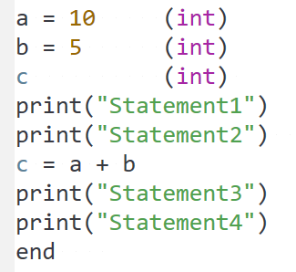
CPU
Program area
a= 10 (int)
b = 5 (int)
Statement1
Statement2
Statement3
Statement4
c (int)
print(“Statement1”)
print(“Statement2”)
c = a + b
print(“Statement3”)
print(“Statement4”)
end
Hard Drive

Slide 37
Notes to self
Invite students to the next chapter where we learn about variables and data types.

