Slide 1

Rental Housing Market
Danny Cabrera
Data 205
Prof. Perine
Montgomery College Spring 2025

Slide 2
What am I trying to answer
I’m trying to show some causes of rental vacancy rates
Through my research I found some of the causes of rental vacancies. One of them is new construction. Although new construction is great sometimes the unintended consequence is that there is too much places to rent, it causes less renters as there is abundance of places on the market.
Plus some potential renters may be priced out as the rents on the new place might be higher than the rest in that area or they can get completely priced out of an area.
This is important because it can help us as consumers and governments understand how to control/fix this problem and what are the causes of it. So, in these next few examples I’ll try to show that.

Slide 3
What is the dataset
The dataset is an excel sheet I combined with different datasets from the sources I used.
For ease on my part I decided to split it into three parts.
One dataset includes the national data of rental vacancy rates, new construction permits, avg. price of a home, avg. salaries
The other includes the data for Rockville of rental vacancy rates, new construction permits, avg. price of a home, avg. salaries
And lastly the third dataset is for DC’s rental vacancy rates, new construction permits, avg. price of a home, avg. salaries

Slide 4
Tools I used to help me
Data Ingestion and Cleaning: Python (Pandas, NumPy) for data manipulation and cleaning.
Exploratory Data Analysis (EDA): Python (Matplotlib, Seaborn) for visualizing trends and patterns.
Statistical Analysis: Correlation analysis to help me create a t test to find how significant the relationship between columns.

Slide 5
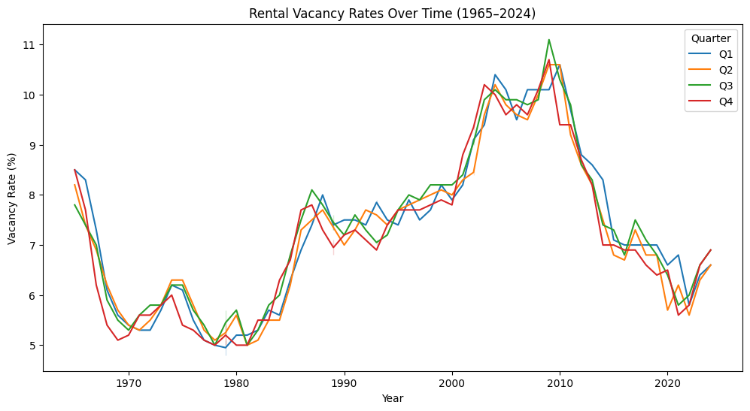
Rental Vacancy Rates Overtime (1965-2024)
This visualization shows the rental vacancy rate since data was collected. This data was collected by the US Housing Vacancy Survey (HVS), published by the US Census Bureau.
It has quarter 1, 2, 3, and 4 for each year since 1965. It shows how rental vacancy increases and decreases throughout these 60 years.
This helpful as it shows how overtime rental vacancies change for multitude of reasons (financial, supply and demand, a pandemic, etc.)
Also, it can be used for future predictions and trends we see overtime in the market

Slide 6
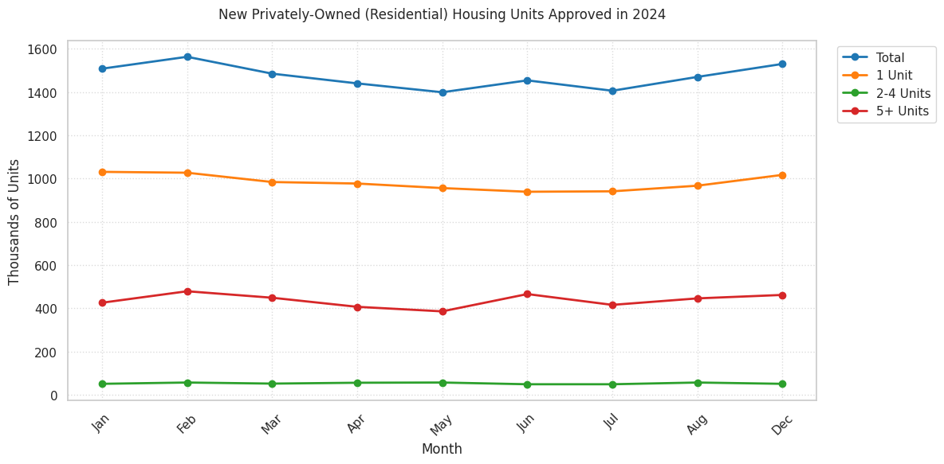
New Residential Const. Permits for the US
For this graph I decided to show a smaller timeframe and use the year of 2024 to look at new residential construction permits approved each month
The trend shown in the graph is of the 1.5 million (on average) new permits being approved about 1 million are going to 1-unit apartments
400-450k are going to 5+ units multi family use buildings (think of duplexes, triplexes, four plexes)
50k 2-to-4-unit buildings are approved to be built.

Slide 7
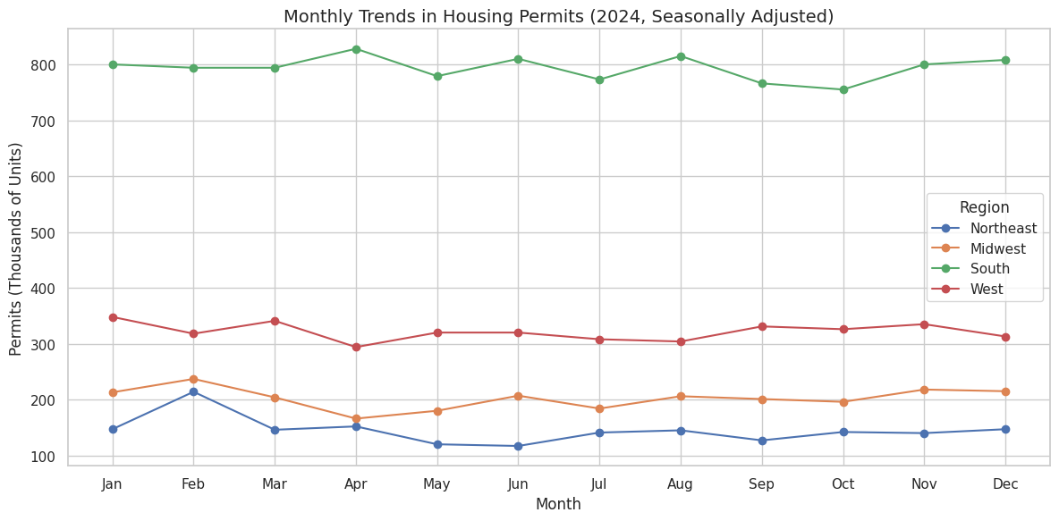
New Residential Construction Permits by Region
This dataset shows housing permits in the US for 2024. Separated by region (Northeast, Midwest, South, West).
South leads the country with the most number of permits (peaked in April with 828k units)
followed by the west (peaked in March with 318k units, then the
Midwest which was relativity stable (peaked in February with 237k units),
Lastly the northeast (peaked in February with 214k units).
This data shows that the south has a lot of new construction meaning there is more demand to rent for people looking to move south or live there currently.

Slide 8
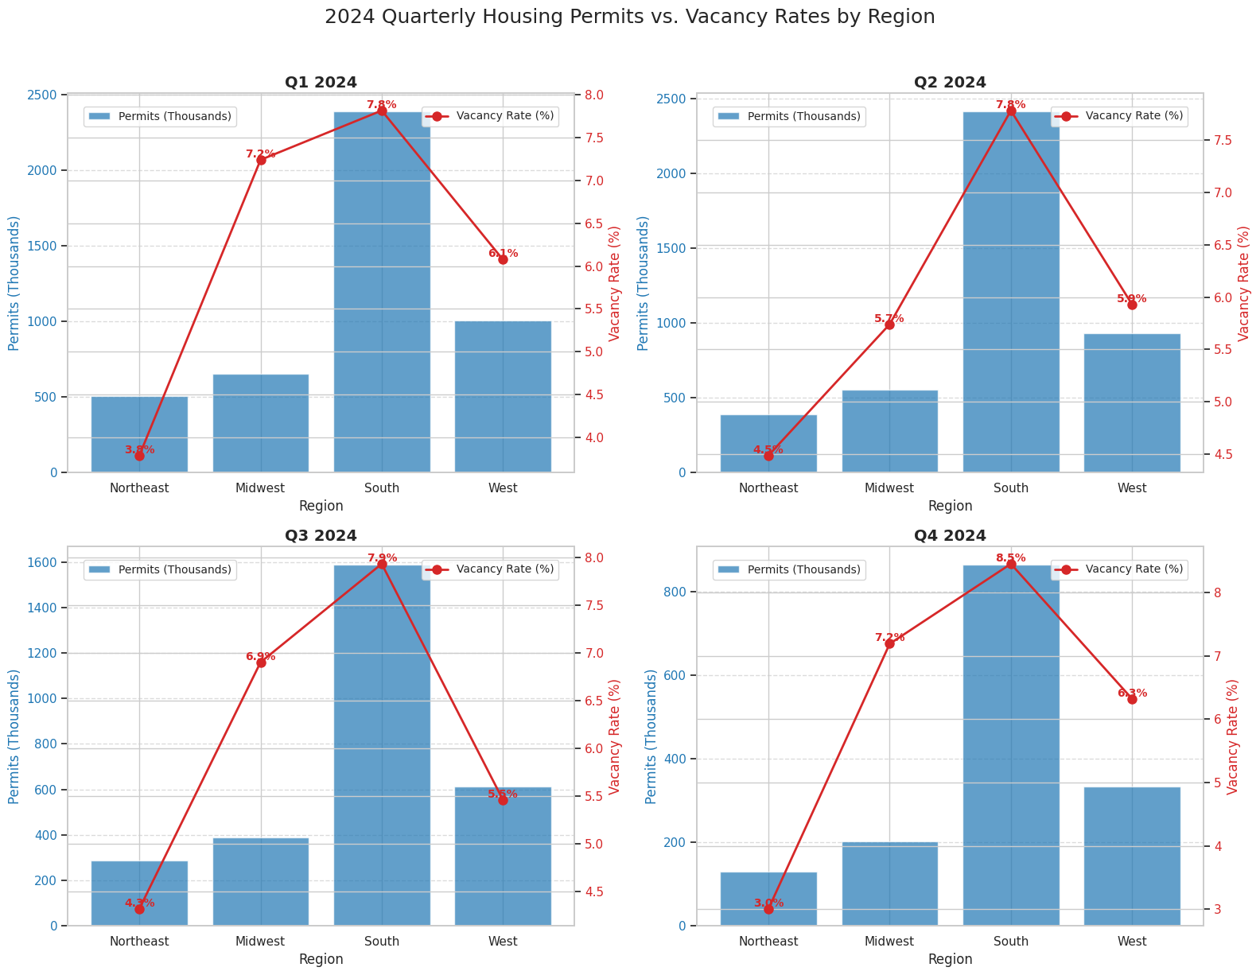
Rental Vacancy vs New Const. Permits
Focusing on 2024 again but for each quarter I tried to compared rental vacancy rates and new residential construction permits for each region of the US
I found that the Midwest has a high van any rate and low numbers of permits being approved
This in turn is driving prices up in the region as supply can’t meet the demand
For every other region in the US it’s meeting or close to meeting the demand for residential units and there vacancy rates

Slide 9
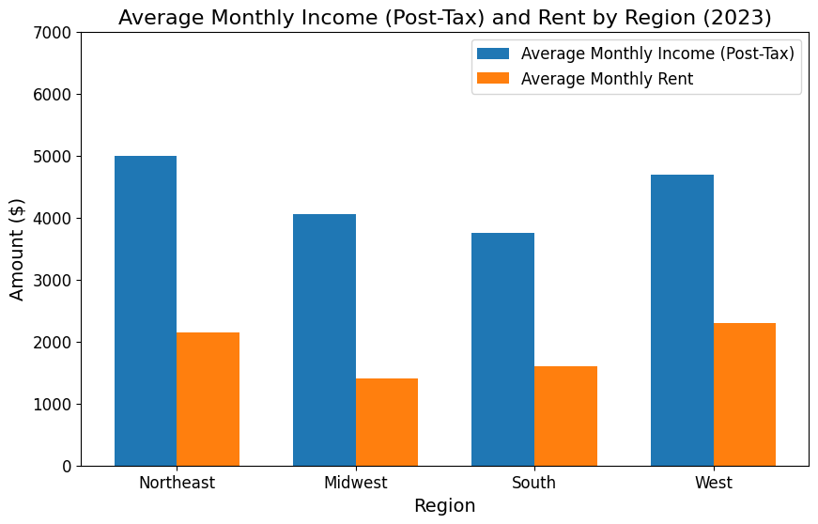
What’s the cost monthly?
How much does the average American spend on rent
As we can see post tax depending on which region you live in you are looking at about 34% to 50% of your monthly income going to rent.
Of course there are cities that are outliers like NYC, LA, Chicago, San Francisco, etc.

Slide 10
Money Talks
It’s easy to say that would want to live anywhere in the US. But for many they can’t live that dream.
Imagine living in cities like of New York, Chicago, Los Angeles, Miami, Portland, Seattle, Denver, San Diego, etc.
These cities tend to be very expensive for the average individual. In fact all those mentioned above are in the top 30 most expensive cities in the US
So that leaves many seeking an opportunity to make big city money without having to live in the big cities. In these next few slides I’ll go over one of these smaller cities outside of a bigger city.

Slide 11
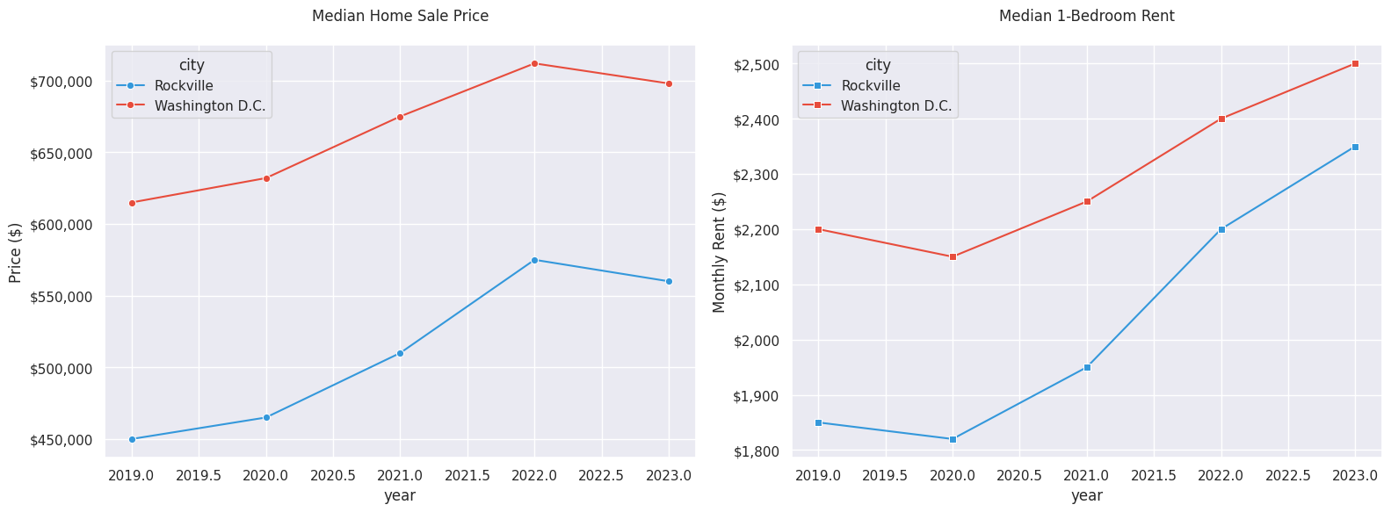
DC and Rockville Comparison
After looking at the national data, I decided to take a more local approach
In these two graphs the median home sale and the median rent for 1 bedroom apartment are compared
As we can Rockville is more affordable than dc over the course of the last 5 years

Slide 12
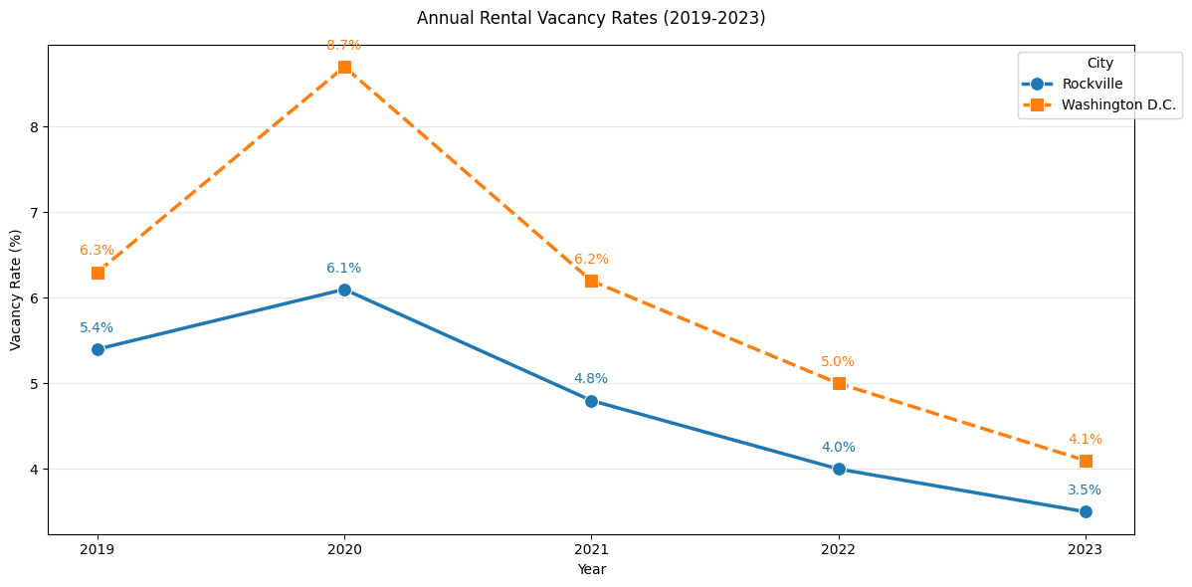
Rental vacancy rates for Rockville and DC
Over the last 5 years the vacancy rate has come down in both cities
There was the spike of covid, but things have returned to normal
As shown in the previous slides the northeast has the lowest vacancy rates in the country this proves that further

Slide 13
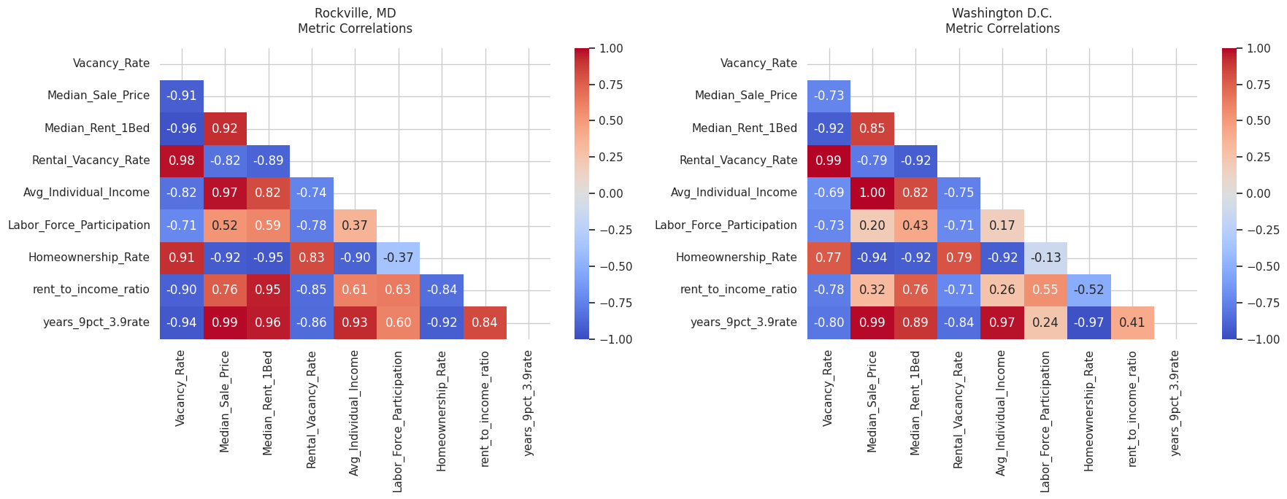
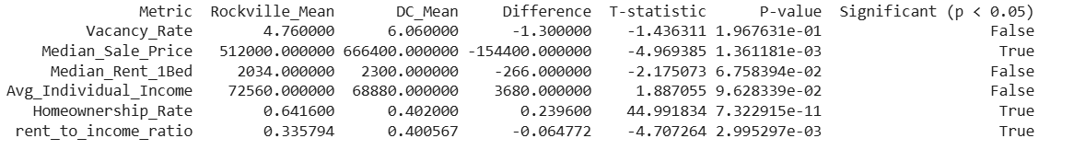

Slide 14
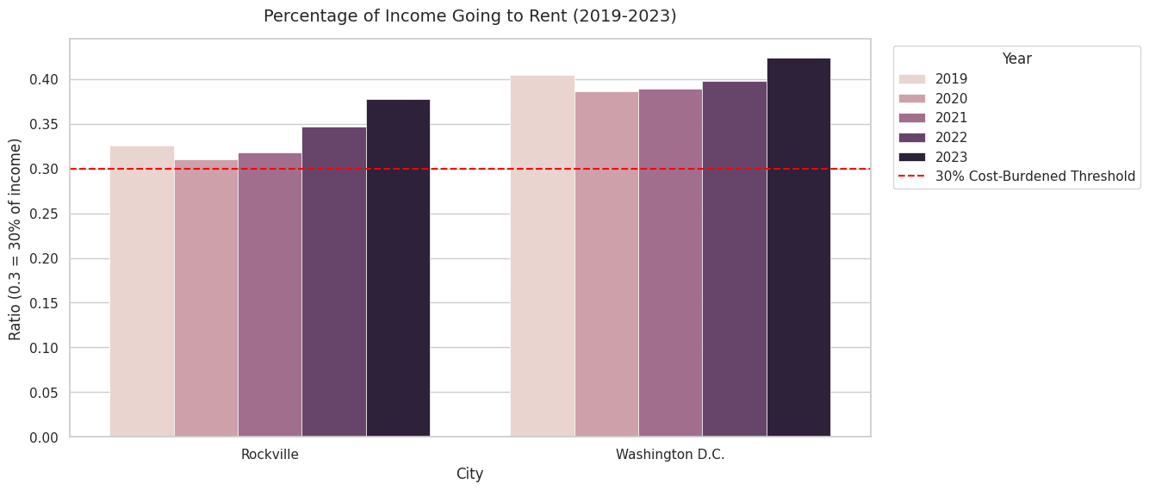
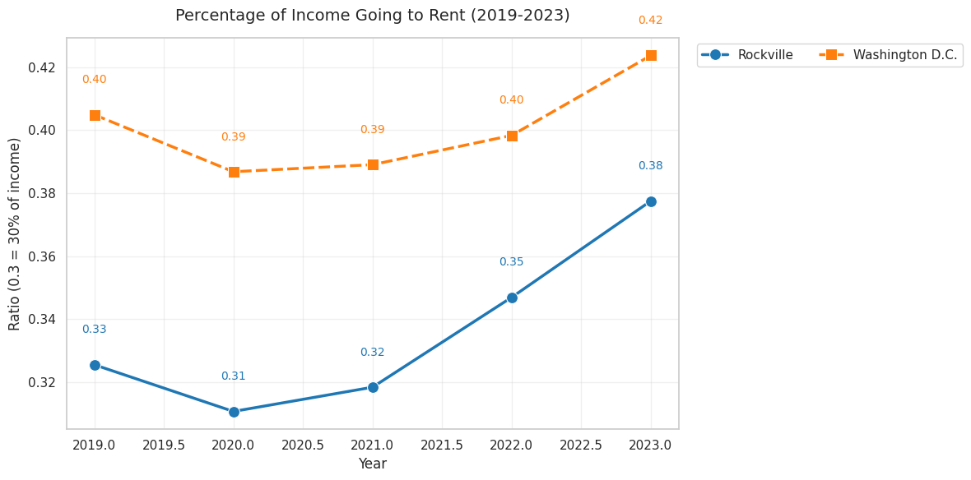
How much of your income is going to rent
On average about 37% of your monthly income is going to your rent in Rockville. In DC about 42% of your monthly income is going rent for a 1-bedroom apartment currently.
These are averages of the average income in Rockville is $6.2k and in DC it is $5.8k per month.
The average rents are $2350 for Rockville and $2500 for DC.
The cost burdened threshold is a good rule of thumb to not spending over 30% of your monthly income on housing.

Slide 15
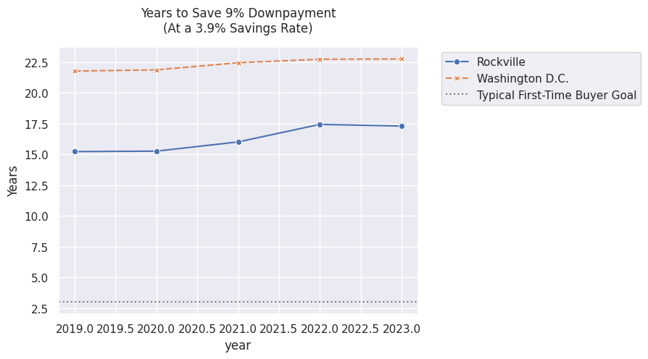
How long does it take to try and buy a home
At a 3.9% saving rate It would take 17.5 years to save a down payment of 9% in Rockville and 22.5 years in DC
The first time buyer goal is a common goal many first time homebuyers have of saving there down payment in 3 years
Overtime the time the needed to save a downpayment has increased
* The 9% down payment and 3.9% saving rates are national averages for first time home buyers.

Slide 16
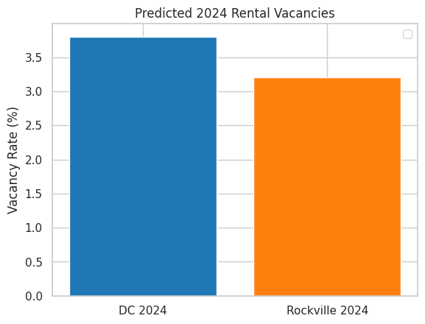
What is the prediction for 2024?
For fun I tried to predict the average vacancy rates for 2024
I used the average income, median rent, median sale prices and homeownership rates to create a predict model
What I found is that for both the rates will go down
DC from 4.2 to 3.8 percent
Rockville from 3.5 to 3.2 percent

Slide 17
What does this mean?
In all these graphs/data it shows how prices keep increasing
Overtime housing is becoming less affordable
It is not a building/construction problem for most of the country expect the Midwest
More and more of your income is going to housing. At least more than the recommended amount
This suggests many might to move further away from big cities to afford housing

Slide 18
Where does this data fall short
We can’t draw a 100% conclusion from all this data
For one, although there are a lot of permits being approved for residential buildings, these are just permits not the finished building. This does not take into account construction delays, construction companies going bust, new zoning laws, etc.
Secondly, A lot of the numbers used for income, rent, and home prices for example are averages not the number for every single person. There are some places available to rent or buy for less or more than the number mentioned.
Thirdly, this data has let me with more questions than answers like what other factors cause increases in rental/home prices other than income and location, How much does a new residential construction project increase prices in the area, Where in the city are people moving to.

Slide 19
SPECIAL THANKS TO THE ENTIRE DATA SCIENCE DEPARTMENT!

Slide 20
Sources of Data
U.S. Census Bureau
American Community Survey (ACS)
https://www.census.gov/construction/nrc/index.html
https://www.census.gov/housing/hvs/index.html
https://www.census.gov/housing/hvs/index.html
https://www.census.gov/programs-surveys/acs/data.html
Zillow Research
Zillow Observed Rent Index (ZORI)
Home Value Index (ZHVI)
Realtor.com Market Data
Monthly Housing Trends
Rockville Data
https://data.montgomerycountymd.gov/
DC Data
https://opendata.dc.gov/

