Slide 1
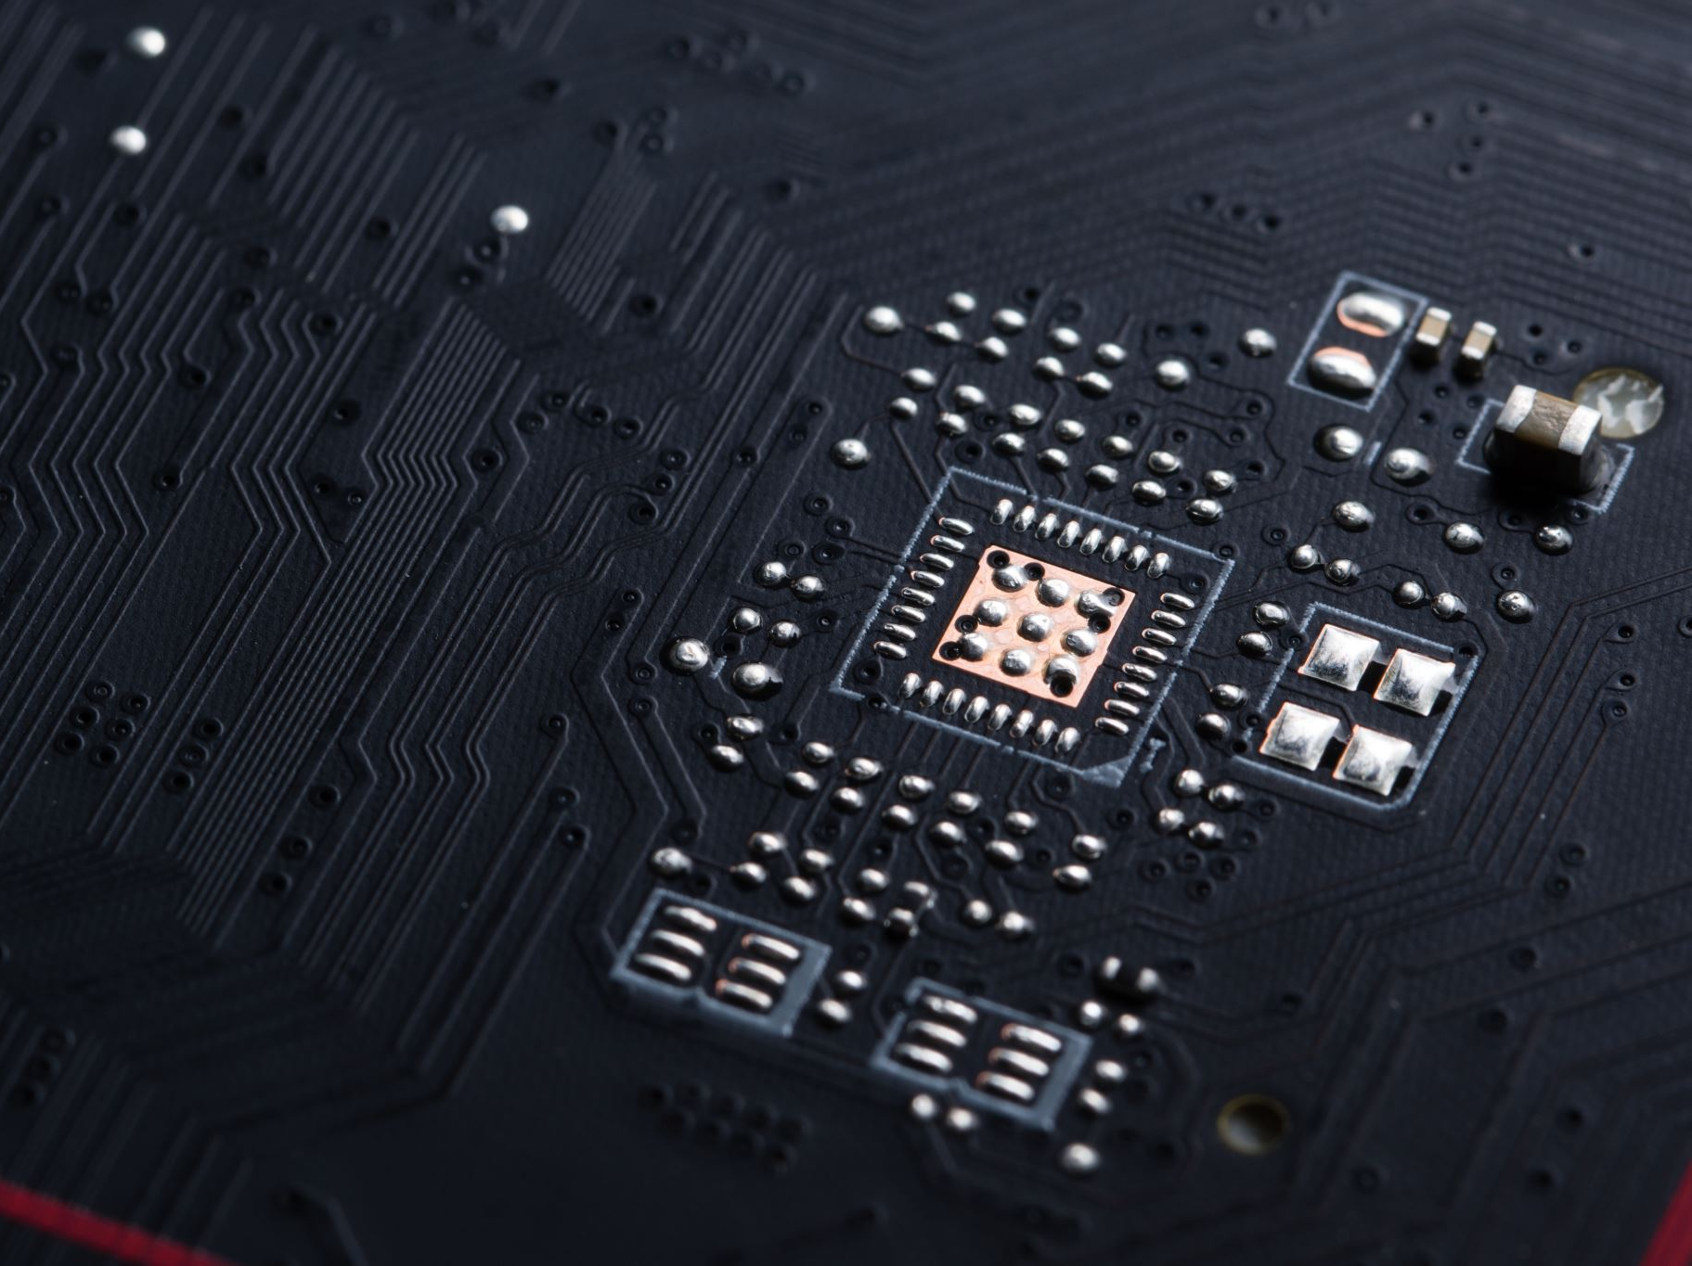
Arduino Button Control
Hold vs Toggle LED

Slide 2

Objectives
Understand
Understand hold vs toggle
Build
Build circuit
Explain
Explain wiring

Slide 3
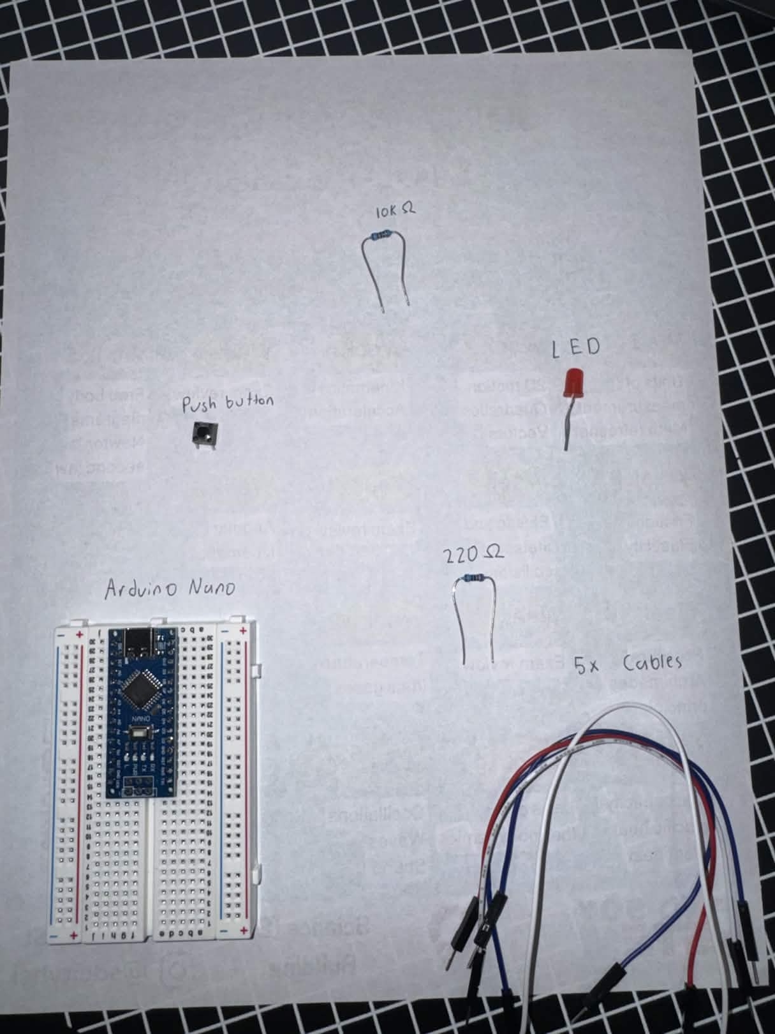
Components
10kΩ
LED
Push Button
220Ω
Arduino nano
5x Cables

Slide 4
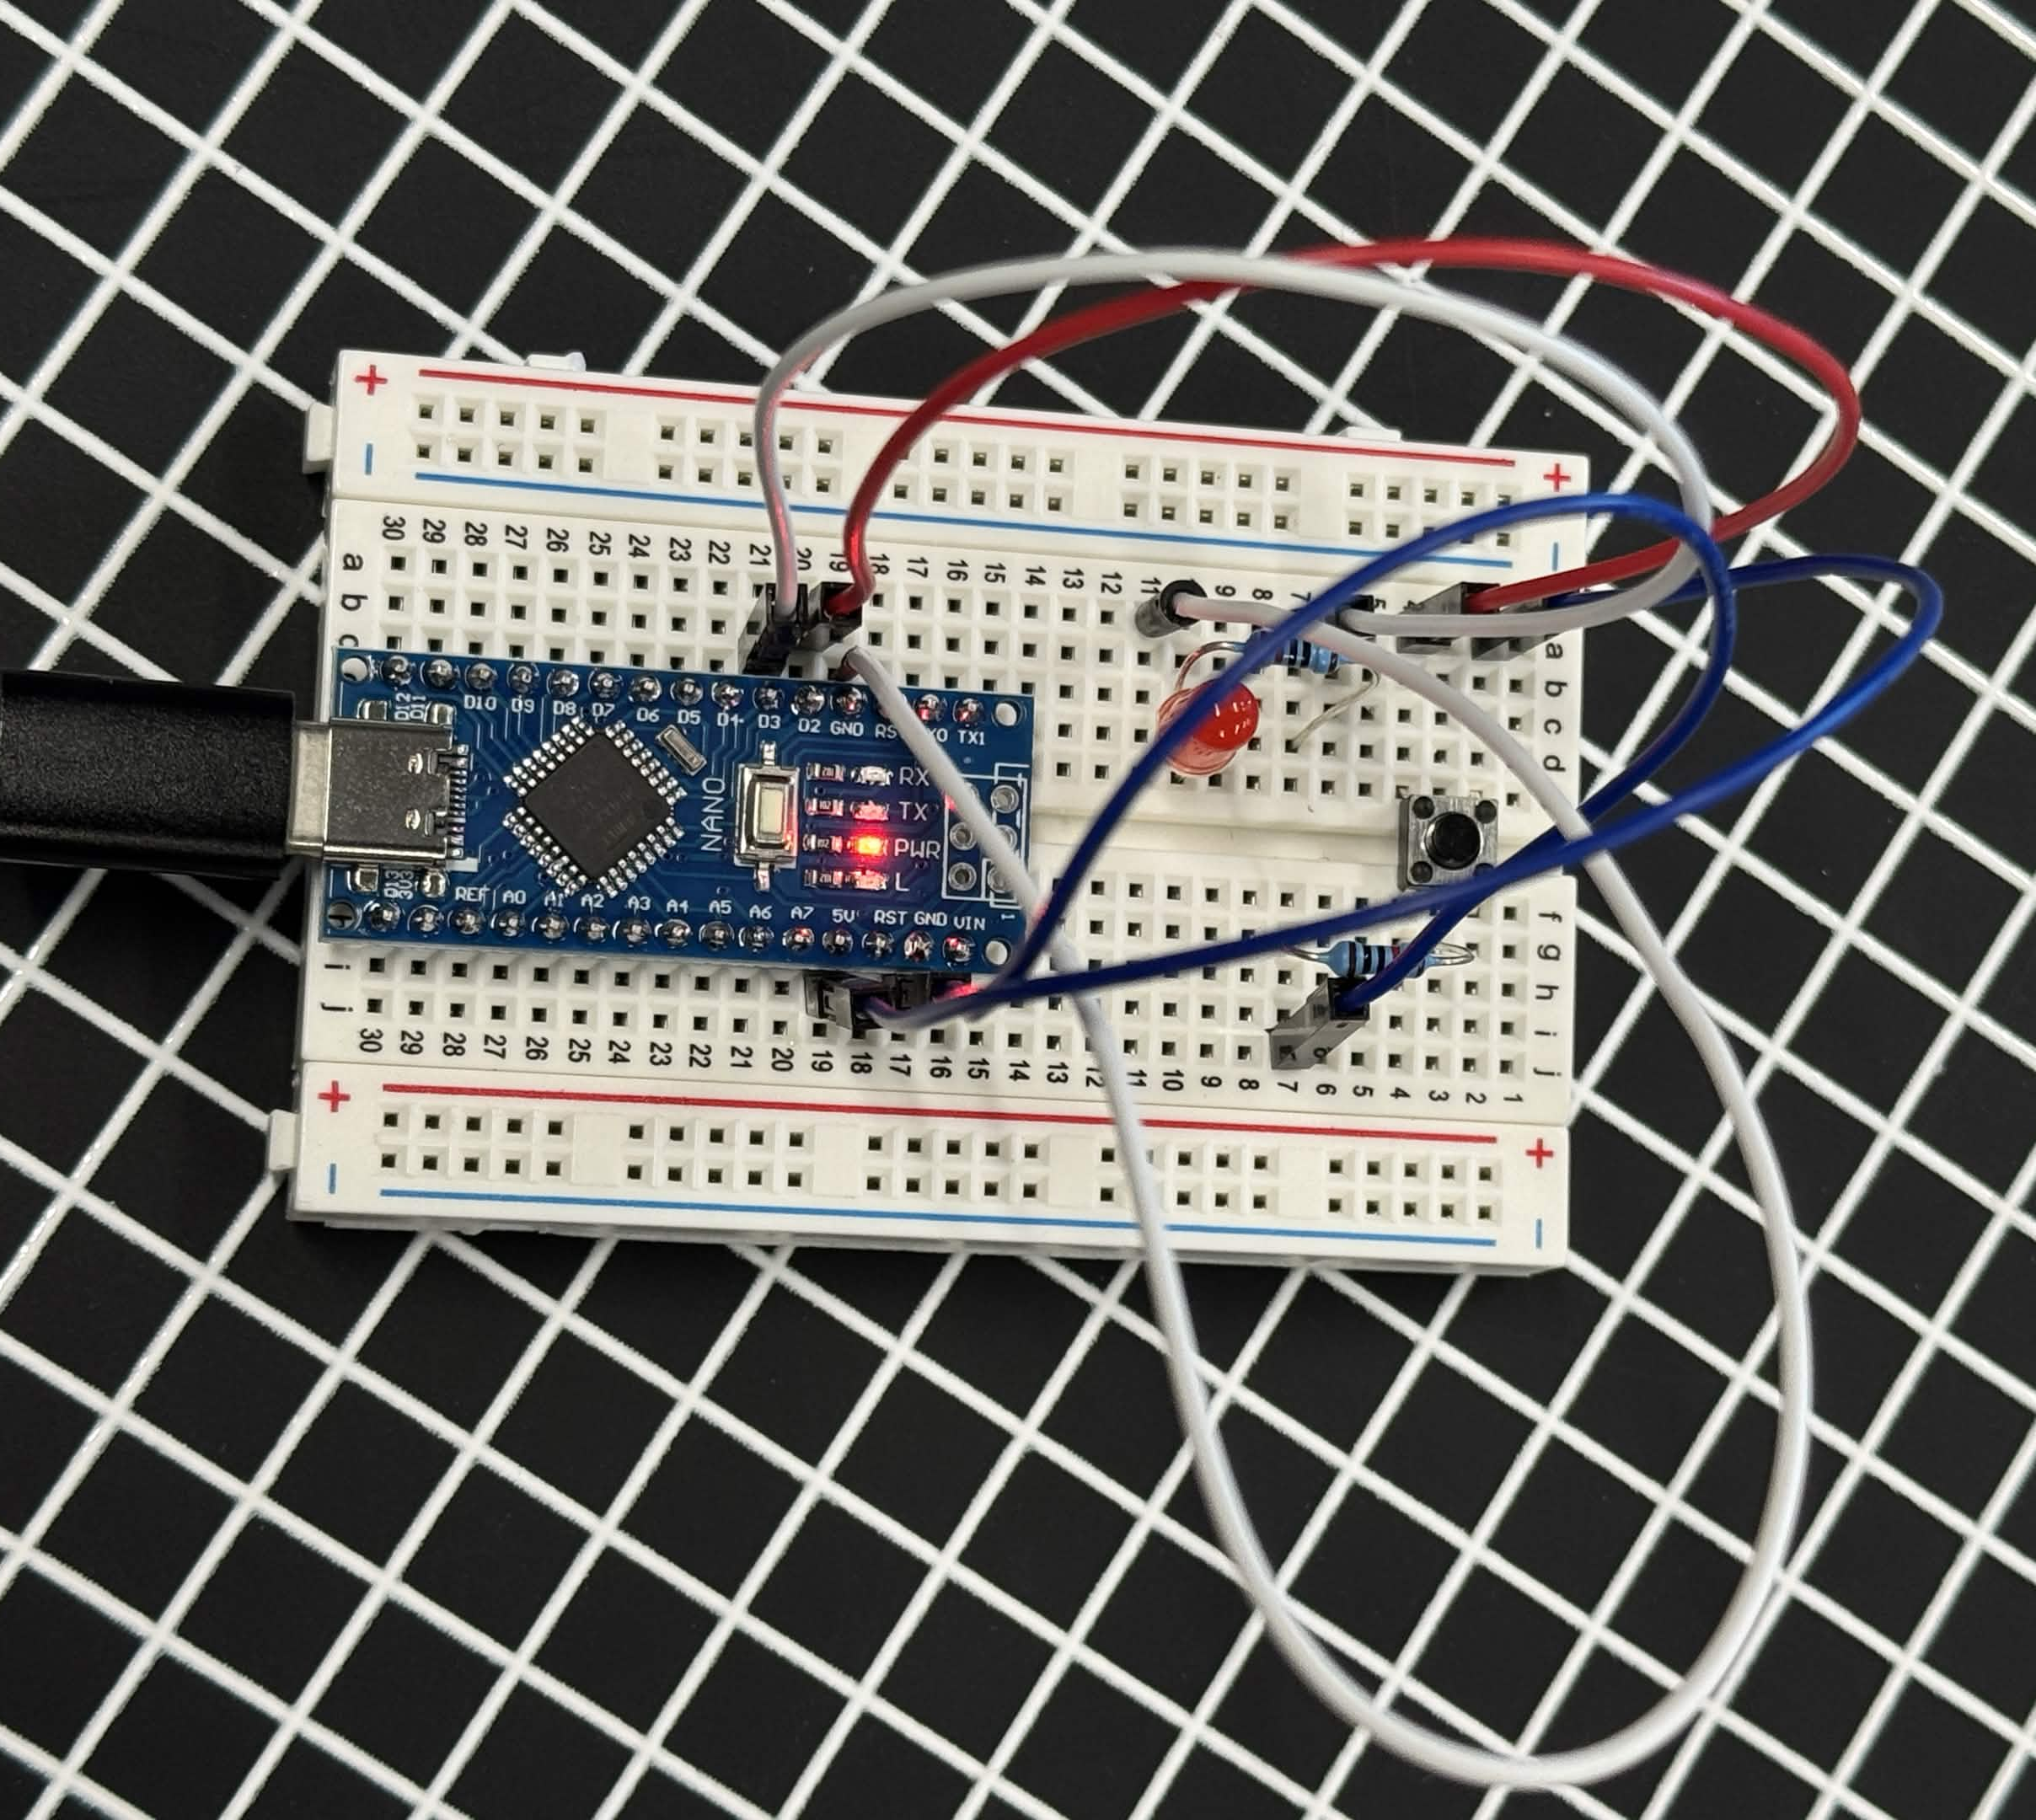
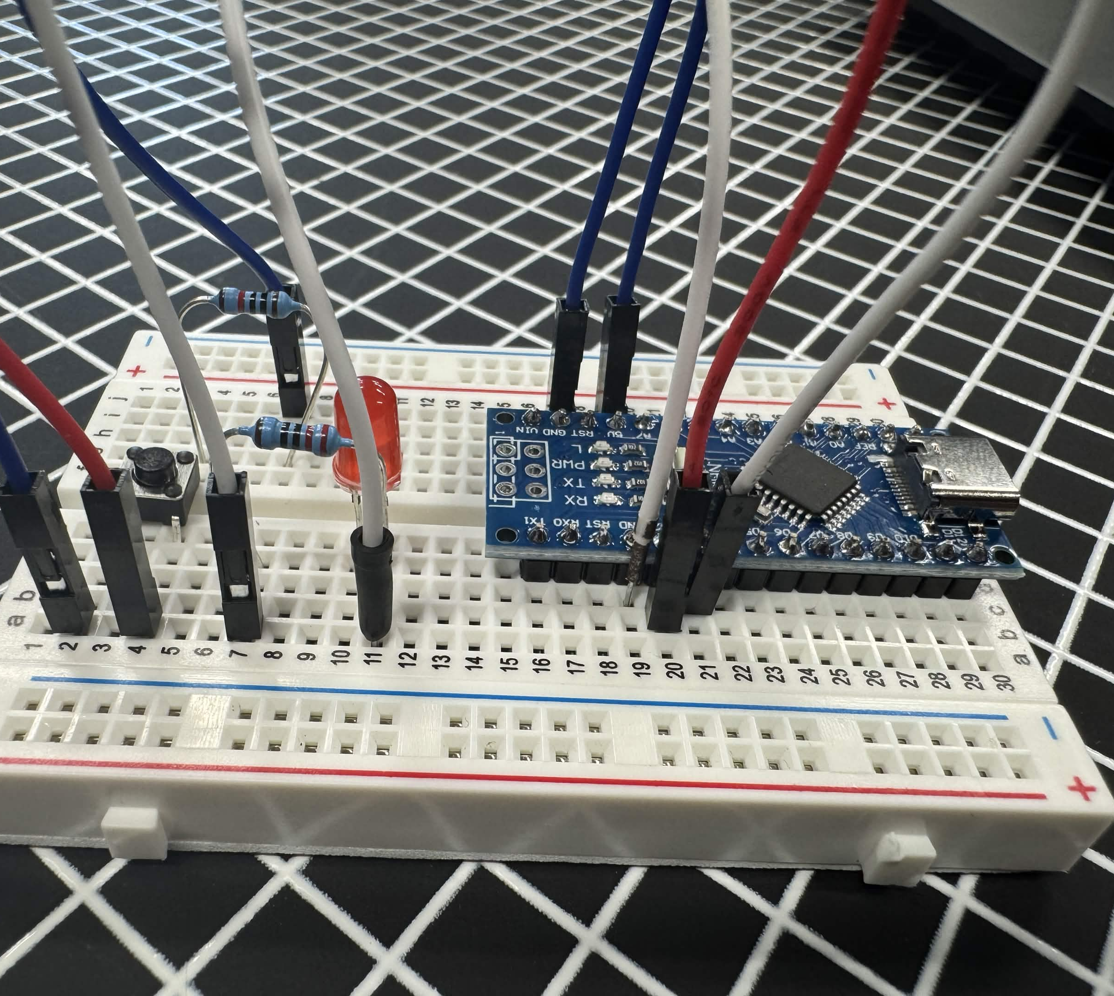
Assembly

Slide 5
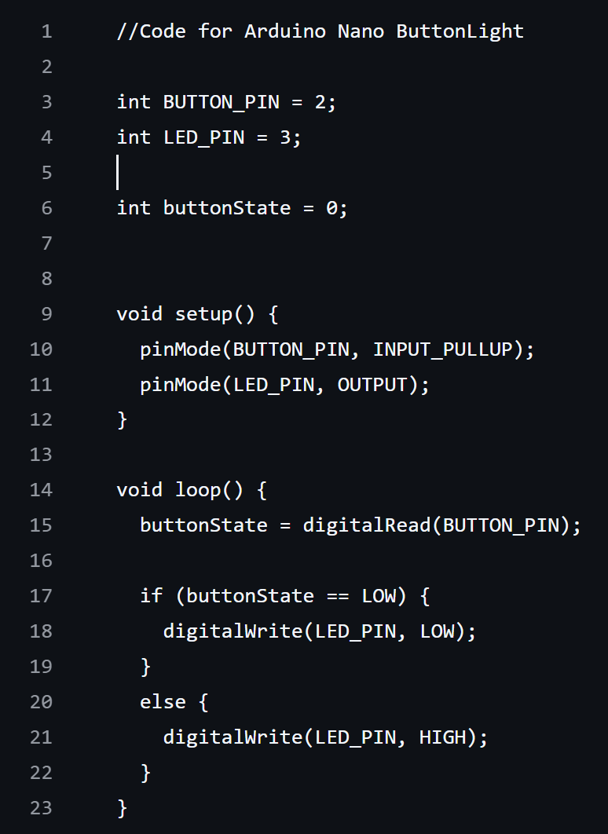
Button Hold
In this mode, the LED will only turn on while holding the button. The moment you let go, it will turn off. It's simple, but it's a great first look at how an Arduino is going to read input and control outputs in real time.

Slide 6
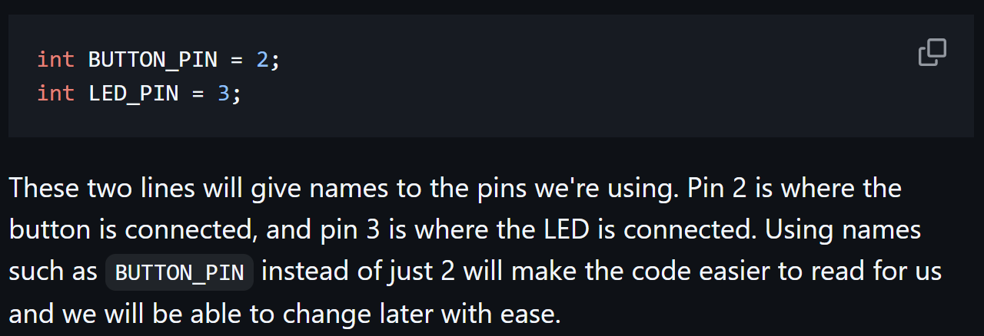
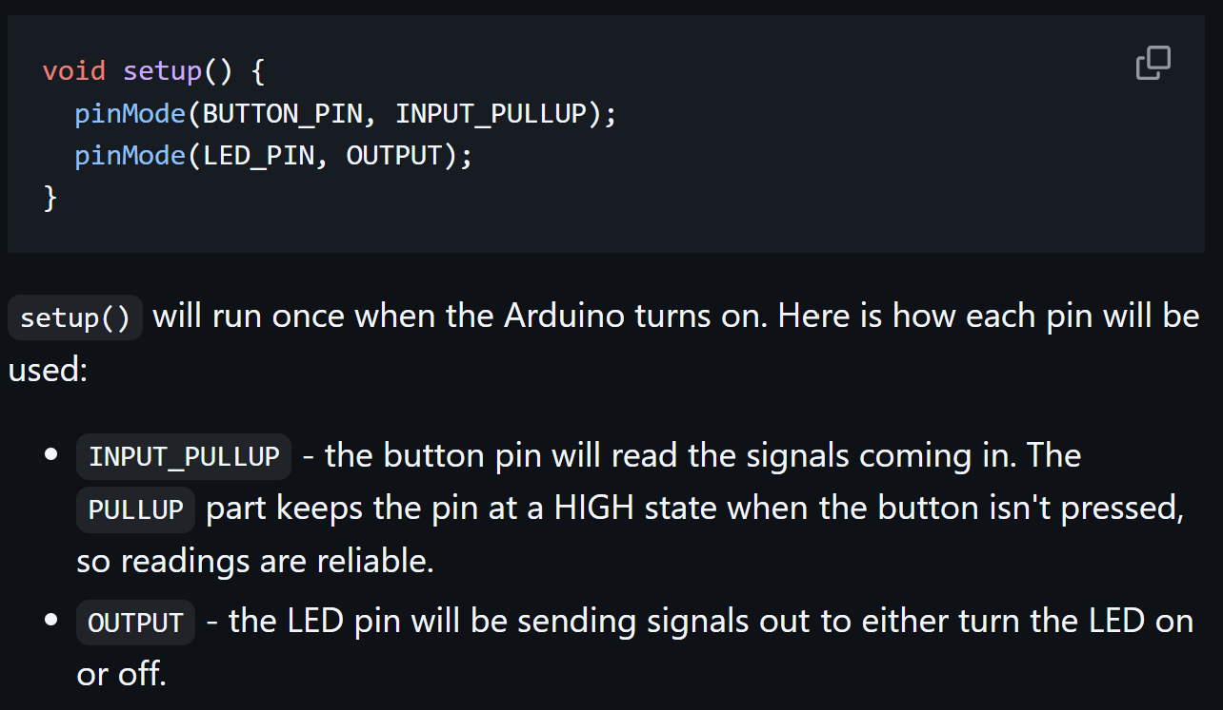
Button Hold Cont.

Slide 7
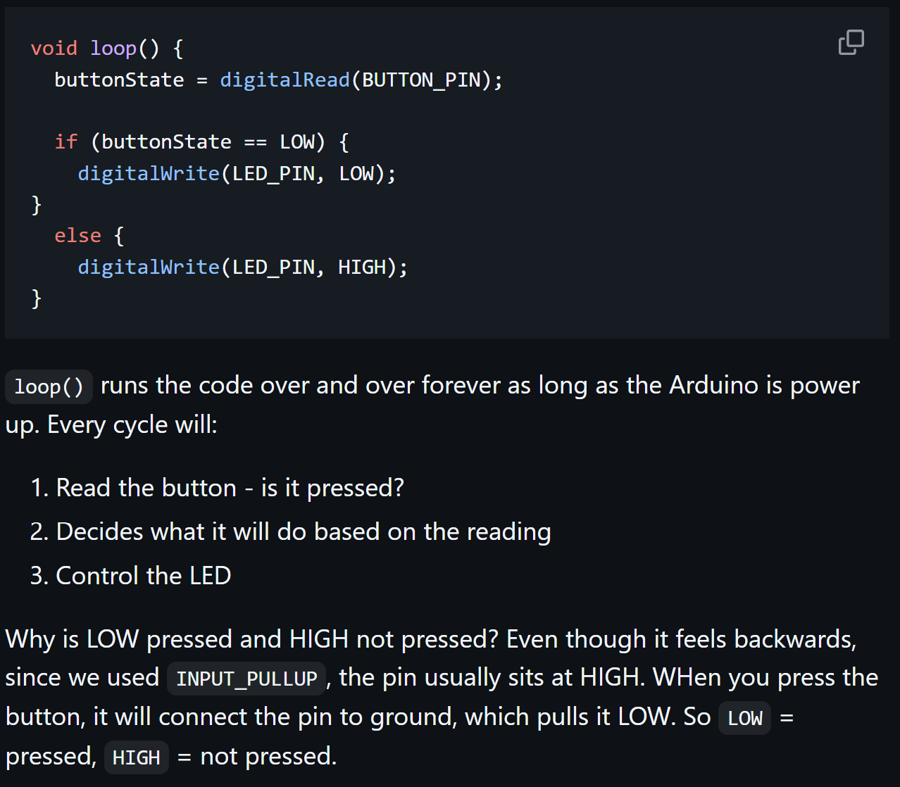
Button Hold Cont.

Slide 8
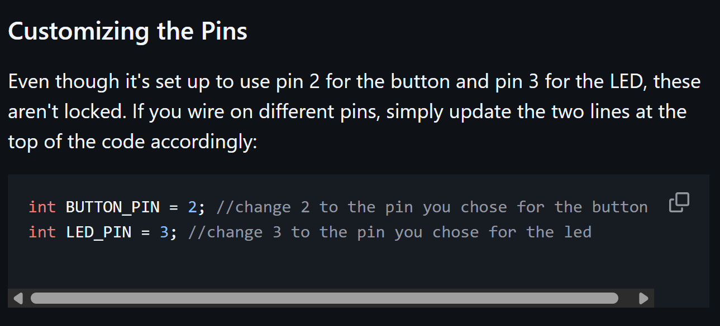
Button Hold Cont.

Slide 9

Toggle
In this mode, we will be toggling the LED on and off with the button. Press once--it'll stay on. Press again--it'll turn off. Unlike the Button Hold Project, you don't have to hold anything. The circuit wiring is exactly the same as before. Only the code changes

Slide 10
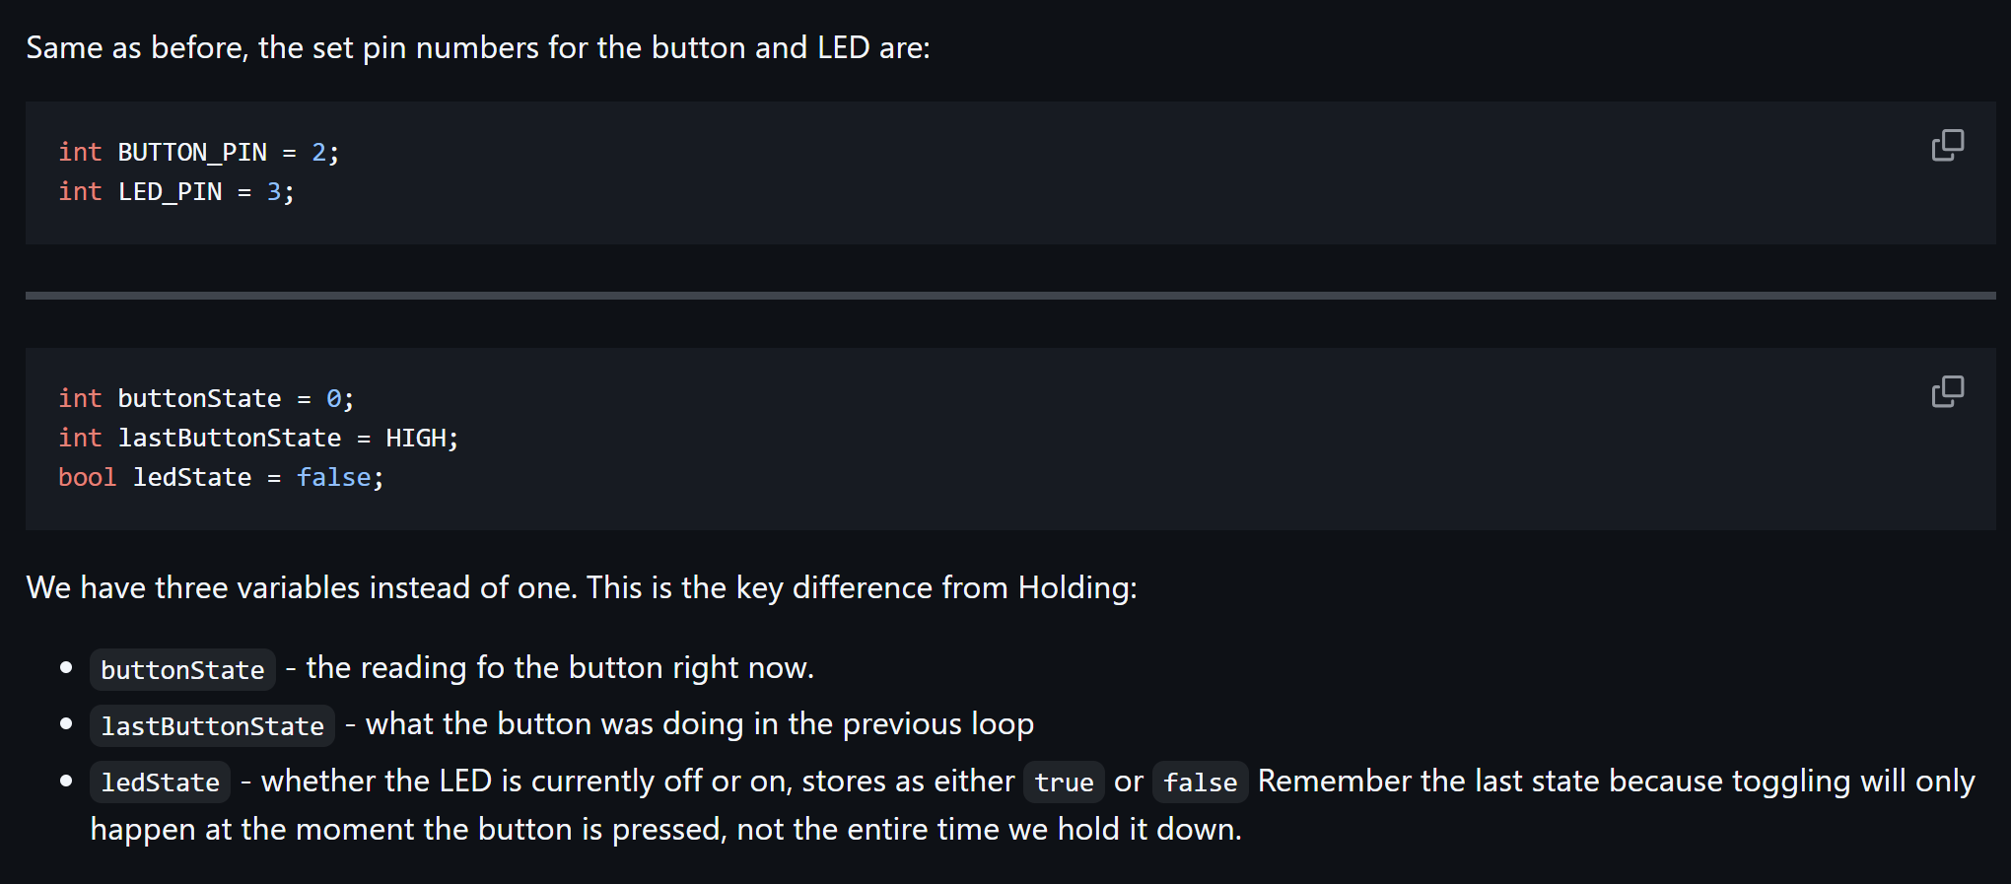
Toggle Cont.

Slide 11
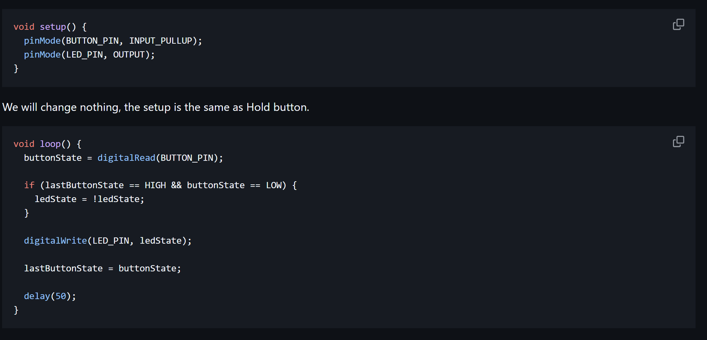
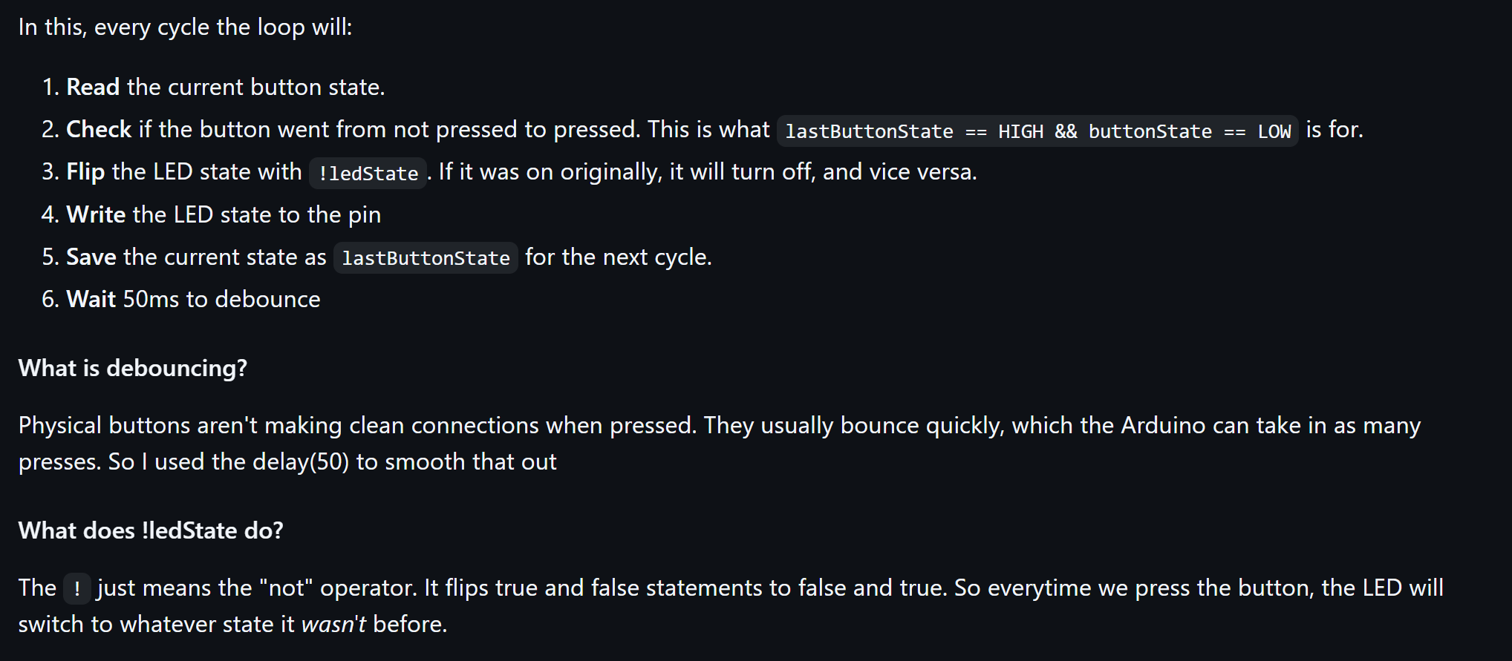
Toggle Cont.

Slide 12
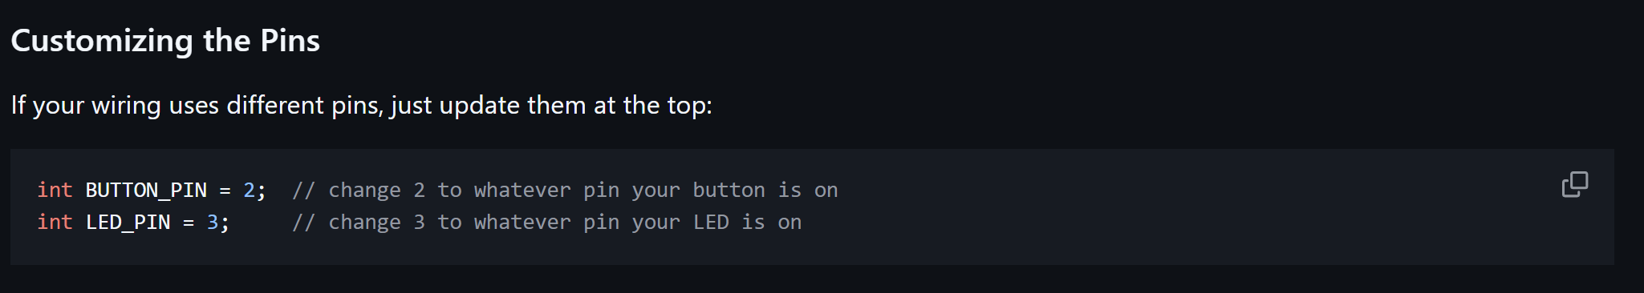
Toggle Cont.

