Slide 1
Natural Language Processing

Slide 2
Natural Language

Slide 3
Some Facts about Natural Language
Everyone has a mother tongue (known as L1)
What language do you count in? What language do you dream in?
Unique to humans
Poverty of the Stimulus argument

Slide 4
Language is…
… a computational mechanism
The key is recursion
… alive!
… software running in our brains
Many languages are ‘mildly context sensitive’ (so between type-1 and type-2 on the Chomsky Hierarchy)
Just for comparison, the set of all syntactically-valid C/Python/etc. programs is context-free (but compilable programs are context-sensitive)

Slide 5
Components of Natural Language
Syntax –
What is a grammatical sentence in the language?
Semantics
Compsitionality – meaning of sentence built from combining meaning of words
Interfacing strongly with syntax
Bill and Ted’s parents arrived in the house (how many people in the house?)
Phonology
Pragmatics
That was a great movie! Not!
Language | Ortography | Pronounication
Hebrew | zaken | zaken
Hebrew | Zkena | skena
Hebrew | savta | safta

Slide 6
Principles and Parameters
Theory in Linguistics (Chomsky & Lasnik)
Languages are composed of general principles, where each principle can have different parameter values
Big debate – are we born with the principles built-in to the brain?
So, in Python:
my_language = Language(principle1 = parameter1, principle2 = parameter2, …)

Slide 7
Some Examples

Slide 8
Principle: Word Order (1)
english = Language(word_order = WordOrder.SVO)
assert english.is_valid_sentence(‘John eats apples’)
japanese = Language(word_order = WordOrder.SOV)
assert spanish.is_valid_sentence(‘Jon wa ringo o taberu’)

Slide 9
Principle: Word Order (2)
Word Order | Languages | Percentage
SOV | Urdu, Amharic, Armenian, Kurdish | 41%
SVO | English, Bulgarian, Mandarin | 35.4%
VSO | Classical Arabic, Biblical Hebrew | 6.9%
VOS | Many Native-American languages | 1.8%
OVS | Mexican Languages, Klingon | 0.8%
OSV | Languages of the Amazon Basin, Yoda English | 0.3%
Unfixed | Japanese, Korean, Turkish, Persian, Latin | 13.7%
Dryer, 2013 – Investigation of 1377 languages

Slide 10
Principle: Null Subject
my_lang = Language(null_subject = True) | my_lang = Language(null_subject = False)
assert spanish.is_valid_sentence(‘esta lloviendo’) assert hebrew.is_valid_sentence(‘yored geshem’) | assert english.is_valid_sentence(‘it is raining’) assert german.is_valid_sentence(‘es regnet’)
Equivalently:
my_lang = Language(null_subject = True) | my_lang = Language(null_subject = False)
assert spanish.is_valid_sentence(None + ‘esta lloviendo’) assert hebrew.is_valid_sentence(None + ‘yored geshem’) | assert english.is_valid_sentence(‘it is raining’) assert german.is_valid_sentence(‘es regnet’)

Slide 11
Principle: Grammatical Gender
german = Language(genders =
{“masculine”: [‘Mond’,…],
“feminine”: [‘Sonne’,..],
“neuter”: […]
})
spanish = Language(genders =
{“masculine”: [‘sol’,…],
“feminine”: [‘luna’,..]
})

Slide 12
Language Universals
All languages have nouns and verbs
All spoken languages have consonants and vowels
He₁ looks at him₁ in the mirror ❌
He₁ looks at himself₁ in the mirror ✔️

Slide 13
The Computational Aspect of Language (1)
We saw a hypothetical function is_valid_sentence
So given a set of words w₁, w₂, ..., w_{n} in a language lang, we have:
is_valid_sentence_{lang}(w₁,w₂,...,w_{n}) → {True, False}
is_valid_sentence is a very complicated function!
DNNs to the rescue!

Slide 14
The Computational Aspect of Language (2)
is_valid_sentence is for syntax – is this a valid sentence in lang?
Equivalent function for semantics (i.e., NLU – Natural Language Understanding):
get_semantics(sentence, truth conditions) → {True, False}
Equivalent function for phonology (i.e., ASR – Automatic Speech Recogniztion):
get_morphemes(phonemes) → {words}

Slide 15
The Computational Aspect of Language (3)
Given sentences s_{lang1} and s_{lang2} and a set of truth conditions tc then we need a function translate:
translate(s_{lang1}, s_{lang2}) ⬄
is_valid_sentence_{lang1}(s_{lang1}) and is_valid_sentence_{lang2}(s_{lang2}) and get_semantics_{lang1}(s_{lang1 ,}tc) and get_semantics_{lang2}(s_{lang ,}tc)

Slide 16
Language Representations

Slide 17
Classic NLP – Bag Of Words (1)
‘The cat sat on the mat’
* Word Counts:
* Binary:
the | cat | sat | on | mat | dog | …
2 | 1 | 1 | 1 | 1 | 0 | …
the | cat | sat | on | mat | dog | …
1 | 1 | 1 | 1 | 1 | 0 | …

Slide 18
Classic NLP – Bag Of Words (2)
TF-IDF: Assign a weight to a term, based on how many documents it appears in / how important it is to a document
Compare ‘cat’ to ‘the’
Issues with Bag-Of-Words:
Bag-of-Words | Bag-of-Words
Order is not taken into account – representation of ‘dog bites man’ and ‘man bites dog’ is identical. No connection between representation of similar words (‘cat’ and ‘dog’, ‘sit’ and ‘stand’, etc.) | Words are 1-grams. How to deal with 2,3,..-grams? (New York, New York City, etc.) Given a vocabulary of |V| words, the 1-hot encoded representation of a word will be very sparse: |V|-1 zeros and a single 1

Slide 19
The Distributional Hypothesis
A word is characterized by the company it keeps
Firth (1957)
A semantic statement on how words combine to create the meaning of a sentence
Implies that words need to appear in a context and have little value on their own
But different domains/corpora predicate different contexts!!

Slide 20
Example – Single Word Context
The cat sat on the mat
Target Word
Context
Word
Context
Word

Slide 21
Example – 2-Word Context
<pad> The cat sat on the mat
Target Word
Context
Word
Context
Word
Context
Word
Context
Word

Slide 22
Word Embeddings
Embedding - ‘Representing the same information in a lower-dimensional space’

Slide 23
Motivating Example (1)
What do we know about X from a single word context?
Syntax
Semantics
The X sat …

Slide 24
Motivating Example (2)
Feature | Type | Contents
1 | Syntax | X is a Noun-Phrase (NP)
2 | Semantics | X has volition
3 | Semantics | X is able to sit
The X sat …

Slide 25
Word Embeddings Concepts
Set of features that can represent semantic domain concepts
Semantics built on top of syntax, so ideally we should be able to learn embeddings automatically
We can choose the dimensionality d of the feature set, so it’s computationally convenient for us
Words with similar meanings have similar representations
I.e, distance(embedding(cat), embedding(dog)) < distance(embedding(cat), embedding(plane)).
Corpus dependent!!!
However, we may not understand the selected features (i.e., black-box model)
Proper selection of embedding algorithm will…
… converge quickly
… give dense representations, so a single word vector will have length d << |V|
… encode very useful information into individual word representations, meaning less work for downstream tasks

Slide 26
Word2Vec – the canonical embedding algorithm
Mikolov et al., 2013 (while at Google)
Trained on Google News corpus
Target and context are both individual words
Vocabulary grows linearly with corpus size
No provisions for n-grams (n>1) or for morphologically-complex languages
Unsupervised – no labeled data needed
More precisely, self-supervised
Extremely successful!

Slide 27
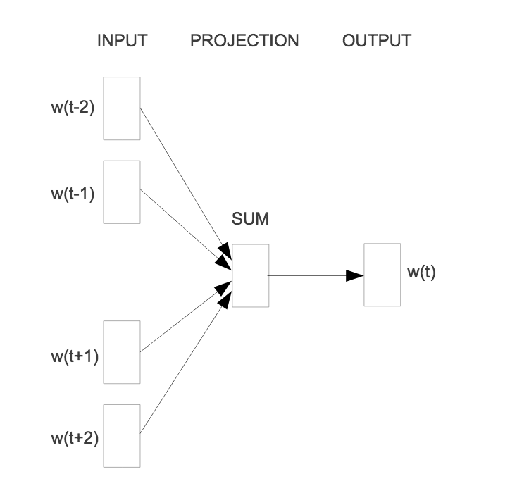
Word2Vec – Continous Bag-of-Words (CBOW)
Predict target from context
2-word context
Dense representations
Bag-of-words loses word order

Slide 28
Word2Vec CBOW – Pytorch Implementation
DEMO

Slide 29
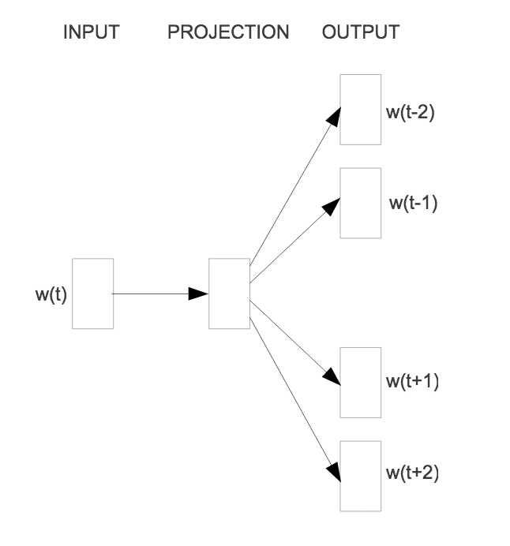
Word2Vec – Skip-gram
Predict context from target
2-word context
Dense representations
Individual networks/objectives for each context word

Slide 30
Word2Vec Skip-gram – Pytorch Implementation
DEMO

Slide 31
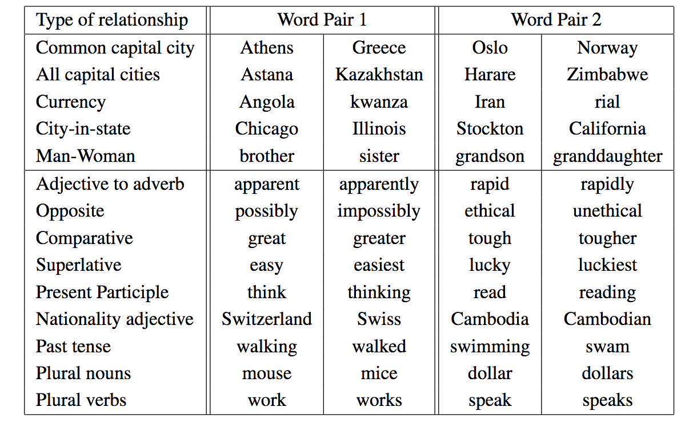
Word2Vec – Interesting Results
WP2₂ ~ WP1₁ – WP1₂ + WP2₁

Slide 32
Additional Word Embedding Algorithms
FastText – Mikolov et al., 2016 (while at Facebook)
Embedd character n-grams, not entire words:
embedding(train) = embedding({ ‘<tr’, ‘tra’, ’rai’, ’ain’, ‘in>’ }) (3-grams)
Better handle languages with complex prefix/suffix morphology
Generate embeddings for rare/out-of-vocabulary words (the <UNK> token)
GloVe – Pennington et al., 2014
Use word co-occurrence statistics (i.e., how many times do ‘cat’ and ’dog’ appear together?)
Use matrix factorization, not neural networks
Not ‘predictive’, in the sense that there is no optimization of the objective Loss(target word | context word)

Slide 33
Embed Other Structures
Syntactical word sense disambiguation, i.e., ‘train’ in ‘train a network’ vs. ‘ride on a train’ (verbs vs. nouns): Sense2Vec
Sentences: Skip-thought
Paragraphs: Doc2Vec
Documents: Hierarchical Document Networks
And many, many more!!

Slide 34
Word Embedding Summary
Dense representations with ‘smart’ understanding of domain semantics
Configurable dimensionality for selecting latent feature granularity
Basic elements for more complex tasks (classification, question-answering, etc.)
Tokenization required for working with larger vocabularies
It’s all about finding better ways to embed and make word vectors ‘smarter’

Slide 35
Every Solution Brings New Problems
In our discussion of embeddings, we saw methods that take a word a produce a single d-dimensional dense representation of that word. That representation has ‘built-in’ semantic qualities.
But what if the word has multiple different meanings and/or can be used in multiple different ways? Example:
“I put my money in the bank” (the land next to a river or a financial institution?)
Word2Vec, FastText, etc. combine all of these semantics. We need contextual embeddings that can give us representations that are context-dependent.

Slide 36
Language Models
Language models are predictive models that can generate the next word in a sequence given the previous n words. I.e., what will X be in the sequence:
The cat sat on the X
We can measure the quality of a language model using a metric named perplexity. Roughly, it is how many choices the model has for X.
Training the LM can be done in an unsupervised fashion, so we can use massive amounts of unlabeled data

Slide 37
New Problems, New Solutions
And so we enter the next phase for word embeddings: the incorporation of information coming from language models.
Assuming we have a language model implemented as an RNN, we can take its hidden state (its ‘context’) and add that to a ‘base’ Word2Vec or GloVe embedding. This is our new contextual embedding.
Do we even need Word2Vec anymore? Since most of the important information is now contextual and coming from the LM, let’s use a base embedding of something very simple – a single character, not even a word. This is ELMo - Peters et al., 2018

Slide 38
Attention

Slide 39

Concept of Attention

Slide 40
Attention Mechanisms
Focus on what matters for the current task, and not on what doesn’t
Interestingly, get their inspiration from visual processes as opposed to language
Assign different weights to different vectors (== embeddings) depending on how much they ‘matter’ ‘at the current time’

Slide 41
Simple Example - Translation
Translate from English to Japanese (SVO to SOV). What to focus on?
At different steps in the result, different source words are important. So a linear, word-to-word translation is not sufficient.
Step | English Source | Japanese Result
1 | John eats apples | Jon wa
2 | John eats apples | Jon wa ringo o
3 | John eats apples | Jon wa ringo o taberu

Slide 42
Another Simple Example – Translation (kind of)
Convert a long date format into a short date format (dd/mm/yyyy). What to focus on?
Step | Long Date Source | Short Date Result
1 | February 2nd, 2020 | 02/
2 | February 2nd, 2020 | 02/02
3 | February 2nd, 2020 | 02/02/2020
Step | Long Date Source | Short Date Result
1 | Sunday, the 2nd of February 2020 | 02/
2 | Sunday, the 2nd of February 2020 | 02/02/
3 | Sunday, the 2nd of February 2020 | 02/02/2020

Slide 43
Slightly More Complex Example
English and Spanish are both SVO, but Spanish is less rigidly so:
A translation function (=DNN) needs to know whether to put the adjective before or after the noun. This can vary in the same sentence!
English | Spanish
Eurpean Union | Unión Europea
Prime Minister | Primer Ministro
Smart child | Niño inteligente
New York | Nueva York

Slide 44
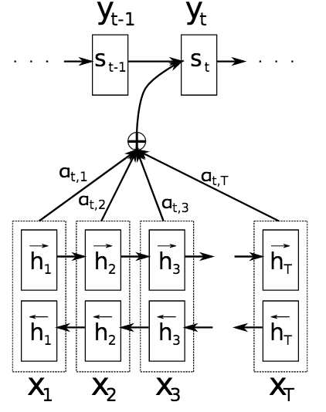
Attention – Implementation (Bahdanau et al., 2015)
Bidirectional LSTM for encoding text – going from start to end as well as from end to start
α_{i,j} determines how well the vector at input position j is ‘similar’ to output position i.
α_{i,j} is computed by an alignment model (itself a small NN)

Slide 45
Attention – Make NLP Great Again (MNGA)!
Attention enables a general pattern for fairly effective end-to-end NLP:
Embed – Inputs to algorithm are indices in vocabulary (produces task-specific embeddings)
Encode – Use RNN (often BiDi LSTM) for contextualizing embeddings
Attend – Apply attention to contextual embeddings
Predict – Classifier on top the attention vector
Still very relevant approach!

Slide 46
Attention – Pytorch Implementation
DEMO

Slide 47
Nice, but…
This kind of pattern uses LSTMs, which are a type of RNN
RNNs are inherently serial. Even on a GPU, they are difficult to parallelize and are a performance hit.
Essentially, using RNNs (LSTMs, GRUs and all of their variants) sets a limit on the size of models that can be trained in a reasonable amount of time. Bigger is (much) better in this case.
We also discussed the use of LSTMs for language models - so a limit there also affects our ability to train large LMs.

Slide 48
Getting Rid of RNNs
We used LSTMs (or other RNNs) because of their ability to handle long-term dependencies. I.e.,:
The small cat with the sharp teeth and white ears sat on the mat
But we’ve already seen that attention mechanisms can assign weights to vectors based on how much we need them at a particular moment.
So we can do the same thing – only in the context of a single sentence. For each target words, our context will be the entire sentence and we assign attention scores based on how much each context word affects the target.
This is known as Self-Attention – (from Attention is All You Need, Vaswani et al., 2017)

Slide 49
The Transformer
The Transformer is the current SOTA architecture that is used by models such as BERT and GPT-2. It uses self-attention extensively.
Rather than have a single relationship between target and context words, a transformer block has multiple such attention heads. This means that context can be much more complex than previous language models.
Since the Transformer was originally designed for NMT, it has both encoder and decoder type of blocks.
A transformer-based model often uses multiple such blocks. Context can then be extremely complex and nuanced, explaining the amazing power such models have in NLP tasks.

Slide 50
Bidirectional Encoder Representations from Transformers - BERT
So now we can finally explain what BERT is: a transformer-based language model for training contextual word embeddings. What makes it different than other such models?
There are 2 parts to BERT’s objective function:
Masked Language Model (MLM) - rather than just trying to predict the next word in a sequence, BERT uses masking – 15% of all words in the document are randomly removed from anywhere inside their sentence. In this way, BERT can use a bidirectional context. Example:
The [MASK] sat on the mat.
Next Sentence Prediction (NSP) – During training, BERT receives not one, but two sentences. It then tries to predict whether the second sentence follows the first sentence in the original document.

Slide 51
Using BERT in Practice (1)
Do you actually need BERT?
Embed/Encode/Attend/Predict still works quite well
Time-to-market is important
Do you have enough data for BERT?
Do you have enough compute for BERT?

Slide 52
Using BERT in Practice (2)
There are 2 stages to training a BERT model:
Pre-training - this is the ‘heavy-duty’ part of the training. Massive amounts of data and compute power are required, as during this phase the language model is built. The ’base’ version of BERT contains 110 million parameters, while the ‘large’ version contains 345 million.
Fine-Tuning – during this phase the contextual embeddings are adjusted to fit a specific task – classification, question answering, etc. While still computationally intensive, this stage is far less demanding than the pre-training phase.

