Slide 1
YYZ GATE ASSIGNMENT
A safer, more stable
gate plan
How four contributors combine flight ordering, gate selection,
disruption recovery, and plan validation
Team project overview | under 7 minutes
YYZ, decision support prototype
Notes:
Four roles coordinate gate recommendations. The final slide reports evaluator results.
Sources:
https://github.com/Dannyzhang2022/YYZ-Gate-Assignment

Slide 2
PROJECT WORKFLOW
One observation, four connected roles
The evaluator supplies the current schedule, bookings, gate limits, outages, and updates.
Person 2
Person 3
Person 4
Person 1
Orders waiting flights by urgency and gate scarcity
Ranks gates that pass safety and availability checks
Assesses changed flights during disruption recovery
Builds, improves, and validates whole-plan candidates
Validated assignments and ordered reassignments return to the evaluator
Candidate plans are replayed against hard constraints before the coordinator selects one.
Workflow described by the repository’s four solution modules
Notes:
Person 2 orders flights. Person 3 ranks gates. Person 4 assesses disruptions. Person 1 plans and validates.
Sources:
https://github.com/Dannyzhang2022/YYZ-Gate-Assignment/blob/main/person1/solution_team.py
https://github.com/Dannyzhang2022/YYZ-Gate-Assignment/blob/main/person2/flight_order.py
https://github.com/Dannyzhang2022/YYZ-Gate-Assignment/blob/main/person3/gate_choice.py
https://github.com/Dannyzhang2022/YYZ-Gate-Assignment/blob/main/person4/disruption_repair.py

Slide 3
PERSON 1: INTEGRATION AND OPTIMIZATION
Build one view of the disruption
The coordinator prepares current flight and gate state before planning.
Combines waiting and assigned flights, gate occupancy, outages, and changed profiles.
Evaluator state
Flights, gates, occupancy, updates
Calls Person 4’s assessment to flag changed flights that cannot safely stay at their gates.
↓
Connects Person 2’s flight order and Person 3’s gate rankings to the planning step.
Prepared inputs
Current plan plus disruption status
Person 1: person1/solution_team.py
Notes:
Person 1 brings the team’s work together. At each decision point, the coordinator receives waiting and assigned flights, gate occupancy, aircraft needs, outages, and recent changes. It asks Person 4 to assess changed flights, then prepares the inputs that the planners share.
Sources:
https://github.com/Dannyzhang2022/YYZ-Gate-Assignment/blob/main/person1/solution_team.py
https://github.com/Dannyzhang2022/YYZ-Gate-Assignment/blob/main/person4/disruption_repair.py

Slide 4
PERSON 1: INTEGRATION AND OPTIMIZATION
Search improves a feasible plan
The joint optimizer explores small changes while honoring the hard gate rules.
Starts from a feasible, scarcity-first plan using Person 2 and Person 3’s modules.
Tests single-flight moves and exchanges between two flights.
Scores walking distance, gate stability, reassignments, and unassigned flights.
Feasible plan
Single move
Two-flight exchange
All assignments pass hard checks
Try a better gate for one flight
Test a paired gate swap
Person 1: person1/plan_optimizer.py
Notes:
The joint optimizer uses Person 2’s flight ordering and Person 3’s safe gate rankings. It starts from a feasible plan and tests single-flight moves and two-flight exchanges. Each change must respect hard constraints. The cost also reflects walking distance, gate stability, reassignments, and flights left unassigned.
Sources:
https://github.com/Dannyzhang2022/YYZ-Gate-Assignment/blob/main/person1/plan_optimizer.py
https://github.com/Dannyzhang2022/YYZ-Gate-Assignment/blob/main/person2/flight_order.py
https://github.com/Dannyzhang2022/YYZ-Gate-Assignment/blob/main/person3/gate_choice.py

Slide 5
PERSON 1: INTEGRATION AND OPTIMIZATION
Keep only valid plan candidates
Separate planner paths help the coordinator recover from an individual planning failure.
Runs the joint optimizer and best-fit recovery in separate exception boundaries.
Replays each candidate against gate compatibility, outages, occupancy, and move order.
Returns the lower-cost candidate when both are safe, as ordered assignments and reassignments.
Planner candidates
Safety replay
Evaluator output
Joint optimizer plus best-fit
Reject an invalid plan
Assignments and reassignments
Person 1: person1/solution_team.py
Notes:
Person 1 also runs best-fit recovery in a separate exception boundary. The coordinator replays each candidate against the observation and rejects unsafe plans. This isolates a planner failure without losing the other path. If both plans are valid, it returns the lower-cost one as ordered assignments and reassignments.
Sources:
https://github.com/Dannyzhang2022/YYZ-Gate-Assignment/blob/main/person1/solution_team.py

Slide 6
PERSON 2: FLIGHT ORDERING
Give scarce gates to the flights that need them
Compatibility and live availability determine who the planners consider first.
compatible checks gate type, aircraft wingspan, and jetbridge needs.
1
Emergency
count_usable_gates removes gates blocked by bookings or outages.
2
Fewest usable gates
order_waiting_flights sorts emergencies first, then scarcity, delay, and earliest start.
3
Longest delay
4
Earliest start
Person 2: person2/flight_order.py
Notes:
Person 2 determines which waiting flight gets considered first. compatible checks aircraft wingspan, required jetbridge, and gate category. count_compatible_gates measures a flight’s basic options. count_usable_gates excludes gates blocked during its occupancy intervals by bookings or outages. order_waiting_flights gives priority to emergencies. Among other flights, fewer usable gates wins, protecting constrained aircraft from losing their only option to a more flexible flight. Longer delay breaks remaining ties, followed by earliest occupancy start. Stable input order settles any final tie. Person 1’s joint optimizer uses this ordering, as does best-fit recovery. Person 2 does not select the final gate. This consistent priority rule helps planners protect scarce capacity when availability changes, and keeps a flexible flight from taking the only usable gate from a constrained flight. That protects options for flights with few alternatives.
Sources:
https://github.com/Dannyzhang2022/YYZ-Gate-Assignment/blob/main/person2/flight_order.py
https://github.com/Dannyzhang2022/YYZ-Gate-Assignment/blob/main/person1/plan_optimizer.py

Slide 7
PERSON 3: GATE SELECTION
Explain why each gate passes or fails
The module separates hard safety checks from soft cost ranking.
Rejects gates that fail category, wingspan, jetbridge, outage, or occupancy checks.
All gates
Compatibility and time checks
Ranks safe options by walking distance, premium-gate use, and reassignment cost.
↓
Returns the lowest-cost safe gate; the visualizer shows the decision reasons.
Safe choices
Ranked with reasons and costs
Person 3: person3/gate_choice.py, solution_gatechoice.py, and gate_choice_visualizer.html
Notes:
Person 3 developed gate selection and ranking. The code first checks hard requirements: gate category, aircraft wingspan, required jetbridge, booking overlaps, and outages. It keeps every gate in the ranked output with a safe flag and reasons, making rejected options explainable. Only safe gates are compared on soft costs: walking distance, using an international gate for a domestic flight, and moving an existing assignment. choose_gate returns the lowest-cost safe option, or no gate if none can be proved safe. The solution module applies this process to waiting and disrupted flights, and the visualizer shows the checks and rankings. This helps reviewers see why a gate passed or failed. Person 3’s contribution makes recommendations easier to inspect. The project remains decision support; airport operators and their systems retain authority in live operations.
Sources:
https://github.com/Dannyzhang2022/YYZ-Gate-Assignment/blob/main/person3/gate_choice.py
https://github.com/Dannyzhang2022/YYZ-Gate-Assignment/blob/main/person3/solution_gatechoice.py
https://github.com/Dannyzhang2022/YYZ-Gate-Assignment/blob/main/person3/gate_choice_visualizer.html

Slide 8
PERSON 4: DISRUPTION REPAIR
Recheck assignments after a change
This section covers the base repair module only, not the connection-aware variant.
assess_changed_flights checks whether current gates still fit the updated flight.
Safety checks
Gate category
Wingspan and jetbridge
Outages and booking conflicts
repair_changed_flights stages new intervals, releases invalid gates, and searches replacements.
Helpers detect overlaps, copy bookings, and rank safe candidates; the caller handles flights with no safe replacement.
Prototype checks only. Production use needs regulatory and local procedure review.
Person 4: person4/disruption_repair.py, no regulatory approval is claimed
Notes:
Person 4’s base module handles flights whose gate may become invalid after an update. assess_changed_flights reports whether a changed flight can stay and why it may need to move, including incompatibility, outages, or fixed booking conflicts. repair_changed_flights is a separate pure helper. It copies bookings, stages new intervals, releases invalid gates, and searches for safe replacements, considering constrained flights first. Supporting helpers check overlaps and rank candidates without changing original bookings. The function returns reassignment pairs and updated occupancy. If none is safe, the caller handles that flight. Person 1 uses the assessment in joint planning. Production review must consider Canadian Aviation Regulations and GTAA procedures. The prototype does not claim certification.
Sources:
https://github.com/Dannyzhang2022/YYZ-Gate-Assignment/blob/main/person4/disruption_repair.py
https://github.com/Dannyzhang2022/YYZ-Gate-Assignment/blob/main/OPERATIONAL_READINESS.md

Slide 9
SAFETY AND REGULATORY CONTEXT
How requirements shaped the code
The code applies selected constraints. Broader regulatory mapping remains production review.
CBSA customs flow is reflected in the rule that international flights use international gates.
IN CODE
Gate fit
+ availability
Assignment checks cover gate category, wingspan, jetbridge needs, outages, and overlapping bookings.
Production review includes Canadian Aviation Regulations, GTAA SMS/local procedures, Canada Labour Code worker safety, and ICAO/IATA guidance.
Selected rules only. No regulatory approval is claimed.
Sources: gms/compat.py and OPERATIONAL_READINESS.md
Notes:
CBSA customs flow appears directly in the gate-category rule: international flights require international gates. Assignment validation also applies selected physical and availability constraints. Canadian Aviation Regulations, GTAA SMS and local procedures, worker-safety requirements, and ICAO/IATA guidance are production review areas. The repository does not map exact provisions to code or claim compliance.
Sources:
https://github.com/Dannyzhang2022/YYZ-Gate-Assignment/blob/main/gms/compat.py
https://github.com/Dannyzhang2022/YYZ-Gate-Assignment/blob/main/OPERATIONAL_READINESS.md

Slide 10
AI IN THE PROJECT
No AI model is documented in the assignment runtime
The repository describes rule checks and search-based planning.
No LLM, machine-learning model, or external AI service appears in the assignment workflow.
ASSIGNMENT ENGINE
Rules +
Search
Gate decisions use compatibility rules, interval checks, and deterministic cost-ranked search.
The repository does not document whether AI tools assisted development.
Sources: README.md, person1/plan_optimizer.py, person3/gate_choice.py
Notes:
The assignment runtime has no AI model or external AI service. It uses rule checks and cost-based search. Developer AI use is undocumented.
Sources:
https://github.com/Dannyzhang2022/YYZ-Gate-Assignment/blob/main/README.md
https://github.com/Dannyzhang2022/YYZ-Gate-Assignment/blob/main/person1/plan_optimizer.py
https://github.com/Dannyzhang2022/YYZ-Gate-Assignment/blob/main/person3/gate_choice.py

Slide 11
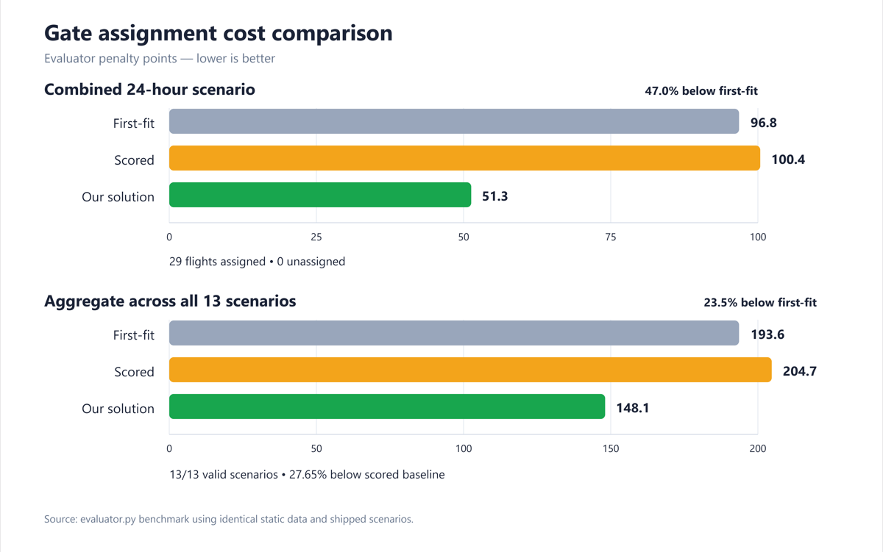
FIGURES: EVALUATOR RESULTS
Notes:
The assignment runtime has no AI model or external AI service. It uses rule checks and cost-based search. Developer AI use is undocumented.
Sources:
https://github.com/Dannyzhang2022/YYZ-Gate-Assignment/blob/main/README.md
https://github.com/Dannyzhang2022/YYZ-Gate-Assignment/blob/main/person1/plan_optimizer.py
https://github.com/Dannyzhang2022/YYZ-Gate-Assignment/blob/main/person3/gate_choice.py

Slide 12
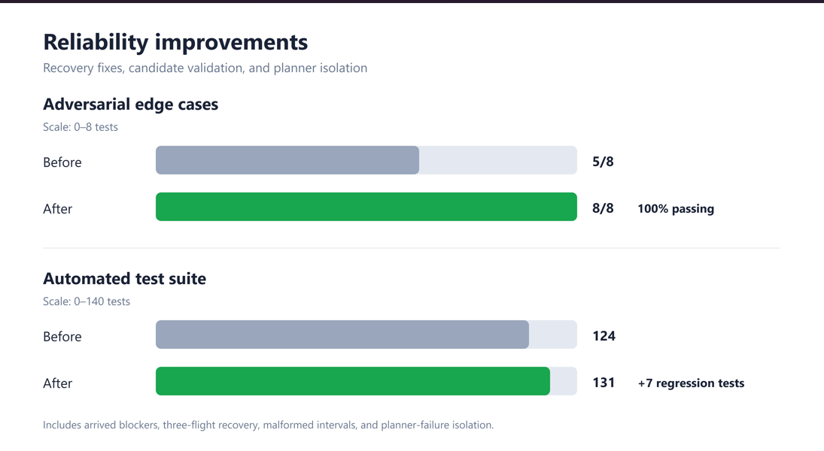
FIGURES: EVALUATOR RESULTS
Notes:
The assignment runtime has no AI model or external AI service. It uses rule checks and cost-based search. Developer AI use is undocumented.
Sources:
https://github.com/Dannyzhang2022/YYZ-Gate-Assignment/blob/main/README.md
https://github.com/Dannyzhang2022/YYZ-Gate-Assignment/blob/main/person1/plan_optimizer.py
https://github.com/Dannyzhang2022/YYZ-Gate-Assignment/blob/main/person3/gate_choice.py

