Slide 1
YYZ GATE ASSIGNMENT
A safer, more stable
gate plan
How four contributors combine flight ordering, gate selection,
disruption recovery, and plan validation
Team project overview | under 7 minutes
YYZ, decision support prototype
Notes:
Four roles coordinate gate recommendations. The final slide reports evaluator results.
Sources:
https://github.com/Dannyzhang2022/YYZ-Gate-Assignment

Slide 2
PROJECT WORKFLOW
One observation, four connected roles
The evaluator supplies the current schedule, bookings, gate limits, outages, and updates.
Person 2
Person 3
Person 4
Person 1
Orders waiting flights by urgency and gate scarcity
Ranks gates that pass safety and availability checks
Assesses changed flights during disruption recovery
Builds, improves, and validates whole-plan candidates
Validated assignments and ordered reassignments return to the evaluator
Candidate plans are replayed against hard constraints before the coordinator selects one.
Workflow described by the repository’s four solution modules
Notes:
Person 2 orders flights. Person 3 ranks gates. Person 4 assesses disruptions. Person 1 plans and validates.
Sources:
https://github.com/Dannyzhang2022/YYZ-Gate-Assignment/blob/main/person1/solution_team.py
https://github.com/Dannyzhang2022/YYZ-Gate-Assignment/blob/main/person2/flight_order.py
https://github.com/Dannyzhang2022/YYZ-Gate-Assignment/blob/main/person3/gate_choice.py
https://github.com/Dannyzhang2022/YYZ-Gate-Assignment/blob/main/person4/disruption_repair.py

Slide 3
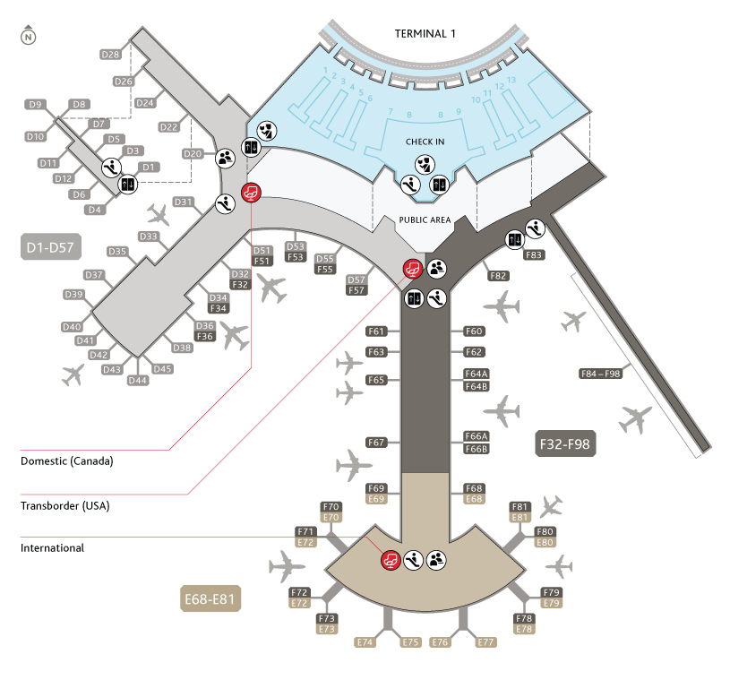
NOAH: FLIGHT ORDERING
Ordering and Organizing Flights
Some flights are more important than others.
6 total functions which check flight-gate compatibility, number of compatible gates, flight time overlaps, and flight order from most to least important.
1
Emergency Flights
Flights are ordered according to: emergencies, most constrained, longest delay, then earliest interval.
2
Most Constrained Flights
3
Flights with the longest delay
4
Flights with the shortest stay
Code can be found in noah/flight_order.py
Notes:
Person 2 determines which waiting flight gets considered first. compatible checks aircraft wingspan, required jetbridge, and gate category. count_compatible_gates measures a flight’s basic options. count_usable_gates excludes gates blocked during its occupancy intervals by bookings or outages. order_waiting_flights gives priority to emergencies. Among other flights, fewer usable gates wins, protecting constrained aircraft from losing their only option to a more flexible flight. Longer delay breaks remaining ties, followed by earliest occupancy start. Stable input order settles any final tie. Person 1’s joint optimizer uses this ordering, as does best-fit recovery. Person 2 does not select the final gate. This consistent priority rule helps planners protect scarce capacity when availability changes, and keeps a flexible flight from taking the only usable gate from a constrained flight. That protects options for flights with few alternatives.
Sources:
https://github.com/Dannyzhang2022/YYZ-Gate-Assignment/blob/main/person2/flight_order.py
https://github.com/Dannyzhang2022/YYZ-Gate-Assignment/blob/main/person1/plan_optimizer.py

Slide 4
YUJI: GATE SELECTION
Explain why each gate passes or fails
The module separates hard safety checks from soft cost ranking.
Rejects gates that fail category, wingspan, jetbridge, outage, or occupancy checks.
All gates
Compatibility and time checks
Ranks safe options by walking distance, premium-gate use, and reassignment cost.
↓
Returns the lowest-cost safe gate; the dashboard shows the selected one and reasons for failure of the other gates.
Safe choices
Ranked with reasons and costs
Notes:
Person 3 developed gate selection and ranking. The code first checks hard requirements: gate category, aircraft wingspan, required jetbridge, booking overlaps, and outages. It keeps every gate in the ranked output with a safe flag and reasons, making rejected options explainable. Only safe gates are compared on soft costs: walking distance, using an international gate for a domestic flight, and moving an existing assignment. choose_gate returns the lowest-cost safe option, or no gate if none can be proved safe. The solution module applies this process to waiting and disrupted flights, and the visualizer shows the checks and rankings. This helps reviewers see why a gate passed or failed. Person 3’s contribution makes recommendations easier to inspect. The project remains decision support; airport operators and their systems retain authority in live operations.
Sources:
https://github.com/Dannyzhang2022/YYZ-Gate-Assignment/blob/main/person3/gate_choice.py
https://github.com/Dannyzhang2022/YYZ-Gate-Assignment/blob/main/person3/solution_gatechoice.py
https://github.com/Dannyzhang2022/YYZ-Gate-Assignment/blob/main/person3/gate_choice_visualizer.html

Slide 5
DANNY: DISRUPTION REPAIR
Recheck assignments after a change
assess_changed_flights checks whether current gates still fit the updated flight.
Safety checks
Gate category
Wingspan and jetbridge
Outages and booking conflicts
repair_changed_flights stages new intervals, releases invalid gates, and searches replacements.
Helpers detect overlaps, copy bookings, and rank safe candidates; the caller handles flights with no safe replacement.
Notes:
Person 4’s base module handles flights whose gate may become invalid after an update. assess_changed_flights reports whether a changed flight can stay and why it may need to move, including incompatibility, outages, or fixed booking conflicts. repair_changed_flights is a separate pure helper. It copies bookings, stages new intervals, releases invalid gates, and searches for safe replacements, considering constrained flights first. Supporting helpers check overlaps and rank candidates without changing original bookings. The function returns reassignment pairs and updated occupancy. If none is safe, the caller handles that flight. Person 1 uses the assessment in joint planning. Production review must consider Canadian Aviation Regulations and GTAA procedures. The prototype does not claim certification.
Sources:
https://github.com/Dannyzhang2022/YYZ-Gate-Assignment/blob/main/person4/disruption_repair.py
https://github.com/Dannyzhang2022/YYZ-Gate-Assignment/blob/main/OPERATIONAL_READINESS.md

Slide 6
DAVID: INTEGRATION AND OPTIMIZATION
Build one view of the disruption
Combines waiting and assigned flights, gate occupancy, outages, and changed profiles.
Evaluator state
Flights, gates, occupancy, updates
Calls Person 4’s assessment to flag changed flights that cannot safely stay at their gates.
↓
Connects Person 2’s flight order and Person 3’s gate rankings to the planning step.
Prepared inputs
Current plan plus disruption status
Notes:
Gate Repair Code: Hackathon Pitch
When flight details change, a gate assignment may no longer be safe or available. This module checks whether each affected flight can keep its gate by verifying aircraft compatibility, gate outages, and overlapping bookings.
It works on a copy of the schedule, so the original booking data stays unchanged. It stages the updated flight times before checking conflicts, which helps ensure the decisions reflect the full incoming update. It also checks for collisions between flights changing at the same time, so two updated flights are not kept at the same gate if their schedules overlap.
For flights that need to move, it considers the most constrained flights first—the ones with fewer compatible gate options. It then chooses from gates that are compatible, available, and conflict-free, ranking them by distance and gate-use penalties.
The result is a list of proposed gate changes and an updated local occupancy map for the coordinator to use in the next planning step. If no safe replacement is available, the caller can handle that flight separately.

Slide 7
DAVID: INTEGRATION AND OPTIMIZATION
Search improves a feasible plan
Starts from a feasible, scarcity-first plan using Person 2 and Person 3’s modules.
Tests single-flight moves and exchanges between two flights.
Scores walking distance, gate stability, reassignments, and unassigned flights.
Feasible plan
Single move
Two-flight exchange
All assignments pass hard checks
Try a better gate for one flight
Test a paired gate swap
Notes:
The joint optimizer uses Person 2’s flight ordering and Person 3’s safe gate rankings. It starts from a feasible plan and tests single-flight moves and two-flight exchanges. Each change must respect hard constraints. The cost also reflects walking distance, gate stability, reassignments, and flights left unassigned.
Sources:
https://github.com/Dannyzhang2022/YYZ-Gate-Assignment/blob/main/person1/plan_optimizer.py
https://github.com/Dannyzhang2022/YYZ-Gate-Assignment/blob/main/person2/flight_order.py
https://github.com/Dannyzhang2022/YYZ-Gate-Assignment/blob/main/person3/gate_choice.py

Slide 8
DAVID: INTEGRATION AND OPTIMIZATION
Keep only valid plan candidates
Runs the joint optimizer and best-fit recovery in separate exception boundaries.
Replays each candidate against gate compatibility, outages, occupancy, and move order.
Returns the lower-cost candidate when both are safe, as ordered assignments and reassignments.
Planner candidates
Safety replay
Evaluator output
Joint optimizer plus best-fit
Reject an invalid plan
Assignments and reassignments
Notes:
Person 1 also runs best-fit recovery in a separate exception boundary. The coordinator replays each candidate against the observation and rejects unsafe plans. This isolates a planner failure without losing the other path. If both plans are valid, it returns the lower-cost one as ordered assignments and reassignments.
Sources:
https://github.com/Dannyzhang2022/YYZ-Gate-Assignment/blob/main/person1/solution_team.py

Slide 9

SAFETY AND REGULATION COMPLIANCE
How does our program follow airport safety and regulations?
Flight_order.py checks that every flight gets to an appropriate gate safely, without pushing flights into inappropriate gates.
A manual override button in the dashboard enables employers and operators to stop the program and manually change flights according to their discretion.
Gate operators are given access to multiple solutions and the ability to move forwards within the timeline to make changes and ensure the safety of pilots and workers ahead of time.
Our prototype should not be considered an authorized operational assignment; manual discretion is advised before applying our solution directly to the airport according to COHSR Section 19.3 and CAR section 302.502.
Sources: gms/compat.py and OPERATIONAL_READINESS.md
Notes:
CBSA customs flow appears directly in the gate-category rule: international flights require international gates. Assignment validation also applies selected physical and availability constraints. Canadian Aviation Regulations, GTAA SMS and local procedures, worker-safety requirements, and ICAO/IATA guidance are production review areas. The repository does not map exact provisions to code or claim compliance.
Sources:
https://github.com/Dannyzhang2022/YYZ-Gate-Assignment/blob/main/gms/compat.py
https://github.com/Dannyzhang2022/YYZ-Gate-Assignment/blob/main/OPERATIONAL_READINESS.md

Slide 10
AI IN THE PROJECT
AI Assistance in the Project
AI-assisted development
We used AI tools to help draft and refine parts of the code. Our team set the project requirements, made the design decisions, reviewed and integrated the code, and tested the system against our scenarios.
ASSIGNMENT ENGINE
Rules +
Search
The assignment engine itself uses explicit gate rules and search logic; it does not make decisions with an AI model.
We also used AI to generate additional test and edge cases to further ensure the performance of our program.

Slide 11
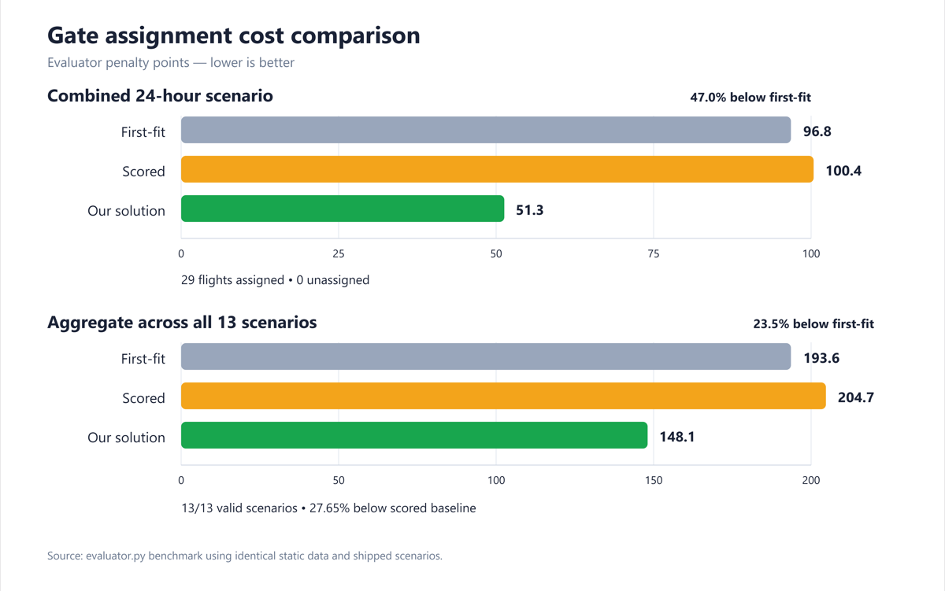
FIGURES: EVALUATOR RESULTS
Notes:
The assignment runtime has no AI model or external AI service. It uses rule checks and cost-based search. Developer AI use is undocumented.
Sources:
https://github.com/Dannyzhang2022/YYZ-Gate-Assignment/blob/main/README.md
https://github.com/Dannyzhang2022/YYZ-Gate-Assignment/blob/main/person1/plan_optimizer.py
https://github.com/Dannyzhang2022/YYZ-Gate-Assignment/blob/main/person3/gate_choice.py

Slide 12
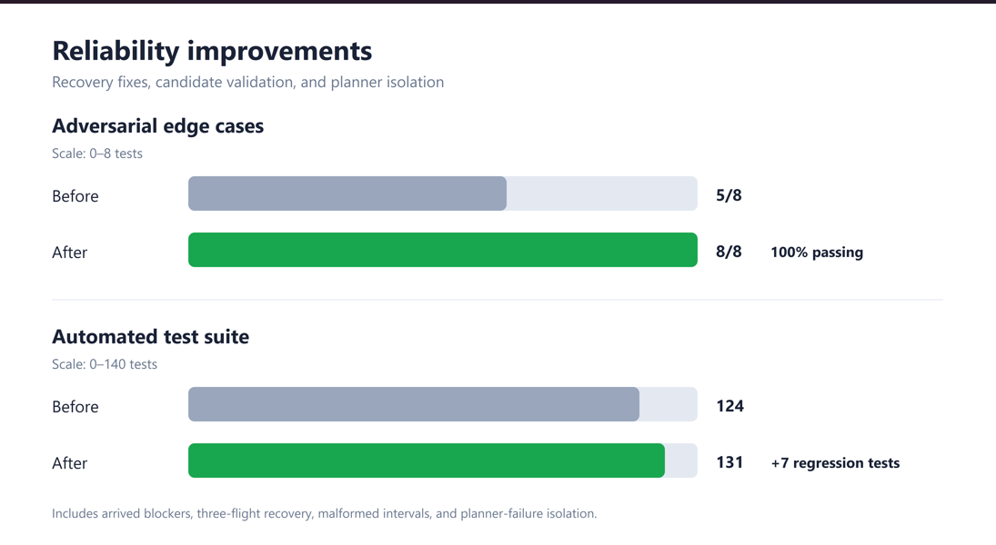
FIGURES: EVALUATOR RESULTS
Notes:
The assignment runtime has no AI model or external AI service. It uses rule checks and cost-based search. Developer AI use is undocumented.
Sources:
https://github.com/Dannyzhang2022/YYZ-Gate-Assignment/blob/main/README.md
https://github.com/Dannyzhang2022/YYZ-Gate-Assignment/blob/main/person1/plan_optimizer.py
https://github.com/Dannyzhang2022/YYZ-Gate-Assignment/blob/main/person3/gate_choice.py

