Slide 1

SECURE PASSWORD MANAGEMENT SYSTEM
Danoja Dias
Jayamine Alupotha
Janaka Alawathugoda
University of Peradeniya

Slide 2

WHY DO WE NEED A PASSWORD MANAGER?
Low entropy passwords
High Entropy Passwords
"xL'xDBYxESfZm7md9"dkft
:5>{3XfkRgwU_(3s*!+cP)[
Low Entropy Passwords
Namal12345
0777320354Naveena

Slide 3
WHY DO WE NEED A PASSWORD MANAGER?
Low entropy passwords
Same passwords for each account
Difficult to remember High entropy password

Slide 4
FEATURES
A Password manager
- Keep passwords and user names of web accounts
- Only the user can access the password manager – face recognition
- Protect passwords
- fill the log in pages

Slide 5
HOW DOES IT WORKS?
Face recognition
Encryption
Master password
User friendly interface
browser

Slide 6
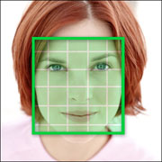
Face Recognition
When creating the account of the user
- Face detection
- Capture images of the user’s face
When logging in to the password manager
- Face detection
- Face recognition

Slide 7

Encryption
AES 256 bit Encryption method
Salt and master password are used to generate the key for encryption
All the account passwords have been encrypted

Slide 8

Master Password
When creating the account of the user
- High entropy password – But not stored in the database
Create account
Encrypt a word using master password
When logging in
Decrypt the word
If matches
User can log in to the account
Compare

Slide 9
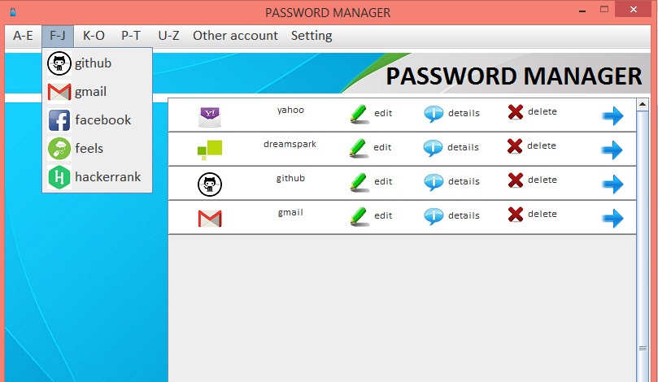
Graphical User Interface
User friendly GUI
- Add accounts
- Edit accounts
- Find account

Slide 10
Database
User
Accounts
ID | NAME | ENCRYPTED_WORD
ID | USERNAME | PASSWORD | LAST LOGIN DATE | LAST LOGIN TIME | URL | TEXTFIELD | PASSWORDFIELD

Slide 11

BROWSER
When user wants to log in to an account
Browser is opened.
Decrypt the password
Fill the User name and the password

Slide 12






Technologies
the

Slide 13
Benefits
High security
- user must be represent
- Only user knows the master password
- high entropy passwords
It supports 83% of website accounts
Easy to access
- User friendly interface
- Only have to click the submit button

Slide 14
DEMO

