Slide 1

SMARTICE
The Smart Notice Board

Slide 2
Why we built SMARTICE?
To reduce paperwork, save time and to make things interesting

Slide 3
How does SMARTICE work?

Slide 4
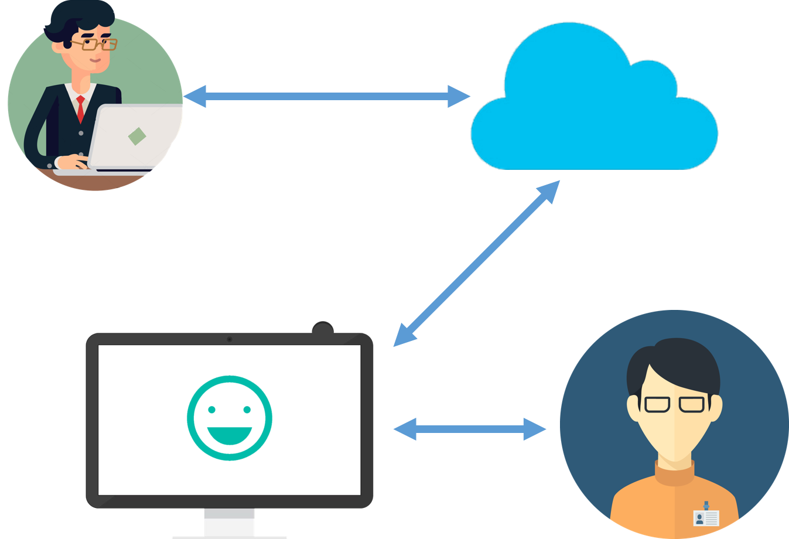

Slide 5
How we built SMARTICE?

Slide 6







Slide 7
SMARTICE
The Smart Notice Board

