Slide 1
Data Mining Of Video Streaming Data Using Apriori Algorithm
Presented By: Utkarsh Sen(ST4A-2106)

Slide 2
Table of contents
01
03
05
02
04
06
Problem Statement
Data Analysis
Results
Intuition and motivation of the problem
Understanding the collected data
Results obtained through data mining
Data Collection
Apriori Algorithm
Conclusion and limitations
Data Source and explanation of the data
Working of the apriori algorithm
Use cases and limitations

Slide 3
Problem Statement
If you define the problem correctly, you almost have the solution
-Steve Jobs

Slide 4
Problem Statement
Worldwide many people use video streaming platforms like YouTube, Amazon Prime, etc. for various purposes. People use a large amount of time consuming content. But,
Is their any association between different video streaming platforms?
Does they show any kind of pattern?
Which video streaming platform is most likely to be available?
How can people benefit from this association?
How apriori algorithm works?

Slide 5


Data Collection

Slide 6
Data Collection
Demographic
Subject Specific
Name
Gender
Age
Place of residence
Profession
Source of Income
Platforms Used
Subscription pay
Time spend
Frequency
Devices Used

Slide 7
Data Analysis

Slide 8
Data Cleaning
Missing Values
Wrong Format
Missing values were replaced or removed
All values into lower string
Column names
Location
For ease of analysis
Extracting City

Slide 9
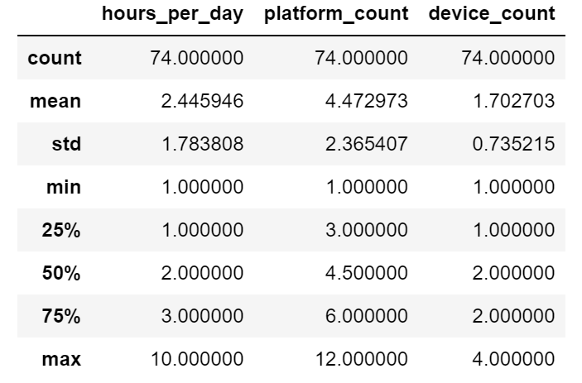
Descriptive Statistics
Total responses: 74
Average 2.4 hrs spend on streaming per day.
75% of respondent use 2 or less devices.
Half of the respondent uses 4 or less platforms

Slide 10
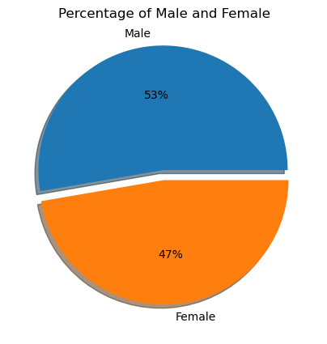
Gender
53% (39) are male.
47% (35) are female.

Slide 11
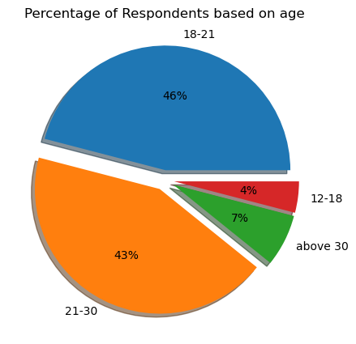
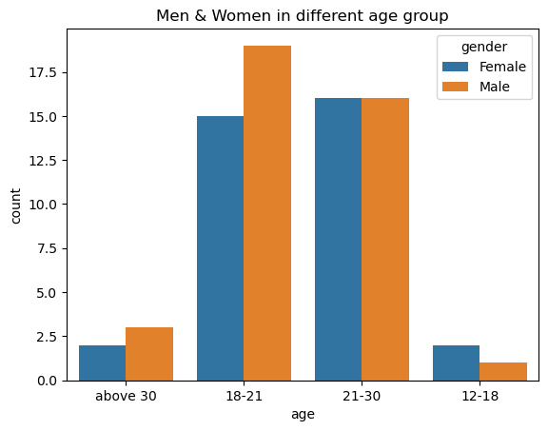
Age
46% (34) belongs to 18-21 age.
43% (32) belong to 21-30 age.
7% (5) are above 30.
4% (3) belongs to 12-18.
Except in group 12-18, male respondents are more.

Slide 12
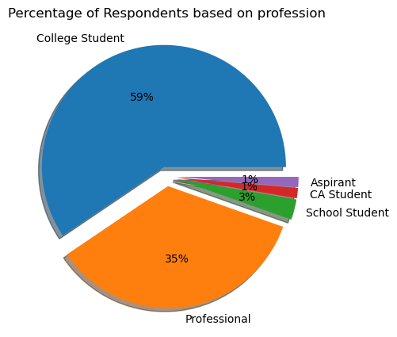
Profession
59% (44) are college students.
35% (26) are Professionals.
3% (2) are school students.
The remaining are Aspirants and CA student.

Slide 13
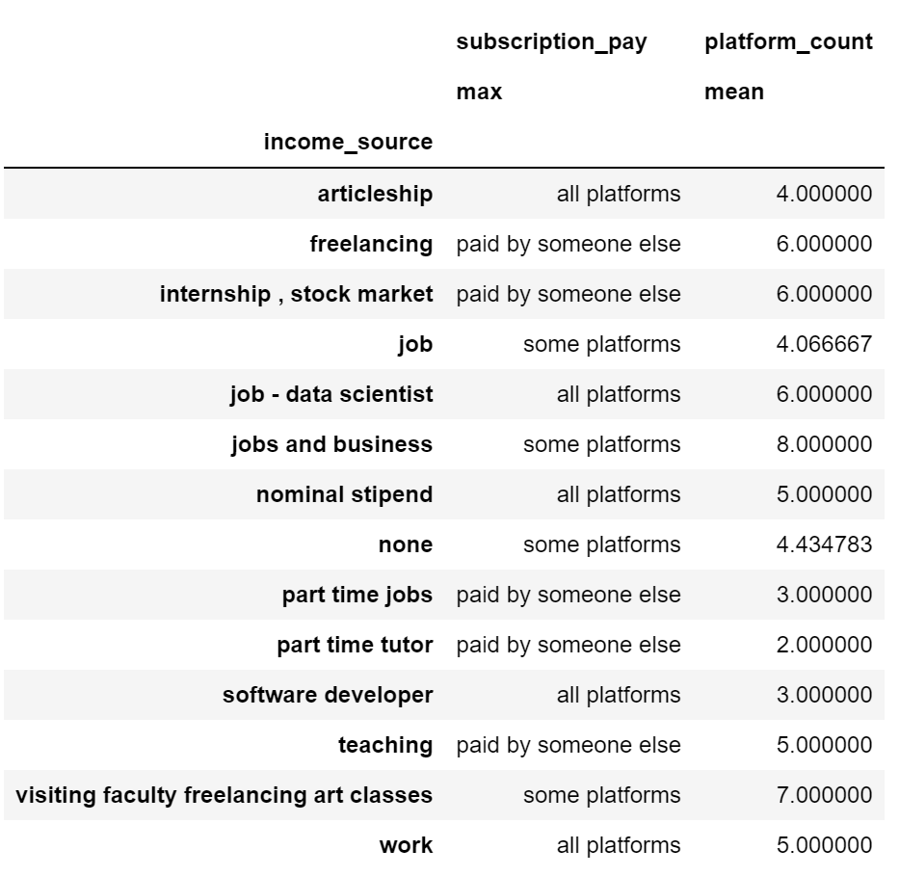
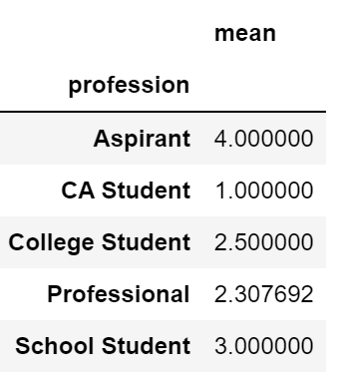
Profession(Cont.)
People who pay for some of the subscription ends up with more platforms than people who pays for all of the platforms
School student spend most of their time on streaming

Slide 14
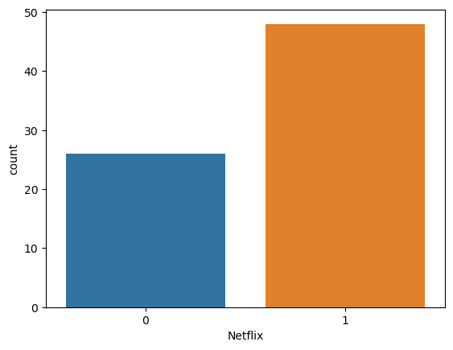
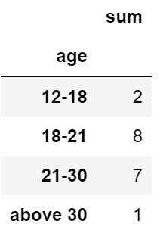
Video Streaming Apps
Around 27 respondents do not use Netflix.
The table shows respondents using Sony Liv.

Slide 15
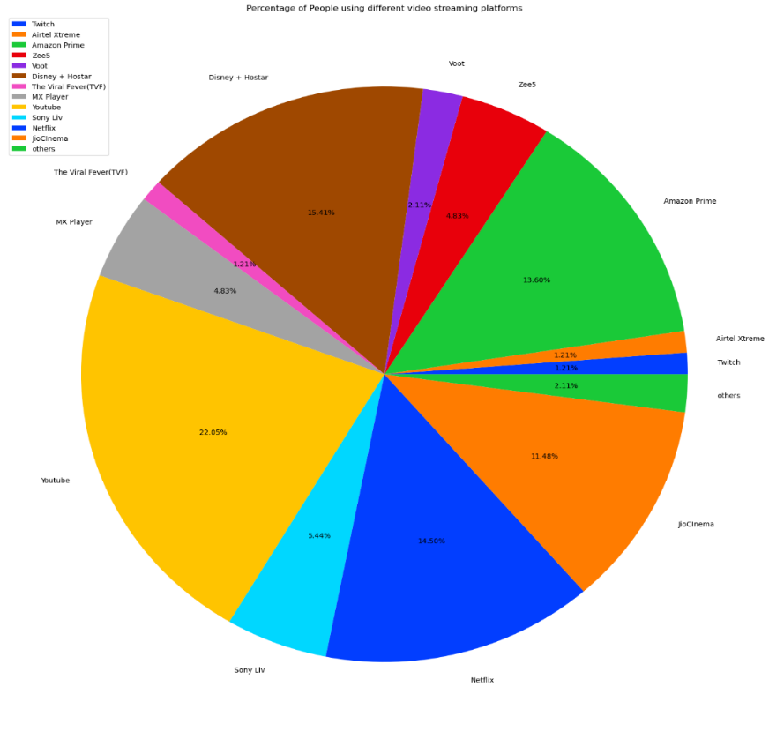
Video Streaming Apps(cont.)
Most popular streaming platform is YouTube, followed by Voot, Sony Liv and Netflix.

Slide 16
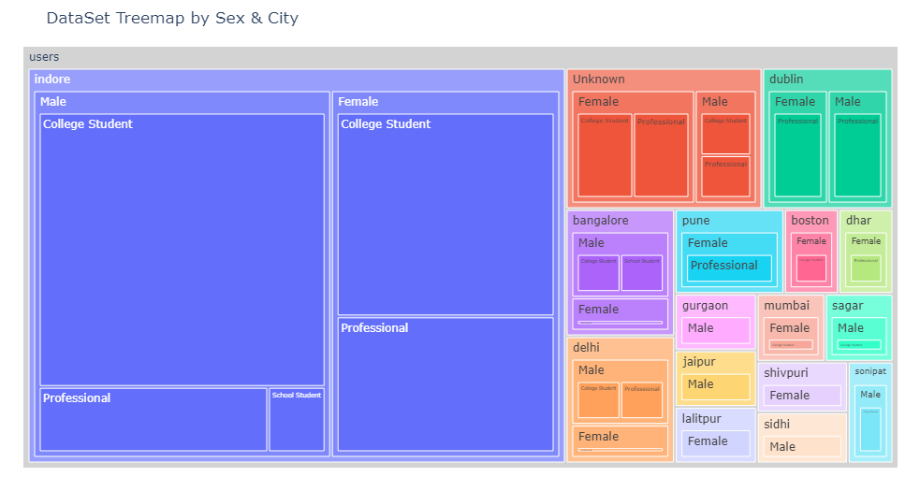
Demography
Tree map showing demography of the respondents

Slide 17


Slide 18
Assocation Rule Mining
Definition: Association rule mining can be defined as identification of frequent patterns, correlations, associations, or causal structures among sets of objects or items in transactional databases, relational databases, and other information repositories.
Rules are if/then statement.
Consist of two parts:
Antecedent (if) is the item found in the data
Consequent (then) is the item found in the combination with the antecedent.
Association rules are often written as X → Y meaning that whenever X appears Y also tends to appear.

Slide 19
What is Apriori Algorithm?
Data Mining Technique.
Used to find frequent item sets.
Uses Connecting and Pruning
Need to define minimum Support and Minimum Confidence
Useful to get first hand information about data.

Slide 20
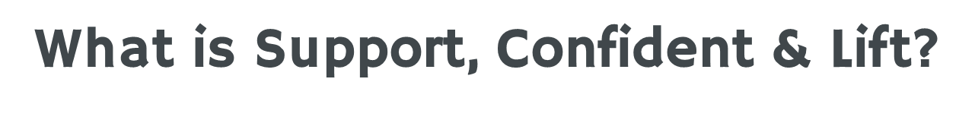
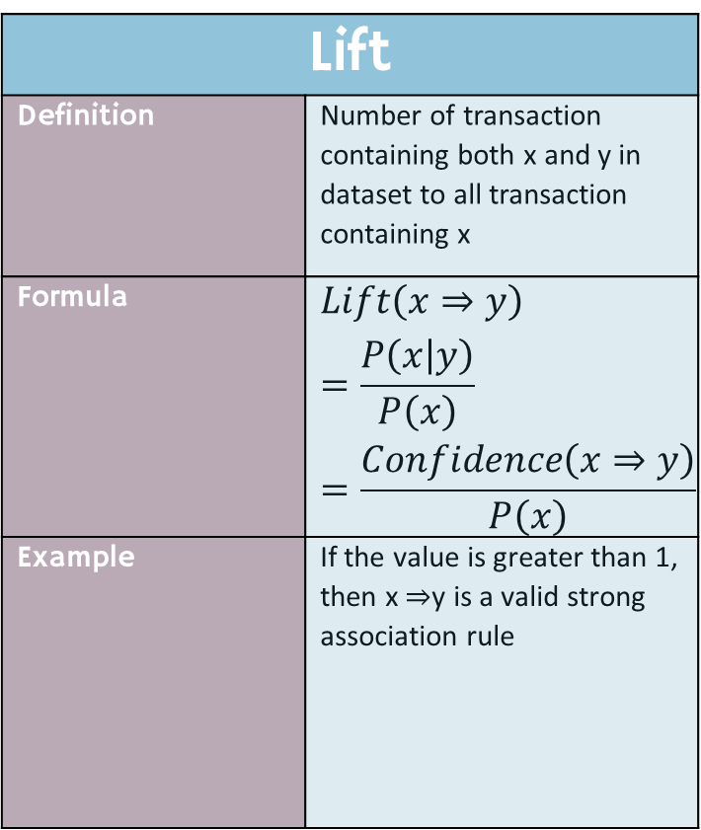
Support
Definition | Number of transaction containing both x and y in dataset to all transaction
Formula | $$Support\left(xy\right)=P\left(xy\right)=\frac{Num\left(xy\right)}{Num\left(Allsamples\right)}$$
Example | a support rating of 28% means that “there is a 28% probability that an individual in the population will contain both X and Y”
Confidence
Definition | ratio of the number of transactions including x and y to the number of transactions including y
Formula | $$Confidence\left(x⇒y\right)=P\left(x | y\right)=\frac{P\left(xy\right)}{P\left(y\right)}$$
Example | Assuming that “52% of the terms containing X contain Y”, the confidence is 52%
Lift
Definition | Number of transaction containing both x and y in dataset to all transaction containing x
Formula | $$Lift\left(x⇒y\right)=\frac{P\left(x | y\right)}{P\left(x\right)} =\frac{Confidence\left(x⇒y\right)}{P\left(x\right)}$$
Example | If the value is greater than 1, then x ⇒y is a valid strong association rule

Slide 21
Results

Slide 22
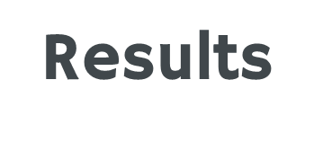
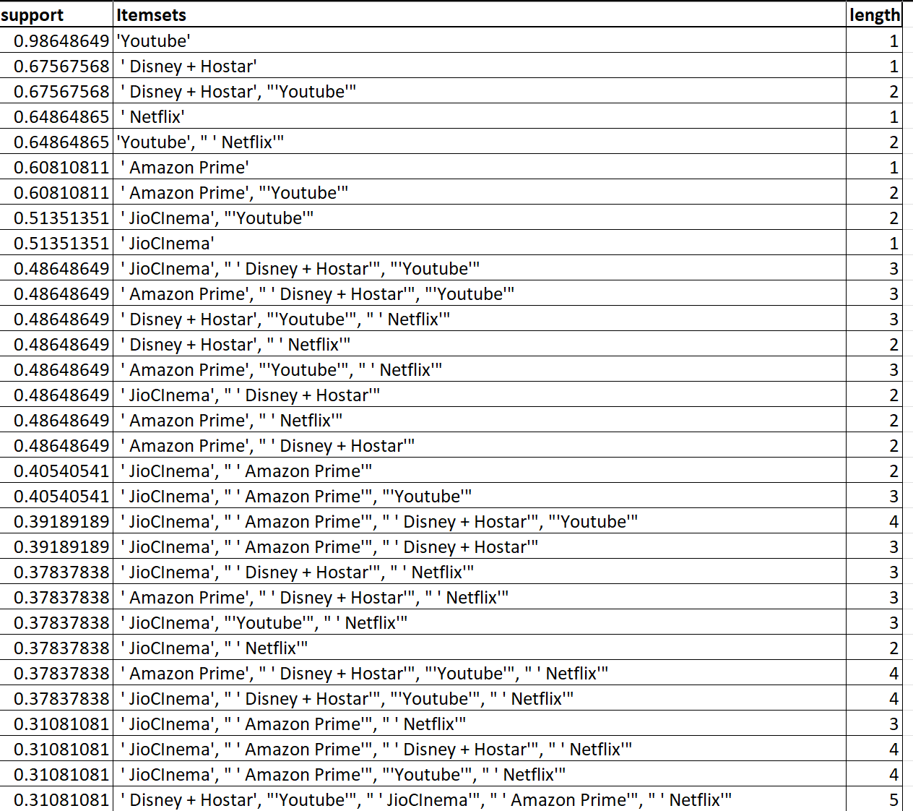
YouTube has maximum support.
Only 1 pair with 5 length has support more than 30%.

Slide 23
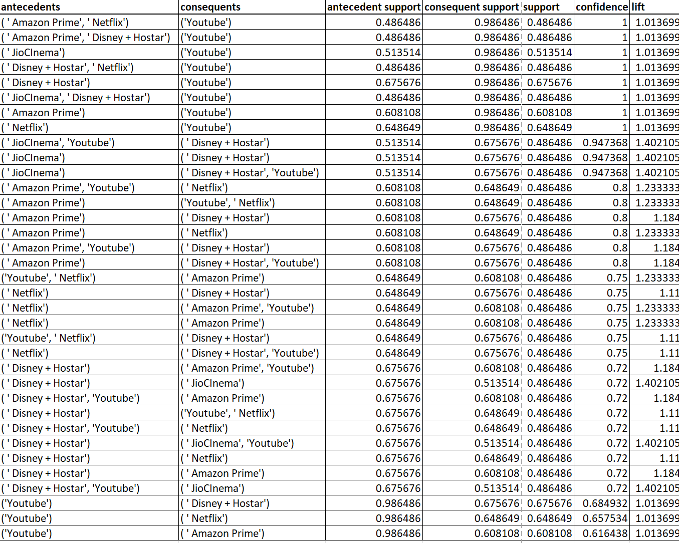

Slide 24
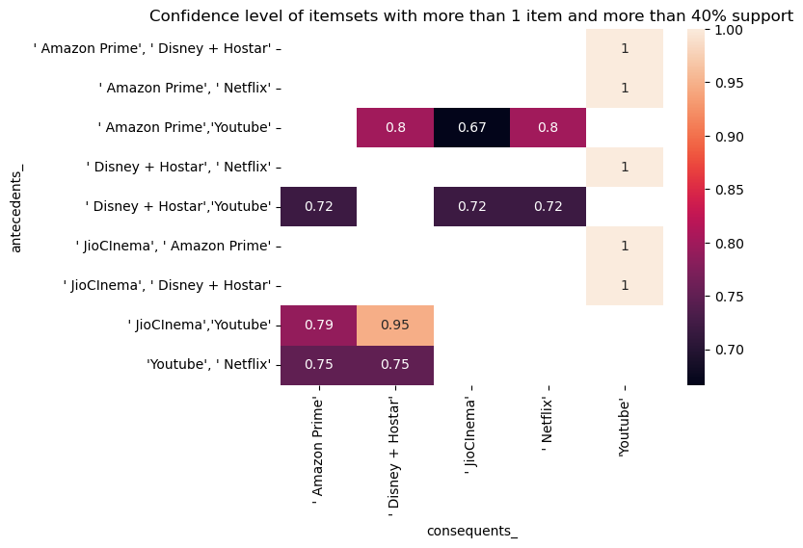
Results (Cont.)
YouTube is present in almost all device.
Confidence(JioCinema,Youtube => Disney+Hotstar) = 95%

Slide 25
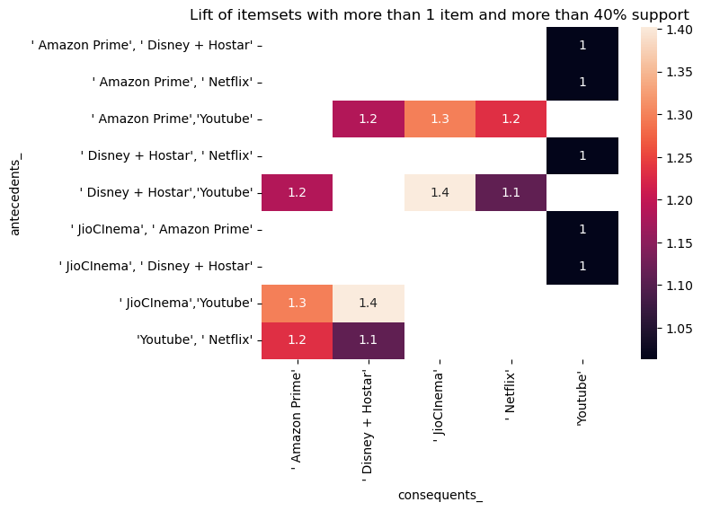
Results (Cont.)
YouTube does not have any association with any one.
Lift(JioCinema,Youtube => Disney+Hotstar) = Lift(Disney+Hotstar,Youtube => JioCinema) = 1.4

Slide 26
Conclusions and Limitations

Slide 27
Conclusions
Hence, the apriori algorithm was successful in forming the association between various video streaming platforms. Out of 16 platforms selected for the study, only 5 had strong association with confidence more than 60%. This 5 are:
- YouTube
- Netflix
- Amazon Prime
- Jio Cinema
- Disney + Hotstar
The owner of the remaining platforms can request the owner of above platforms to promote their product. They can run advertisement on the above mentioned. For example, Amazon Prime plays short advertisement promoting Amazon Mini TV.
They can also convince telecommunication companies to add their product with one of the high support value products. In this way people would also buy their subscription and there would be an opportunity the user might explore their content and end up liking it. For example, Airtel provides packages where Disney+Hotstar subscription and Zee5 both are available. A user of Airtel might end up watching content like “Chintu ka B’day” and end up liking the content provided by Zee5.

Slide 28
Limitations
Less Data
Importance
Less efficient
Slow
Since all 74 responses are recorded, bias maybe present
Does not take importance of platform into consideration
Apriori is less efficient compared to other data mining techniques
As data increases, time and space complexity of apriori increases

Slide 29
Thank You

