Slide 1

Problem Statement:
To diagnose patients into Normal, Depressive, Bipolar Type-2, and Bipolar Type-1 Individuals.
Methodology:
Data Collection
Data Preparation
Exploratory Data Analysis(EDA)
Data Preprocessing
Model Training
Base Model Formulation
Other Models Formulation
Models Comparison
Model Deployment

Slide 2

Data Collection
Data Preparation
Secondary Data
120 Patients Data
Features
Renaming Columns
Handling Null Values
Treating Features
Removing White Spaces
Converting Qualitative Data into Quantitative
Sadness
Exhaustness
Euphoric
Sleep Disorder
Mood Swings
Suicidal Thoughts
Anorexia
Anxiety
Try Explaining
Nervous Breakdown
Ignore and Move On
Admitting Mistakes
Overthinking
Aggressive Response
Optimism
Sexual Activity
Concentration
Source: https://www.kaggle.com/datasets/cid007/mental-disorder-classification

Slide 3
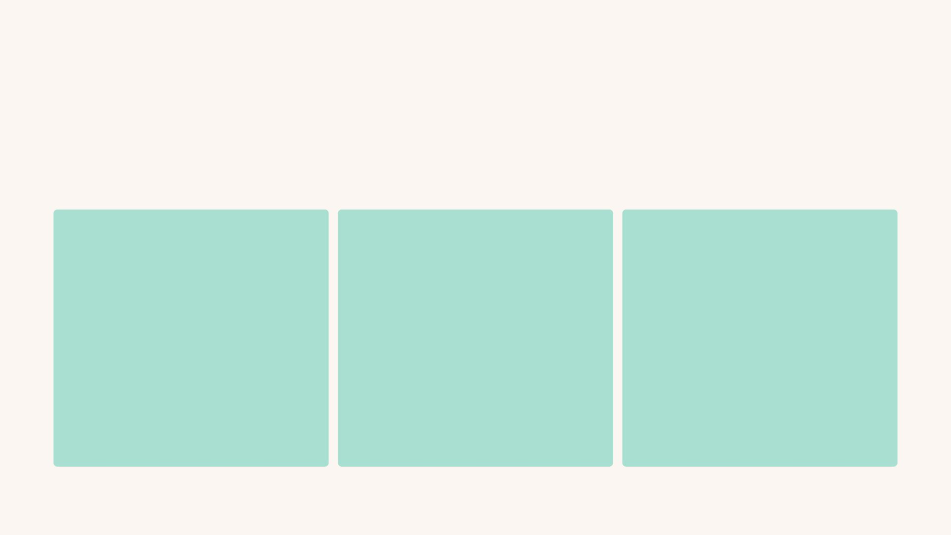
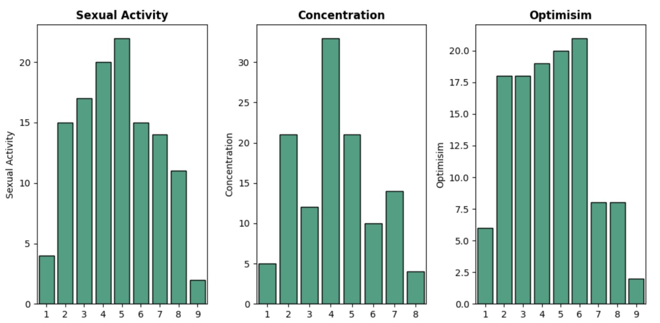
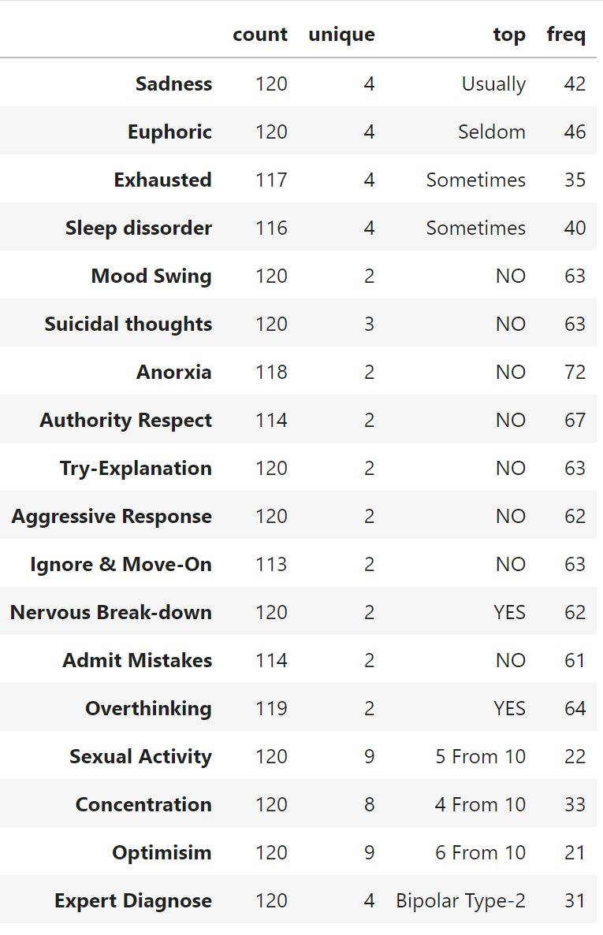
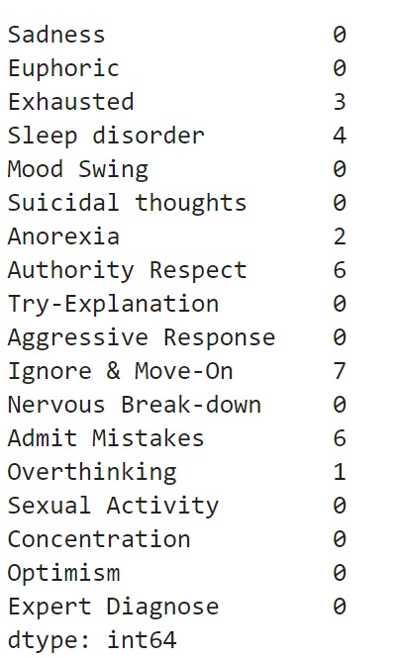
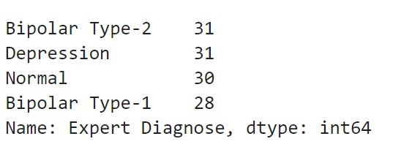
Exploratory Data Analysis (EDA):
5.83% of data is missing.

Slide 4

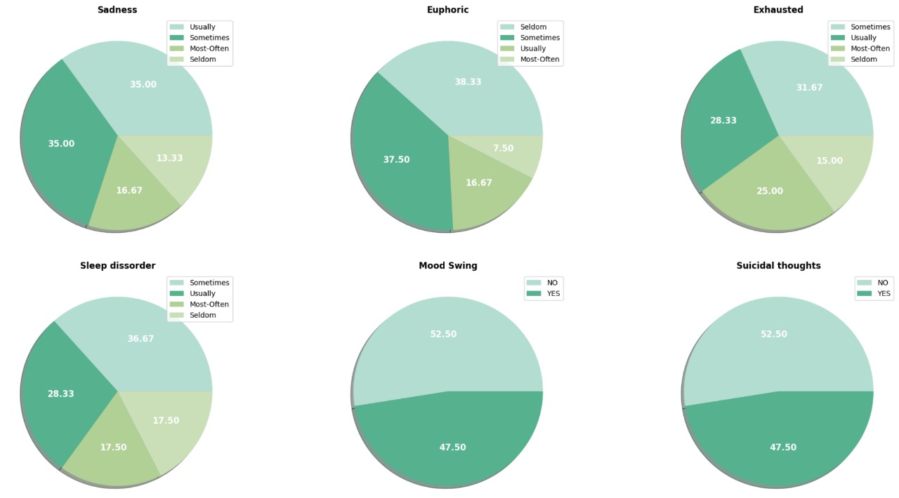
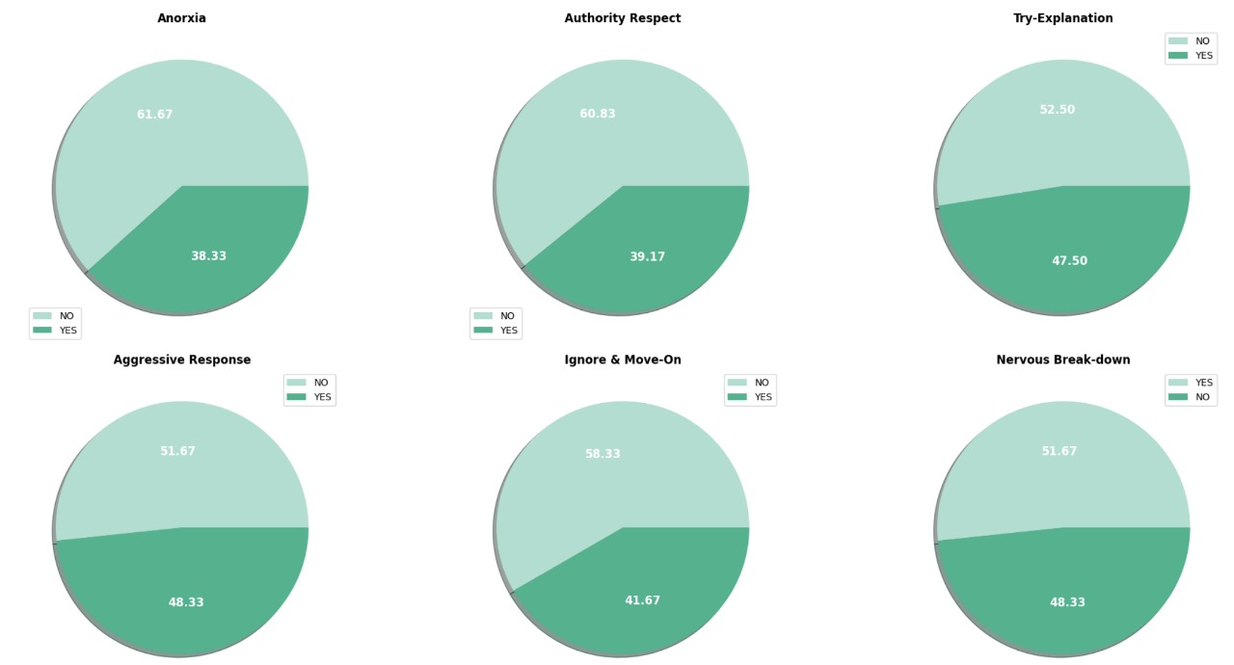
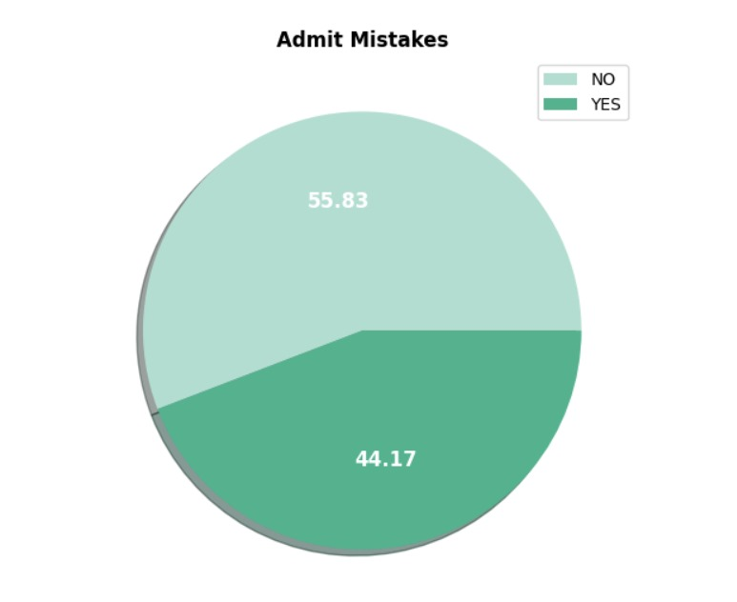
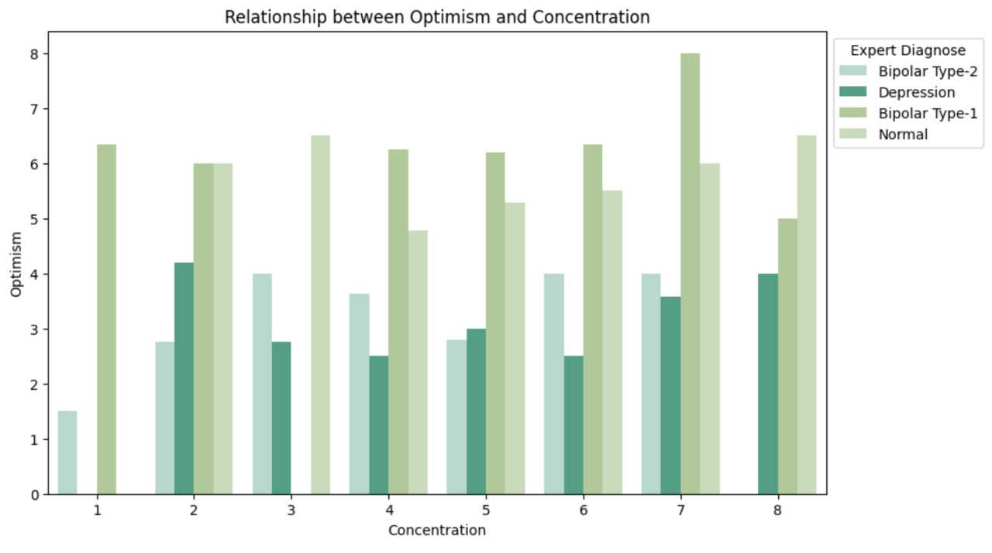
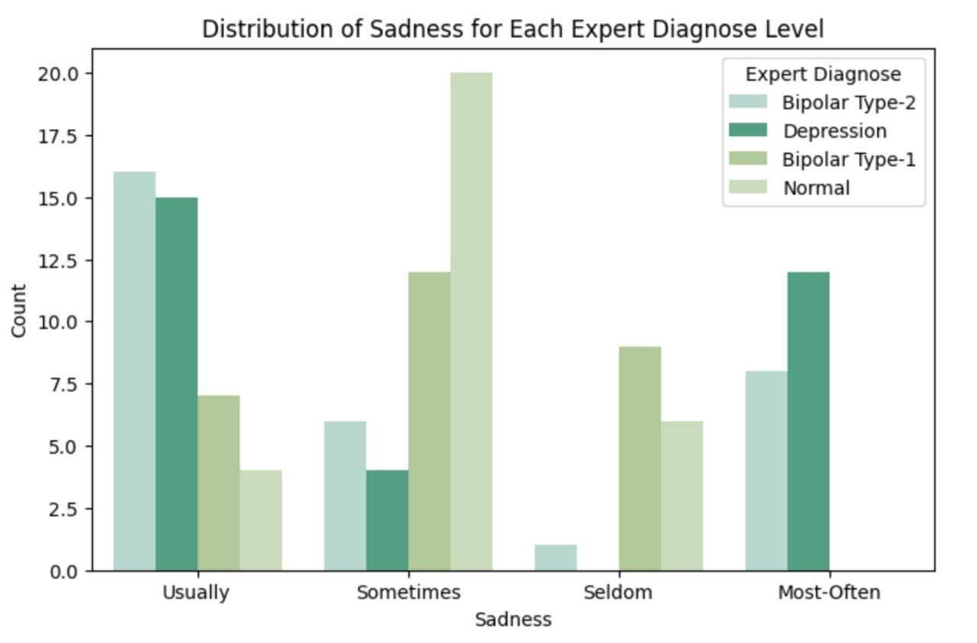
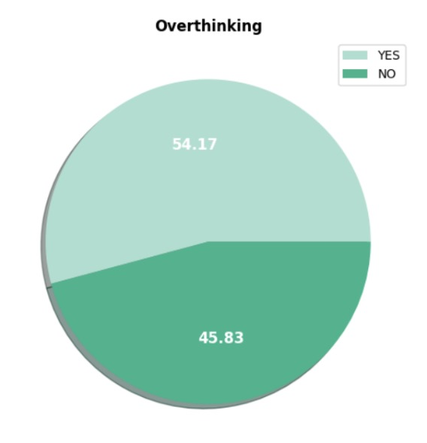

Slide 5
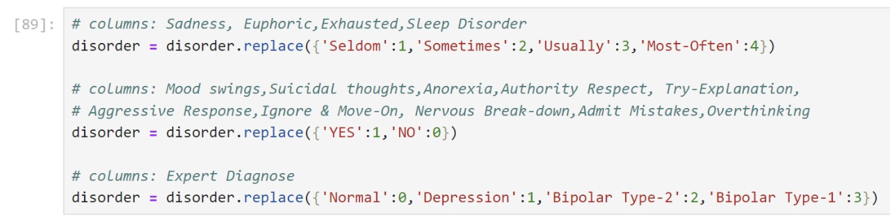
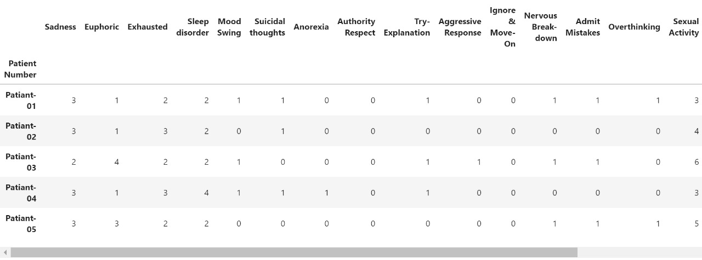
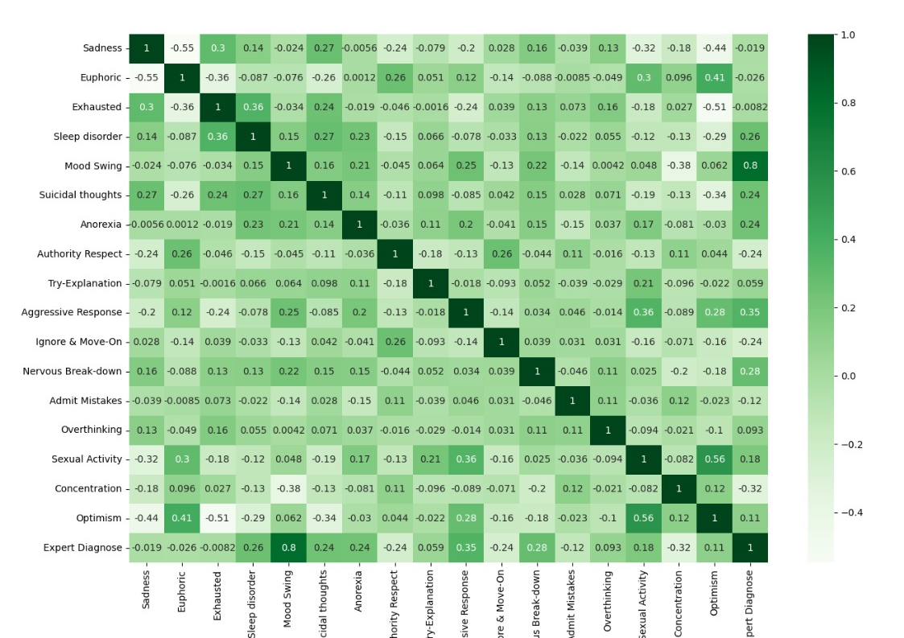
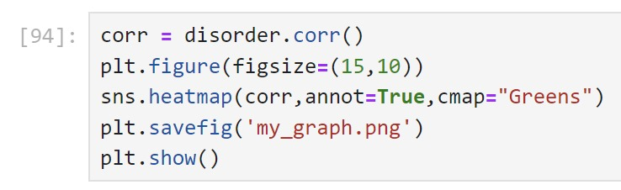
Data Preprocessing:
Converting Qualitative Data into Quantitative Data
Correlation Matrix

Slide 6
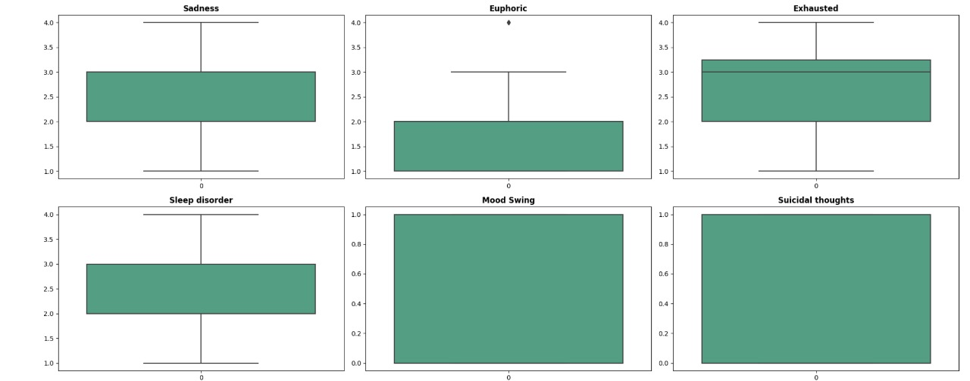
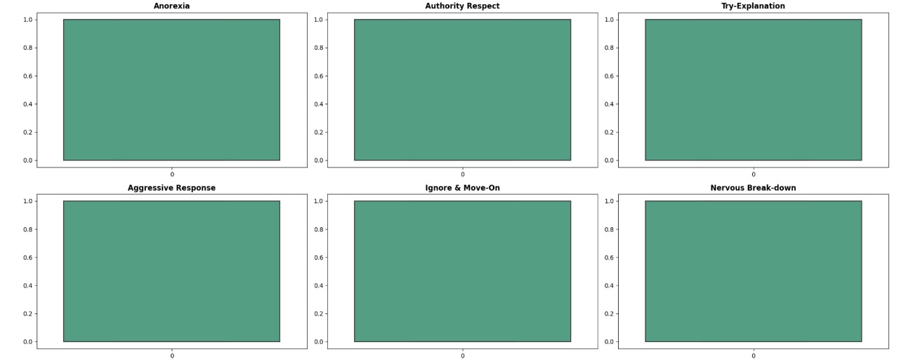
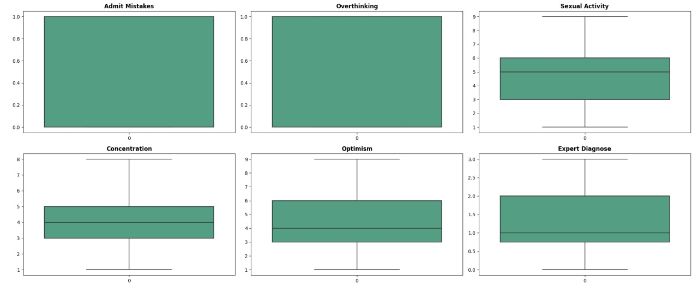
Detecting Outliers
Since only one outlier is present in Euphoric, which is critical for the model. So, we will neglect it.

Slide 7
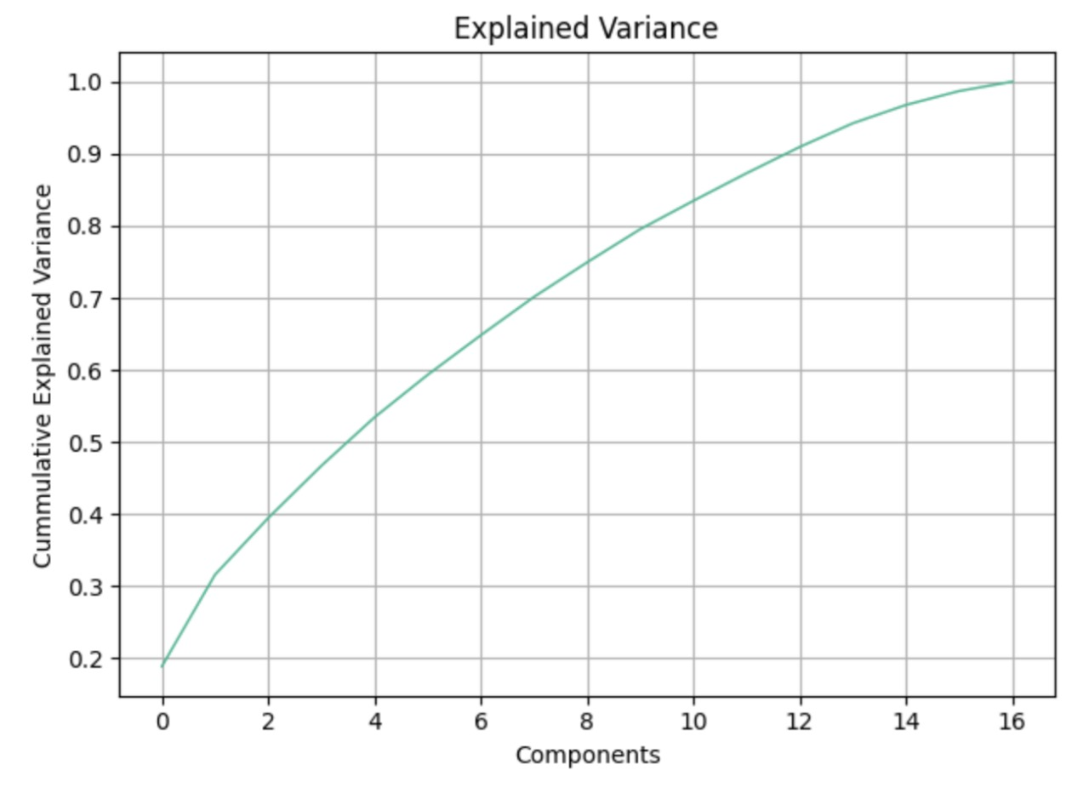
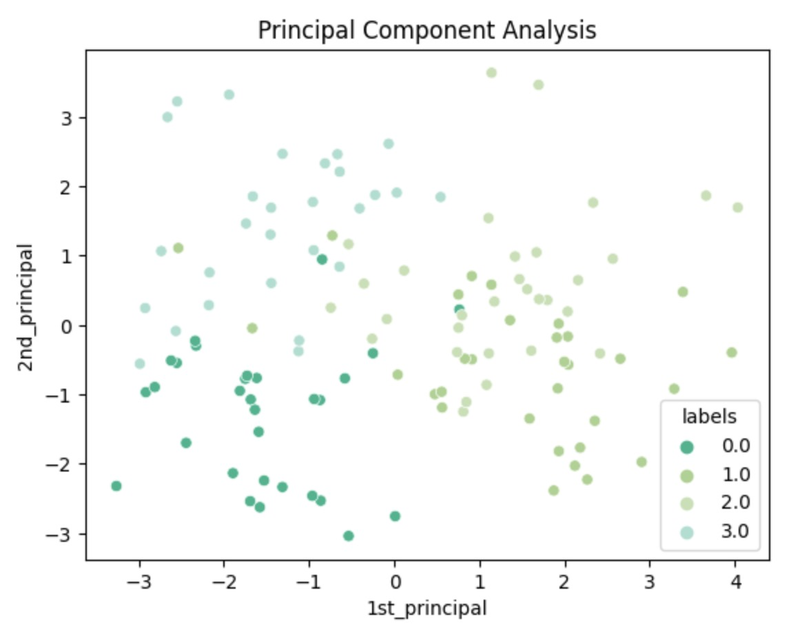
Features Importance
14 of the 17 features can explain around 98% of the labels.

Slide 8


Model Training:
Base Model
Logistic Regression
Other Models Formulation
Random Forest Regressor
Neural Network
K Nearest Neighbourhood
Support Vector Classifier(SVC)
Models Comparision
Comparing different models based on their accuracy.

Slide 9

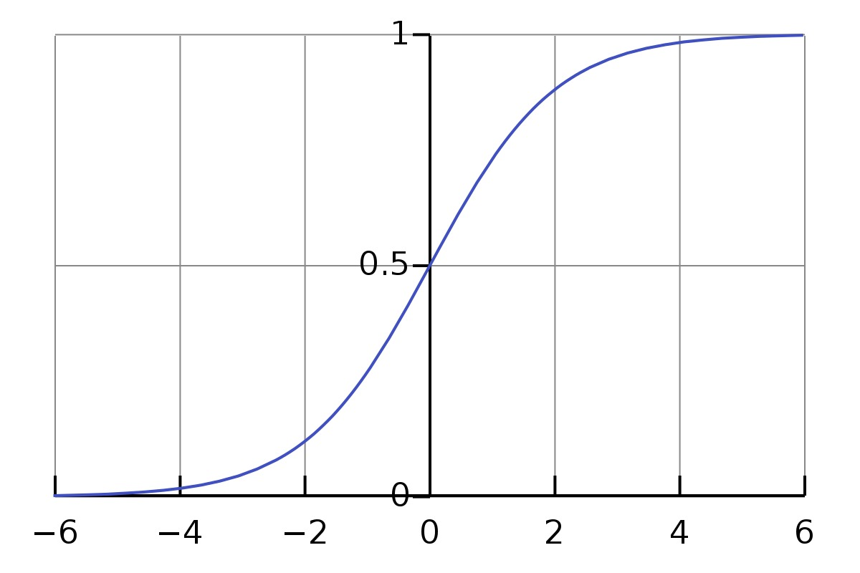

Logistic Regression
Logistic regression is a statistical method used for binary and multiclass classification tasks, predicting the probability of a categorical outcome based on one or more predictor variables. It models the relationship between the dependent and independent variables by estimating probabilities using the logistic function, which maps continuous values to the range [0, 1]. It's widely used in healthcare, finance, and marketing for its simplicity and interpretability.
$$f\left(x\right)=\frac{1}{1+ e^{−x}}$$

Slide 10
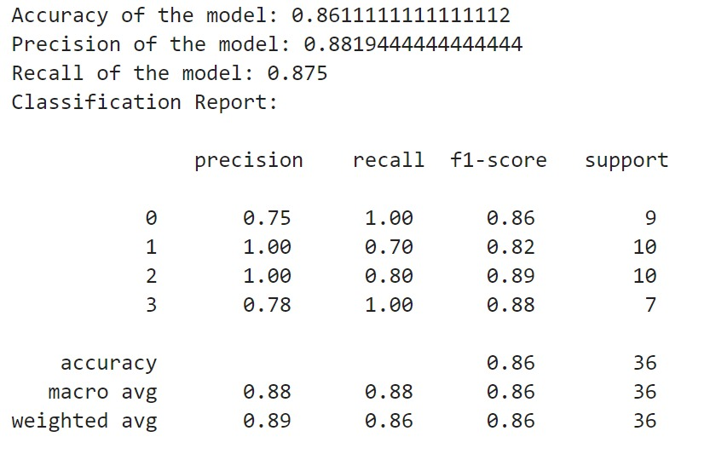
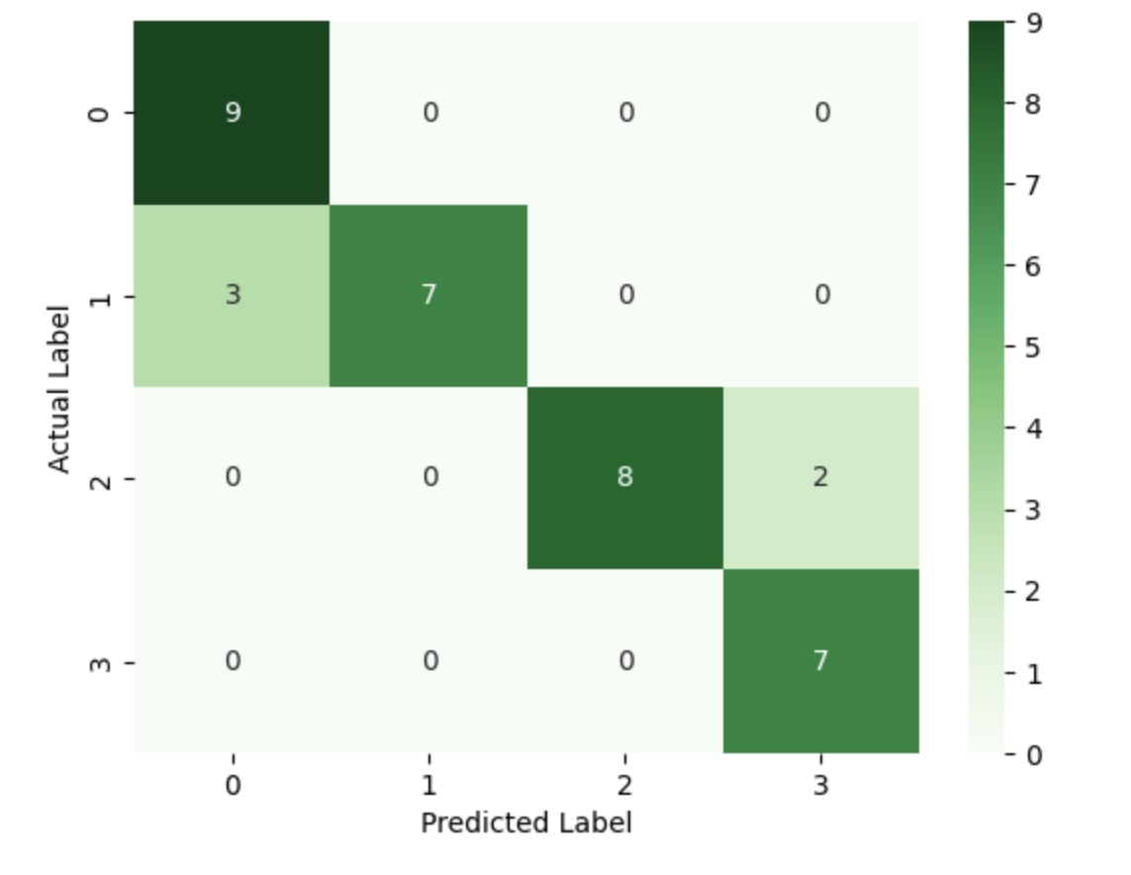
Result
Scores
Confusion Matrix

Slide 11

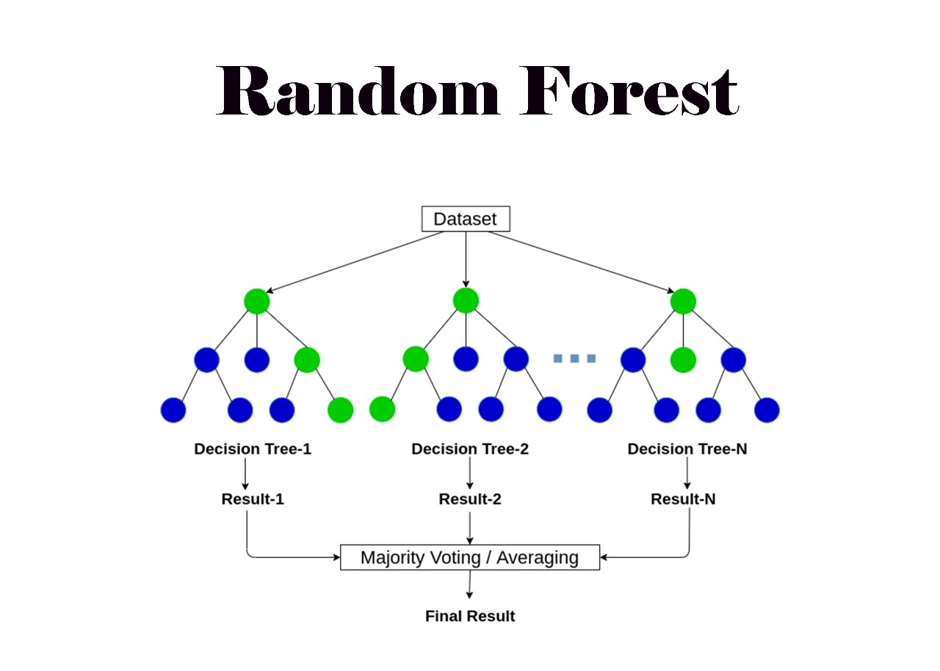
Random Forest Regressor
Random forest is a machine learning algorithm used for both classification and regression tasks. It builds multiple decision trees during training and combines their predictions through a process of averaging or voting to improve accuracy and reduce overfitting. Each tree in the forest is trained on a random subset of the training data and features, making the algorithm robust and effective for various types of data and predictive tasks.

Slide 12
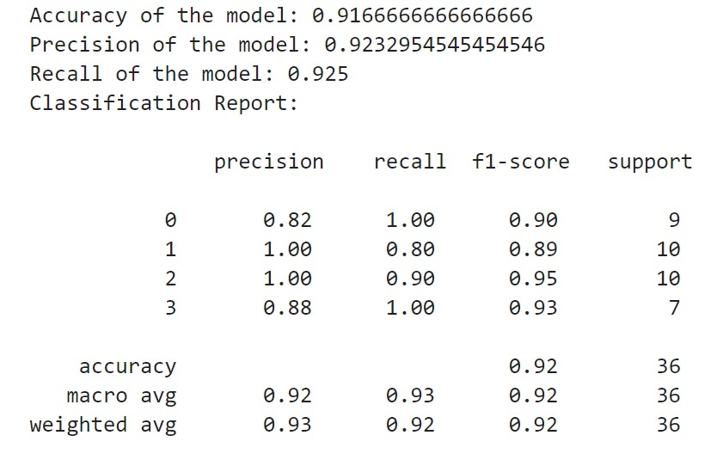
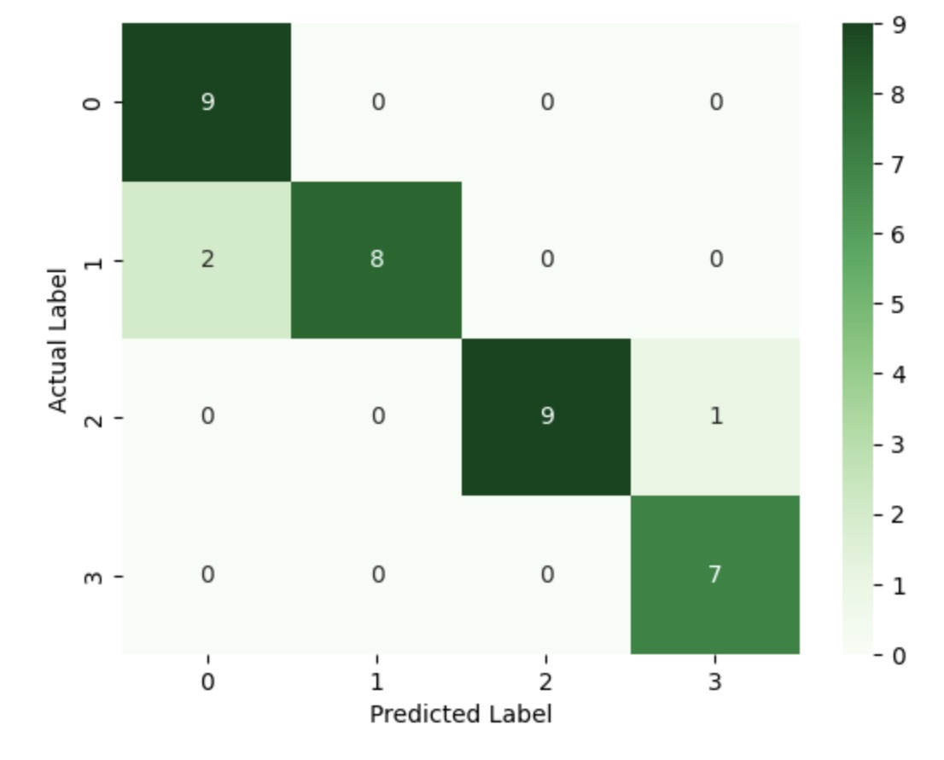
Result
Scores
Confusion Matrix

Slide 13

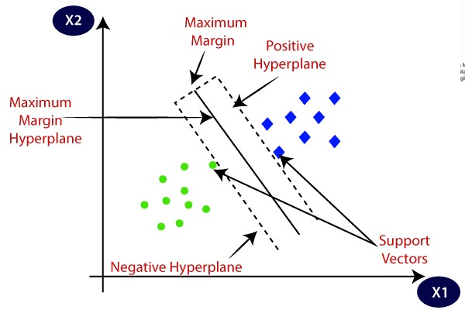
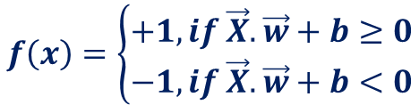
Support Vector Classifier
A Support Vector Classifier (SVC) is a supervised learning algorithm used primarily for classification tasks. It works by finding the optimal hyperplane that best separates the classes in a high-dimensional feature space. SVC aims to maximize the margin between the closest points of different classes, known as support vectors. It's effective for linearly separable as well as non-linearly separable data when used with appropriate kernel functions.
$$f\left(x\right)=\left\{\begin{aligned}+1, if \vec{X}.\vec{w}+b≥0 \\ −1, if \vec{X}.\vec{w}+b<0\end{aligned}\right.$$

Slide 14
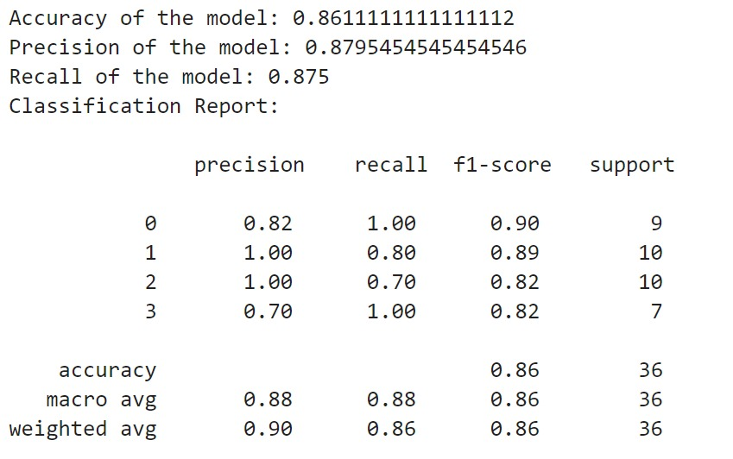
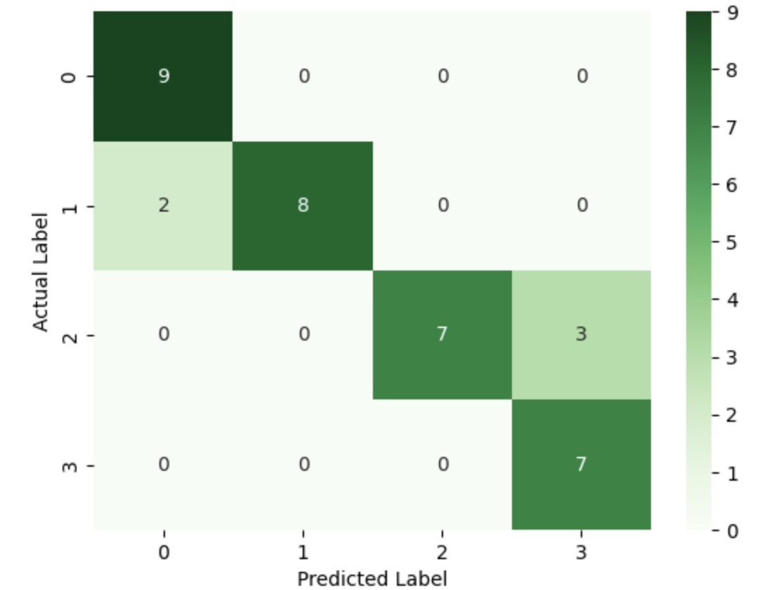
Result
Scores
Confusion Matrix

Slide 15
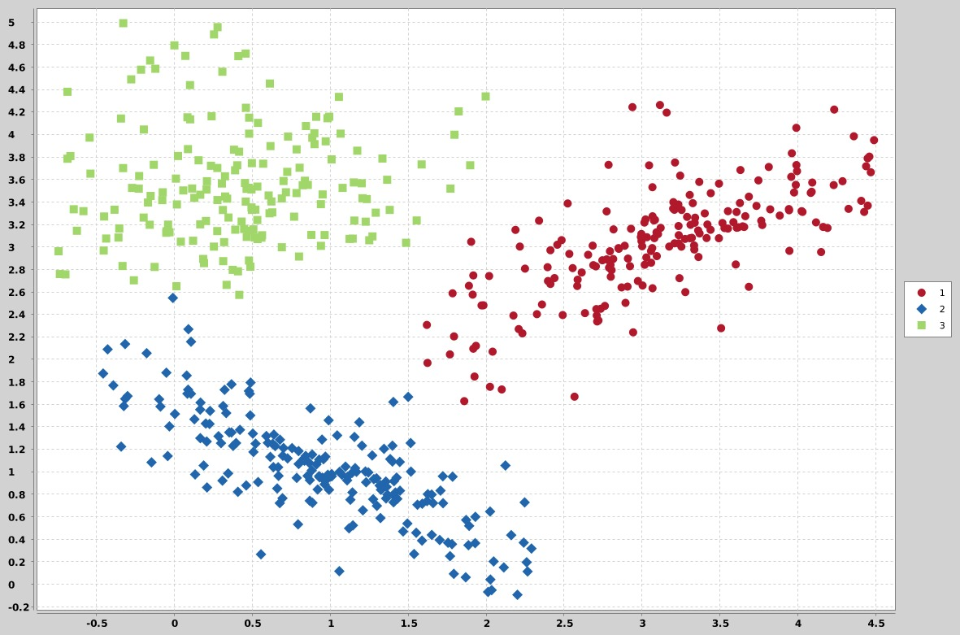
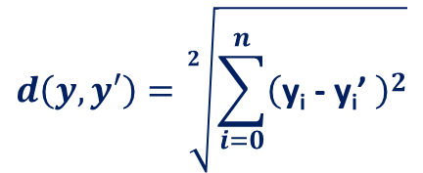
K Nearest Neighbour
K Nearest Neighbor (KNN) classifier is a simple and intuitive supervised learning algorithm used for classification tasks. It assigns a class label to an input data point based on the majority class of its k nearest neighbors in the feature space. The choice of k determines the smoothness of the decision boundary: smaller k values lead to more complex boundaries, while larger k values lead to smoother boundaries. KNN is non-parametric and does not require training, making it easy to implement but sensitive to the choice of distance metric and the number of neighbors.
$$d\left(y, y′\right)=\sqrt[2]{\sum_{i=0}^{n}{{\left(\text{y}\text{i}\text{ − }\text{yi}\text{’ }\right)}^{2}}}$$

Slide 16
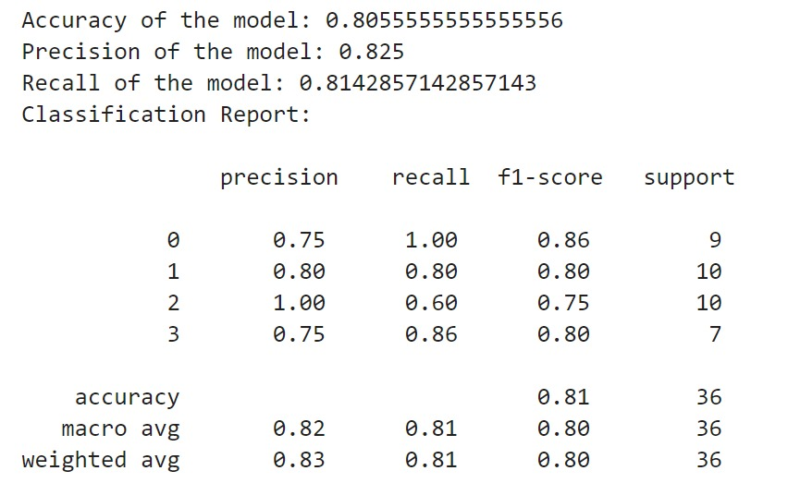
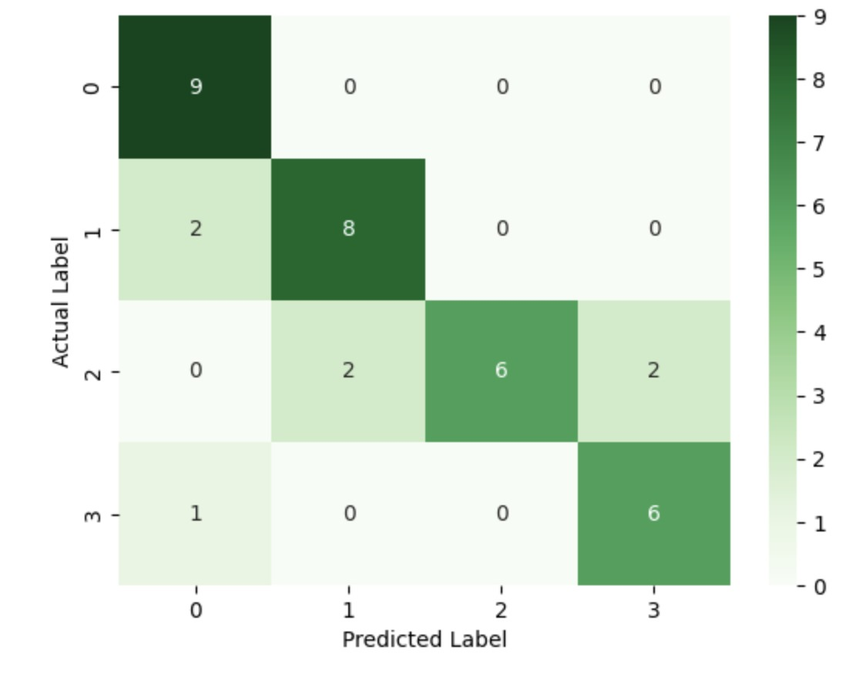
Result
Scores
Confusion Matrix

Slide 17
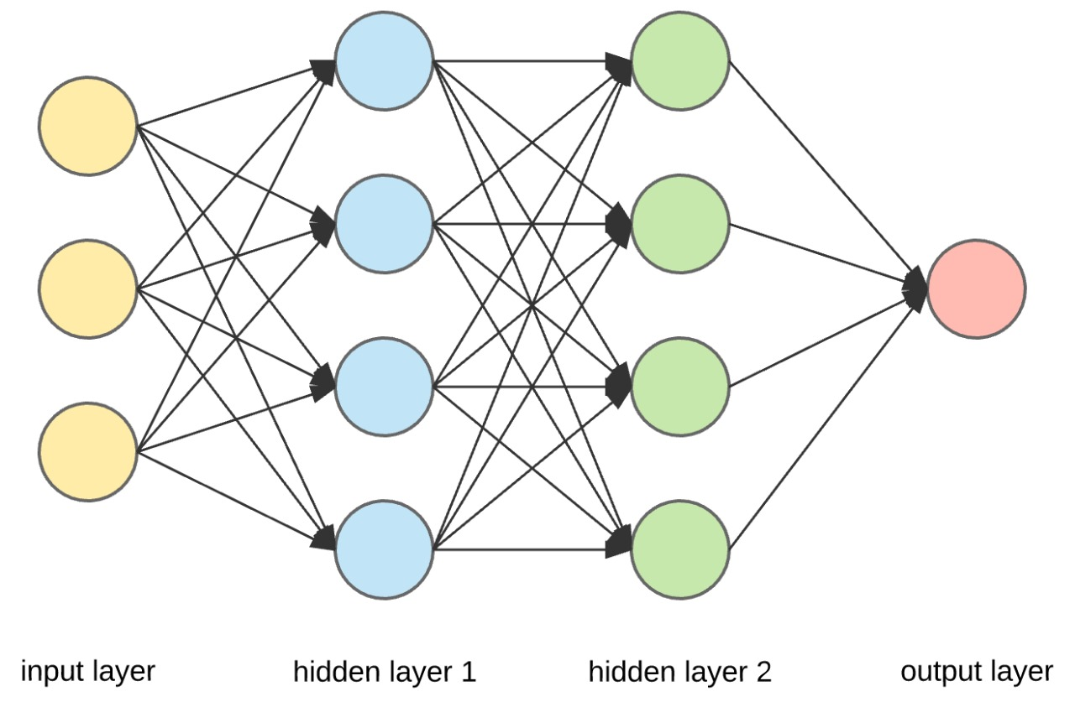
Neural Networks
A neural network is a computational model inspired by the structure and function of the human brain. It consists of interconnected nodes organized into layers, including input, hidden, and output layers. Each node applies a transformation to its inputs and passes the result to nodes in the next layer. Through a process of forward and backward propagation, neural networks learn to approximate complex functions and patterns in data, making them powerful tools for tasks such as classification, regression, and pattern recognition.

Slide 18
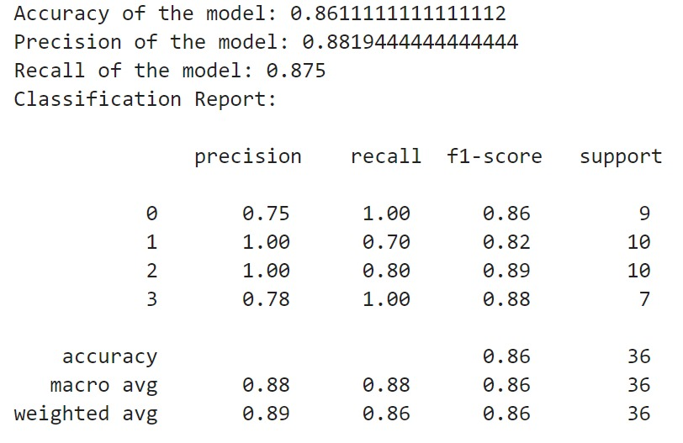
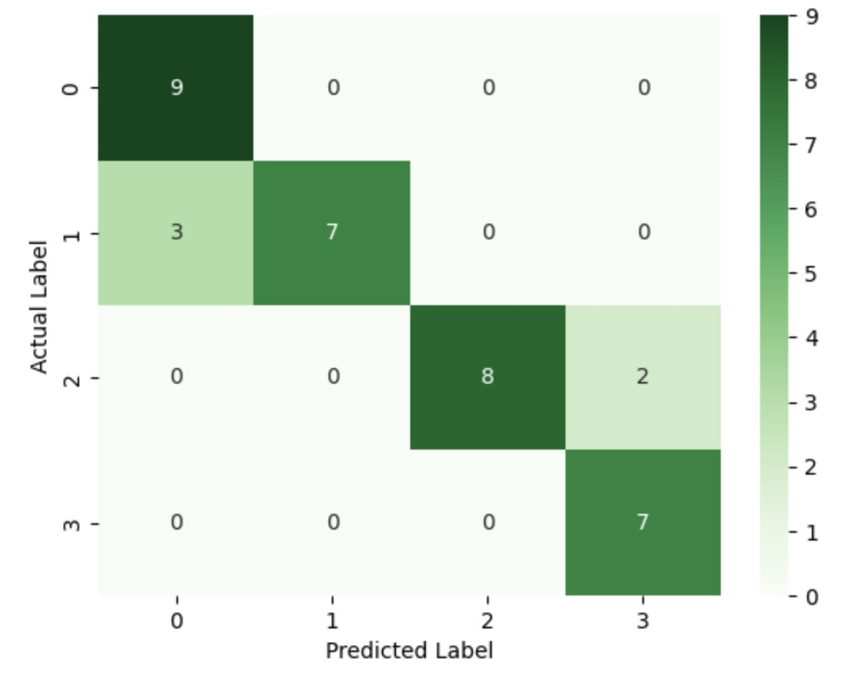
Result
Scores
Confusion Matrix

Slide 19
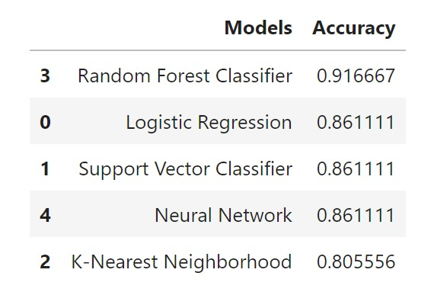
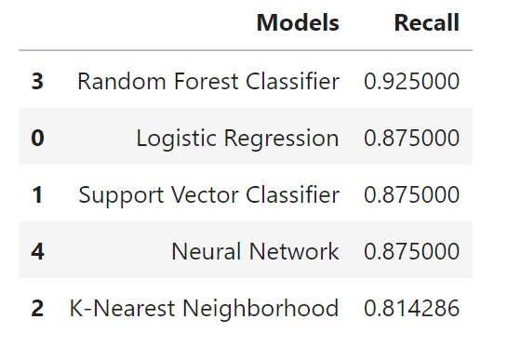
Models Comparison
Accuracy
Decision
Recall
Out of all the models trained, Random Forest Classifier had the best accuracy and recall score. Hence, the Random Forest model is used for model deployment. Apart from the random forest, Logistic Regression and Neural Networks are also used to provide an alternate model for prediction.

Slide 20
Conclusion:
Based on the EDA performed and model training, the best models are used to deploy and create a website to Diagnose patients with Normal, Depression, Bipolar Type-2, and Bipolar Type-1.
The website can be accessed using the URL: Mental Health Diagnoses
Drawbacks:
Insufficient Data
Secondary Source of Data
Lack of Field Expertise

Slide 21

Thank
You…

