Slide 1

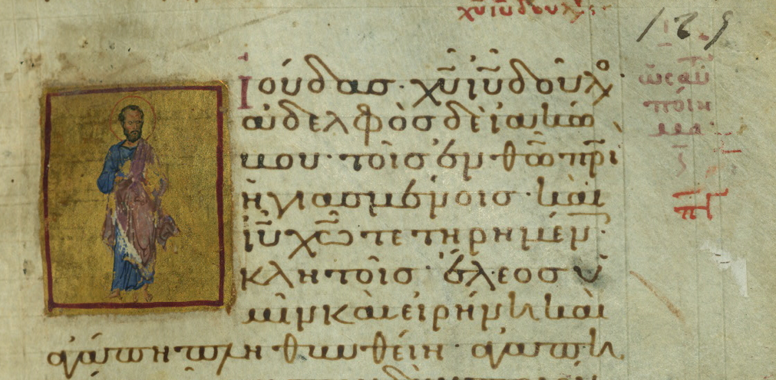

annotation
across variants
Dirk Roorda @ DANS (KNAW)
Open Humanities Hack 2012-11-21/22 London
Data Archiving and Networked Services
demo.datanetworkservice.nl/mediawiki/index.php/Jude:_Text_Fabric

Slide 2
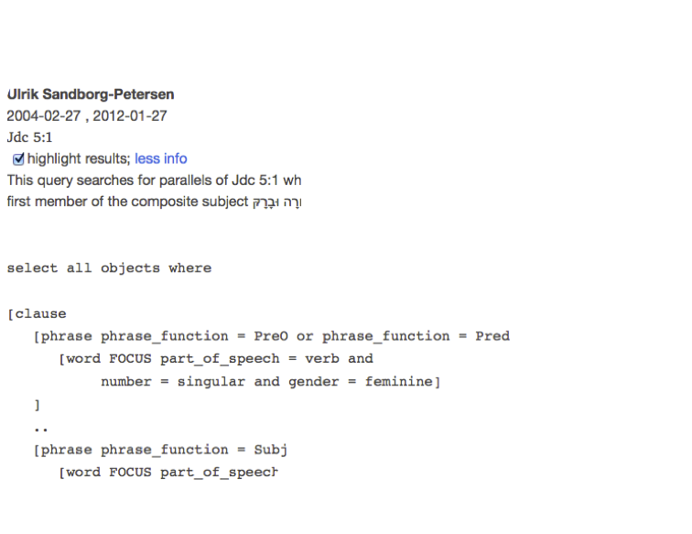
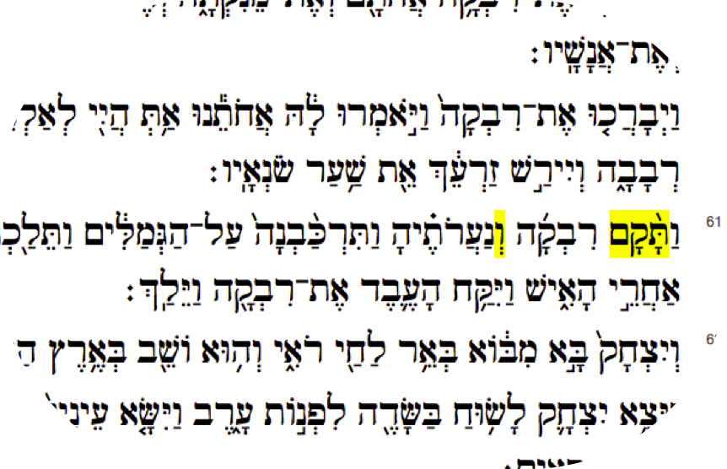

queries-as-annotations
datanetworkservice.nl/qaa
Inverting the direction
=> first the query then the results
<= from result to query
  in context
  with context

Slide 3
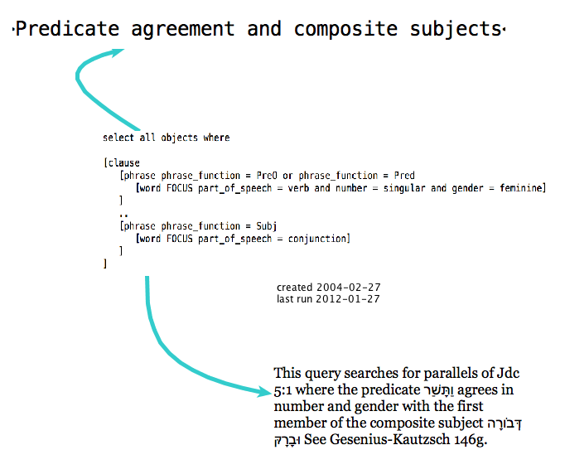
queries in context

Slide 4
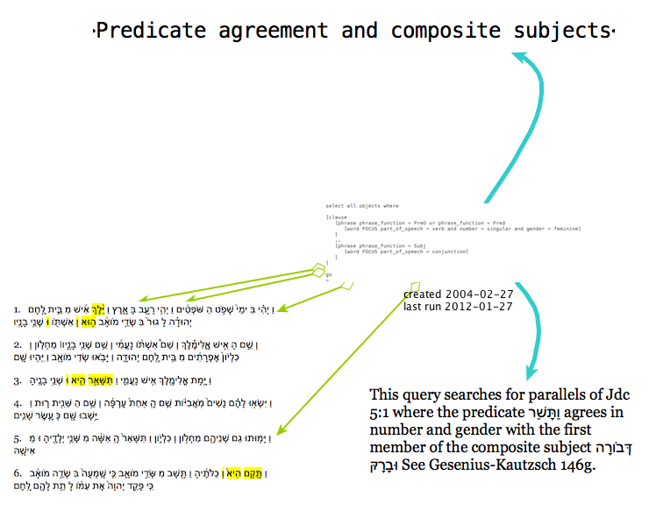
queries in context

Slide 5
portable annotations:
Jude on graph paper
Jude: Text Fabric
0┃ 10│ 20│ 30│ 40│ 50│ 60│┏━ℵ 01━━━━1━━╋┯┯┯┯┯┯┯┯┯┿┯┯┯┯┯┯┯┯┯┿┯┯┯┯┯┯┯┯┯┿┯┯┯┯┯┯┯┯┯┿┯┯┯┯┯┯┯┯┯┿┯┯┯┯┯┯┯┯┯┿┓┠SRC ╂ιουδας ιυ χυ δουλος αδελφος δε ιακωβου τοις εν θω πατρι ηγαπ┨┠SRC-NS ╂┼┼┼┼┼┼┼⊚⊚┼⊚⊚┼┼┼┼┼┼┼┼┼┼┼┼┼┼┼┼┼┼┼┼┼┼┼┼┼┼┼┼┼┼┼┼┼┼┼⊚⊚┼┼┼┼┼┼┼┼┼┼┼┨┣━line 2━━━━━╋┿┿┿┿┿┿┿┿┿┿┿┿┿┿┿┿┿┿┿┿┿┿┿┿┿┿┿┿┿┿┿┿┿┿┿┿┿┿┿┿┿┿┿┿┿┿┿┿┿┿┿┿┿┿┿┿┿┿┿┿┫┠SRC ╂ημενοις και ιυ χω τετηρημενοις κλητοις┼┼┼┼┼┼┼┼┼┼┼┼┼┼┼┼┼┼┼┼┼┼┨┠SRC-NS ╂┼┼┼┼┼┼┼┼┼┼┼┼⊚⊚┼⊚⊚┼┼┼┼┼┼┼┼┼┼┼┼┼┼┼┼┼┼┼┼┼┼┼┼┼┼┼┼┼┼┼┼┼┼┼┼┼┼┼┼┼┼┼┨┗━ℵ 01━━━━1━━╋┷┷┷┷┷┷┷┷┷┿┷┷┷┷┷┷┷┷┷┿┷┷┷┷┷┷┷┷┷┿┷┷┷┷┷┷┷┷┷┿┷┷┷┷┷┷┷┷┷┿┷┷┷┷┷┷┷┷┷┿┛
London, Brit. Libr., Add. 43725
0┃ 10│ 20│ 30│ 40│ 50│ 60│┏━1022━━━━1━━╋┯┯┯┯┯┯┯┯┯┿┯┯┯┯┯┯┯┯┯┿┯┯┯┯┯┯┯┯┯┿┯┯┯┯┯┯┯┯┯┿┯┯┯┯┯┯┯┯┯┿┯┯┯┯┯┯┯┯┯┿┓┠SRC ╂ιουδας χριστου ιησου δουλος αδελφος δε ιακωβου τοις εν θεω π┨┣━line 2━━━━━╋┿┿┿┿┿┿┿┿┿┿┿┿┿┿┿┿┿┿┿┿┿┿┿┿┿┿┿┿┿┿┿┿┿┿┿┿┿┿┿┿┿┿┿┿┿┿┿┿┿┿┿┿┿┿┿┿┿┿┿┿┫┠SRC ╂ατρι ηγιασμενοις και ιησου χριστω τετηρημενοις κλητοις┼┼┼┼┼┼┨┠COMMENT ╂ ▲ ┨┠COMMENT ╂in mg ωσαυτου ποιημα ┨┗━1022━━━━1━━╋┷┷┷┷┷┷┷┷┷┿┷┷┷┷┷┷┷┷┷┿┷┷┷┷┷┷┷┷┷┿┷┷┷┷┷┷┷┷┷┿┷┷┷┷┷┷┷┷┷┿┷┷┷┷┷┷┷┷┷┿┛
Baltimore/Maryland, Walters Art Gall., Ms. W. 533
Tommy Wasserman: The Epistle of Jude: Its Text and Transmission. ConBNT 43. Stockholm: Almqvist & Wiksell International, 2006.
Jesus Christ
id=xaz
Jesus Christ
id=xaz
Jacob, id=x75
Jacob, id=x75

Slide 6
Jude in Maryland
0┃ 10│ 20│ 30│ 40│ 50│ 60│┏━1022━━━━1━━╋┯┯┯┯┯┯┯┯┯┿┯┯┯┯┯┯┯┯┯┿┯┯┯┯┯┯┯┯┯┿┯┯┯┯┯┯┯┯┯┿┯┯┯┯┯┯┯┯┯┿┯┯┯┯┯┯┯┯┯┿┓┠SRC ╂ιουδας χριστου ιησου δουλος αδελφος δε ιακωβου τοις εν θεω π┨┣━line 2━━━━━╋┿┿┿┿┿┿┿┿┿┿┿┿┿┿┿┿┿┿┿┿┿┿┿┿┿┿┿┿┿┿┿┿┿┿┿┿┿┿┿┿┿┿┿┿┿┿┿┿┿┿┿┿┿┿┿┿┿┿┿┿┫┠SRC ╂ατρι ηγιασμενοις και ιησου χριστω τετηρημενοις κλητοις┼┼┼┼┼┼┨┠COMMENT ╂ ▲ ┨┠COMMENT ╂in mg ωσαυτου ποιημα ┨┗━1022━━━━1━━╋┷┷┷┷┷┷┷┷┷┿┷┷┷┷┷┷┷┷┷┿┷┷┷┷┷┷┷┷┷┿┷┷┷┷┷┷┷┷┷┿┷┷┷┷┷┷┷┷┷┿┷┷┷┷┷┷┷┷┷┿┛
W.533 folio 129r

Slide 7
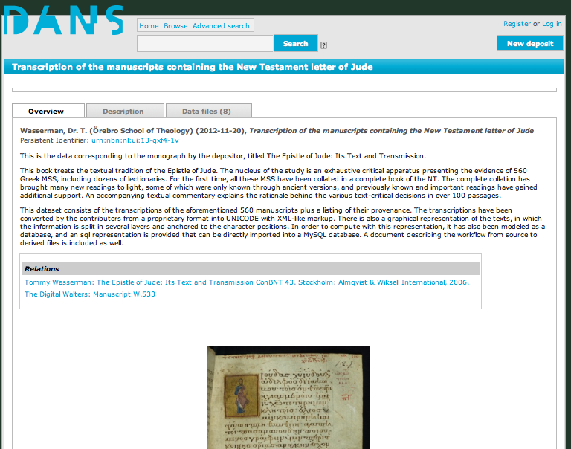
Jude @ DANS
urn:nbn:nl:ui:13-qxf4-1v

Slide 8

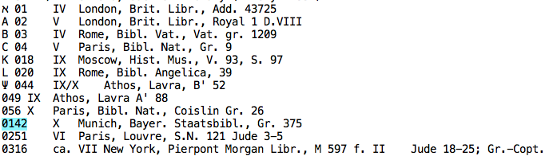
source
demo.datanetworkservice.nl/mediawiki/index.php/Jude:_Text_Fabric

Slide 9
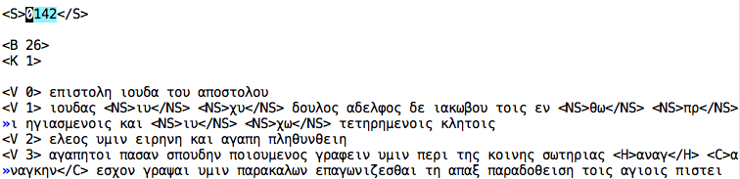
unicode plus markup
demo.datanetworkservice.nl/mediawiki/index.php/Jude:_Text_Fabric

Slide 10
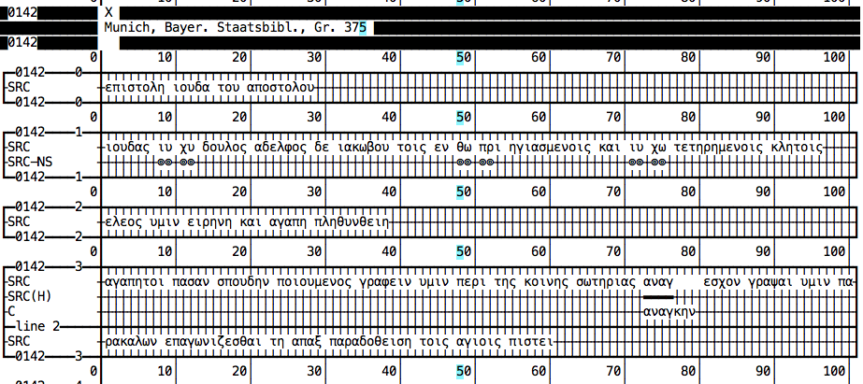
layering
demo.datanetworkservice.nl/mediawiki/index.php/Jude:_Text_Fabric

Slide 11
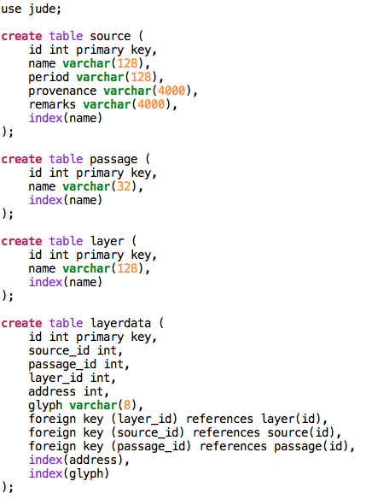
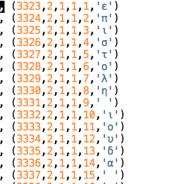
sql

Slide 12
nomina sacra
address | glyph | name | name
8 | ι | 142 | 1
9 | υ | 142 | 1
11 | χ | 142 | 1
12 | υ | 142 | 1
48 | θ | 142 | 1
49 | ω | 142 | 1
51 | π | 142 | 1
52 | ρ | 142 | 1
71 | ι | 142 | 1
72 | υ | 142 | 1
74 | χ | 142 | 1
75 | ω | 142 | 1

Slide 13
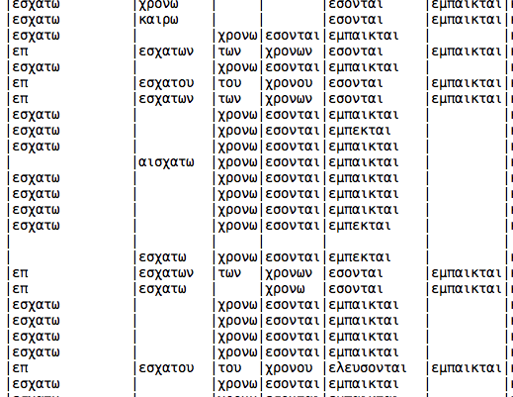
collation
demo.datanetworkservice.nl/mediawiki/index.php/Jude:_Text_Fabric

Slide 14
challenge 1: data
link character positions
  in source i (i in 1..563)
with corresponding positions
  in source j (j in 1..563)
efficiently

Slide 15
challenge 2: visual
given a reasonable position correspondence across variants
design an interface that takes advantage of it

Slide 16
challenge 3: geo
in facsimiles:
can we detect the glyphs of the main text and box them?
between facsimiles and transcriptions:
can we link the unicode chars to the boxes?
if yes: we can navigate the sea of facsimiles and transcriptions with ultimate precision and recall

Slide 17
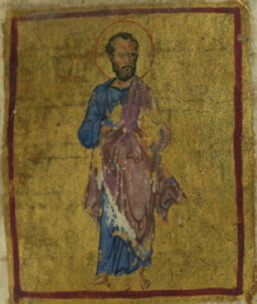
thanks
demo.datanetworkservice.nl/mediawiki/index.php/Jude:_Text_Fabric

