Slide 1












SHEBANQ relies on data and tools created by
Welcome to
SHEBANQ
 | Eep Talstra, founder of ETCBC. Still computing (Pascal): participant data in the making.
 | Constantijn Sikkel, data designer for ETCBC. Inventor of efficient data creation work flows.
 | Janet Dyk, linguist at ETCBC. Long-time data contributor, specialized in verbal valence and language variation.
 | Reinoud Oosting, data designer for Leiden University. Contributed ETCBC data, now key user.
 | Ulrik Sandborg-Petersen, creator of Emdros. Without it, SHEBANQ would not exist!
User Guide
download as pdf
 | Wido van Peursen, leader of ETCBC. Initiator and strategic leader.
 | Oliver Glanz, Andrews University. ETCBC data expert, contributing numerous queries for teaching.
 | Dirk Roorda, DANS. Author of most of the code.
contributors in the past
 | Henk van den Berg, DANS. Programmed the first versions.
 | Heleen van de Schraaf, then DANS. Programmed the first user interface.
System for HEBrew Text:
ANnotations for Queries and Markup
funded by
CLARIN-NL, The Language Archive

Slide 2
Basic Usage
View and visualize
The Text
Context View
Data
Words
Queries
Charts
Export and share
Export Data
Citation
More about Words
Word Highlights
Single Word View
Working with Queries
Queries Advanced
Query Highlights
Single Query View
Executing Queries
Go your own way
Beyond: LAF-Fabric
Documentation and Support

Slide 3





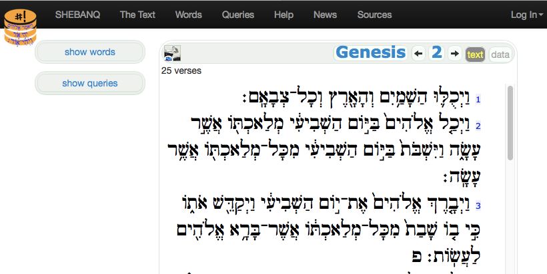




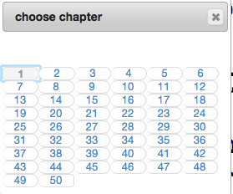


Read the Text
you start with the passage where you left off (in this browser)
select a Bible book
show a dialog to go to other chapters - press Esc to dismiss
select text view or data view
show relevant words and queries
go directly to previous or next chapter
students/teachers:
go directly to this chapter in Bible OL.
Over there are links to carry you back to SHEBANQ
hint: click a verse number to show data for that verse only

Slide 4





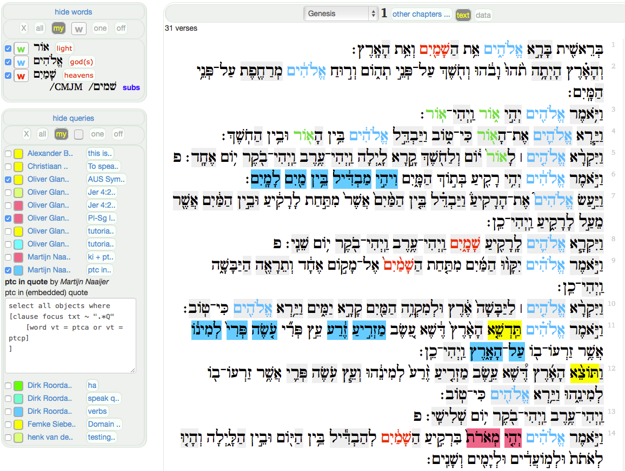







Context items for this chapter
click entry to goto word and all occurrences
click gloss to toggle preview of word
click any word to toggle its highlight
words with highlighted occurrences
queries with highlighted hits
click author to goto query and all hits
click name to toggle preview of query
enlarge preview of query in a pop-up

Slide 5
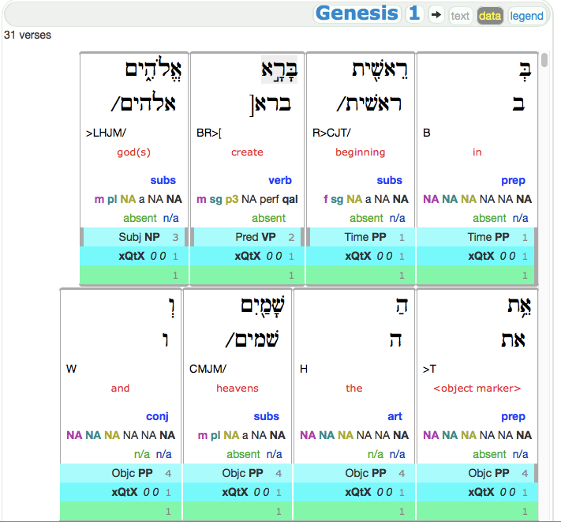



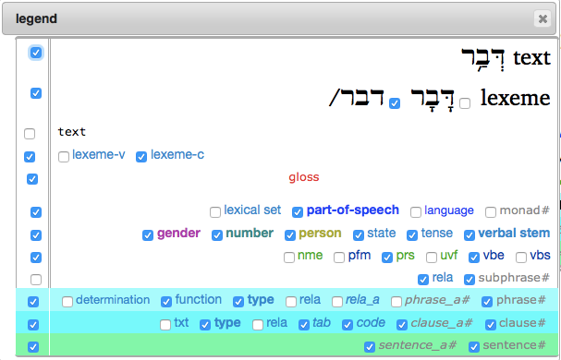


Show the Data
click legend to select features
show/hide a single feature
show/hide an entire row
click the labels to jump to feature documentation
hint: loading data for multiple verses is sluggish. Click a verse number to toggle data view for that verse only

Slide 6



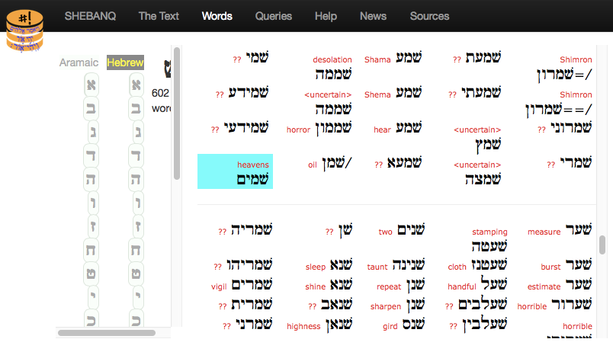
click an entry to view more info, including the occurrences of this word
click the gloss to toggle between the entry and the disambiguation
Show the words

Slide 7






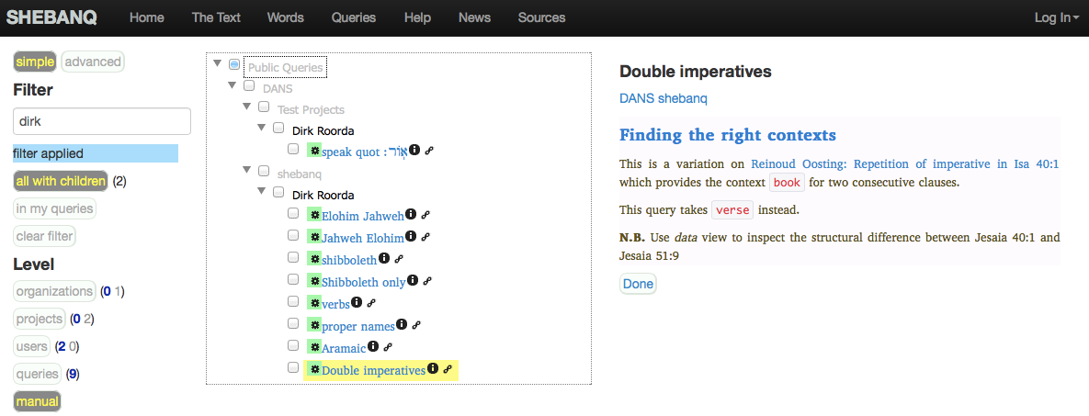

Queries and muting (simple)
click the triangles to expand and collapse
This is your dashboard for queries.
Find the queries ordered by organization, then project, then user.
Then act: preview, mute, generate a link, edit, go to the results page.
full text search on organization, project, people and queries
use checkboxes to mute queries, so that they do not show up in the sidebar
go to the page of this query to edit and run it
quickly expand/collapse the tree to a specific level
your mutings are not stored on the server but on your browser
preview/edit the description of this query right here by clicking the info icon
generate a pretty hyperlink to this query to be used in the description of an other query
pretty means: mark-down. This description has been entered in mark-down.

Slide 8

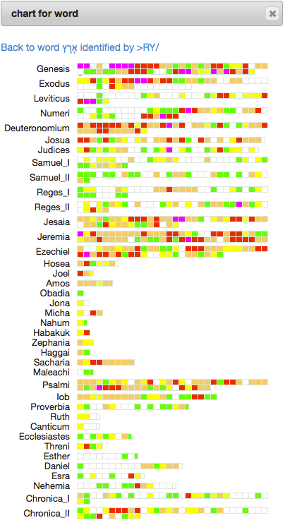
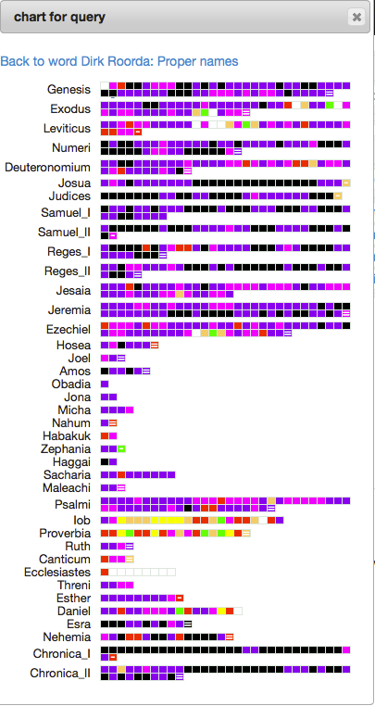





Charts show you where in the Bible the occurrences and hits are
Back to the word or query you came from
Every cell corresponds to a block of 500 words. Clicking it leads you to it.
Hover to see the chapter range and the amount of hits/occurrences
The color in the cell indicates the absolute number of hits/occurrences in that block
0
1
2
3-5
6-10
11-20
21-50
>50
Last blocks of a book have lesser size. The size is indicated in a tooltip (%) and the block is marked with = (< 25%) or - (between 25% and 75%)
Chapter ranges:
23.Z = chapter 23, last word
23.z = chapter 23, at position >95%
23.6 = chapter 23, at position 60%

Slide 9
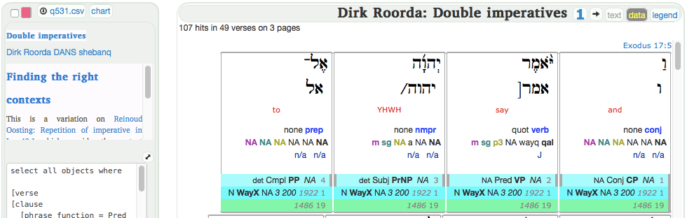


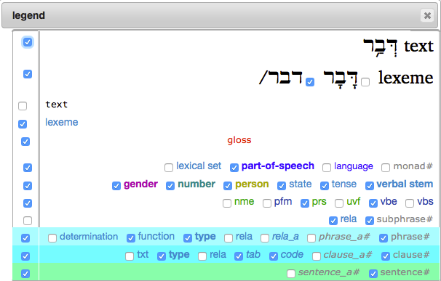



Download hits or occurrences as spreadsheet
This file opens best in Open Office.
Excel struggles with the Unicode/utf8.
Numbers (Apple) works reasonably.
the whole list will be exported, not just this page
Every word occupies a separate row.
There are fixed columns for
book name, chapter #, verse #.
The rest depends on your data view settings:
word number, hebrew text
as selected in legend

Slide 10
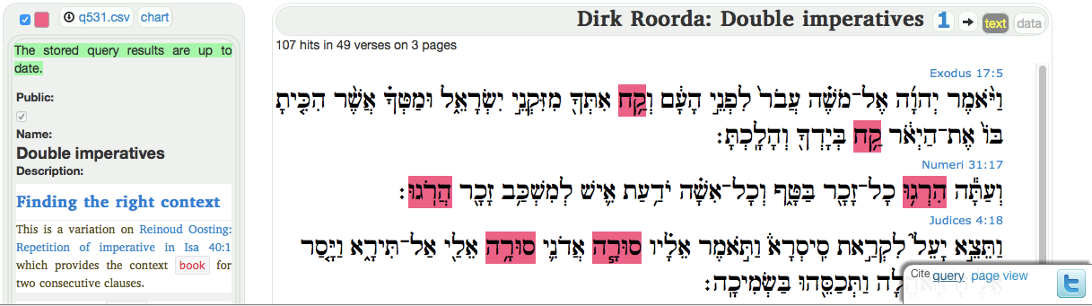

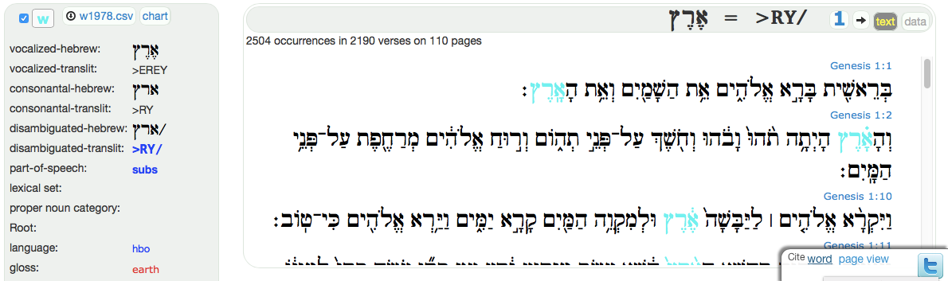

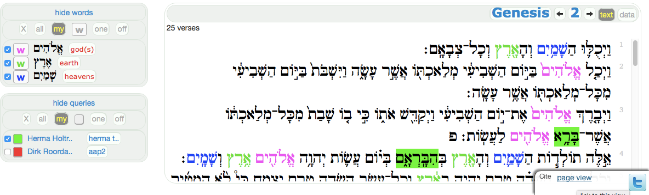


Click Cite to share a query, a word, or a page view
Click query and word to generate short, permanent links
Click page view to generate a long link to the page as it looks now
or tweet the view directly

Slide 11








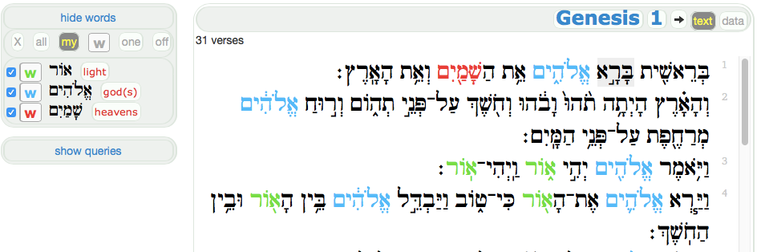


Customize highlighting of words
show all words of the chapter in the list
show word highlights according to my settings
reset word highlighting to factory settings
show word highlights in one fixed, selectable color
click any word to toggle its highlight. Highlighted words count as customized.
switch off all word highlighting
customize the highlight color of a single word. Uncheck the box to uncustomize.

Slide 12


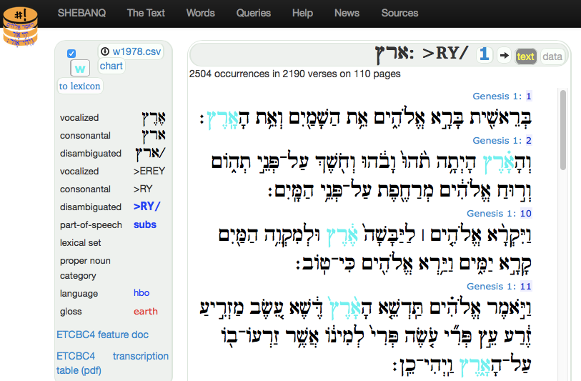






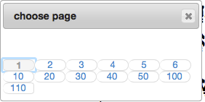


Single word view
download csv file of all occurrences of this word, not just the ones shown on this page
click chapter labels to view whole chapter
visualize occurrences throughout the Bible on a clickable chart
show a dialog to go to other pages - press Esc to dismiss
customize the highlight color for this word also from here
find this word in the list of word entries
occurrences in verse context
all available information about this word
hint: Click a verse number to toggle data view for that verse only

Slide 13


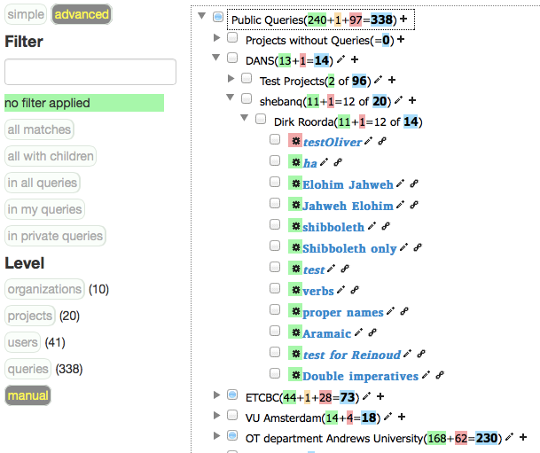



Queries and muting (advanced)
total # queries in this sub tree
total # queries of this organization, project or user
# of queries that are up-to-date, have never run, have outdated results
full text search on organization, project, people and queries. The meaning of the numbers are explained in other boxes.
if logged in you can add/edit orgs, projects, queries here
without a filter, you can quickly select your own queries and your unpublished queries
my queries are bold, and if they are private they are italic too
# queries/matches in the levels. The bold number indicates real matches, the grey number indicates how many items there are with a match in its subtree

Slide 14






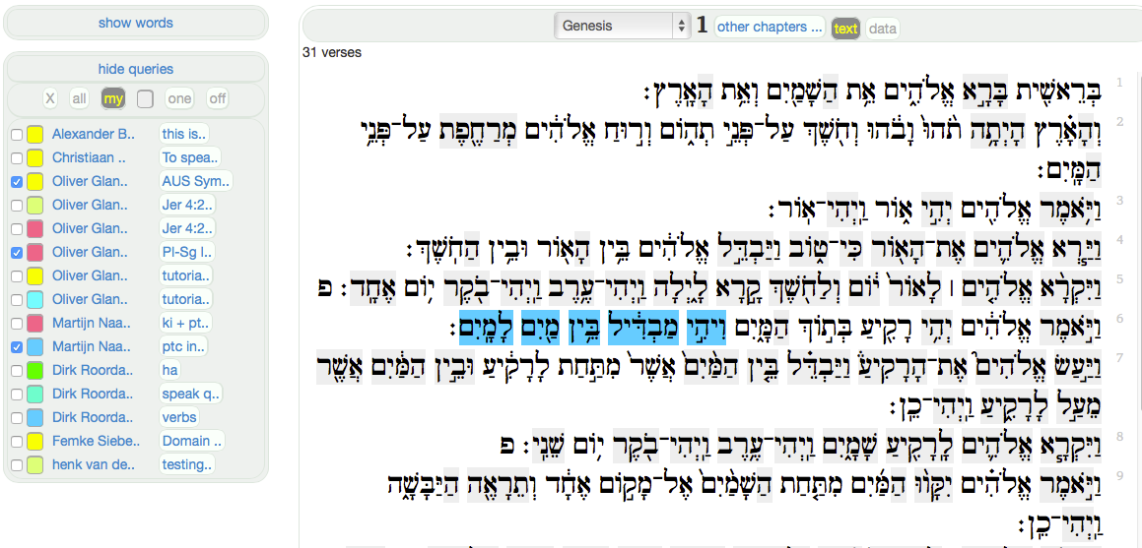


Why does my query not appear in the list?
it is not public
its results are outdated
it has no results in this chapter
I have muted this query
Customize highlighting of queries
highlight hits of all queries in the list
show query highlights according to my settings
show query highlights in one fixed, selectable color
reset query highlighting to factory settings
switch off all query highlighting
customize the highlight color of a single query. Uncheck the box to uncustomize.

Slide 15





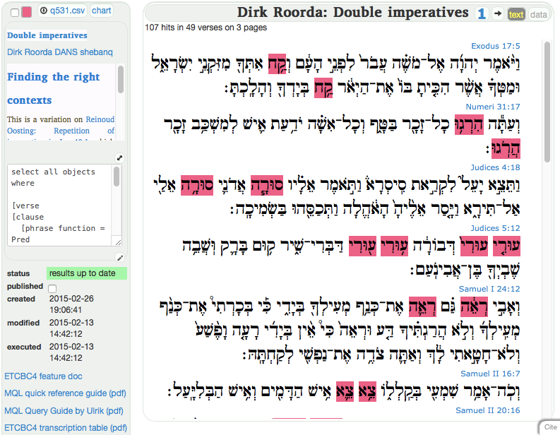





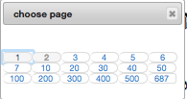




Single query view
download csv file of all hits of this query, not just the ones shown on this page
CHART! see later on
show a dialog to go to other pages - press Esc to dismiss
click chapter labels to view whole chapter
customize the highlight color
jump to this query in tree view
hits in verse context
description in mark-down with pretty links to other queries
If a modified query is not executed, its hits are outdated. Outdated queries are not shown in the sidebar.
enlarge preview of query in a pop-up
go to edit and execute view
all available information about this query and links to documentation
Publish if you are content with the query. Public queries show up in the sidebar, if the results are up-to-date.

Slide 16

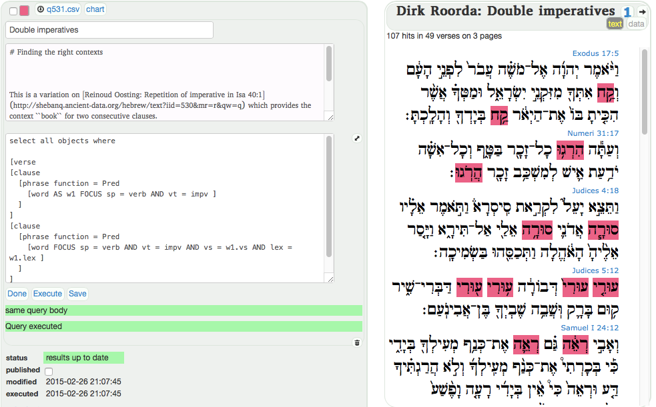





Query developer view
Help others understand your query by writing in mark-down
after execution, results will be refreshed
Hint: if you want to link to an other query, you can get a valid mark-down link from the Queries page.
Edit the query body
Back to normal layout
Save and execute
Just save
Watch the messages from the query engine
clear messages

Slide 17


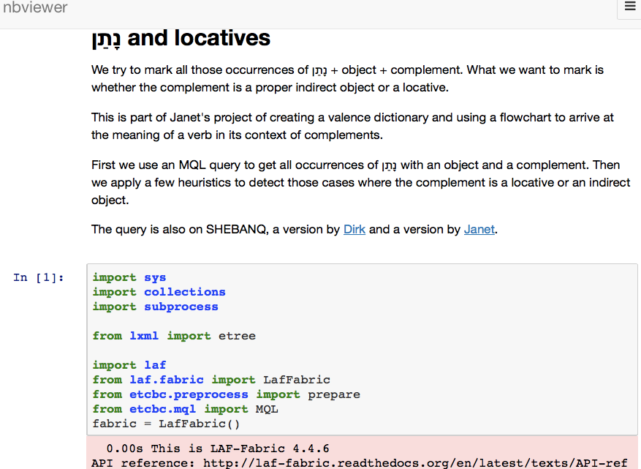
Familiar with Python? Feeling the urge to do more with this data?
LAF-Fabric offers an API by which you can master the data
LAF-Fabric supports walking over the data.
You can fire MQL queries within LAF-Fabric as a starting point ...
and then use the full, detailed results programmatically
It is an off-line tool, open source, and you can download the ETCBC4 data, Open Access.
Start with readthedocs.
The notebooks you create with LAF-Fabric, you can share online

Slide 18
Documentation and Support
MQL quick reference guide (pdf)
MQL Query Reference by Ulrik (pdf)
ETCBC4 feature doc
ETCBC4 transcription table (pdf)
Please report issues to Dirk Roorda.

