Slide 1




Workshop on R and movement ecology:
Hong Kong University, Jan 2018
Eric Dougherty, Dana Seidel, Wayne Getz
Lecture 3
Home Ranges, Utilization Distributions,
and Resource Selection

Slide 2
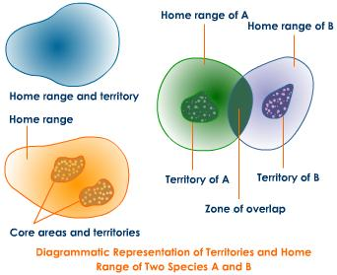
Home Range Primer

Slide 3
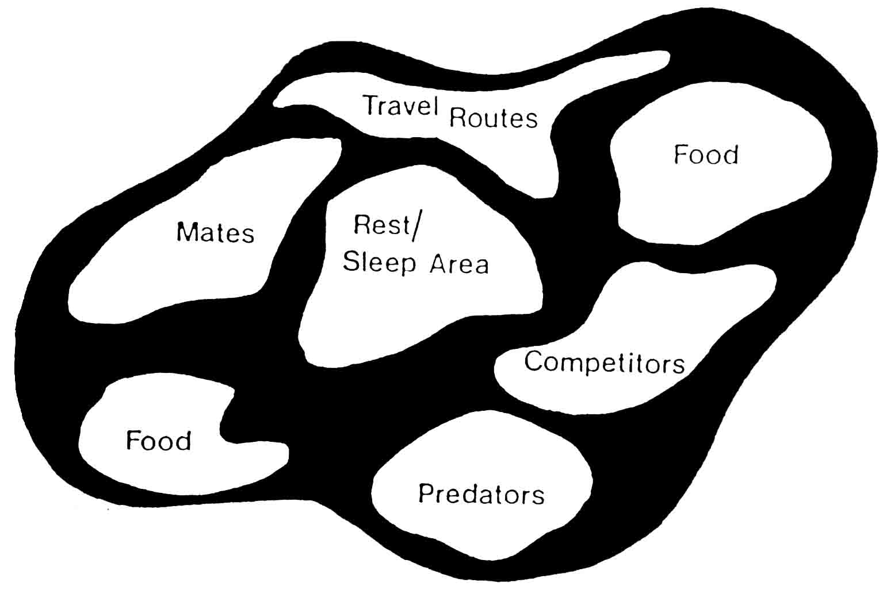
What is a Home Range?
The idea that animals restrict their movements has been established since the earliest ecological studies
The most commonly cited definition of a home range (Burt, 1943):
“that area traversed by an individual in its normal activities of food gathering, mating and caring for young”
‘Occasional sallies’ should not be considered as part of the home range

Slide 4
What issues might arise from that definition?
What qualifies as ‘normal’ activity?

Slide 5
What issues might arise from that definition?
What qualifies as ‘normal’ activity?
Space use patterns can arise from various behaviors, including the three mentioned by Burt. But these do not necessarily encapsulate all ‘normal’ activities. What about refuge use as a means of predator avoidance? Any
others you can think of?
Also, does normality shift over time? The home range of a young animal moving in conjunction with its mother will likely differ markedly from its movements as a sub-adult or adult.

Slide 6
What issues might arise from that definition?
What qualifies as ‘normal’ activity?
What qualifies as a ‘sally’?

Slide 7
What issues might arise from that definition?
What qualifies as ‘normal’ activity?
What qualifies as a ‘sally’?
In order to determine what qualifies as a ‘sally’, we need to have a clearly delimited home range, but to do that, we must first define which points should be removed because they are sallies! This circular reasoning means we need to lay down some a priori rules beforehand, but Burt gives no guidance on that front.

Slide 8
What issues might arise from that definition?
What qualifies as ‘normal’ activity?
What qualifies as a ‘sally’?
How important is variation in the intensity of usage within this area?

Slide 9
What issues might arise from that definition?
What qualifies as ‘normal’ activity?
What qualifies as a ‘sally’?
How important is variation in the intensity of usage within this area?
Even at extremely fine scales, my movements reflect differential use of certain areas over others. I am in my bed for about 8 hours each day, but spend only about half an hour in my bathroom. According to Burt’s definition, we would not be able to differentiate between these magnitudes of intensity of use in my house.

Slide 10
What issues might arise from that definition?
What qualifies as ‘normal’ activity?
What qualifies as a ‘sally’?
How important is variation in the intensity of usage within this area?
How should one delimit this region?

Slide 11
What issues might arise from that definition?
What qualifies as ‘normal’ activity?
What qualifies as a ‘sally’?
How important is variation in the intensity of usage within this area?
How should one delimit this region?
Here we come to one of the great challenges that researchers in wildlife ecology and, in particular, movement ecology, have faced over the past few decades. Various people have offered a number of alternative methods for delimiting a home range; we will discuss a few today and continue our discussion in the next lecture and activities.

Slide 12
Why do we care?
Conservation and Management: It is difficult to conserve a species if you do not understand how they utilize space. Will parks be successful? Will fences inhibit the ability of an animal to gather resources and survive?

Slide 13
Why do we care?
Conservation and Management: It is difficult to conserve a species if you do not understand how they utilize space. Will parks be successful? Will fences inhibit the ability of an animal to gather resources and survive?
Disease Transmission: Do individuals utilize the same spaces at the same or different times? Pathogens transmitted via direct or indirect means will have different aspects that are important for predicting spread

Slide 14
Why do we care?
Conservation and Management: It is difficult to conserve a species if you do not understand how they utilize space. Will parks be successful? Will fences inhibit the ability of an animal to gather resources and survive?
Disease Transmission: Do individuals utilize the same spaces at the same or different times? Pathogens transmitted via direct or indirect means will have different aspects that are important for predicting spread
Human-Wildlife Conflict: When and where are humans and wildlife likely to come into contact? Are human settlements within the home ranges of animals?

Slide 15
Why do we care?
Conservation and Management: It is difficult to conserve a species if you do not understand how they utilize space. Will parks be successful? Will fences inhibit the ability of an animal to gather resources and survive?
Disease Transmission: Do individuals utilize the same spaces at the same or different times? Pathogens transmitted via direct or indirect means will have different aspects that are important for predicting spread
Human-Wildlife Conflict: When and where are humans and wildlife likely to come into contact? Are human settlements within the home ranges of animals?
Tourism, Hunting & Recreation: Many human industries are built upon knowledge of where animals move and where one can (or cannot) find them. When these expectations begin shifting, conflict may ensue

Slide 16
Why do we care?
Conservation and Management: It is difficult to conserve a species if you do not understand how they utilize space. Will parks be successful? Will fences inhibit the ability of an animal to gather resources and survive?
Disease Transmission: Do individuals utilize the same spaces at the same or different times? Pathogens transmitted via direct or indirect means will have different aspects that are important for predicting spread
Human-Wildlife Conflict: When and where are humans and wildlife likely to come into contact? Are human settlements within the home ranges of animals?
Tourism, Hunting & Recreation: Many human industries are built upon knowledge of where animals move and where one can (or cannot) find them. When these expectations begin shifting, conflict may ensue
Any others you can think of?

Slide 17
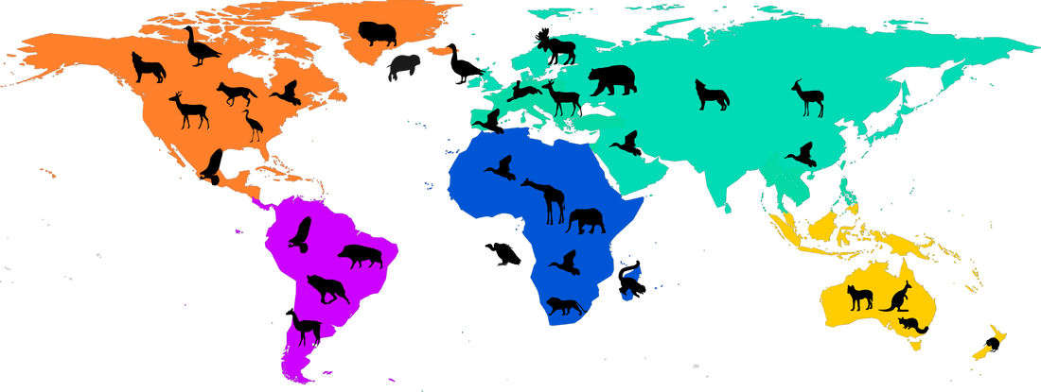
Home Range Size Predictors
According to a recent meta-analysis based on available GPS data (Tucker et al. 2014), body size explains the majority of the differences in home range size (53-85% of the variance). Diet explained about 15% of the variance, but the environment seems to play a relatively small role in differences in home range size (1.7% of variance).

Slide 18
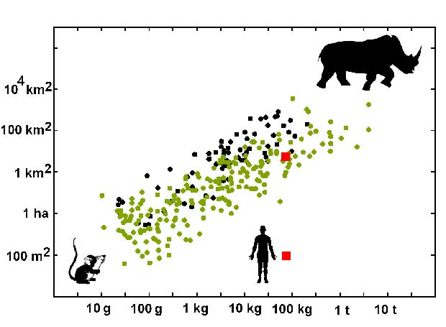
Patterns in Home Ranges
Larger body masses are associated with larger home ranges. Black dots represent
Carnivores, green dots represent herbivores. (Kelt & Van Vuren 2001, American Naturalist)

Slide 19
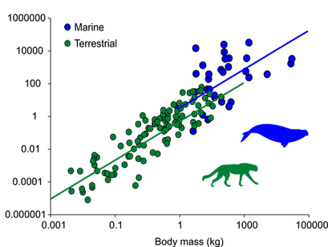
Patterns in Home Ranges
Marine species (blue dots) tend to have larger home ranges than terrestrial species (green dots), but mostly because they have larger bodies. (Tucker et al. 2014, Global Ecology and Biogeography)

Slide 20
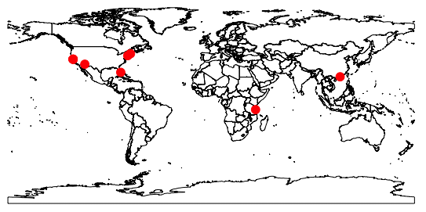
Delimiting Home Ranges
Here, I have mapped some of my GPS locations over the past six months. I spent some time in California, Arizona, Florida, New Hampshire, and New York, not to mention Tanzania and now Hong Kong!

Slide 21
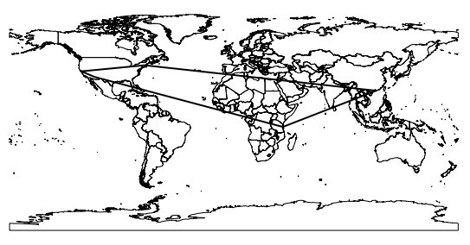
Delimiting Home Ranges
Let’s take a look at the most basic method of delimiting a home range: the minimum convex polygon (MCP) method. This draws a polygon around the outermost points and calls everything within that polygon the home range

Slide 22
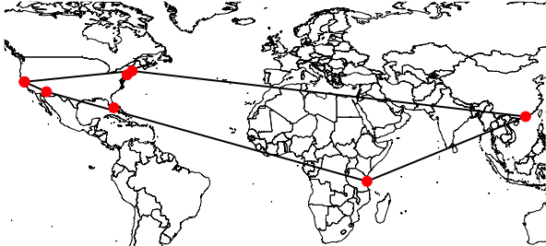
Delimiting Home Ranges
Let’s zoom in a bit, and you’ll see that we have included a ton of space in which I have never set foot: Much of the southeastern US, northern and central Africa, the Arabian Peninsula, India, several Southeast Asian countries. If we used the 100% MCP, we might expect that I have frequented all of those countries and the oceans separating them!

Slide 23
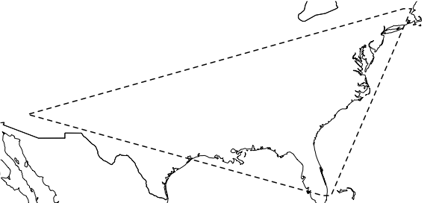
Delimiting Home Ranges
Now if we zoom in on my core area, we can see that my trips to Tanzania and Hong Kong are eliminated (they are treated as sallies), but so is Berkeley, because I spent a bit less time there this semester than usual. Still we have quite a lot of space in there that I’ve never occupied: Louisiana, Mississippi, Alabama, Kentucky, etc.

Slide 24
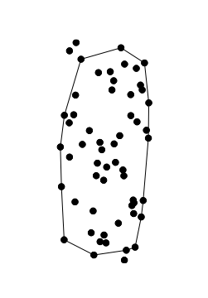
Delimiting Home Ranges
Perhaps if we zoomed into just one of these clusters of points, we could delineate a more reasonable home range using the MCP method. Here is the 95% MCP of the Arizona-based points. The MCP is really quite reflective of the space-use during the period of time during which this cluster of points was taken

Slide 25

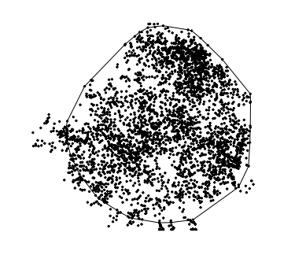
Delimiting Home Ranges
Clearly the MCP method is not an especially effective home range delimiter, particularly when an animal is relatively wide ranging (like me). For animal that stay within a relatively small home range throughout a season or year, treading over the same area quite regularly rather than migrating long distances, it may be somewhat more accurate.
Territorial
Migratory

Slide 26
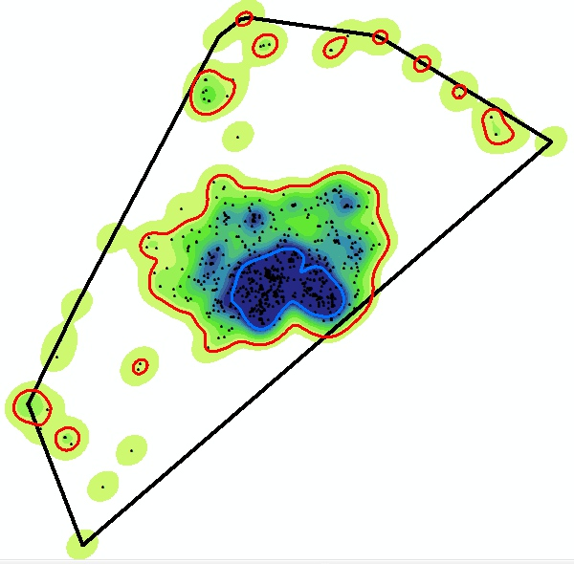
Delimiting Home Ranges
In 1989, Bruce Worton introduced the concept of using kernel density estimator to define the utilization distribution, which goes beyond simply delimiting the borders of the home range to describing the probability of use throughout these areas

Slide 27
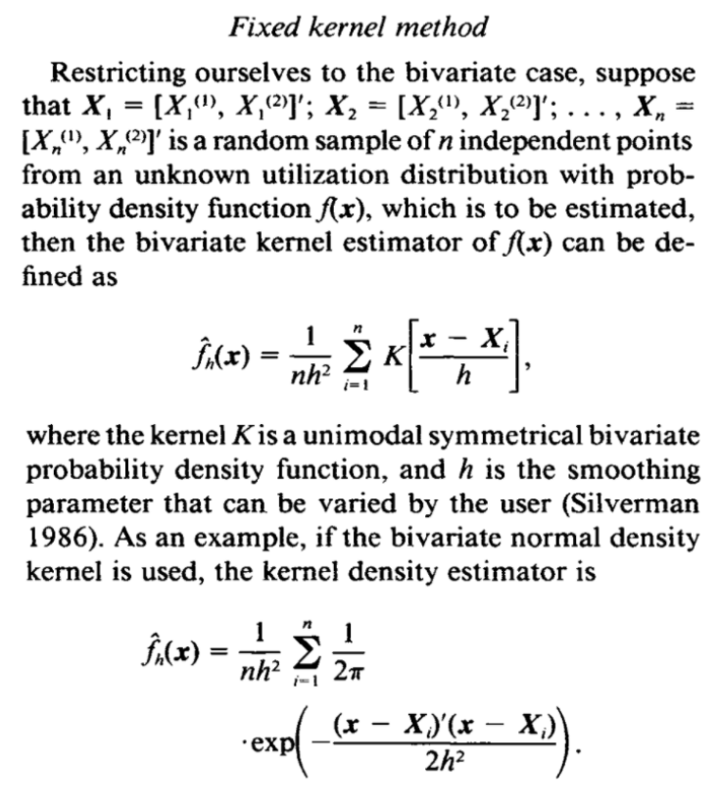
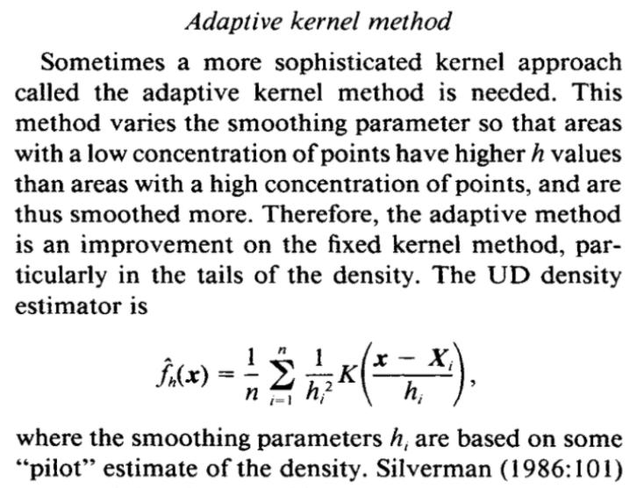
Delimiting Home Ranges
The Utilization Distribution (UD) represents the distribution of an individual’s position in the plane. To create this distribution, kernel density estimator (KDE) methods are used. We will not go over this in too much detail, but Worton set forth a fixed kernel method and an adaptive kernel method. The equations presented for both are below:

Slide 28
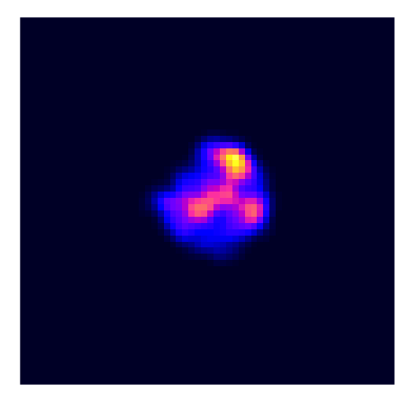
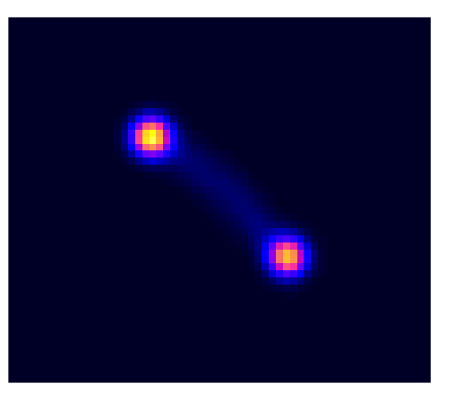
Delimiting Home Ranges
Fortunately, we need not worry too much about the mathematics behind the kernel density estimation methods, though it should be noted that the process does involve some user-defined parameters (namely, the smoothing method and the bandwidth value) that may result in different implementations and resulting home ranges.
Here are the same territorial and migratory individual as for the MCPs we developed before. Clearly there is some variation in the intensity of use of the home ranges that we cannot see using the 95% MCP home range

Slide 29
Delimiting Home Ranges
MCP and UD represent two of the many possible methods one can apply to movement data to delimit a home range. If one is interested in finer-scale details of where within a home range an animal is likely to occur, the UD method may be most useful. For broader-scale processes like potential disease transmission based on home range overlap, the MCP may be sufficient.

Slide 30
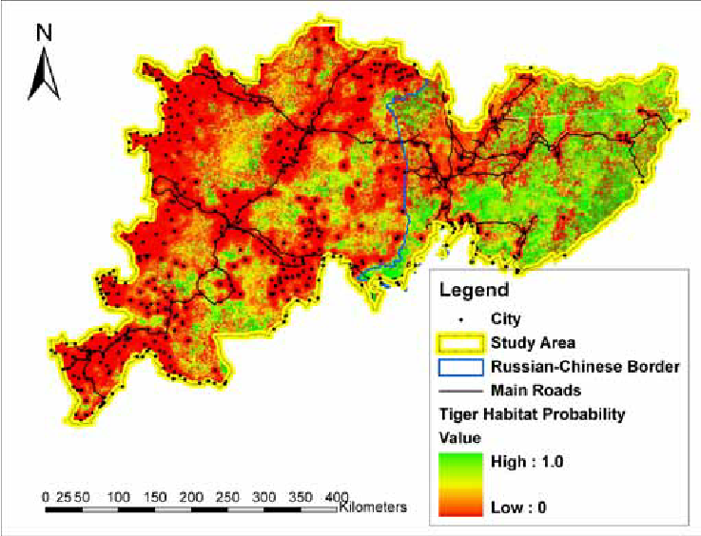
From Description to Prediction
The home range methods that we have discussed are meant to describe the movement patterns of individuals across landscapes based on recorded positional data. But what if we want to predict where an animal might be based on previous knowledge of their whereabouts?

Slide 31
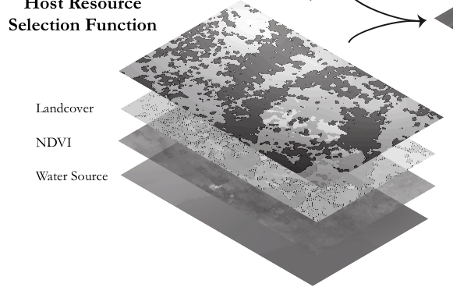
Resource Selection Functions
At a relatively broad-scale (landscape-level), one can consider all of the potential (or at least measurable) contributors to an animal’s movement patterns. The resource selection function (RSF) framework was developed to create predictive maps or where we should expect animals to be based on their previous locations.

Slide 32

Resource Selection Functions
An RSF is a model that yields values proportional to the probability of use of a resource unit. These are often fit using generalized linear models (GLMs), and model selection (i.e., selecting the right predictor variables to consider) is normally done through AIC or BIC approaches.
Where w(x) is the relative probability of a pixel being selected, β₀ is the intercept, and β₁ is the estimated coefficient for variable χ_{1.}
If β > 1, a preference for that resource is indicated, whereas β < 1 indicates avoidance of that resource relative to its availability on the landscape

Slide 33
Used vs. Available Framework
In order to use a logistic regression model, we must have a binomial response variable and a set of associated predictor variables. We can use presence (1) versus pseudo-absence (0; we don’t know with with 100% certainty that an animal didn’t go there, but we know we did not record them there)
100% MCP
Used
Available (but unused)

Slide 34
Used vs. Available Framework
By extracting the values of various predictor variables (say, NDVI, distance to water, land cover type, elevation, and predator density) associated with these 1s and 0s, we can ascertain a pattern that can be extended to predict the probability of an animal being in each cell based on the predictors there.
100% MCP
Used
Available (but unused)

Slide 35
Used vs. Available Framework
In this very simplistic schematic, it is evident that the blue (used) points tend to fall on the greener resource units and the red (available) points tend to fall on the browner units. Assuming that greener indicates higher NDVI, this would suggest that the animal is selected for (β > 1) high NDVI.
100% MCP
Used
Available (but unused)

Slide 36
RSF Considerations
When developing a resource selection model, the resolution of the location (presence) points and the scale of the predictor variables can be quite influential. In some cases, different scales will be reveal different patterns of preference.

Slide 37
RSF Considerations
When developing a resource selection model, the resolution of the location (presence) points and the scale of the predictor variables can be quite influential. In some cases, different scales will be reveal different patterns of preference.
Alternative approaches exist to eliminate autocorrelation between positional fixes (i.e., removing points from the trajectory to get a subset of the points that are separated more distinctly in time)

Slide 38
RSF Considerations
When developing a resource selection model, the resolution of the location (presence) points and the scale of the predictor variables can be quite influential. In some cases, different scales will be reveal different patterns of preference.
Alternative approaches exist to eliminate autocorrelation between positional fixes (i.e., removing points from the trajectory to get a subset of the points that are separated more distinctly in time)
There are also different approaches the sampling of pseuco-absence points. Some will use the entire 100% MCP, others will place a buffer around presence points to exclude available points falling too close to known locations. There is technically no “right” way to approach it, however.

Slide 39
RSF Considerations
When developing a resource selection model, the resolution of the location (presence) points and the scale of the predictor variables can be quite influential. In some cases, different scales will be reveal different patterns of preference.
Alternative approaches exist to eliminate autocorrelation between positional fixes (i.e., removing points from the trajectory to get a subset of the points that are separated more distinctly in time)
There are also different approaches the sampling of pseuco-absence points. Some will use the entire 100% MCP, others will place a buffer around presence points to exclude available points falling too close to known locations. There is technically no “right” way to approach it, however.
Decisions must also be made regarding the temporal extent of the trajectory in question. Are there notable shifts in preferences across seasons that one should attempt to account for? Or perhaps individuals of different ages may select resources differently.

Slide 40
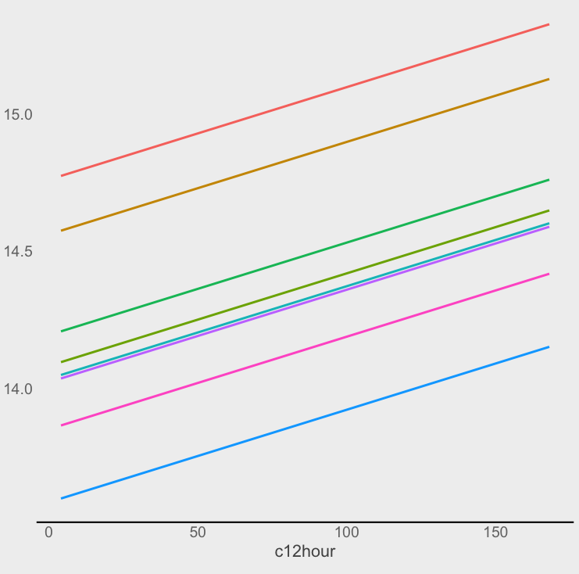
Population-Level RSF
Another important consideration is whether you are trying to predict the selection of an entire population or simply an individual. When the former is the goal, practitioners will often implement a generalized linear MIXED model. The “mixed” refers to the fact that both fixed (standard environmental predictor variables) and random effects. A random effect (say, individual ID) may offer insight into the differences among individuals within the population.

Slide 41
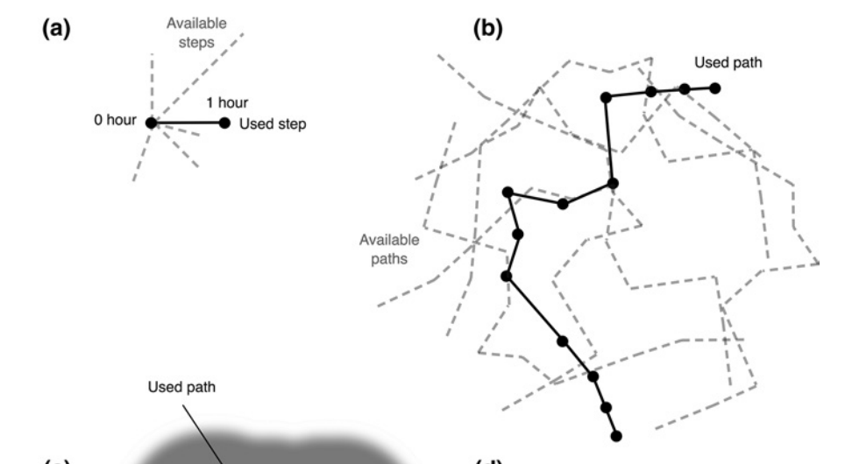
RSF Alternatives (SSF and PSF)
When fine-scale environmental data is available, it may be useful to use a more biologically realistic means of selecting available points.
In the case of a step selection function (SSF), the available points are chosen from within a buffer around each point (i.e., readily reachable points). In the case of a path selection function (PSF), sets of points are used and available (but unused) paths are identified.

