Slide 1




Workshop on R and movement ecology:
Hong Kong University, Jan 2018
Eric Dougherty, Dana Seidel, Wayne Getz
Lecture 5
Selection Functions

Slide 2
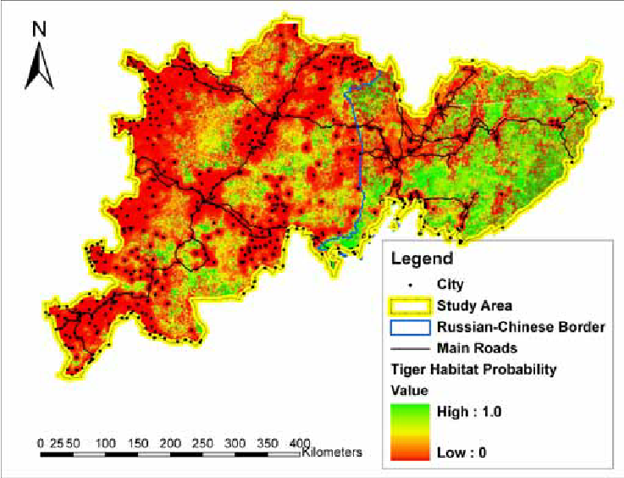
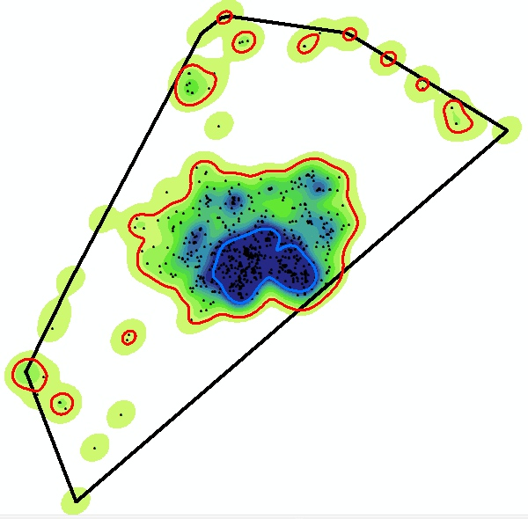
From Description to Prediction
The home range methods that we have discussed are meant to describe the movement patterns of individuals across landscapes based on recorded positional data. But what if we want to predict where an animal might be based on previous knowledge of their whereabouts?

Slide 3
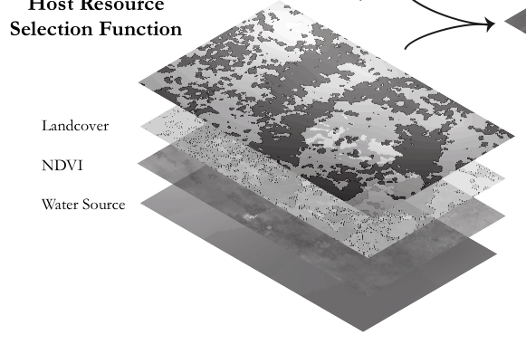
Resource Selection Functions
At a relatively broad-scale (landscape-level), one can consider all of the potential (or at least measurable) contributors to an animal’s movement patterns. The resource selection function (RSF) framework was developed to create predictive maps or where we should expect animals to be based on their previous locations.

Slide 4

Resource Selection Functions
An RSF is a model that yields values proportional to the probability of use of a resource unit. These are often fit using generalized linear models (GLMs), and model selection (i.e., selecting the right predictor variables to consider) is normally done through AIC or BIC approaches.
Where w(x) is the relative probability of a pixel being selected, β₀ is the intercept, and β₁ is the estimated coefficient for variable χ_{1.}
If β > 1, a preference for that resource is indicated, whereas β < 1 indicates avoidance of that resource relative to its availability on the landscape

Slide 5
Used vs. Available Framework
In order to use a logistic regression model, we must have a binomial response variable and a set of associated predictor variables. We can use presence (1) versus pseudo-absence (0; we don’t know with with 100% certainty that an animal didn’t go there, but we know we did not record them there)
100% MCP
Used
Available (but unused)

Slide 6
Used vs. Available Framework
By extracting the values of various predictor variables (say, NDVI, distance to water, land cover type, elevation, and predator density) associated with these 1s and 0s, we can ascertain a pattern that can be extended to predict the probability of an animal being in each cell based on the predictors there.
100% MCP
Used
Available (but unused)

Slide 7
Used vs. Available Framework
In this very simplistic schematic, it is evident that the blue (used) points tend to fall on the greener resource units and the red (available) points tend to fall on the browner units. Assuming that greener indicates higher NDVI, this would suggest that the animal is selected for (β > 1) high NDVI.
100% MCP
Used
Available (but unused)

Slide 8
RSF Considerations
When developing a resource selection model, the resolution of the location (presence) points and the scale of the predictor variables can be quite influential. In some cases, different scales will be reveal different patterns of preference.

Slide 9
RSF Considerations
When developing a resource selection model, the resolution of the location (presence) points and the scale of the predictor variables can be quite influential. In some cases, different scales will be reveal different patterns of preference.
Alternative approaches exist to eliminate autocorrelation between positional fixes (i.e., removing points from the trajectory to get a subset of the points that are separated more distinctly in time)

Slide 10
RSF Considerations
When developing a resource selection model, the resolution of the location (presence) points and the scale of the predictor variables can be quite influential. In some cases, different scales will be reveal different patterns of preference.
Alternative approaches exist to eliminate autocorrelation between positional fixes (i.e., removing points from the trajectory to get a subset of the points that are separated more distinctly in time)
There are also different approaches the sampling of pseuco-absence points. Some will use the entire 100% MCP, others will place a buffer around presence points to exclude available points falling too close to known locations. There is technically no “right” way to approach it, however.

Slide 11
RSF Considerations
When developing a resource selection model, the resolution of the location (presence) points and the scale of the predictor variables can be quite influential. In some cases, different scales will be reveal different patterns of preference.
Alternative approaches exist to eliminate autocorrelation between positional fixes (i.e., removing points from the trajectory to get a subset of the points that are separated more distinctly in time)
There are also different approaches the sampling of pseuco-absence points. Some will use the entire 100% MCP, others will place a buffer around presence points to exclude available points falling too close to known locations. There is technically no “right” way to approach it, however.
Decisions must also be made regarding the temporal extent of the trajectory in question. Are there notable shifts in preferences across seasons that one should attempt to account for? Or perhaps individuals of different ages may select resources differently.

Slide 12
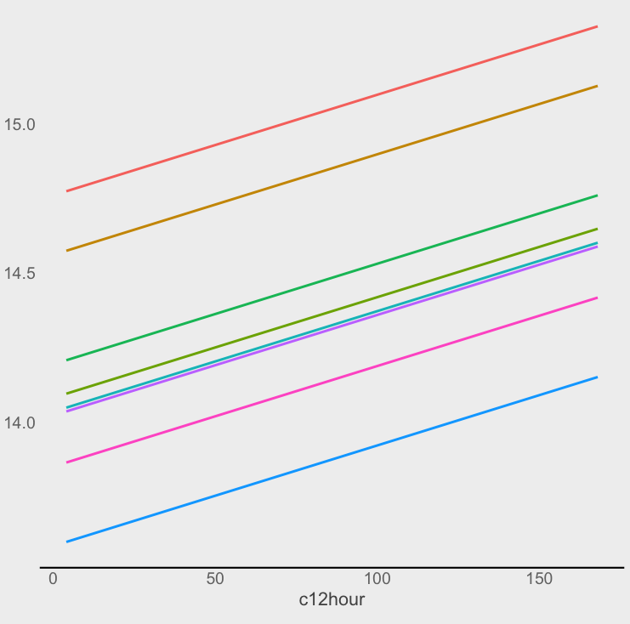
Population-Level RSF
Another important consideration is whether you are trying to predict the selection of an entire population or simply an individual. When the former is the goal, practitioners will often implement a generalized linear MIXED model. The “mixed” refers to the fact that both fixed (standard environmental predictor variables) and random effects. A random effect (say, individual ID) may offer insight into the differences among individuals within the population.

Slide 13
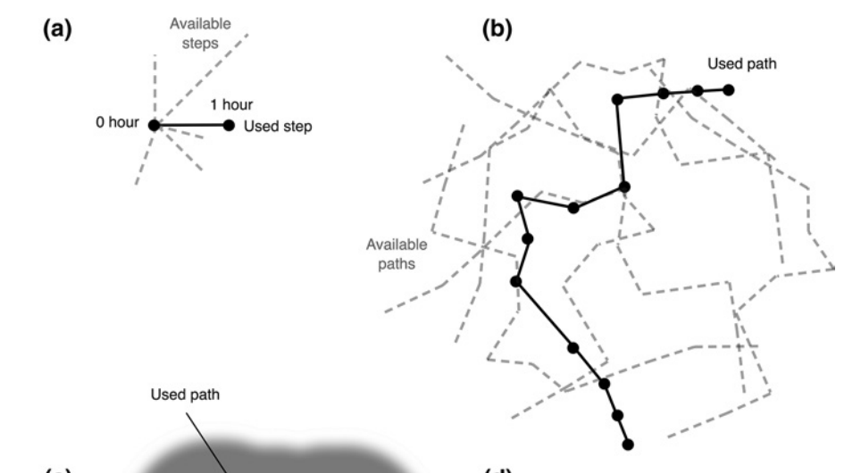
RSF Alternatives (SSF and PSF)
When fine-scale environmental data is available, it may be useful to use a more biologically realistic means of selecting available points.
In the case of a step selection function (SSF), the available points are chosen from within a buffer around each point (i.e., readily reachable points). In the case of a path selection function (PSF), sets of points are used and available (but unused) paths are identified.

