Slide 1
Entangled Multiplexing Transceiver
EMT
A Proposed Architecture for Faster-Than-Light Signalling via Entangled Particle Grids, Magnetic Orientation Encoding and Ensemble Weak Measurement with Full-Duplex Operation.
Daniel Miles
25/04/2026
Original Concept Paper
https://alternitech.square.site
Rev.5

Slide 2
Abstract
This paper proposes the Entangled Multiplexing Transceiver (EMT) - a novel architecture for faster-than-light communication using entangled particle arrays. Each EMT unit contains a grid of entangled Calcium ions (Ca⁺) held in a multi-zone Paul trap. Ions are the preferred substrate due to their stationary nature, long coherence times, and sub-degree spin orientation control via magnetic field pulses.
Each row of ions is magnetically aligned to the same orientation angle, corresponding to an alphanumeric character on a lookup table called the Rotary Orientation Ring. The slab is divided into a TX half and an RX half, enabling full-duplex communication.
The home position at zero degrees is permanently reserved as a message delimiter. All N ions in each row are set to the same orientation - the receiver averages all N readings to recover the angle with noise reduced by root-N.
Orientation is written using miniature coils surrounding each ion trap cavity - magnetic field pulses rotate the spin state to any target angle in nanoseconds. A single MCU handles disc lookup, averaging, framing, and coil addressing.
Both units are manufactured as one combined trap, entangled in situ using the Molmer-Sorensen gate, then cleaved and shipped. Coherence is maintained indefinitely via dynamical decoupling and a continuous self-healing bootstrap protocol running on a dedicated system channel.

Slide 3
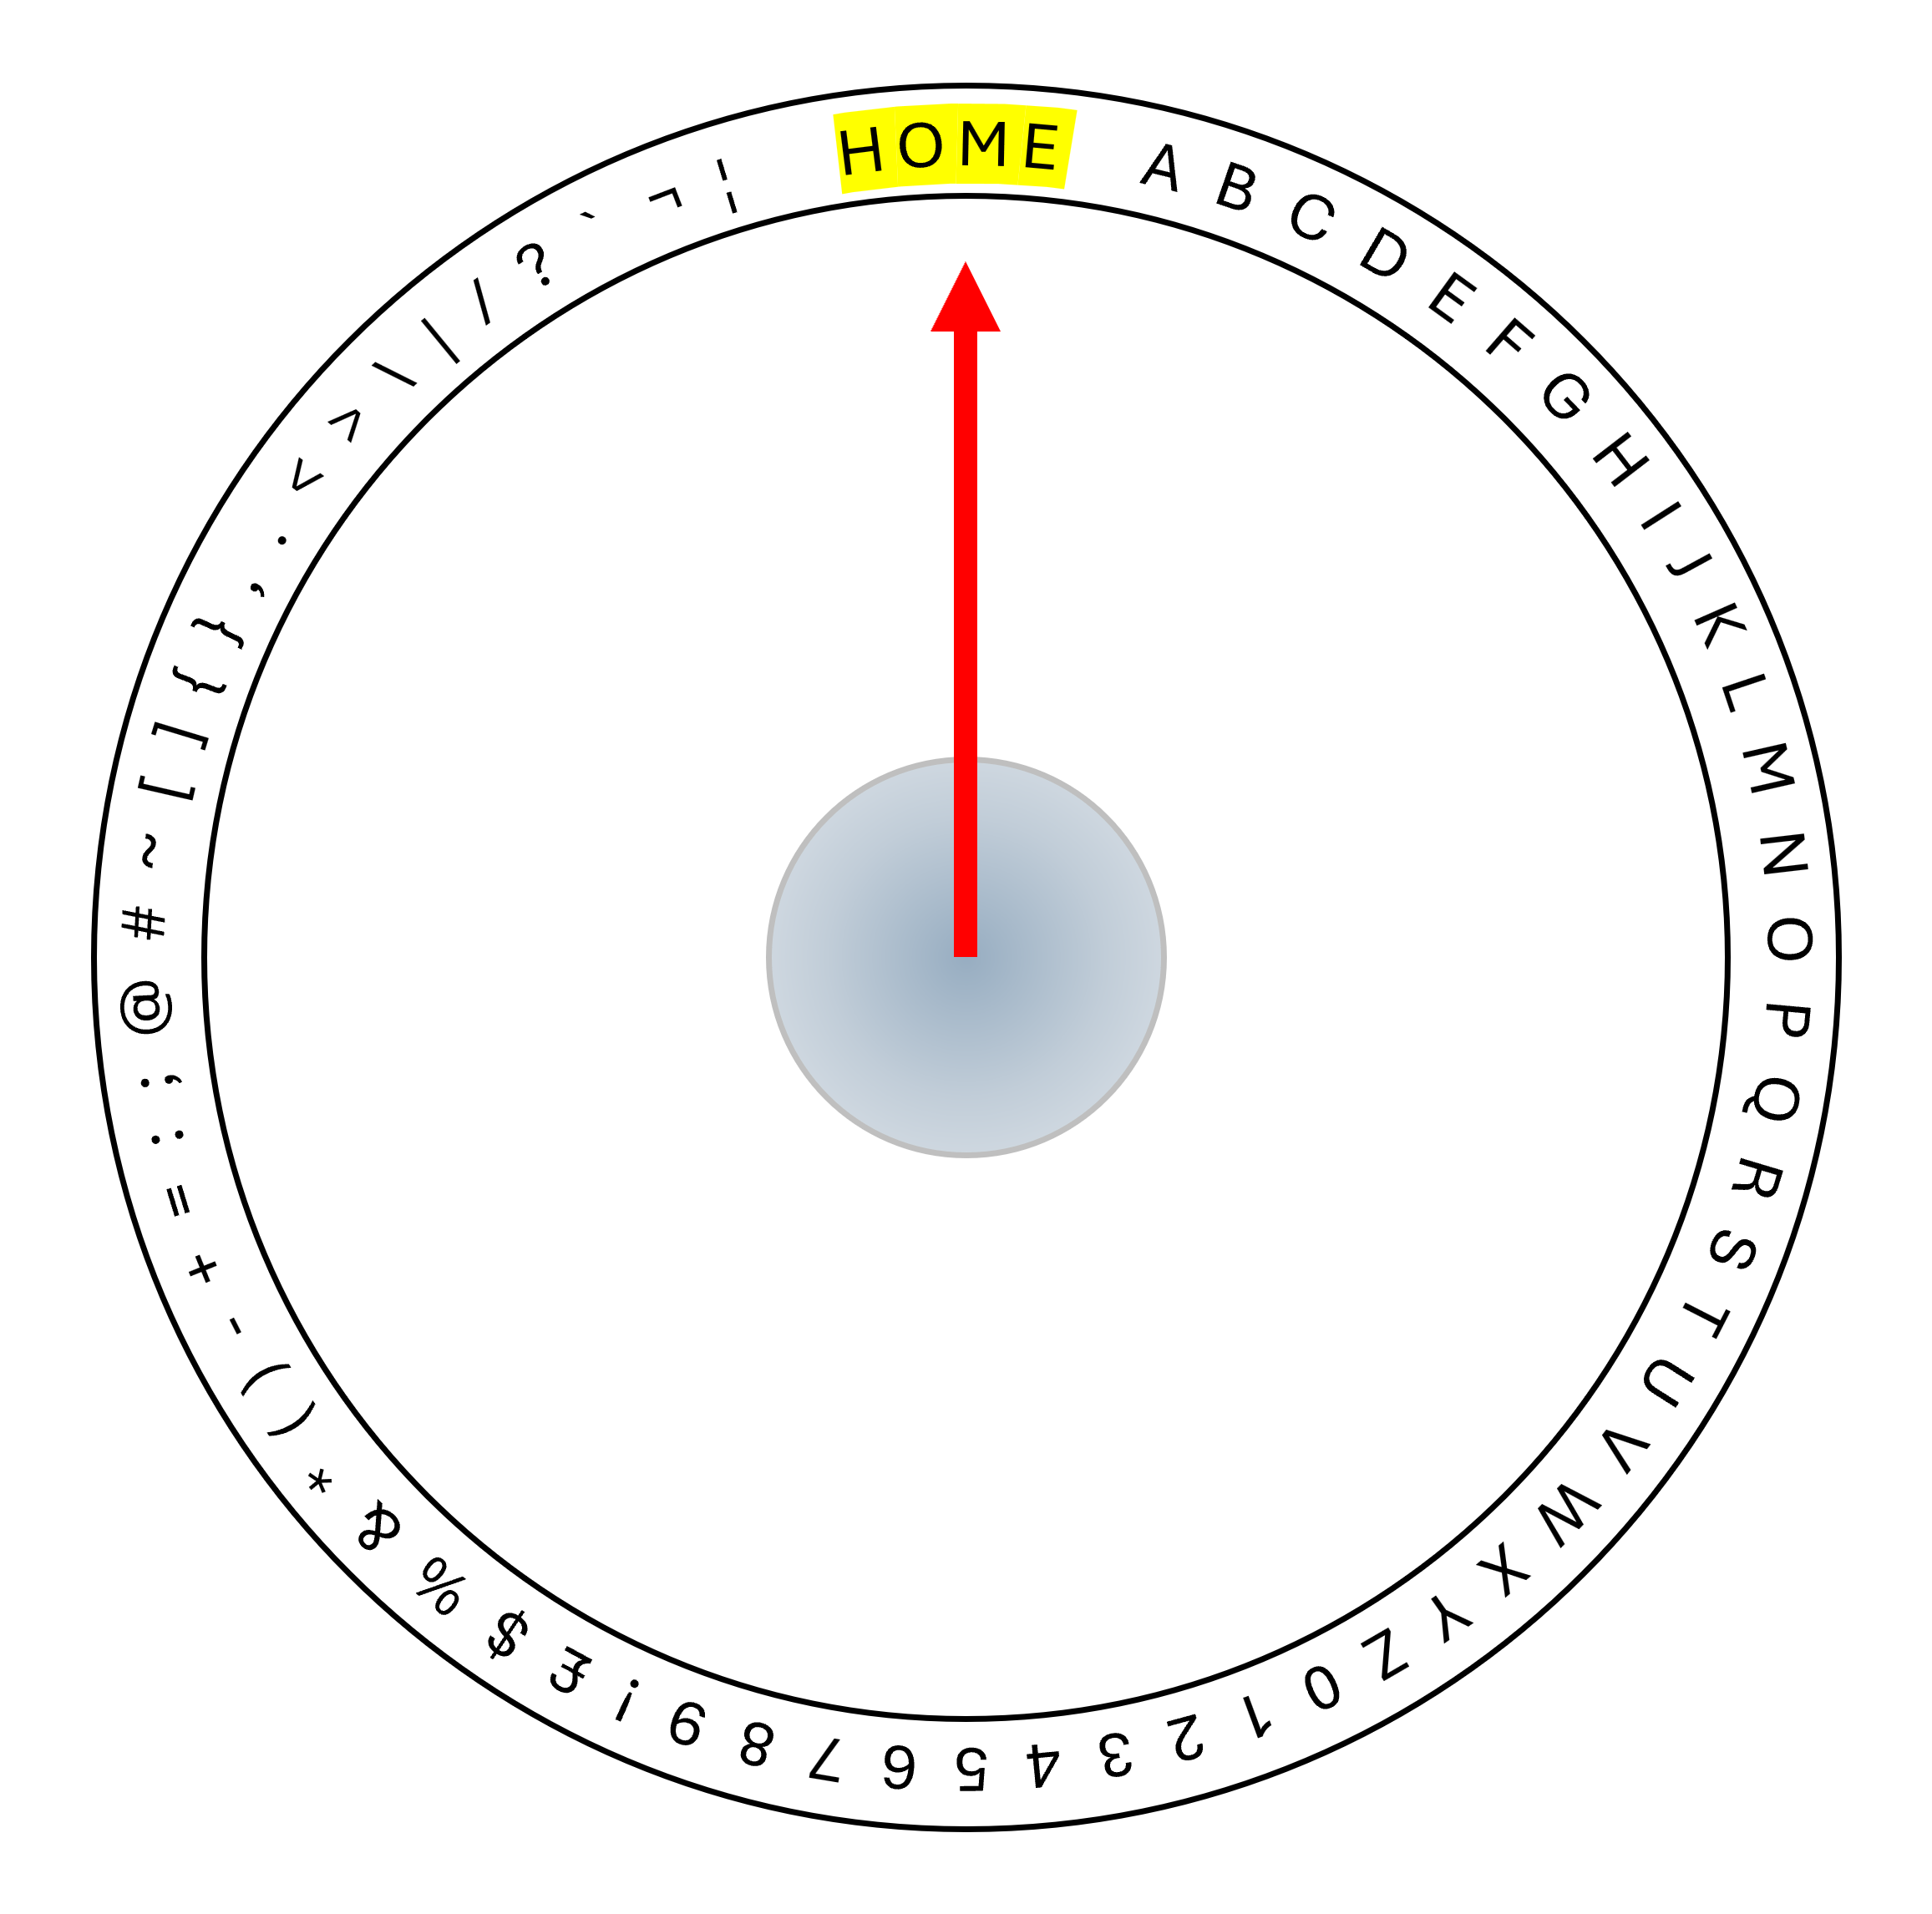
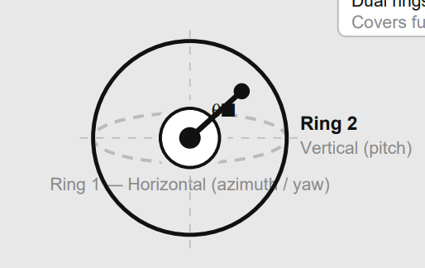
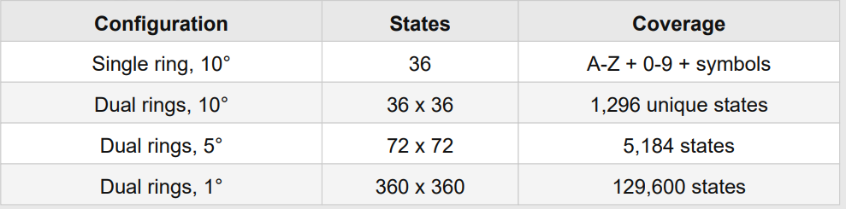
Rotary Orientation Ring
The virtual disc is a software lookup table loaded identically onto both EMT units at manufacture. Device B has its table's orientations reversed to match the spin-up/spin-down pairing of entangled ion pairs. It maps each character to a unique orientation angle. The home position at exactly 0 degrees (180 for device B) is permanently reserved and never assigned to any character. Character A begins at the first angular position immediately after the home zone.
Adding a second ring on the perpendicular vertical plane gives two independent orientation axes per ion. At ten-degree resolution per axis this yields 36 x 36 = 1,296 unique states - sufficient for full alphanumeric and extended character coverage including upper/lower case and symbols.

Slide 4
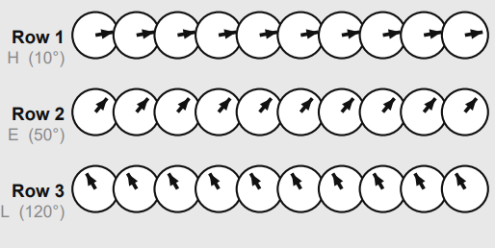
Multiplexing
Each row of ions encodes exactly one character. Every ion in the row is set to the identical orientation angle for that character. All ions per row carry orientation data - the receiver weak-measures all simultaneously and averages, recovering the orientation with noise reduced by the square root of N.
This uniform orientation within each row is the core principle of ensemble noise reduction. The receiver averages all readings across the row and maps the result to the nearest disc position via the Rotary Orientation Ring lookup table.

Slide 5
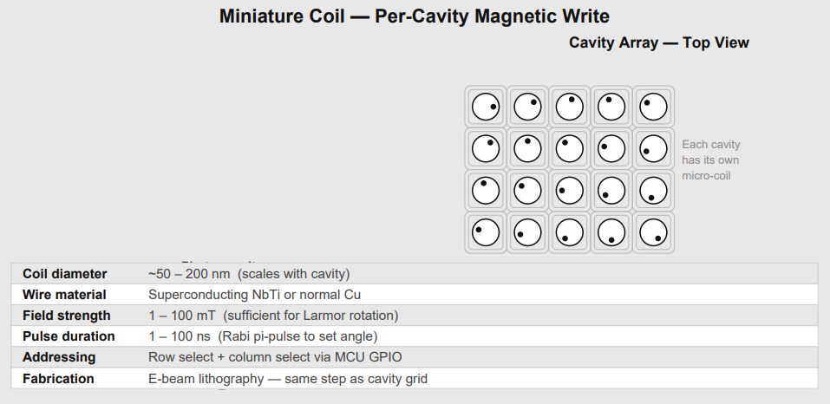
Magnetic Orientation
Each ion trap cavity in the slab is surrounded by a miniature coil fabricated in the same electron-beam lithography step as the cavity grid. The coil generates a localised magnetic field when driven by a current pulse from the MCU. The field pulse rotates the spin state via the Zeeman effect to any target orientation angle with nanosecond precision and sub-degree accuracy. Similar to how an electric motor rotates under a controlled field.
A static bias field (1-10 mT) is applied continuously to split the Zeeman energy levels and define the quantisation axis. This field does not interfere with the electric trapping field, which operates at a completely different frequency (10-100 MHz). The spin is then rotated by a microwave pulse at the Larmor frequency - pulse duration sets the rotation angle, pulse phase sets the axis.
Coil diameter scales with cavity size: 50-200 nm. Row and column addressing is achieved via a matrix of MCU GPIO pins. No optical alignment is required for the write operation.

Slide 6
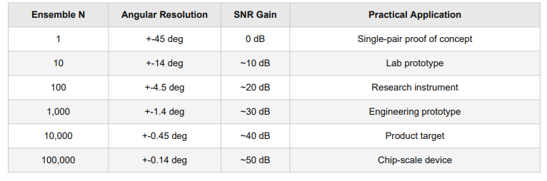
Noise Reduction
Each character row contains N particles all set to the same orientation. The MCU averages N weak measurements. Angular resolution improves as root-N. At N = 10,000 the resolution reaches 0.45 degrees - well below the 5-degree step size required for full character coverage.

Slide 7
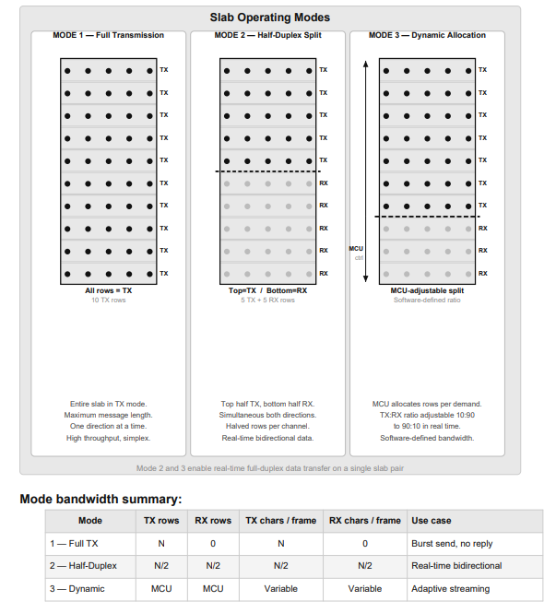
Operating Modes
The EMT slab supports three software-defined operating modes. In Mode 1, the entire slab transmits, maximising the number of characters per frame. In Mode 2, the slab is split horizontally - the top half transmits and the bottom half receives simultaneously, enabling real-time bidirectional data transfer on a single slab pair. In Mode 3, the MCU dynamically adjusts the TX-to-RX row ratio in software to match the asymmetric bandwidth demands of the application.

Slide 8
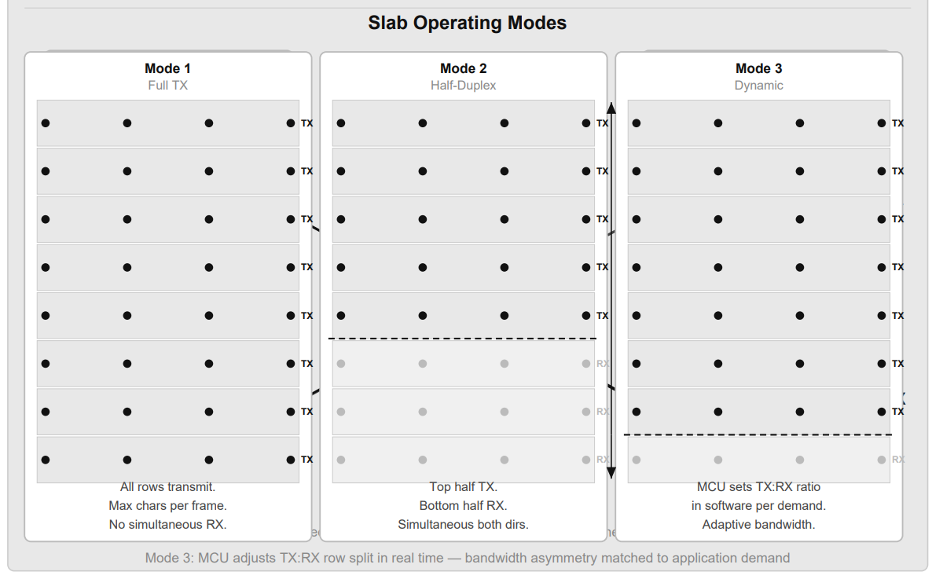
Full-Duplex Transceiver Architecture
Each EMT unit contains one slab. The slab is divided horizontally: the top half operates in TX mode (orienting ions to transmit characters) and the bottom half operates in RX mode (weak-reading ions to receive characters). This gives simultaneous bidirectional communication on a single slab.
The entanglement is crossed: TX rows of Machine A are entangled with RX rows of Machine B, and vice versa. Both slabs are manufactured as a single combined trap, entangled using the Molmer-Sorensen gate, then physically cleaved at the centre and shipped to their respective sites.
Three slab operating modes:
Mode 1 - Full TX: all rows transmit for maximum ensemble size and SNR.
Mode 2 - Half-duplex split: top half TX, bottom half RX simultaneously.
Mode 3 - Dynamic: MCU adjusts TX/RX row ratio in software per demand.

Slide 9
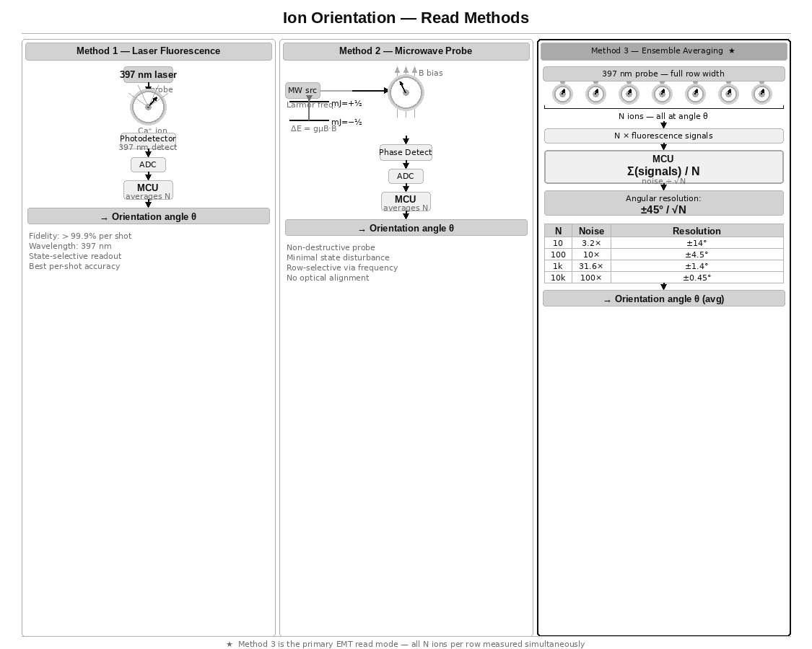
Reading Mechanism
Ion orientation is read using weak measurement - a low-power probe laser interaction that extracts partial orientation information without fully collapsing the quantum state. The Ca⁺ ion emits state-selective fluorescence at 397 nm when probed. A photodetector collects the fluorescence output, an ADC samples the signal, and the MCU averages N samples per row, mapping the result to the nearest Rotary Orientation Ring position. Readout fidelity exceeds 99.9% per shot.
Each weak read disturbs the state minimally. Averaging N reads across the ensemble row converges on the true orientation angle with noise reducing as root-N.

Slide 10
Fluorescence Photon Direction — A Pointer?
When a Ca⁺ ion is probed by the 397 nm laser and emits a fluorescence photon, a natural question arises: does that photon emerge along the spin axis, giving us a directional pointer to the orientation? The answer distinguishes two separate physical properties of the emission.
Emission direction — governed by the transition, not the spin
The 397 nm transition in Ca⁺ is an electric dipole transition. The photon emission pattern is a torus — strongest perpendicular to the dipole axis, zero along it. This dipole axis is fixed by the laser polarisation and the quantisation axis (the applied B-field direction). The spin orientation of the individual ion does not change which direction the photon travels.
What the spin orientation does affect
The spin state determines which transition is driven and therefore the intensity and polarisation of the emitted photon — not its direction.
Probing with σ+ polarised light: mJ = +½ ions fluoresce brightly, mJ = −½ ions do not absorb and remain dark.
The continuous orientation angle modulates the probability amplitude of emitting into a given polarisation state — measurable as intensity variation as the probe polarisation is rotated.
Reconstructing the angle — polarimetry not directionality
Probe with known polarisation → measure fluorescence intensity → gives projection of spin onto that axis.
Rotate probe polarisation → measure again → gives projection onto a second axis.
Combine both measurements → reconstruct full orientation angle θ.
This is weak quantum state tomography applied per row — the angle is recovered from intensity variation, not photon direction.
The chiral waveguide exception — where direction IS a pointer
In nanophotonic waveguide geometries, spin-momentum locking occurs: an ion positioned near a chiral waveguide emits photons preferentially left or right depending on its spin state. The photon direction directly encodes the spin projection.
This is experimentally demonstrated. It would make the EMT read mechanism significantly more elegant — a directional detector rather than an intensity detector. It requires the ions to be coupled to a nanophotonic structure rather than sitting in free space, which is an active research direction and a meaningful potential upgrade to the EMT read architecture.

Slide 11
Writing Mechanism
Setting ion orientation requires a controlled rotation of the spin state. Three methods exist; Method 3 (miniature coil, magnetic pulse) is recommended for the EMT as it requires no optical alignment and is directly MCU-compatible.
Method 1 - ESR / Microwave Pulse:
Microwave pulse at Larmor frequency. Pulse duration sets rotation angle. Rabi oscillation achieves any target angle. Precision < 0.1 degrees.
Method 2 - Optical Pumping:
Resonant laser pulse drives spin to target state. Nanosecond timescale. Precision approximately 1 degree per pulse.
Method 3 - Miniature Coil (recommended):
Nanoscale coil per cavity, MCU GPIO-driven. No optical alignment. Row and column matrix addressing. Fabricated in same lithography step as grid. Sub-degree angular control. Nanosecond pulse duration.

Slide 12
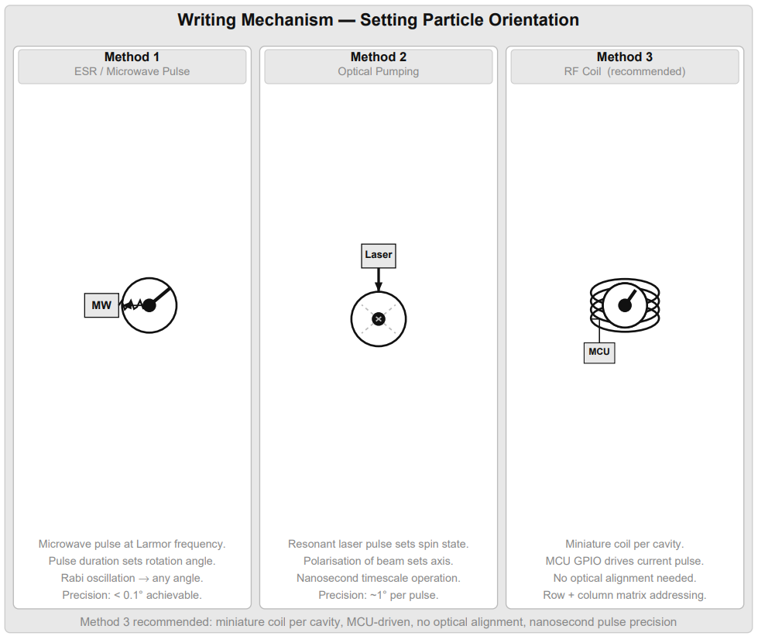

Slide 13
Manufacturing Process
Both slabs are produced as a single combined multi-zone Paul trap. Ca⁺ ions are laser-cooled to the motional ground state. Entanglement is established in situ using the Molmer-Sorensen two-qubit gate, which uses the shared Coulomb motional mode to entangle spin states without requiring the ions to physically touch. No external photon intermediary is needed at this stage.
Manufacturing steps:
1. Trap chip fabricated by electron-beam lithography. Miniature coils deposited in the same step as the cavity grid.
2. Ca⁺ ions loaded by photoionisation of neutral calcium metal.
3. Ions laser-cooled to ground state. Grid mapped and verified.
4. Molmer-Sorensen gates applied to entangle all ion pairs across the central cleavage plane.
5. Trap chip cleaved along the central plane. Slab A and Slab B result. Position correspondence is guaranteed by geometry.
6. Each slab sealed in vacuum housing with laser optics, photodetector array, coil driver board, and MCU.
7. Slab B shipped to remote site. Dynamical decoupling activated. System channel initialised. Ready to operate.

Slide 14
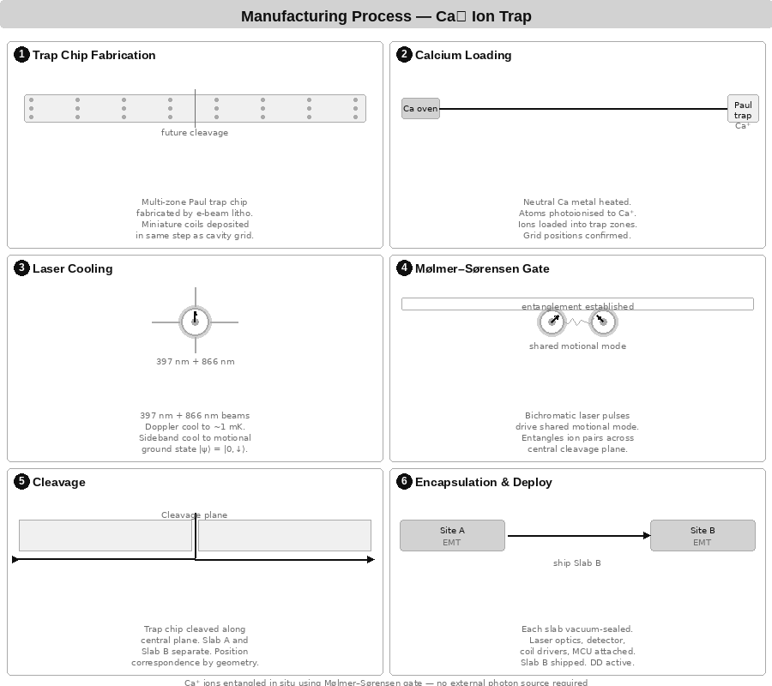

Slide 15
Operational Process
The EMT supports three transmission modes, each suited to different use cases. In all modes the receiver continuously weak-reads all RX rows, averages across the ensemble, and decodes via the virtual disc. HOME (0°) always serves as the start and end delimiter. Mode A - Maximum Signal (all rows, same character): All TX rows in the slab are set to the same orientation simultaneously. This maximises the total ensemble size available to the receiver for that character - if the slab has 100 rows each with 10 particles, the receiver averages 1,000 readings for a single character. This gives the highest possible signal-to-noise ratio and is used when the channel quality is poor or the angular resolution needs to be maximised. Mode B - Parallel Message (each row = one character): Each TX row is set to a different orientation corresponding to a different character in the message - all simultaneously. A 50-row slab transmits 50 characters at once. After the dwell window the transmitter loads the next 50 characters and updates all rows simultaneously again. This gives maximum throughput at the cost of per-character ensemble size. Mode C - Cascading Pipeline (rolling character advance): Rows are treated as a shift register. When row 1 has completed its dwell, it advances to the next character while row 2 is still holding its current character. This creates a continuous pipeline where the receiver is always decoding a moving window of characters. As soon as row N completes, character N+1 loads into row 1. This gives the lowest latency for streaming data at the cost of slightly reduced per-character dwell time.

Slide 16
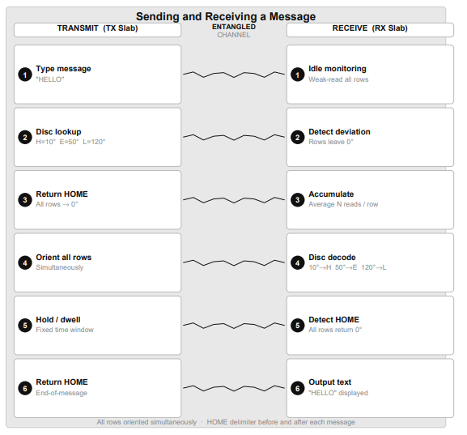
Message Logistics
Title

Slide 17
Chip Scale Integration
Each EMT unit targets a standard chip package. The entangled ion trap slab occupies the central die area, surrounded by: a miniature RF coil write array, a 397 nm laser and photodetector read array, and a single microcontroller (MCU) handling all logic - ADC averaging, Rotary Orientation Ring lookup, message framing, GPIO coil addressing, and dynamical decoupling pulse generation. A Peltier cooling layer maintains the trap temperature. No FPGA required.
Target form factor: 12 mm x 8 mm chip package plus vacuum housing. The calcium source (a small piece of calcium metal) provides ions for the self-healing reserve. Calcium is a common, non-toxic metal requiring no special handling.
Internal layers (bottom to top):
Peltier cooling layer
Microcontroller - disc lookup, framing, averaging, DD pulses, GPIO
Photodetector array - RX weak-read and ADC
Ion trap slab - Ca⁺ entangled grid
RF coil array + 397 nm laser probe - TX write and RX read
Calcium ion source - refillable reserve for self-healing protocol

Slide 18
Substrate Materials
Coherence time is the dominant factor for EMT longevity. Practical EMT deployment requires coherence times of hours, days, or ideally weeks. The table below is ordered by FTL fitness with coherence as the primary criterion.
Recommended material: Ca⁺ trapped ions
Coherence: seconds to minutes (electron spin); up to 10 hours with dynamical decoupling on nuclear spin of Ca-43. Readout fidelity > 99.9%. Write precision < 0.1 degrees. Room temperature operation possible with modest laser cooling. Entanglement established by Molmer-Sorensen gate in situ at manufacture. This is the primary design substrate for EMT.
Second choice: Rare Earth YSO (Eu or Pr doped Yttrium Silicate)
Coherence: hours (record holder for solid-state systems). Requires 4 K cooling (achievable with a small Peltier). Optical quantum memory demonstrated. Best choice if Ca⁺ trap infrastructure is too large for the application.
Third choice: Phosphorus in Silicon (Si:P)
Nuclear spin coherence of seconds at room temperature. CMOS compatible and manufacturable using existing semiconductor fabs. Strong long-term candidate for a fully solid-state chip-scale EMT.
Materials with coherence times below one second (SiC, photonic crystal, superconducting qubits, quantum dots) are rated POOR for EMT deployment beyond same-building range regardless of other advantages.

Slide 19
Open Experimental Question
The no-communication theorem is proven within the current quantum mechanical formalism for discrete single-shot measurements. The EMT architecture operates in a regime not fully addressed by existing proofs: spatially parallel transmission, continuous-variable orientation encoding, large-ensemble weak-measurement averaging, and a global phase reference shared at manufacture.
The critical experimental question is whether, at some ensemble size N, the averaged orientation signal on the receiver slab exceeds the uncertainty-principle noise floor for a controlled orientation applied to the transmitter slab. Either experimental outcome is a significant scientific result.
The self-healing grid as the experiment:
The bootstrap re-entanglement protocol (see later sections) uses the EMT system channel to coordinate grid maintenance. If the EMT channel operates faster than light, the grid self-heals at any distance. If it does not, the grid fails to self-heal beyond the coherence-limited range. The self-healing experiment and the FTL experiment are the same experiment.

Slide 20
Expanding the reach
While a pair of these enable communication across the solar system, it is restricted to the 2 devices:
Mars <-> Earth
Or Earth <-> Spaceship
To overcome this limitation, imagine a “call centre” that houses all Earth bound transceivers (or a dedicated space station) - by housing and connecting them together, communication channels can be extended, for example:
Mars wants to call a Ship orbiting Jupiter but the Ship only has 1 EMT that is entangled with a EMT on the “Call Centre Station”..
Mars would call the Station and the Station would route the call using classical means in-between the multiple EMTs.
DynamicDecoupling
Continuous re-entanglement
Calcium ions

Slide 21
Calcium Ions as Particle Substrate
Calcium ions (Ca⁺) are the preferred substrate for the EMT. Unlike photons or NV centres, Ca⁺ ions are stationary qubits - they sit in an ion trap and hold their spin state indefinitely (with dynamical decoupling), rather than flying through a waveguide and needing to be caught in flight.
Key advantages over other substrates:
Coherence: seconds to minutes (electron spin); up to 10 hours (nuclear spin, Ca-43 with dynamical decoupling).
Write precision: microwave pulse at Larmor frequency sets orientation to any angle with < 0.1 degree precision in nanoseconds.
Read fidelity: state-selective fluorescence at 397 nm. Readout fidelity > 99.9% per shot - significantly better than NV-centre alternatives (~95%).
Trap compatibility: Ca⁺ is confined by oscillating electric fields in a Paul trap. The magnetic manipulation field operates at a completely different frequency and does not disturb the trap - this is standard in all ion trap experiments.
Entanglement: Molmer-Sorensen gate entangles ions in the same trap via their shared Coulomb motional mode. For remote re-entanglement, the Delft photon-mediated method is used - each ion emits an entanglement photon, the photons meet at a Bell measurement, and the classical result coordinates the ion correction.
Ion shuttling:
Ca⁺ ions can be moved between trap zones on a multi-zone trap chip without losing coherence. This is the basis for the ion reserve hopper - ions are stored in a holding zone and shuttled into the active grid on demand.

Slide 22
Dynamical Decoupling - Extending Coherence
Dynamical decoupling (DD) is a technique that extends the coherence time of a qubit by applying a continuous sequence of precisely timed refocusing pulses. The pulses cancel the effect of slow environmental noise - magnetic field fluctuations, phonon coupling, charge noise - by reversing accumulated phase error before it destroys the entanglement.
Coherence times for Ca⁺ with DD:
Electron spin, no DD: ~1 millisecond
Electron spin, CPMG-8 sequence: ~1 second
Nuclear spin, no DD: ~1 minute
Nuclear spin, XY-64 DD sequence: ~10 hours (demonstrated)
Nuclear spin, optimal DD: days (theoretical limit)
Application to EMT:
The MCU runs the DD pulse sequence continuously on all active rows while the EMT is operating. The DD pulses are interleaved between transmission dwell windows. No additional hardware is required beyond the existing coil array - the same miniature coils used for orientation writing also deliver the DD pulses.
With nuclear spin encoding and DD, a single EMT grid achieves an effective coherence window of hours to days, covering the entire inner solar system for seamless re-entanglement coordination via the system channel.

Slide 23
Continuous Re-entanglement - The Seed Protocol
Even with dynamical decoupling, entangled pairs eventually decohere. The EMT uses a continuous self-healing protocol to refresh decohered pairs from a reserve of ordinary unentangled Ca⁺ ions, coordinated via a dedicated system channel running on a reserved portion of the active grid.
What the system channel carries:
Coherence quality reports per row, row refresh requests, Bell measurement results, correction pulse parameters, ion reserve status, dynamical decoupling sync.
Bootstrap re-entanglement sequence:
1. MCU monitors coherence quality per row continuously.
2. Row drops below threshold - system channel flags the row ID to remote unit.
3. Both units simultaneously excite a reserve Ca⁺ ion, emitting an entanglement photon via the Delft protocol.
4. Bell measurement performed at one site. Classical result sent on system channel.
5. Correction pulses applied. Reserve ion is now entangled - shuttled into the active grid to replace the decohered row.
6. Dynamical decoupling activated on the new pair immediately.
Ion reserve:
Ordinary unentangled Ca⁺ ions held in a storage zone of the trap chip. Replenished by photoionisation of neutral calcium metal from a small on-board source. Calcium is a common non-toxic metal. The reserve requires no entanglement - it is simply a supply of raw ions.

Slide 24
Self-Healing Grid - From One Seed Pair
The most efficient form of the protocol starts from a single pre-entangled pair at manufacture. All other ions in the reserve are unentangled and cheap. The grid builds itself through an exponential bootstrap process.
Exponential bootstrap:
Step 1: Seed pair (1 entangled pair) is operational.
Step 2: Use seed as system channel. Bootstrap pair 2 via Delft protocol.
Step 3: Use pairs 1 and 2 as channel and resource. Bootstrap pairs 3 and 4.
Step N: After N generations, grid contains 2ᵏ entangled pairs.
10 generations builds 1,024 pairs. 14 generations builds 16,384 pairs.
Ongoing self-maintenance:
Once the full grid is operational, the same protocol runs continuously. Decohered rows are detected, flagged on the system channel, and replaced from the ion reserve. The reserve is topped up from the calcium source. The system never runs out as long as the calcium source is non-empty.
Key insight:
The self-healing protocol is itself a test of whether the EMT channel works. A grid that successfully maintains itself at interplanetary distance confirms the EMT channel is operational. The device is the experiment.

Slide 25
Refresh Rate vs Decoherence Rate - Mathematics
For the self-healing grid to be stable, the refresh rate must exceed the decoherence rate. The condition is derived formally below.
Definitions:
N_grid = total entangled pairs in active grid
τ_c = coherence time per pair (with DD)
R_d = decoherence rate = N_grid / τ_c [pairs/s]
t_refresh = time to bootstrap one new pair
R_r = refresh rate = 1 / t_refresh [pairs/s]
N_sys = rows reserved for system channel
B_sys = system channel bandwidth [chars/s]
C_proto = chars needed per refresh cycle
Stability condition:
R_r > R_d
1 / t_refresh > N_grid / τ_c
τ_c > N_grid × t_refresh
Worked example - Ca⁺ electron spin + DD (τ_c = 10 min):
N_grid = 10,000 R_d = 10,000 / 600 = 16.7 pairs/s
B_sys (5 rows, 100ms dwell) = 50 chars/s
C_proto = 10 chars/refresh → R_r = 50/10 = 5.0 pairs/s
5.0 < 16.7 ← NOT stable at 5 system rows
Required system rows:
N_sys_min = ceil(N_grid × C_proto × t_dwell / τ_c)
N_sys_min = ceil(10,000 × 10 × 0.1 / 600) = ceil(16.7) = 17 rows
∴ Reserve at least 17 system rows (17% of a 100-row grid)

Slide 26
Refresh Rate Mathematics - Extended Cases
With Ca⁺ nuclear spin + DD (τ_c = 10 hours = 36,000 s):
N_sys_min = ceil(10,000 × 10 × 0.1 / 36,000)
= ceil(0.28) = 1 row
∴ A SINGLE system row maintains 10,000 pairs indefinitely.
General formula:
f_sys = N_sys / N_total = C_proto × t_dwell / τ_c
As τ_c increases, the system channel overhead tends toward zero.
Ion reserve buffer size (with bootstrap, not pre-loaded):
N_buffer = R_d × t_refresh × safety_factor
= 16.7 × 1.0 × 10 ≈ 167 ions in active buffer
(Plus calcium metal source for continuous top-up)
Mission duration analysis - 1 year mission, 10,000-pair grid:
Without bootstrap (pre-loaded pairs):
Ca⁺ electron spin (τ_c = 10 min):
N_reserve = 10,000 × 525,600 / 10 = 525,600,000 pairs
Ca⁺ nuclear spin (τ_c = 10 hr):
N_reserve = 10,000 × 8,760 / 10 = 8,760,000 pairs
With bootstrap re-entanglement:
N_reserve → ~167 ordinary ions in rolling buffer
Plus ~1g calcium metal (abundant, non-toxic, cheap)
Key result: with the seed bootstrap protocol and nuclear spin encoding, the ion reserve reduces from millions of pre-entangled pairs to a buffer of approximately 200 ordinary ions plus a calcium metal source.

Slide 27
Re-entanglement and the Speed of Light
The re-entanglement coordination signal travels on the EMT system channel. Its speed is the speed of the EMT channel itself. This creates a direct connection between two fundamental questions.
If EMT transmits information faster than light:
The re-entanglement coordination also travels FTL. The bootstrap protocol works at any distance with no delay. The grid is truly self-sustaining at interstellar distances. Range is unlimited.
If EMT does not transmit information faster than light:
Coordination is light-speed limited. Re-entanglement at distance D takes a minimum D/c round-trip time. The grid self-sustains within the coherence-limited range.
Practical range without FTL - Ca⁺ nuclear spin (τ_c = 10 hours):
Max coordination round-trip < τ_c = 36,000 s
Max distance = c × τ_c / 2
= 3×10⁸ m/s × 36,000 s / 2
= 5.4 × 10¹² m = 36 AU (Saturn orbit)
Without FTL, EMT covers the entire inner solar system seamlessly.
The two questions resolve together:
A self-maintaining grid at Jupiter distance simultaneously confirms FTL signalling and demonstrates indefinite range operation. A grid that fails to self-maintain beyond Saturn confirms the no-communication theorem. Either result is a significant scientific outcome. Either result, the device already covers Earth to Jupiter - a transformative capability for deep space communication.

Slide 28
Total Decoherence - The Worst Case
The self-healing bootstrap protocol keeps the EMT grid alive indefinitely as long as at least one entangled pair survives and the calcium reserve is non-empty. However a catastrophic failure - extreme radiation, power loss, physical damage - could decohere the entire grid simultaneously.
In this scenario, by assumption:
All entangled ion pairs are lost.
The calcium reserve contains only ordinary unentangled Ca⁺ ions.
No EMT channel exists - no system channel, no user channel.
No classical communication channel is available.
No photon link of any kind can be established.
The standard Delft re-entanglement method is impossible: it requires both a photon link and a classical channel to broadcast the Bell measurement result. Neither is available.
The honest physics position:
Within known quantum mechanics, entanglement cannot be created between two separated systems with no physical connection between them. This is not an engineering limit. It is a structural consequence of quantum mechanics itself - two systems with no shared history cannot occupy a joint quantum state.
However, the EMT hypothesis already operates in a regime where the standard formalism may be incomplete. The same open question that asks whether EMT can transmit information also asks whether the deeper non-local structure it implies could support re-entanglement without a physical link. These are not two questions. They are one.

Slide 29
Retroactive Causality - What Quantum Mechanics Shows
Retroactive causality is not science fiction. It is experimentally confirmed in quantum mechanics. The key result is the delayed-choice entanglement swapping experiment (Ma et al., 2012).
The delayed-choice result:
Source 1 produces entangled pair: photons 1 and 2.
Source 2 produces entangled pair: photons 3 and 4.
Photons 1 and 4 are sent to Alice and Bob. Measured. Results recorded.
Photons 2 and 3 are sent to Victor.
Victor later decides: perform a Bell measurement on 2 and 3, or not.
If Victor performs the Bell measurement: Alice and Bob's already-recorded results show entanglement correlations - retroactively.
If Victor does not: Alice and Bob's results show no correlations.
Victor's decision, made after Alice and Bob have finished measuring, determines whether their particles were entangled. The causal arrow does not point the way classical physics expects.
What this means:
Entanglement is not simply established at the moment of physical interaction and then passively maintained. It can be established retroactively by a measurement that occurs after the entangled particles have already been detected. The joint quantum state is not fully determined until the complete measurement context is fixed.
This is the foundation for the pairing code recovery protocol.

Slide 30
The Virtual Bell Measurement
In the delayed-choice experiment, Victor performs a real Bell measurement on real photons. The retroactivity comes from the timing. The physical intermediary exists.
The pairing code protocol asks whether the physical intermediary is strictly necessary, or whether two devices performing the correct local operations - independently, with no connection - can produce the same result.
What a Bell measurement does mathematically:
It projects a joint system into one of four Bell states. It transforms the joint Hilbert space. Each of the four outcomes corresponds to a specific correction operation that one party must apply to recover a target entangled state.
The virtual Bell measurement:
Device A prepares its fresh Ca⁺ ions to state α - specified exactly by the pairing code.
Device B prepares its fresh Ca⁺ ions to state β - specified exactly by the pairing code.
Both devices independently perform the local unitary operations that constitute their half of a Bell measurement on a virtual joint system - as if a physical intermediary existed between them.
No intermediary exists. No photons are exchanged. No classical message is sent. Each device only acts on its own ions.
The open question:
Is the physical existence of the intermediary mandatory, or is the mathematical equivalence of the operations sufficient? Standard QM says mandatory. The EMT hypothesis implies there may be a deeper non-local structure in which mathematical equivalence is sufficient. Both questions are decided by the same experiment.

Slide 31
Correction Operations - No Classical Channel Needed
In standard quantum teleportation, after the Bell measurement, the sender broadcasts the result (one of four outcomes) classically. The receiver applies the corresponding correction operation to recover the target state. The classical channel is mandatory.
In the pairing code protocol, no classical channel exists. The correction operation cannot be communicated. This appears to be a fatal problem - but it is not.
The solution - pre-computed corrections:
A Bell measurement has exactly four possible outcomes.
Each outcome requires a specific correction operation: I, X, Z, or XZ (the four Pauli operations).
The pairing code pre-specifies all four correction operations for this specific device pair.
Both devices apply all four corrections simultaneously in superposition - a procedure that is mathematically equivalent to applying the correct correction without knowing which it is.
This only produces a consistent result if the two devices are operating on a joint quantum state - which is exactly what the retroactive entanglement would have established.
The self-consistency:
The correction operations only work if the systems are already in a joint state. The joint state only exists if the corrections are applied. This is a circular dependency - but in the context of retroactive causality it is a self-consistent loop, not a paradox. The delayed-choice experiment demonstrates that exactly this kind of loop can have a physical solution.
The pairing code is designed to be the unique self-consistent solution for this specific device pair. No other device pair shares the same code, so no other pair can accidentally satisfy the same self-consistency condition.

Slide 32
Phone-Like Operation
If the virtual Bell measurement and retroactive re-entanglement work, the EMT architecture changes fundamentally. Entanglement no longer needs to be pre-established at manufacture between a fixed pair. Any two EMT devices can connect to any other, on demand, using the pairing code as a phone number.
Current architecture - fixed pairs:
Device A ↔ Device B (fixed at manufacture)
Device A ↔ Device C (impossible without call centre)
Device B ↔ Device C (impossible without call centre)
Pairing code architecture - peer to peer:
Device A knows B's pairing code → can call B directly
Device A knows C's pairing code → can call C directly
Device B knows C's pairing code → can call C directly
No call centre. No hub. No classical infrastructure.
What the pairing code is:
A complete quantum state specification - the exact trap parameters, secular frequencies, initial spin state, and correction operations needed to perform the virtual Bell measurement for that specific device.
Unique to each device pair - generated from the physical characteristics of the trap chip at manufacture.
Shareable like a phone number - give it to anyone you want to be reachable by.
Not a secret - knowing the code lets you call the device. It does not let you impersonate it, because the physical hardware of the caller is part of the protocol.

Slide 33
The Ring Protocol - How a Call is Made
To initiate a call, the caller performs the virtual Bell protocol using the target device's pairing code - tuning to the target's quantum state specification, not broadcasting their own. The called device detects activity on its own ions and knows a call is incoming, but does not yet know who is calling.
Step 1 - Ring:
Caller prepares its ions using the destination's pairing code.
Caller performs its half of the virtual Bell measurement for the target device.
Target's ions respond - target detects an incoming call attempt.
Target knows: someone is calling. Target does not know: who.
Ring repeats on a fixed schedule until answered or caller gives up.
Step 2 - Answer:
User accepts the call. Target performs no separate outgoing connection - the entanglement is bidirectional by nature. Answering simply completes the virtual Bell protocol already initiated by the caller.
Step 3 - Connect:
Virtual Bell measurement completes. The entire ion grid re-entangles on both devices simultaneously.
Entanglement is inherently bidirectional - no TX/RX distinction exists at the entanglement level. Full-duplex is available from the first moment of connection.
The TX/RX row split is a software choice applied on top of the entangled channel, not a property of the entanglement itself.
Step 4 - End call:
Either party transmits the end-of-call sequence (sustained HOME orientation on all rows).
Both devices detect the end signal, release the entanglement, and return to standby. Calcium partially consumed from reserve.

Slide 34
Eliminating the Call Centre
The call centre described in the earlier section exists because entanglement is a fixed bilateral relationship. Device A can only reach Device B. If A wants to reach C, the call centre bridges A-to-station and station-to-C using classical routing between two pre-entangled pairs.
Problems with the call centre model:
Hub and spoke topology - the station is a single point of failure.
Scalability - each new destination requires a new pre-entangled device at the station.
Range - the station must be reachable by both parties.
Infrastructure - a physical facility must be maintained.
The pairing code model replaces all of this:
Any device can reach any other device directly, with no intermediary.
No station. No hub. No pre-established entanglement pairs sitting idle at a call centre.
Adding a new device to the network requires only publishing its pairing code. No hardware changes at any other node.
A network of N devices supports N×(N-1)/2 possible connections with no central infrastructure.
Network topology comparison:
Call centre model: hub and spoke
Pairing code model: fully connected peer-to-peer mesh
Failure modes: single point vs no single point
Scalability: linear vs quadratic connection space
The single dependency:
The entire pairing code architecture rests on the same foundation as the EMT channel itself - the open experimental question of whether the ensemble orientation weak-measurement regime supports non-local information transfer. One experiment answers both questions simultaneously.

