Slide 1
Entangled Multiplexing Transceiver
EMT
A proposed architecture for non-classical signalling via entangled Ca⁺ ion arrays, ensemble weak measurement, and orientation-encoded multiplexing.
Daniel Miles · 2026 · Original Concept Paper · https://alternitech.square.site
Rev.2

Slide 2
Part 1 — Theoretical Foundation
Overview of this section
This section establishes the physical and mathematical foundation of the EMT concept before any hardware is described. The sequence is:
1.1 The no-communication theorem — what it says and where it has been tested.
1.2 Quantum entanglement and the joint state — what entanglement is physically.
1.3 Weak measurement theory — how partial information is extracted without full collapse.
1.4 Ensemble averaging — the statistical mechanism that reduces noise by √N.
1.5 The central experimental question — the specific regime not covered by existing proofs.
1.6 Orientation encoding — the Rotary Orientation Ring and the character-to-angle mapping.
All claims in this section are grounded in published experimental results. The central experimental question in section 1.5 is explicitly identified as unresolved. No claim of FTL signalling is made without this qualification.

Slide 3
1.1 The No-Communication Theorem
Statement
For any bipartite quantum state ρ_AB shared between Alice and Bob, Alice's local operations Λ_A ⊗ I_B produce no detectable change in Bob's reduced density matrix ρ_B = Tr_A(ρ_AB). Formally:
Tr_A[(Λ_A ⊗ I_B)(ρ_AB)] = Tr_A[ρ_AB] = ρ_B
This holds for all local operations: unitary rotations, measurements, preparation of ancilla states, and any classical post-processing. It is proven from the linearity of quantum mechanics and the tensor product structure of composite systems.
What it does and does not say
It says: Bob's marginal statistics are unchanged by Alice's actions. Single-shot measurements on individual entangled pairs carry no information about what Alice has done.
It does not say: the theorem has been experimentally tested in the regime of large ensembles (N ≫ 1), continuous-variable orientation encoding, shared global phase reference, or sustained coherent state preparation. These are the conditions under which the EMT experiment operates.
Scope of existing experimental tests
Bell test experiments (Aspect 1982, Hensen et al. 2015, Rosenfeld et al. 2017) confirm entanglement and rule out local hidden variables. They do not test ensemble orientation signalling. The EMT experiment is genuinely novel.

Slide 4
1.2 Quantum Entanglement — The Joint State
What entanglement is
Two particles are entangled when their joint quantum state cannot be written as a product of individual states. For a maximally entangled Bell state:
|Φ⁺⟩ = (1/√2)(|↑⟩_A|↑⟩_B + |↓⟩_A|↓⟩_B)
Neither ion A nor ion B has a definite spin state individually. The state is a property of the pair. Measurement of A instantly determines the correlated outcome of B, regardless of separation.
What entanglement is not
Entanglement is not a signal channel in standard QM. Alice setting ion A to a specific state is equivalent to performing a measurement — it projects the joint state and changes the correlations. Bob's marginal statistics (the distribution he sees averaging his own measurements) are unchanged by this projection. This is the content of the no-communication theorem.
The Zeeman sublevel encoding
For Ca⁺ in a Paul trap with static bias field B, the S₁/₂ ground state splits into Zeeman sublevels m_J = ±½ with energy separation ΔE = gμ_B·B. The qubit is encoded in a superposition of these sublevels. An arbitrary superposition |ψ⟩ = α|↑⟩ + β|↓⟩ with |α|² + |β|² = 1 represents a spin orientation angle θ on the Bloch sphere, where θ = 2·arctan(|β|/|α|).

Slide 5
1.3 Weak Measurement Theory
Definition
A weak measurement couples the system to a meter with interaction strength g ≪ 1. The system state is disturbed by order g per read. The meter registers a partial projection. The expectation value of observable A is recovered by averaging many weak reads:
⟨A⟩ = lim_{N→∞} (1/N) Σᵢ aᵢ
where a_i are the individual meter outcomes. For finite N, the estimator has uncertainty σ/√N where σ is the single-shot uncertainty.
Application to spin orientation
For a Ca⁺ ion in state |ψ(θ)⟩, probing with σ+ polarised 397 nm light gives fluorescence intensity I ∝ P(↑) = cos²(θ/2). Probing with σ− gives I ∝ P(↓) = sin²(θ/2). The ratio recovers θ to precision limited by photon shot noise.
Weak measurement regime: probe power set so that the average photon recoil per interaction is much less than the spin coherence energy. Each read disturbs the state by a small rotation on the Bloch sphere. The ion remains in a superposition throughout the measurement sequence.
State disturbance per weak read
Each fluorescence event has probability p of flipping the spin. For off-resonance probing, p ≪ 1. The coherence decays as e^(−Np) over N reads. For N = 1000 reads and p = 10⁻³, coherence loss is e^(−1) ≈ 37%. This is the fundamental trade-off: more reads give better SNR but at the cost of greater state disturbance.

Slide 6
1.4 Ensemble Averaging — Noise Reduction by √N
Statistical basis
If N independent estimates x_i each have mean μ and standard deviation σ, the sample mean μ_hat = (1/N)Σx_i has standard deviation σ/√N. This is the central limit theorem. It applies to any averaging process regardless of the underlying distribution.
Application to EMT row structure
Each row contains N ions all prepared in the same orientation state θ. Each ion is independently weak-measured. The MCU averages the N results. The noise on the estimated angle is:
σ_θ = σ_single / √N = ±45° / √N
The baseline single-ion uncertainty of ±45° is set by the Heisenberg limit for a spin-½ particle in a single projective measurement. Weak measurement degrades this somewhat; the ±45° figure is the practical order-of-magnitude estimate.
Resolution vs ensemble size
For 10° angular spacing between characters (36 characters per ring):
N = 10 σ_θ = ±14.2° — marginal for 10° spacing
N = 100 σ_θ = ±4.5° — reliable for 10° spacing
N = 1,000 σ_θ = ±1.4° — reliable for 5° spacing
N = 10,000 σ_θ = ±0.45° — full character set achievable
For dual-ring (two perpendicular axes), the character space is 36×36 = 1,296 states at 10° resolution per axis. This covers the full ASCII printable set with margin.

Slide 7
1.5 The Central Experimental Question
The critical question
Standard quantum mechanics predicts that setting all N ions in a row to orientation θ on Alice's side produces no change in the statistics of Bob's measurements on his N entangled partner ions. The reduced density matrix of Bob's system is:
ρ_B = Tr_A(ρ_AB) = I/2 (maximally mixed)
regardless of Alice's orientation θ. Bob always sees 50/50 outcomes.
The untested regime
The theorem is proven for arbitrary local operations on individual pairs. What has not been directly tested is whether a macroscopic ensemble of N entangled pairs, all prepared identically, with a shared global phase reference established at manufacture, produces a coherent collective response that is detectable by ensemble averaging.
The EMT hypothesis is not that the theorem is wrong. It is that the theorem may be incomplete in this regime — that there exists a collective variable of the N-pair ensemble that is not captured by the sum of N individual reduced density matrices. This is the measurement object of the experiment.
Guaranteed scientific value
Result A — signal detected: requires revision of QM formalism. Historic.
Result B — no signal: confirms the theorem in a previously untested regime. Publishable. Tightens the bounds on any non-local hidden variable theories.
The experiment has significant scientific value regardless of outcome.

Slide 8
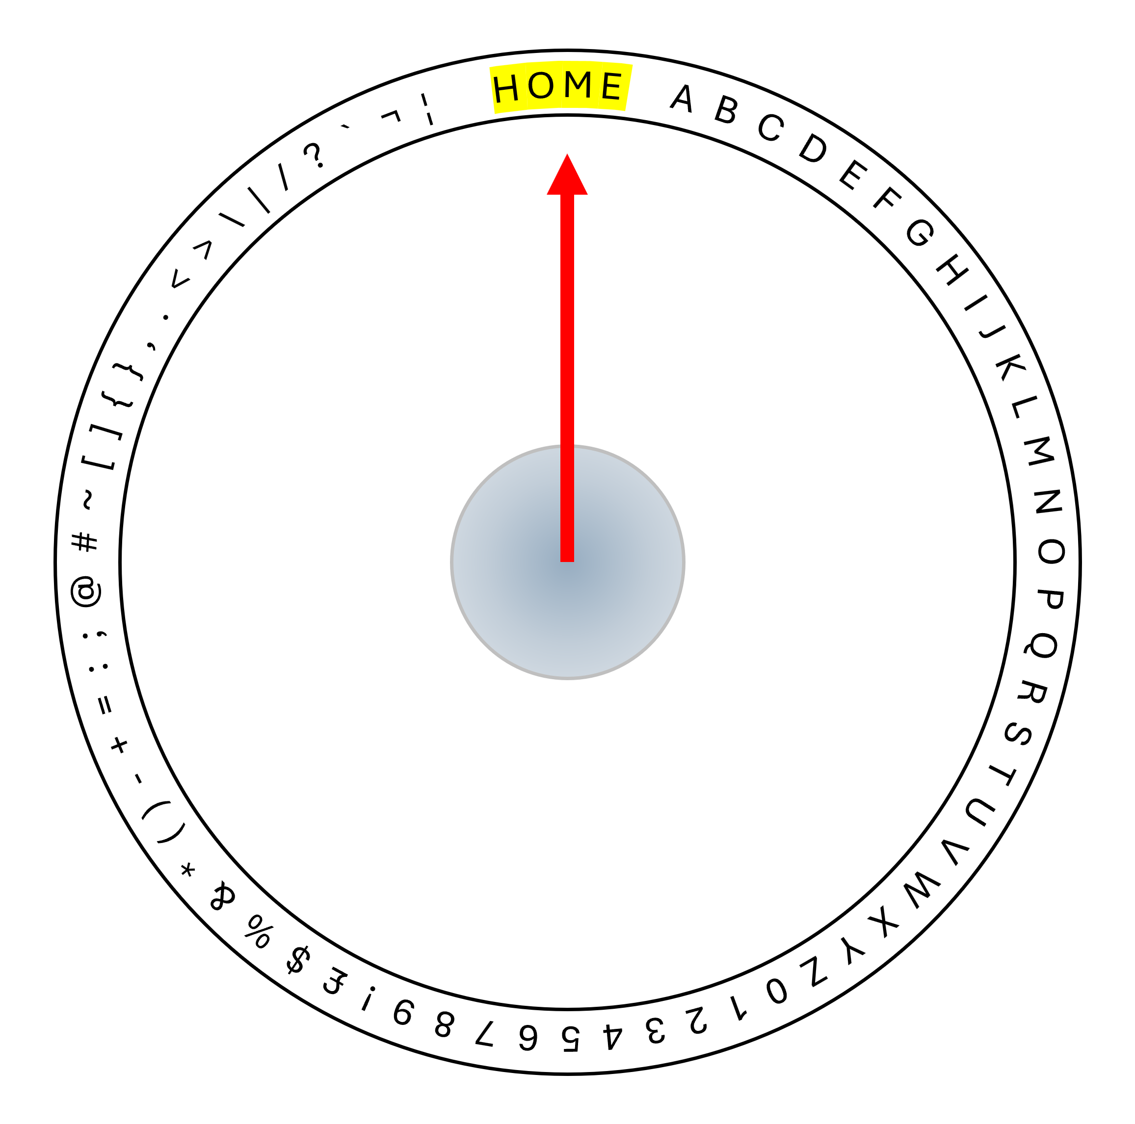
1.6 Orientation Encoding — The Rotary Orientation Ring
Encoding principle
Each character is assigned a unique orientation angle θ on a circular lookup table — the Rotary Orientation Ring (ROR). The HOME position at θ = 0° is permanently reserved as a message delimiter and is never assigned to any character. Character A begins at the first angular position after the HOME zone.
The ROR table is loaded identically onto both EMT units at manufacture. Device B's table is inverted (θ_B = 180° − θ_A) to account for the spin-anticorrelation of the Bell state used for entanglement.
Single-ring configuration
36 positions at 10° spacing → 35 characters + HOME
72 positions at 5° spacing → 71 characters + HOME
360 positions at 1° spacing → limited by angular resolution
Dual-ring configuration
Adding a second ring oriented on the perpendicular vertical axis gives two independent orientation axes per ion. At 10° resolution per axis:
36 × 36 = 1,296 unique states
Covers: A–Z, a–z, 0–9, punctuation, control characters
Row multiplexing
Each row of N ions encodes exactly one character. All N ions in the row are set to the identical orientation angle. Multiple rows in the slab allow multiple characters to be transmitted or received simultaneously. The number of rows determines the channel throughput.

Slide 9
Part 2 — Experimental Pathway
Overview of this section
This section describes the experimental programme in order of increasing complexity. Each stage tests a specific hypothesis and produces publishable results independent of subsequent stages.
Stage 1 — Single Ca⁺ pair: entanglement, orientation control, weak readout.
Stage 2 — Single pair, remote sites: Mach-Zehnder isolation test.
Stage 3 — Small ensemble (N = 10–100): orientation SNR characterisation.
Stage 4 — Large ensemble (N = 1,000+): the primary EMT signal test.
Stage 5 — Multi-row slab: multiplexed transmission test.
Stage 6 — Self-healing grid: dynamical decoupling + bootstrap re-entanglement.
Stages 1–3 are achievable with existing ion trap apparatus at institutions including Oxford, Innsbruck, NIST, and PTB. Stage 4 is the critical experiment. Stages 5–6 are engineering development contingent on Stage 4.

Slide 10
2.1 Ca⁺ as the Experimental Substrate
Why Ca⁺ is the correct choice
Calcium-40 ions in a Paul trap are the most mature platform for the precision quantum state control required by the EMT experiment. Every capability required has been individually demonstrated:
Coherence time: T₂* ∼ 1 ms (electron spin, no decoupling); T₂ ∼ 1 s with CPMG-8 dynamical decoupling; up to 10 hours with XY-64 DD on the nuclear spin of Ca-43.
Write mechanism: microwave pulse at the Larmor frequency ω_L = gμ_B B/ħ rotates the spin to any target angle. Rabi oscillation gives precise angle control. Precision < 0.1° demonstrated.
Read mechanism: state-selective fluorescence at 397 nm. Readout fidelity > 99.9% per shot demonstrated at PTB and NIST. This is the highest single-shot readout fidelity of any qubit platform.
Entanglement: Mølmer–Sørensen (MS) two-qubit gate entangles ions via their shared axial motional mode. Gate fidelity > 99.9% demonstrated. No external photon intermediary required.
Ion shuttling: multi-zone trap chips allow ions to be moved between trap zones without coherence loss. Demonstrated at Oxford and Innsbruck.
Trap compatibility with magnetic orientation control
The Paul trap confines Ca⁺ via oscillating electric fields at 10–100 MHz. A static magnetic bias field (1–10 mT) defines the quantisation axis and splits the Zeeman sublevels. These operate at completely different frequencies and do not interfere.

Slide 11
2.2 Stage 1 — Single Pair Entanglement and Readout
Objective
Demonstrate entanglement of a single Ca⁺ ion pair, controlled orientation setting via magnetic pulse, and weak-measurement readout of the orientation angle. This is existing ion trap quantum computing capability, adapted for continuous-variable orientation rather than discrete qubit states.
Protocol
1. Load two Ca⁺ ions into adjacent zones of a multi-zone Paul trap.
2. Laser cool both ions to motional ground state: Doppler cooling (397 nm) then sideband cooling (729 nm) to achieve ⟨n⟩ < 0.05.
3. Apply Mølmer–Sørensen gate pulse to create Bell state |Φ⁺⟩ = (1/√2)(|↑↑⟩ + |↓↓⟩). Verify entanglement by measuring Bell inequality violation.
4. Apply magnetic pulse to ion A to set orientation angle θ_A at a target value from the ROR table.
5. Weak-measure ion B with rotating probe polarisation. Average multiple reads. Decode orientation angle θ_B.
6. Verify: θ_B corresponds to the entanglement-correlated value.
Expected result
Ion B will show the correlated orientation in its fluorescence intensity pattern. This confirms the write/read chain works for a single pair. It does not yet test FTL signalling.

Slide 12
2.3 Stage 2 — Remote Isolation Test
Objective
Repeat Stage 1 with ions A and B separated by a distance sufficient to exclude classical electromagnetic coupling. The Delft NV-centre experiment (Hensen et al. 2015) used 1.3 km separation with photon-mediated entanglement. For Ca⁺ the same principle applies using the MS gate at manufacture followed by physical separation of the trap halves.
Separation requirement
The Paul trap chip is cleaved along a central plane, separating ion A and ion B into two independent vacuum systems. Minimum useful separation: > 1 m to exclude RF field leakage from the trapping electrodes. Optimal: > 10 m to exclude all conceivable classical coupling.
Both trap halves must be independently shielded with mu-metal magnetic shielding to exclude common-mode field noise. This is standard in precision spectroscopy.
Test condition
Alice (ion A side) applies orientation pulses. Bob (ion B side) performs weak measurements with no knowledge of Alice's actions. The experiment is run double-blind: Alice's orientation settings are pre-programmed and recorded; Bob's measurements are recorded independently. Data are compared only after both sequences complete.
Control conditions
Identical experiment with non-entangled ion pair: both in |+x⟩ state. Should show no correlation. Identical experiment with entangled pair, Alice holds fixed orientation. Should show stable correlation.

Slide 13
2.4 Stages 3 & 4 — Ensemble Size Scaling
Stage 3: Small ensemble (N = 10 to 100)
Fabricate a trap chip containing a 1D array of N ion pairs (N between 10 and 100) all entangled and all set to the same orientation angle by Alice. Bob averages his N weak measurements. The purpose is to characterise the SNR as a function of N and verify the √N scaling in the entangled regime.
Expected: SNR improves as √N for the correlated measurement of the entanglement orientation. The orientation angle should be recoverable with decreasing error as N increases. This is established physics and should be confirmable within existing experimental capability.
Stage 4: Large ensemble — the primary EMT signal test
Scale to N = 1,000 to 10,000 ion pairs per row. Alice sets all ions to orientation θ. Bob averages all N reads. The question: does the averaged output on Bob's side encode θ, above the noise floor predicted by the no-communication theorem?
Signal threshold
NCT prediction: Bob's output = noise only (zero signal)
EMT hypothesis: Bob's output = f(θ) + noise/√N
Required SNR for detection: > 5σ above NCT noise floor
Required N at 5σ: determined by Stage 3 calibration
Stage 4 is the critical experiment. All subsequent sections describe hardware and architecture that is built only if Stage 4 produces a positive result.

Slide 14
2.5 Stage 5 — Multi-Row Slab and Multiplexing
Objective
Demonstrate simultaneous transmission of multiple characters by operating multiple rows of the ion slab in parallel. Each row is set to a different orientation angle by Alice. Bob reads all rows simultaneously. This tests the channel capacity and multiplexing concept.
Transmission modes under test
Mode A — Maximum signal: all rows set to the same orientation simultaneously. Total ensemble = N_rows × N_per_row. Maximises SNR per character at the cost of throughput.
Mode B — Parallel message: each row set to a different character. Throughput = N_rows characters per dwell window. Each character uses only N_per_row ensemble averaging.
Mode C — Cascading pipeline: rows advance as a shift register, giving continuous character throughput with no dead time between transmission windows.
Dwell window
The dwell window t_dwell is the time Alice holds an orientation while Bob accumulates reads. The minimum t_dwell is set by the number of reads N required to achieve the target SNR:
t_dwell = N × t_read
t_read ≈ 10–100 μs per weak measurement
For N = 1000: t_dwell ≈ 10–100 ms
Throughput at 100 rows: 100 chars / t_dwell

Slide 15
2.6 Stage 6 — Self-Healing Grid and Coherence Maintenance
Dynamical decoupling
Entangled pairs decohere due to magnetic field noise, phonon coupling, and charge noise. Dynamical decoupling (DD) applies refocusing pulses that cancel slow-frequency noise by reversing accumulated phase error before it destroys the entanglement.
Electron spin, no DD: T₂* ≈ 1 ms
Electron spin, CPMG-8: T₂ ≈ 1 s
Nuclear spin, XY-64: T₂ ≈ 10 hours (demonstrated)
Bootstrap re-entanglement protocol
When a row's coherence drops below threshold, the system channel (a reserved subset of rows still operational) transmits a refresh request to the remote unit. Both units simultaneously emit entanglement photons from a reserve Ca⁺ ion. A Bell measurement is performed at one site. The classical result is sent on the system channel. Correction pulses applied. New ion pair entangled and loaded into the active grid.
Stability condition
R_refresh > R_decoherence
1/t_refresh > N_grid / τ_c
Required system rows: N_sys = ⌈N_grid × C_proto × t_dwell / τ_c⌉
Ca⁺ nuclear spin (τ_c = 36,000 s): N_sys = 1 row for 10,000 pairs
The ion reserve is a store of ordinary unentangled Ca⁺ ions, replenished by photoionisation from a small calcium metal source on-chip. No pre-entangled pairs are required in the reserve.

Slide 16
Part 3 — System Architecture
Overview of this section
This section describes the hardware architecture of a production EMT unit, contingent on Stage 4 experimental confirmation. The design uses Ca⁺ ion traps as the primary substrate throughout.
3.1 Manufacturing process — Ca⁺ ion trap chip.
3.2 Write mechanism — miniature coil array.
3.3 Read mechanism — 397 nm fluorescence and ensemble averaging.
3.4 Full-duplex transceiver architecture.
3.5 Chip-scale integration.
3.6 Substrate material comparison.
All hardware described in this section is an engineering extrapolation of demonstrated laboratory techniques. No new physical mechanisms are required beyond the Stage 4 confirmation.

Slide 17
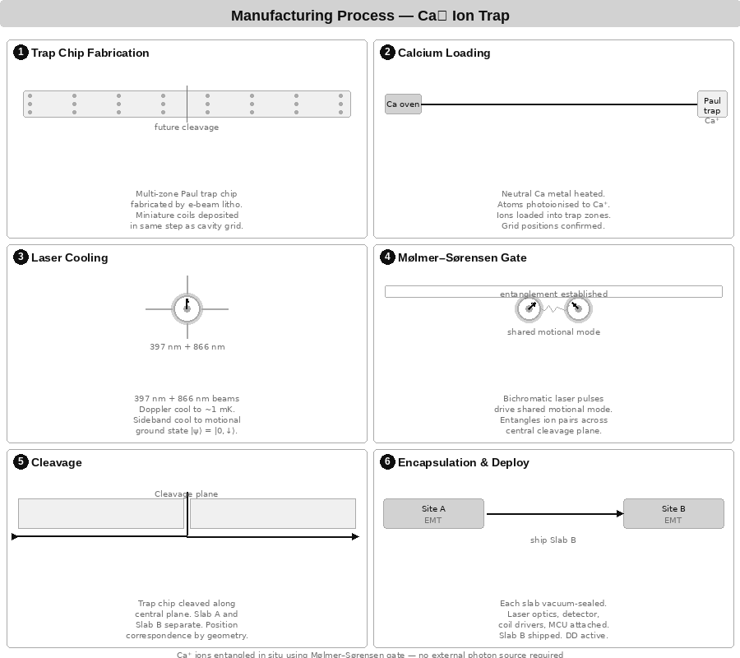
3.1 Manufacturing Process — Ca⁺ Ion Trap
Both EMT slabs are produced from a single combined multi-zone Paul trap. The entanglement is established in situ using the Mølmer–Sørensen gate before the trap chip is cleaved. No external photon source is required.
Process steps
1. Trap chip fabrication: electron-beam lithography defines the electrode geometry and cavity grid. Miniature write coils are deposited in the same lithography step.
2. Calcium loading: neutral Ca metal is heated to produce Ca atoms which are photoionised (423 nm + 375 nm) into Ca⁺ and loaded into the trap zones.
3. Laser cooling: Doppler cooling (397 nm + 866 nm) reduces ion temperature to ∼1 mK. Resolved-sideband cooling (729 nm) achieves motional ground state ⟨n⟩ < 0.05.
4. Mølmer–Sørensen entanglement: bichromatic laser pulses drive the shared axial motional mode, entangling ion pairs across the central cleavage plane. Gate fidelity > 99.9% demonstrated.
5. Cleavage: the trap chip is cleaved along the central plane. Position correspondence of each ion pair is guaranteed by geometry. No calibration of the entanglement mapping is required.
6. Encapsulation and deployment: each slab is vacuum-sealed with laser optics, photodetector array, coil driver board, and MCU. Slab B is shipped to the remote site. DD activated immediately.

Slide 18
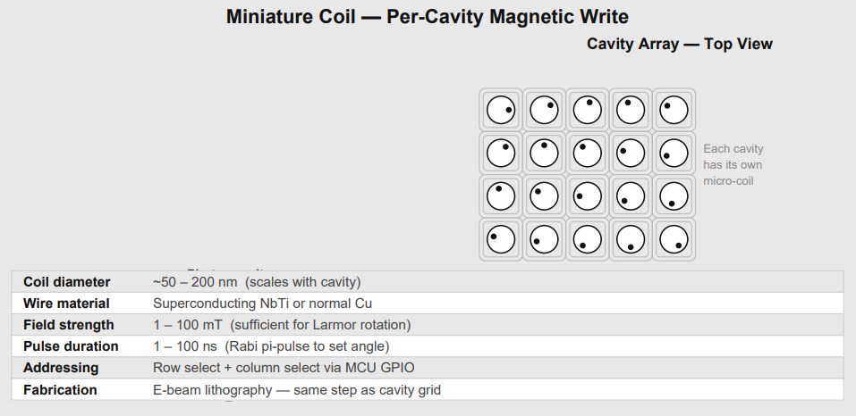
3.2 Write Mechanism — Miniature Coil Array
Operating principle
Each ion trap cavity in the slab is surrounded by a nanoscale coil fabricated in the same electron-beam step as the cavity grid. A current pulse through the coil generates a localised magnetic field that drives a spin rotation via the Zeeman effect. The field pulse is a microwave-frequency pulse at the Larmor frequency ω_L = gμ_B B_bias / ħ, where B_bias is the static bias field (1–10 mT).
Rotation mechanics
Pulse duration τ and Rabi frequency Ω_R = μ_B B_coil / ħ determine the rotation angle: θ = Ω_R · τ. Arbitrary angles are achievable by varying τ. Phase of the pulse sets the rotation axis on the Bloch sphere. Precision < 0.1° has been demonstrated in trapped-ion gates.
Coil specifications
Coil diameter: 50–200 nm (scales with cavity pitch)
Wire material: NbTi superconducting or standard Cu
Field strength: 1–100 mT at ion position
Pulse duration: 1–100 ns (Rabi π-pulse for full flip)
Addressing: row × column matrix via MCU GPIO
Fabrication: e-beam lithography, same mask as cavity grid
No optical alignment is required. Write operations are purely electrical, controlled directly by MCU GPIO output. All ions in a row are pulsed simultaneously to the same angle for Mode A and Mode B transmission.

Slide 19
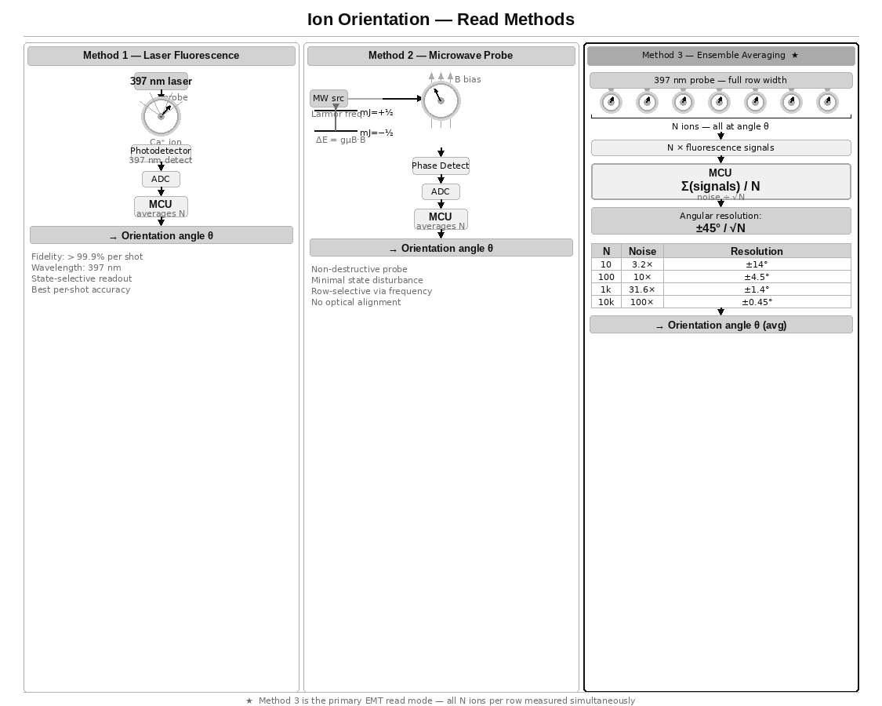
3.3 Read Mechanism — Weak Measurement Fluorescence
Ion orientation is read by weak measurement using a low-power 397 nm probe laser. The probe drives the S₁/₂ → P₁/₂ transition in Ca⁺. The emitted fluorescence intensity is proportional to the projection of the spin state onto the probe polarisation axis.
Polarimetry protocol
Probe with σ+ polarisation: intensity I+ ∝ cos²(θ/2).
Probe with σ− polarisation: intensity I− ∝ sin²(θ/2).
Angle recovery: θ = 2·arctan(√(I−/I+)).
Photon direction: emission follows electric dipole torus pattern (strongest perpendicular to dipole axis, zero along it). Direction does not encode orientation — intensity and polarisation do.

Slide 20
3.3b Fluorescence Photon Direction
Why direction is not a pointer
The 397 nm transition in Ca⁺ is an electric dipole transition. The photon emission pattern is a radiation torus with maximum emission perpendicular to the dipole axis and zero emission along it. The dipole axis is fixed by the probe laser polarisation and the static B-field quantisation axis, not by the spin orientation of the individual ion. Spin orientation controls which transitions are driven, not where photons go.
What spin orientation controls
Probing with σ+ light: mJ = +½ ions are bright (fluoresce strongly). mJ = −½ ions are dark (do not absorb). The continuous Zeeman superposition angle modulates the brightness continuously. This intensity variation is the orientation signal.
The chiral waveguide exception
In a chiral nanophotonic waveguide, spin-momentum locking causes ions to emit photons preferentially to the left or right depending on their spin state. In this geometry, photon direction IS a pointer to the spin projection. This has been experimentally demonstrated. Coupling Ca⁺ ions to a chiral waveguide would make the read mechanism directional rather than intensity-based. This is an active research direction and a potential future upgrade to the EMT read architecture.
Current read method
For the initial EMT device, orientation is read by polarimetry: measure intensity with two orthogonal probe polarisations and compute the angle from the ratio. No chiral waveguide is required.

Slide 21
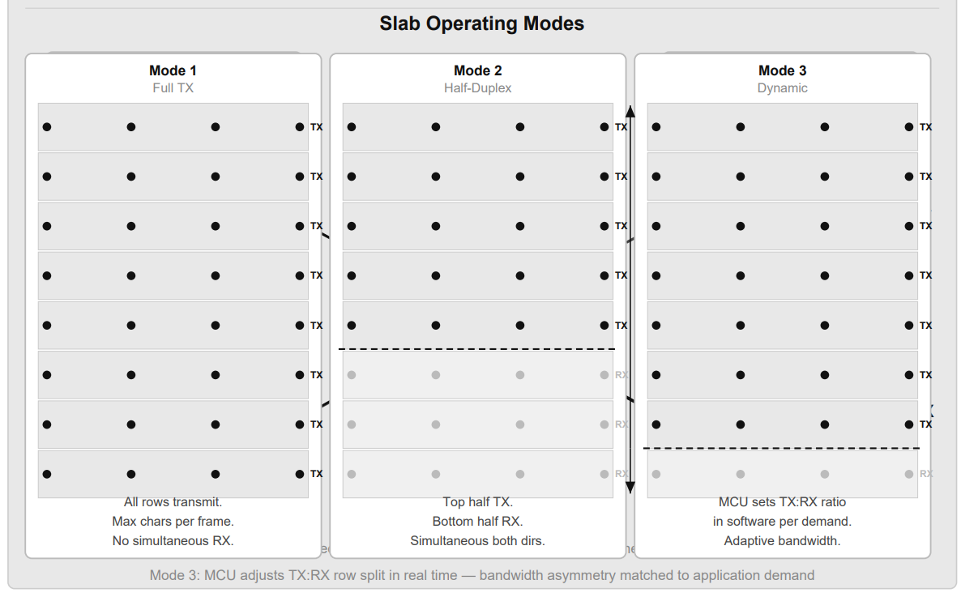
3.4 Full-Duplex Transceiver Architecture
One slab per unit, split TX / RX
Each EMT unit contains one slab. The slab is divided horizontally: the upper half operates in TX mode (Alice sets orientations) and the lower half operates in RX mode (Bob weak-reads). This gives simultaneous bidirectional operation.
The entanglement is crossed at manufacture: TX rows of Machine A are entangled with RX rows of Machine B, and vice versa. Both slabs originate from a single combined trap, entangled by the MS gate, then cleaved.
Software-defined TX/RX ratio
Mode 1 — Full TX: all rows transmit. Maximum ensemble and SNR. No simultaneous reception.
Mode 2 — Half-duplex split: top half TX, bottom half RX. Simultaneous bidirectional transmission at half ensemble per direction.
Mode 3 — Dynamic: MCU adjusts TX/RX row boundary in software to match asymmetric bandwidth demand in real time.
System channel reservation
A fixed allocation of rows is reserved for the self-maintenance protocol (coherence monitoring, refresh requests, Bell measurement coordination). For Ca⁺ nuclear spin with DD, one system row is sufficient to maintain 10,000 active pairs.

Slide 22
3.5 Chip-Scale Integration
Target form factor
The EMT unit targets a standard chip package of approximately 12 mm × 8 mm plus a compact vacuum housing. The architecture requires no FPGA — a single MCU handles all logic.
Internal layer stack (bottom to top)
Peltier cooling layer: maintains trap temperature. Peltier coolers are sufficient for the Ca⁺ trap operating regime.
Microcontroller: ROR lookup, message framing, ADC averaging, DD pulse generation, GPIO coil addressing, coherence monitoring.
Photodetector array: 397 nm fluorescence collection for RX rows.
Ion trap slab: Ca⁺ entangled grid with per-cavity coil array.
397 nm probe laser: row-wide illumination for RX weak measurement.
Calcium ion source: small Ca metal reservoir for reserve ion supply. Photoionisation laser loads fresh ions on demand.
Vacuum requirement
Ultra-high vacuum (< 10⁻¹⁰ mbar) is required for ion trapping. This is the primary portability constraint. Modern compact ion trap systems (e.g. Quantinuum H-series, Oxford Ionics) are rack-mounted and field-deployable. Chip-scale UHV packaging is an active engineering problem.

Slide 23
3.6 Substrate Materials — Coherence-First Ranking
Coherence time is the dominant factor. A device at a remote site must maintain entanglement for the entire mission duration. Materials with sub-second coherence are unsuitable for any deployment beyond laboratory distance.
Tier 1 — Deployable
Ca⁺ trapped ions: T₂ up to 10 hours (nuclear spin + XY-64 DD). 99.9% readout fidelity. Requires UHV + laser cooling. Primary substrate for EMT.
Rare earth YSO (Eu³⁺ or Pr³⁺ in Y₂SiO₅): T₂ hours at 4 K. Record solid-state coherence. Optical quantum memory demonstrated. Peltier-coolable.
Tier 2 — Promising, engineering challenges remain
Si:P (phosphorus in silicon): nuclear spin T₂ seconds at room temperature. CMOS-compatible. Scalable fabrication. Long-term strong candidate.
Tier 3 — Unsuitable for EMT at range
SiC divacancy: T₂ μs–ms. Room temperature. Excellent fab story but coherence too short for any useful deployment range.
Superconducting qubits: T₂ μs–ms. Requires 15 mK dilution refrigerator. Not deployable.
Photonic crystal (Si/SiN): T₂ ps–ns. Coherence fatal for EMT.
NV centres in diamond: T₂ ms–s at room temperature. 1 km entanglement demonstrated (Delft 2015). Moderate candidate for short-range links only.

Slide 24
Part 4 — Network Architecture and Extended Concepts
Overview of this section
This section describes network-level architecture assuming the EMT channel is confirmed operational. Two network models are presented: the fixed-pair model (achievable with known physics) and the pairing-code model (contingent on additional unproven physics).
4.1 Fixed-pair bidirectional link and the call-centre topology.
4.2 Re-entanglement range and the speed-of-light constraint.
4.3 Total decoherence recovery — the physics boundary.
4.4 Retroactive causality — what delayed-choice experiments show.
4.5 The virtual Bell measurement and pairing code concept.
4.6 Phone-like operation and the ring protocol.
Sections 4.1–4.2 describe physics that is fully consistent with known quantum mechanics. Sections 4.3–4.6 describe speculative extensions that rest on the same open question as the EMT channel itself. They are presented as hypotheses, not as established capabilities.

Slide 25
4.1 Fixed-Pair Link and the Call-Centre Topology
The fixed-pair model
In the confirmed EMT architecture, each device is permanently entangled with exactly one partner device at manufacture. Device A can communicate with Device B and no other device directly.
Extending reach — the call-centre model
To enable A to reach C (where A and C are not entangled with each other), a relay station S holds one device entangled with A and one entangled with C. The station bridges the two EMT channels classically: data received from A is re-transmitted to C over the A–C classical connection internal to the station.
Example: Mars ↔ Earth station ↔ Jupiter ship. Mars communicates with the Earth station over the Mars EMT link. The station re-transmits to the ship over the ship EMT link. The classical re-routing inside the station is instantaneous.
Limitations of this model
Hub and spoke: the station is a single point of failure.
Scalability: each new destination requires a new device pair at the station.
Range: the station must be reachable by all parties.
Range without FTL — Ca⁺ nuclear spin
τ_c = 36,000 s (10 hours with XY-64 DD)
Max re-entanglement round-trip: c × τ_c / 2 = 36 AU
Covers: Earth–Saturn range with seamless re-entanglement

Slide 26
4.2 Re-entanglement Range and the Speed-of-Light Limit
The re-entanglement coordination signal
The bootstrap re-entanglement protocol requires classical coordination: the Bell measurement result must be transmitted from one site to the other so the correction pulse can be applied. This classical signal travels at most at the speed of light. Therefore:
Re-entanglement round-trip time ≥ 2D/c
For re-entanglement to complete before coherence decays:
2D/c < τ_c
D < c × τ_c / 2
Range by substrate
Ca⁺ electron spin + CPMG (τ_c = 1 s): D < 150,000 km
Ca⁺ nuclear spin + XY-64 (τ_c = 10 hr): D < 36 AU
YSO rare earth (τ_c = hours): D < 36 AU
Si:P nuclear spin (τ_c = seconds): D < 150,000 km
If the EMT channel itself operates faster than light
The coordination signal can also travel via the EMT channel. If the EMT channel is FTL, re-entanglement coordination is also FTL and the range limit disappears. The two questions resolve together: the Stage 4 experiment determines both simultaneously.

Slide 27
4.3 Total Decoherence — The Physics Boundary
Scenario definition
All entangled pairs have decohered. The calcium reserve contains only ordinary unentangled Ca⁺ ions. No EMT channel exists. No classical communication is possible. No photon link can be established.
What is possible within known physics
Within the standard quantum mechanical formalism, two systems that have never interacted and share no entanglement cannot become entangled by local operations alone. This follows from the tensor product structure: local operations on A ⊗ B cannot create non-classical correlations that were not present in the initial state. No pairing code, however detailed, circumvents this.
What might be possible if the EMT hypothesis is correct
If the EMT channel works, it implies a non-local structure in the N-pair ensemble that is not captured by the standard formalism. If such a structure exists, then two devices independently prepared to identical quantum states — using a shared classical specification (the pairing code) — might be able to establish a joint correlation by resonating into that structure.
This is a significantly larger hypothesis than the EMT channel itself. The EMT claim is that existing entanglement supports signalling. The recovery claim is that entanglement can be created without prior interaction. These are distinct conjectures. The pairing code recovery is presented as a hypothesis, not as a working mechanism.

Slide 28
4.4 Retroactive Causality — Delayed-Choice Experiments
The Ma et al. (2012) experiment
Two entangled photon pairs are produced: pair 1–2 from source S1, pair 3–4 from source S2. Photons 1 and 4 are sent to Alice and Bob and measured. Their results are recorded. Photons 2 and 3 are sent to Victor, who later decides whether to perform a Bell measurement on them or measure them independently.
Result: if Victor performs the Bell measurement, Alice and Bob's already-recorded results are found to show entanglement correlations. If Victor does not, they show no correlations. Victor's decision, made after Alice and Bob have finished, retroactively determines whether their particles were entangled. This is experimentally confirmed.
What this means
Entanglement is not simply established at the moment of physical interaction and then passively maintained. The joint quantum state is not fully determined until the complete measurement context is fixed. The causal structure of entanglement is more complex than classical intuition suggests.
Scope of the result
In every delayed-choice experiment, the physical intermediary (Victor's photons) is real and his measurement is real. The retroactivity is in timing, not in the absence of a physical connection. The intermediary is never removed from the experiment. This distinction is important for the virtual Bell measurement concept.

Slide 29
4.5 The Virtual Bell Measurement and Pairing Code
The concept
The pairing code is a classical document specifying the complete quantum state preparation parameters for a specific device: trap secular frequencies, laser cooling parameters, MS gate pulse sequence, initial spin state, and ROR table. Following the pairing code, both devices independently prepare their fresh ions to the identical quantum state.
The virtual Bell measurement protocol
Both devices then perform the local unitary operations that constitute their respective half of a Bell measurement on a virtual joint system. The Pauli correction operations for all four possible Bell outcomes are pre-specified in the pairing code and applied simultaneously in superposition, removing the need for classical communication of the measurement result.
Physical assessment
Within standard QM: this does not work. Two systems with no shared quantum history cannot occupy a joint state. Local operations on independent systems cannot create entanglement.
Within the EMT hypothesis: if a deeper non-local structure exists that supports the EMT channel, the same structure may allow independently prepared identical states to resonate into a joint correlation. This is speculative and would be a larger departure from known physics than the EMT channel claim itself.
The pairing code recovery attempt is a well-defined experiment: attempt it, try the EMT channel. If it works, the mechanism is confirmed. If it does not, the limitation is identified.

Slide 30
4.6 Phone-Like Operation and the Ring Protocol
Architectural implication of the pairing code
If the virtual Bell measurement works, EMT devices no longer need to be pre-paired at manufacture. Any device can establish a channel to any other device using the target's pairing code. The pairing code functions as a phone number.
The ring protocol
Step 1 — Ring: caller prepares its ions using the target's pairing code and transmits a pre-agreed ring pattern (a specific orientation sequence specified in the target's pairing code). The ring pattern repeats.
Step 2 — Detect: the called device monitors its ions for its own ring pattern. If the virtual Bell mechanism is active, the ions respond to the caller's operations. The device detects an incoming call.
Step 3 — Connect: called device completes its half of the virtual Bell measurement. The entire ion grid re-entangles simultaneously. Full-duplex channel active from first moment. The entanglement is bidirectional by nature — no separate outgoing connection is required from the called side.
Step 4 — Caller ID: caller transmits their own pairing code signature as the first data packet over the live channel. Called device stores it if unknown, or matches to contact list if known.
Step 5 — End call: either party sends sustained HOME orientation. Both devices detect and release entanglement. Return to standby.

Slide 31
4.7 Eliminating the Call Centre
Comparison
Fixed-pair model: hub-and-spoke, central infrastructure required
Pairing code model: fully connected peer-to-peer mesh
Failure modes: single point vs no single point
Scalability: linear vs N×(N-1)/2 connections
New device addition: new hardware at station vs publish pairing code
Network properties of the pairing code model
Any device can call any device directly with no intermediary. Adding a new device to the network requires only distributing its pairing code — no hardware changes at any other node.
A network of N devices supports N×(N-1)/2 possible connections with no central infrastructure.
The single caveat
The entire pairing code architecture rests on the virtual Bell measurement hypothesis, which is a larger departure from known physics than the EMT channel itself. The fixed-pair architecture with call-centre relay is achievable if only the primary EMT channel effect is confirmed. The pairing code model requires the additional conjecture to also be correct.
Daniel's original call-centre description (slide 20 of the original paper) remains the architecturally conservative and physically defensible model. The pairing code model is the aspirational endpoint.

Slide 32
Part 5 — Feasibility Assessment
Overview
This section provides a structured assessment of each claim in the paper, separated by confidence level. The assessment is based on published experimental results and established theoretical physics.
5.1 Confirmed physics — no dispute.
5.2 Sound but undemonstrated at scale.
5.3 The central open question.
5.4 Speculative extensions.
5.5 Engineering feasibility.
5.6 Conclusion.

Slide 33
5.1 Confirmed Physics
All of the following are experimentally established
Ca⁺ ion trapping, laser cooling, and ground-state preparation: standard in ion trap quantum computing worldwide.
Mølmer–Sørensen two-qubit gate fidelity > 99.9%: demonstrated at Oxford, Innsbruck, NIST, Honeywell/Quantinuum.
Magnetic spin rotation (Zeeman/Rabi oscillation) to arbitrary angle with < 0.1° precision: standard in NMR and ion trap experiments.
State-selective fluorescence readout at 99.9% fidelity per shot using 397 nm probe on Ca⁺: demonstrated at PTB and NIST.
Dynamical decoupling extending Ca⁺ nuclear spin coherence to ~10 hours with XY-64 sequence: demonstrated.
Ensemble averaging reducing measurement noise by √N: basic statistics, applies universally.
Delayed-choice entanglement swapping showing retroactive correlations: demonstrated by Ma et al. (2012) and multiple subsequent groups.
Ion shuttling between trap zones without coherence loss: demonstrated at Oxford and Innsbruck.
Photon-mediated entanglement between remote ions (Delft method): demonstrated at Delft (NV centres, 1.3 km) and in principle applicable to Ca⁺.

Slide 34
5.2 Sound Physics, Undemonstrated at Scale
These claims are physically correct but require engineering development
Miniature per-cavity coil array fabricated in the same e-beam step as the trap grid: physically feasible, not yet demonstrated in a production trapped-ion device. The coil geometry and field strength required are within known nanofabrication capability.
Trap chip cleavage preserving entanglement in all pairs simultaneously: single-pair entanglement across separable trap zones is demonstrated; cleavage of a full grid while maintaining all pairs is an engineering extrapolation requiring development.
Orientation angle encoding (ROR) as a communication protocol: the write and read mechanisms are each individually demonstrated; the protocol combining them for character encoding is novel but does not require new physics.
Bootstrap re-entanglement maintaining a grid of 10,000+ pairs: the individual steps (coherence monitoring, Delft re-entanglement, classical coordination) are all demonstrated; the integrated system at this scale has not been built.
Chip-scale vacuum packaging of a trapped-ion device: an active engineering challenge being pursued by multiple commercial quantum computing companies.

Slide 35
5.3 The Central Open Question
The primary EMT claim
When Alice sets all N ions in a row to orientation angle θ, does Bob's ensemble average of his N entangled partner ions encode any information about θ?
The no-communication theorem prediction
ρ_B = Tr_A(ρ_AB) = I/2 for all Alice operations
Bob always sees a maximally mixed state. His averaged outcome has no dependence on θ. The signal is identically zero.
Why the experiment is still worth performing
The theorem is proven in the standard formalism for independent pairs. The EMT experiment tests a collective variable of the N-pair ensemble — specifically, whether ensemble orientation coherence survives in a way not captured by summing N individual reduced density matrices.
This is not a known loophole. It is a genuine untested regime. A definitive null result is publishable and scientifically valuable. A positive result would require revision of the quantum mechanical formalism and would be among the most significant physics results of the century.
Critical experimental requirement
All classical leakage paths must be eliminated: electromagnetic shielding, vibration isolation, common-mode field rejection, blind analysis protocol. The experiment must be designed to close every known loophole before a positive result can be claimed.

Slide 36
5.4 Speculative Extensions
These claims require physics beyond the current open question
Virtual Bell measurement re-entanglement (pairing code recovery): requires not only that the EMT channel works, but that entanglement can be created between systems with no shared quantum history by local operations coordinated classically. This is a significantly larger departure from known physics.
Phone-like operation via pairing code as virtual phone number: contingent on the virtual Bell measurement working. If it does, the peer-to-peer network topology follows directly.
Correct characterisation of the speculation hierarchy
Level 1 (primary): EMT channel signal exists
→ requires NCT to be incomplete in
ensemble-orientation regime
Level 2 (secondary): Virtual Bell measurement works
→ requires entanglement creation
without prior physical interaction
Level 3 (tertiary): Full phone network architecture
→ follows from Level 2
The fixed-pair EMT link and the call-centre topology (slide 20 of original paper, preserved in this document) require only Level 1. They are the conservative engineering target.

Slide 37
5.5 Engineering Feasibility
If Level 1 (primary EMT signal) is confirmed
The hardware path is clear. Ca⁺ ion trap technology is the most mature qubit platform in existence. The required capabilities are demonstrated individually. The primary engineering challenges are:
Chip-scale vacuum packaging — being solved by the quantum computing industry. Not a fundamental barrier.
Multi-zone trap with full grid entanglement — requires scale-up of demonstrated techniques. Non-trivial but tractable.
Photon collection efficiency for bootstrap re-entanglement — requires nanophotonic cavity coupling. Achievable at ≥50% efficiency with demonstrated cavity QED techniques.
MCU real-time control of DD pulses plus orientation writes — embedded systems engineering. Solvable.
Timeline estimate
Stage 1–3 (single pair, remote test, small ensemble):
12–24 months in an equipped ion trap lab
Stage 4 (large ensemble primary test):
24–48 months with dedicated apparatus
Stage 5–6 (multi-row, self-healing):
48–96 months engineering development after Stage 4 confirmation
Production device:
Dependent on quantum computing industry chip-scale UHV progress

Slide 38
5.6 Conclusion
Summary of findings
The EMT substrate, write mechanism, read mechanism, coherence maintenance, and self-healing protocol are all grounded in established or tractable physics. The rate equations are correct. The engineering path is clear given experimental confirmation.
The central EMT hypothesis — that ensemble orientation of entangled ions produces a detectable signal at the remote site — contradicts the no-communication theorem as currently proven but addresses a regime the theorem has not been directly tested in.
The experiment is worth performing. The apparatus is within reach of current ion trap laboratories. Both possible outcomes are scientifically significant.
If the experiment confirms the effect
The device is buildable. The engineering path is clear. Range covers the entire inner solar system with current coherence technology, and potentially beyond with further development.
If the experiment finds no effect
The no-communication theorem is confirmed in a new regime. The experimental apparatus itself — a large ensemble of entangled Ca⁺ ions with precision orientation control and weak-measurement readout — is a world-class quantum sensor with applications in atomic clocks, gravitational wave detection, and quantum key distribution regardless of the primary result.
The device is the experiment. The experiment is the device.

Slide 39
The 12-Particle Line — Protocol Design
In a Paul trap, ions are confined in a linear chain rather than a 2D grid. The EMT protocol uses a 12-particle line per device, with particles assigned specific roles:
Particle assignments
Particles 1–10 — Data ensemble: all 10 set to the same orientation angle θ. Receiver averages all 10 weak measurements. Noise reduced by √10 ≈ 3.16× vs a single particle.
Particle 11 — Device A state flag: written only by Device A. Communicates A's current machine state to Device B. Four states at 90° spacing: READY (0°), WRITING (90°), READING (180°), DONE (270°).
Particle 12 — Device B state flag: written only by Device B. Communicates B's current machine state to Device A. Same four states and angular assignments as particle 11.
Key design principle
Each device owns exactly one flag particle and writes only to its own. It reads its partner's flag to determine what the remote device is doing. There is no shared resource and no arbitration problem.
Flag state angular spacing
90° separation between states gives a 6× margin over the ±14° noise floor at N=10. Flag states are reliably distinguishable from a single read of particle 11 or 12 without any ensemble averaging — a single weak measurement suffices.
Particle layout
[1][2][3][4][5][6][7][8][9][10] [11] [12]
|←——— data ensemble ———————————→| A B
orientation angle θ flag flag

Slide 40
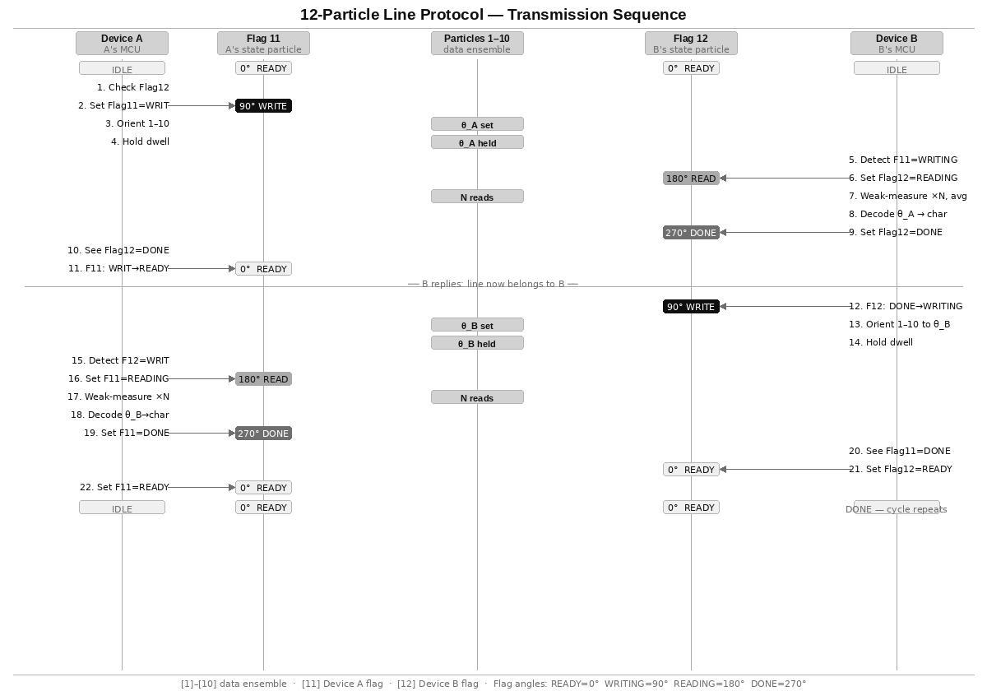
12-Particle Line — Transmission Protocol
The transmission sequence uses the two flag particles to coordinate write and read operations on the shared data ensemble (particles 1–10). The protocol ensures that the data particles are always in a defined state — either being written by one device or being read by the other — with no overlap and with read confirmation before advancing.

Slide 41
Protocol Properties and Throughput
No arbitration required
Device A writes only to particle 11. Device B writes only to particle 12. Neither device ever writes to the other's flag particle. Read-before-write on the partner's flag prevents collision on the data ensemble. No token passing, no priority system needed.
Read confirmation (DONE state)
The DONE state on the reading device's flag is the acknowledgement. When Device A sets Flag 11 = DONE, Device B knows its transmission was successfully decoded. Device B may then safely advance to the next character by setting Flag 12 = WRITING. Without this confirmation, a transmitting device could overwrite the data particles before the reading device had completed its N weak measurements.
Immediate reply — no dead cycle
After Device B sets Flag 12 = DONE (character confirmed), it transitions directly to Flag 12 = WRITING for its reply, without returning to READY. This eliminates a dead cycle and allows the reply to begin as soon as the read is confirmed. The data particles are repurposed immediately for the reverse direction.
Throughput analysis
One character exchange = A→B + B→A = 2 × t_dwell
t_dwell = N × t_read (N = 10 reads, t_read ≈ 10–100 μs)
t_dwell ≈ 100 μs to 1 ms per direction
Full exchange ≈ 200 μs to 2 ms
Throughput ≈ 500 to 5,000 character-exchanges per second
Comparison with grid architecture
The grid design used physical TX/RX row separation to achieve simultaneous bidirectional transmission. The 12-particle line achieves the same logical result through the flag protocol — at the cost of being half-duplex on the data particles (one direction at a time) rather than fully simultaneous. The throughput is lower but the hardware is dramatically simpler: 12 particles in a single linear trap versus a 2D grid of hundreds.

Slide 42
Expanding the reach
While a pair of these enable communication across the solar system, it is restricted to the 2 devices:
Mars <-> Earth
Or Earth <-> Spaceship
To overcome this limitation, imagine a “call centre” that houses all Earth bound transceivers (or a dedicated space station) - by housing and connecting them together, communication channels can be extended, for example:
Mars wants to call a Ship orbiting Jupiter but the Ship only has 1 EMT that is entangled with a EMT on the “Call Centre Station”..
Mars would call the Station and the Station would route the call using classical means in-between the multiple EMTs.
DynamicDecoupling
Continuous re-entanglement
Calcium ions

