Slide 1
Entangled Multiplexing Transceiver
EMT
A proposed architecture for non-classical signalling via entangled Ca⁺ ion pairs, orientation encoding, and ensemble weak measurement in a linear ion trap.
Daniel Miles · 2026 · Original Concept Paper · Rev.2 https://alternitech.square.site

Slide 2
The EMT Hypothesis
In plain terms: the EMT proposes that pointing a set of entangled ions in a specific direction causes the partner ions at the other location to show a detectable signal. Standard physics says this is impossible. The EMT tests whether that prediction holds in one specific untested situation.
The hypothesis, stated precisely
When all 10 data ions in Device A are prepared simultaneously in orientation state θ, the ensemble average of weak measurements on the 10 partner ions at Device B produces a statistically detectable signal encoding θ.
This would constitute information transfer via quantum correlations — forbidden by the no-communication theorem for individual pairs, but untested for a large ensemble of identically-oriented pairs sharing a global phase reference established at manufacture.
Why the standard proof may be incomplete here
The NCT sums N individual pair density matrices: each gives ρ_B = I/2. The EMT hypothesis is that this summation misses a collective variable of the N-pair ensemble — a coherent orientation of the global state not visible in any individual pair but detectable in the average.
The three layers
Layer 1 (testable now): Ensemble orientation signal exists
Layer 2 (if L1 confirmed): Bootstrap re-entanglement via EMT
Layer 3 (if L2 confirmed): Virtual Bell / pairing code calls
This paper describes all three layers but clearly distinguishes them. Layer 1 is an experiment. Layers 2 and 3 are consequences.

Slide 3
Part 1 — Theoretical Foundation
What this section covers: the physics that underpins the EMT concept before any hardware is discussed.
1.1 The no-communication theorem — what it says and where it has been tested.
1.2 Quantum entanglement — what it is physically and what it is not.
1.3 Weak measurement — how to extract partial information without destroying a quantum state.
1.4 Ensemble averaging — how reading many particles reduces noise.
1.5 The central experimental question — the specific untested regime.
1.6 Orientation encoding — the Rotary Orientation Ring.
All claims in this section are grounded in published results. The central question in 1.5 is explicitly unresolved.

Slide 4
1.1 The No-Communication Theorem
In plain terms: quantum entanglement cannot be used to send a message under the rules of standard quantum mechanics. This paper asks whether those rules are complete.
Formal statement
For any bipartite quantum state ρ_AB shared between Alice and Bob, Alice's local operations produce no detectable change in Bob's reduced density matrix. Formally:
Tr_A[(Λ_A ⊗ I_B)(ρ_AB)] = Tr_A[ρ_AB] = ρ_B
This holds for all local operations — unitary rotations, measurements, state preparation, and any classical post-processing. It follows from the linearity of quantum mechanics and the tensor product structure of composite systems.
What it does and does not say
It says: Bob's measurement statistics are unchanged regardless of what Alice does to her half of the entangled pair. No information is transferred.
It does not say: the theorem has been tested in the regime of large ensembles of ion pairs (N ≫ 1) with continuous-variable orientation encoding and a shared global phase reference. This untested regime is where the EMT experiment operates.
Scope of existing experimental tests
Bell test experiments (Aspect 1982, Hensen 2015, Rosenfeld 2017) confirm entanglement and rule out local hidden variables. None tests ensemble orientation signalling. The EMT experiment is genuinely novel.

Slide 5
1.2 Quantum Entanglement — The Joint State
In plain terms: two entangled particles share a single quantum state between them. Measuring one instantly tells you something about the other, no matter how far apart they are — but standard physics says you cannot use this to send a message.
What entanglement is
Two particles are entangled when their joint state cannot be written as a product of individual states. For a maximally entangled Bell state:
|Φ⁺⟩ = (1/√2)(|↑⟩_A|↑⟩_B + |↓⟩_A|↓⟩_B)
Neither ion A nor ion B has a definite spin individually. The state is a property of the pair. Measuring A instantly determines the correlated outcome of B, regardless of separation.
What entanglement is not
Entanglement is not a signal channel in standard QM. When Alice orients her ion to angle θ, she is performing a local operation. Bob's marginal statistics — what he sees averaging his own measurements — are unchanged. This is the content of the no-communication theorem.
The Zeeman sublevel encoding in Ca⁺
In a Paul trap with static bias field B (1–10 mT), the S₁/₂ ground state splits into Zeeman sublevels m_J = ±½ with separation ΔE = gμ_B·B. An arbitrary superposition |ψ⟩ = α|↑⟩ + β|↓⟩ represents a spin orientation angle θ = 2·arctan(|β|/|α|) on the Bloch sphere. This continuous angle is what the EMT encodes as a character.

Slide 6
1.3 Weak Measurement Theory
In plain terms: instead of making one definitive measurement that destroys the quantum state, we nudge the particle very gently many times. Each nudge gives a tiny amount of information. Adding them up recovers the answer with less disturbance.
Definition
A weak measurement couples a system to a meter with interaction strength g ≪ 1. Each read disturbs the state by order g. The expectation value of observable A is recovered by averaging N reads:
⟨A⟩ = lim_{N→∞} (1/N) Σᵢ aᵢ
For finite N, the estimator has uncertainty σ/√N where σ is the single-shot uncertainty.
Application to Ca⁺ spin orientation
Probing with σ+ polarised 397 nm light gives intensity I ∝ cos²(θ/2). Probing with σ− gives I ∝ sin²(θ/2). The ratio recovers θ to precision limited by photon shot noise. Readout fidelity > 99.9% per shot is demonstrated for Ca⁺ at PTB and NIST.
State disturbance per weak read
Each fluorescence event has probability p of flipping the spin. For off-resonance probing, p ≪ 1. Over N reads, coherence decays as e^⁻^ᴽ^^ᵖ. For N=1000 reads and p=10⁻³, loss is e⁻¹ ≈37%. This trade-off — more reads give better SNR but greater state disturbance — sets the practical operating point.

Slide 7
1.4 Ensemble Averaging — Noise Reduction by √N
In plain terms: if 10 people each estimate the same distance and you average their guesses, the error in your average is about 3 times smaller than any single guess. The same principle applies to ion measurements. With 10 ions all pointing the same direction, the error drops by √10 ≈3.
Statistical basis
If N independent estimates x_i each have mean μ and standard deviation σ, the sample mean has standard deviation σ/√N. This is the central limit theorem. It applies universally.
Application to EMT — 10 data ions per device
Each of the 10 data ions (particles 1–10) is prepared in the same orientation state θ. Each is independently weak-measured. The MCU averages the 10 results:
σ_θ = σ_single / √N = ±45° / √10 = ±14.2°
For a 10° character spacing, the ±14.2° noise floor is marginal. Reducing the spacing to 5° or increasing to 100 ions per device would improve reliability. The 10-ion design is a starting point; the optimal ensemble size is an experimental parameter.
Resolution at different ensemble sizes
N = 10 σ_θ = ±14.2° (marginal at 10° spacing)
N = 100 σ_θ = ±4.5° (reliable at 10° spacing)
N = 1,000 σ_θ = ±1.4° (reliable at 5° spacing)
N = 10,000 σ_θ = ±0.45° (full character set)
The 12-particle design (N=10 data ions) is the minimum viable configuration. A longer linear trap or a 2D crystal would improve SNR at the cost of increased engineering complexity.

Slide 8
1.5 The Central Experimental Question
In plain terms: standard quantum physics predicts that Bob will see random noise no matter what Alice does to her ions. This paper asks: has that prediction actually been tested with a large group of ions all pointing the same direction? The answer is no. That is the experiment.
The standard prediction
When Alice sets all N ions to orientation θ, standard QM predicts that Bob's reduced density matrix is:
ρ_B = Tr_A(ρ_AB) = I/2 (maximally mixed, always)
Bob always sees 50/50 outcomes regardless of θ. Signal is identically zero.
The untested regime
The theorem is proven for arbitrary local operations on individual pairs. What has not been directly tested is whether a macroscopic ensemble of N entangled pairs, all prepared identically with a shared global phase reference, produces a collective response detectable by ensemble averaging. The EMT hypothesis is not that the theorem is wrong — it is that the theorem may be incomplete in this specific regime.
Guaranteed scientific value
Signal detected: requires revision of QM formalism. Historic result.
No signal: confirms the theorem in a previously untested regime. Publishable. Tightens bounds on any non-local hidden variable theories.
The apparatus itself — precision Ca⁺ orientation control with weak-measurement readout — is a world-class quantum sensor regardless of the primary result.

Slide 9
1.6 Orientation Encoding — The Rotary Orientation Ring
In plain terms: think of a clock face. Each hour position is a letter. The ion's spin points to a position on the clock face, and the other device reads which position it is pointing to. HOME (12 o'clock) means start or end of message.
Encoding principle
Each character maps to a unique orientation angle θ on a circular lookup table — the Rotary Orientation Ring (ROR). HOME at θ = 0° is permanently reserved as message delimiter. Device B's table is inverted (θ_B = 180° − θ_A) to account for the spin-anticorrelation of the entangled Bell state.
Single ring at 10° spacing: 35 characters + HOME
Dual ring at 10°/axis: 36 × 36 = 1,296 unique states

Slide 10
Part 2 — Experimental Pathway
What this section covers: the sequence of experiments needed to test the EMT idea, starting from something simple (one pair of ions) and building up to the full device.
Stage 1 — Single Ca⁺ pair: entanglement, orientation control, weak readout.
Stage 2 — Remote isolation test: physically separate the two ions and repeat the measurement to rule out classical coupling.
Stage 3 — Coherence maintenance: dynamical decoupling and bootstrap re-entanglement for long-duration operation.
Stages 1 and 2 are achievable with existing ion trap apparatus at Oxford, Innsbruck, NIST, and PTB. Stage 3 is engineering development contingent on Stage 2 confirmation.

Slide 11
2.1 Ca⁺ as the Experimental Substrate
In plain terms: calcium ions in a trap are the best-studied quantum system in the world for this kind of precision work. Everything the EMT needs has already been individually demonstrated in Ca⁺ ion trap experiments.
Why Ca⁺ is the correct choice
Coherence time: T₂* ∼ 1 ms (electron spin, no decoupling). T₂ ∼ 1 s with CPMG-8. Up to 10 hours with XY-64 DD on nuclear spin.
Write mechanism: microwave pulse at Larmor frequency ω_L = gμ_B B/ħ. Rabi oscillation gives arbitrary angle. Precision < 0.1° demonstrated.
Read mechanism: state-selective fluorescence at 397 nm. Readout fidelity > 99.9% per shot (PTB, NIST).
Entanglement: Mølmer–Sørensen gate via shared axial motional mode. Gate fidelity > 99.9% demonstrated. No external photon needed.
Ion shuttling: multi-zone trap chips move ions without coherence loss (Oxford, Innsbruck).
Linear ion trap — the EMT substrate
In a Paul trap, ions arrange themselves in a linear chain. The EMT uses a 12-ion chain: 10 data ions for orientation encoding and SNR averaging, plus 2 flag ions for protocol coordination (see Part 3 — Protocol Design). This is a natural fit for existing multi-zone ion trap hardware.
Trap and magnetic field compatibility
The Paul trap confines Ca⁺ via oscillating electric fields at 10–100 MHz. The static magnetic bias field (1–10 mT) operates at a completely different frequency and does not disturb the trap. This is standard practice in all ion trap experiments.

Slide 12
2.2 Stage 1 — Single Pair Entanglement and Readout
In plain terms: load two calcium ions into a trap, link them together with a quantum gate, point one ion at a specific angle, and check whether the other ion's measurements reflect that. This is the proof-of-concept for the entire EMT chain.
Objective
Demonstrate the complete write–transmit–read chain for a single entangled Ca⁺ pair: controlled orientation set on ion A, weak-measurement decode on ion B.
Protocol
1. Load two Ca⁺ ions into adjacent zones of a multi-zone Paul trap.
2. Laser cool to motional ground state: Doppler (397 nm) then sideband cooling (729 nm) to ⟨n⟩ < 0.05.
3. Apply Mølmer–Sørensen gate to create Bell state |Φ⁺⟩ = (1/√2)(|↑↑⟩ + |↓↓⟩). Verify by Bell inequality measurement.
4. Apply magnetic pulse to ion A to set orientation angle θ_A from the ROR table.
5. Weak-measure ion B with rotating probe polarisation. Average reads. Decode θ_B.
6. Verify: θ_B shows the entanglement-correlated value.
Expected result
Ion B will show the correlated orientation in its fluorescence intensity pattern. This confirms the write/read chain works. It does not yet test FTL signalling — both ions are in the same lab.

Slide 13
2.3 Stage 2 — Remote Isolation Test
In plain terms: repeat Stage 1 but move the two ions far apart — far enough that no conventional signal could travel between them during the measurement. This rules out the possibility that the result is caused by ordinary physics rather than entanglement.
Objective
Repeat Stage 1 with ions A and B separated by a distance sufficient to exclude all classical electromagnetic coupling between the two traps.
Separation and shielding requirements
Minimum useful separation: > 1 m to exclude RF field leakage from the trapping electrodes.
Optimal: > 10 m to exclude all conceivable classical coupling.
Both trap halves independently shielded with mu-metal magnetic shielding to exclude common-mode field noise.
Trap chips are produced as a single combined device, entangled using the MS gate at manufacture, then physically separated by cutting the vacuum connection between the two trap halves.
Experimental protocol
Alice (ion A side) runs pre-programmed orientation sequences. Bob (ion B side) records weak measurements with no knowledge of Alice's actions. Data compared only after both sequences complete — double-blind analysis.
Control conditions
Non-entangled pair in |+x⟩ state: should show no correlation.
Entangled pair, Alice holds fixed orientation: should show stable correlation.
Entangled pair, Alice varies orientation: the critical test.

Slide 14
2.4 Stage 3 — Coherence Maintenance and Self-Healing
In plain terms: quantum states don't last forever — they fade. This stage is about keeping the entanglement alive as long as possible using pulse sequences that fight the fading, and rebuilding it automatically when it does fade.
Dynamical decoupling
Entangled states decohere due to magnetic field noise, phonon coupling, and charge noise. Dynamical decoupling (DD) applies precisely timed refocusing pulses that cancel slow-frequency noise by reversing accumulated phase error before it destroys the entanglement.
Electron spin, no DD: T₂* ≈ 1 ms
Electron spin, CPMG-8: T₂ ≈ 1 s
Nuclear spin, XY-64: T₂ ≈ 10 hours (demonstrated)
Bootstrap re-entanglement protocol
When a pair's coherence drops below threshold, the two flag ions (particles 11 and 12) coordinate a refresh: both devices simultaneously emit entanglement photons from a reserve Ca⁺ ion. A Bell measurement is performed at one site. The result is sent via the flag protocol. Correction pulses applied. New pair loaded. DD activated immediately.
Stability condition
R_refresh > R_decoherence
1/t_refresh > N_pairs / τ_c
Ca⁺ nuclear spin (τ_c = 36,000 s): one flag ion channel
is sufficient to maintain 10 data pairs indefinitely.
The ion reserve is a store of ordinary unentangled Ca⁺ ions, replenished by photoionisation from a calcium metal source on-chip. No pre-entangled pairs required in the reserve.

Slide 15
Part 3 — System Architecture
What this section covers: how to build the actual device, assuming the experiment confirms the effect works. Every component described here uses existing or near-term technology.
3.1 Manufacturing — how both units are made from one trap.
3.2 Write mechanism — how to set ion orientation.
3.3 Read mechanism — how to measure ion orientation.
3.3b Fluorescence photon direction — an interesting side question.
3.4 12-particle line protocol — the flag-based handshake.
3.5 Chip-scale integration — the target form factor.
3.6 Substrate materials — what else could be used.
All hardware described here is an engineering extrapolation of demonstrated laboratory techniques.

Slide 16
3.1 Manufacturing Process
In plain terms: both EMT units are built separately. Entanglement is loaded in after manufacture, either by delivering a pair of seed ions to each unit, or — if retroactive causality works — not at all.
Method 1 — Seed ion delivery (confirmed physics)
Two Ca⁺ ions are entangled in a lab using the Mølmer–Sørensen gate. One ion is transported to Unit A, one to Unit B, each in a portable sealed UHV trap. These form the seed pair from which the full 12-ion chain is bootstrapped.
Transport coherence is maintained by DD pulses. Only one entangled pair needs to survive transit.
Method 2 — No pre-entanglement (speculative)
If the virtual Bell measurement protocol works, each unit is built with 12 ordinary unentangled Ca⁺ ions. Entanglement is established on demand via the pairing code. Contingent on Level 2 physics (section 5.4).
Per-unit build steps
1. Ion trap chip fabricated by e-beam lithography. Miniature write coils in the same step.
2. Glass or fused silica vacuum envelope sealed around chip. Getter pump inside. Optical windows for laser access.
3. Ca metal loaded; photoionised (423+375 nm) to Ca⁺. 12-ion chain formed.
4. Laser cooling: Doppler (397+866 nm) then sideband (729 nm) to motional ground state ⟨n⟩ < 0.05.
5. Seed ion installed and bootstrap entanglement built (Method 1), or pairing code loaded (Method 2). DD activated.

Slide 17
3.1 Manufacturing — Diagram
Schematic of Ca⁺ ion trap manufacturing steps. Both units are built independently; entanglement is established by seed ion delivery or bootstrap protocol after build.

Slide 18
3.2 Write Mechanism — Miniature Coil
In plain terms: each ion has a tiny wire coil around it, like a miniature electromagnet. A brief pulse of current rotates the ion's spin to whatever angle the MCU tells it to — the same way a compass needle swings when you move a magnet near it.
Operating principle
Each ion's trap zone is surrounded by a nanoscale coil fabricated in the same electron-beam lithography step as the electrode geometry. A current pulse through the coil generates a localised magnetic field. The field pulse drives a Rabi oscillation that rotates the spin state to any target angle with nanosecond precision.
Rotation mechanics
Rotation angle: θ = Ω_R · τ, where Ω_R = μ_B B_coil / ħ is the Rabi frequency and τ is the pulse duration. Pulse phase sets the rotation axis on the Bloch sphere. Arbitrary angles achievable with < 0.1° precision.
Coil specifications
Diameter: 50–200 nm (scales with ion spacing)
Wire material: NbTi superconducting or standard Cu
Field strength: 1–100 mT at ion position
Pulse duration: 1–100 ns (Rabi π-pulse for full flip)
Addressing: individual ion via MCU GPIO
Fabrication: e-beam litho, same mask as electrode geometry
No optical alignment required. Write operations are entirely electrical, controlled by MCU GPIO output. The flag ions (particles 11 and 12) are written using the same mechanism with 90°-spaced angles for the four protocol states.

Slide 19
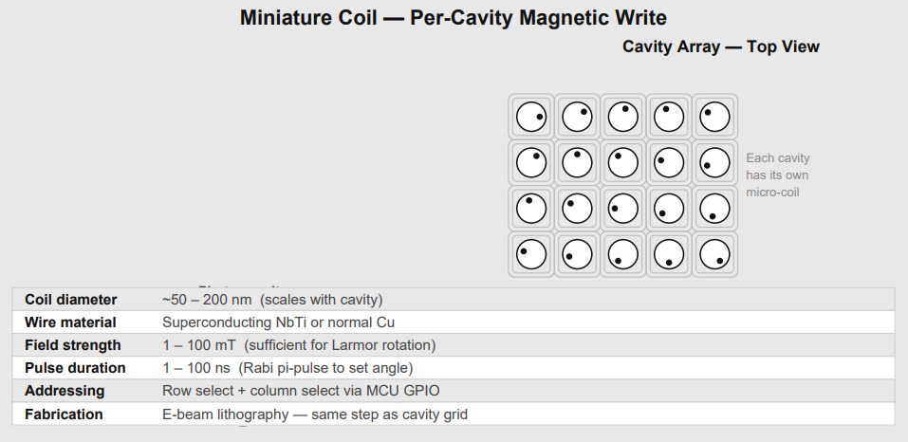
3.2 Write Mechanism — Diagram
Miniature coil per ion — MCU-driven magnetic pulse sets orientation angle

Slide 20
3.3 Read Mechanism — Weak Measurement
In plain terms: a very faint laser beam is shone on the ion. The ion glows slightly in response. How brightly it glows depends on which direction it is pointing. By measuring the brightness with two different light polarisations, the MCU works out the angle. Because the light is faint, the ion's state is barely disturbed.
Mechanism
Ion orientation is read by weak measurement using a low-power 397 nm probe. The probe drives the S₁/₂ → P₁/₂ transition in Ca⁺. Fluorescence intensity is proportional to the spin projection onto the probe polarisation axis.
Polarimetry protocol
Probe with σ+ polarisation: I⁺ ∝ cos²(θ/2).
Probe with σ− polarisation: I− ∝ sin²(θ/2).
Angle recovery: θ = 2·arctan(√(I−/I⁺)).
Readout fidelity: > 99.9% per shot demonstrated for Ca⁺.
Photon emission direction
The 397 nm transition is an electric dipole transition. The emission pattern is a torus — strongest perpendicular to the dipole axis, zero along it. Spin orientation controls fluorescence intensity and polarisation, not the direction of emitted photons. The angle is recovered from the intensity ratio, not from photon direction.

Slide 21
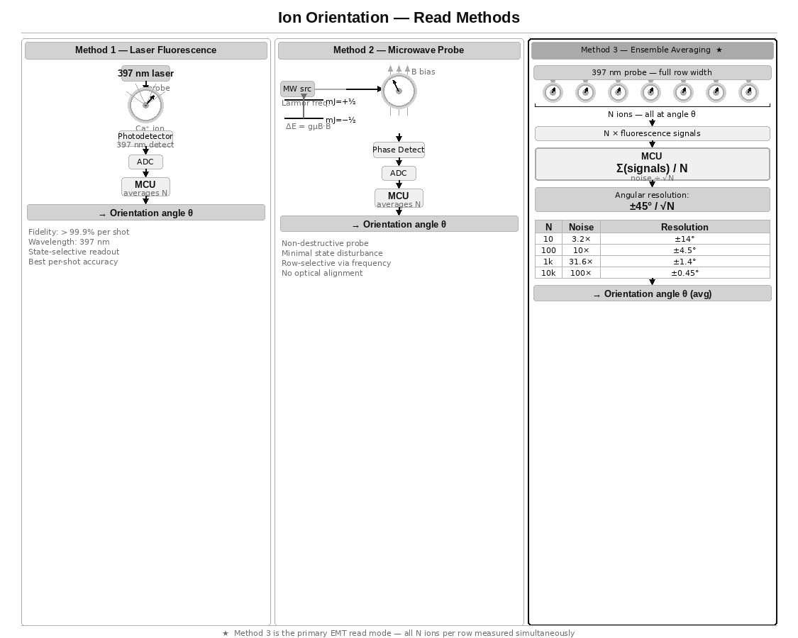
3.3 Read Mechanism — Diagram
Three read methods — Method 3 (ensemble averaging) is the primary EMT read mode

Slide 22
3.3b Fluorescence Emission — The Dark Axis
In plain terms: the ion emits light in a doughnut shape — there is a dark cone along one axis where no light comes out. Could that dark direction be used as a pointer? Short answer: it points along the probe laser axis, not the ion's spin. But the idea has a real cousin in microscopy.
The emission torus
Electric dipole radiation has zero emission along the dipole axis and maximum emission in the perpendicular plane. This creates a dark cone along the axis of the probe laser polarisation. Importantly, the dark axis is fixed by the probe geometry, not by the spin orientation angle θ. Rotating Alice's spin does not rotate the dark cone.
Why the dark axis cannot be used as a spin pointer
The dark region aligns with the probe laser axis — a fixed direction in the lab frame determined by how the experiment is set up, not by the quantum state of the ion. The spin orientation θ modulates fluorescence intensity and polarisation, but does not change the spatial direction of the radiation pattern.
The real analogue — STED microscopy
This is not a dead end as a concept. Stimulated Emission Depletion (STED) microscopy uses exactly a doughnut-shaped dark region to achieve sub-diffraction resolution. A doughnut beam depletes fluorescence everywhere except at the dark centre, allowing localisation below the diffraction limit. The principle of using the dark region as a pointer is real — but it points to position, not spin orientation.
The chiral waveguide exception
In a chiral nanophotonic waveguide, spin-momentum locking causes emission preferentially left or right depending on spin state. Here photon direction IS a pointer to the spin projection. This is experimentally demonstrated and would make the EMT read mechanism directional rather than intensity-based. It requires coupling the ions to a nanophotonic structure — an active research direction and a potential future upgrade.

Slide 23
3.4 The 12-Particle Line and Flag Protocol
In plain terms: in a linear ion trap, the 12 ions sit in a line. Ten of them carry the message. One is a flag that tells the other device what Device A is doing right now. The last one is Device B's flag. The flags work like traffic lights — they stop one device from writing while the other is still reading.
Particle assignments
Ions 1–10: Data ensemble (orientation angle θ)
All 10 set to the same angle, averaged on receive
Ion 11: Device A state flag (written only by Device A)
Ion 12: Device B state flag (written only by Device B)
Flag states — four angles at 90° spacing
0° READY — idle, not transmitting or receiving
90° WRITING — currently transmitting, data ions hold θ
180° READING — currently reading partner's data ions
270° DONE — read complete, partner may advance
Why 90° spacing works for flags
At N=10 data ions the noise floor is ±14.2°. At N=1 (single flag ion, no averaging) the noise floor is ±45°. 90° separation gives a 2× margin over the single-ion noise floor. Flag states are reliably decoded from one weak measurement.
Key design principle
Each device owns one flag particle and writes only to its own. No arbitration, no token passing, no collision possible. The handshake enforces correct sequencing of write, read, and confirm.

Slide 24
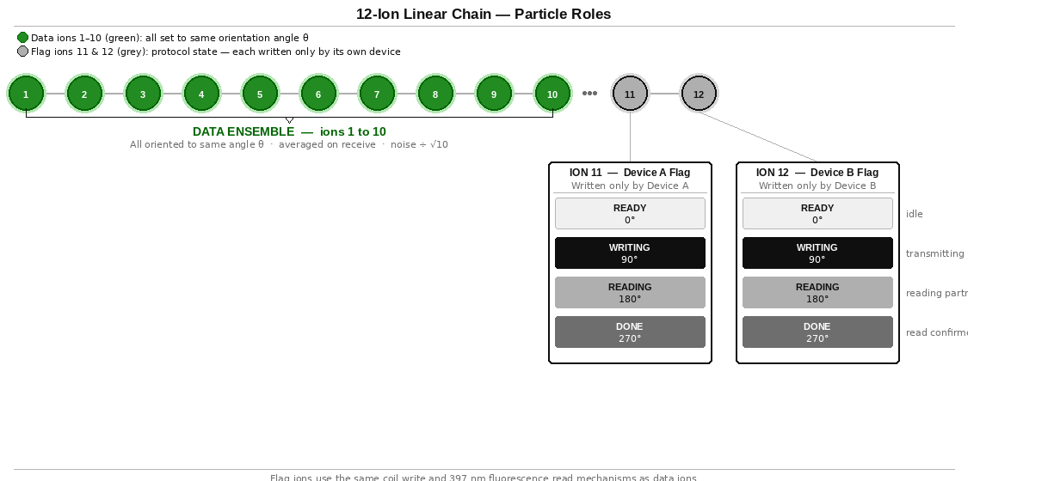
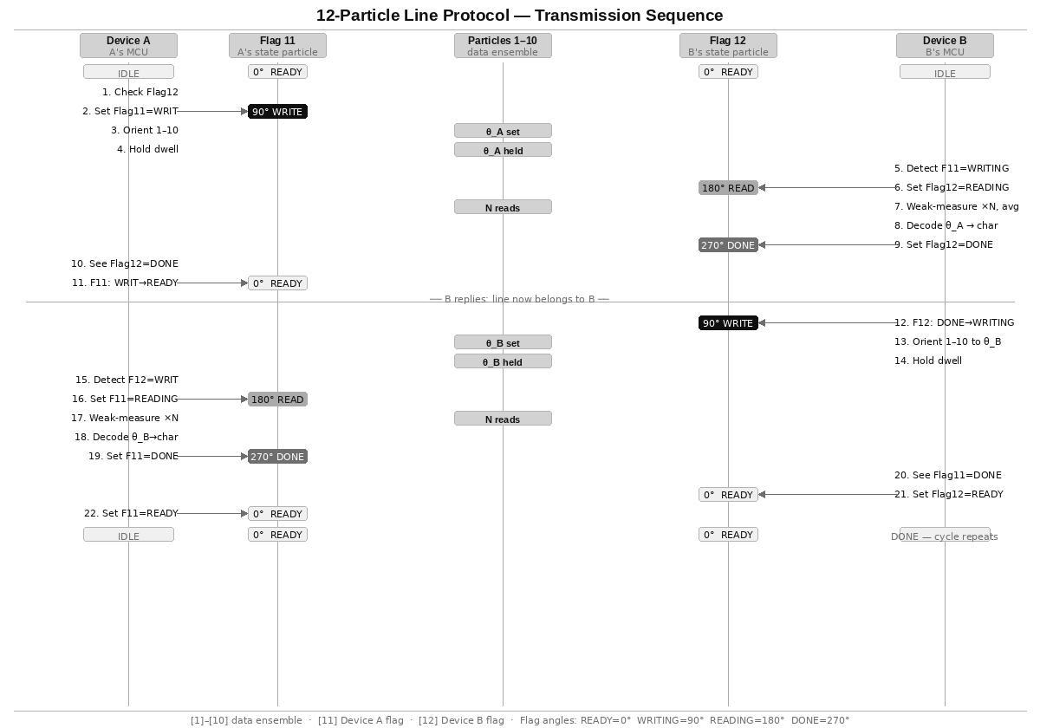
3.4b Flag Protocol Sequence Diagram
In plain terms: this diagram shows the step-by-step sequence of one complete message exchange — Device A sends a character, Device B reads and confirms it, then Device B sends its reply.

Slide 25
3.5 Chip-Scale Integration
In plain terms: the ion trap sits inside a small sealed glass bulb — like a miniature vacuum tube — with electronics outside. Proven technology. The hard part is miniaturisation.
The vacuum vessel
Ion traps require ultra-high vacuum (< 10⁻¹⁰ mbar). The EMT uses a sealed glass or fused silica envelope — identical in principle to a cathode ray tube or thermionic valve. Evacuated before sealing. A chemical getter pump sealed inside absorbs residual gas over the device lifetime.
Optical access: fused silica windows bonded into the envelope, or optical fibres through glass-metal feedthroughs. Standard in precision spectroscopy.
Target form factor
Ion trap chip: 10 mm × 6 mm
Sealed vacuum envelope: 30 mm × 15 mm
Full unit with MCU: ~60 mm × 40 mm
Internal components
Ion trap with 12-ion linear chain and per-ion coil array.
397 nm photodetector for fluorescence readout.
Chemical getter pump.
Microcontroller: ROR lookup, framing, averaging, DD pulses, coil GPIO, flag monitoring.
Calcium reservoir with photoionisation laser.

Slide 26
Part 4 — Network Architecture
What this section covers: once you have a working EMT device, how do you connect more than two people? And what if all entanglement is lost — can it be recovered?
4.1 Fixed-pair link and the call-centre topology.
4.2 Re-entanglement range and the speed-of-light limit.
4.3 Total decoherence — the physics boundary.
4.4 Retroactive causality — what quantum experiments show.
4.5 The virtual Bell measurement and pairing code.
4.6 Phone-like operation and the ring protocol.
4.7 Eliminating the call centre.
Sections 4.1–4.2 are fully consistent with known physics. Sections 4.3–4.7 are speculative extensions that rest on the same open question as the EMT channel itself.

Slide 27
4.1 Fixed-Pair Link and the Call-Centre Topology
In plain terms: each EMT device is permanently linked to exactly one other device. To talk to a third person, you need a relay station in the middle that re-routes the message.
The fixed-pair model
Each EMT unit is permanently entangled with exactly one partner at manufacture. Direct communication is only possible between that pair.
The call-centre model
A relay station holds multiple EMT units, one entangled with each remote site. Mars calls Earth station over the Mars–Earth link. Earth station re-routes classically to the Jupiter ship link. The classical re-routing inside the station is instantaneous.
Limitations
Hub and spoke: the station is a single point of failure.
Scalability: each new destination needs a new device at the station.
Range: the station must be reachable by all parties.
Maximum range without FTL — Ca⁺ nuclear spin
τ_c = 36,000 s (10 hours, XY-64 DD)
Max range = c × τ_c / 2 = 36 AU (Saturn orbit)
Covers entire inner solar system with seamless re-entanglement

Slide 28
4.2 Re-entanglement Range and the Speed-of-Light Limit
In plain terms: when an entangled pair loses coherence, a coordination signal must travel between the two devices to re-establish it. That signal is limited by the speed of light. How far apart the devices can be depends on how long the entanglement lasts.
The constraint
Re-entanglement round-trip time ≥ 2D/c
For re-entanglement before coherence decays:
2D/c < τ_c
D < c × τ_c / 2
Range by substrate
Ca⁺ electron spin + CPMG (τ_c = 1 s): D < 150,000 km
Ca⁺ nuclear spin + XY-64 (τ_c = 10 hr): D < 36 AU
YSO rare earth (τ_c = hours): D < 36 AU
If the EMT channel operates faster than light
The re-entanglement coordination signal can also travel via the EMT channel. If EMT is FTL, re-entanglement coordination is also FTL and the range limit disappears. The Stage 2 experiment determines both simultaneously.

Slide 29
4.3 Total Decoherence — The Physics Boundary
In plain terms: if all entanglement is lost and there is no way to send any signal between the two devices — no light, no radio, nothing — can the devices reconnect? Standard physics says no. But the same question applies to the EMT itself.
The scenario
All entangled pairs decohered. Calcium reserve contains only ordinary ions. No EMT channel. No classical communication. No photon link possible.
Standard quantum mechanics
Two systems with no shared quantum history cannot become entangled by local operations alone. This follows from the tensor product structure of composite quantum systems. No pairing code circumvents this.
If the EMT hypothesis is correct
If the EMT channel works, it implies a non-local structure not captured by the standard formalism. If that structure exists, two devices independently prepared to identical states by a shared classical specification might be able to establish a joint correlation. This is a larger conjecture than the EMT channel itself — it requires not just that existing entanglement supports signalling, but that entanglement can be created without prior interaction.

Slide 30
4.4 Retroactive Causality — Delayed-Choice Experiments
In plain terms: a physicist named Victor decided whether two photons had been entangled — after Alice and Bob had already measured theirs. His decision retroactively changed what Alice and Bob found in their data. This is real, confirmed physics, and it is the foundation for the pairing code idea.
The Ma et al. (2012) experiment
Two entangled photon pairs (1–2 and 3–4) are produced. Photons 1 and 4 are measured by Alice and Bob. Results recorded. Victor later decides whether to perform a Bell measurement on photons 2 and 3.
If Victor performs the Bell measurement: Alice and Bob's already-recorded results show entanglement correlations — retroactively.
If Victor does not: Alice and Bob's results show no correlations.
What this means
The joint quantum state is not fully determined until the complete measurement context is fixed. Entanglement can be established retroactively by a later measurement. The causal arrow is not what classical intuition expects.
Scope of the result
In every delayed-choice experiment, the physical intermediary (Victor's photons) is real. The retroactivity is in timing, not in the absence of a physical link. This distinction matters for the virtual Bell measurement concept.

Slide 31
4.5 The Virtual Bell Measurement and Pairing Code
In plain terms: the pairing code is like a sheet music score that both devices follow independently. If they play the exact same notes at the exact same time, could the result be the same as if they had been tuned together in person? Standard physics says no. The EMT hypothesis leaves it open.
The pairing code
A classical document specifying complete quantum state preparation parameters: trap secular frequencies, cooling protocol, MS gate pulse sequence, initial spin state, flag ion configuration, and ROR table. Both devices follow it independently.
The virtual Bell measurement
Both devices perform the local unitary operations constituting their half of a Bell measurement on a virtual joint system. All four Pauli corrections are pre-specified in the code and applied in superposition — removing the need for classical communication of the measurement result.
Physical assessment
Standard QM: this does not work. Local operations on independent systems cannot create entanglement.
EMT hypothesis: if a deeper non-local structure exists, identically prepared states might resonate into a joint correlation. This is speculative — a larger departure from known physics than the primary EMT claim.
The attempt is a well-defined experiment: prepare per code, try the EMT channel. Works or it doesn't.

Slide 32
4.6 Phone-Like Operation and the Ring Protocol
In plain terms: if the pairing code works, any EMT device can call any other using the code as a phone number. The device rings by transmitting a specific pattern. The called device detects it and answers. The first thing sent over the live channel is who is calling.
Architectural implication
Devices no longer need to be pre-paired at manufacture. Any device can connect to any other using the target's pairing code.
The ring protocol
Ring: caller prepares ions per target's pairing code and transmits a pre-agreed ring pattern unique to the target device.
Detect: called device monitors its ions for its own ring pattern. If the virtual Bell mechanism is active, the ions respond.
Connect: both halves of the virtual Bell protocol complete. Entanglement established. Full protocol active from first moment. Entanglement is bidirectional — no separate outgoing connection needed.
Caller ID: caller transmits their own pairing code signature as the first data packet. Called device stores it if unknown.
End call: either party transmits sustained HOME. Both devices detect end signal and return to standby.

Slide 33
4.7 Eliminating the Call Centre
In plain terms: with the pairing code model, there is no need for a relay station. Any device calls any other directly, the way mobile phones work — without needing a physical cable between them.
Comparison
Fixed-pair: hub-and-spoke, relay station required
Pairing code: peer-to-peer mesh, no infrastructure
Failure modes: single point vs none
Scalability: linear vs N×(N-1)/2 connections
Network properties
Any device reaches any other directly with no intermediary.
Adding a new device requires only publishing its pairing code.
N devices: N×(N-1)/2 possible direct connections.
The single dependency
The pairing code model requires the virtual Bell measurement to work, which is a larger hypothesis than the primary EMT channel. The fixed-pair with relay station is the conservative, physically defensible architecture. The pairing code model is the aspirational endpoint.

Slide 34
Part 5 — Feasibility Assessment
What this section covers: an honest assessment of what is confirmed, what is plausible but unproven, what is the central unknown, and what is speculative.
5.1 Confirmed physics.
5.2 Sound physics, not yet demonstrated at this scale.
5.3 The central open question.
5.4 Speculative extensions.
5.5 Engineering feasibility.
5.6 Conclusion.

Slide 35
5.1 Confirmed Physics
In plain terms: everything in this list has been demonstrated in a real laboratory and is not disputed.
Ca⁺ ion trapping, laser cooling, motional ground state: standard worldwide.
Mølmer–Sørensen gate fidelity > 99.9%: Oxford, Innsbruck, NIST, Quantinuum.
Magnetic spin rotation to arbitrary angle, < 0.1° precision: standard NMR/ion trap.
397 nm fluorescence readout at > 99.9% fidelity per shot: PTB, NIST.
Dynamical decoupling extending Ca⁺ nuclear spin coherence to ~10 hours: demonstrated.
Ensemble averaging reducing noise by √N: basic statistics, universal.
Delayed-choice entanglement swapping showing retroactive correlations: Ma et al. 2012.
Ion shuttling between trap zones without coherence loss: Oxford, Innsbruck.
Photon-mediated remote entanglement (Delft method): demonstrated, NV centres, 1.3 km.
Linear ion chain of 12+ ions in a Paul trap: routinely demonstrated in quantum computing.

Slide 36
5.2 Sound Physics, Undemonstrated at Scale
In plain terms: these are things that should work based on physics we know, but that nobody has actually built yet at the scale the EMT requires.
Miniature per-ion coil fabricated in the same e-beam step as the trap electrodes: physically feasible, not yet demonstrated in a production device.
Simultaneous entanglement of all 12 ion pairs across a separation point with subsequent physical division: single-pair entanglement across zones is demonstrated; 12-pair simultaneous entanglement plus physical separation is an extrapolation.
Orientation angle encoding (ROR) as a communication protocol: write and read mechanisms each individually demonstrated; the combined protocol is novel but requires no new physics.
Flag protocol (particles 11 and 12) for handshake coordination: requires only state-selective fluorescence and magnetic pulses, both demonstrated.
Bootstrap re-entanglement maintaining 10+ pairs long-term: individual steps demonstrated; the integrated system is new.
Chip-scale UHV packaging: active engineering challenge in quantum computing industry.

Slide 37
5.3 The Central Open Question
In plain terms: will it actually work? Does pointing Device A's ions at a certain angle cause Device B's ions to show any trace of that angle? Standard physics says no. That prediction has not been tested in the conditions the EMT uses. This experiment will test it.
The primary EMT claim
When Alice sets all 10 data ions to orientation θ, does Bob's average of his 10 entangled partner ions encode any information about θ?
Standard QM prediction
ρ_B = Tr_A(ρ_AB) = I/2 for all Alice operations
Bob always sees a maximally mixed state. Signal is identically zero.
Why the experiment is worth performing
The theorem is proven for individual pairs. The EMT tests a collective variable of the N-pair ensemble — whether ensemble orientation coherence survives in a way not captured by summing N individual density matrices.
A definitive null result is publishable and tightens bounds on all non-local theories. A positive result would require revision of QM.
Critical experimental requirement
All classical leakage paths must be eliminated before any positive result can be claimed: EM shielding, vibration isolation, common-mode field rejection, blind analysis. Loophole-free design is as important as the measurement itself.

Slide 38
5.4 Speculative Extensions
In plain terms: these ideas require even more new physics than the basic EMT channel. They are included because they follow logically if the EMT works — but they should not be treated as likely.
Virtual Bell measurement / pairing code recovery
Requires not only that the EMT channel works, but that entanglement can be created between systems with no shared quantum history. This is a significantly larger departure from known physics.
Phone-like peer-to-peer network
Contingent on the virtual Bell measurement working. If it does, the architecture follows directly.
Speculation hierarchy
Level 1: EMT channel signal exists
→ NCT incomplete in ensemble-orientation regime
Level 2: Virtual Bell measurement works
→ entanglement creatable without prior interaction
Level 3: Full peer-to-peer phone network
→ follows from Level 2
The fixed-pair EMT link with relay station (section 4.1) requires only Level 1. It is the conservative, buildable target.

Slide 39
5.5 Engineering Feasibility
In plain terms: if the experiment works, how hard is it to build the actual device? The honest answer is: hard, but nothing about it requires inventing new physics or new materials.
If Stage 2 confirms the primary effect
The hardware path is clear. Ca⁺ ion trap technology is the most mature qubit platform. All required capabilities are individually demonstrated.
Chip-scale UHV packaging: being solved by quantum computing industry.
12-ion chain with full entanglement at separation: requires scale-up of demonstrated MS gate technique.
Photon collection efficiency for bootstrap re-entanglement: nanophotonic cavity QED achieves > 50% efficiency.
MCU control of DD pulses plus coil writes: embedded systems engineering.
Timeline estimate
Stage 1 (single pair, same lab):
6–12 months in existing ion trap lab
Stage 2 (remote isolation, primary test):
12–24 months with dedicated apparatus
Stage 3 (coherence maintenance, self-healing):
24–48 months engineering after Stage 2 confirmation
Production device:
Dependent on chip-scale UHV packaging progress

Slide 40
5.6 Conclusion
In plain terms: the device is physically plausible, the experiment is feasible, and both possible results are scientifically valuable. It is worth building and testing.
Summary
The substrate (Ca⁺), write mechanism (miniature coil), read mechanism (397 nm fluorescence polarimetry), coherence maintenance (DD), flag protocol (12-particle line), and self-healing bootstrap are all grounded in established or tractable physics.
The central EMT hypothesis — that ensemble orientation of entangled ions produces a detectable signal — contradicts the no-communication theorem as currently proven but addresses a regime not directly tested.
If the experiment confirms the effect
The device is buildable. Range covers the entire inner solar system with current Ca⁺ nuclear spin coherence technology.
If the experiment finds no effect
The theorem is confirmed in a new regime. The apparatus — a 12-ion linear chain with precision orientation control and weak-measurement readout — is a world-class quantum sensor applicable to atomic clocks, gravitational wave detection, and quantum key distribution regardless of the primary result.
The device is the experiment. The experiment is the device.

Slide 41
Protocol Properties and Throughput
In plain terms: the flag protocol ensures that only one device is changing the data ions at a time, and that the other device has finished reading before the first one moves on. This gives us a reliable two-way conversation with no dropped characters.
No arbitration required
Device A writes only to ion 11. Device B writes only to ion 12. Neither writes to the other's flag. Read-before-write on the partner's flag prevents data corruption. No token passing or priority system needed.
Read confirmation (DONE state)
When Device A sets Flag 11 = DONE, Device B knows its transmission was successfully decoded and may safely advance to the next character. Without this, a transmitter could overwrite the data ions before the reader had finished.
Immediate reply — no dead cycle
After DONE, the reading device transitions directly to WRITING without returning to READY. This eliminates one dead cycle and allows the reply to begin immediately.
Throughput analysis
One exchange = A→B + B→A = 2 × t_dwell
t_dwell = N × t_read (N=10, t_read ≈ 10–100 μs)
t_dwell ≈ 100 μs to 1 ms per direction
Throughput ≈ 500 to 5,000 character-exchanges per second
Comparison with larger ensembles
A longer ion chain (e.g. 100 data ions instead of 10) would reduce the angular noise from ±14.2° to ±4.5°, enabling finer character spacing and a larger character set. The 12-ion design is the minimum viable starting point.

Slide 42
Expanding the reach
While a pair of these enable communication across the solar system, it is restricted to the 2 devices:
Mars <-> Earth
Or Earth <-> Spaceship
To overcome this limitation, imagine a “call centre” that houses all Earth bound transceivers (or a dedicated space station) - by housing and connecting them together, communication channels can be extended, for example:
Mars wants to call a Ship orbiting Jupiter but the Ship only has 1 EMT that is entangled with a EMT on the “Call Centre Station”..
Mars would call the Station and the Station would route the call using classical means in-between the multiple EMTs.
DynamicDecoupling
Continuous re-entanglement
Calcium ions

