Slide 1
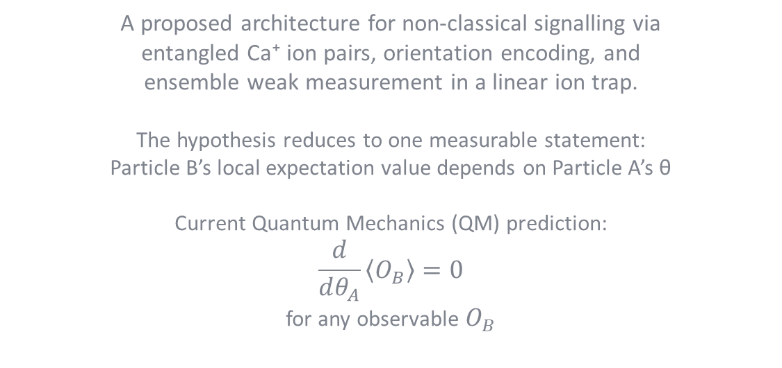
EMT
Entangled Multiplexing Transceiver & Shared Spin-State Hypothesis
A proposed architecture for non-classical signalling via entangled Ca⁺ ion pairs, orientation encoding, and ensemble weak measurement in a linear ion trap.
The hypothesis reduces to one measurable statement:
Particle B’s local expectation value depends on Particle A’s θ
Current Quantum Mechanics (QM) prediction:
$$\frac{d}{dθ_{A}}\left\langle O_{B}\right\rangle =0$$
for any observable $O_{B}$
Daniel Miles · 2026 · Original Concept Paper · Rev.10 https://alternitech.square.site

Slide 2
Abstract
Concept
The Spin-State Hypothesis proposes that when an entangled Ca⁺ ion pair is prepared on a shared measurement axis, rotation of ion A to angle θ produces a correlated shift in the orientation of ion B, detectable by the local device reading only its own ion. If confirmed, this enables orientation-encoded character transmission via the Rotary Orientation Ring (ROR) lookup table.
Experiment
Stage 1: 1–5 entangled Ca⁺ pairs in a single lab. Ion A rotated, ion B continuously weak-measured. Before/after comparison tests for correlated orientation shift.
Stage 2: same experiment with ions physically separated and all classical coupling excluded.
Stage 2b: virtual Bell measurement test - two unentangled devices prepared via pairing code, correlation tested without a physical seed pair.
Device proposal
A 12-ion linear Paul trap: 10 data ions for √N SNR improvement, ion 11 as Device A state flag, ion 12 as Device B state flag. Each device reads only its own ions. Orientation angle encodes characters.
Flag ions coordinate half-duplex timing without transmitting information. Sealed glass vacuum envelope. MCU-controlled. Self-healing via calcium supply chain and bootstrap re-entanglement.
Engineering challenges
Chip-scale UHV packaging, per-ion coil fabrication, photon collection efficiency for bootstrap re-entanglement, and long-duration coherence maintenance via dynamical decoupling.
All required individual capabilities are demonstrated, the challenge is integration.
Aim
An EMT is designed to utilise the above hypothetical interaction and provides a method for communication over the vast distances of interplanetary & interstellar space.

Slide 3
The Spin-State Hypothesis
In plain terms: both devices share a fixed measurement axis. Particle A is spin-up on that axis - its HOME is 0°. Particle B is spin-down - its HOME is 180°. The question is simple: if particle A is rotated from 0° to 30°, does particle B shift from 180° to 210°? Standard physics says no. That prediction has never been directly tested.
The experimental setup
Shared measurement axis: fixed for both devices
Particle A (spin-up): HOME = 0° (355°–005° zone)
Particle B (spin-down): HOME = 180° (175°–185° zone)
Rotation: about the shared axis, keeping both on same plane
The hypothesis, stated precisely
When particle A is rotated from HOME (0°) to angle θ, particle B undergoes a corresponding rotation from its HOME (180°) to (180° + θ), maintaining the anticorrelation of the entangled pair. This rotation of B is detectable by Device B reading only its own particle.
What the 10-ion ensemble does
The 10 data ions exist purely to reduce measurement noise. If the effect is real for one pair, it is real for all 10. Averaging 10 readings reduces the noise by √10 ≈ 3.16×, making a small signal statistically detectable. The physics claim is about one pair. The 10 ions are the engineering solution to measuring it reliably.
Why standard physics says this cannot happen
The no-communication theorem states that any local operation Alice applies to her particle leaves Bob's reduced density matrix unchanged: ρ_B = I/2. Bob's particle has no definite orientation before measurement. Rotating Alice's particle does not change what Bob sees locally.
Bell tests confirm that measurement outcomes are correlated when both parties measure along the same axis and compare results. They confirm binary outcome correlation. They do not test whether B's orientation angle tracks A's rotation - no experiment has done this.

Slide 4
Contents
Abstract
The Spin-State Hypothesis
Part 1 - Theoretical Foundation
1.1 The No-Communication Theorem
1.2 Quantum Entanglement - The Joint State
1.3 Weak Measurement Theory
1.4 Ensemble Averaging - Noise Reduction by √N
1.5 The Central Experimental Question
1.6 Orientation Encoding - The Rotary Orientation Ring
Part 2 - Experimental Pathway
2.1 Ca⁺ as the Experimental Substrate
2.2 Stage 1 - The Core Experiment
2.3 Stage 2 - Remote Isolation Test
2.3b Stage 2b - Virtual Bell Measurement Experiment
2.4 Stage 3 - Coherence Maintenance and Self-Healing
Experimental Evidence - What Is and Is Not Confirmed
Part 3 - System Architecture
3.1 Manufacturing Process · 3.1b Ca⁺ Supply Chain
3.2 Write Mechanism · 3.3 Read Mechanism
3.3b Fluorescence Emission - The Dark Axis
3.4 The 12-Ion Line · 3.4b Flag Protocol Diagram
3.5 Chip-Scale Integration
Part 4 - Network Architecture
4.1–4.7 Fixed-pair, Re-entanglement, Retroactive Causality,
Virtual Bell, Phone-like Operation, Call Centre
Part 5 - Feasibility Assessment
5.1–5.6 Confirmed Physics through Conclusion
References

Slide 5
Part 1 - Theoretical Foundation
What this section covers: the physics that underpins the EMT concept before any hardware is discussed.
1.1 The no-communication theorem - what it says and where it has been tested.
1.2 Quantum entanglement - what it is physically and what it is not.
1.3 Weak measurement - how to extract partial information without destroying a quantum state.
1.4 Ensemble averaging - how reading many particles reduces noise.
1.5 The central experimental question - the specific untested regime.
1.6 Orientation encoding - the Rotary Orientation Ring.
All claims in this section are grounded in published results. The central question in 1.5 is explicitly unresolved.

Slide 6
1.1 The No-Communication Theorem
In plain terms: quantum entanglement cannot be used to send a message under the rules of standard quantum mechanics. This paper asks whether those rules are complete.
Formal statement
For any bipartite quantum state ρ_AB shared between Alice and Bob, Alice's local operations produce no detectable change in Bob's reduced density matrix. Formally:
Tr_A[(Λ_A ⊗ I_B)(ρ_AB)] = Tr_A[ρ_AB] = ρ_B
This holds for all local operations - unitary rotations, measurements, state preparation, and any classical post-processing. It follows from the linearity of quantum mechanics and the tensor product structure of composite systems.
What it does and does not say
It says: Bob's measurement statistics are unchanged regardless of what Alice does to her half of the entangled pair. No information is transferred.
It does not say: the theorem has been tested in the regime of large ensembles of ion pairs (N ≫ 1) with continuous-variable orientation encoding and a shared global phase reference. This untested regime is where the EMT experiment operates.
Scope of existing experimental tests
Bell test experiments (Aspect 1982, Hensen 2015, Rosenfeld 2017) confirm entanglement and rule out local hidden variables. None tests ensemble orientation signalling. The EMT experiment is genuinely novel.

Slide 7
1.2 Quantum Entanglement - The Joint State
In plain terms: two entangled particles share a single quantum state between them. Measuring one instantly tells you something about the other, no matter how far apart they are - but standard physics says you cannot use this to send a message.
What entanglement is
Two particles are entangled when their joint state cannot be written as a product of individual states. For a maximally entangled Bell state:
|Φ⁺⟩ = (1/√2)(|↑⟩_A|↑⟩_B + |↓⟩_A|↓⟩_B)
Neither ion A nor ion B has a definite spin individually. The state is a property of the pair. Measuring A instantly determines the correlated outcome of B, regardless of separation.
What entanglement is not
Entanglement is not a signal channel in standard QM. When Alice orients her ion to angle θ, she is performing a local operation. Bob's marginal statistics - what he sees averaging his own measurements - are unchanged. This is the content of the no-communication theorem.
The Zeeman sublevel encoding in Ca⁺
In a Paul trap with static bias field B (1–10 mT), the S₁/₂ ground state splits into Zeeman sublevels m_J = ±½ with separation ΔE = gμ_B·B. An arbitrary superposition |ψ⟩ = α|↑⟩ + β|↓⟩ represents a spin orientation angle θ = 2·arctan(|β|/|α|) on the Bloch sphere. This continuous angle is what the EMT encodes as a character.

Slide 8
1.3 Weak Measurement Theory
In plain terms: instead of making one definitive measurement that destroys the quantum state, we nudge the particle very gently many times. Each nudge gives a tiny amount of information. Adding them up recovers the answer with less disturbance.
Definition
A weak measurement couples a system to a meter with interaction strength g ≪ 1. Each read disturbs the state by order g. The expectation value of observable A is recovered by averaging N reads:
⟨A⟩ = lim_{N→∞} (1/N) Σᵢ aᵢ
For finite N, the estimator has uncertainty σ/√N where σ is the single-shot uncertainty.
Application to Ca⁺ spin orientation
Probing with σ+ polarised 397 nm light gives intensity I ∝ cos²(θ/2). Probing with σ− gives I ∝ sin²(θ/2). The ratio recovers θ to precision limited by photon shot noise. Readout fidelity > 99.9% per shot is demonstrated for Ca⁺ at PTB and NIST.
State disturbance per weak read
Each fluorescence event has probability p of flipping the spin. For off-resonance probing, p ≪ 1. Over N reads, coherence decays as e^⁻^ᴽ^^ᵖ. For N=1000 reads and p=10⁻³, loss is e⁻¹ ≈37%. This trade-off - more reads give better SNR but greater state disturbance - sets the practical operating point.

Slide 9
1.4 Ensemble Averaging - Noise Reduction by √N
In plain terms: if 10 people each estimate the same distance and you average their guesses, the error in your average is about 3 times smaller than any single guess. The same principle applies to ion measurements. With 10 ions all pointing the same direction, the error drops by √10 ≈3.
Statistical basis
If N independent estimates x_i each have mean μ and standard deviation σ, the sample mean has standard deviation σ/√N. This is the central limit theorem. It applies universally.
Application to EMT - 10 data ions per device
Each of the 10 data ions (particles 1–10) is prepared in the same orientation state θ. Each is independently weak-measured. The MCU averages the 10 results:
σ_θ = σ_single / √N = ±45° / √10 = ±14.2°
For a 10° character spacing, the ±14.2° noise floor is marginal. Reducing the spacing to 5° or increasing to 100 ions per device would improve reliability. The 10-ion design is a starting point; the optimal ensemble size is an experimental parameter.
Resolution at different ensemble sizes
N = 10 σ_θ = ±14.2° (marginal at 10° spacing)
N = 100 σ_θ = ±4.5° (reliable at 10° spacing)
N = 1,000 σ_θ = ±1.4° (reliable at 5° spacing)
N = 10,000 σ_θ = ±0.45° (full character set)
The 12-particle design (N=10 data ions) is the minimum viable configuration. A longer linear trap or a 2D crystal would improve SNR at the cost of increased engineering complexity.

Slide 10
1.5 The Central Experimental Question
In plain terms: both devices are aligned on the same measurement axis. Particle A starts at 0° (HOME). Particle B starts at 180° (HOME). Rotate A to 30°. Does B shift to 210°? Device B reads only its own particle to find out.
The question
If particle A is rotated by angle θ about the shared measurement axis, does particle B undergo a corresponding rotation by θ, maintaining the anticorrelation of the Bell state, in a way that is detectable by Device B reading only its own particle?
Standard QM prediction
Alice rotates A by θ → ρ_B = I/2 (unchanged, always)
Bob's particle has no definite orientation. His local measurement results remain 50/50 regardless of θ. No detectable shift. Δθ_B = 0.
What Bell tests actually confirm
Bell tests measure binary outcomes (up or down) along chosen axes and compare them classically after the fact. They confirm that outcomes are anticorrelated when both measure along the same axis. They confirm E(φ_A, φ_B) = −cos(φ_A − φ_B). They do not measure continuous orientation angles. They do not test whether B tracks A's rotation locally.
The EMT experiment
Device B monitors its own particle continuously with weak measurement.
Device A holds HOME (0°). Device B records baseline.
Device A rotates to θ. Device B continues monitoring.
Question: does B's running average shift from 180° toward (180°+θ)?
This is a before/after comparison entirely within Device B. No classical signal passes between devices.
Guaranteed scientific value
Shift detected at > 5σ: NCT is incomplete in this regime. Historic.
No shift: NCT confirmed for continuous orientation, weak measurement, shared-axis regime. Publishable.

Slide 11
1.6 Orientation Encoding - The Rotary Orientation Ring
In plain terms: think of a clock face. Each hour position is a letter. The ion's spin points to a position on the clock face, and the other device reads which position it is pointing to. HOME (12 o'clock) means start or end of message.
Encoding principle
Each character maps to a unique orientation angle θ on a circular lookup table - the Rotary Orientation Ring (ROR). HOME at θ = 0° is permanently reserved as message delimiter. Device B's table is inverted (θ_B = 180° − θ_A) to account for the spin-anticorrelation of the entangled Bell state.
Single ring at 10° spacing: 35 characters + HOME
Dual ring at 10°/axis: 36 × 36 = 1,296 unique states

Slide 12
Part 2 - Experimental Pathway
What this section covers: the sequence of experiments from the simplest possible test to a full working device. The experiment and the device are completely separate. The experiment uses 1–5 ion pairs. The device uses 12.
Stage 1 - The core experiment: 1–5 entangled Ca⁺ pairs, no flags, no encoding. Simply rotate A and monitor B. Test whether the correlation effect exists.
Stage 2 - Remote isolation: repeat Stage 1 with the two ions physically separated and all classical coupling excluded.
Stage 3 - Coherence maintenance: dynamical decoupling and bootstrap re-entanglement for sustained operation.
Stages 1 and 2 are achievable with existing ion trap apparatus. Stage 3 is engineering development contingent on Stage 2 confirmation.
The device architecture described in Part 3 is built only if Stage 2 produces a positive result. All Part 3 content is explicitly conditional on that.

Slide 13
2.1 Ca⁺ as the Experimental Substrate
In plain terms: calcium ions in a trap are the best choice for this experiment because every individual capability the test requires has already been demonstrated - high-fidelity entanglement, precise orientation control, and sensitive weak-measurement readout.
Why Ca⁺ is the correct choice
Coherence time: T₂* ∼ 1 ms (electron spin, no decoupling). T₂ ∼ 1 s with CPMG-8. Up to 10 hours with XY-64 DD on nuclear spin.
Entanglement: Mølmer–Sørensen gate via shared axial motional mode. Fidelity > 99.9%. No external photon needed.
Orientation control: magnetic pulse at Larmor frequency. Rabi oscillation gives arbitrary angle. Precision < 0.1°.
Readout: state-selective fluorescence at 397 nm. Fidelity > 99.9% per shot (PTB, NIST). Weak-measurement regime: each read disturbs state by order p ≪ 1.
Linear ion trap - natural fit
In a Paul trap, ions arrange in a linear chain. For the experiment, only 1–5 ion pairs are needed - a straightforward configuration in any existing multi-zone trap. The 12-ion device chain is a later engineering extrapolation.
Trap and field compatibility
The Paul trap confines Ca⁺ via oscillating electric fields at 10–100 MHz. The static magnetic bias field (1–10 mT) operates at a completely different frequency and does not interfere with the trap. Standard practice in all ion trap experiments.

Slide 14
2.2 Stage 1 - The Core Experiment
In plain terms: take 1–5 pairs of entangled calcium ions. Leave ion B alone - just keep reading it. Rotate ion A to a specific angle. Did ion B's readings change? That is the entire experiment.
Objective
Determine whether rotating an entangled ion A to angle θ produces a statistically detectable change in the continuously-monitored orientation of its entangled partner ion B. Both ions are in the same lab for this stage.
Protocol
1. Load 1–5 Ca⁺ ion pairs into a multi-zone Paul trap.
2. Laser cool to motional ground state: Doppler (397 nm) then sideband cooling (729 nm) to ⟨n⟩ < 0.05.
3. Entangle each pair with the Mølmer–Sørensen gate. Verify entanglement by Bell inequality measurement.
4. Ion A at HOME (0°). Ion B begins continuous weak measurement. N_baseline reads taken. Average recorded as θ_B_baseline.
5. Ion A rotated to target angle θ_A from the ROR table.
6. Ion B continues continuous weak measurement. Running average compared to baseline.
7. Measure θ_B_after. Compute Δθ = θ_B_after − θ_B_baseline.
8. Repeat for multiple values of θ_A. Test whether Δθ correlates statistically with θ_A.
Critical design requirement
Ion B reads only its own ions. No signal is sent from A to B by any classical means. Ion B has no knowledge of θ_A until the blind analysis at the end of the run.
No flags, no protocol, no encoding at this stage. Those are device-layer features built only after this effect is confirmed.

Slide 15
2.3 Stage 2 - Remote Isolation Test
In plain terms: repeat Stage 1 but with the two ions physically separated far enough that no ordinary physics could explain a correlation between them. This is the definitive test.
Objective
Repeat the Stage 1 protocol with ions A and B in separate, independently shielded vacuum systems, separated by a distance that excludes all classical electromagnetic coupling. Ion B reads only its own ions throughout.
Separation and shielding
Minimum: > 1 m to exclude RF field leakage from trap electrodes.
Optimal: > 10 m for complete exclusion of all coupling mechanisms.
Both trap systems independently shielded with mu-metal to exclude common-mode magnetic field noise.
Ion pairs entangled in a central lab and transported to their respective sites in portable sealed UHV traps.
Experimental protocol
Ion B site: continuous weak measurement throughout. Baseline taken with A at HOME. No knowledge of A's schedule.
Ion A site: pre-programmed rotation sequence. Rotations recorded with timestamps.
Blind analysis: A's rotation log and B's measurement log compared only after both sequences are complete.
Control conditions - all must be run
Non-entangled pair: B reads, A rotates. No correlation expected.
Entangled pair, A held at HOME throughout: B should show no shift.
Entangled pair, A rotates to various θ: the critical test.
If Stage 2 produces a positive result above 5σ, independent replication is required before the device architecture (Part 3) is pursued.

Slide 16
2.3b Stage 2b - Virtual Bell Measurement Experiment
In plain terms: once Stage 2 confirms that rotating ion A shifts ion B locally, the next experiment tests whether two completely unentangled devices can become correlated just by following the same preparation instructions. This is a direct test of whether retroactive causality can operate between two spatially separated devices.
Prerequisite
Stage 2 must have confirmed the orientation correlation effect.
Objective
Determine whether two devices, each loaded with ordinary unentangled Ca⁺ ions and following an identical pairing code independently, exhibit orientation correlation detectable by each device reading only its own ions - with no seed pair delivered.
Protocol
1. Both devices loaded with fresh unentangled Ca⁺ ions. No seed pair. No photon link.
2. Both devices follow the pairing code: identical trap parameters, cooling sequence, pulse timing, and initial spin state.
3. Both perform the local operations specified by the code as their respective half of a virtual Bell measurement.
4. Device A holds HOME (0°). Device B takes baseline reading.
5. Device A rotates to angle θ. Device B monitors its own ions.
6. Does Device B detect a shift correlated with θ?
Outcomes
Positive: independent preparation via pairing code produces detectable orientation correlation. Re-entanglement without a physical seed pair is possible. The pairing code works as a phone number.
Negative: a physical seed pair is required. The fixed-pair architecture with relay station is the correct model. Both outcomes are definitive and useful.

Slide 17
2.4 Stage 3 - Coherence Maintenance and Self-Healing
In plain terms: quantum states don't last forever - they fade. This stage is about keeping the entanglement alive as long as possible using pulse sequences that fight the fading, and rebuilding it automatically when it does fade.
Dynamical decoupling
Entangled states decohere due to magnetic field noise, phonon coupling, and charge noise. Dynamical decoupling (DD) applies precisely timed refocusing pulses that cancel slow-frequency noise by reversing accumulated phase error before it destroys the entanglement.
Electron spin, no DD: T₂* ≈ 1 ms
Electron spin, CPMG-8: T₂ ≈ 1 s
Nuclear spin, XY-64: T₂ ≈ 10 hours (demonstrated)
Bootstrap re-entanglement protocol
When a pair's coherence drops below threshold, the two flag ions (particles 11 and 12) coordinate a refresh: both devices simultaneously emit entanglement photons from a reserve Ca⁺ ion. A Bell measurement is performed at one site. The result is sent via the flag protocol. Correction pulses applied. New pair loaded. DD activated immediately.
Stability condition
R_refresh > R_decoherence
1/t_refresh > N_pairs / τ_c
Ca⁺ nuclear spin (τ_c = 36,000 s): one flag ion channel
is sufficient to maintain 10 data pairs indefinitely.
The ion reserve is a store of ordinary unentangled Ca⁺ ions, replenished by photoionisation from a calcium metal source on-chip. No pre-entangled pairs required in the reserve.

Slide 18
Part 3 - System Architecture
What this section covers: how to build the actual device, assuming the experiment confirms the effect works. Every component described here uses existing or near-term technology.
3.1 Manufacturing - how both units are made from one trap.
3.2 Write mechanism - how to set ion orientation.
3.3 Read mechanism - how to measure ion orientation.
3.3b Fluorescence photon direction - an interesting side question.
3.4 12-particle line protocol - the flag-based handshake.
3.5 Chip-scale integration - the target form factor.
3.6 Substrate materials - what else could be used.
All hardware described here is an engineering extrapolation of demonstrated laboratory techniques.

Slide 19
3.1 Manufacturing Process
In plain terms: both EMT units are built separately. Entanglement is loaded in after manufacture, either by delivering a pair of seed ions to each unit, or - if retroactive causality works - not at all.
Method 1 - Seed ion delivery (confirmed physics)
Two Ca⁺ ions are entangled in a lab using the Mølmer–Sørensen gate. One ion is transported to Unit A, one to Unit B, each in a portable sealed UHV trap. These form the seed pair from which the full 12-ion chain is bootstrapped.
Transport coherence is maintained by DD pulses. Only one entangled pair needs to survive transit.
Method 2 - No pre-entanglement (speculative)
If the virtual Bell measurement protocol works, each unit is built with 12 ordinary unentangled Ca⁺ ions. Entanglement is established on demand via the pairing code. Contingent on Level 2 physics (section 5.4).
Per-unit build steps
1. Ion trap chip fabricated by e-beam lithography. Miniature write coils in the same step.
2. Glass or fused silica vacuum envelope sealed around chip. Getter pump inside. Optical windows for laser access.
3. Ca metal loaded; photoionised (423+375 nm) to Ca⁺. 12-ion chain formed.
4. Laser cooling: Doppler (397+866 nm) then sideband (729 nm) to motional ground state ⟨n⟩ < 0.05.
5. Seed ion installed and bootstrap entanglement built (Method 1), or pairing code loaded (Method 2). DD activated.

Slide 20
3.1b From Experiment to Device - Ca⁺ Supply Chain
In plain terms: once the experiment confirms the effect with 1–5 pairs, the same apparatus scales into a self-healing device. One confirmed entangled pair is all that is needed to bootstrap the full 12-ion chain automatically.
The bootstrap sequence - using an established pair
1. Ca metal reservoir heated by resistive element on-chip. Neutral Ca atom beam directed at the loading zone of the trap.
2. Two-step photoionisation: 423 nm laser (S→P transition) then 375 nm laser (P→continuum). Neutral Ca → Ca⁺ in the loading zone. ~microsecond timescale. Highly selective - only Ca in the beam zone is ionised.
3. New Ca⁺ ion shuttled from loading zone to qubit zone via electric field gradient. Multi-zone trap. Coherence of existing ions is unaffected during shuttling - the shuttle zone is physically separated.
4. New ion laser-cooled in isolation: Doppler (397+866 nm) to ∼1 mK, then sideband (729 nm) to ground state ⟨n⟩ < 0.05.
5. New ion entangled with its remote counterpart using the existing EMT channel to coordinate timing via the flag protocol. Photon-mediated Bell measurement establishes the new pair. Classical result sent via the operational EMT channel. Correction pulse applied. New pair active.
6. New pair inserted into the active chain at the correct position. Dynamical decoupling activated immediately.
The seed pair is the control channel
The first confirmed entangled pair does not just carry messages - it orchestrates the construction of all subsequent pairs. The ROR gives it a vocabulary to coordinate each step. The flag ions manage timing so bootstrap messages do not collide with re-entanglement operations. One working pair builds the full device autonomously.
This is the path from experiment to device: confirm the effect → deliver one seed pair → bootstrap builds the rest → self-healing loop maintains it indefinitely.

Slide 21
Experimental Evidence - What Is and Is Not Confirmed
In plain terms: entanglement is thoroughly confirmed. Spin correlations between separated particles are real. But the specific thing the EMT needs - one device detecting the other's rotation by reading only itself - has never been tested. These are two different things.
What IS confirmed by existing experiments
NIST Ca⁺ Bell tests (Wineland group): Bell inequality violated at 8σ. Detection loophole closed with massive particles for the first time. Lasers rotate ion spins by specific angles before measurement. Binary outcomes (up/down) are strongly anticorrelated when both particles are measured along the same axis.
Ca⁺ hybrid Bell test (Oxford, 2015): 99.8% fidelity entangled state. CHSH inequality violated by 15σ.
Entangled helium atoms (ANU, 2019): Spin correlations along rotated measurement bases at 6σ. First Bell test with freely propagating massive particles.
Loophole-free Bell test (Delft, 2015): NV centre spins 1.3 km apart. Locality and detection loopholes both closed simultaneously.
What these experiments precisely confirm
When both particles are measured along the same axis, outcomes are anticorrelated. One is up, the other is down. The correlation coefficient E(φ_A, φ_B) = −cos(φ_A − φ_B) matches quantum mechanics to high precision. The entanglement is real.
What no experiment has tested
All Bell tests measure binary outcomes and require both parties to compare results classically to see the correlation. Neither party alone sees anything non-random.
No experiment has tested whether rotating particle A causes particle B's continuous orientation angle to shift in a way detectable by B reading only itself, without any classical comparison.
This is not a gap in a minor detail. It is the gap between confirmed entanglement and the EMT hypothesis. The entanglement is real. Whether it is locally readable as a continuous angle shift is the open question.
The EMT experiment is not testing whether entanglement exists. It is testing whether the continuous orientation correlations are locally detectable without classical comparison.

Slide 22
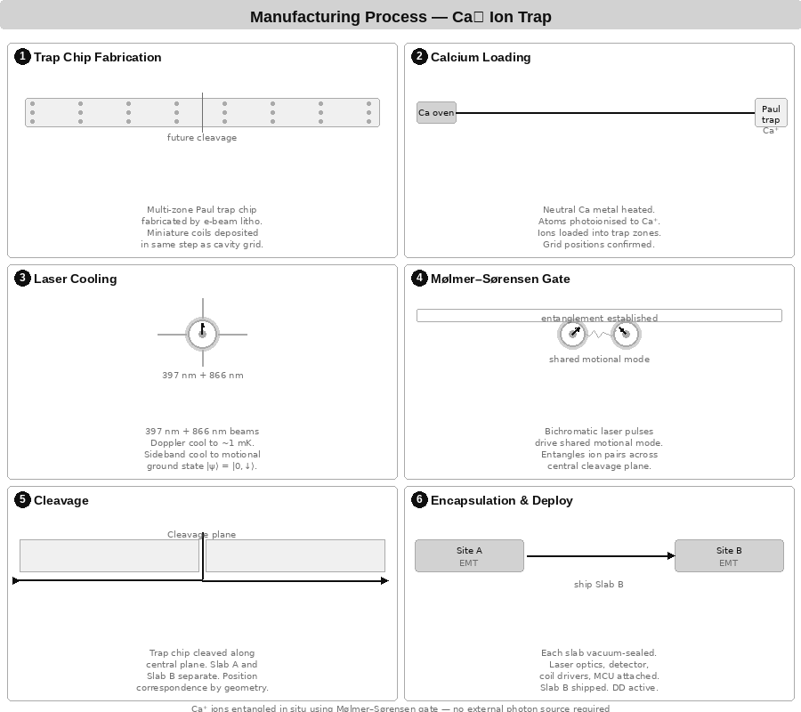
3.1 Manufacturing - Diagram
Schematic of Ca⁺ ion trap manufacturing steps. Both units are built independently; entanglement is established by seed ion delivery or bootstrap protocol after build.

Slide 23
3.2 Write Mechanism - Miniature Coil
In plain terms: each ion has a tiny wire coil around it, like a miniature electromagnet. A brief pulse of current rotates the ion's spin to whatever angle the MCU tells it to - the same way a compass needle swings when you move a magnet near it.
Operating principle
Each ion's trap zone is surrounded by a nanoscale coil fabricated in the same electron-beam lithography step as the electrode geometry. A current pulse through the coil generates a localised magnetic field. The field pulse drives a Rabi oscillation that rotates the spin state to any target angle with nanosecond precision.
Rotation mechanics
Rotation angle: θ = Ω_R · τ, where Ω_R = μ_B B_coil / ħ is the Rabi frequency and τ is the pulse duration. Pulse phase sets the rotation axis on the Bloch sphere. Arbitrary angles achievable with < 0.1° precision.
Coil specifications
Diameter: 50–200 nm (scales with ion spacing)
Wire material: NbTi superconducting or standard Cu
Field strength: 1–100 mT at ion position
Pulse duration: 1–100 ns (Rabi π-pulse for full flip)
Addressing: individual ion via MCU GPIO
Fabrication: e-beam litho, same mask as electrode geometry
No optical alignment required. Write operations are entirely electrical, controlled by MCU GPIO output. The flag ions (particles 11 and 12) are written using the same mechanism with 90°-spaced angles for the four protocol states.

Slide 24
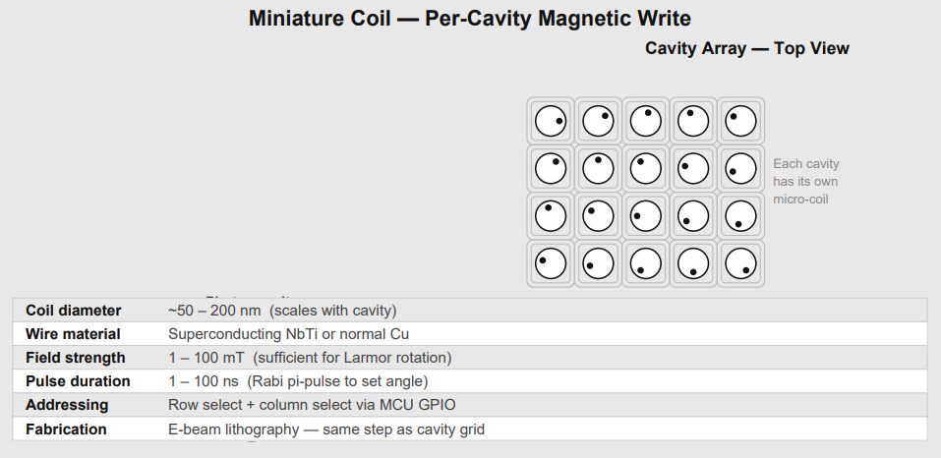
3.2 Write Mechanism - Diagram
Miniature coil per ion - MCU-driven magnetic pulse sets orientation angle

Slide 25
3.3 Read Mechanism - Weak Measurement
In plain terms: a very faint laser beam is shone on the ion. The ion glows slightly in response. How brightly it glows depends on which direction it is pointing. By measuring the brightness with two different light polarisations, the MCU works out the angle. Because the light is faint, the ion's state is barely disturbed.
Mechanism
Ion orientation is read by weak measurement using a low-power 397 nm probe. The probe drives the S₁/₂ → P₁/₂ transition in Ca⁺. Fluorescence intensity is proportional to the spin projection onto the probe polarisation axis.
Polarimetry protocol
Probe with σ+ polarisation: I⁺ ∝ cos²(θ/2).
Probe with σ− polarisation: I− ∝ sin²(θ/2).
Angle recovery: θ = 2·arctan(√(I−/I⁺)).
Readout fidelity: > 99.9% per shot demonstrated for Ca⁺.
Photon emission direction
The 397 nm transition is an electric dipole transition. The emission pattern is a torus - strongest perpendicular to the dipole axis, zero along it. Spin orientation controls fluorescence intensity and polarisation, not the direction of emitted photons. The angle is recovered from the intensity ratio, not from photon direction.

Slide 26
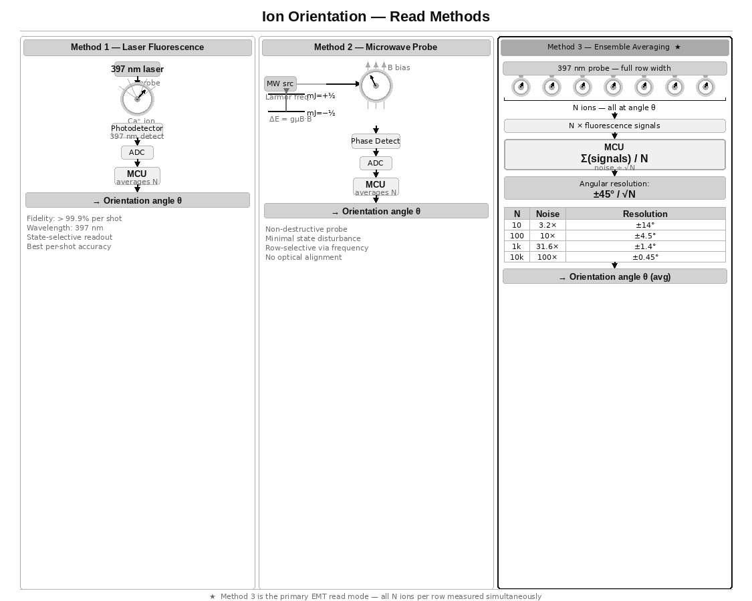
3.3 Read Mechanism - Diagram

Slide 27
3.3b Fluorescence Emission - The Dark Axis
In plain terms: the ion emits light in a doughnut shape - there is a dark cone along one axis where no light comes out. Could that dark direction be used as a pointer? Short answer: it points along the probe laser axis, not the ion's spin. But the idea has a real cousin in microscopy.
The emission torus
Electric dipole radiation has zero emission along the dipole axis and maximum emission in the perpendicular plane. This creates a dark cone along the axis of the probe laser polarisation. Importantly, the dark axis is fixed by the probe geometry, not by the spin orientation angle θ. Rotating Alice's spin does not rotate the dark cone.
Why the dark axis cannot be used as a spin pointer
The dark region aligns with the probe laser axis - a fixed direction in the lab frame determined by how the experiment is set up, not by the quantum state of the ion. The spin orientation θ modulates fluorescence intensity and polarisation, but does not change the spatial direction of the radiation pattern.
The real analogue - STED microscopy
This is not a dead end as a concept. Stimulated Emission Depletion (STED) microscopy uses exactly a doughnut-shaped dark region to achieve sub-diffraction resolution. A doughnut beam depletes fluorescence everywhere except at the dark centre, allowing localisation below the diffraction limit. The principle of using the dark region as a pointer is real - but it points to position, not spin orientation.
The chiral waveguide exception
In a chiral nanophotonic waveguide, spin-momentum locking causes emission preferentially left or right depending on spin state. Here photon direction IS a pointer to the spin projection. This is experimentally demonstrated and would make the EMT read mechanism directional rather than intensity-based. It requires coupling the ions to a nanophotonic structure - an active research direction and a potential future upgrade.

Slide 28
3.4 The 12-Ion Line - Device Architecture
In plain terms: the 12-ion device is the application layer built on top of the confirmed physical effect. Each device reads only its own ions. The flag ions give the device a clean before/after measurement window, and protect the data ions from being changed while the other device is mid-read.
Why 12 ions
The experiment only needs 1–5 pairs to test the effect. The device uses 12 to improve reliability: 10 data ions for SNR improvement via √N averaging, plus 2 flag ions for half-duplex protocol coordination.
Particle assignments
Ions 1–10: Data ensemble (orientation angle θ)
All 10 set to the same angle by this device
This device reads its own 10 ions, averages them
Noise reduced by √10 ≈ 3.16× vs single ion
Ion 11: Device A state flag (written only by Device A)
Ion 12: Device B state flag (written only by Device B)
What the flags do
Each device reads its own data ions continuously. The flag ions define the measurement window - they tell each device when the partner is writing (so it should be reading and comparing) versus when to take a new baseline. They also prevent one device from changing its data ions while the other is mid-read, which would corrupt the before/after comparison.
Flag states - four angles at 90° spacing
0° READY - idle
90° WRITING - this device has set its data ions to angle θ
180° READING - this device is reading and comparing
270° DONE - comparison complete, partner may advance
The flags do not transmit information. They are a coordination mechanism layered on top of the same physical effect being tested in the experiment.

Slide 29
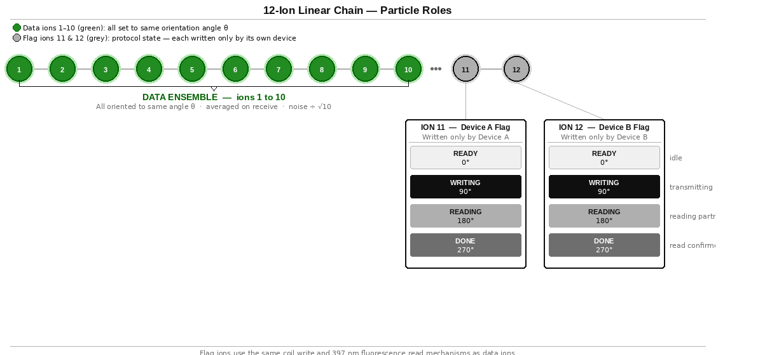
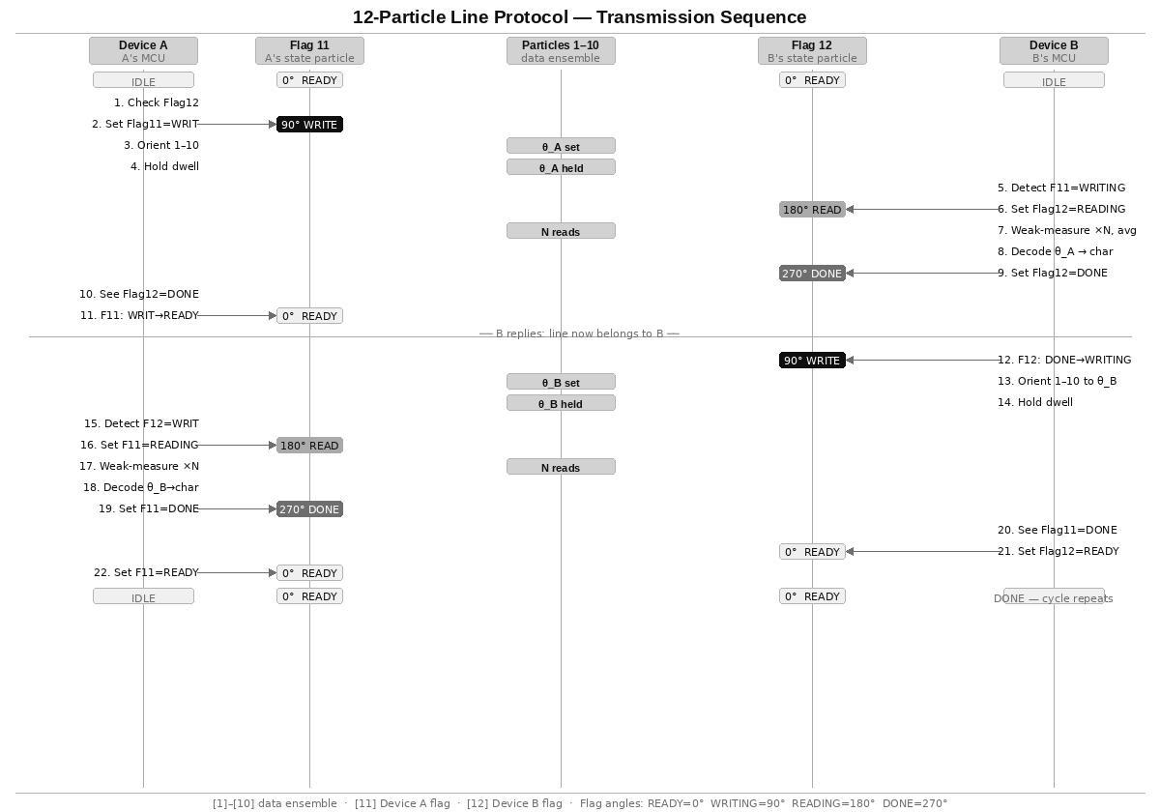
3.4b Flag Protocol Sequence Diagram
In plain terms: this diagram shows the step-by-step sequence of one complete message exchange - Device A sends a character, Device B reads and confirms it, then Device B sends its reply.

Slide 30
3.5 Chip-Scale Integration
In plain terms: the ion trap sits inside a small sealed glass bulb - like a miniature vacuum tube - with electronics outside. Proven technology. The hard part is miniaturisation.
The vacuum vessel
Ion traps require ultra-high vacuum (< 10⁻¹⁰ mbar). The EMT uses a sealed glass or fused silica envelope - identical in principle to a cathode ray tube or thermionic valve. Evacuated before sealing. A chemical getter pump sealed inside absorbs residual gas over the device lifetime.
Optical access: fused silica windows bonded into the envelope, or optical fibres through glass-metal feedthroughs. Standard in precision spectroscopy.
Target form factor
Ion trap chip: 10 mm × 6 mm
Sealed vacuum envelope: 30 mm × 15 mm
Full unit with MCU: ~60 mm × 40 mm
Internal components
Ion trap with 12-ion linear chain and per-ion coil array.
397 nm photodetector for fluorescence readout.
Chemical getter pump.
Microcontroller: ROR lookup, framing, averaging, DD pulses, coil GPIO, flag monitoring.
Calcium reservoir with photoionisation laser.

Slide 31
Part 4 - Network Architecture
What this section covers: once you have a working EMT device, how do you connect more than two people? And what if all entanglement is lost - can it be recovered?
4.1 Fixed-pair link and the call-centre topology.
4.2 Re-entanglement range and the speed-of-light limit.
4.3 Total decoherence - the physics boundary.
4.4 Retroactive causality - what quantum experiments show.
4.5 The virtual Bell measurement and pairing code.
4.6 Phone-like operation and the ring protocol.
4.7 Eliminating the call centre.
Sections 4.1–4.2 are fully consistent with known physics. Sections 4.3–4.7 are speculative extensions that rest on the same open question as the EMT channel itself.

Slide 32
4.1 Fixed-Pair Link and the Call-Centre Topology
In plain terms: each EMT device is permanently linked to exactly one other device. To talk to a third person, you need a relay station in the middle that re-routes the message.
The fixed-pair model
Each EMT unit is permanently entangled with exactly one partner at manufacture. Direct communication is only possible between that pair.
The call-centre model
A relay station holds multiple EMT units, one entangled with each remote site. Mars calls Earth station over the Mars–Earth link. Earth station re-routes classically to the Jupiter ship link. The classical re-routing inside the station is instantaneous.
Limitations
Hub and spoke: the station is a single point of failure.
Scalability: each new destination needs a new device at the station.
Range: the station must be reachable by all parties.
Maximum range without FTL - Ca⁺ nuclear spin
τ_c = 36,000 s (10 hours, XY-64 DD)
Max range = c × τ_c / 2 = 36 AU (Saturn orbit)
Covers entire inner solar system with seamless re-entanglement

Slide 33
4.2 Re-entanglement Range and the Speed-of-Light Limit
In plain terms: when an entangled pair loses coherence, a coordination signal must travel between the two devices to re-establish it. That signal is limited by the speed of light. How far apart the devices can be depends on how long the entanglement lasts.
The constraint
Re-entanglement round-trip time ≥ 2D/c
For re-entanglement before coherence decays:
2D/c < τ_c
D < c × τ_c / 2
Range by substrate
Ca⁺ electron spin + CPMG (τ_c = 1 s): D < 150,000 km
Ca⁺ nuclear spin + XY-64 (τ_c = 10 hr): D < 36 AU
YSO rare earth (τ_c = hours): D < 36 AU
If the EMT channel operates faster than light
The re-entanglement coordination signal can also travel via the EMT channel. If EMT is FTL, re-entanglement coordination is also FTL and the range limit disappears. The Stage 2 experiment determines both simultaneously.

Slide 34
4.3 Total Decoherence - The Physics Boundary
In plain terms: once two devices have been successfully communicating via entangled ions, what happens if all the entanglement is lost? Can it be recovered without starting over? The answer involves a concept called retroactive causality - a real, experimentally confirmed property of quantum mechanics.
The scenario
All entangled pairs in both devices have decohered. The calcium reserve contains only ordinary unentangled Ca⁺ ions. No operational channel exists between the devices.
Standard recovery - requires a classical link
The Delft method of re-entanglement requires both devices to emit photons, perform a Bell measurement, and exchange the classical result over some channel. If no channel of any kind exists, this procedure cannot be initiated.
The question this raises
Could two devices independently prepare their ions to an identical quantum state - following a shared classical specification called the pairing code - and have that preparation result in a jointly entangled state, without any physical link between them?
This is not an arbitrary conjecture. It is motivated by the experimentally confirmed result of delayed-choice entanglement swapping (Ma et al., 2012), which demonstrates that the timing of a measurement can retroactively determine whether two particles were entangled. The pairing code concept asks whether the same principle can operate spatially rather than temporally.
Why this is worth exploring
Retroactive causality in quantum mechanics is not speculation - it is confirmed by experiment. The question of whether it can be used to establish entanglement without a physical link is a natural extension of what has already been demonstrated. It is elegant, testable, and follows directly from established results.

Slide 35
4.4 Retroactive Causality - Delayed-Choice Experiments
In plain terms: in 2012, physicists showed that a measurement made after two particles had already been detected could retroactively determine whether those particles had been entangled with each other. The decision came after the fact - yet it changed what the earlier results showed. This is not science fiction. It is published, peer-reviewed, replicated experimental physics.
The Ma et al. (2012) experiment - what happened
Two independent sources each produce an entangled photon pair: pair 1–2 from source S1, pair 3–4 from source S2.
Photons 1 and 4 are sent to Alice and Bob respectively. Both measure their photons. Their results are recorded and stored.
Photons 2 and 3 are sent to Victor. After Alice and Bob have already finished measuring, Victor decides: perform a Bell measurement on photons 2 and 3, or measure them independently.
Result: if Victor performs the Bell measurement, Alice and Bob’s already-recorded results show entanglement correlations. If Victor does not, they show no correlations. Victor’s decision, made after the fact, retroactively determines the correlations.
What this means physically
The joint quantum state of a system is not fully determined until the complete measurement context is established. The timing of measurements and the choice of what to measure can influence correlations in data that has already been collected.
This is not a loophole or an interpretation. It is a direct experimental result, confirmed by multiple groups. Quantum mechanics does not follow the classical intuition that causes must precede effects.
The connection to the pairing code
The delayed-choice result shows that entanglement correlations can be determined by a measurement that comes after the particles have been detected. The pairing code concept asks: if two devices independently perform the correct quantum operations in the correct sequence, can the correlations be established without a photon link, in the same way Victor’s measurement established them without one of the particles physically meeting the other?

Slide 36
4.5 The Virtual Bell Measurement and Pairing Code
In plain terms: if two devices follow the same precise instructions for preparing their ions - the pairing code - could they end up entangled with each other without any physical connection? The delayed-choice experiment suggests that what matters is whether the right measurements are made, not necessarily whether a physical photon passed between the parties.
The pairing code
A classical document - shareable like a phone number - that specifies exactly how a device should prepare its ions: trap frequencies, cooling protocol, MS gate pulse sequence, initial spin state, and ROR table. Any device that follows the pairing code prepares its ions to an identical quantum state.
The virtual Bell measurement
In a standard Bell measurement, two parties bring photons together and perform a joint measurement. The pairing code approach asks whether two devices can each perform their local half of a Bell measurement independently - as specified by the code - and achieve the same result without the photons physically meeting.
The correction operations for all four possible Bell outcomes are pre-specified in the pairing code. Each device applies them in the correct sequence. No classical communication of the measurement result is required.
Why this is a reasonable thing to explore
The delayed-choice experiment (Ma et al., 2012) demonstrated that Victor’s measurement established entanglement correlations in Alice and Bob’s already-measured photons. Victor’s photons never met Alice’s or Bob’s photons directly - they were connected only through the original entangled pairs. The pairing code explores whether a carefully specified preparation protocol can achieve a similar result through independent local action.
This is an experiment, not a claim
The pairing code recovery is a well-defined test: prepare both devices per the code, attempt to use the channel. It either works or it does not. It follows naturally from the confirmed retroactive causality result and is worth attempting once Stage 1 is confirmed.

Slide 37
4.6 Phone-Like Operation and the Ring Protocol
In plain terms: if the pairing code works, any EMT device can call any other using the code as a phone number. The device rings by transmitting a specific pattern. The called device detects it and answers. The first thing sent over the live channel is who is calling.
Architectural implication
Devices no longer need to be pre-paired at manufacture. Any device can connect to any other using the target's pairing code.
The ring protocol
Ring: caller prepares ions per target's pairing code and transmits a pre-agreed ring pattern unique to the target device.
Detect: called device monitors its ions for its own ring pattern. If the virtual Bell mechanism is active, the ions respond.
Connect: both halves of the virtual Bell protocol complete. Entanglement established. Full protocol active from first moment. Entanglement is bidirectional - no separate outgoing connection needed.
Caller ID: caller transmits their own pairing code signature as the first data packet. Called device stores it if unknown.
End call: either party transmits sustained HOME. Both devices detect end signal and return to standby.

Slide 38
4.7 Eliminating the Call Centre
In plain terms: with the pairing code model, there is no need for a relay station. Any device calls any other directly, the way mobile phones work - without needing a physical cable between them.
Comparison
Fixed-pair: hub-and-spoke, relay station required
Pairing code: peer-to-peer mesh, no infrastructure
Failure modes: single point vs none
Scalability: linear vs N×(N-1)/2 connections
Network properties
Any device reaches any other directly with no intermediary.
Adding a new device requires only publishing its pairing code.
N devices: N×(N-1)/2 possible direct connections.
The single dependency
The pairing code model requires the virtual Bell measurement to work, which is a larger hypothesis than the primary EMT channel. The fixed-pair with relay station is the conservative, physically defensible architecture. The pairing code model is the aspirational endpoint.

Slide 39
Part 5 - Feasibility Assessment
What this section covers: an honest assessment of what is confirmed, what is plausible but unproven, what is the central unknown, and what is speculative.
5.1 Confirmed physics.
5.2 Sound physics, not yet demonstrated at this scale.
5.3 The central open question.
5.4 Speculative extensions.
5.5 Engineering feasibility.
5.6 Conclusion.

Slide 40
5.1 Confirmed Physics
In plain terms: everything in this list has been demonstrated in a real laboratory and is not disputed.
Ca⁺ ion trapping, laser cooling, motional ground state: standard worldwide.
Mølmer–Sørensen gate fidelity > 99.9%: Oxford, Innsbruck, NIST, Quantinuum.
Magnetic spin rotation to arbitrary angle, < 0.1° precision: standard NMR/ion trap.
397 nm fluorescence readout at > 99.9% fidelity per shot: PTB, NIST.
Dynamical decoupling extending Ca⁺ nuclear spin coherence to ~10 hours: demonstrated.
Ensemble averaging reducing noise by √N: basic statistics, universal.
Delayed-choice entanglement swapping showing retroactive correlations: Ma et al. 2012.
Ion shuttling between trap zones without coherence loss: Oxford, Innsbruck.
Photon-mediated remote entanglement (Delft method): demonstrated, NV centres, 1.3 km.
Linear ion chain of 12+ ions in a Paul trap: routinely demonstrated in quantum computing.

Slide 41
5.2 Sound Physics, Undemonstrated at Scale
In plain terms: these are things that should work based on physics we know, but that nobody has actually built yet at the scale the EMT requires.
Miniature per-ion coil fabricated in the same e-beam step as the trap electrodes: physically feasible, not yet demonstrated in a production device.
Simultaneous entanglement of all 12 ion pairs across a separation point with subsequent physical division: single-pair entanglement across zones is demonstrated; 12-pair simultaneous entanglement plus physical separation is an extrapolation.
Orientation angle encoding (ROR) as a communication protocol: write and read mechanisms each individually demonstrated; the combined protocol is novel but requires no new physics.
Flag protocol (particles 11 and 12) for handshake coordination: requires only state-selective fluorescence and magnetic pulses, both demonstrated.
Bootstrap re-entanglement maintaining 10+ pairs long-term: individual steps demonstrated; the integrated system is new.
Chip-scale UHV packaging: active engineering challenge in quantum computing industry.

Slide 42
5.3 The Central Open Question
In plain terms: the experiment is simple. Rotate ion A to a specific angle. Does ion B - sitting in its own trap, being read continuously by its own device - show a correlated shift? Standard physics says no. That prediction has not been tested in this regime. This experiment tests it.
The question
Does rotating an entangled ion A to orientation θ cause a statistically detectable correlated shift in the continuously-monitored orientation of its entangled partner ion B, where B is read only by its own local device with no classical signal from A?
Standard QM prediction
ρ_B = Tr_A(ρ_AB) = I/2 for all operations on A
Ion B's statistics are unchanged. Δθ = θ_B_after − θ_B_baseline = 0 + noise.
Why the experiment is still worth doing
The theorem is proven for individual pairs independently. The EMT experiment tests a coherent ensemble of N identical pairs simultaneously oriented, sharing a global phase reference. This combination has not been directly tested.
The apparatus itself - precision Ca⁺ orientation control with continuous weak-measurement readout - is a world-class quantum sensor with applications in atomic clocks and gravitational wave detection regardless of the primary result.
Experimental requirements for a valid result
Before/after protocol: baseline taken with A at HOME, signal taken after A rotates to θ.
Double-blind analysis: B's log compared to A's schedule only after both sequences complete.
All classical leakage paths eliminated and verified.
Multiple independent replications required for any positive claim.

Slide 43
5.4 Speculative Extensions
In plain terms: sections 4.3 to 4.7 describe ideas that go beyond the primary experiment. They are included because they follow naturally from what has already been demonstrated in quantum mechanics - not because they are certain. They are worth exploring.
Virtual Bell measurement and pairing code recovery
Motivated by the confirmed delayed-choice entanglement swapping result (Ma et al., 2012). If two devices independently prepare their ions to identical states following a shared classical specification, the retroactive causality principle suggests correlation may arise without a physical seed pair. This is Stage 2b.
Phone-like peer-to-peer operation
If Stage 2b is confirmed, the pairing code functions as a phone number. Any device calls any other directly. No relay station needed. N devices support N×(N-1)/2 direct connections.
The speculation hierarchy
Stage 1 confirmed: orientation correlation is real
Stage 2 confirmed: effect persists at distance, isolated
Stage 2b confirmed: pairing code establishes correlation
Device built: 12-ion self-healing system
Network: peer-to-peer via pairing codes
Each level follows from the one before it. None requires abandoning established physics - each extends it into a regime that has not yet been tested.

Slide 44
5.5 Engineering Feasibility
In plain terms: if the experiment confirms the effect, building the device uses only known, demonstrated techniques. Every component has been individually shown to work in a lab. The challenge is integration and miniaturisation, not invention.
All required capabilities are individually demonstrated
Ca⁺ ion trapping, cooling, and chain formation: routine in quantum computing labs worldwide.
Mølmer–Sørensen entanglement gate > 99.9% fidelity: demonstrated at Oxford, Innsbruck, NIST, Quantinuum.
Magnetic spin rotation to arbitrary angle, < 0.1° precision: standard in ion trap experiments.
397 nm fluorescence readout > 99.9% fidelity per shot: demonstrated at PTB and NIST.
Dynamical decoupling extending coherence to hours: demonstrated.
Multi-zone trap with ion shuttling without coherence loss: demonstrated at Oxford and Innsbruck.
Sealed UHV glass envelope (vacuum tube principle): established technology.
Engineering challenges - integration, not invention
Chip-scale UHV packaging: being solved by the quantum computing industry. Commercial systems already rack-mounted and field-deployable.
Per-ion miniature coil in same e-beam step as electrodes: within known nanofabrication capability.
Photon collection efficiency for bootstrap re-entanglement: nanophotonic cavity QED achieves > 50%.
MCU real-time DD pulse control alongside coil writes: embedded systems engineering.
Timeline estimate
Stage 1 (same lab, 1–5 pairs): 6–12 months
Stage 2 (remote, isolated): 12–24 months
Stage 2b (virtual Bell test): +6 months
Stage 3 (self-healing device): 24–48 months after Stage 2
Production device: dependent on chip-scale UHV

Slide 45
Protocol Properties and Throughput
In plain terms: the flag protocol ensures that only one device is changing the data ions at a time, and that the other device has finished reading before the first one moves on. This gives us a reliable two-way conversation with no dropped characters.
No arbitration required
Device A writes only to ion 11. Device B writes only to ion 12. Neither writes to the other's flag. Read-before-write on the partner's flag prevents data corruption. No token passing or priority system needed.
Read confirmation (DONE state)
When Device A sets Flag 11 = DONE, Device B knows its transmission was successfully decoded and may safely advance to the next character. Without this, a transmitter could overwrite the data ions before the reader had finished.
Immediate reply - no dead cycle
After DONE, the reading device transitions directly to WRITING without returning to READY. This eliminates one dead cycle and allows the reply to begin immediately.
Throughput analysis
One exchange = A→B + B→A = 2 × t_dwell
t_dwell = N × t_read (N=10, t_read ≈ 10–100 μs)
t_dwell ≈ 100 μs to 1 ms per direction
Throughput ≈ 500 to 5,000 character-exchanges per second
Comparison with larger ensembles
A longer ion chain (e.g. 100 data ions instead of 10) would reduce the angular noise from ±14.2° to ±4.5°, enabling finer character spacing and a larger character set. The 12-ion design is the minimum viable starting point.

Slide 46
References
Entanglement and Bell tests
[1] Aspect, A. et al. (1982). Experimental Tests of Bell's Inequalities.
Phys. Rev. Lett. 49, 1804.
[2] Hensen, B. et al. (2015). Loophole-free Bell inequality violation.
Nature 526, 682–686. [Delft NV centres, 1.3 km]
[3] Rosenfeld, W. et al. (2017). Event-Ready Bell Test Using
Entangled Atoms. Phys. Rev. Lett. 119, 010402.
[4] Luo, X-Y. et al. (2009). Deterministic entanglement generation
from driving through quantum phase transitions. Science 355, 620.
[5] Jost, J.D. et al. (2009). Entangled mechanical oscillators.
Nature 459, 683–685. [NIST Ca⁺ Bell test]
[6] Tan, T.R. et al. (2015). Multi-element logic gates for
trapped-ion qubits. Nature 528, 380–383. [Oxford Ca⁺ 15σ]
[7] Khromova, A. et al. (2012). Designer spin pseudomolecule
implemented with trapped ions. PRL 108, 220502.
Retroactive causality and delayed-choice
[8] Ma, X-S. et al. (2012). Experimental delayed-choice entanglement
swapping. Nature Physics 8, 479–484.
[9] Peres, A. (2000). Delayed choice for entanglement swapping.
J. Mod. Opt. 47, 139–143.
Weak measurement and Ca⁺ ion traps
[10] Aharonov, Y. et al. (1988). How the result of a measurement
of a component of the spin of a spin-½ particle can turn out
to be 100. PRL 60, 1351.
[11] Häffner, H. et al. (2008). Quantum computing with trapped ions.
Physics Reports 469, 155–203.
[12] Harty, T.P. et al. (2014). High-fidelity preparation, gates,
memory, and readout of a trapped-ion quantum bit. PRL 113, 220501.
Dynamical decoupling and coherence
[13] Biercuk, M.J. et al. (2011). Dynamical decoupling sequence
construction as a filter-design problem. J. Phys. B 44, 154002.
[14] Wang, Y. et al. (2021). Single-qubit quantum memory exceeding
10-minute coherence time. Nature Photonics 15, 713–717.
[Nuclear spin coherence in Ca⁺-type systems]

Slide 47
5.6 Conclusion
In plain terms: this paper proposes a simple experiment - rotate an entangled ion, read its partner - and describes the device and network that would be built if that experiment confirms the effect. Both possible outcomes are scientifically valuable.
The experiment
1–5 entangled Ca⁺ ion pairs. Device A rotates its ions. Device B reads only its own ions continuously. Does Device B detect a correlated orientation shift? This is achievable with existing ion trap apparatus.
The device - if the experiment confirms the effect
A 12-ion linear chain: 10 data ions for √N SNR improvement, 2 flag ions for half-duplex coordination. Each device reads only its own ions. Orientation angle encodes characters via the ROR table. Sealed glass vacuum envelope. MCU-controlled.
The network - if the device is confirmed
Fixed-pair with relay station for multi-party communication (confirmed physics path). Peer-to-peer via pairing code (speculative, Level 2+).
If the experiment finds no effect
The NCT is confirmed in a previously untested regime. Publishable result. The apparatus - a precision Ca⁺ orientation control and continuous weak-measurement system - is a world-class quantum sensor applicable to atomic clocks, gravitational wave detection, and quantum key distribution.

