Slide 1
Entangled Multiplexing Transceiver
EMT
A Proposed Architecture for Faster-Than-Light Signalling via Entangled Particle Grids, Magnetic Orientation Encoding and Ensemble Weak Measurement with Full-Duplex Operation.
Daniel Miles
25/04/2026
Original Concept Paper
https://alternitech.square.site
Rev.1

Slide 2
Abstract
This paper proposes the Entangled Multiplexing Transceiver (EMT) - a novel architecture for faster-than-light communication using entangled particle arrays.
Each EMT unit contains a grid of entangled particles held within a lattice structure (a slab). Each row of particles are magnetically aligned to the same orientation, corresponding with an alpha-numeric-symbol character on a look-up table I call the Rotary Orientation Ring.
Each slab is entangled at the time of manufacture to another slab and each slab is divided into a TX half and an RX half, enabling simultaneous bidirectional (full-duplex) communication on a pair of entangled slabs.
The home position at zero degrees (180 for device B due to opposite spin in entangled particle pairs) is permanently reserved as a message delimiter - a neutral position to indicate “ready” or “standby”.
All particles (N) in each row are set to the same orientation - the receiver averages all readings to recover the angle with noise reduced by root-N.
Orientation is written using miniature coils surrounding each particle cavity - magnetic field pulses rotate the spin state to any target angle in nanoseconds.
Orientation is read by weak laser measurement averaged by the microcontroller. The TX-to-RX row split is software-adjustable for real-time adaptive bandwidth. A single MCU handles all disc lookup, averaging, and framing.

Slide 3
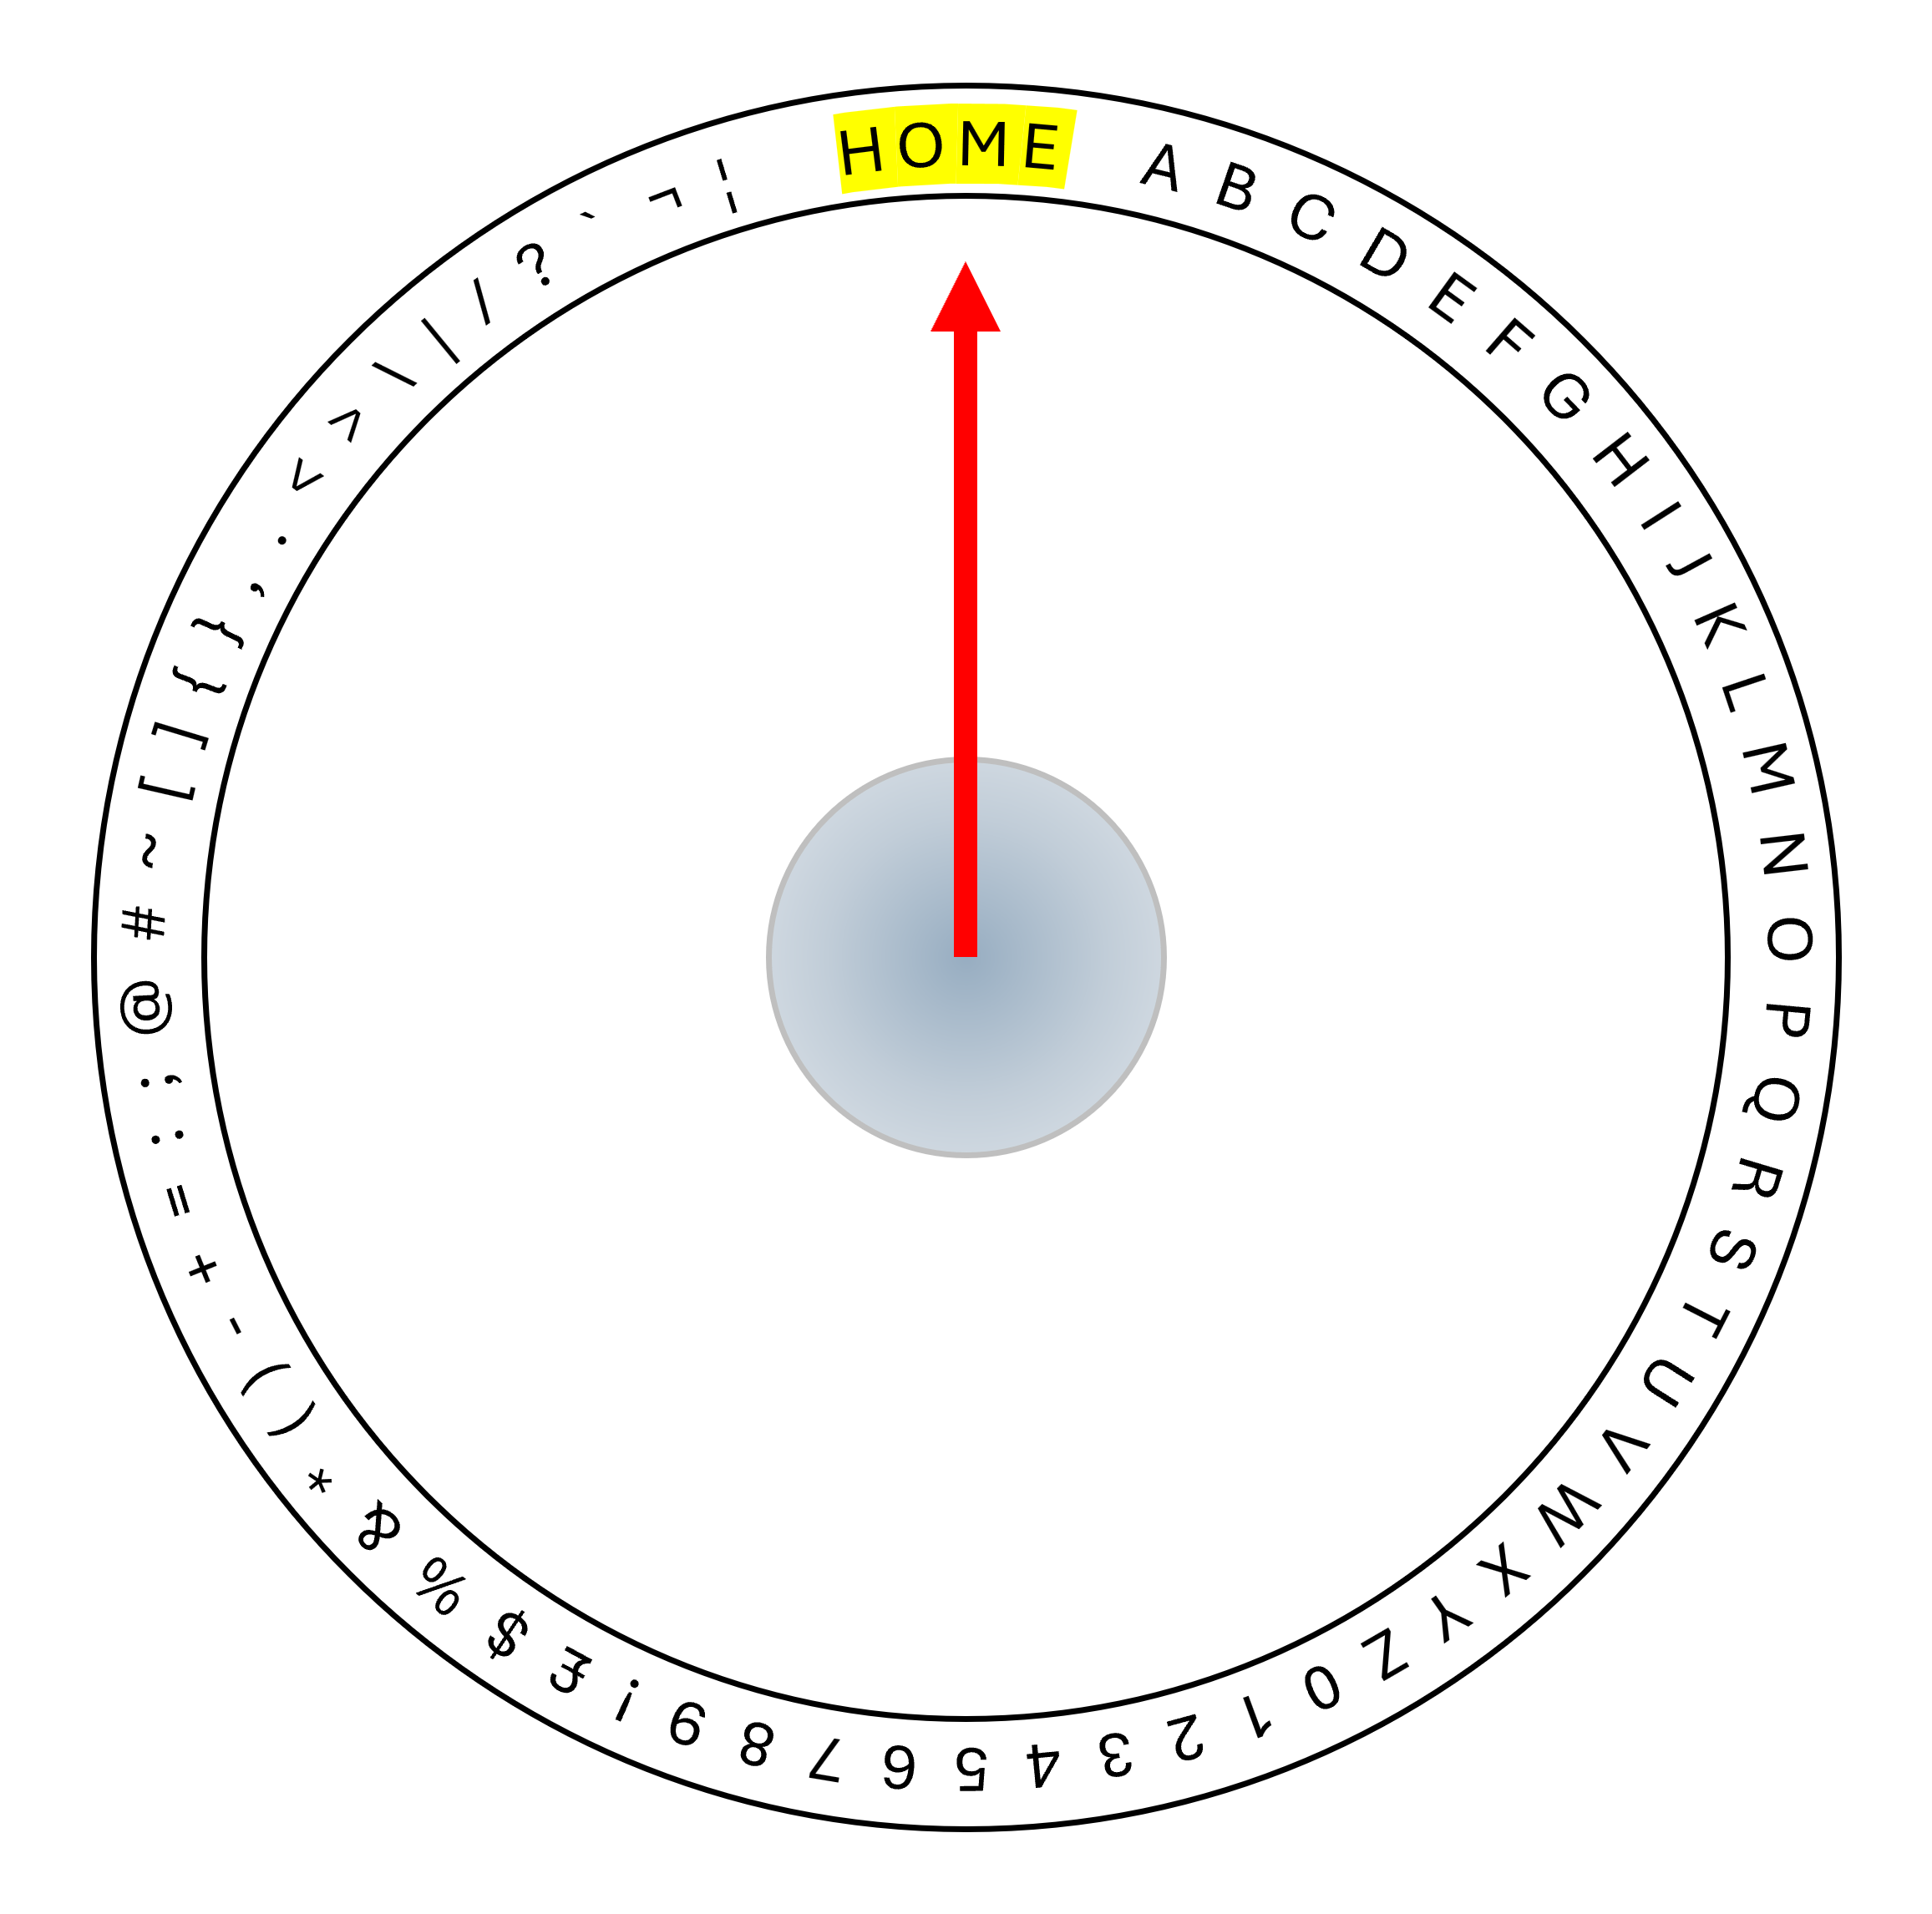
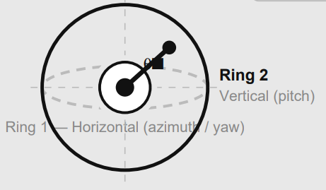
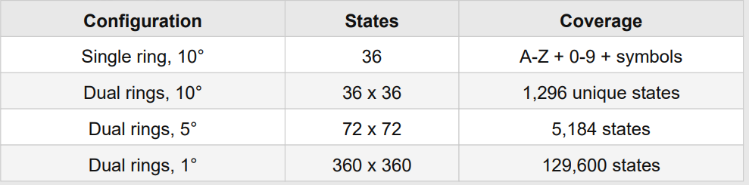
Rotary Orientation Ring
The virtual disc is a software lookup table loaded identically onto both EMT units at manufacture, device B has its table’s orientations reversed to match the spin-up/spin-down pairing of the entangled Photons. It maps each character to a unique orientation angle of the particle’s spin axis. The home position at exactly 0 degrees (180 for device B) is permanently reserved and is never assigned to any character. The character A begins at the first angular position immediately after the home zone.
Adding a second ring on the perpendicular vertical plane gives two independent orientation axes per particle.
At ten-degree resolution this yields 1,296 unique states,
sufficient for full alphanumeric
and extended character coverage.

Slide 4
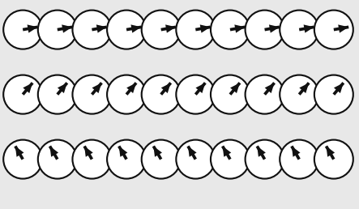
Multiplexing
Each row of particles encodes exactly one character. Every particle in the row is set to the identical orientation angle corresponding to that character, all 10 particles per row carry orientation data. The receiver weak-measures all 10 simultaneously and averages the results, recovering the orientation with noise reduced by the square root of 10 compared to a single-particle read. This uniform orientation within each row is the core principle of ensemble noise reduction. The receiver does not need to know which particle is which — it simply averages all readings across the row and maps the result to the nearest disc position via the virtual disc lookup table (see Rotary Orientation Ring).
Row 1
Row 2
Row 3
H
E
Y

Slide 5
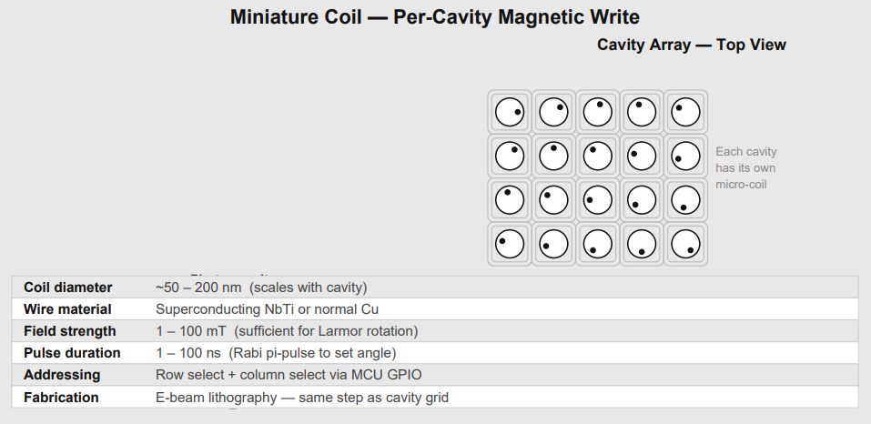
Magnetic Orientation
Each photon cavity in the slab is surrounded by a miniature coil fabricated in the same electron-beam lithography step as the cavity grid. The coil generates a localised magnetic field when driven by a current pulse from the MCU. The field pulse rotates the spin state via the Zeeman effect to any target orientation angle with nanosecond precision and sub-degree accuracy. Similar to how an electric motor works. Coil diameter scales with cavity size, ranging from 50 nm for photonic crystal slabs to 200 nm for NV-centre diamond grids. Row addressing is achieved by a row-select and column-select matrix driven directly from MCU GPIO pins — no optical alignment is required for the write operation.

Slide 6
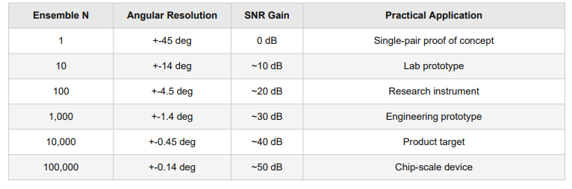
Noise Reduction
Each character row contains N particles all set to the same orientation. The MCU averages N weak measurements. Angular resolution improves as root-N. At N = 10,000 the resolution reaches 0.45 degrees — well below the 5-degree step size required for full character coverage.

Slide 7
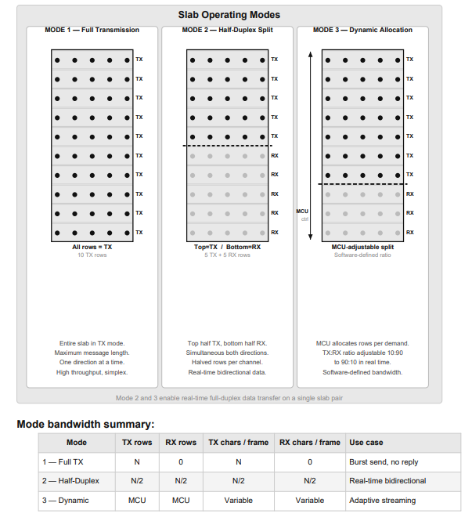
Operating Modes
The EMT slab supports three software-defined operating modes. In Mode 1, the entire slab transmits, maximising the number of characters per frame. In Mode 2, the slab is split horizontally — the top half transmits and the bottom half receives simultaneously, enabling real-time bidirectional data transfer on a single slab pair. In Mode 3, the MCU dynamically adjusts the TX-to-RX row ratio in software to match the asymmetric bandwidth demands of the application

Slide 8
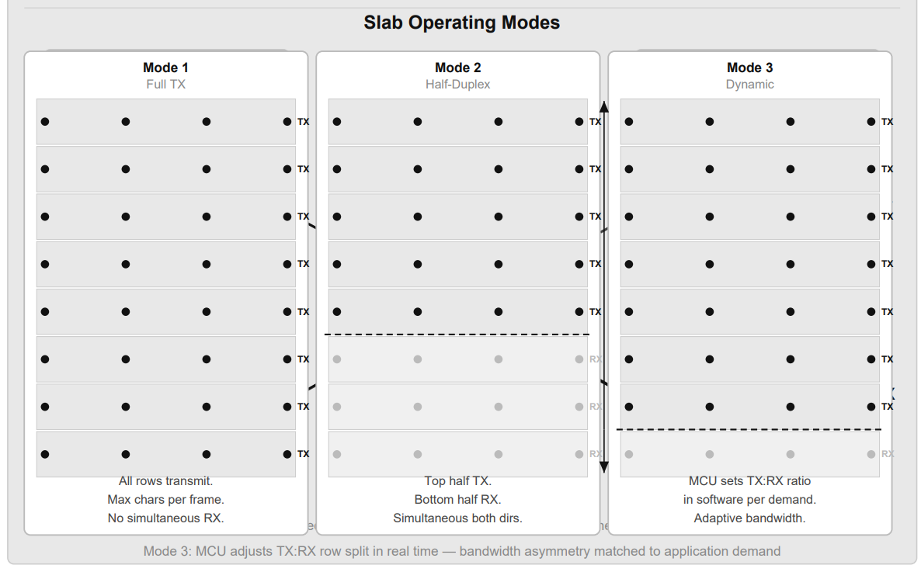
Full-Duplex Transceiver Architecture
Each EMT unit contains one slab. The slab is divided horizontally: the top half operates in TX mode (orienting particles to transmit characters) and the bottom half operates in RX mode (weak-reading particles to receive characters). This gives simultaneous bidirectional communication on a single slab. The entangled relationship is crossed: the TX rows of Machine A are entangled with the RX rows of Machine B, and the RX rows of Machine A are entangled with the TX rows of Machine B. Both slabs are manufactured as one unit, cleaved at the centre, and shipped to their respective sites

Slide 9
Reading Mechanism
Particle orientation is read using weak measurement — a low-power probe interaction that extracts partial orientation information without fully collapsing the quantum state. A probe laser illuminates the particle row; a photodetector collects the fluorescence or phase-shifted output; an ADC samples the signal; and the MCU averages N samples and maps the result to the nearest disc position.

Slide 10
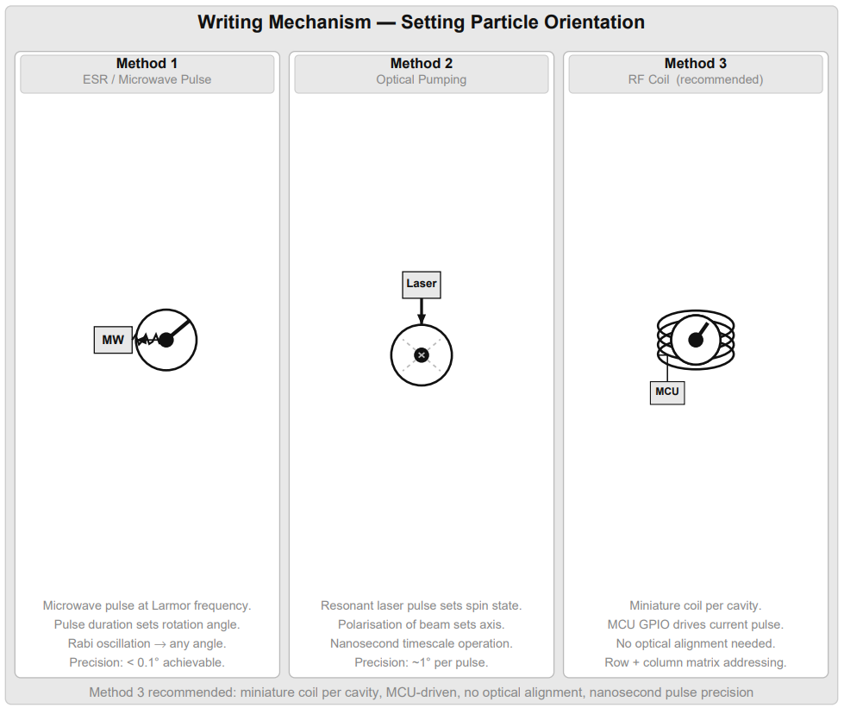
Writing Mechanism
Setting particle orientation requires a controlled rotation of the spin state. Three methods are described. The recommended production method is the miniature coil described in Section 8, which combines Method 3 (magnetic field) with per-cavity addressing and MCU-compatible drive signals

Slide 11
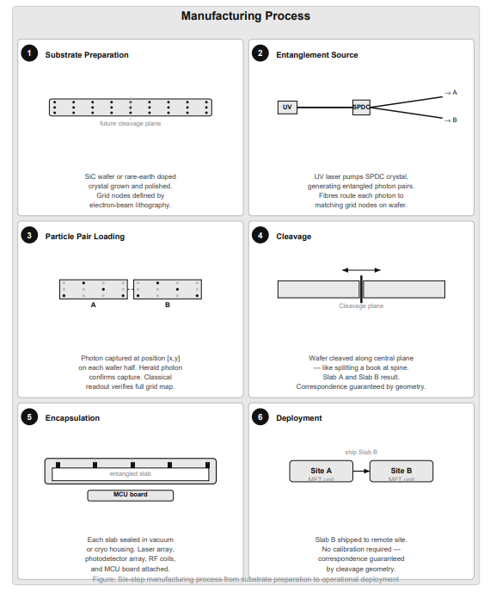
Manufacturing Process
Both slabs are produced as one unit and cleaved after entanglement. Each EMT unit requires two such cleavage pairs: one for its TX channel and one for its RX channel. The miniature coils are fabricated in the same lithography step as the cavity grid, adding no additional process stages.

Slide 12
Operational Process
The EMT supports three transmission modes, each suited to different use cases. In all modes the receiver continuously weak-reads all RX rows, averages across the ensemble, and decodes via the virtual disc. HOME (0°) always serves as the start and end delimiter. Mode A — Maximum Signal (all rows, same character): All TX rows in the slab are set to the same orientation simultaneously. This maximises the total ensemble size available to the receiver for that character — if the slab has 100 rows each with 10 particles, the receiver averages 1,000 readings for a single character. This gives the highest possible signal-to-noise ratio and is used when the channel quality is poor or the angular resolution needs to be maximised. Mode B — Parallel Message (each row = one character): Each TX row is set to a different orientation corresponding to a different character in the message — all simultaneously. A 50-row slab transmits 50 characters at once. After the dwell window the transmitter loads the next 50 characters and updates all rows simultaneously again. This gives maximum throughput at the cost of per-character ensemble size. Mode C — Cascading Pipeline (rolling character advance): Rows are treated as a shift register. When row 1 has completed its dwell, it advances to the next character while row 2 is still holding its current character. This creates a continuous pipeline where the receiver is always decoding a moving window of characters. As soon as row N completes, character N+1 loads into row 1. This gives the lowest latency for streaming data at the cost of slightly reduced per-character dwell time.

Slide 13
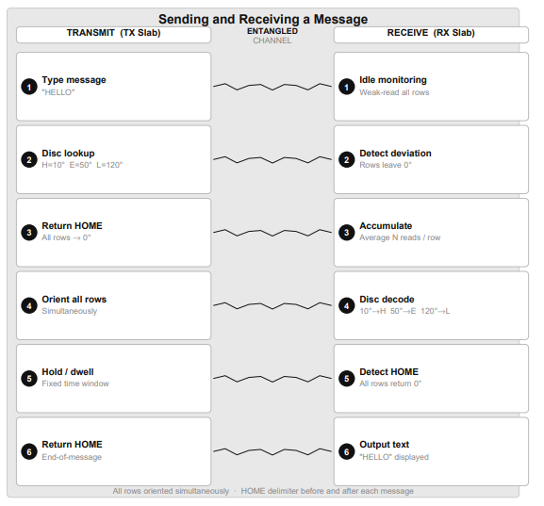
Message Logistics
Title

Slide 14
Chip Scale Integration
Each EMT unit targets a standard chip package. The entangled slab occupies the central die area, surrounded by a miniature RF coil write array, a laser and photodetector read array, and a single microcontroller (MCU) handling all logic: ADC averaging, virtual disc lookup, message framing, and GPIO coil addressing. A Peltier cooling layer completes the stack — all within a 12 mm x 8 mm form factor. The MCU is sufficient for all real-time processing at the data rates involved.

Slide 15
Substrate Materials
Coherence time is the dominant factor for EMT longevity. A device at a remote site - on another continent, in orbit, or on the Moon - must maintain entanglement for the entire mission window.
Microsecond or millisecond coherence limits the device to same-room distances at best.
Practical QEMT deployment requires coherence times of hours, days, or ideally weeks. The table below is ordered by FTL fitness with coherence as the primary ranking criterion.
Only the top three candidates are realistically viable for any deployment beyond the same building.
More research needs to be conducted into suitable materials for increased duration of coherence & stability.
Material | Coherence | Temp | Scalability | FTL Fitness
Rare Earth YSO (Eu/Pr) | HOURS ★★★★★ | 4 K | Moderate | EXCELLENT #1
NV Centres in Diamond | ms – s ★★★★ | Room temp | Limited | GOOD #2
Phosphorus in Si (Si:P) | s ★★★★ | Room temp* | Excellent | GOOD #3
Silicon Carbide (SiC) | us – ms ★★ | Room temp | Excellent | MARGINAL
Trapped Ions (Ca+) | s – min ★★★ | Near 0 K | Very Poor | MARGINAL (lab only)
Photonic Crystal (Si) | ps – ns ★ | Room temp | Excellent | POOR — coherence fatal
Superconducting Qubits | us – ms ★★ | 15 mK | Good | POOR — coherence + cryo
Quantum Dots (InAs) | ns – us ★ | 4 K | Good | POOR — coherence short

Slide 16
Open Experiment Question
The no-communication theorem is proven within the current quantum mechanical formalism for discrete single-shot measurements.
The EMT architecture operates in a regime not fully addressed by existing proofs: spatially parallel transmission, continuous-variable orientation encoding, large-ensemble weak-measurement averaging, and a global phase reference shared at manufacture.
The critical experimental question is whether, at some ensemble size N, the averaged orientation signal on the receiver slab exceeds the uncertainty-principle noise floor for a controlled orientation applied to the transmitter slab.
Either experimental outcome is a significant scientific result.

Slide 17
Expanding the reach
While a pair of these enable communication across the solar system, it is restricted to the 2 devices:
Mars <-> Earth
Or Earth <-> Spaceship
To overcome this limitation, imagine a “call centre” that houses all Earth bound transceivers (or a dedicated space station) - by housing and connecting them together, communication channels can be extended, for example:
Mars wants to call a Ship orbiting Jupiter but the Ship only has 1 EMT that is entangled with a EMT on the “Call Centre Station”..
Mars would call the Station and the Station would route the call using classical means in-between the multiple EMTs.
DynamicDecoupling
Continuous re-entanglement
Calcium ions

