Slide 1
TITLE DEFENSE
IC2MB – Group 3

Slide 2
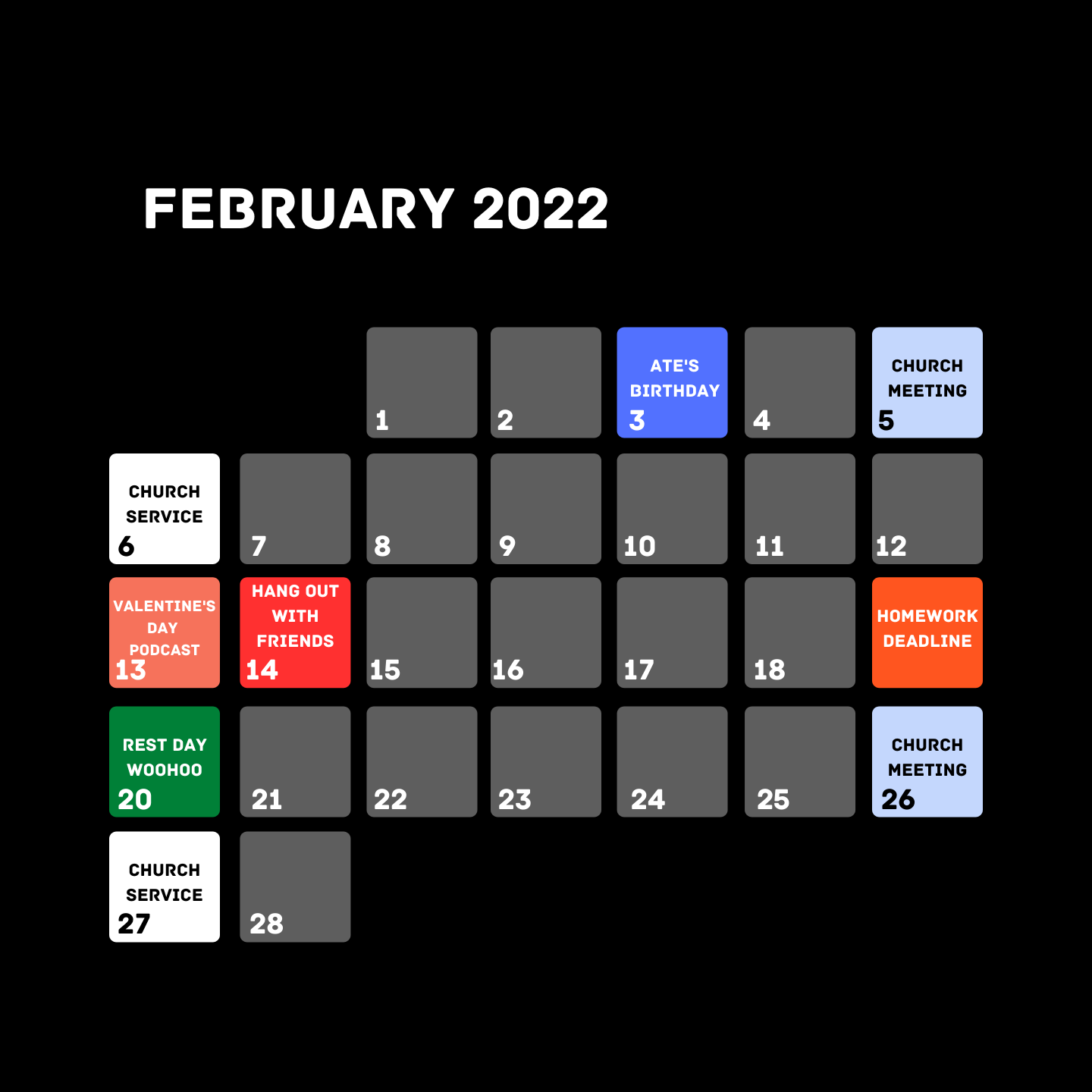
Development of Web based Productivity Calendar Application using Node JS for Students

Slide 3


BACKGROUND OF THE STUDY
As we all know, many students are now in home do their Online classes. Students can benefit inside and outside of schools from organizational tools like calendars, presentation templates, and note-taking apps. Whether students are setting goals, receiving homework reminders, using mind maps, or tweaking their schedules, they are sure to be building long-lasting skills.

Slide 4

SCOPE AND LIMITATION
Schedule
6:00 – 6:30
Make Breakfast
This study focuses on the use of the Productivity Calendar Application using Node JS for Students of the Asian Institute of Computer Studies Montalban. This can help students to input their schedules or to set their important tasks.
6:30 – 8:00
Clean the House
8:00 – 10:00
Do Laundry
10:00 – 10:30
Take a Shower
10:30 – 11:00
Make Lunch
11:00 – 15:00
Finish Homework
15:00 – 17:00
Free Time

Slide 5

POSSIBLE APPROACH
Finish Homework
We could create an entire calendar application connected to a database via Node JS using: the Express JS framework to serve the HTTP server, Socket IO to keep the connection between the client and the server, and sqlite3 as the database.
First, the user would visit the website, and then the server would serve an HTML page to the user with a JavaScript function connected to the server via Socket IO. From there, the server would detect if the user is already logged in or not based on an account token on the user's browser LocalStorage. If the user is not yet authorized or logged in, the server will prompt a Login Page. However, if there's a valid account token on the user's browser LocalStorage, the server would send data from the database corresponding to the user's data (E.g. Profile, Informations, Schedules, etc.).
Subjects
OJT
MIL122
HUM122

Slide 6

Finish Homework
POSSIBLE APPROACH
MIL122
Not Done
Second, the user would start interacting with the page, and the server would keep track of it. Every element the user interacts with, the server would respond. If the user added a schedule to a specific date, the server would save that to the database.
Third, if the user decides to move a schedule to another day, they can click a button that would trigger an algorithm to start calculating possible choices.
Good Morning! Please answer these following: Module 2: Activity 1 Activity 2
Deadline: February 19, 2022
After answering, kindly submit on Google Classroom
All of the work must be handwritten
Indicate your full name on each page of your paper

Slide 7


Implementation of Web based Student Attendance Monitoring System using Node JS for both MDL and ODL modality in Asian Institute of Computer Studies Montalban

Slide 8

BACKGROUND OF STUDY
NAME OF SCHOOL
As we all know, it presents Attendance Monitoring System that can be accessed without the understudy login data being provided. Which also incorporates the section period, the student must enter his or her student ID number. The admin may include understudy records from the admin board by entering the ID, title, course, and segment. All the participation records can be accessed by the admin.'
TEACHER’S PROFILE
SECTION
IC2MB
HU2AA
IC2MA
AB2MC

Slide 9

SCOPE AND LIMITATION
NAME OF SCHOOL
SECTION
IC2MB
Learner’s Name
(Last Name, First Name, Middle Name)
Baynosa, Daniel John
This study focuses of developing web based student attendance using node Js for Online Classes to the Asian Institute of Computer Studies Montalban, that can help students especially teachers to list and record the student's presence during online classes.
Flores, Mark Isaac Tabo
Flores, Reiuel Agonoy
Loyola, Andrian Mark
Santiago, John Red Norbe
Turalde, Rine Dela Cruz
Marzo, Jhean Glyneth Mascareñas
Valencia, Daphney Gwen Delequeña

Slide 10
POSSIBLE APPROACH
To make this application, we will use Node JS as our backend server and the: Express JS framework to serve the HTTP server; Socket IO to keep the connection with the client; and sqlite3 as our database for attendance data.
First, the user would visit the website. The server would prompt a login page using an HTTP server. The login page would take an input of student ID and password. After the user inputs their student or teacher ID and password, the server will send an HTTP request to an API to check if the student or teacher ID and password are valid.
Second, if the user is a teacher, the

Slide 11

Development of Web based S.O.S game for Entertainment using Node JS

Slide 12


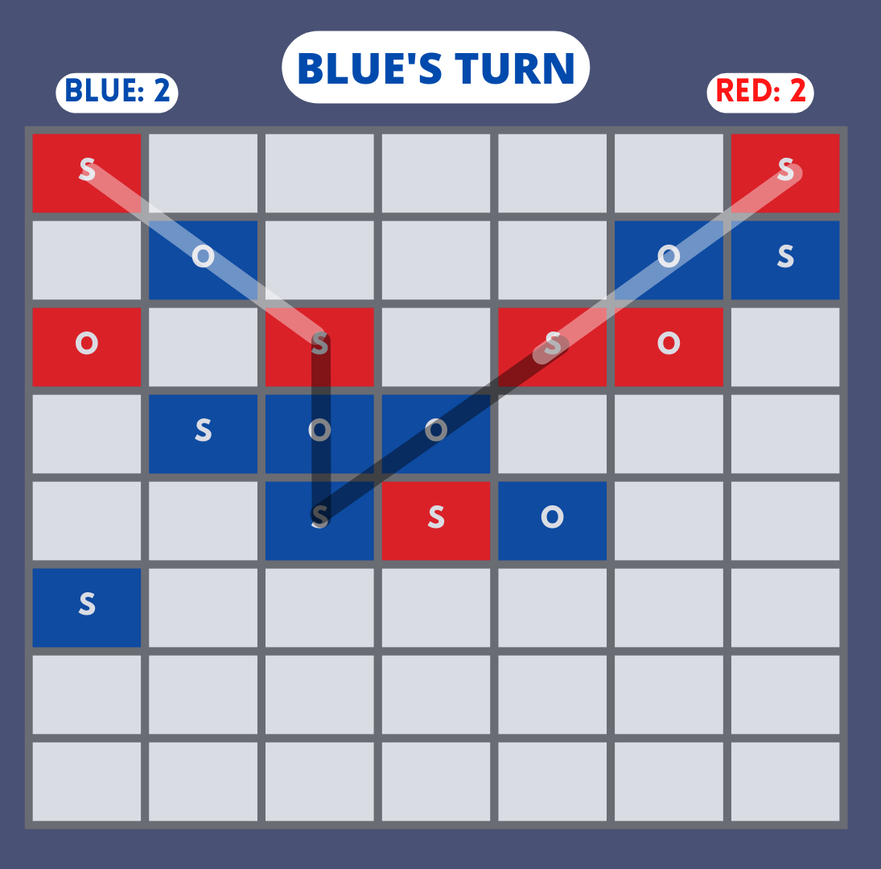

BACKGROUND OF STUDY
This is a design and implementation of a prototype application using server-side JavaScript programming language, Node JS as a backend database. It scales and evaluates the developed prototype application like the S.O.S game, Before the game begins, a square grid of at least 3x3 squares in size is drawn. The object of the game is for each player to attempt to create the straight sequence S-O-S among connected squares. If a player succeeds in creating an SOS, that player immediately takes another turn and continues to do so until no SOS can be created on their turn. The goal of this study is to improve the game's scalability and performance. As specified in Node JS website, one of the node’s goals is to make an easy way of developing scalable network programs.

Slide 13



SCOPE AND LIMITATION
The Study may Focus mainly on the "Development Of the Game S.O.S" with the used of "Node JAVA script" inside and tutored by the Asian Institute of Computer Studies Montalban. The S.O.S Game is made for entertainment purposes.

Slide 14
POSSIBLE APPROACH
To make this game, we could still use Node JS as our backend server and the: Express JS framework to serve the HTTP server; Socket IO to keep the connection between the Players; and sqlite3 as our database for user progress data.
First, same as the previous possible approaches, the server would check if the user is authorized or logged in.
Second, when the user clicks the play button, the website would ask if the user wants to play offline or online: If the user decides to play offline, the user will go against a computer; And if the user chose to play online, they would play against another player.
Third, to give all players an equal chance to play, all players who clicked the multiplayer button will be added to the queue. So, the first two players from the queue line will play against each other, and the server will remove them from the queue.

