Slide 1
Can a dosing policy do better by remembering, or by thinking in continuous time?
Continuous-time reinforcement learning for adaptive cancer therapy: what we built, how it works, what we found
Status report, 18 October 2026 · virtual patients only, no clinical claims
Notes:
Written for a bioinformatician who knows a little RL. Slides 2-6 explain the biology and the model, 7-9 the RL set-up, 10-15 the results.

Slide 2
The question, in three steps
1 Adaptive therapy
2 A learned policy
3 What kind of network?
Treat until the tumour shrinks, pause, restart when it regrows. Sensitive cells stay alive and hold the resistant cells back.
A neural network reads the tumour measurement each week and picks a dose: none, half or full. It learns by trial and error on virtual patients.
Does a network that remembers the past (LSTM) or that models time as a flow (ODE-RNN) beat one that sees only today's value (MLP)?
Answer in our simulator: no. The memoryless network matches or beats both. The ODE-RNN is about 50 days worse, and the gap is a training cost, not a limit of what the network can represent.
Notes:
The numbers are days of score on virtual patients; the score is defined on slide 8.

Slide 3
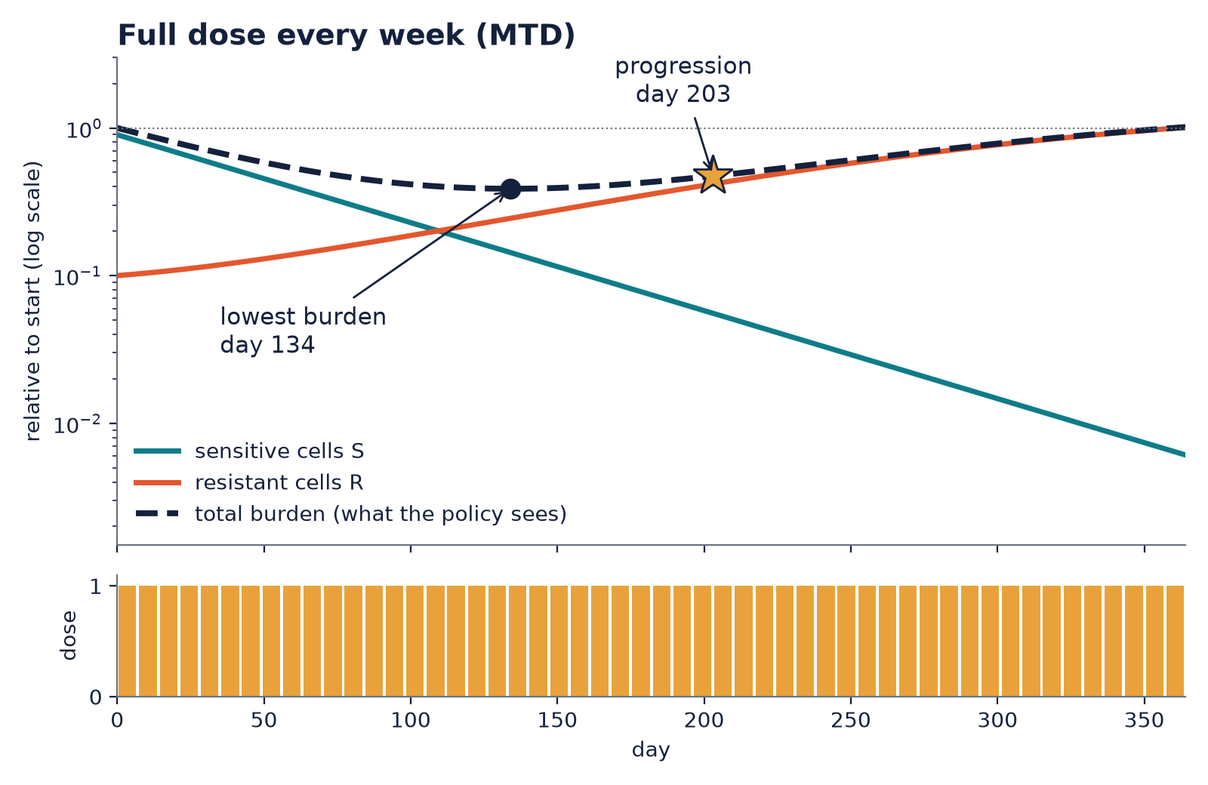
Why full dosing stops working
1
Start
Mostly sensitive cells S, a few resistant cells R. They compete for the same space.
2
Full dose
The drug stops S from growing, so S shrinks and the total burden falls.
3
Release
With S gone, nothing holds R back. The drug does not touch R, so R grows into the space.
4
Regrowth
Total burden follows R. Dose is still maximal, but there is nothing left to act on.
Illustrative patient from a re-implementation of the paper's equations (r_R/r_S 0.9, d_T/r_S 0.5, start fill 0.3, resistant fraction 0.1; all inside the Strobl ranges). Not the patient of the paper's Figure 1.
Notes:
Competitive release. Nothing in the model mutates: resistant cells are present from the start. Burden reaches its lowest value at day 134 and progression (20% above the lowest, confirmed over 28 days) is at day 203.

Slide 4
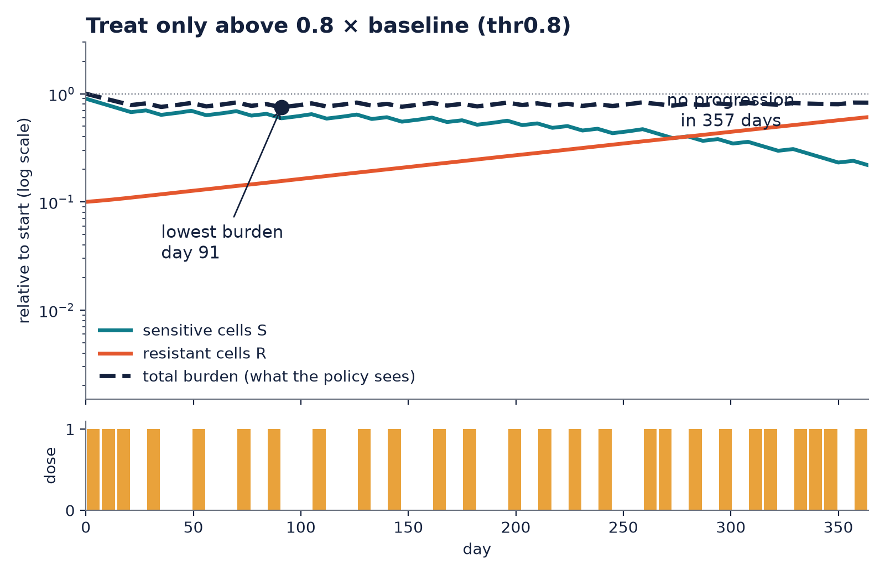
Sparing the sensitive cells delays the regrowth
203 d
>357 d
MTD: progression
thr0.8: no progression
52
26
MTD: doses given
thr0.8: doses given
thr0.8 gives a full dose only while burden is above 0.8 times its starting value. Some S survives and keeps R at 74% of the tumour at the end, against 99% under MTD.
Same illustrative patient as the previous slide. Burden is higher for much of the year: the price of a later regrowth.

Slide 5
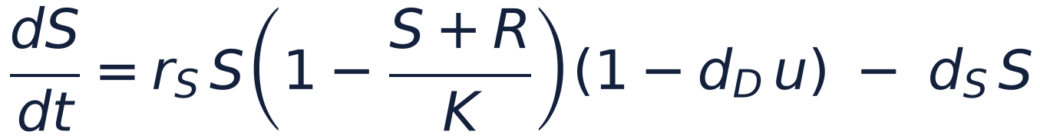
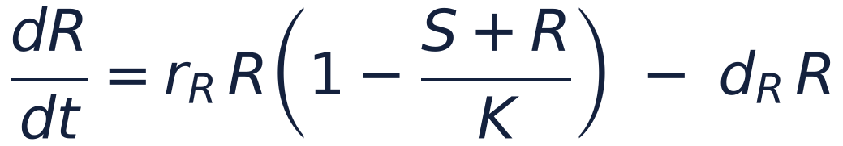
The virtual patient: two cell populations competing
S, R
sensitive and resistant cells (S + R is the burden)
r_S, r_R
growth rates; r_R < r_S is the cost of resistance
K
shared capacity: growth slows as S + R approaches K
d_S, d_R
natural death (turnover)
Patients are samples, not people. Each patient is one Latin-hypercube draw of the ranges of Strobl et al. (2021): r_R/r_S 0.5 to 1, turnover 0 to 0.5 r_S, start fill 0.1 to 0.75 of K, resistant fraction 0.1% to 10%.
Check: with those parameters our code reproduces all 14 published progression times and gains we checked, within 3%.
d_D u
drug kill acts on S only; u is the drug effect (next slide)
The policy never sees S, R or the parameters. Only total burden, with noise.

Slide 6
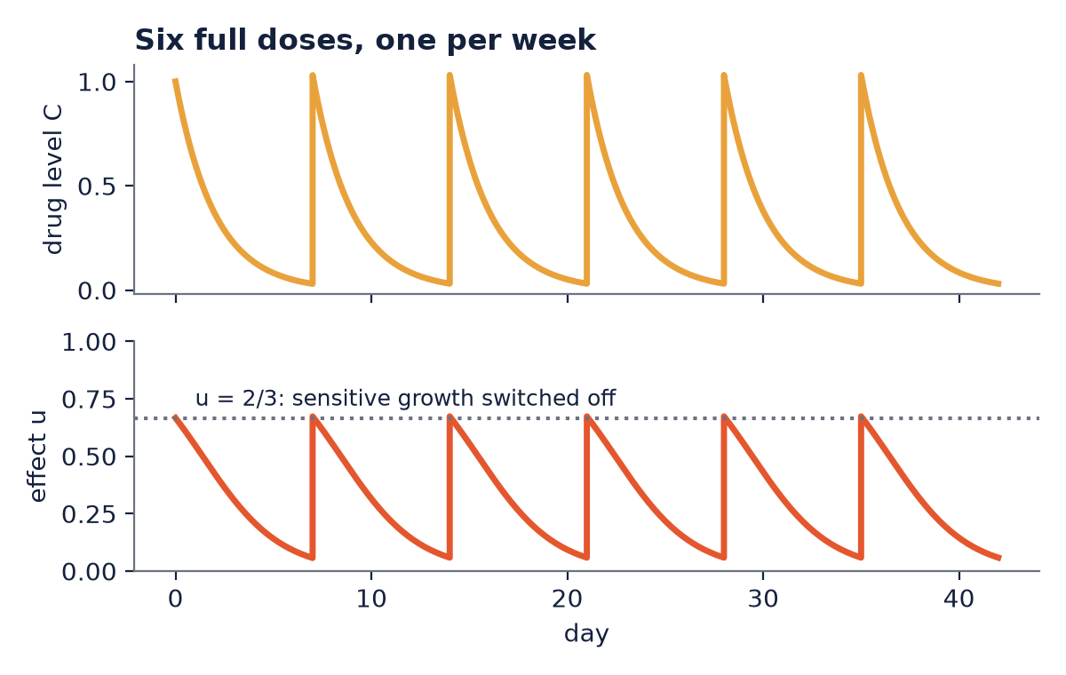
The drug: a bolus that decays
A dose is added to one compartment at each weekly visit and cleared at 0.5 per day.
The effect saturates. Doubling the dose does not double the kill, so a policy cannot buy unlimited effect with unlimited drug.
In the model, a full dose gives u close to 2/3, which is where 1 - d_D u reaches 0: sensitive growth is switched off and S then declines by turnover.
Doses available to the policy: 0, 1/2 or 1 per visit. The effect u is held constant over the 7 days between visits.

Slide 7
The decision problem is a POMDP
Virtual patient
o_t
Policy
Each week: the policy gets o_t, a noisy log of total burden, and picks a dose a_t. The patient then evolves for 7 days. 52 weeks per episode.
hidden state: S, R, drug level C and the parameters. Evolves by the ODE.
MLP, LSTM or ODE-RNN. Memory (if any) lives inside the network.
a_t
Why partially observable?
The same burden can come from very different mixes of S and R. A falling burden can mean the sensitive cells are dying while resistant ones already dominate.
Why memory could help
The history of burden carries information about the hidden mix. That is the case for LSTM and ODE-RNN, and what we test.
Notes:
POMDP: partially observable Markov decision process. Tuple (state, action, transition, reward, observation space, observation function, discount, horizon).

Slide 8
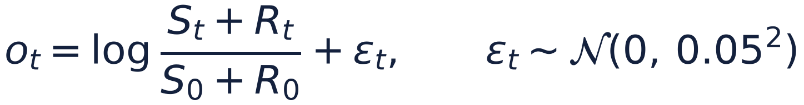
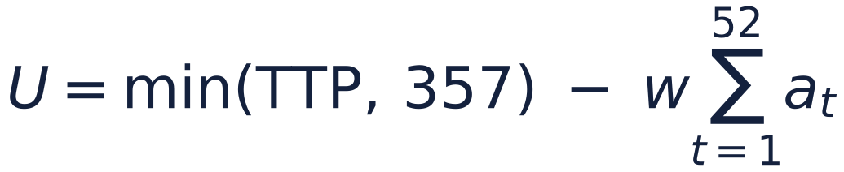
Observation, reward and score
What the policy sees
One number per visit: log of burden relative to the patient's start, plus 5% noise. Never S, R or the parameters. A missed visit gives no observation and no decision; the last dose continues.
What training rewards
Penalty for burden above 1.2 times the lowest so far, minus the price w of drug. w is 0.05, 0.1, 0.2 or 0.4; one network per w.
What we report
Days until progression (capped at the 357-day year) minus the same drug price. Progression: burden 20% above its lowest, for 28 days.
What is optimised
Standard discounted return over 52 visits, with no early termination.
The reward is a proxy for the score: it penalises burden at every visit, while the score counts days to a confirmed progression.

Slide 9
The four networks compared
MLP
Positional MLP
LSTM
ODE-RNN
Sees only today's measurement. The memoryless baseline.
Today's measurement plus a clock. Tests whether knowing the time is enough.
Recurrent: carries a summary of the past in discrete steps. The standard memory.
Hidden memory flows as a differential equation between visits. The continuous-time candidate.
Fair comparison. Same trainer (PQN, a simple Q-learning method), same size (about 3,100 parameters), published settings, no per-network tuning, 10 seeds each. Only the architecture differs.

Slide 10
How we test: three robustness settings
Tier 0: in range
Tier 1: shifted
Tier 4: missed visits
Test patients come from the same ranges as training.
Growth rates x1.5 and capacity x0.6: outside the training ranges.
Each visit is missed with probability 20 to 50%; the last dose continues.
200 + 200
10
95% CI
training and test patients per seed
training seeds per network
bootstrap over seeds and patients, paired

Slide 11
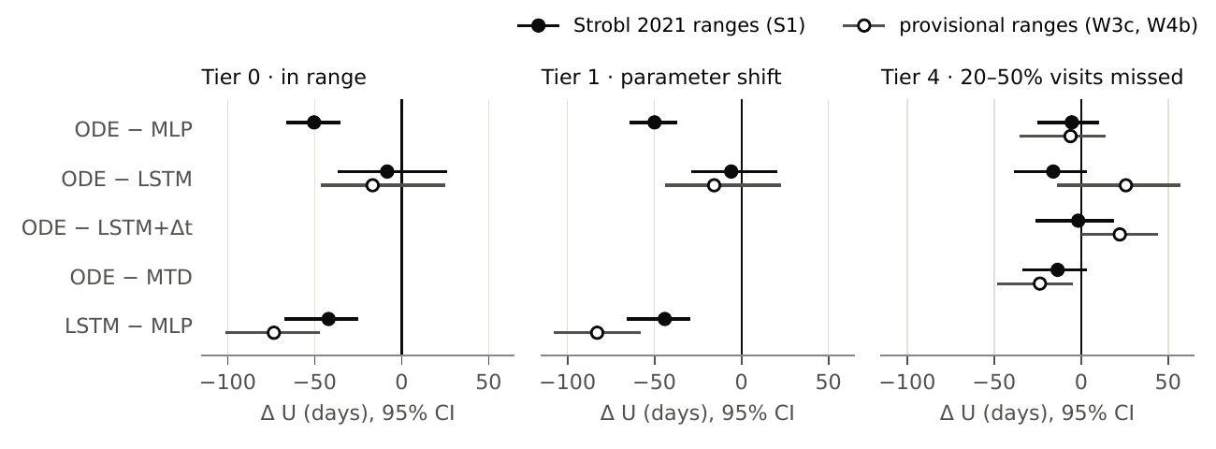
Result 1: no continuous-time edge
Reading the plot. Dot: mean score difference in days. Line: 95% interval. Right of zero favours the first-named network.
ODE-RNN minus MLP: -50.0 d [-63.5, -37.9] under the shift.
ODE-RNN minus LSTM: -5.9 [-27.9, +19.9]: no difference.
With missed visits: -5.4 [-24.3, +9.3]; never above a fixed-schedule MTD rule.

Slide 12
Headroom exists; little of it needs memory
+23.1 d
search on the true simulator over the MLP [+20.3, +25.8]
Only the last two bars need memory-type information: at most about 15 days. Training the recurrent networks costs 40 to 50 days. This is a split of one rule family's gain, not a proof that no memory policy could help.
Gain in days of a search on the true simulator, split by what it needs (approximate thirds).

Slide 13
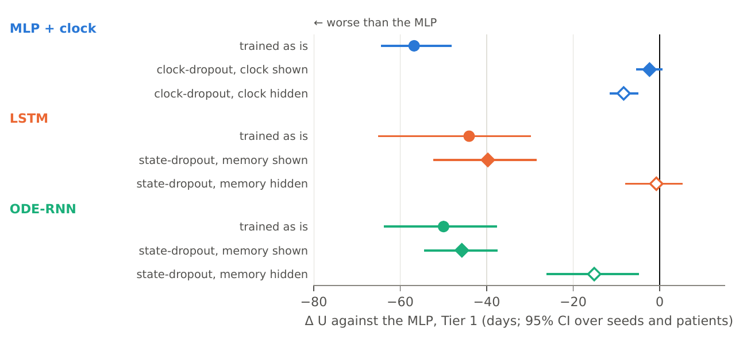
Result 2: a training shortcut, found and removed
The clock costs the MLP 57 days. The trainer fits a time-keyed schedule instead of reacting to the tumour.
Hide the clock half of the time and the whole cost goes: +54.4 d, tied with the MLP (-2.4 [-5.2, +0.4]).
The same trick on LSTM and ODE-RNN changes little (+4.3, +4.2 d); both stay 40 to 46 d below the MLP.

Slide 14
Objections we tested
Objection | Run | Result
The trainer cannot use memory at all | W10: three POPGym memory tasks | LSTM beats the MLP on 2 of 3: the trainer can use memory where it pays
The LSTM is too small | V11: 5x and 22x the parameters | No recovery: still 47 to 49 d below the MLP
Only one training algorithm | V12: PPO instead of PQN | Inconclusive: the validity check failed; recurrent arms collapse to a fixed schedule in 12 and 22 of 40 runs
The networks cannot represent the policy | W11: clone a threshold policy, then fine-tune | All three can represent it; PQN fine-tuning destroys it in the recurrent arms only
Each run was registered, with pass and kill criteria, before it was run.

Slide 15
A learning cost, not a representation limit
Step 1. Teach each network to copy a threshold rule by supervised learning. All three succeed (score about 284.6 d).
Step 2. Let PQN keep training from there. The MLP is unchanged; the LSTM loses 69 days and the ODE-RNN 88.
So: the recurrent networks can hold the good policy, but PQN's training moves them away from it. Only PQN was tested.
Change in score (days) when PQN fine-tunes a network that already copies a good threshold policy.

Slide 16
Limits, and what comes next
Limits
One simulator family (Lotka-Volterra with competitive resistance); virtual patients; no clinical claims.
Mostly one training algorithm, untuned; recurrent networks are unstable across seeds.
Weekly visits and fixed 7/8-day ODE-RNN steps: missed visits carry no timing information.
Next
A second training algorithm that passes the full-information check. It needs a new idea, not a re-tune.
Optional: a tighter bound on the headroom, and an MLP scaled up to match.
Anonymised code link, then submission to TMLR.

