Slide 1
Does a continuous-time policy dose cancer therapy more robustly?
Continuous-time RL for adaptive therapy — what we built, ran, and learned
Program report · 2026-09-27 · virtual patients only, no clinical claims
Notes:
Result numbers are read from run artifacts by research/report.py; earlier facts cite RESEARCH_LOG lines. Virtual patients only.

Slide 2
The question
Is it the differential-equation structure that helps — or just memory?
Virtual patient
ODE solver
Burden only
Policy
Dose
model + θ
diffrax, weekly
noisy, σ = 0.05
MLP · LSTM · ODE-RNN
0 · ½ · 1
1
MLP
2
LSTM
3
ODE-RNN
memoryless — the null hypothesis
memory, discrete steps
memory + continuous time between visits
Endpoints, always together: time to progression (TTP: +20% over running nadir, 28-day confirmation) and cumulative drug exposure. Paired by patient, ≥ 3 seeds.
Notes:
The ablation axis is the policy architecture; everything else in the loop is fixed. The agent only sees total burden, never the sensitive/resistant split, so this is a POMDP.

Slide 3
Three tumour models, three different biologies
Lotka–Volterra
Hahnfeldt
Kuznetsov
competition
angiogenesis
immune predation
dS/dt = r_S S (1 − (S+R)/K)(1 − d_D u) − d_S S
dR/dt = r_R R (1 − (S+R)/K) − d_R R
dV/dt = −a V ln(V/K)
dK/dt = b V − d V^(2/3) K − e u K
dE/dt = s + pET/(g+T) − mET − δE
dT/dt = aT(1 − bT) − nET − uT
Observed: S + R. Drug slows only sensitive cells; resistant cells are held back by competition — the mechanism adaptive therapy exploits.
Observed: V. The limit is the vascular capacity K, not competition. Drug attacks K.
Observed: T. Effector cells hunt the tumour; oscillation and dormancy are possible. Drug kills T.
Notes:
Three mechanistically distinct families. Treatment enters differently in each: it slows sensitive-cell growth (LV), destroys vasculature (Hahnfeldt), or kills tumour cells (Kuznetsov).

Slide 4
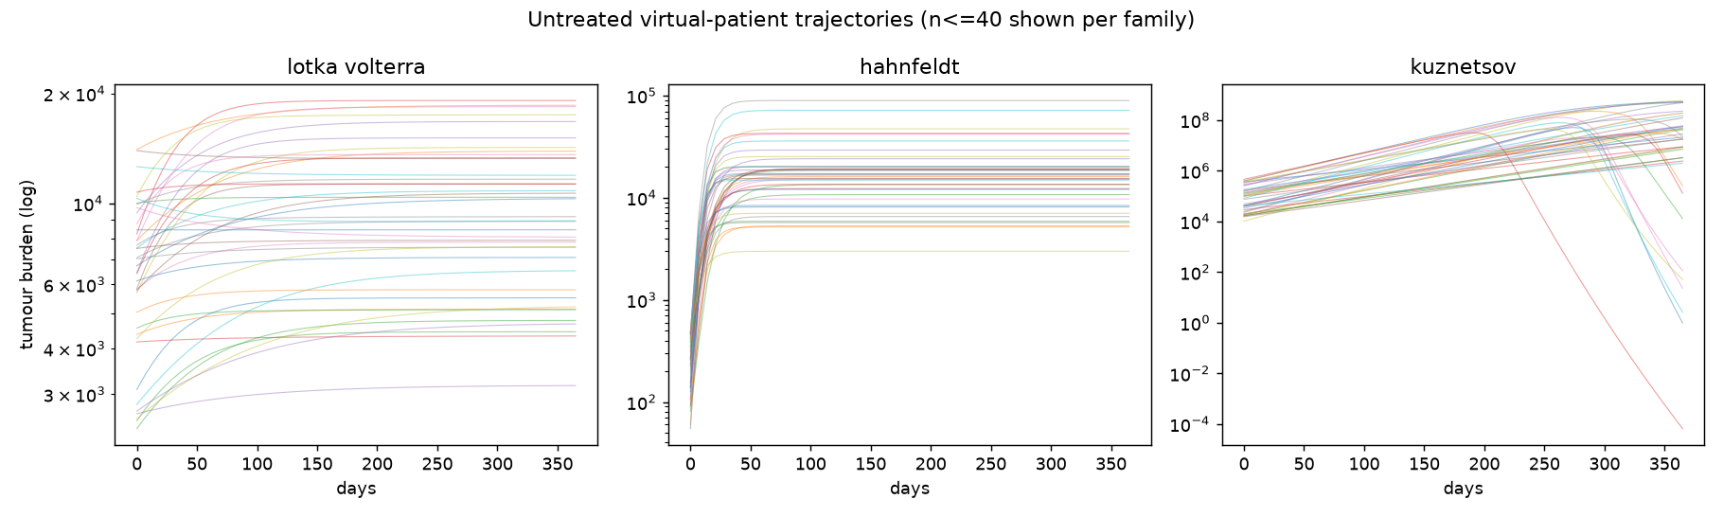
Untreated, they behave nothing alike
Phase 0–1: families separable from burden alone (0.996, L48), but θ is not identifiable
Untreated TTP at weekly visits: LV 28 d, Hahnfeldt 7 d, Kuznetsov 14 d (L88). Only LV has dynamic range, so the architecture comparison uses LV.
Notes:
Phase 0-1: RESEARCH_LOG L13, L48, L88.

Slide 5
Dosing regimes compared
Same simulator loop, same weekly visit, only the decision rule changes
none
MLP
never treat
trained, memoryless
MTD
LSTM
full dose every visit — standard of care
trained, discrete-time memory
AT50
ODE-RNN
treat until burden < 50% of baseline, hold until back at baseline (Zhang trial)
trained, continuous-time memory
thr0.8
treat whenever burden > 0.8 × baseline — the rule Gallagher 2024's RL found
Notes:
Every regime runs through the same closed-loop rollout. The trained networks are LV-trained (w 0.05, seed 0) and only RUN on the other two models.

Slide 6
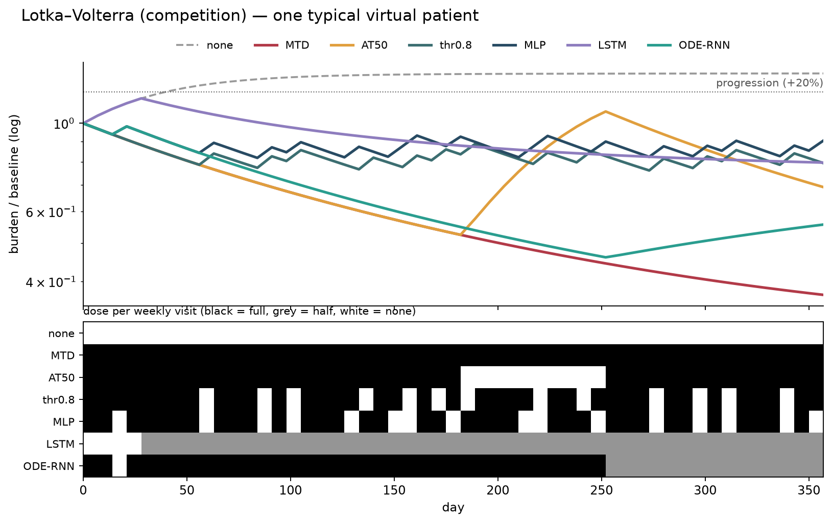
LV: holding burden near 80% contains resistance
1
MLP and the 0.8 threshold rule cycle the drug and keep the tumour below baseline all year.
2
AT50 lets it rebound to baseline before re-treating; MTD shrinks it fastest with the most drug.
3
The LSTM switches to half dose and drifts; the ODE-RNN holds full dose, then half.
Notes:
Illustration, not a registered result: the patient whose untreated TTP is closest to the median of 100 sampled. Networks trained on LV only. research/deck_figures.py.

Slide 7
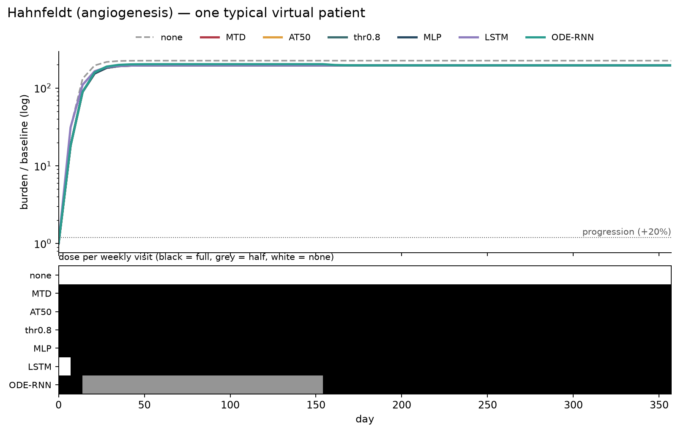
Hahnfeldt: no regime changes the outcome
1
The tumour grows ~200× within weeks whatever the dose: every regime progresses on day 7.
2
This is Phase 1's resolution limit (L88): treated TTP has no dynamic range here.
3
W5 (mechanism shift) needs this fixed before it can be registered.
Notes:
Illustration, not a registered result: the patient whose untreated TTP is closest to the median of 100 sampled. Networks trained on LV only. research/deck_figures.py.

Slide 8
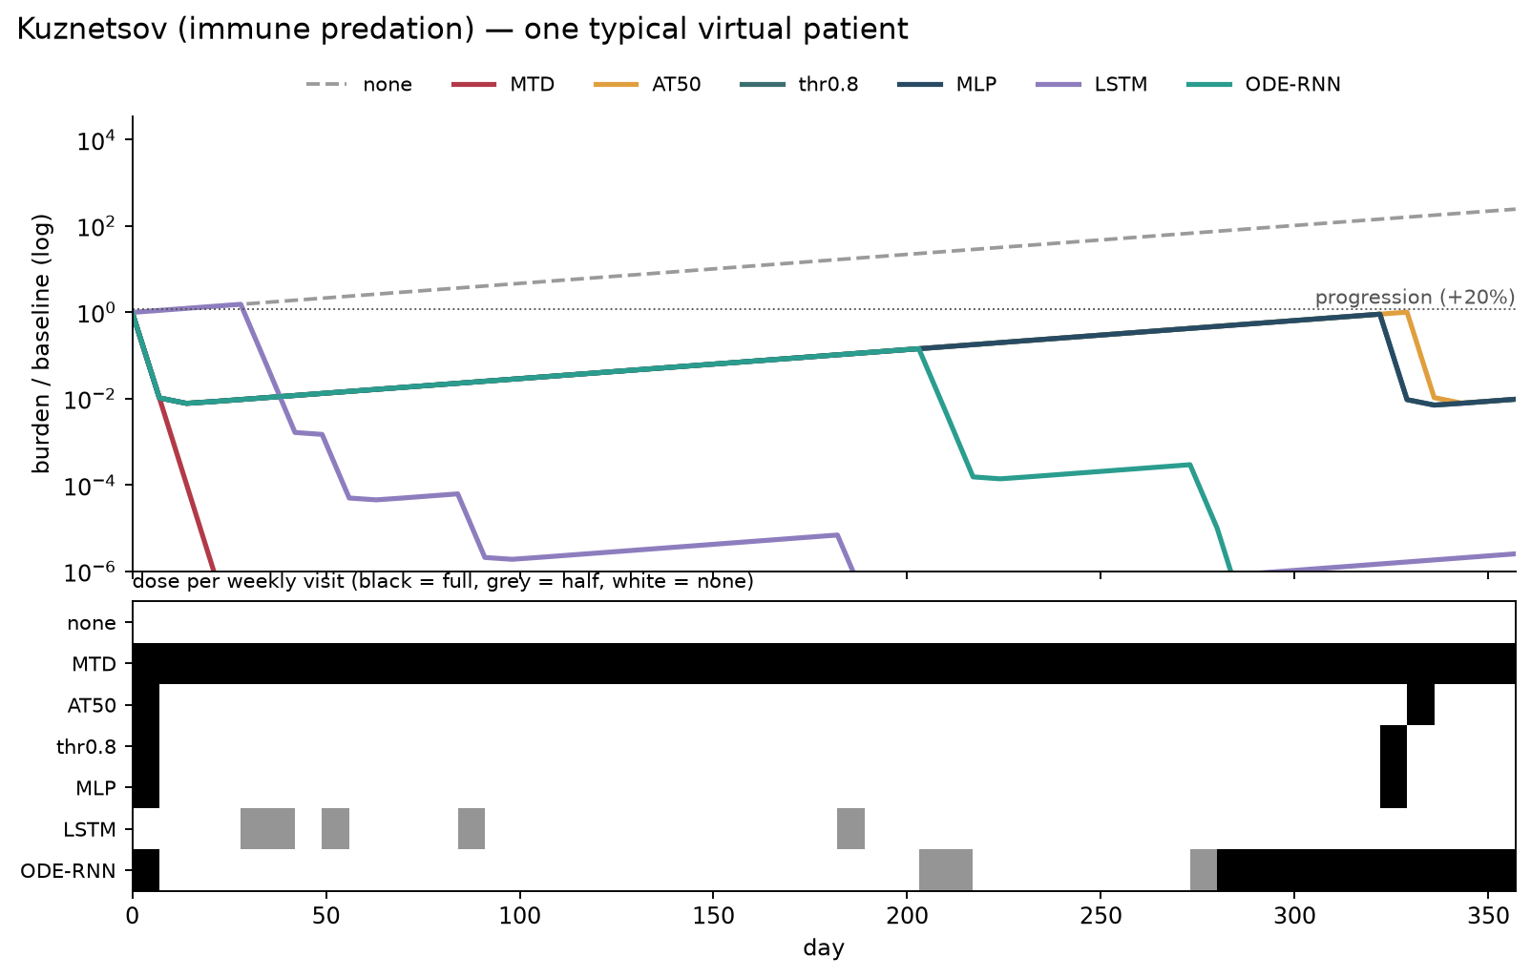
Kuznetsov: only full dose eradicates
1
LV-style rules treat once, see burden fall 100×, and stop while the immune balance is lost.
2
MTD drives the tumour to extinction; the recurrent nets suppress it at very different drug.
3
A threshold learned on one biology does not transfer to another.
Notes:
Illustration, not a registered result: the patient whose untreated TTP is closest to the median of 100 sampled. Networks trained on LV only. research/deck_figures.py.

Slide 9
Across 100 patients: TTP bought, and at what dose
Restricted-mean TTP (days, capped at 357) · illustration, not a registered comparison
Lotka–Volterra
MLP 334 d at exposure 245
thr0.8 335 d at 259
MTD 332 d at 357
→ the trained MLP ≈ a one-line rule, with 31% less drug than MTD.
Hahnfeldt
7 d for every regime: no signal at weekly visits.
Kuznetsov
only MTD reaches the horizon (357 d).
Notes:
100 virtual patients per model, 52 weekly visits; restricted-mean TTP = mean of TTP capped at 357 d. Illustration, not registered.

Slide 10
What was run, in order
Every comparison pre-registered; void and invalid runs kept in the record
Phase 0
Phase 1
Phase 2
Phase 2 / 2b
Phase 2c
W1
W3
W3b
W3c
PASS
DONE
VOID
INVALID
FAIL
DONE
INVALID
INVALID
FAIL
families separable
from burden
simulator +
TTP rule
shifted cohort
mis-built
PPO: ODE-RNN
open-loop
PQN: first valid
run
diagnosis on
saved policies
+ LSTM arm,
frontiers
fresh seeds,
RMST
per-cell validity,
trained objective
Why so many invalid runs? Each caught a way this evaluation can lie: a policy that ignores its input, a median that rewards letting patients progress, a cohort built from the unshifted parameter, a metric stuck at its ceiling. Each is now a gate in every run.
Notes:
Every comparison pre-registered in PREREG.md and logged in RESEARCH_LOG.md whatever the outcome. Void and invalid runs stay in the record.

Slide 11
Phase 2c: the first valid run — the ODE-RNN loses
LV, Tier-1 shift (×1.5 growth rates, ×0.6 capacity), PQN for both arms, 3 seeds × 200 patients
264 vs 19
337 vs 22
-31%
patients progressing earlier vs later on the ODE-RNN
patients progressing earlier vs later on the ODE-RNN
drug given by the ODE-RNN (194 vs 280)
exposure weight 0.05
exposure weight 0.20
so TTP is not exposure-matched
Kill criterion fired: no continuous-time edge on the clean single-model case, with either trainer (PPO or PQN). The multi-model curriculum was not built.
Notes:
L424. Paired by patient, pooled over 3 seeds x 200 patients. Caveat: the MLP doses more, and on LV more drug alone lengthens TTP, so 'worse at equal drug' is not established here.

Slide 12
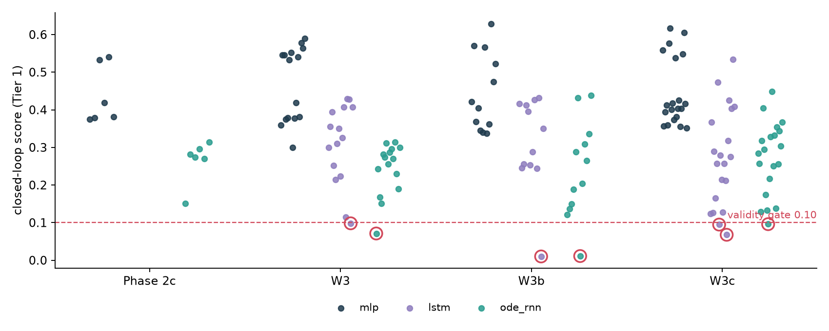
The recurrent arms sometimes stop listening
Closed-loop score of every trained cell; circled cells fail the 0.10 gate
Below the gate
W3 lstm w0.4 s1: 0.098
W3 ode_rnn w0.0 s0: 0.071
W3B lstm w0.4 s4: 0.010
W3B ode_rnn w0.2 s3: 0.011
W3C lstm w0.1 s7: 0.095
W3C lstm w0.2 s8: 0.068
W3C ode_rnn w0.1 s8: 0.096
The MLP never fails; 7 recurrent cells have. W3c's per-cell rule excludes such cells instead of voiding the arm.
Notes:
Closed-loop score = fraction of patient-visits whose greedy dose changes when another patient's observation history is swapped in. 0 = one fixed schedule for everyone.

Slide 13
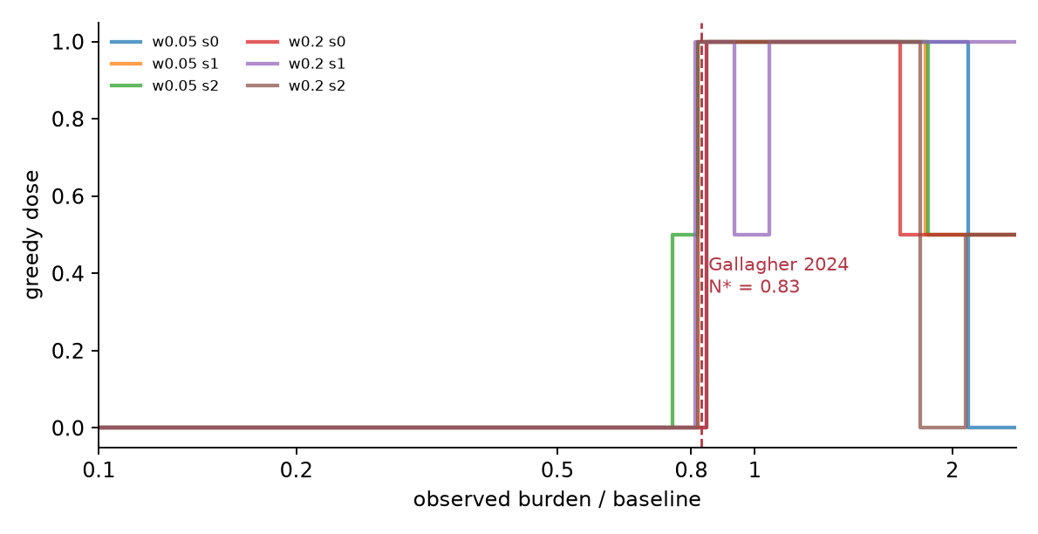
W1: it is a training gap, not a robustness gap
The same policies on the patients before the shift (Tier 0)
Tier 0 (no shift)
164 vs 10
ODE-RNN earlier vs later (w 0.05)
Tier 1 (shifted)
264 vs 19
the shift moves both arms, not the gap
The MLP learned a switch: no drug below ~0.8 × baseline, full dose above, in all 6 seeds (≥ 94% of doses explained by the current reading). The ODE-RNN doses partly from memory (64%–88%).
Notes:
L461. Tier 0 = the same test patients without the shift.

Slide 14
What the two closest papers actually show
Read in full from the PDFs, with page locators
Gallagher et al. 2024, Cancer Research
Kiram et al. 2026, arXiv 2605.02552
• Same setting: LV, burden-only, TTP = +20%.
• Their RL policy is a switch at N* = 0.83 × n₀ (Fig. 4B, p.1935) — our MLP found ~0.80.
• Evaluating less often than trained lowers TTP (Fig. 3C, p.1934): predicts W4's direction.
• Means over 100 evaluations; exposure not matched.
• Recurrent TD3 380 ± 12 vs TD3 −50 ± 252 (Table I, p.5).
• But: one fixed patient, no shift, means over 10 seeds.
• The hidden variable is a toxicity state in the reward — not our S/R split.
• Justifies an LSTM arm; not evidence that memory helps here.
Notes:
Both read from the PDFs with page locators (literature/papers/).

Slide 15
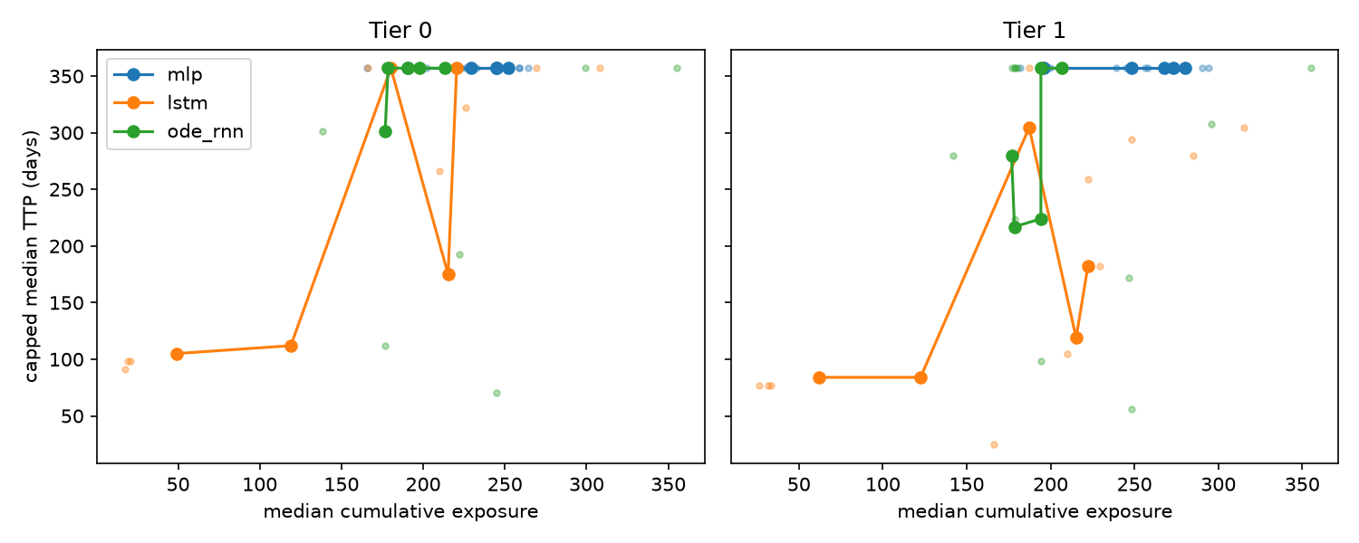
W3: adding an LSTM arm
MLP vs LSTM isolates memory; LSTM vs ODE-RNN isolates continuous time
Memory: LSTM − MLP
Tier 1 -182 d [-233, -136]
overlap 16% · INVALID
Continuous time: ODE − LSTM
Tier 1 +22 d [-41, +158]
overlap 19% · INVALID
No verdict: arms with an open-loop cell: lstm, ode_rnn. Gaps are descriptive only.
Notes:
W3: frontier = TTP (capped median) vs exposure across exposure weights; gaps are mean differences over the shared exposure range with a paired patient bootstrap CI.

Slide 16
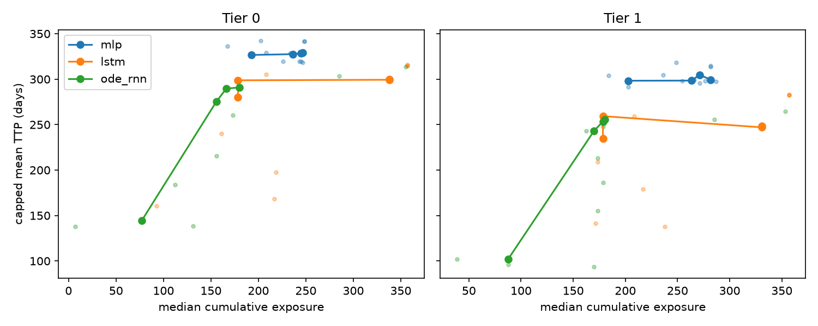
W3b: fresh seeds, restricted-mean TTP
Same design; the ceiling removed
Memory: LSTM − MLP
Tier 1 -45 d [-59, -40]
overlap 52% · INVALID
Continuous time: ODE − LSTM
Tier 1 -5 d [-15, +12]
overlap 1% · INVALID
No verdict: arms with an open-loop cell: lstm, ode_rnn. Gaps are descriptive only.
Notes:
W3B: frontier = TTP (RMST) vs exposure across exposure weights; gaps are mean differences over the shared exposure range with a paired patient bootstrap CI.

Slide 17
W3c: memory hurts, continuous time hurts further
First valid three-arm run · trained objective U = TTP − w · exposure, paired per patient
Memory: LSTM − MLP
-82.9 d [-88, -78] Tier 1
Tier 0: -73.5 d · FAILS
Continuous time: ODE − LSTM
-15.7 d [-20, -11] Tier 1
Tier 0: -16.7 d · FAILS
Excluded cells: 3/60, none from the MLP
The MLP only ties the one-line 0.8 × baseline rule.
Notes:
PREREG W3c: per-cell validity, 5 fresh seeds, primary = paired U = min(TTP, 357) - w * exposure, the survival and exposure terms each cell was trained to maximise, averaged over w. Rules are descriptive reference points on the same patients.

Slide 18
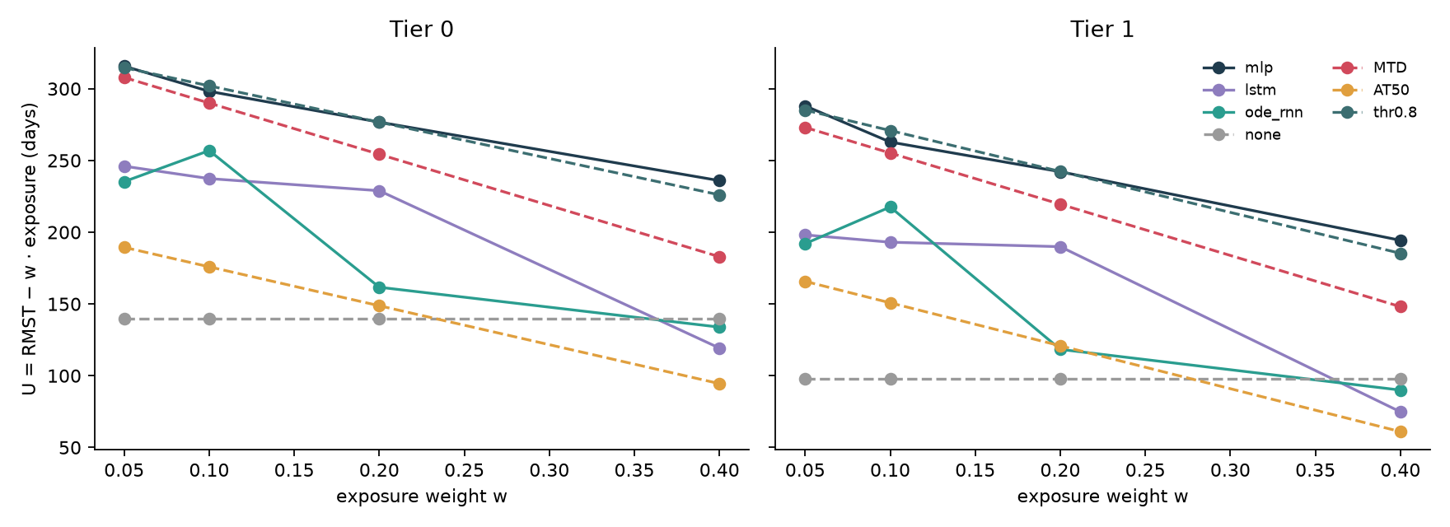
W3c per exposure weight
Dashed = fixed rules, solid = trained policies
The gap is present without the shift (Tier 0), so it is a controller-quality gap, not a robustness gap — the same shape W1 found for Phase 2c.
Notes:
Per exposure weight. At w = 0.40 both recurrent arms score below never treating on Tier 1; the ODE-RNN beats the LSTM at w 0.10 and 0.40 but loses badly at 0.20.

Slide 19
Four ways this evaluation lied — each now a gate
1
An open-loop schedule
2
The progressor-only median
The ODE-RNN gave all 200 patients one identical dosing history and still reported a respectable TTP (L312).
Averaging only patients who progress rewards letting more of them progress; it inverted the paired result 3 times.
Fix: closed-loop validity ≥ 0.10 per cell
Fix: min(TTP, horizon) over all patients
3
A mis-built shifted cohort
4
A metric at its ceiling
Scaling K after building y0 put half the test cohort above capacity; NaN blow-ups scored as 'never progressed' (L242).
Once > 50% never progress, a capped median is flat at the horizon and ranks nothing (L496).
Fix: rebuild y0 from shifted θ; refuse NaN
Fix: restricted-mean TTP (W3b)
Notes:
ROADMAP traps 4-6 plus the W3 ceiling; each now has an automatic check.

Slide 20
Next
Target: ICLR 2027 workshop — a clean negative is still the paper
Law
promote 'no continuous-time edge on Tiers 0/1' — two valid closures (vs MLP, vs LSTM)
W4
irregular visits (20% / 50% dropped) — where continuous time has a mechanical reason to help; LSTM + Δt as the strong discrete baseline
W5
mechanism shift — only if Hahnfeldt's day-7 resolution limit is fixed
W6
write-up: validity across trainers, frontiers, the learned threshold rule, every run in one table
Notes:
Target: an ICLR 2027 workshop; a clean negative is still the paper.

