Slide 1
Can a learned dosing policy do better by remembering, or by thinking in continuous time?
Reinforcement learning for adaptive cancer therapy: a pre-registered negative result
Project status report · 18 October 2026
Notes:
Plain framing: we asked whether a smarter, memory-carrying or continuous-time AI scheduler beats a trivial one for adaptive cancer therapy. The answer in our simulator is no, and I will show why and how sure we are.

Slide 2
The short answer
−50 days
+23 days
≤ 15 days
ODE-RNN vs a memoryless network, parameter shift (95% interval −64 to −38)
headroom a per-patient search finds over that network: the task is not solved
of that gain can need memory, while training recurrent networks costs 40 to 50
A network that looks only at today's tumour size, with a one-line threshold rule, matches or beats memory and continuous-time models trained the same way.
2
Notes:
Three numbers carry the talk. ODE-RNN is the continuous-time model. Days are our score, defined later. The task still has room, so this is not 'nothing to gain'; it is 'memory is not where the gain is, and these learners cannot capture it'.

Slide 3
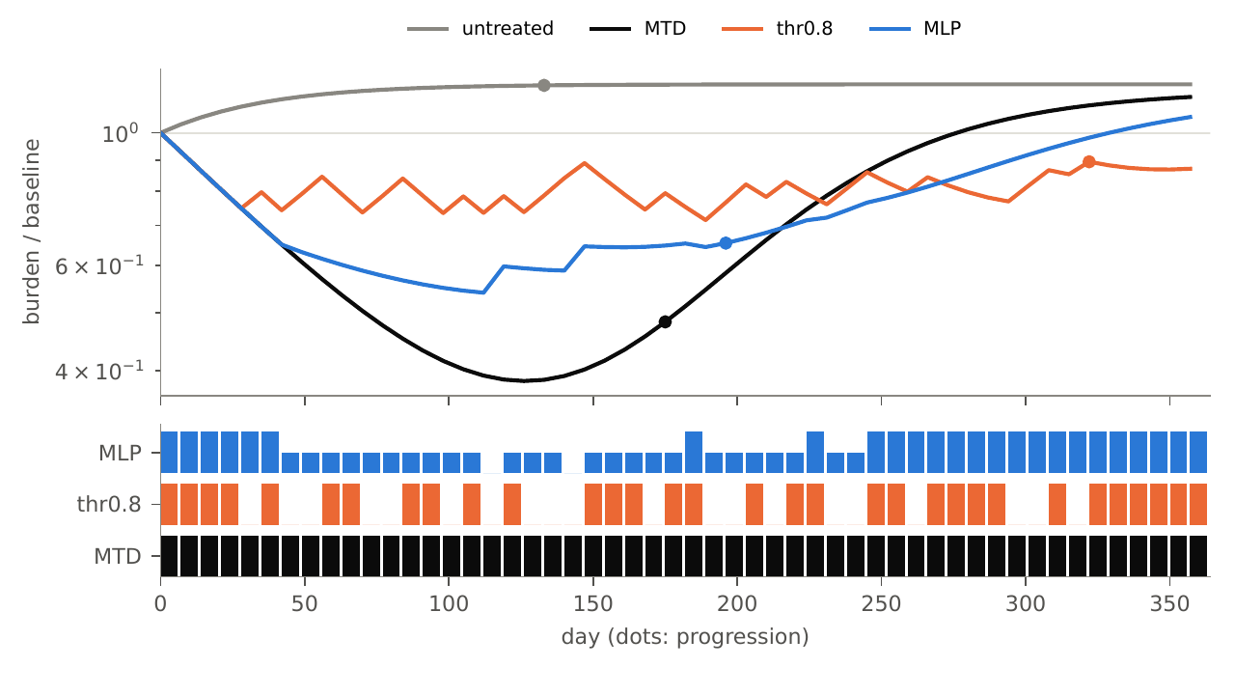
Adaptive therapy: treat less, delay resistance
Maximum dose kills sensitive cells and lets resistant ones take over.
Adaptive therapy pauses the drug when the tumour has shrunk and restarts it on regrowth, so sensitive cells keep suppressing resistant ones.
The clinical rule is a threshold on a marker such as PSA.
How to read it. Top: tumour size relative to its start (log scale) over one year; each line is one dosing policy (grey = no treatment). Dots = progression. Bottom: one bar per week where that policy gave drug (tall = full dose, short = half, none = gap). Here MTD (black) shrinks the tumour most but progresses at day 175; the orange and blue policies give less drug and progress at day 322 and 196.
3
Notes:
The simulator is a two-population Lotka-Volterra model. The figure is one patient from the test set picked by a fixed rule, not by hand.

Slide 4
RL set-up: the policy sees only total tumour size
Virtual patient
sensitive + resistant cells (hidden)
Measurement
total burden, 5% noise, weekly
Policy
a neural network
Dose
none · half · full
Trial and error on 200 virtual patients per training run; reward = low tumour burden, charged for drug.
Partially observable: the same measurement can hide different underlying cell mixes. The textbook remedy is memory.
52 weekly decisions (one year); progression = a 20% rise above the lowest burden, confirmed over 28 days.
4
Notes:
Reinforcement learning in one sentence: the network tries doses, gets a score at the end, and adjusts. 'Partially observable' is the key concept: the clinician (and the network) sees tumour size, not which cells are resistant.

Slide 5
The patient model: two cell types competing for space
Sensitive cells S
grow, die naturally, and are killed by the drug
Resistant cells R
grow (usually slower: a cost of resistance), are not touched by the drug
The drug: each dose is cleared at 0.5 per day and its effect saturates.
The policy sees only S + R, relative to the start, with 5% noise.
Parameters follow Strobl et al. 2021; our code reproduces 14 of 14 of that paper's published numbers within 3%.
200 training and 200 test patients per seed, each a random draw from the parameter ranges.
Both share one capacity K: the fuller the tumour, the slower both grow.
Why two cell types? Adaptive therapy works only because treatment-sensitive cells keep resistant ones in check; this is the smallest model that has that mechanism.
5
Notes:
In words: sensitive cells change by growth times crowding times drug survival minus death; resistant cells by growth times crowding minus death. Hahnfeldt and Kuznetsov models were tried and have no resistance, and two published three-type models did not reproduce, so every result is for this one family.

Slide 6
One episode = one year of weekly decisions
Each dot = a weekly visit: measure the tumour, choose a dose (none, half, full) held for 7 days; open dots = a missed visit (Tier 4), the last dose just continues.
day 0
day 357 (52 visits)
Between visits
Model equations solved in small fixed steps; ODE-RNN memory advances in 7/8-day steps.
Training
300 updates × 32 patients; 10 seeds per network; four exposure prices; nothing tuned.
Testing
200 held-out patients per seed: in range (Tier 0), parameters shifted (Tier 1), visits missed 20–50% (Tier 4).
Progression
Burden 20% above its lowest value, confirmed over 28 days; score capped at 357 days.
6
Notes:
Time step: the decision step is one week (7 days); the episode is 52 decisions, 357 days. All networks see the same weekly measurement; only the ODE-RNN also advances its memory in between.

Slide 7
Four policies, matched in size (~3,100 parameters)
MLP
LSTM
Looks only at today's measurement. The memoryless baseline.
Remembers the past in discrete steps. The standard memory network.
ODE-RNN
MLP + clock
Hidden memory flows as a differential equation between visits. The continuous-time candidate.
Today's measurement plus the elapsed time. Tests whether 'when' is enough.
7
Notes:
All four are trained with the same algorithm (PQN, a recent simple Q-learning method) on the same patients; only the network differs, so any difference is about the architecture.

Slide 8
How we score, and how sure we are
U = days until progression (capped at 357) − w × drug given
Compare two policies on the same patients (paired); a positive difference favours the first.
95% intervals resample both training runs (seeds) and patients; 10 seeds per network.
Every run counts, including failures; hypothesis and pass/kill rule are written before the run (pre-registration).
Three test settings: in range (Tier 0), parameters shifted out of range (Tier 1), 20 to 50% of visits missed (Tier 4).
8
Notes:
Seed-level resampling matters: an early comparison that resampled only patients made the ODE-RNN look significantly worse than the LSTM; with seeds resampled the intervals widen and it is a tie. We kept every failed run in the count.

Slide 9
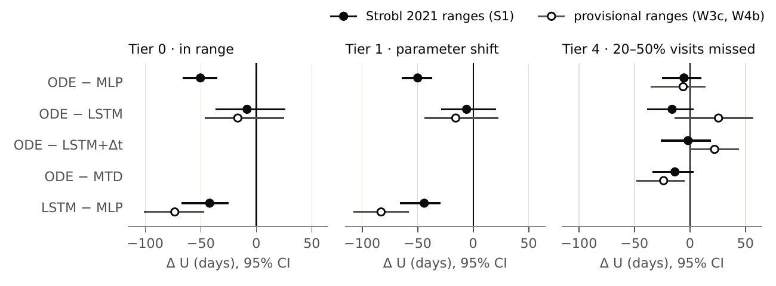
No continuous-time edge in any test setting
ODE-RNN − MLP: −50 days under shift.
ODE-RNN − LSTM: a tie (−5.9, interval spans 0).
Fitted to 55 real PSA patients: both negatives replicate.
How to read it. Each row compares two networks (for example ODE − MLP). The dot is the average difference in score, in days, over the test patients; the line is its 95% interval. Right of the zero line means the first-named network is better, left means worse; a line that crosses zero means we cannot tell them apart. Three panels = three test settings. Filled dots: the main simulator ranges (Strobl 2021); open dots: a second, higher-cost regime. No ODE row sits to the right of zero.
9
Notes:
Read the plot as: if a dot and its line were right of zero, the first-named network would be better. None of the ODE-RNN rows is. The LSTM also trails the MLP, so memory itself does not help here.

Slide 10
The task has room, but memory is a small part of it
A per-patient search on the true simulator beats the MLP by +23 days.
The first third needs nothing the MLP lacks. Only the other two thirds (about 15 days) could need memory.
Training the recurrent networks costs 40 to 50 days.
A split of one rule family's gain, not a proof that no memory policy could help.
How to read it. Each bar is extra score, in days, that a better policy could win over the learned MLP; together the three bars are the +26 days a patient-tuned threshold gains. Only the second and third bars come from knowing more about the patient, the kind of thing memory could supply.
10
Notes:
This answers 'maybe the recurrent networks are just undertrained'. A threshold policy could gain at most about 15 days from memory-type information, and training costs three times that. The first bar is a plain threshold near baseline that the MLP could represent but did not learn.

Slide 11
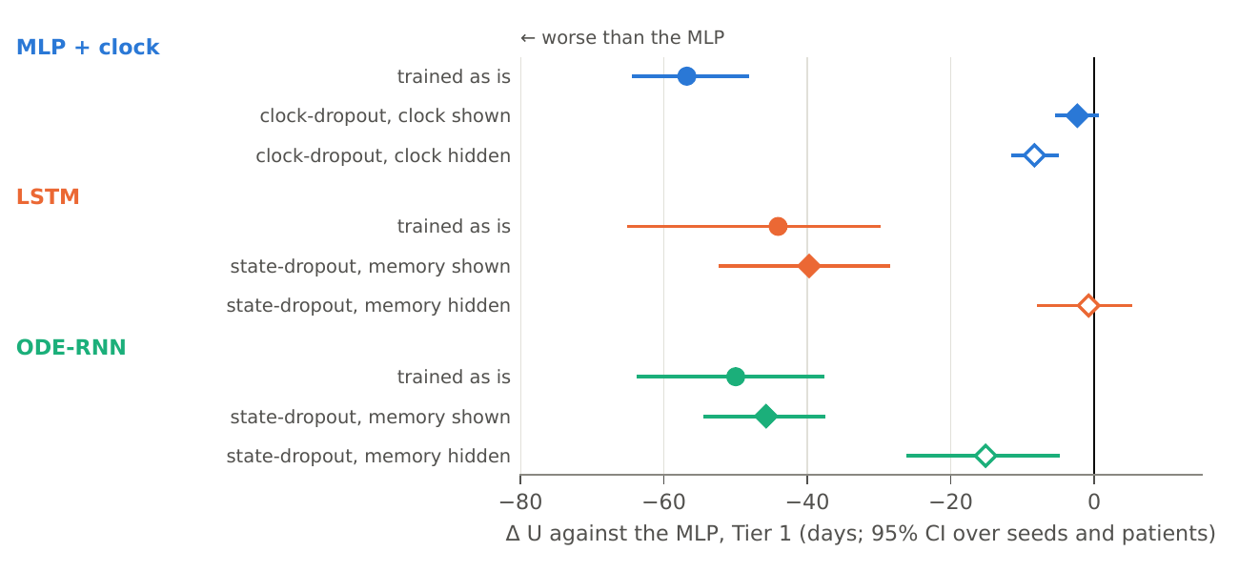
A training shortcut explains the clock's cost
MLP + clock is 57 days worse. Hiding the clock half the time in training removes all of it (+54 days).
The same trick for the LSTM and ODE-RNN changes little (about +4 days).
With their memory switched off at test they do 31 to 39 days better.
How to read it. Same layout as the previous figure, but every row is compared with the plain MLP (the zero line), in the shifted-parameter setting. Colour = network type. Round dot = trained normally; filled diamond = trained with the clock (or memory) hidden half the time; open diamond = the clock or memory is also switched off at test. A dot near zero means 'as good as the MLP'.
11
Notes:
The learner latches onto a time-keyed schedule instead of reacting to the tumour. That is a plausible general hazard for any extra input given to a learned controller, and the most reusable finding.

Slide 12
Three objections, three controls
Can it use memory?
LSTM too small?
Second algorithm?
Same algorithm on POPGym memory tasks: the LSTM beats the MLP on 2 of 3 (return +1.38 and +1.04, perfect is +1). Yes, where memory pays.
5× and 22× the parameters: no recovery (−5 and −3 days vs the small LSTM). Still 47 to 49 days below the MLP.
PPO, all arms retrained: the validity check failed (a network shown the true cell counts did not beat the MLP), so it is inconclusive. LSTM and ODE-RNN again trail by 28–42 days.
12
Notes:
These came from two outside reviews. Each is a pre-registered run. POPGym is a standard benchmark of memory tasks.

Slide 13
Second training algorithm: PPO instead of PQN
Re-ran the whole comparison with PPO (600 updates, untuned) instead of PQN.
Our rule: a network shown the true hidden state must beat the MLP under the new trainer. It did not (−1.6 days, interval −10 to +6), so the run says nothing about trainers.
Descriptively: LSTM and ODE-RNN trail the MLP by 28 to 42 days and tie each other.
They collapse to a fixed full-dose schedule in 12 (LSTM) and 22 (ODE-RNN) of 40 runs: the failure of our first experiments.
So the paper does not claim the result holds under two algorithms. A trainer that passes the check is still missing.
Registered before the run; reported as inconclusive. Run V12 in the log (L1578).
13
Notes:
PPO is the other common policy-gradient algorithm. The rule was fixed beforehand: if the full-information reference does not beat the MLP under PPO, the run says nothing about trainers.

Slide 14
Limits and next steps
Limits
Next
One simulator family; virtual patients; no clinical claim.
Untuned published training settings; recurrent nets are unstable across seeds.
Weekly visits carry no timing information, which limits what a continuous-time model can show.
MLP and ODE-RNN sizes were not scaled.
One year horizon in the main results; one resistance mechanism.
A second trainer that passes the full-information check: the open item both reviewers raised.
Optional: a tighter headroom bound; a larger MLP.
Trim prose, anonymise the code link, check references, submit to TMLR (rolling, double-blind, judged on whether claims are supported).
14
Notes:
Happy to take questions on the biology of the simulator, the RL training, or the submission plan.

