Slide 1
PhysiGym
Bridging Agent-Based Biological Simulation and Reinforcement Learning
A State-Space Study on Tumor Microenvironment Control
Alexandre Bertin· Elmar Bucher· Owen Griere · Marcelo Hurtado · Heber Rocha
Randy Heiland · Paul Macklin · Vincent François-Lavet · Emmanuel Rachelson · Vera Pancaldi
CRCT Toulouse · ISAE-Supaéro · Indiana University · VU Amsterdam
EWRL 2026
Open source: https://anonymous.4open.science/r/PhysiGym-76A7

Slide 2
MOTIVATION
Why connect biological simulation to RL?
Agent-based models (ABMs) simulate biological systems where cells interact dynamically by rules — capturing spatial & cellular heterogeneity that ODEs cannot.
Dynamic treatment regimes (adaptive, sequential interventions) need more than simulation — they need a control framework.
Reinforcement learning learns policies through interaction — a natural fit for adaptive control of biological simulations.
The missing piece: a standardized interface between a high-fidelity ABM and a modern RL API.
We introduce PhysiGym: it bridges PhysiCell (ABM) and Gymnasium (RL), turning any PhysiCell model into an RL environment with minimal code changes.
PhysiGym Bridging Agent-Based Biological Simulation and RL
2

Slide 3
FRAMEWORK
PhysiGym: design & implementation
PhysiCell + Gymnasium
How the bridge works
PhysiCell
Open-source C++ ABM framework. Cells = agents with type-specific rules; substrates (oxygen, cytokines) diffuse via the BioFVM solver. 2D/3D, off-lattice, multiscale.
Splits the C++ simulation loop into 3 Python-callable hooks: physicell_start, physicell_step, physicell_stop.
Three read functions return state: get_cell (positions), get_microenv (substrate fields), get_graph (neighbourhoods).
Gymnasium
Standard Python interface for MDPs (state S, action A, transition T, reward R). Promotes modular, reusable RL code.
Configured via PhysiCell user parameters & custom data — no recompilation; works with PhysiCell Studio.
Subclass CorePhysiCellEnv to define observation space, action space & reward. The base class handles all Gym bookkeeping.
Tested on Linux, WSL, macOS with CI via GitHub Actions.
PhysiGym Bridging Agent-Based Biological Simulation and RL
3

Slide 4
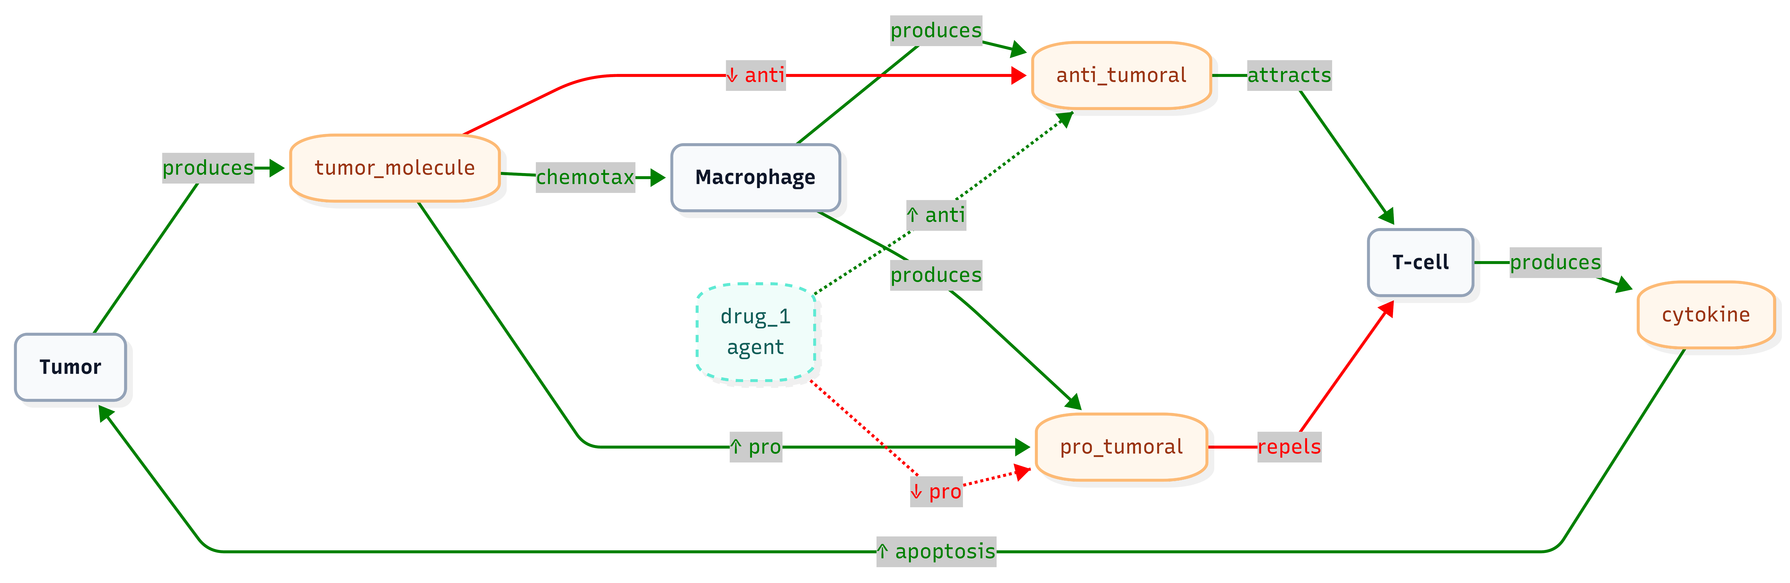
CASE STUDY
A tumor microenvironment (TME) toy model
Small, cheap, but spatially explicit
64×64 µm 2D domain · 3 cell types · 5 substrates. Gym step Δt = 15 min, episodes up to 10,080 min (7 days).
Tumor cells (Target)
Immobile, dividing. Secrete a signal that suppresses local immunity.
Macrophages (Mediators)
Mobile. Tumor signal “hijacks” them: anti- → pro-tumoral.
T-cells (Effectors)
Mobile, can trigger tumor apoptosis — but repelled by pro-tumoral macrophages.
The control challenge: drug_1 has zero direct cytotoxicity — the agent must re-program macrophages to clear a path for T-cells.
TME signalling network — green = activate/attract, red = suppress/repel, dashed = drug intervention.
PhysiGym Bridging Agent-Based Biological Simulation and RL
4

Slide 5
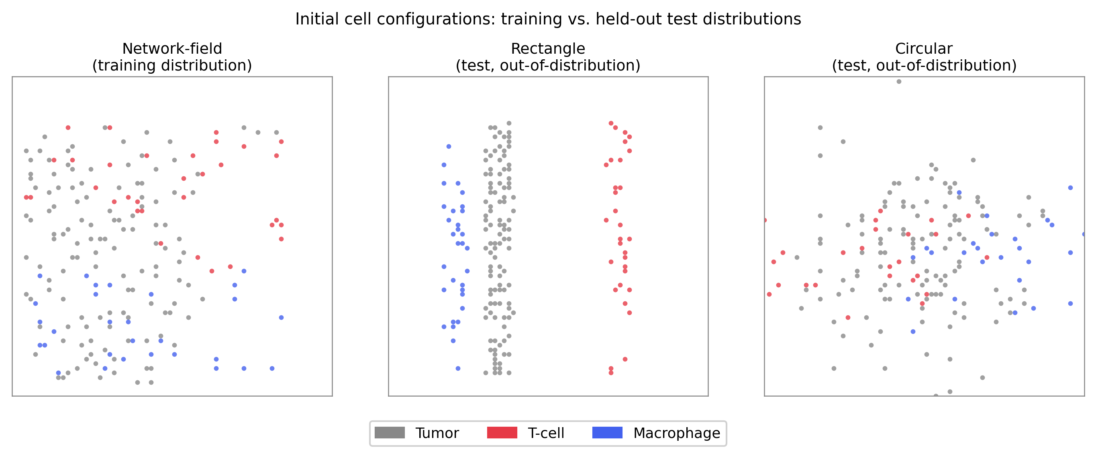
RL FORMULATION
Action, reward & the question we study
Action space
aₜ = (dose, x, y, r) ∈ [0,1]⁴
dose = drug concentration applied
(x, y) = injection centre (normalised)
r = injection radius (norm. by diagonal)
Reward
rₜ = w_cell · (cₜ₋₁−cₜ)/[cₜ₋₁(e^{λΔt}−1)] − dₜ
Normalised tumor-suppression signal minus a drug-cost penalty.
w_cell = 0.3 ; dₜ = normalised dose spent.
Objective: eradicate the tumor while minimizing drug exposure.
The research question: among the observation spaces PhysiGym can expose, which help the agent learn & generalize?
Train on a network-field distribution; test out-of-distribution on two held-out layouts:
PhysiGym Bridging Agent-Based Biological Simulation and RL
5

Slide 6
FORMULATION
The control problem as an MDP
PhysiGym exposes the PhysiCell simulation as a Markov Decision Process — the SAC agent acts, the TME transitions, and a reward is returned each step.
AGENT
SAC policy π(a | s)
state sₜ
scalars / images
reward rₜ
tumor suppression − dose
action aₜ
(dose, x, y, r) ∈ [0,1]⁴
localized drug_1
ENVIRONMENT
PhysiCell TME · 3 cell types · 5 substrates
transition T, reward R
Objective: maximise 𝔼[ Σ γᵗ rₜ ] — eradicate the tumor while minimizing drug exposure.
PhysiGym Bridging Agent-Based Biological Simulation and RL
6

Slide 7
STATE SPACE
Six observation spaces compared
From global scalars to full multi-channel spatial images (N_c = 3 cell types, N_s = 5 substrates)
Scalar observations
Image observations
S1 Normalised cell count
Alive count per type vs. initial. ℝ^Nc
I1 Cell types only
One channel per cell type. ℝ^(Nc×64×64) uint8
S2 Cells + substrate maxima
S1 + max concentration per substrate. ℝ^(Nc+Ns)
I2 Cells + substrates
I1 + all 5 substrate maps. Spatial feedback on drug & macrophage polarisation. ℝ^((Nc+Ns)×64×64)
S3 Per-type spatial statistics
S1 + 6 spatial stats per cell type. ℝ^7Nc
S5 Global spatial statistics
S3 + 6 global stats per substrate. ℝ^(7Nc+6Ns)
Why substrate maps matter:
the indirect drug needs multi-step credit assignment. Only per-pixel substrate channels make polarisation state & drug distribution spatially legible.
PhysiGym Bridging Agent-Based Biological Simulation and RL
7

Slide 8
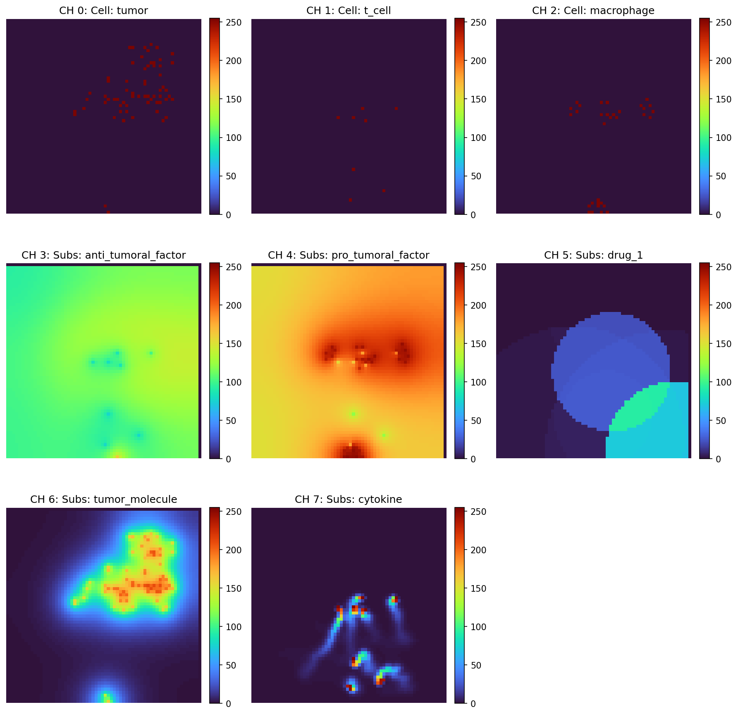
STATE SPACE
What the agent sees: the I2 observation
A single I2 observation = 8 stacked 64×64 channels.
3 cell channels
tumor · T-cell · macrophage — where each population sits in the domain.
5 substrate maps
anti-tumoral & pro-tumoral factors, drug_1, tumor_molecule, cytokine.
Drug_1 channel
shows exactly where the agent injected — the disc visible in CH 5.
Closes the loop
the CNN reads co-localisation (e.g. drug ∩ macrophages) directly from pixels — impossible from scalar summaries.
Example I2 observation at step 40 — 8 channels (3 cell types + 5 substrates), each 64×64.
PhysiGym Bridging Agent-Based Biological Simulation and RL
8

Slide 9
RESULTS
Aggregated performance at end of training
ID | Mode | Dim | n | Trainμ | Trainσ | Testμ | Testσ
I2 | img + substrates | 8×64² | 5 | +77.2 | 8.5 | +56.5 | 10.3
I1 | img cells only | 3×64² | 4 | +50.3 | 11.3 | +20.8 | 18.2
S3 | spatial cells | 21 | 3 | +51.2 | 25.8 | +12.4 | 34.6
S5 | spatial cells+subs | 39 | 2 | +3.2 | 7.3 | +0.5 | 0.5
S2 | scalar cells+subs | 8 | 4 | −16.8 | 38.3 | +12.3 | 27.0
S1 | scalar cells | 3 | 4 | +5.9 | 22.0 | +17.6 | 22.5
Key findings
• Substrate channels are decisive: I1→I2 gives the largest jump (+27 train / +36 test).
• More scalar features doesn’t help — substrate scalars (S2) are even harmful.
• Image modes show 3–4× lower seed variance (I2 σ=8.5 vs S2 σ=38.3).
Spatially explicit image observations including substrate maps learn faster and generalize better than scalar summaries.
PhysiGym Bridging Agent-Based Biological Simulation and RL
9

Slide 10
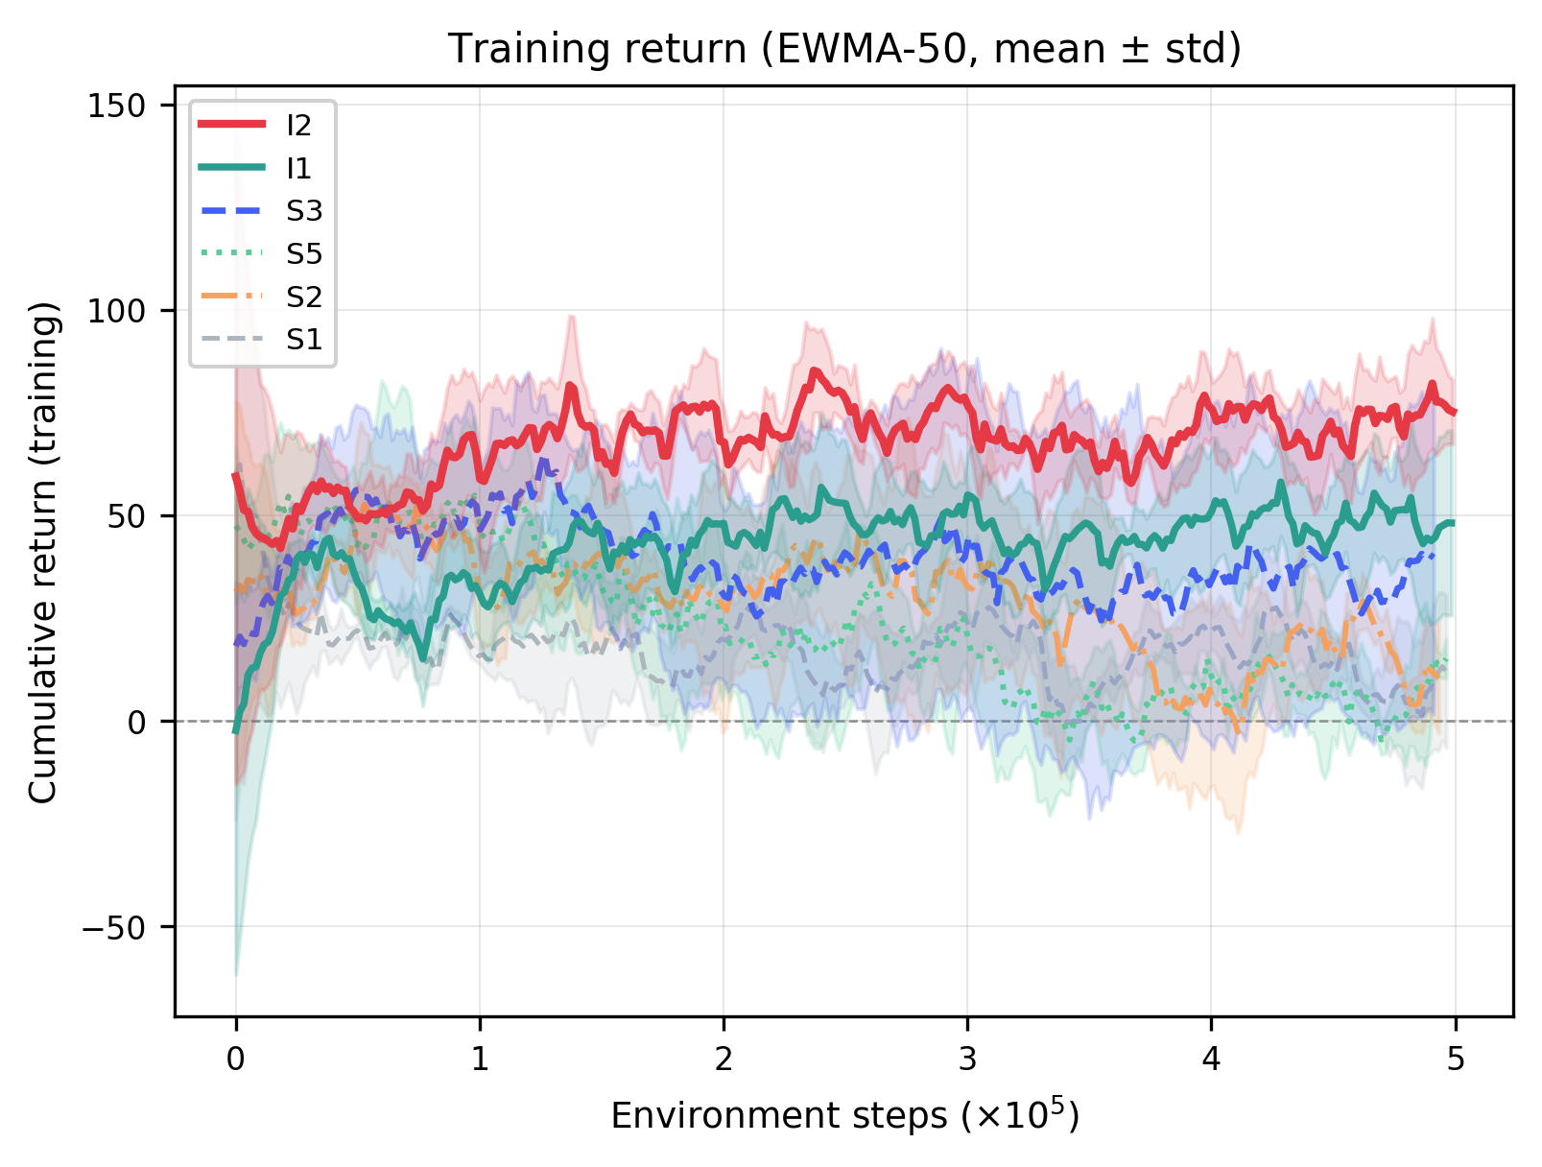
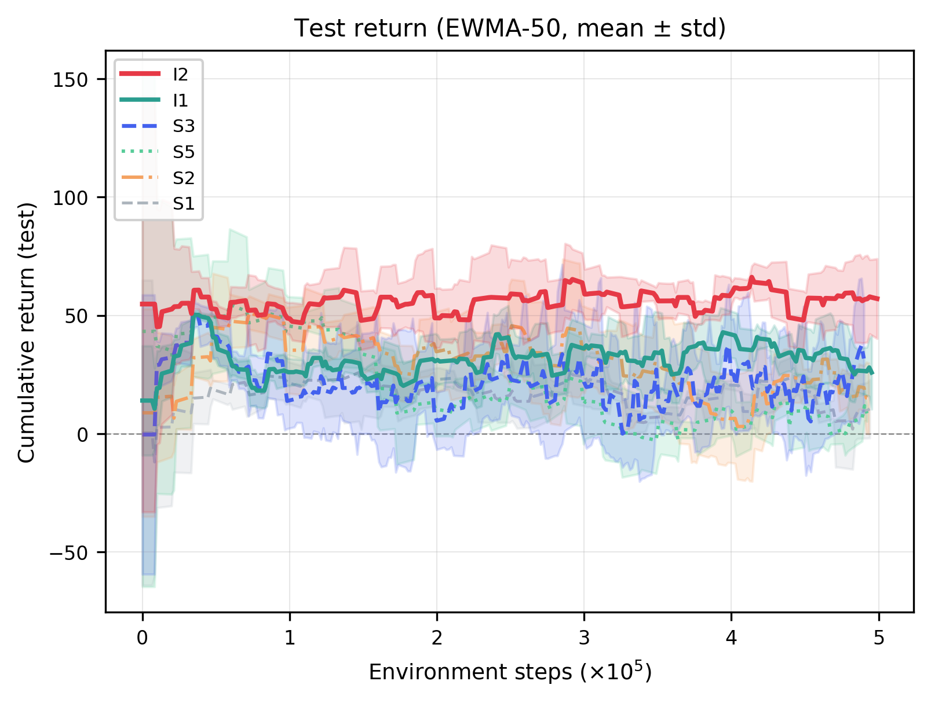
RESULTS
Learning curves: training & generalization
Training return (EWMA-50). I2 (red) separates after ≈0.5×10⁵ steps and widens the gap; scalar modes plateau below +35.
Test return on held-out layouts. I2 keeps climbing; I1 & scalar modes barely improve with high variance.
PhysiGym Bridging Agent-Based Biological Simulation and RL
10

Slide 11
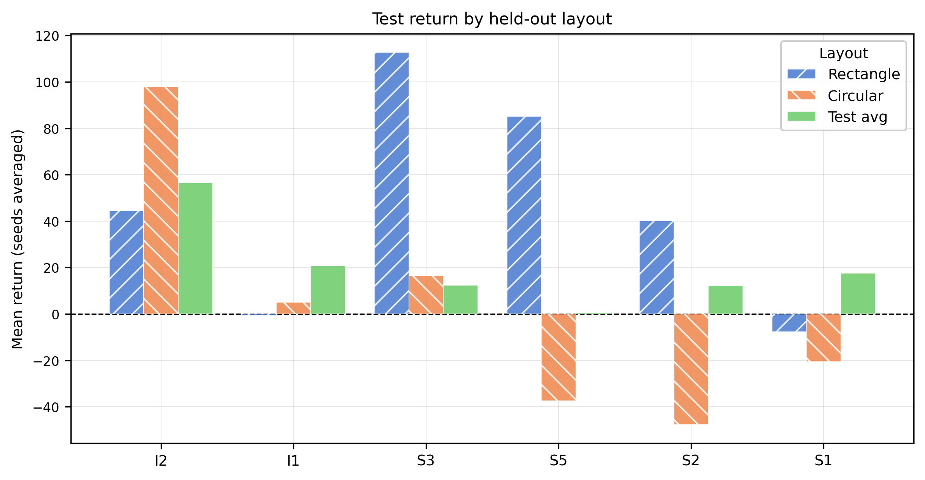
RESULTS
Generalisation to held-out layouts
Mode | Test avg | Rectangle | Circular
I2 | +56.5 | +44.5 | +97.9
I1 | +20.8 | −0.6 | +5.0
S3 | +12.4 | +112.7 | +16.3
S5 | +0.5 | +85.1 | −37.6
S2 | +12.3 | +40.2 | −47.7
S1 | +17.6 | −7.7 | −20.5
I2 achieves the best average test return and the best circular return (+97.9).
I1 fails on both OOD layouts — cell-image policies overfit without substrate feedback.
Scalar modes generalize inconsistently (note the single-seed S3 rectangle outlier).
PhysiGym Bridging Agent-Based Biological Simulation and RL
11

Slide 12
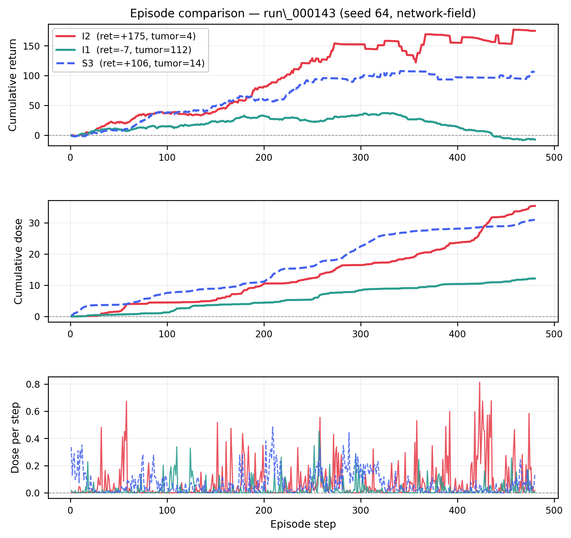
MECHANISM
Step-by-step episode: why substrate maps win
run_000143 — near-eradication episode
I2
near-eradication: 4 tumor cells, +175 return, 35.4 dose.
S3
partial control: 14 cells, +106 return, 31.1 dose.
I1
fails: 112 cells, −7.4 return, only 12.2 dose.
Two failure modes:
I1 under-medicates — without substrate feedback it can’t tell if injections reached macrophages.
S3 suppresses early but can’t finish — it lacks the substrate spatial feedback for the final push to eradication.
PhysiGym Bridging Agent-Based Biological Simulation and RL
12

Slide 13
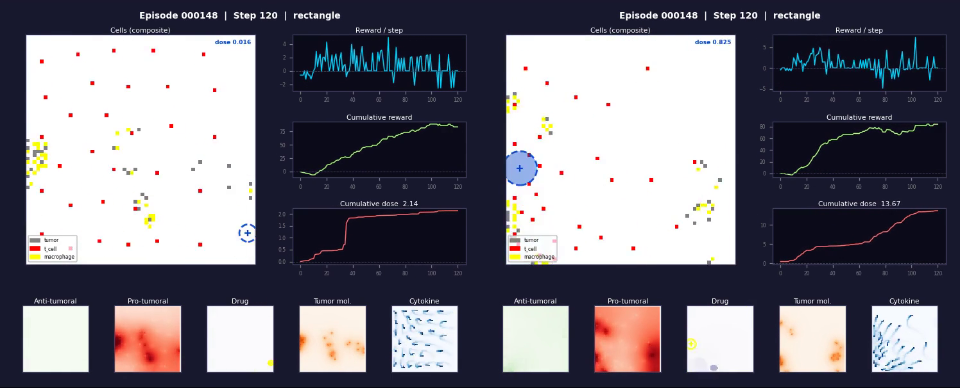
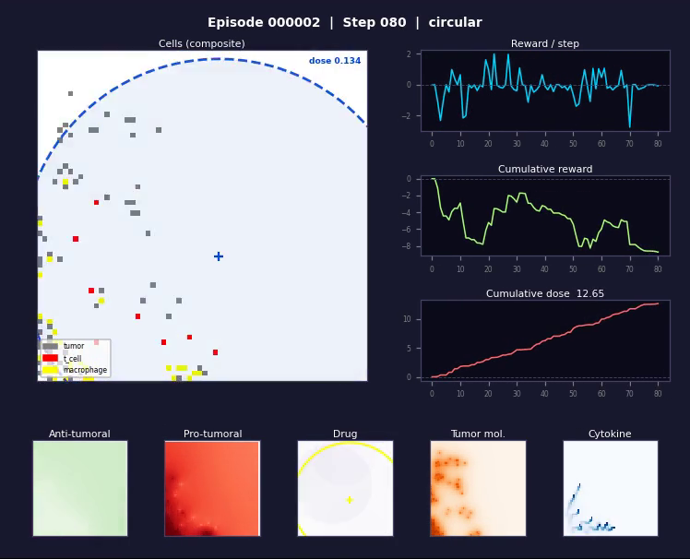
IN ACTION
Learned policy vs. random policy
Learned policy — two best state spaces (I2 & S3)
Random policy — baseline
run_000148 — side-by-side rollout of the two best observation modes. The agent targets drug injections to repolarise macrophages and clear a path for T-cells.
Untrained / random drug deployment — the tumor is not controlled, illustrating the difficulty of the indirect-control task.
PhysiGym Bridging Agent-Based Biological Simulation and RL
13

Slide 14
TRAINING
Asynchronous Soft Actor-Critic
Setup
• SAC — sample-efficient continuous control; handles image obs via CNNs.
• Asynchronous parallel framework: a GPU learner updates networks while 9 CPU env processes generate experience.
• Scalar modes: MLP FC(256)→Mish→FC(256).
• Image modes: IMPALA-style CNN (3 conv → flatten → FC(256)×2).
Parameter | Value
Total training steps | 5×10⁵
Replay buffer size | 3×10⁵
Batch size | 576
Warm-up steps | 5,000
Policy / critic LR | 3×10⁻⁴
Discount γ | 0.99
Target smoothing τ | 0.005
Parallel envs | 9
Update loops / step | 3
SAC hyperparameters (TME v2 experiments).
PhysiGym Bridging Agent-Based Biological Simulation and RL
14

Slide 15
Conclusion
PhysiGym bridges PhysiCell & Gymnasium — direct RL policy learning in spatially explicit biological simulations, no recompilation, arbitrary obs/action spaces.
End-to-end case study works — a SAC agent learns a spatial drug-delivery policy that drives the TME anti-tumoral and, at best, eradicates the tumor.
Substrate spatial images are the critical state — +71 train / +39 test points over scalar baselines — a causal mechanism: they close the drug→repolarisation feedback loop.
A reproducible testbed — for both the computational-biology and RL communities to study these questions principally.
Open source: https://anonymous.4open.science/r/PhysiGym-76A7

