Slide 1
SAC-TME State Space Comparison
Observation design for SAC on a PhysiCell tumour micro-environment
Project: SAC_ASYNC_TME_Tcells (W&B)
Algorithm: Soft Actor-Critic with asynchronous parallel environments
Environment: PhysiGym — PhysiCell TME with T-cells
2026-05-18

Slide 2
Agenda
• Environment & task — PhysiCell TME with T-cells
• Biological model — cell types, substrates, rules
• Reward function & training setup
• Seven observation modes (S1–S5, I1–I2)
• Aggregated results across seeds
• Episode case studies (run_000143, run_000147)
• W&B training & test curves
• Key findings & recommendation
SAC-TME State Space Comparison • PhysiCell TME with T-cells
2 / 28

Slide 3
1. Environment & Task
PhysiCell tumour micro-environment, 2D, 63×63 µm
Cell types modelled
Five microenvironment substrates
Cell type | Role
tumor | Target — to be eliminated
macrophage | Immune effector (M1 / M2)
t_cell | Adaptive immune effector
Substrate | Diff. | Decay | Role
anti_tumoral_factor | 3.0 | 0.001 | Attracts T-cells
pro_tumoral_factor | 3.0 | 0.001 | Promotes tumor growth
drug_1 | 0 | 0.05 | Agent-controlled drug
tumor_molecule | 2.0 | 0.1 | Danger signal (tumor)
cytokine | 0.003 | 0.01 | From T-cells, kills tumor
Domain & time
Parameter | Value
Domain | 63 × 63 µm (2D)
Diffusion dt | 0.01 min
Mechanics dt | 0.1 min
Phenotype dt | 6 min
Max sim time | 10 080 min (7 days)
RL gym step | 15 min
Action: spatially-targeted drug_1 delivery
SAC-TME State Space Comparison • PhysiCell TME with T-cells
3 / 28

Slide 4
2. Biological Model — Cell Properties
Property | Tumor (red) | T-cell (blue) | Macrophage (green)
Proliferation rate | 3×10⁻⁴ / min ≈ 0.432 / day | 0 (no division) | 0
Apoptosis rate | 1×10⁻⁶ / min (rises with cytokine) | 0 (immortal in sim) | 0
Motility | Immobile (speed = 0) | Active (speed 0.1 µm/min) | Active (speed 0.1 µm/min)
Chemotaxis | — | +0.3 toward anti_tumoral_factor | +1 toward tumor_molecule
Secretion | tumor_molecule @ rate 1.0 | cytokine @ rate 1.0 | pro / anti tumoral factor (rule-driven)
Uptake | — | anti & pro tumoral factor (rate 1.0) | —
Adhesion | All cells (affinity 1.0) | Tumor only (1.0) | Tumor only (1.0)
SAC-TME State Space Comparison • PhysiCell TME with T-cells
4 / 28

Slide 5
2.4 Cell Rules (CBHG v3.0)
Signal → response, applied every phenotype step (6 min)
Cell | Signal | Effect | Target | Max | Half | n
macrophage | tumor_molecule ↑ | increases | pro_tumoral_factor secretion | 10 | 0.5 | 1
macrophage | drug_1 ↑ | decreases | pro_tumoral_factor secretion | 0 | 0.5 | 4
macrophage | drug_1 ↑ | increases | anti_tumoral_factor secretion | 10 | 0.5 | 4
macrophage | tumor_molecule ↑ | decreases | anti_tumoral_factor secretion | 0 | 0.5 | 1
macrophage | tumor_molecule ↑ | decreases | migration speed | 0.0001 | 0.5 | 4
tumor | cytokine ↑ | increases | apoptosis rate | 1 | 0.5 | 4
Biological interpretation
• Tumor burden → M2-like macrophages: ↑ pro_tumoral_factor, ↓ anti_tumoral_factor, slower migration.
• drug_1 re-polarises macrophages to M1-like: suppresses pro_tumoral, boosts anti_tumoral — the therapeutic mechanism.
• T-cell cytotoxicity is delivered via cytokine: T-cells must physically reach the tumor to kill it (Hill function, n=4).
SAC-TME State Space Comparison • PhysiCell TME with T-cells
5 / 28

Slide 6
2.5 Complete Signalling Network
Tumor
├── secretes ─▶ tumor_molecule ──▶ macrophage chemotaxis (attracts)
│ ├─▶ macrophage rule: ↑ pro_tumoral_factor
│ ├─▶ macrophage rule: ↓ anti_tumoral_factor
│ └─▶ macrophage rule: ↓ migration speed
└── responds to ◀── cytokine (T-cell) ──▶ ↑ apoptosis rate
T-cell
├── secretes ─▶ cytokine ──▶ tumor apoptosis (rule)
├── uptakes ─── anti_tumoral_factor (depletes pool)
├── uptakes ─── pro_tumoral_factor (depletes pool)
└── chemotaxis ─▶ toward anti_tumoral_factor (+0.3)
◀── indirectly REPELLED from pro_tumoral_factor zones
Macrophage
├── secretes ─▶ pro_tumoral_factor (tumor_molecule high → M2)
├── secretes ─▶ anti_tumoral_factor (drug_1 high → M1)
└── chemotaxis ─▶ toward tumor_molecule
drug_1 (agent-controlled, non-diffusing, half-life ≈ 14 min)
└── re-polarises macrophages: ↓ pro_tumoral, ↑ anti_tumoral
SAC-TME State Space Comparison • PhysiCell TME with T-cells
6 / 28

Slide 7
2.6 Why Substrate Observations Are Crucial
• The drug effect is indirect — the agent cannot observe tumor death per step; it must infer macrophage polarisation from pro/anti tumoral factor gradients.
• T-cell positioning is functionally coupled to substrate gradients — observing them lets the agent predict where cytokine-mediated killing will occur.
• pro_tumoral_factor is the key immunosuppression indicator — high values mean both M2 polarisation and T-cell repulsion.
• A scalar max(pro_tumoral_factor) (S2) loses spatial structure — the agent cannot tell WHERE the immunosuppressive zone is relative to tumor or T-cells.
• The 64×64 substrate channels preserve this spatial coupling — explaining why image modes generalise far better to novel layouts (circular, rectangle).
SAC-TME State Space Comparison • PhysiCell TME with T-cells
7 / 28

Slide 8
3. Reward Function
Normalised tumor-reduction signal, trajectory-sensitive
r(t) = (c_{t-1} − c_t) / expected_growth
where expected_growth = c_{t-1} · (exp(λ·Δt) − 1)
• c_t = alive tumor count at step t
• λ = intrinsic tumor growth rate (PhysiCell XML, 2.99×10⁻⁴ /min)
• Δt = gym step duration (15 min)
• Reward weight: w_cell = 0.3
Interpretation
• +1.0 → agent suppressed exactly the natural growth.
• 0 → no net change. | negative → tumor grew.
• Episode terminates: c_t ≤ 3 (eradication) or c_t > 256 (uncontrolled).
• Metric: charts/train_return_mean50 — EMA over last 50 episodes.
SAC-TME State Space Comparison • PhysiCell TME with T-cells
8 / 28

Slide 9
4. State Spaces Compared
Seven observation modes — five scalar, two image
ID | Mode | Type | Shape | Description
S1 | scalars_cells | scalar | (3,) | Normalised alive count per cell type
S2 | scalars_cells_substrates | scalar | (8,) | Cell counts + max substrate concentration
S3 | spatial_scalars_cells | scalar | (21,) | Cell counts + per-type spatial statistics
S4 | spatial_scalars_cells_substrates | scalar | (27,) | Cell counts + substrate scalars + cell spatial stats
S5 | spatial_scalars_cells_spatial_substrates | scalar | (39,) | Cells + substrate scalars + substrate spatial features
I1 | img_mc_cells | image | (3, 64, 64) | Per cell type spatial density grid
I2 | img_mc_cells_substrates | image | (8, 64, 64) | Cell density grids + all 5 substrate concentration grids
Scalar modes use MLP policy; image modes use IMPALA-style CNN.
SAC-TME State Space Comparison • PhysiCell TME with T-cells
9 / 28

Slide 10
5. Training Setup
Parameter | Value
Algorithm | SAC (Soft Actor-Critic)
Total timesteps | 500 000
Num parallel envs | 9
Replay buffer size | 300 000
Batch size | 576
Policy LR / Q LR | 3e-4
Gamma | 0.99
Tau (soft update) | 0.005
Entropy tuning | Automatic
Learning starts | 5 000 steps
Test frequency | every 4 episodes
Image-mode CNN (IMPALA-style)
Conv(in→32, 8×8, stride 4) → Mish
Conv(32→64, 4×4, stride 2) → Mish
Conv(64→64, 3×3, stride 1) → Mish
Flatten → FC(256) → FC(256)
Layouts
• Training: network-field generative process (Gaussian random field, ℓ = 45 µm, threshold 0.55)
• Test (held-out): circular, rectangle
• Default cells.csv: ~128 tumor, 32 T-cell, 16 macrophage
SAC-TME State Space Comparison • PhysiCell TME with T-cells
10 / 28

Slide 11
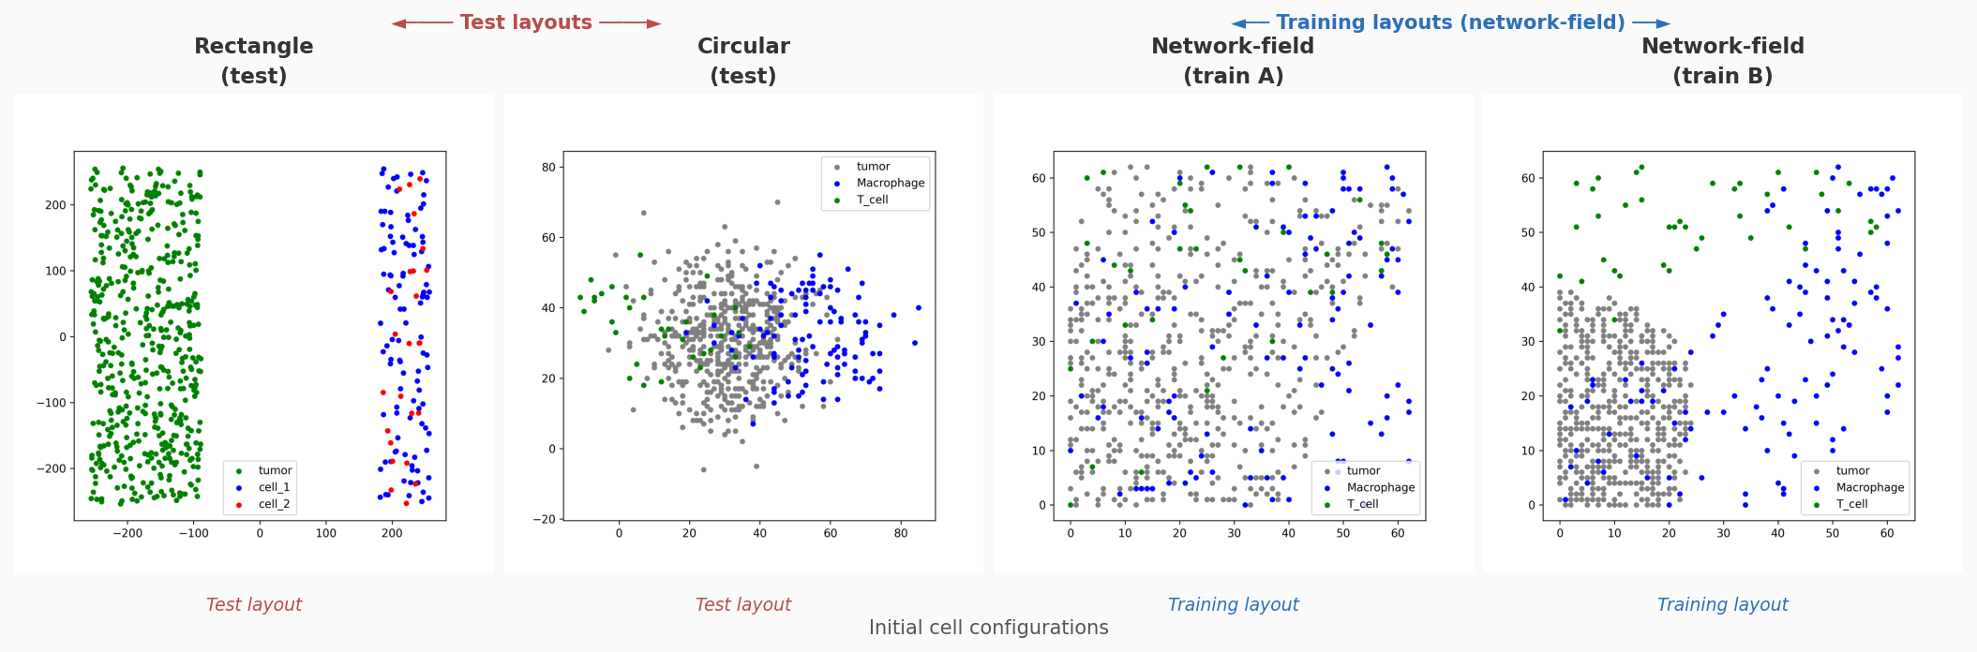
9.1 Spatial Layout Examples
Training layouts are network-field; test layouts are held out
Test layouts (rectangle, circular) are out-of-distribution: good generalisation requires policies that transfer without memorising training positions.
SAC-TME State Space Comparison • PhysiCell TME with T-cells
11 / 28

Slide 12
6. Aggregated Results — by Observation Mode
Only complete runs (≥ 400 k steps); multiple seeds averaged
Mode | n | Train mean50 | Test mean50 | Test Rect | Test Circ
I2 — img_mc_cells_substrates | 5 | +77.2 | +56.5 | +44.5 | +97.9
I1 — img_mc_cells | 4 | +50.3 | +20.8 | −0.6 | +5.0
S3 — spatial_scalars_cells | 3 | +51.2 | +12.4 | +112.7 | +16.3
S4 — spatial_scalars_cells_substrates | 3 | +29.2 | +3.4 | −22.1 | −1.2
S5 — spatial_scalars_cells_spatial_substrates | 2 | +3.2 | +0.5 | +85.1 | −37.6
S1 — scalars_cells | 4 | +5.9 | +17.6 | −7.7 | −20.5
S2 — scalars_cells_substrates | 4 | −16.8 | +12.3 | +40.2 | −47.7
I2 (image + substrates) leads on every metric except Test Rect, where S3 is helped by a single lucky seed (#64).
I2 also has the lowest seed-to-seed variance — both highest mean and most reliable.
SAC-TME State Space Comparison • PhysiCell TME with T-cells
12 / 28

Slide 13
6. Per-Seed Breakdown — Image Modes
I2 — img_mc_cells_substrates (6ch)
I1 — img_mc_cells (3ch)
Seed | Steps | Train50 | Test50 | Rect | Circ
1 | 499 356 | +78.0 | +58.2 | +4.4 | +106.7
32 | 529 501 | +79.7 | +69.9 | +4.9 | +61.4
64 | 410 875 | +86.9 | +47.7 | +109.6 | +33.7
64 | 499 977 | +64.3 | +42.3 | +47.3 | +128.9
128 | 499 914 | +77.1 | +64.5 | +56.1 | +158.8
Seed | Steps | Train50 | Test50 | Rect | Circ
1 | 499 884 | +39.8 | +22.4 | −28.7 | −28.1
32 | 526 602 | +42.4 | +27.8 | −17.4 | −43.9
64 | 499 769 | +51.3 | +14.5 | −0.5 | −2.8
128 | 499 632 | +67.5 | +18.3 | +44.2 | +94.8
S3 — spatial_scalars_cells (21d)
Key takeaways
Seed | Steps | Train50 | Test50 | Rect | Circ
1 | 499 976 | +16.7 | −28.9 | +32.2 | −81.3
64 | 499 996 | +59.8 | +27.3 | +223.1 | +91.1
128 | 499 990 | +77.1 | +38.8 | +82.9 | +39.2
• I2 train50 in tight band [+64, +87] — most consistent mode.
• I1 collapses on rect/circ for 3 of 4 seeds (overfits training layout).
• S3 seed #64 (+223 rect) is an outlier, not a robust trend.
SAC-TME State Space Comparison • PhysiCell TME with T-cells
13 / 28

Slide 14
6. Per-Seed Breakdown — Scalar Modes
S4 — spatial_scalars_cells_substrates (27d)
S5 — spatial_scalars_cells_spatial_substrates (39d)
Seed | Steps | Train50 | Test50 | Rect | Circ
1 | 499 981 | −1.7 | −7.2 | −107.0 | −57.7
64 | 499 951 | −2.3 | −28.5 | −5.4 | −15.5
128 | 499 938 | +91.5 | +46.0 | +46.0 | +69.5
Seed | Steps | Train50 | Test50 | Rect | Circ
1 | 499 979 | +10.4 | +1.2 | +6.0 | −67.5
64 | 499 979 | −4.1 | −0.1 | +164.2 | −7.6
S1 — scalars_cells (3d)
S2 — scalars_cells_substrates (8d)
Seed | Steps | Train50 | Test50 | Rect | Circ
1 | 499 925 | +37.2 | +24.0 | −1.5 | −21.8
32 | 527 895 | +6.2 | +23.3 | +30.3 | +46.7
64 | 499 988 | −20.3 | +6.9 | −52.6 | −33.1
128 | 499 938 | +0.4 | +16.3 | −6.9 | −74.0
Seed | Steps | Train50 | Test50 | Rect | Circ
1 | 499 939 | +1.7 | +26.8 | +144.6 | −0.6
32 | 528 409 | −79.2 | −24.6 | −4.8 | −90.8
64 | 499 942 | +25.3 | +18.8 | +8.0 | −44.4
128 | 499 959 | −15.1 | +28.1 | +12.9 | −54.8
SAC-TME State Space Comparison • PhysiCell TME with T-cells
14 / 28

Slide 15
7.1 Image-Based Modes Outperform Scalar Modes
• I2 (img_mc_cells_substrates) is the best across every metric: train +77.2, test +56.5 (>2× the next mode).
• Low seed variance: all I2 seeds land in [+64, +87] vs S4 ranging from −2.3 to +91.5.
• I1 (img_mc_cells) performs well on training (+50.3) but collapses on held-out test layouts — no substrate channels means no info to generalise.
• Adding substrate channels (I1 → I2) gains +27 train, +36 test — substrate visibility closes the credit-assignment loop.
• All scalar modes (S1–S5) plateau below +35 on training. None matches even I1's training mean.
SAC-TME State Space Comparison • PhysiCell TME with T-cells
15 / 28

Slide 16
7.3–7.4 More Features ≠ Better • Seed Sensitivity
Scalar complexity vs train return (counter-intuitive)
S1 (3d) | S2 (8d) | S3 (21d) | S4 (27d) | S5 (39d)
+5.9 | −16.8 | +51.2 | +29.2 | +3.2
Seed-to-seed standard deviation of train_return_mean50
Mode | Std across seeds
img_mc_cells_substrates (I2) | ~8.5
img_mc_cells (I1) | ~11.3
spatial_scalars_cells (S3) | ~25.8
scalars_cells (S1) | ~22.0
scalars_cells_substrates (S2) | ~38.3
• Adding substrate scalars hurts: noise dominates the signal.
• S5 (39d) underperforms S3 (21d) — the MLP cannot exploit the bigger scalar vector in 500k steps.
• Image modes are 3–4× more stable across seeds — CNN inductive bias matches the physical TME structure.
SAC-TME State Space Comparison • PhysiCell TME with T-cells
16 / 28

Slide 17
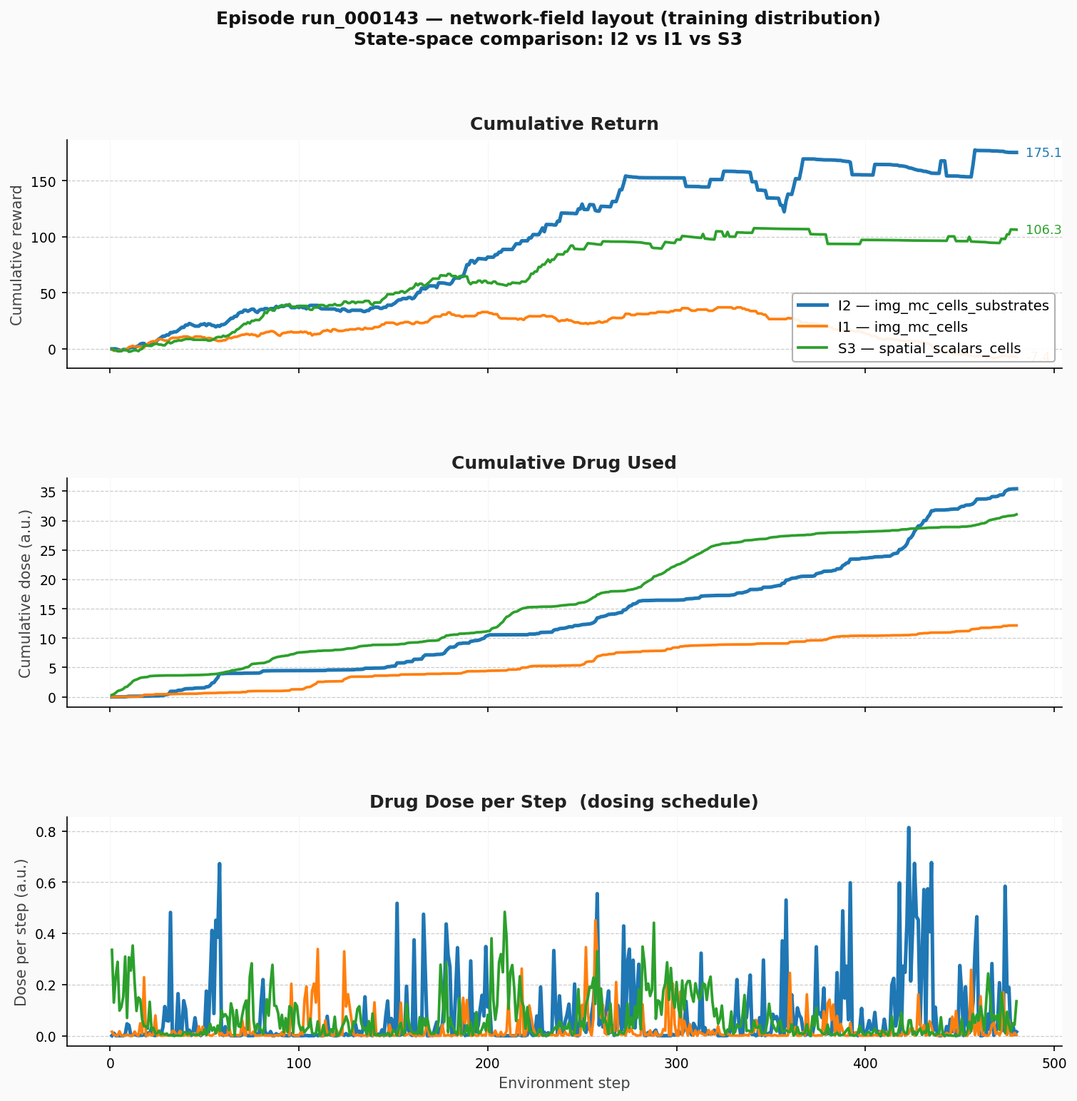
10. Episode Comparison — run_000143
Same matched episode across I2, I1, S3 (best three modes)
Episode statistics
Metric | I2 | I1 | S3
Final tumor | 4 | 112 | 14
Cum. return | +175.1 | −7.4 | +106.3
Cum. dose | 35.42 | 12.16 | 31.05
Peak dose/step | 0.813 | 0.451 | 0.484
Length | 480 | 480 | 480
I2 reaches near-eradication;
I1 under-medicates;
S3 stalls before final push.
SAC-TME State Space Comparison • PhysiCell TME with T-cells
17 / 28

Slide 18
10.2 run_000143 — Why I2 Wins
• Cumulative return — I2 climbs steadily to +175 (near-eradication); S3 reaches +106 then flattens at 14 tumor cells; I1 dips negative and ends with 112 cells (≈ untreated).
• Cumulative dose — I2 and S3 both apply ~31–35 units; I1 under-medicates at 12. Without substrate feedback, I1 can't tell if a dose worked, so it converges to a conservative low-dose policy.
• Dose per step — I2 shows pronounced late-episode spikes (steps 300–480), driving the final push to eradication. S3 distributes dosing more evenly without substrate-guided targeting.
• Substrate channels close the feedback loop: I2 observes pro/anti tumoral factor maps → knows if macrophages were re-polarised; I1 has only cell counts (too noisy for credit assignment).
• Spatial targeting requires spatial state. I2 sees WHERE factors concentrate → can place drug at the immunosuppressive zone. S3 has cell centroids but no substrate coupling.
SAC-TME State Space Comparison • PhysiCell TME with T-cells
18 / 28

Slide 19
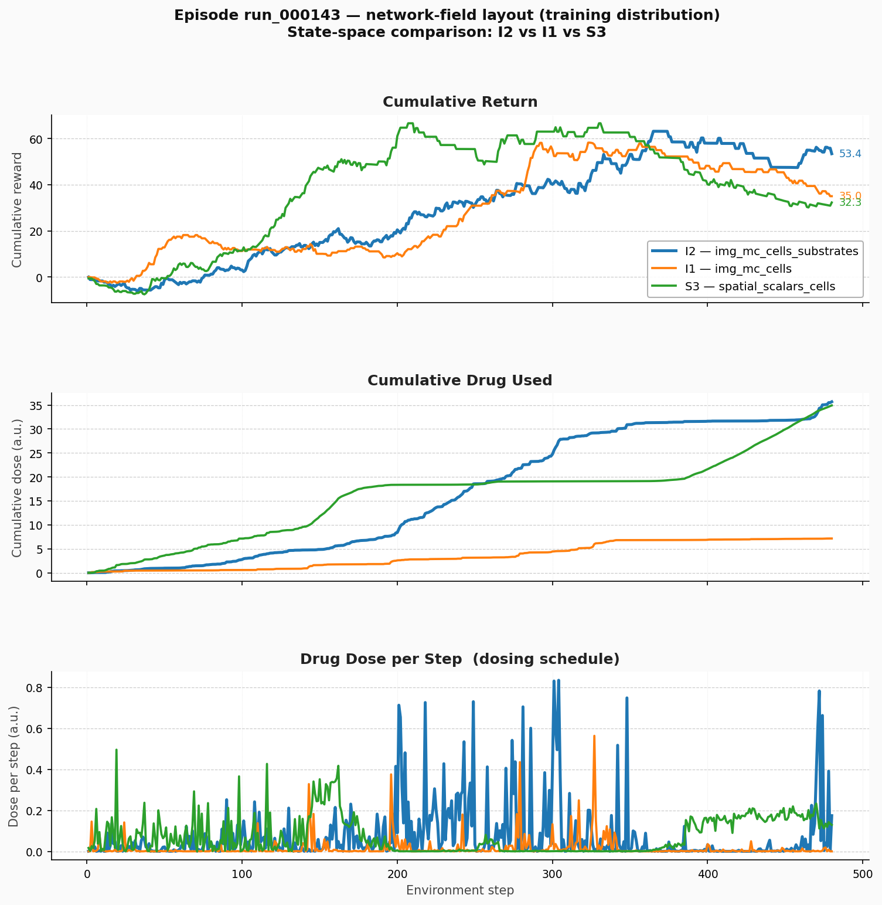
11. Episode Comparison — run_000147 (seed 128)
A harder episode: all three agents face tumor rebound
Episode statistics
Metric | I2 | I1 | S3
Final tumor | 31 | 64 | 43
Cum. return | +53.4 | +35.0 | +32.3
Peak return | +63.1 | +58.2 | +66.6
Cum. dose | 35.69 | 7.16 | 34.92
Peak dose/step | 0.834 | 0.563 | 0.496
I2 still leads despite tumor rebound.
SAC-TME State Space Comparison • PhysiCell TME with T-cells
19 / 28

Slide 20
11.2–11.3 run_000147 — Rebound Dynamics
• All three agents build positive return through step ~330, then the slope flattens or turns negative — the tumor rebounds after initial suppression.
• I2 maintains the lead and declines least after peak (+63.1 → +53.4). S3 peaks highest (+66.6) but loses control fastest (→ +32.3).
• I1 again under-medicates (7.2 vs ~35 units for I2/S3) — no substrate feedback ⇒ conservative dosing.
• Equal cumulative dose (I2 vs S3) but better outcome for I2 ⇒ WHERE the drug goes matters as much as HOW MUCH.
run_000143 vs run_000147
 | run_000143 (seed 64) | run_000147 (seed 128)
I2 final tumor | 4 (near-eradication) | 31 (rebound)
I2 cumulative return | +175.1 | +53.4
I1 final tumor | 112 | 64
S3 final tumor | 14 | 43
Return rollback? | No | Yes
SAC-TME State Space Comparison • PhysiCell TME with T-cells
20 / 28

Slide 21
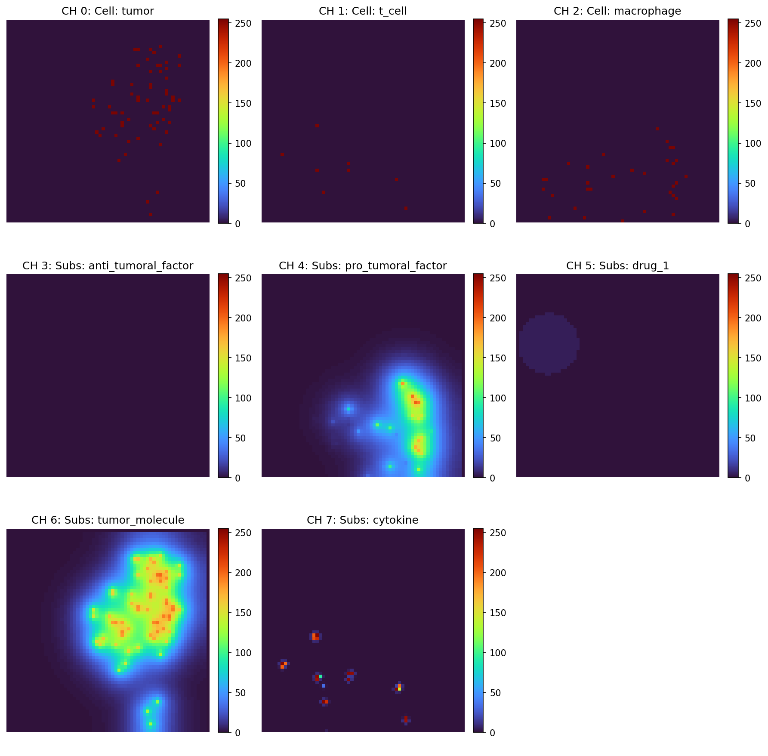
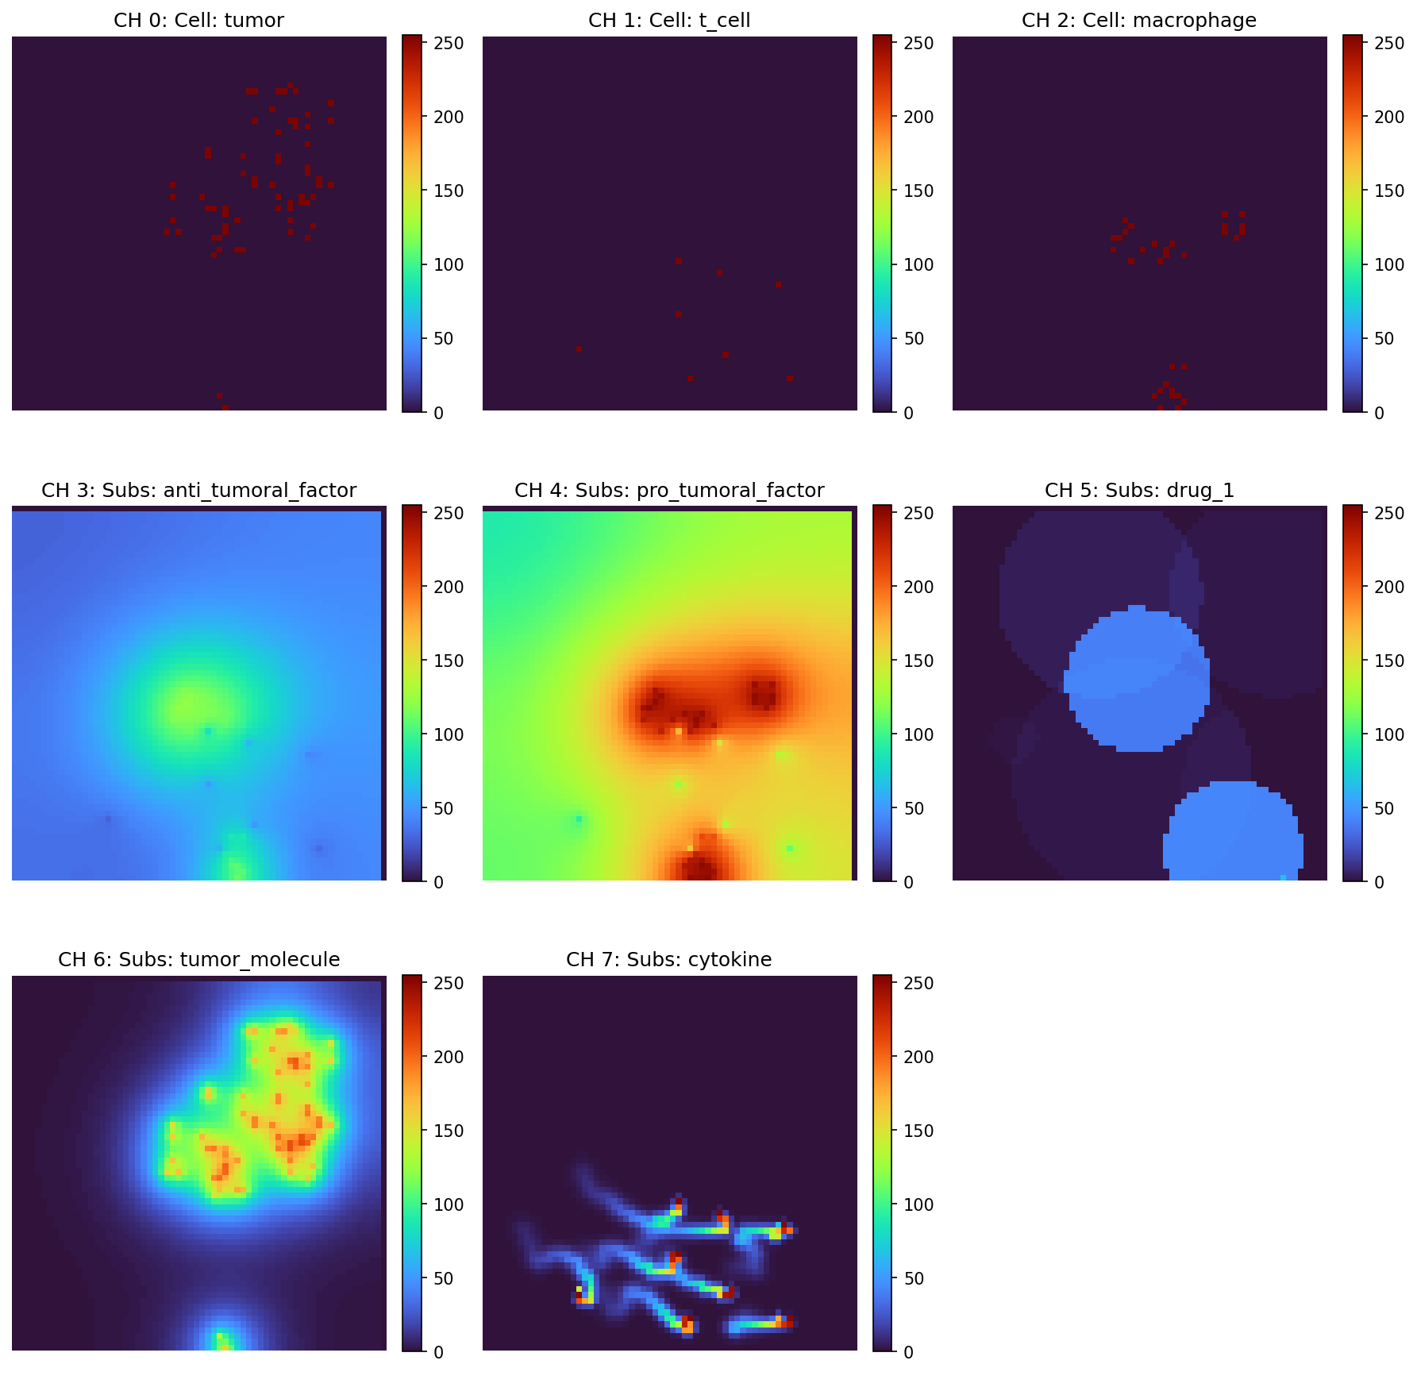
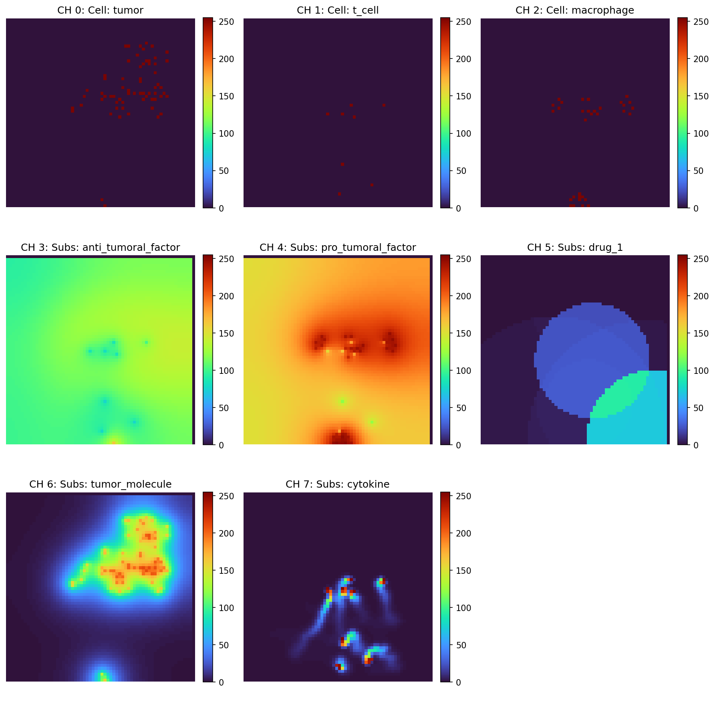
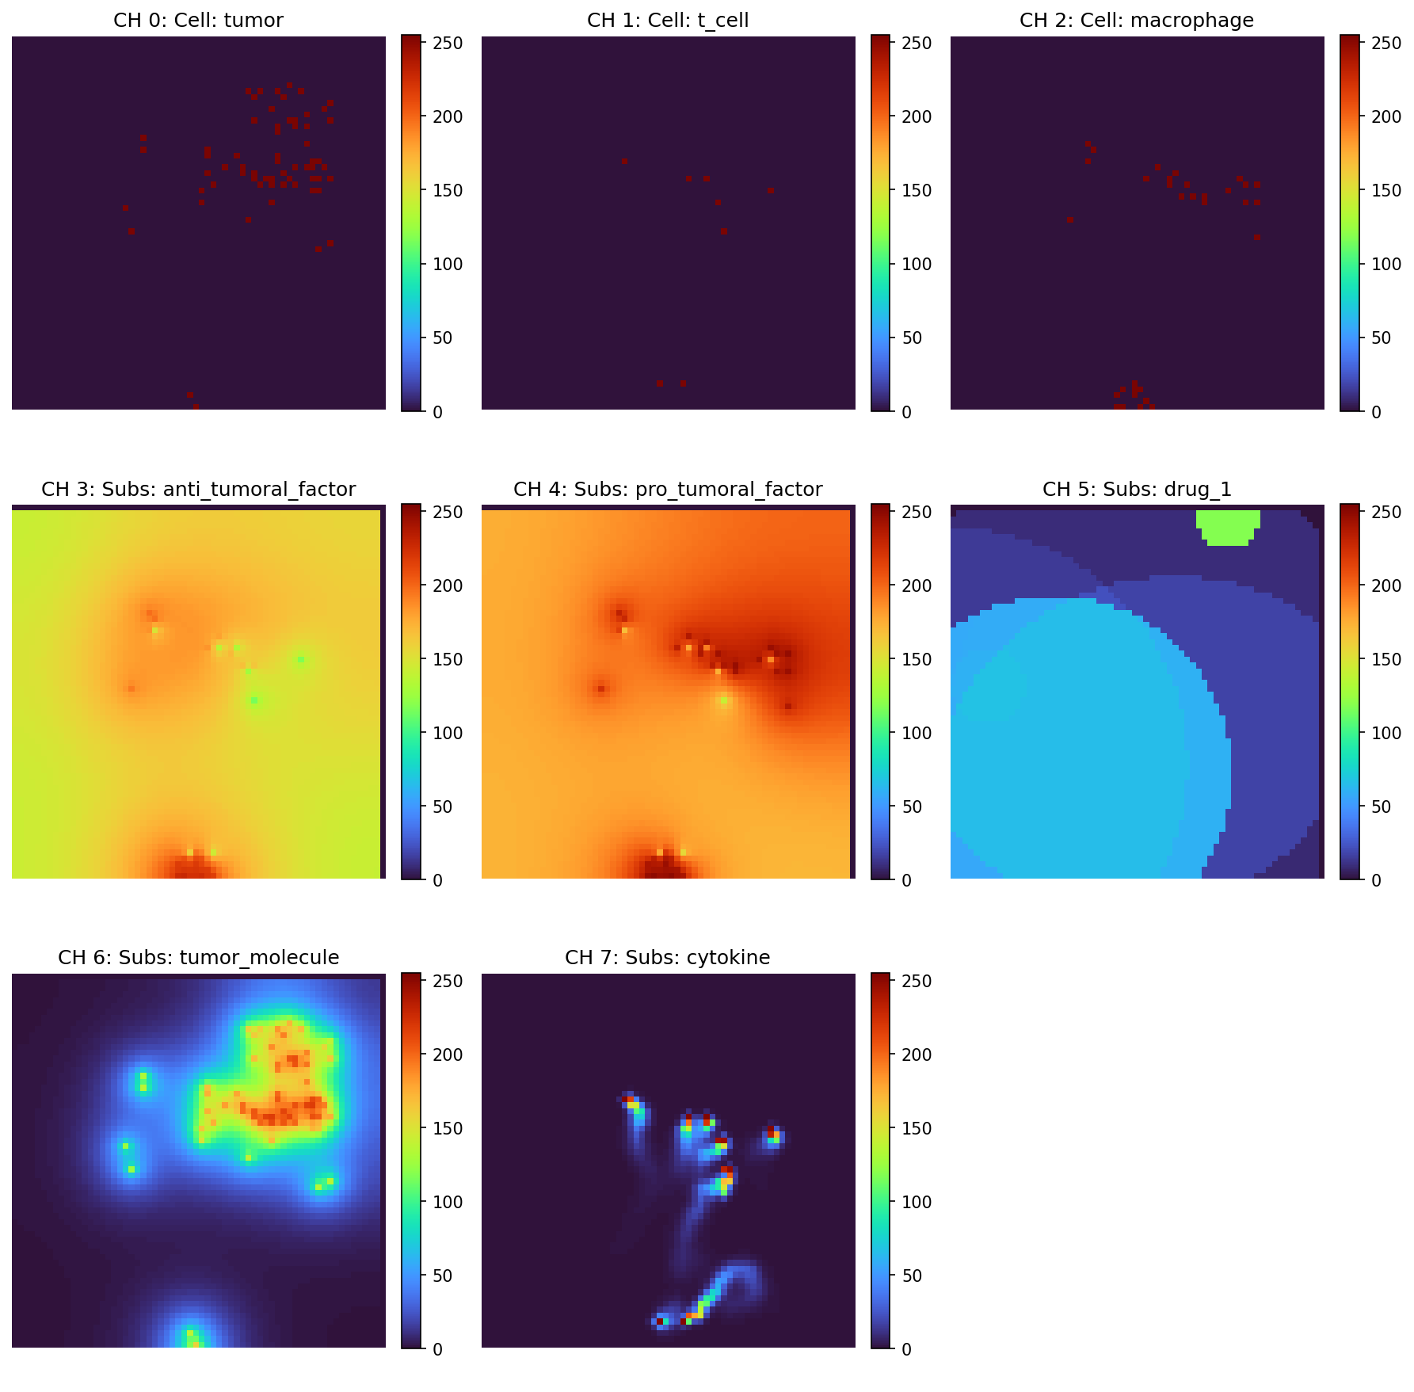
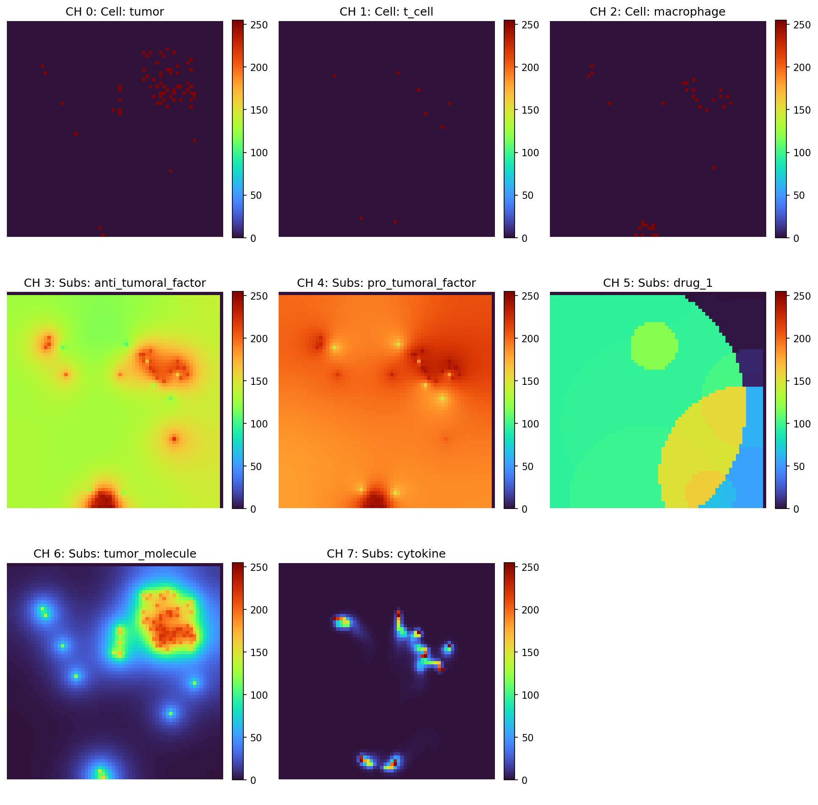
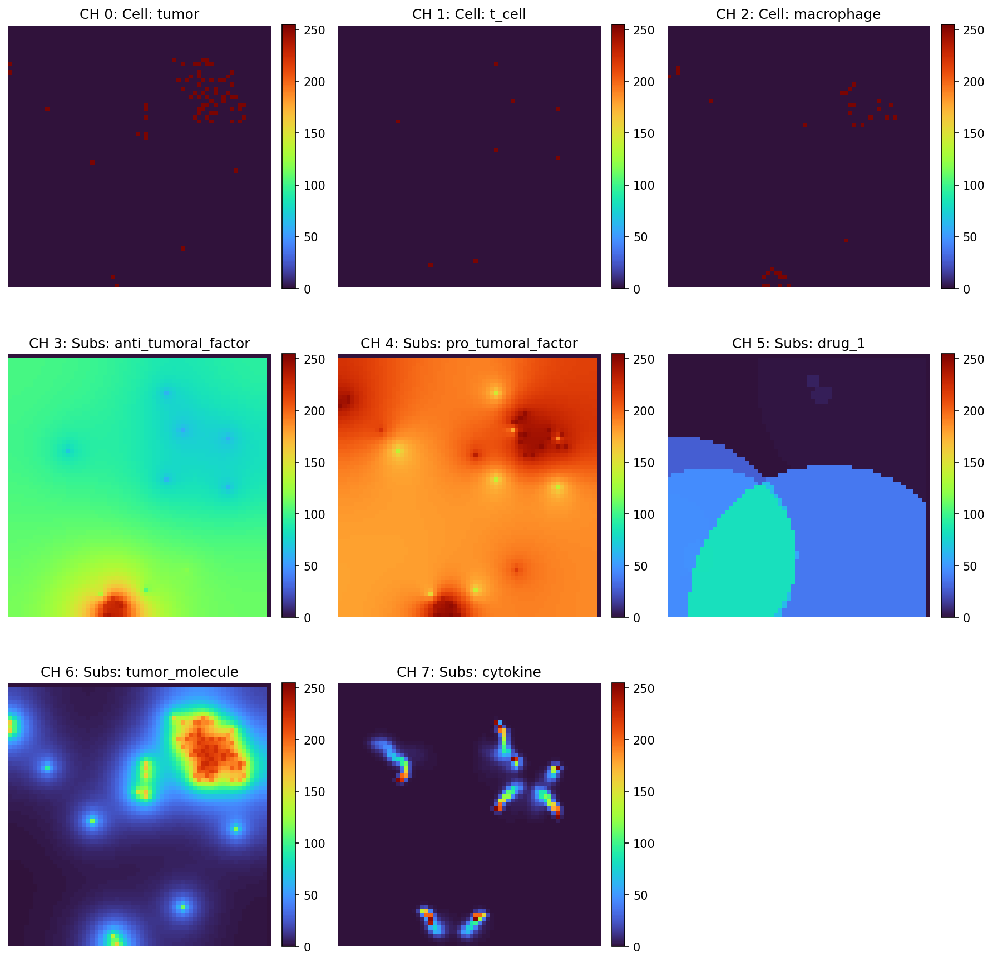
12.1 What the I2 Agent Sees
8-channel observation at six time steps of one episode
Step 0
Step 20
Step 40
CH 0–2: tumor / T-cell / macrophage density • CH 3–7: anti_tumoral, pro_tumoral, drug_1, tumor_molecule, cytokine (all 5 substrates included)
Step 60
Step 80
Step 100
SAC-TME State Space Comparison • PhysiCell TME with T-cells
21 / 28

Slide 22
12.1 What Each State Space Actually Sees
State space | What the agent sees | What is missing
I2 — img_mc_cells_substrates (8ch, 64×64) | All 3 cell types + all 5 substrate maps (anti/pro tumoral, drug_1, tumor_molecule, cytokine) | Nothing — full spatial state
I1 — img_mc_cells (3ch, 64×64) | Spatial layout of tumor, T-cell, macrophage only | All substrate maps — no drug/immune feedback
S3 — spatial_scalars_cells (21-dim) | Per cell type: presence, x/y mean & std, dist_to_center | All substrate information; only centroid/spread of cells
S1 — scalars_cells (3-dim) | Normalised alive count per cell type | Spatial structure, substrate gradients — minimal signal
CH 4 (pro_tumoral_factor) shows the immunosuppressive zone — precisely where the drug must go to repolarise macrophages.
Without this channel, the agent cannot close the dose → polarisation feedback loop.
SAC-TME State Space Comparison • PhysiCell TME with T-cells
22 / 28

Slide 23
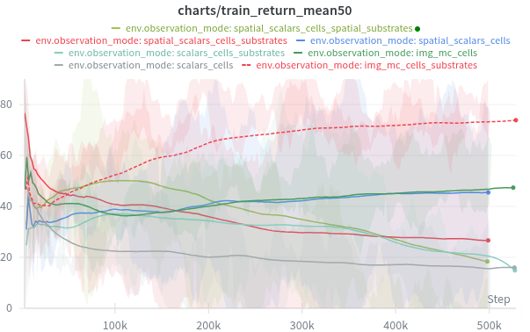
12.2 Training Return — All Modes
charts/train_return_mean50, smoothed
• I2 (red dashed) separates from all others after ~50 k steps.
• Reaches ~75–80 by 500 k steps.
• I1 (dark green) converges to ~47.
• All scalar modes plateau below 35.
• S3 (blue) is the most stable scalar.
• S4/S5 do not beat S3 despite higher dim.
SAC-TME State Space Comparison • PhysiCell TME with T-cells
23 / 28

Slide 24
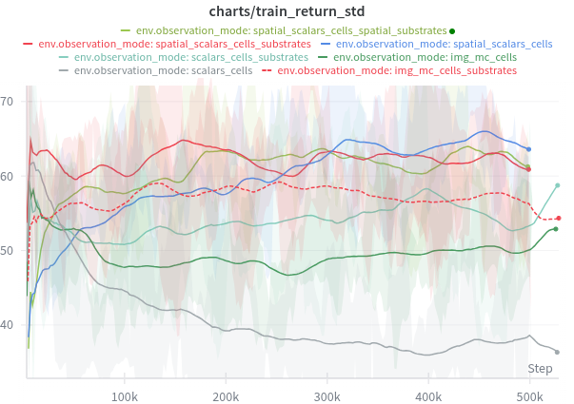
12.2 Training Return Std
Higher std = wider behavioural range
• I2 and I1 keep std ~60–65 throughout.
• Reflects diverse outcomes per episode — some near-eradication, some rebound.
• Scalar modes decay to low std — policies converge to a narrow, less ambitious behaviour.
SAC-TME State Space Comparison • PhysiCell TME with T-cells
24 / 28

Slide 25
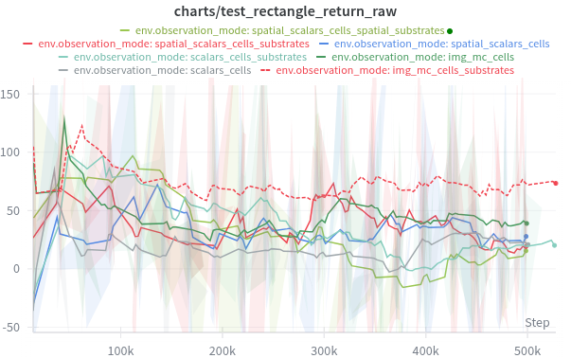
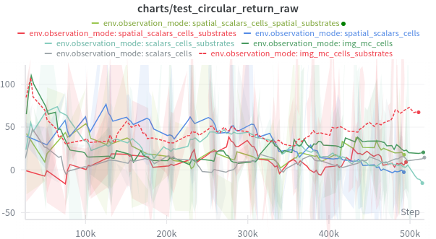
12.2 Test Return — Held-out Layouts (raw)
Left: rectangle • Right: circular
I2 leads with the highest and most consistent test returns; I1 is volatile; scalar modes cluster near zero. Circular is harder than rectangle.
SAC-TME State Space Comparison • PhysiCell TME with T-cells
25 / 28

Slide 26
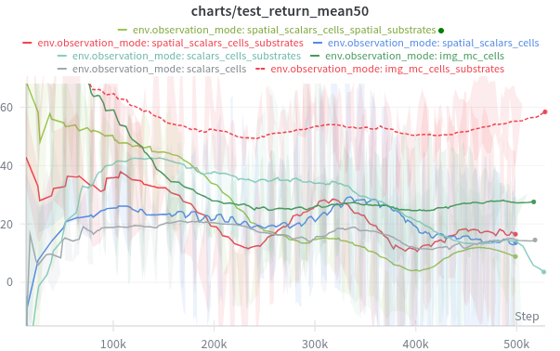
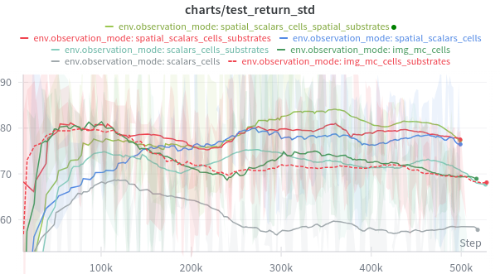
12.2 Test Return — Smoothed and Std
Left: test_return_mean50 • Right: test_return_std
I2 climbs to ~55–60 on test mean50. High I2 test std is capability (near-eradication bursts), not instability — scalar modes converge to low, predictable returns.
SAC-TME State Space Comparison • PhysiCell TME with T-cells
26 / 28

Slide 27
8. Summary of Findings
Finding | Conclusion
Best overall state space | img_mc_cells_substrates (6-ch image, 64×64)
Best scalar state space | spatial_scalars_cells (21d) — but high variance
Worst state spaces | Pure global scalars: scalars_cells, scalars_cells_substrates
Image vs scalar gap | +71 pts on train_mean50 (I2 vs S1); +39 pts on test_mean50
Substrate info impact | Critical: I2 > I1 by +27 train, +36 test
Spatial features value | Helpful in training (S3 > S1), inconsistent on test
More is not always better | S5 (39d) ≈ S1 (3d) due to optimisation difficulty
Seed robustness | Image modes ~3–4× more consistent than scalar modes
SAC-TME State Space Comparison • PhysiCell TME with T-cells
27 / 28

Slide 28
Recommendation
Default state representation for the PhysiCell TME task:
img_mc_cells_substrates (I2)
Provides
• Full spatial layout of all cell types
• Full spatial layout of microenvironmental substrates
• Consistent performance across seeds (std ~8.5)
• Strong generalisation to unseen layouts (circular, rectangle)
Fallback when compute is constrained
spatial_scalars_cells (S3) is the best scalar alternative — but needs more seeds for reliable performance.
SAC-TME State Space Comparison • PhysiCell TME with T-cells
28 / 28

