Slide 1
QuPath_Rust
A stage-verified partial port of QuPath's cell detection
— and the apparatus used to verify it
GPLv3 · github.com/Dante-Berth/QuPath_Rust · every number here is a recorded measurement

Slide 2
What this is
Two parts, and the second is the reason it is interesting
A port of QuPath's WatershedCellDetection
The ten-stage detection chain, with detections stored columnarly — a struct of
arrays, one contiguous column per feature, not a per-object string-keyed map.
A parity harness
Recorders that run inside a live QuPath build and capture its intermediate state
at every stage boundary. Committed fixtures. Tests that feed this port the same
input at the same boundary and compare pixel for pixel.
Parity is measured, not assumed — and it is incomplete
The open count gap is stated on slide 6 rather than in a limitations section at
the end. It is the first thing a user needs to know.

Slide 3
Why port it at all
Not because Java is slow — Rust vs Java on equivalent code is 1–3x
QuPath is built for interactive use
A pathologist inspects objects one at a time, and a per-object string-keyed
measurement map follows sensibly from that.
Across hundreds of slides the same layout costs
An allocation and a hash lookup per measurement, and it scatters values that are
read together.
Columnar storage removes that cost
This is the source of the speedup — the data layout, not the language.
The port is not yet a usable substitute for research work: measurements are not
implemented, and the object count does not yet match. Both are on slide 6.

Slide 4
PART ONE
The port

Slide 5
The detection chain
Every stage pinned against output recorded from a real QuPath build
1 · Colour deconvolution
6 · Labelling and watershed flood
RGB to haematoxylin/eosin optical density
4-connected, thresholded at zero
2 · Background subtraction
7 · Filled-region tracing
Opening by reconstruction — a top hat
Against ImageJ's own Wand
3 · Gaussian blur
8 · Mean-intensity filter
ImageJ's, including its edge handling
Pinned on 17 recorded images
4 · Laplacian of Gaussian
9 · Merge, shape split, refineBoundary
Boundary falls at zero, not a tuned constant
EDM and MaximumFinder
5 · Regional maxima
10 · Area filter and seam dedup
One marker per nucleus, 8-connected
On QuPath's own tile grid

Slide 6
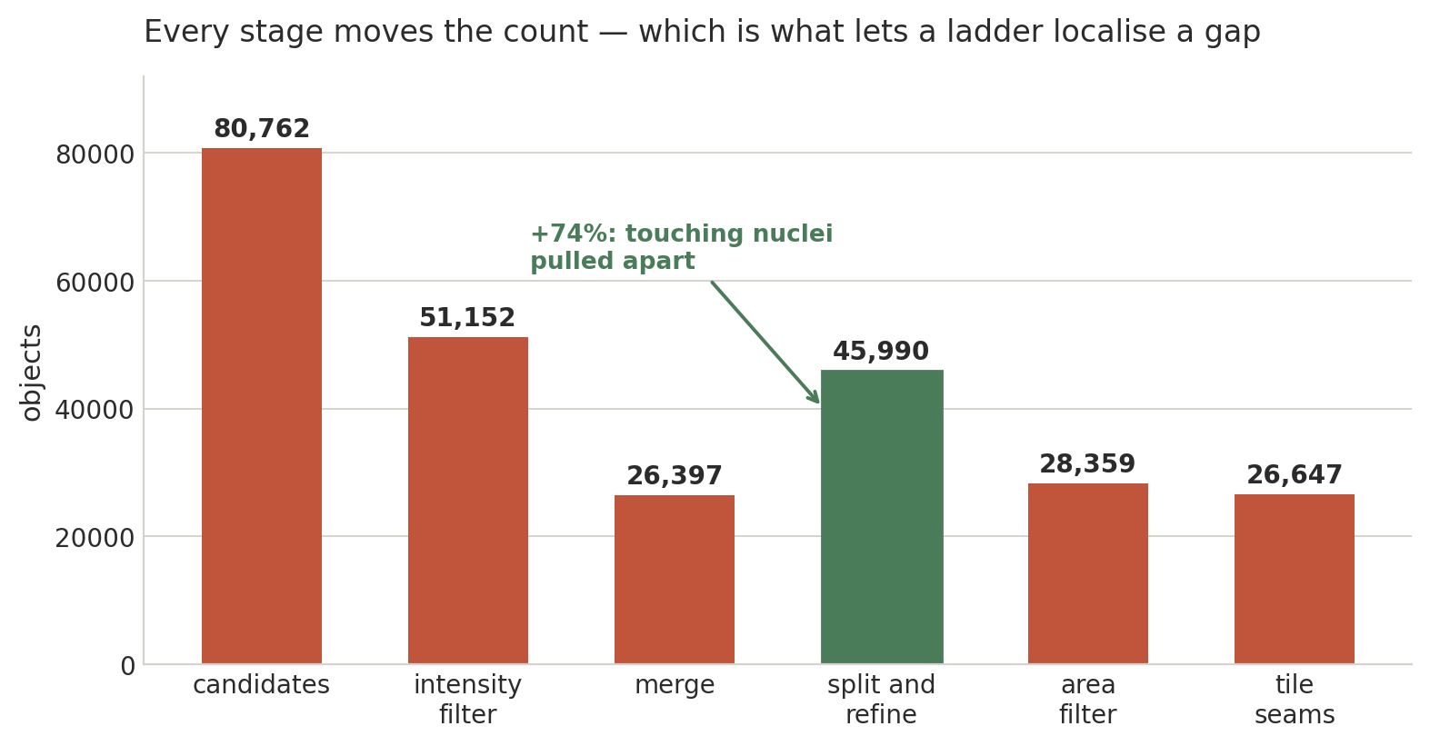
Every stage moves the count
One 4000×4000 region of CMU-1, from `cargo run --example region`
The split raising the count by 74% is not a bug — it is what pulling touching nuclei apart does.
Because each stage moves the count, a ladder of stage boundaries can localise where two pipelines diverge.

Slide 7
PART TWO
Parity — and the gap

Slide 8
The headline, stated plainly
Ten regions of CMU-1, chosen by the slide rather than by hand
1.065x
1.012–1.129
97.9%
0.921
objects found vs QuPath cells,
pooled over ten regions
range by region — and always
in the same direction
of QuPath's 17,079 nuclei
matched one-to-one
mean Dice over those
matched pairs
So the gap is a population of extra objects on sparse tissue —
not boundaries falling in the wrong place.
A single region was quoted for several sessions — 1.035x. That number is still exactly right, and it
was the wrong number to quote: it is one region, measured once, and it is the best of ten.

Slide 9
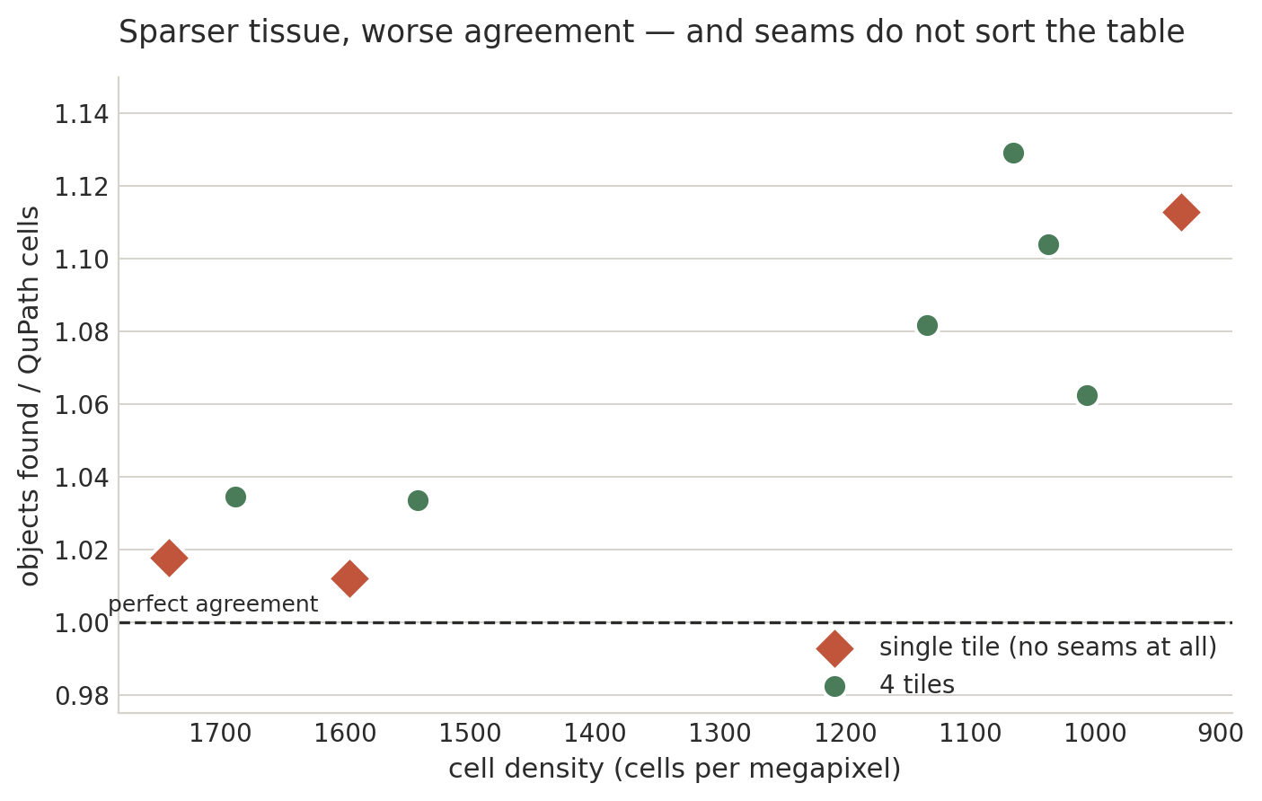
The gap tracks density, not seams
Each point is one region. Diamonds are single-tile: no seams, no duplicates removed
Dense regions agree to within 1–3.5%; sparse ones diverge by 6–13%. The seam count does not sort the table — density does.
That is what rules out tile-seam resolution (D-008) as the whole cause: three of these regions have no seams at all.

Slide 10
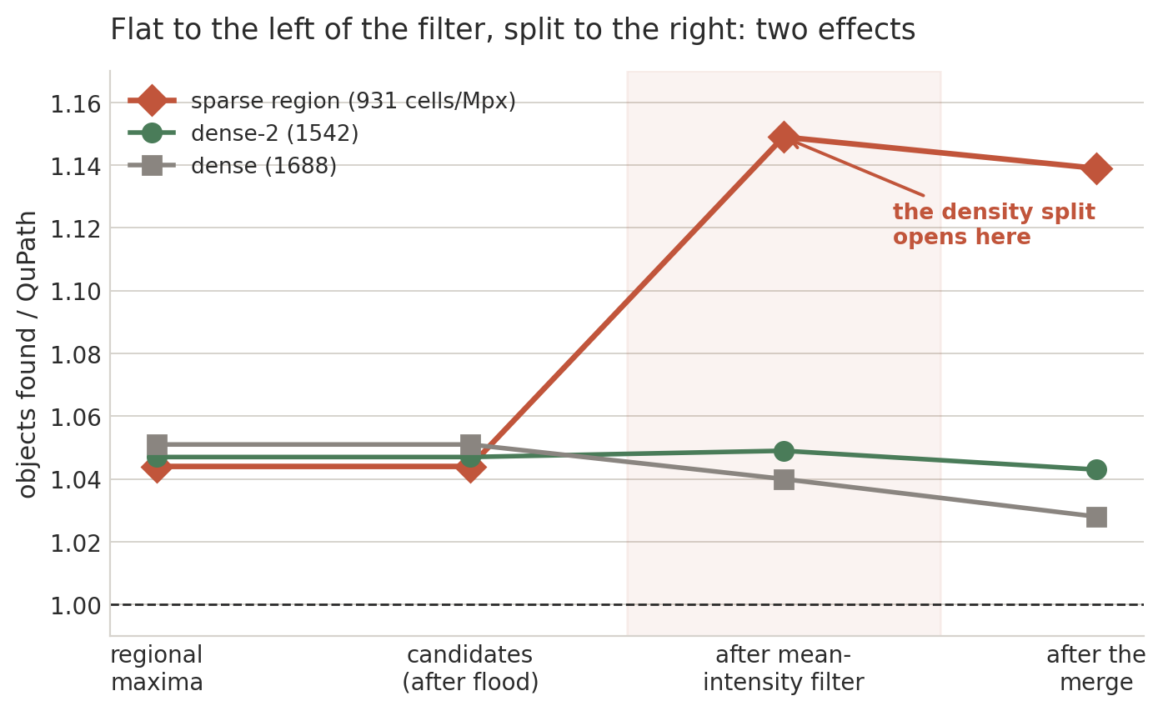
Walking the ladder splits the gap in two
Both sides' counts at four stage boundaries, three whole regions at 2048×2048
The first rung is flat across density (1.044 / 1.047 / 1.051), so that ~4.7% is density-independent and is not what the gap tracks.
The maxima and candidate rungs are identical, which rules out the labelling and the flood. The density split opens at the mean-intensity filter —
and that filter is itself pinned on 17 images, so what differs is not the filter but what it measures.

Slide 11
Where the search stands
Each narrowing has cost a hypothesis rather than confirmed one
Stage
Status
How it was ruled out
Colour deconvolution
Ruled out
Composed with the decode beneath it, on real tissue
JPEG decode
Ruled out
Against OpenSlide, to within one channel step
Background estimate
Ruled out
Bit for bit at 2048×2048, on 12.5 million pixels
Labelling and flood
Ruled out
Maxima and candidate rungs are identical
Merge and shape split
Ruled out
Pixel for pixel on all eight recorded crops
Blur, Laplacian, regional maxima
Remaining
The ~4.7% density-independent excess lives here
What the filter measures
Remaining
The density-dependent half — ipToMeasure
Seven of ten stages excluded against QuPath on real tissue, pixel for pixel. Tracked as D-009 in DIVERGENCES.md.

Slide 12
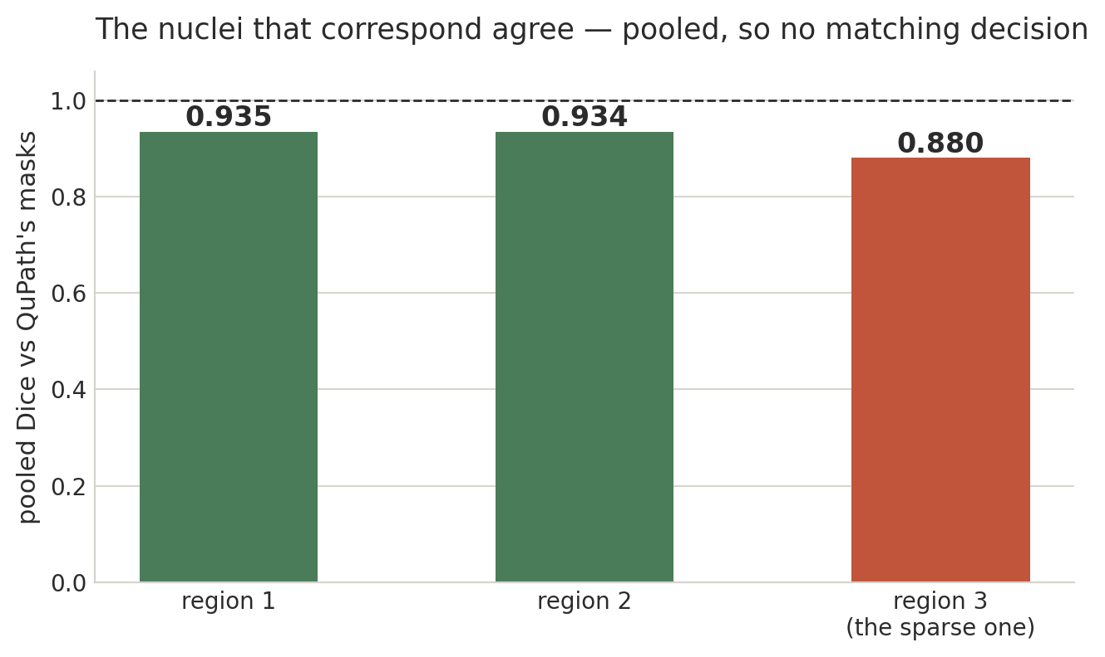
The nuclei themselves, not just how many
Against the mask QuPath recorded for every nucleus it detected, over three single-tile regions
Pooled Dice involves no matching decision, so read it first. Both sides are the pixels each pipeline actually labelled —
comparing QuPath's mask against a rasterisation of our polygon would have measured our rasteriser instead.
The third region has the lowest Dice and the worst count ratio: the same density-dependent gap, now visible as shape.

Slide 13
PART THREE
The method

Slide 14
Three bugs that looked completely fine
Each produced an entirely plausible image. None would have been caught by a count.
A morphological opening, where a top hat was wanted
The output is a smooth, believable background estimate either way.
The DAB stain vector, used under the name EOSIN
A 52% error on the leading coefficient. The channel still looked like a stain channel.
Aperio JPEG tiles carry no Adobe APP14 marker
So a conforming decoder applies the wrong colour transform. The tissue still looked
like tissue.
A count is a one-dimensional projection in which errors cancel.
Visual inspection checks whether output is plausible, not whether it is the same.

Slide 15
So parity is the test suite
The rule CONTRIBUTING.md enforces, and why each half is needed
Record, don't read
Recorders run inside a live QuPath build and capture its intermediate state at each
stage boundary. Checking against a reading of QuPath's source is not a test.
Compare at the boundary, pixel for pixel
Feed this port the same input at the same stage boundary — so a divergence is
localised to one stage instead of showing up as a different total.
Mutation-check every fixture
No test is trusted until it has been shown able to fail. A fixture that cannot fail is
a green light wired to nothing.
Record the deliberate differences too
Matching QuPath includes matching its mistakes. "More correct than QuPath" is a bug
here — ten entries in DIVERGENCES.md.

Slide 16
PART FOUR
Using it

Slide 17
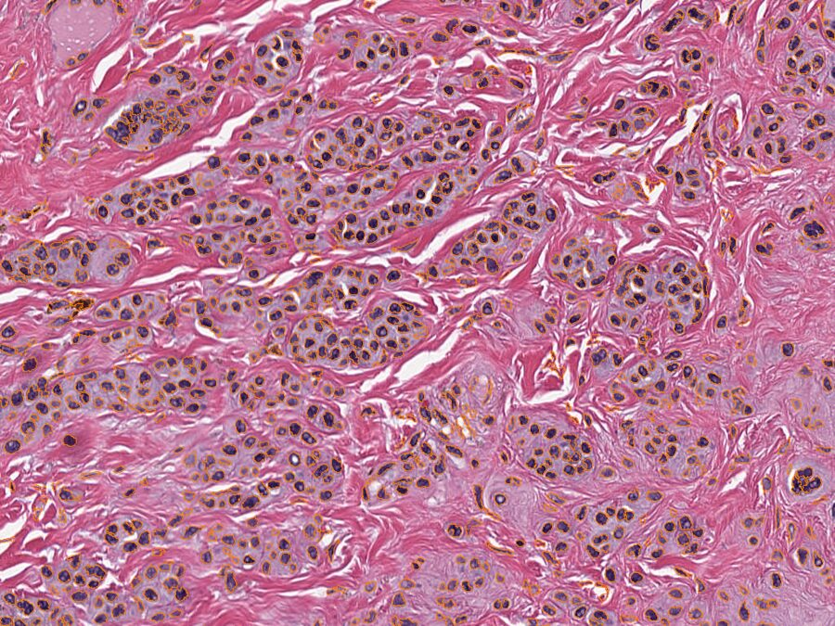
The application
A viewer, a project browser, detection, and GeoJSON out
Open a slide
Aperio SVS and tiled TIFF, pure Rust — no OpenSlide, no Java.
Pan, zoom, detect
`d` detects in what is on screen, on a thread, with a real
progress fraction and a way to stop.
Save as GeoJSON
`s` writes what QuPath's importer reads. Level-0 pixels throughout.
Projects
Opens and writes QuPath's own .qpproj layout.
The viewer claims no parity and no speedup — QuPath's viewer is not what is
being ported.

Slide 18
Two things users get wrong
Both produce a plausible answer, which is why they are on a slide
Detection does not read the level you are looking at
It reads the coarsest level still at 1.0 µm/px or finer. The viewer picks a level to look at; detection picks one to
measure at. At CMU-1's level 2 a pixel is 8 µm and a nucleus is 5–10, so what survives the filters is tissue —
reported as a plausible object count. A fitted whole-slide view once found 1,638 objects where one screenful found 1,357.
What comes out are nuclei, not cells
Cell expansion and boundary smoothing are ported and pinned in qupath-watershed, but nothing in the pipeline
calls them. So the outlines are raw pixel boundaries, and the counts on slide 8 compare our raw nuclei against
QuPath's smoothed cells. A parameter the pipeline ignores gets no control in the panel, rather than an inert one.

Slide 19
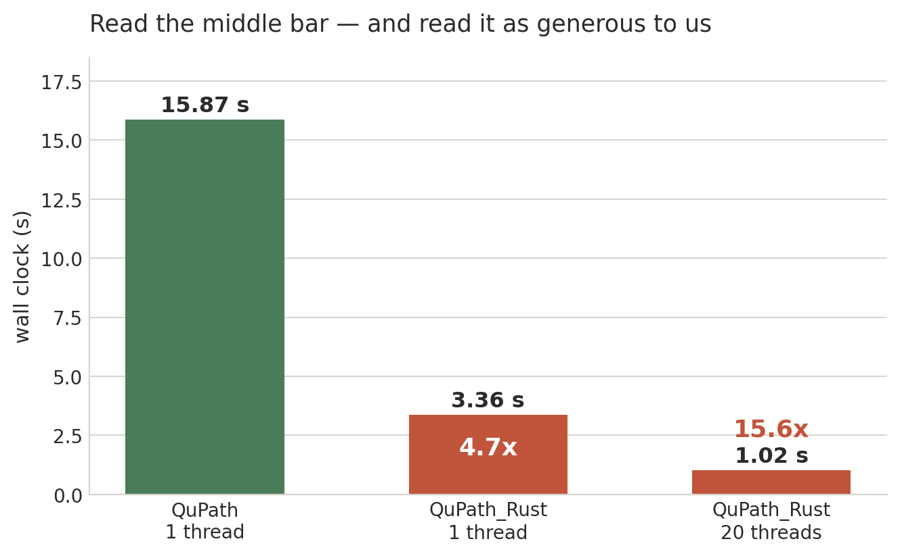
And it is fast — read the middle bar
The 4000×4000 region QuPath was profiled on, same slide, same parameters
QuPath's profile was taken single-threaded, and QuPath parallelises across tiles in real use, so the 15.6x is not the honest comparison.
Read both bars as generous to us: QuPath's 15.87 s includes computing the measurements this pipeline does not implement.
A 6.5% density-dependent over-count is not a rounding difference — what is fast here is not yet what QuPath computes.

Slide 20
Where to go next
Read
For
docs/guide/
The user guide — opening a slide, detecting, exporting
docs/guide/parity.md
What to trust, before relying on any output
DIVERGENCES.md
Every deliberate difference from QuPath, D-001 to D-010
docs/dev/MEMO.md
Twenty minutes of orientation; §2 is the gap
CONTRIBUTING.md
The fixture-and-mutation rule for a new parity claim
The repository is usable as a worked example of stage-boundary verification
as much as it is a detection library.

