Slide 1



Welcome at AICS Cameroon
For Our end of Year defense presentation in view of obtaining a High Technician Diploma (HTD) in Computer Science
1 / 19

Slide 2


CONCEPTION AND REALIZATION OF A SMART COMMUNITY PLATFORM FOR REAL-TIME INCIDENT REPORTING (SOS REPORT)
Internship carried out at MI-TECH from the 6th July to 30th September 2026 in view of obtaining a Higher Technician Diploma (HTD) in Computer Sciences.
Option: Software Engineering
Written By: AKAMBA Walvede Daniel
Level II student at AICS Cameroon
Academic Supervisor
Mr. BILL NELSON
Lecturer at AICS
Professional Supervisor
Mr. SERGIO JUNIOR CHEBEU
Full Stack Developer at MI-TECH
Academic Year 2025 - 2026

Slide 3

01
Introduction
02
Context & Problematic
03
Proposed Solution
AGENDA
04
Project Objectives
05
Methodology
06
Technologies Used
07
Demonstration
08
Conclusion & Perspectives
3 / 19

Slide 4


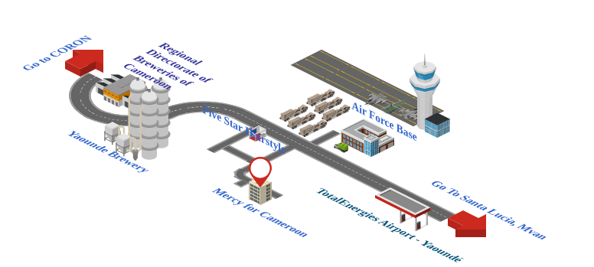
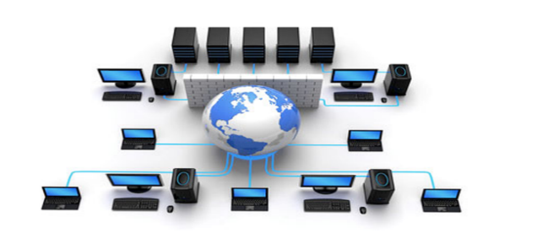

Introduction
Development of Mobile and Web applications
System and Networking
Training
Develop innovative solutions that meet the specific needs of African populations.
4

Slide 5
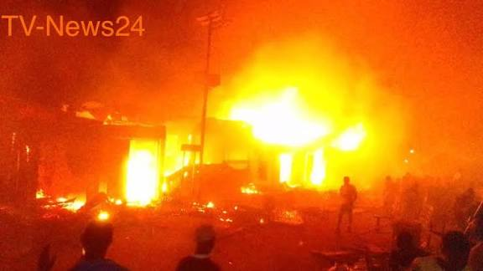
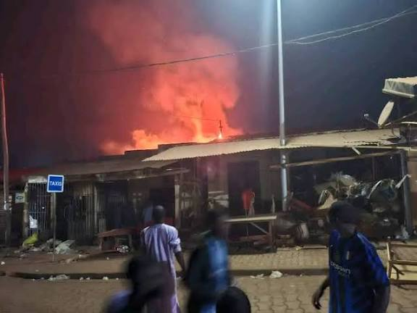

Context & Problematic
5/ 19

Slide 6



Context & Problematic
The Problem: How can we help the Public Services to perform a more rapid Intervention when an Incident is reported ?
6 / 19

Slide 7

Context & Problematic
How can we help the Public Services to perform a more rapid Intervention when an Incident is reported ?
7 / 19

Slide 8

Proposed Solution
SOSReport
8 / 19

Slide 9
Project Objectives
Create a digital interface that will :
01
Enable citizens to quickly report via their phone, safety incidents they encounter,
02
Provide Emergency services with necessary evidences concerning an incident reported,
03
Enable nearby citizens to be aware of critical incidents occurring in their present area,
04
Provide Emergency services with tools that will help them to track citizens which find their leisure in reporting false incident alerts
9 / 19

Slide 10

Methodology
Technical Branch
Functional Branch
Capture of functional requirement
Capture of techinal requirement
Analysis
Generic Design
Preliminary design
Version 2.5
Detailed Design
Coding and tests
Realization Branch
10 / 19

Slide 11
Methodology
Functional Branch
Capture of functional requirement
Analysis
General Use Case Diagram
11 / 19

Slide 12
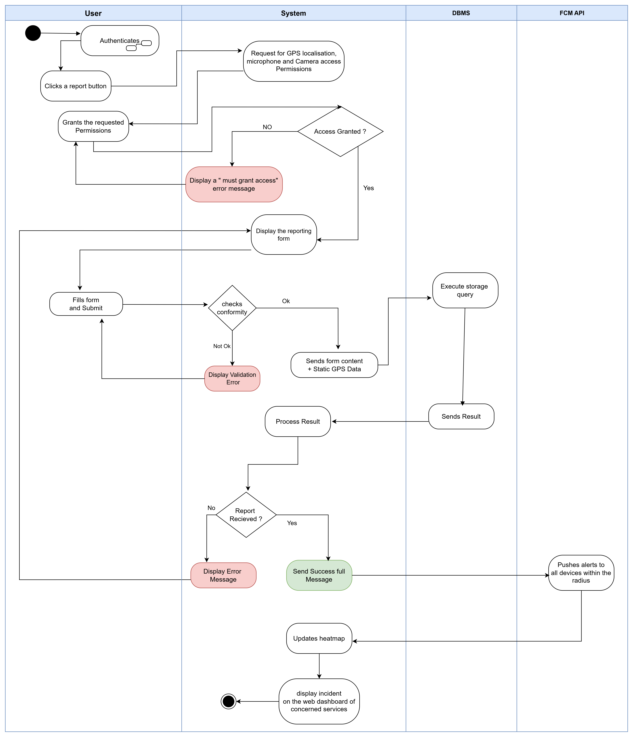
Methodology
Functional Branch
Capture of functional requirement
Analysis
Activity Diagram for Standard Incident Reporting
12 / 19

Slide 13
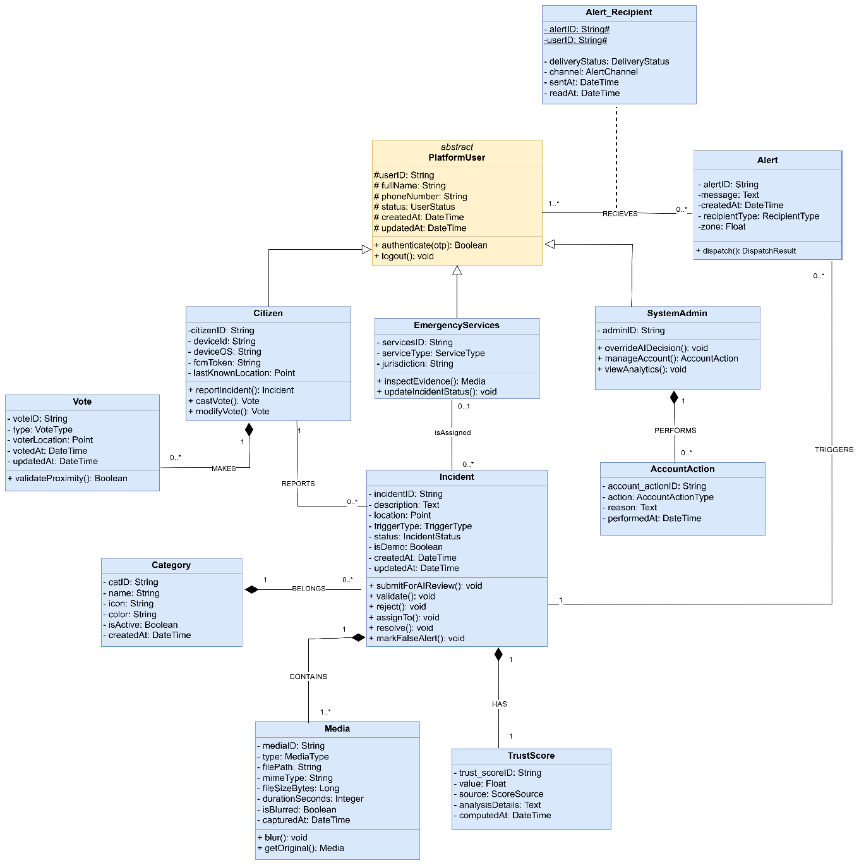
Methodology
Realization Branch
Preliminary design
Detailed Design
Coding and tests
Class Diagram
13 / 19

Slide 14
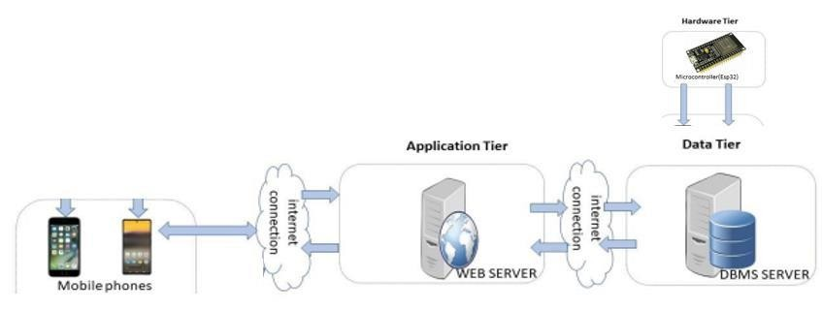
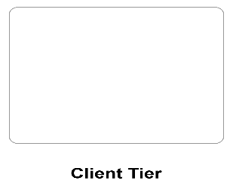


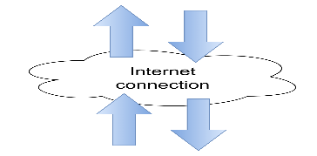
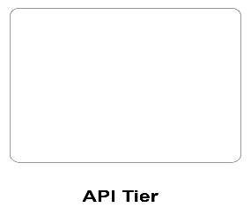

Methodology
Technical Branch
Capture of techinal requirement
Generic Design
Physical
Architecture
14 / 19

Slide 15
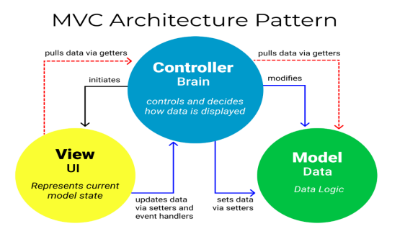
Methodology
Technical Branch
Capture of techinal requirement
Generic Design
Logical
Architecture
15 / 19

Slide 16















Technologies Used
Coding
Documentation
External Services
16 / 19

Slide 17

Demonstration
SOSReport
17 / 19

Slide 18

Conclusion & Perspective
+1
Complete remaining system functionalities such as Confirm arrival, AI face blurring
+2
Implementing the Twilio API and Email API services
+3
Implementing offline SMS fallback in case of low or no internet availability
+4
Deployment of the project
Estimation of our total work done
70%
18 / 19

Slide 19

Thank You
Open for Questions & Criticism
19 / 19

