Slide 1

StatArena Incorporation
Abdoulay Lashley, Alexis Herbert, Dante Caraballo, Tia Tran
October 18, 2024

Slide 2
Background

Slide 3
Background
Users:
UMD Soccer Coaches
UMD Soccer Managers
UMD Soccer Team Data Analysts
UMD Recruiters/Trade Staff
Data Sources:
Maryland Men's Soccer Statistics
2022, 2023 and 2024 Data
StatArena Incorporation

Slide 4
Introduction

Slide 5
Mission Statement
StatArena Incorporation is a sports organization that requires a database to manage its teams, players, stadiums, and games. The database will help manage the logistics and records for all teams, players, stadiums, and games within the organization.
StatArena Incorporation

Slide 6
Mission Objectives
Each team uniquely identifies and stores the team name, city, and the coach's name.
Players are assigned unique identifiers and must have their full name, position, and date of birth recorded. Additionally, each player belongs to a specific team.
The organization also tracks various stadiums, each having a unique identifier, name, capacity, and location.
Games are organized with a unique game ID, and the database must store the game date, scores for both teams and which teams participated. Each game is associated with a specific stadium.
StatArena Incorporation

Slide 7
Conceptual Database Design

Slide 8
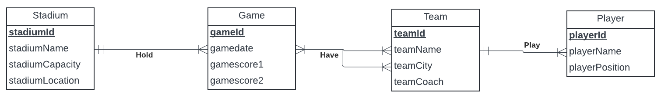
Entity-Relationship Diagram (ERD)
StatArena Incorporation

Slide 9
Logical
Database Design

Slide 10
Relational Schema
Team (teamId, teamName, teamCity, teamCoach)
Player (playerId, playerName, playerPosition, teamId)
Stadium (stadiumId, stadiumName, stadiumCapacity, stadiumLocation)
Game (gameId, gameDate, gameScore1, gameScore2, teamId1, teamId2, stadiumId)

Slide 11
Physical
Database Design

Slide 12
SQL Create Tables
CREATE TABLE Team (
teamId CHAR(3) PRIMARY KEY,
teamName VARCHAR(150),
teamCity VARCHAR(100),
teamCoach VARCHAR(200)
);
CREATE TABLE Player (
playerId CHAR(3) PRIMARY KEY,
playerName VARCHAR(255),
playerPosition VARCHAR(100),
playerDOB DATE,
teamId CHAR(3),
FOREIGN KEY (teamId) REFERENCES Team(teamId) ON DELETE CASCADE ON UPDATE CASCADE
);
CREATE TABLE Stadium (
stadiumId CHAR(3) PRIMARY KEY,
stadiumName VARCHAR(100),
stadiumCapacity INT,
stadiumCity VARCHAR(255)
CREATE TABLE Game (
gameId CHAR(3) PRIMARY KEY,
gameDate DATE,
gameScore1 INT,
gameScore2 INT,
teamId1 CHAR(3),
teamId2 CHAR(3),
stadiumId CHAR (3),
FOREIGN KEY (teamId1) REFERENCES Team(teamId) ON DELETE CASCADE ON UPDATE CASCADE,
FOREIGN KEY (teamId2) REFERENCES Team(teamId) ON DELETE NO ACTION ON UPDATE NO ACTION,
FOREIGN KEY (stadiumId) REFERENCES Stadium(stadiumId) ON DELETE NO ACTION ON UPDATE NO ACTION
);
StatArena Incorporation

Slide 13
Business Transactions

Slide 14
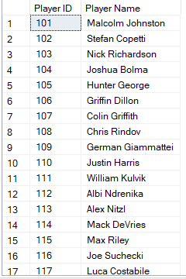
-- Who are the players on
the MD soccer team?
SELECT playerId AS "Player ID",
playerName AS "Player Name"
FROM Player
WHERE teamId = '1';

Slide 15

-- Which games took place in a specific stadium?
SELECT gameId AS "Game ID",
gameDate AS "Game Date",
teamId1 AS "Team 1 ID",
teamId2 AS "Team 2 ID"
FROM Game
WHERE stadiumId = '003';

Slide 16

-- What was the score of a particular game?
SELECT gameScore1 AS "Team 1 Score",
gameScore2 AS "Team 2 Score"
FROM Game
WHERE gameId = '1001';

Slide 17

-- Which teams are assigned to a specific coach?
SELECT teamName AS "Team Name",
teamCity AS "Team City"
FROM Team
WHERE teamCoach = 'Tim O Donohue';

Slide 18
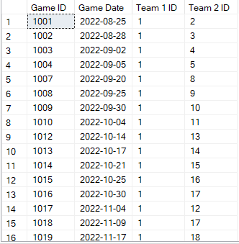
-- What games were played in stadiums with a capacity exceeding 5000?
SELECT gameId AS "Game ID",
gameDate AS "Game Date",
teamId1 AS "Team 1 ID",
teamId2 AS "Team 2 ID"
FROM Game
WHERE stadiumId IN (
SELECT stadiumId
FROM Stadium
WHERE stadiumCapacity > 5000);

Slide 19

-- What is the highest scoring game in a specific stadium?
SELECT TOP 1 gameId AS "Game ID",
gameDate AS "Game Date",
(gameScore1 + gameScore2) AS "Total Score"
FROM Game
WHERE stadiumId = (
SELECT stadiumId
FROM Stadium
WHERE stadiumName = 'Ludwig Field')
ORDER BY (gameScore1 + gameScore2) DESC;

