Slide 1
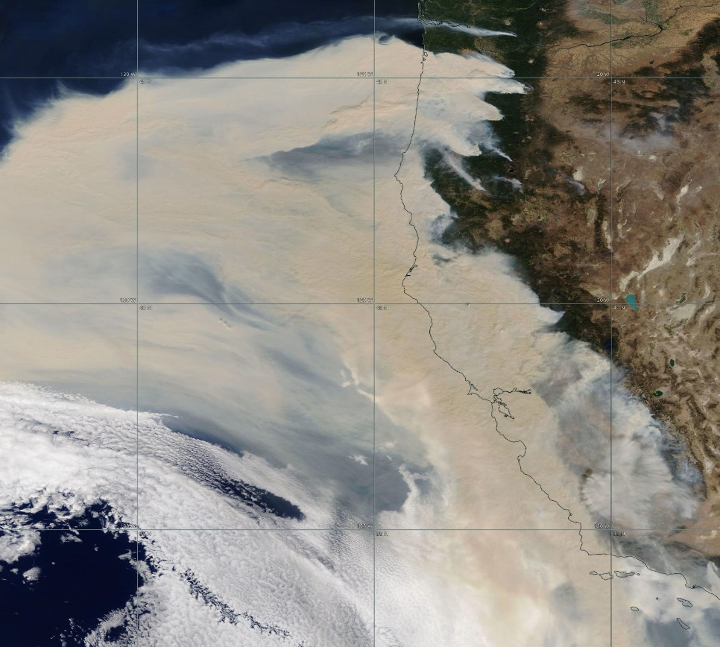
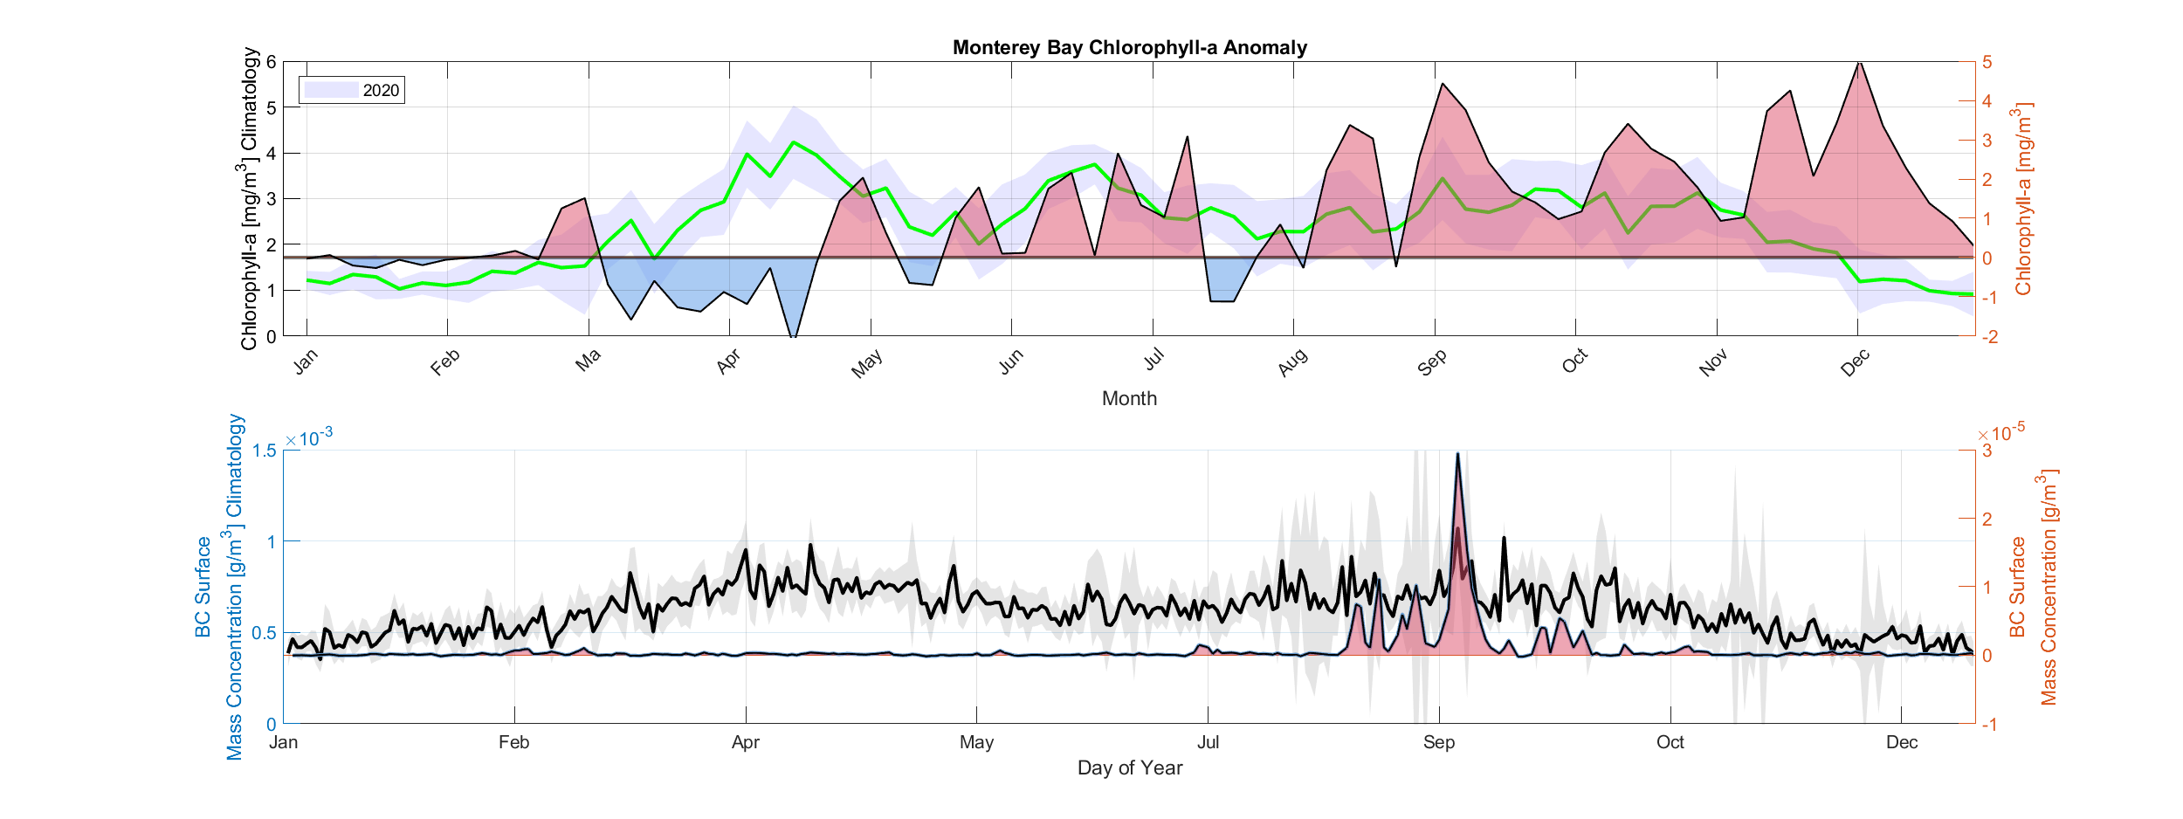
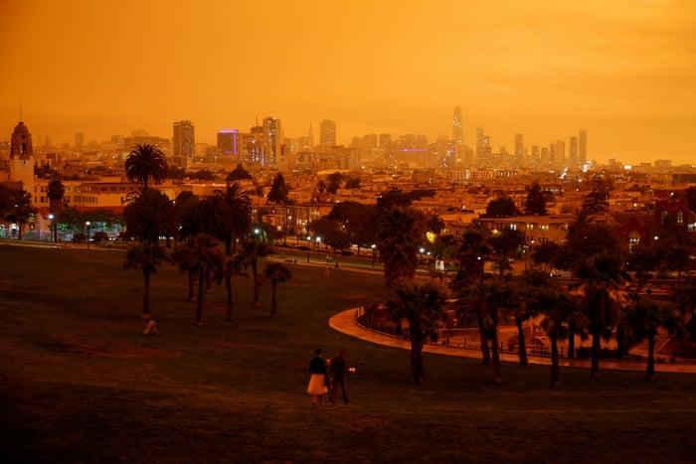
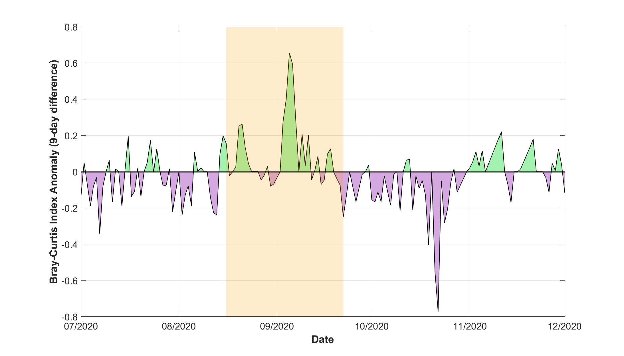
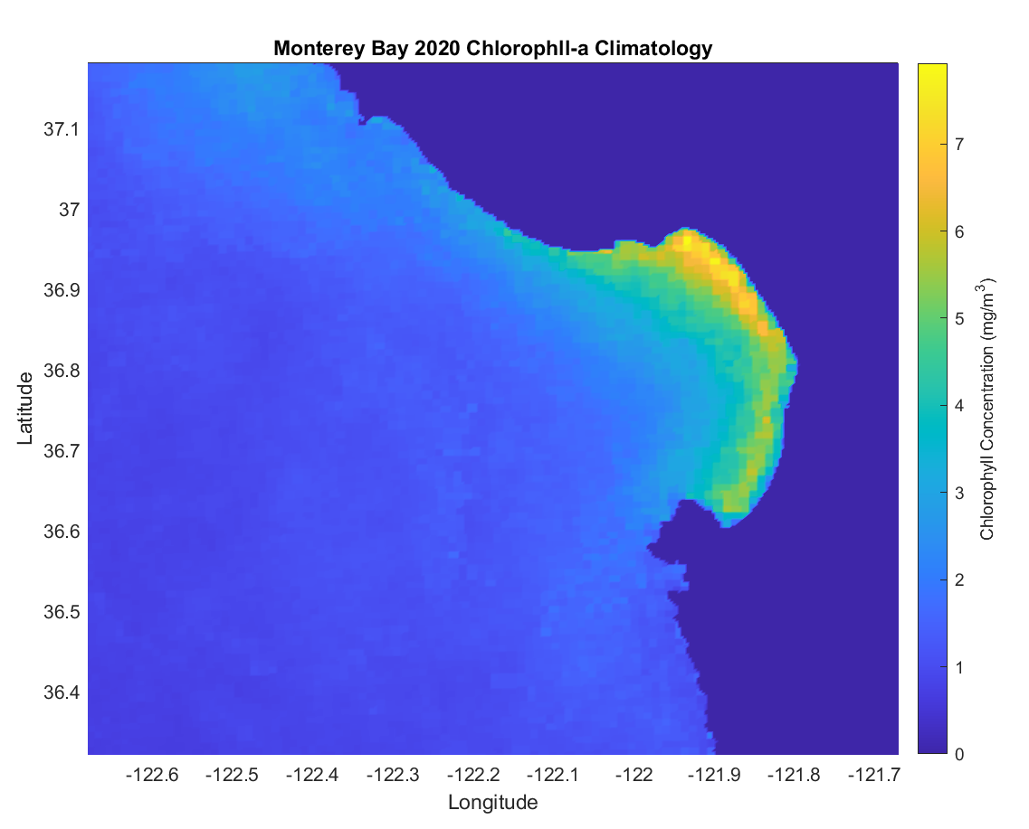
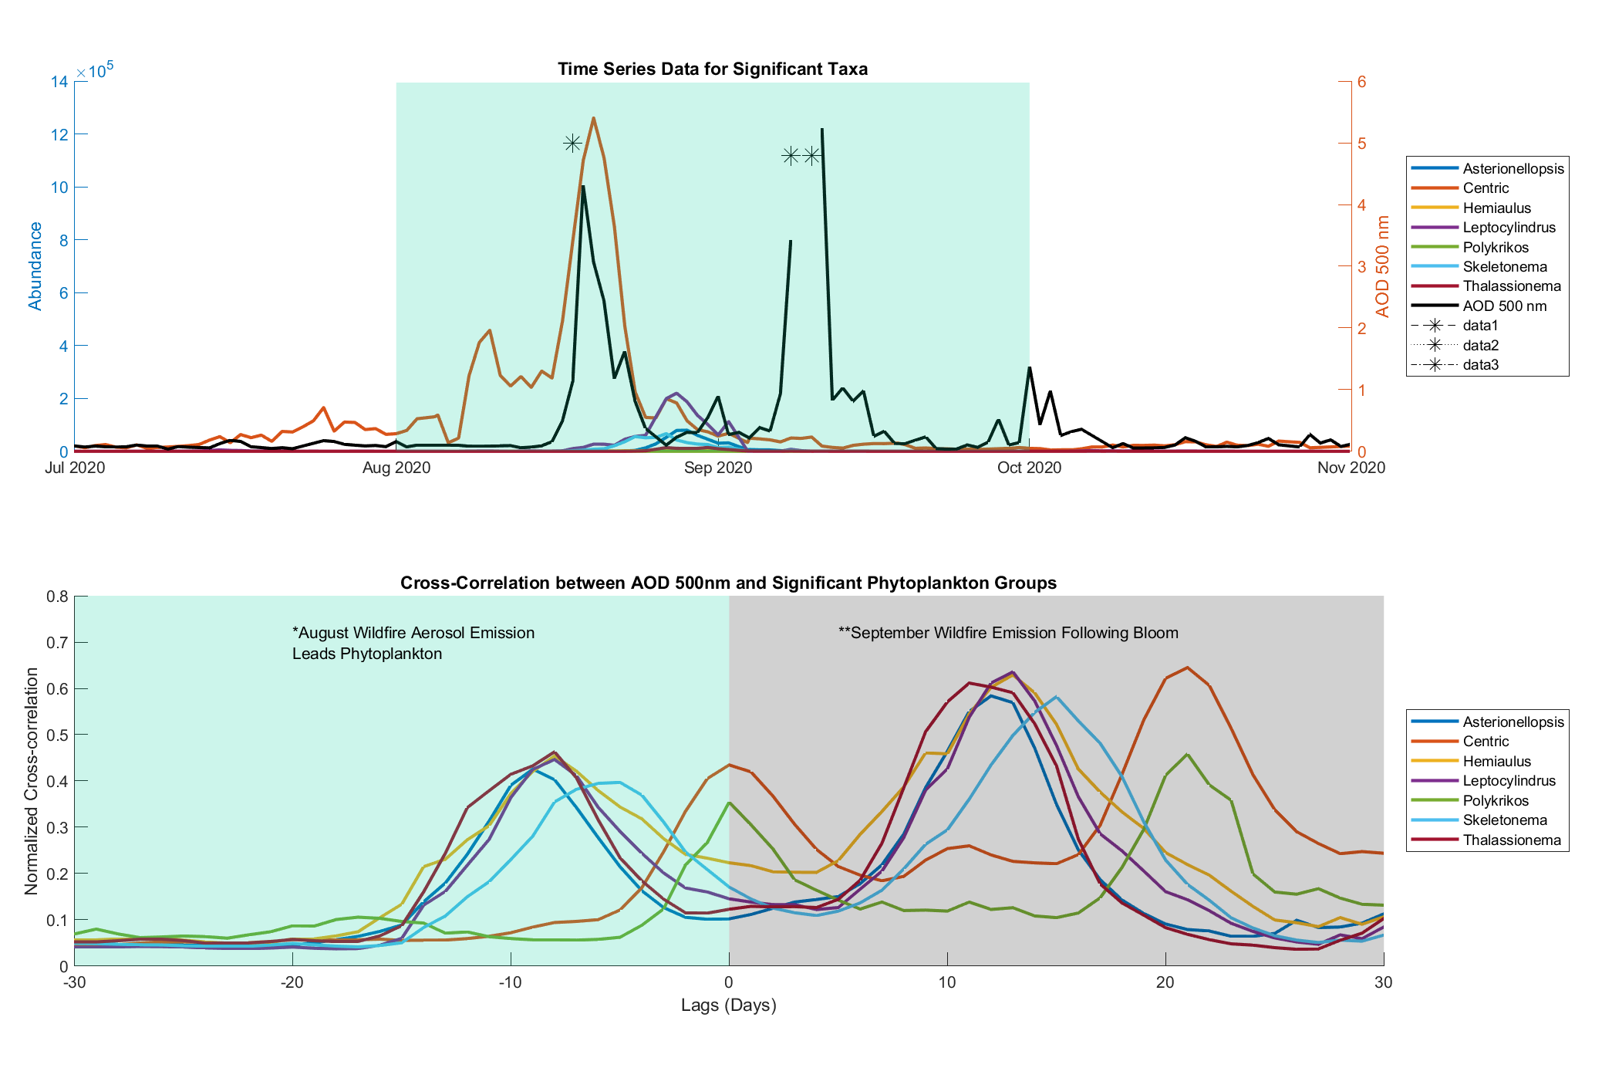
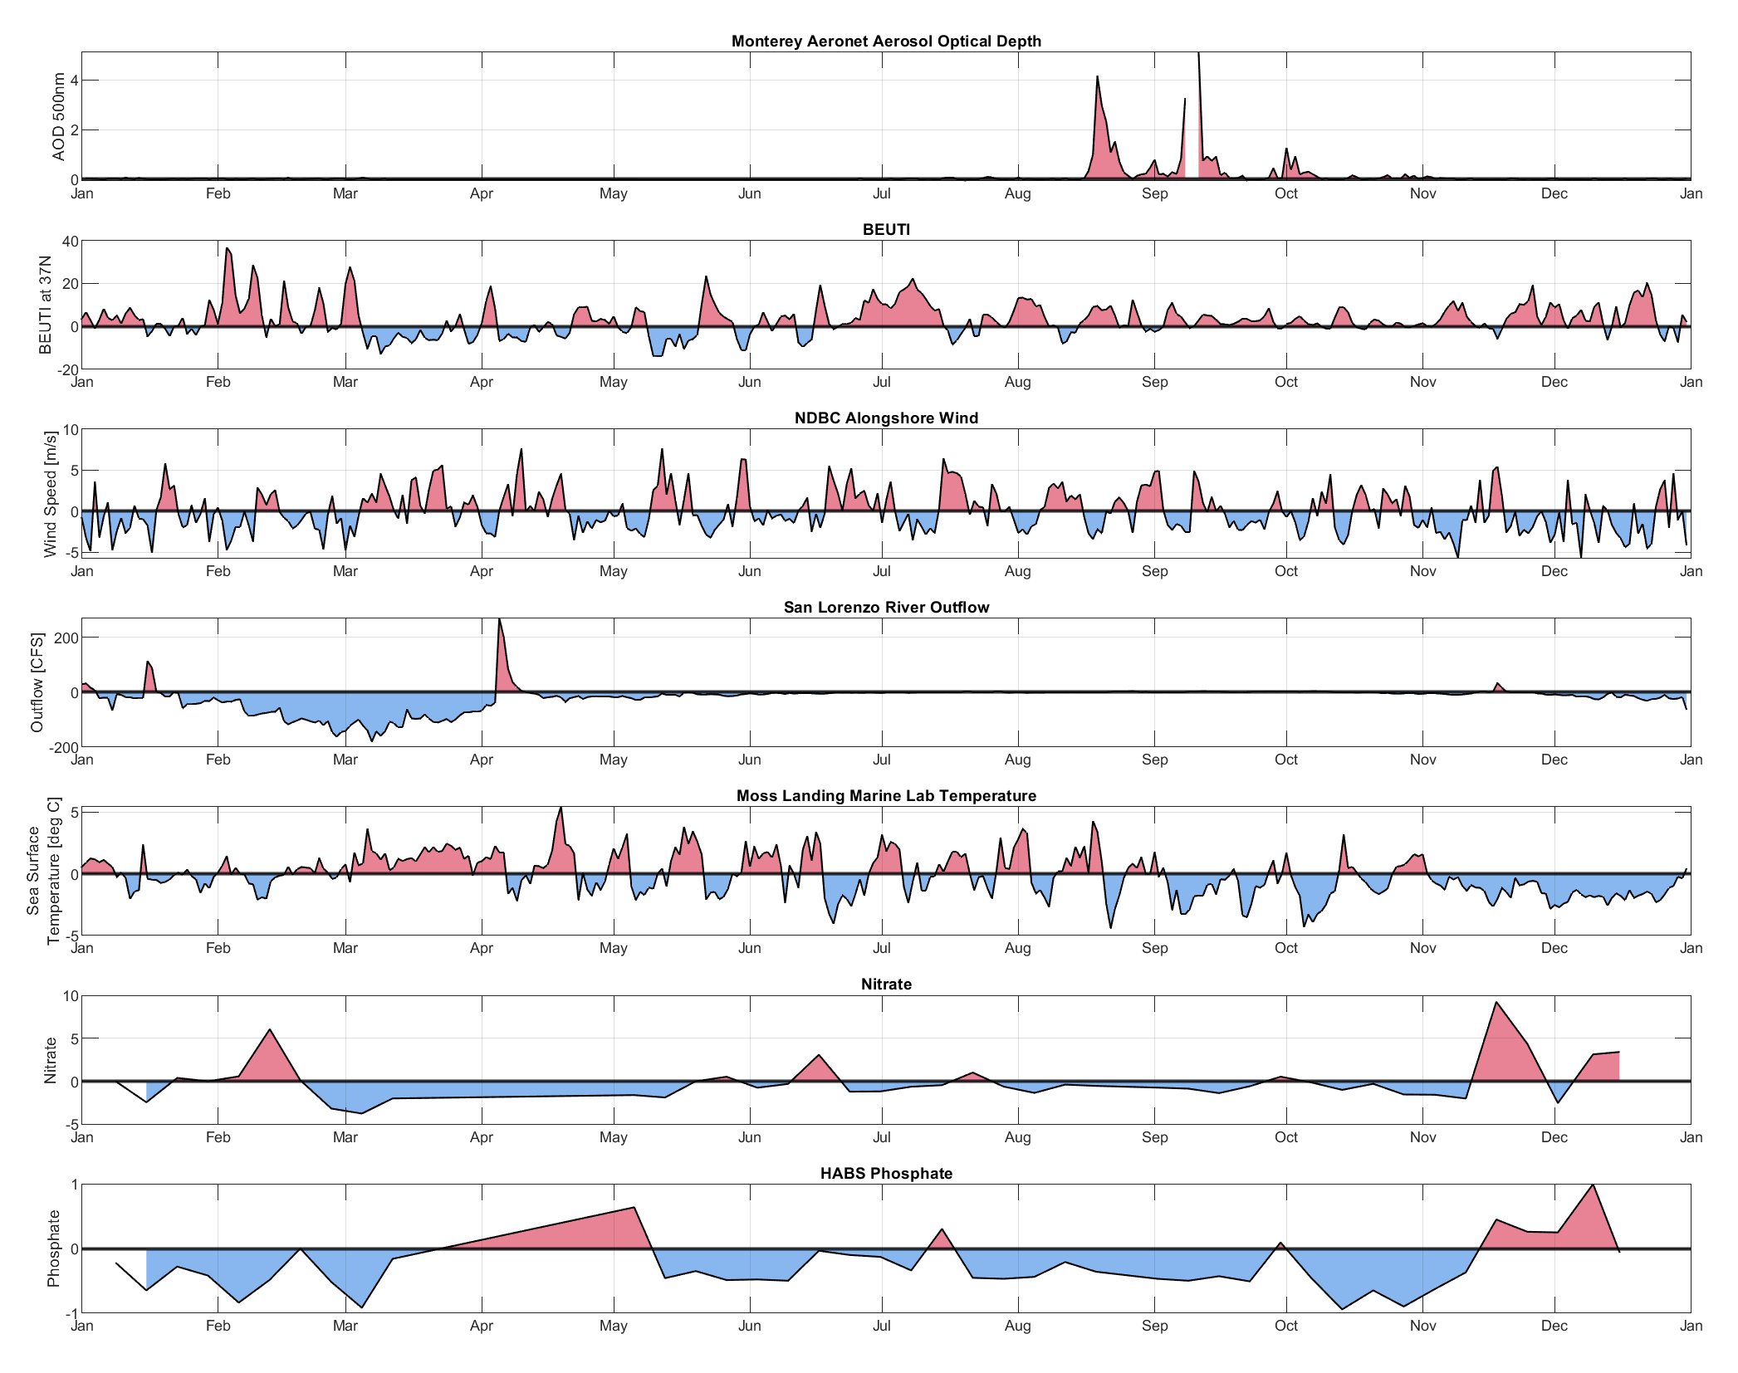
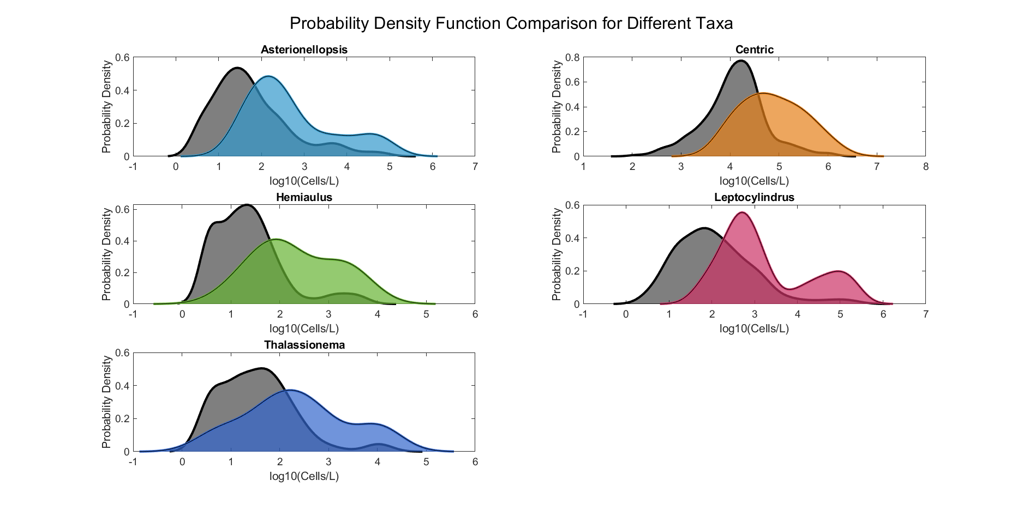
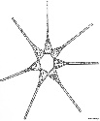

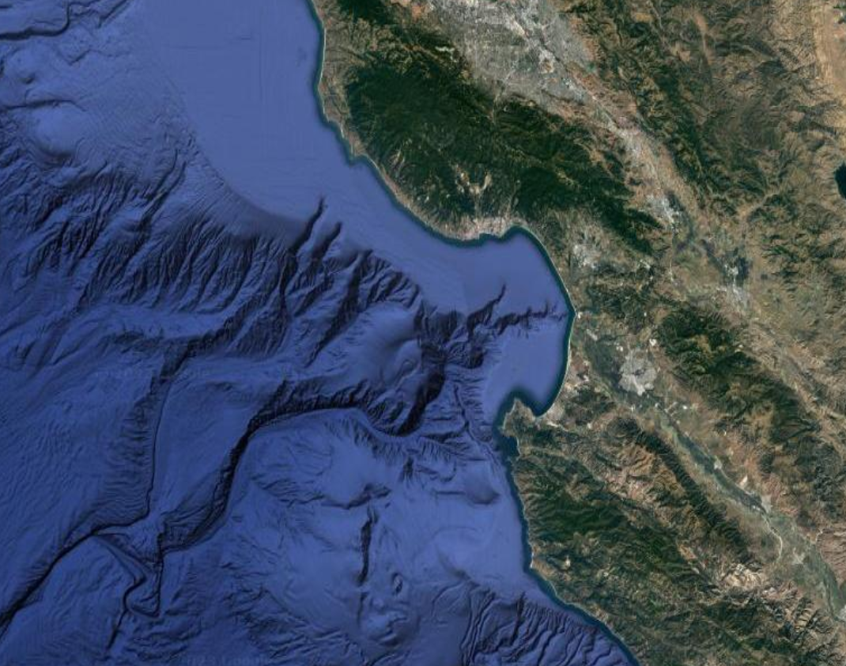


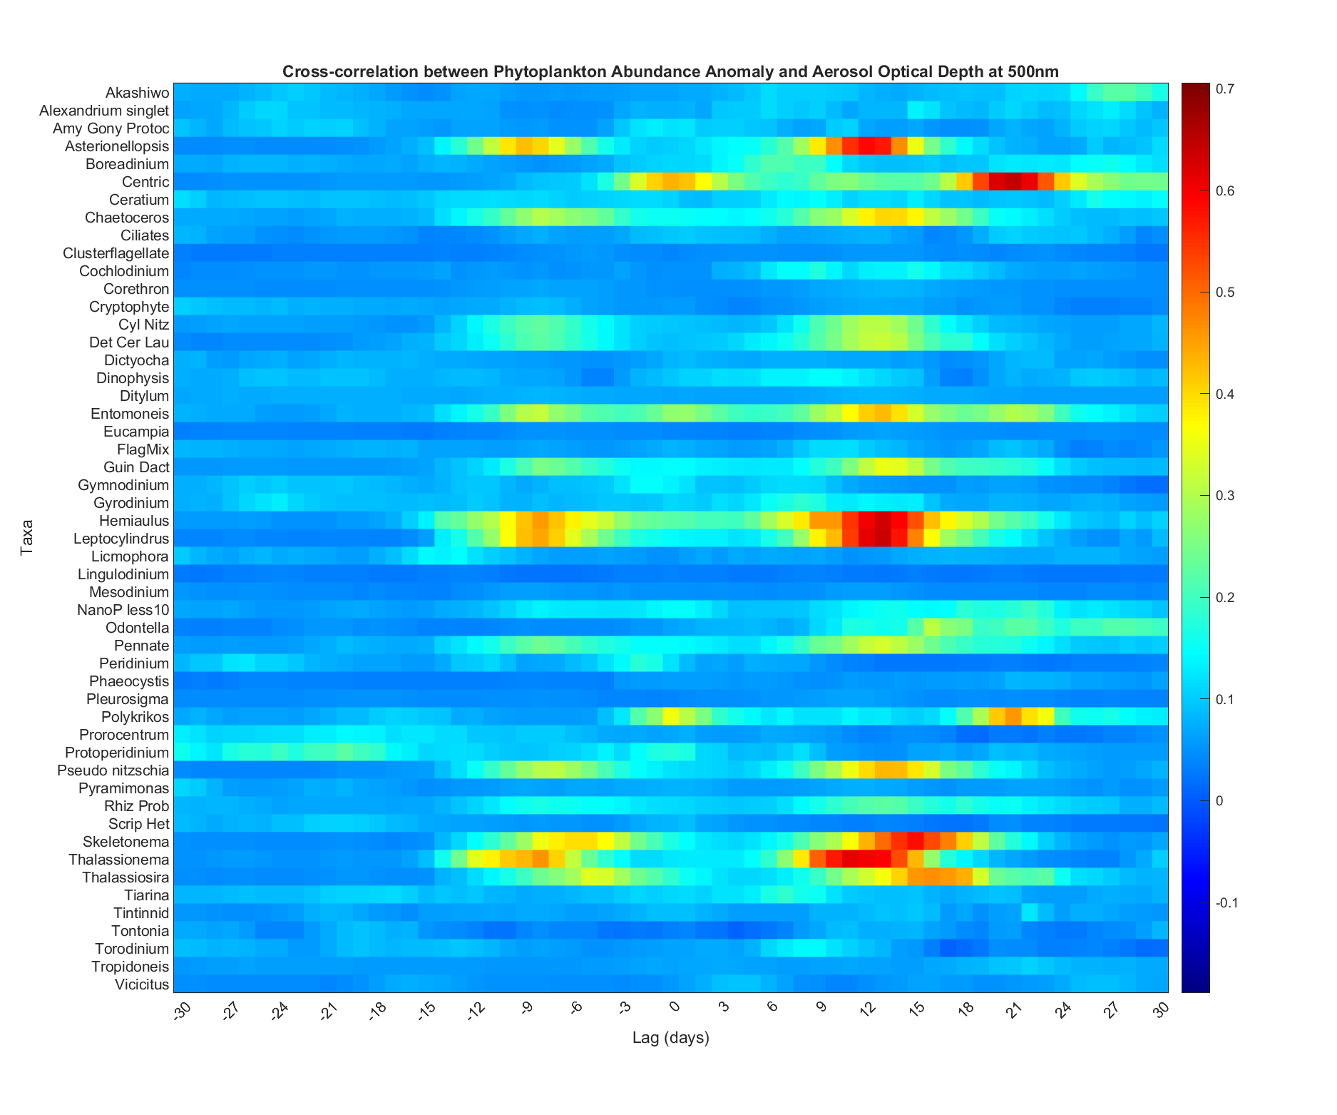



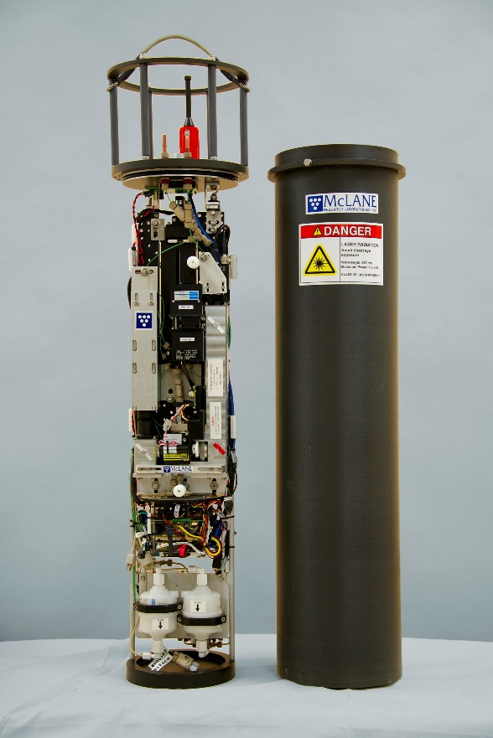
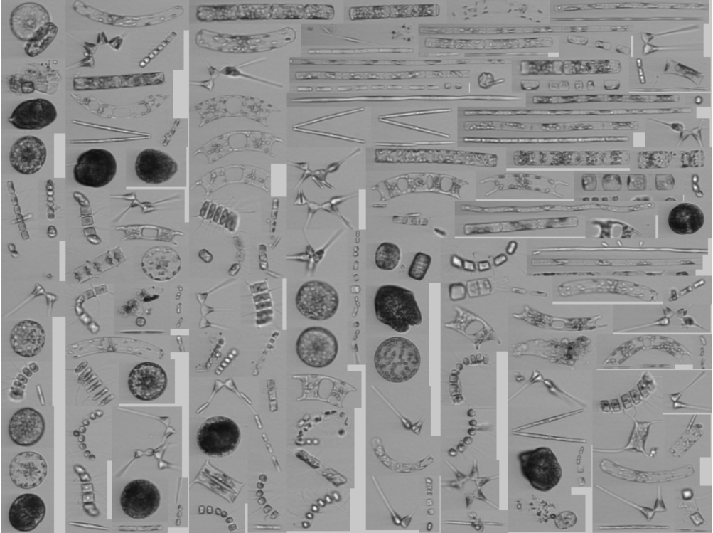
Shore Station Monitoring to Explore Coastal Ecosystem Response to California Wildfires
Dante Capone ¹; Patrick Daniel²; Raphael Kudela^{2,} Andrew Barton^{1,} Moira Décima¹
¹Scripps Institution of Oceanography, ²University of California, Santa Cruz
Background
Results
Discussion
California has experienced a dramatic increase in wildfire frequency and severity in recent decades due to anthropogenic activity and climate change. The 2020 CZU Lightning Complex fires shrouded the Monterey Bay in massive smoke plumes from August through October, with obvious impacts on air quality on human health. Previous studies have linked megafire smoke plumes with phytoplankton blooms through remote sensing and modeling measurements; however observations of wildfire impacts on the ocean are notoriously difficult to collect due to challenges in prediction and preparation. Monitoring networks such as the California Ocean Observing System circumvent this challenge through continuous monitoring, which both captures extreme events and places them into a historical context.
Here, we leverage data from multiple continuous sampling platforms including the Shore Station Network, Aeronet, satellite measurements of chlorophyll, chemical model reanalysis data, and other environmental forcings such as riverine outflow. We use classified data from the Imaging Flow Cytobot time series off the Santa Cruz Wharf to examine whether the 2020 fires impacted phytoplankton abundance and community composition.
Wildfires apparent through both ground-based aeronet measurements and satellite reanalysis
Satellite Chlorophyll-a climatology reveals a positive anomaly in the Monterey Bay region. This signal cross-correlates with the satellite black carbon, with the fire signal leading.
IFCB Analysis reveals 5 taxa with significant cross correlation with AOD (C >0.35), where AOD leads
PDFs reveal the taxa are positively shifted in abundance
Positive lag X-corr due to the 2 fire pulse, no response following the second fire event.
Community composition calculated as the Bray Curtis pairwise difference at the max xcorr lag shows a strong positive anomaly during fire period
No apparent anomalies in other forcings.
Exploration of alternative drivers:
  Slight negative temperature anomaly but no measured increase in nutrients
Possible mechanisms
Why diatoms?
Questions:
During the 2020 CZU Lightning Complex Fires:
Did chlorophyll-a display a response?
Did phytoplankton taxa display anomalous abundances?
Did phytoplankton community composition significantly change?
Methods
Data Streams
Wildfire:
  Aeronet: Aerosol optical depth at 500 nm
Biology
  IFCB: phytoplankton community composition, biovolume
  CalHABMAP: phytoplankton community composition
Biogeochemistry
  Sanat Cruz Wharf/Moss Landing Shore Station: CO2, chlorophyll-a, conductivity, fluorescence, nitrate, dissolved oxygen,
  oxygen saturation, pH, radiative flux: beam attenuation coefficient, salinity, temperature
  transmissivity, water level
Other Forcings:
  San Lorenzo Outflow
  Upwelling (BEUTI, CUTI, winds)
  Climate Indices (MEI, marine heatwaves)
Future Work
Comparative Analysis of other Shore Stations
Compare other events
Biovolume
Extend satellite analysis to large box
Contact
References
Dante Capone
[organization]
[address]
[email]
[phone]

