Slide 1
Metabarcoding Paper Plots

Slide 2
Q1: Physical Environmental Analysis

Slide 3
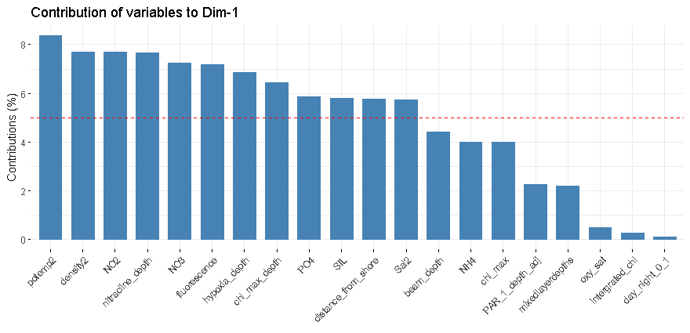
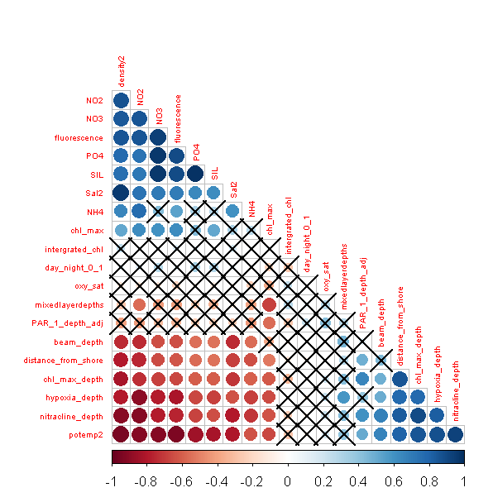
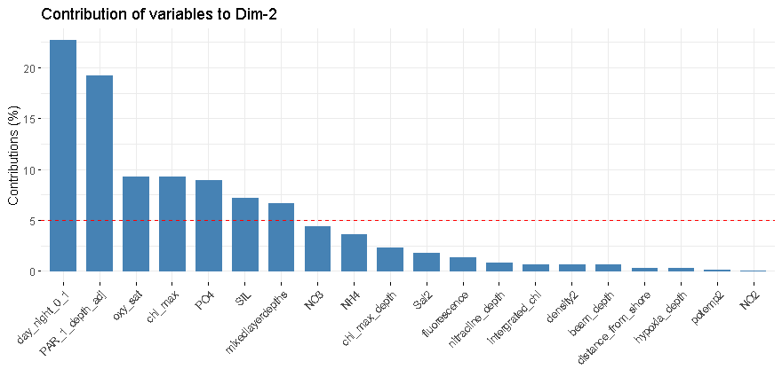
Q1

Slide 4
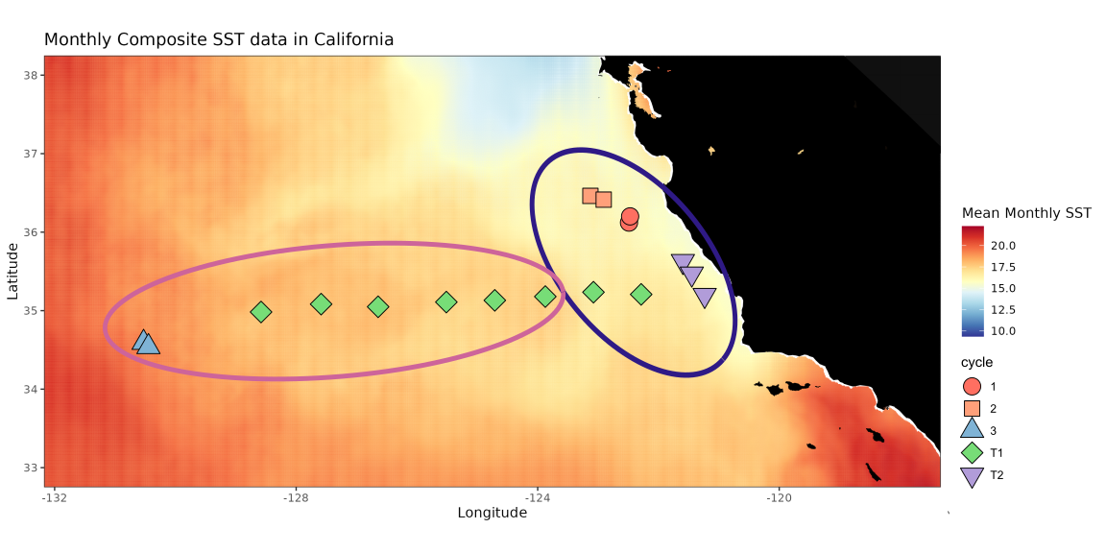
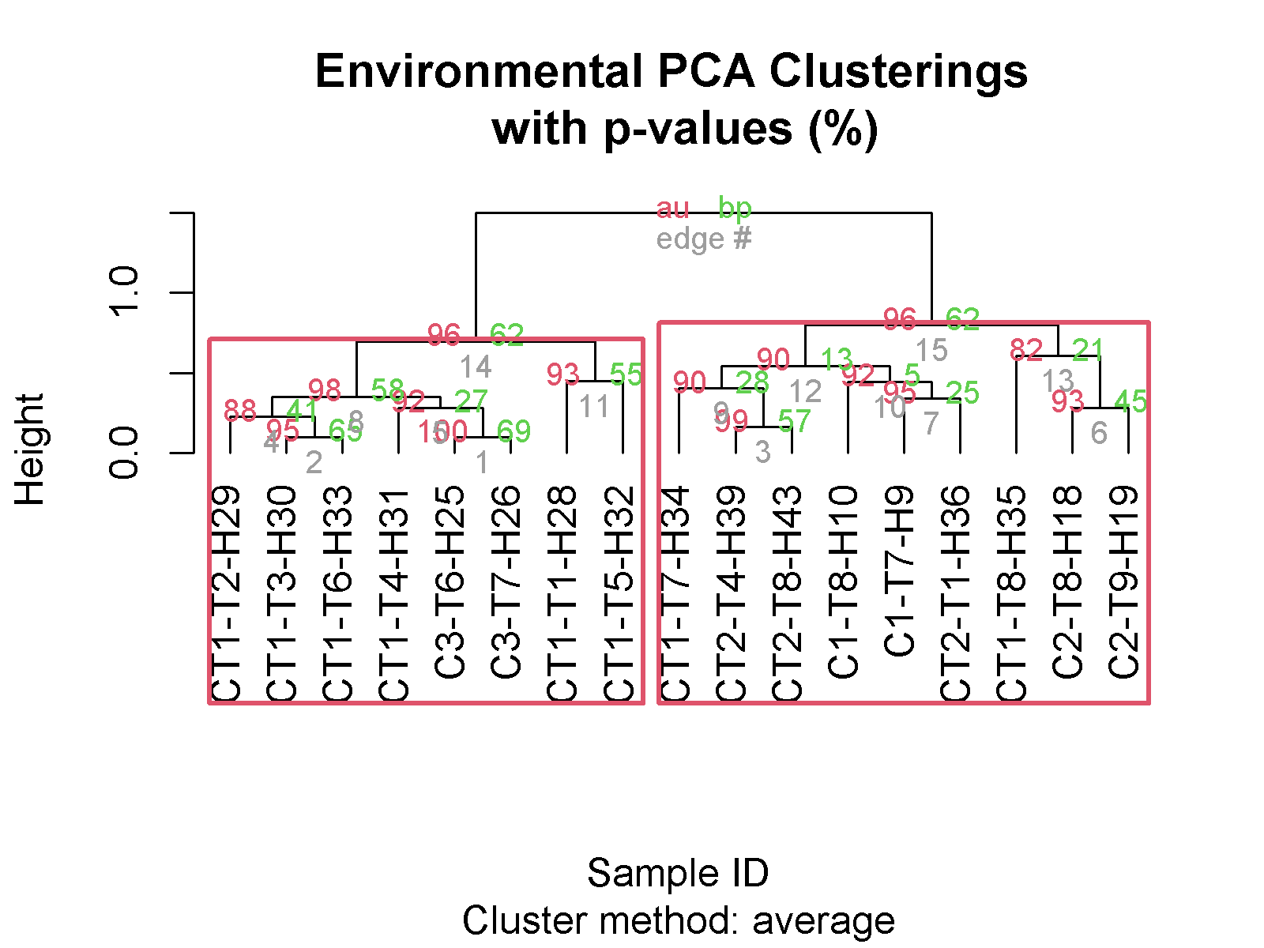
Q1

Slide 5
Q2: Comparison of Zooplankton Community with Physical Environmental Properties

Slide 6
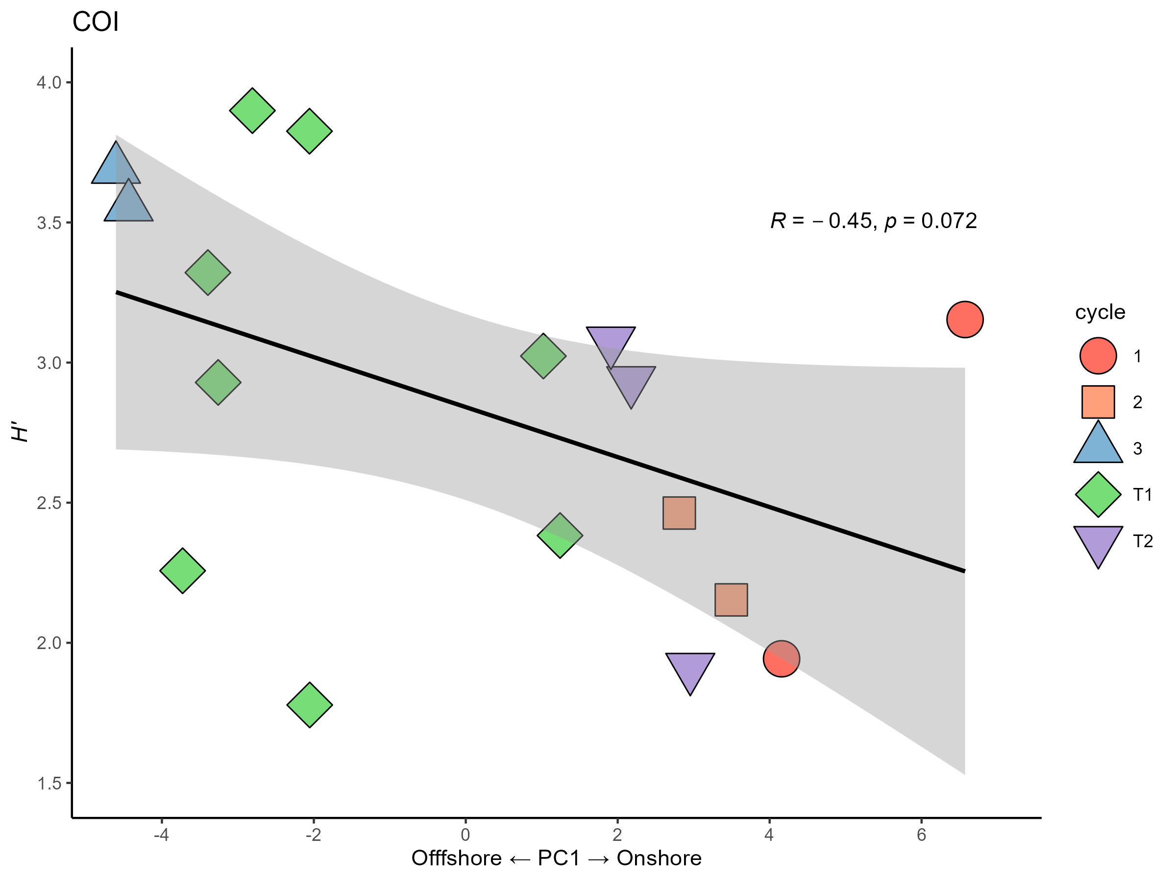
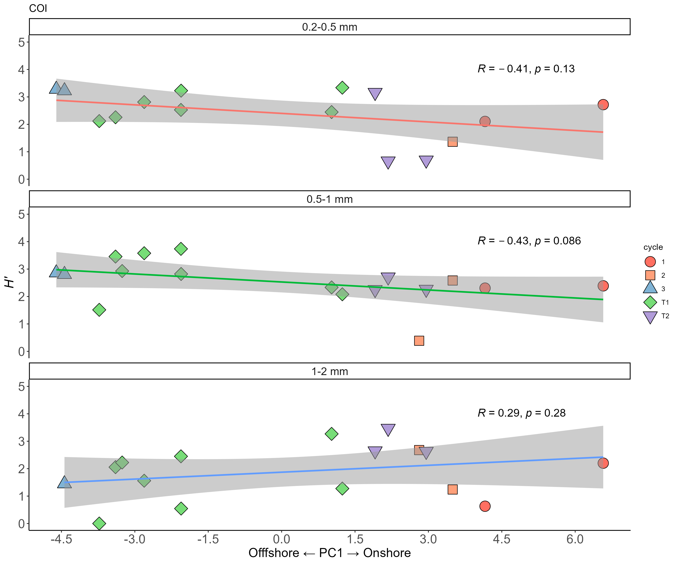
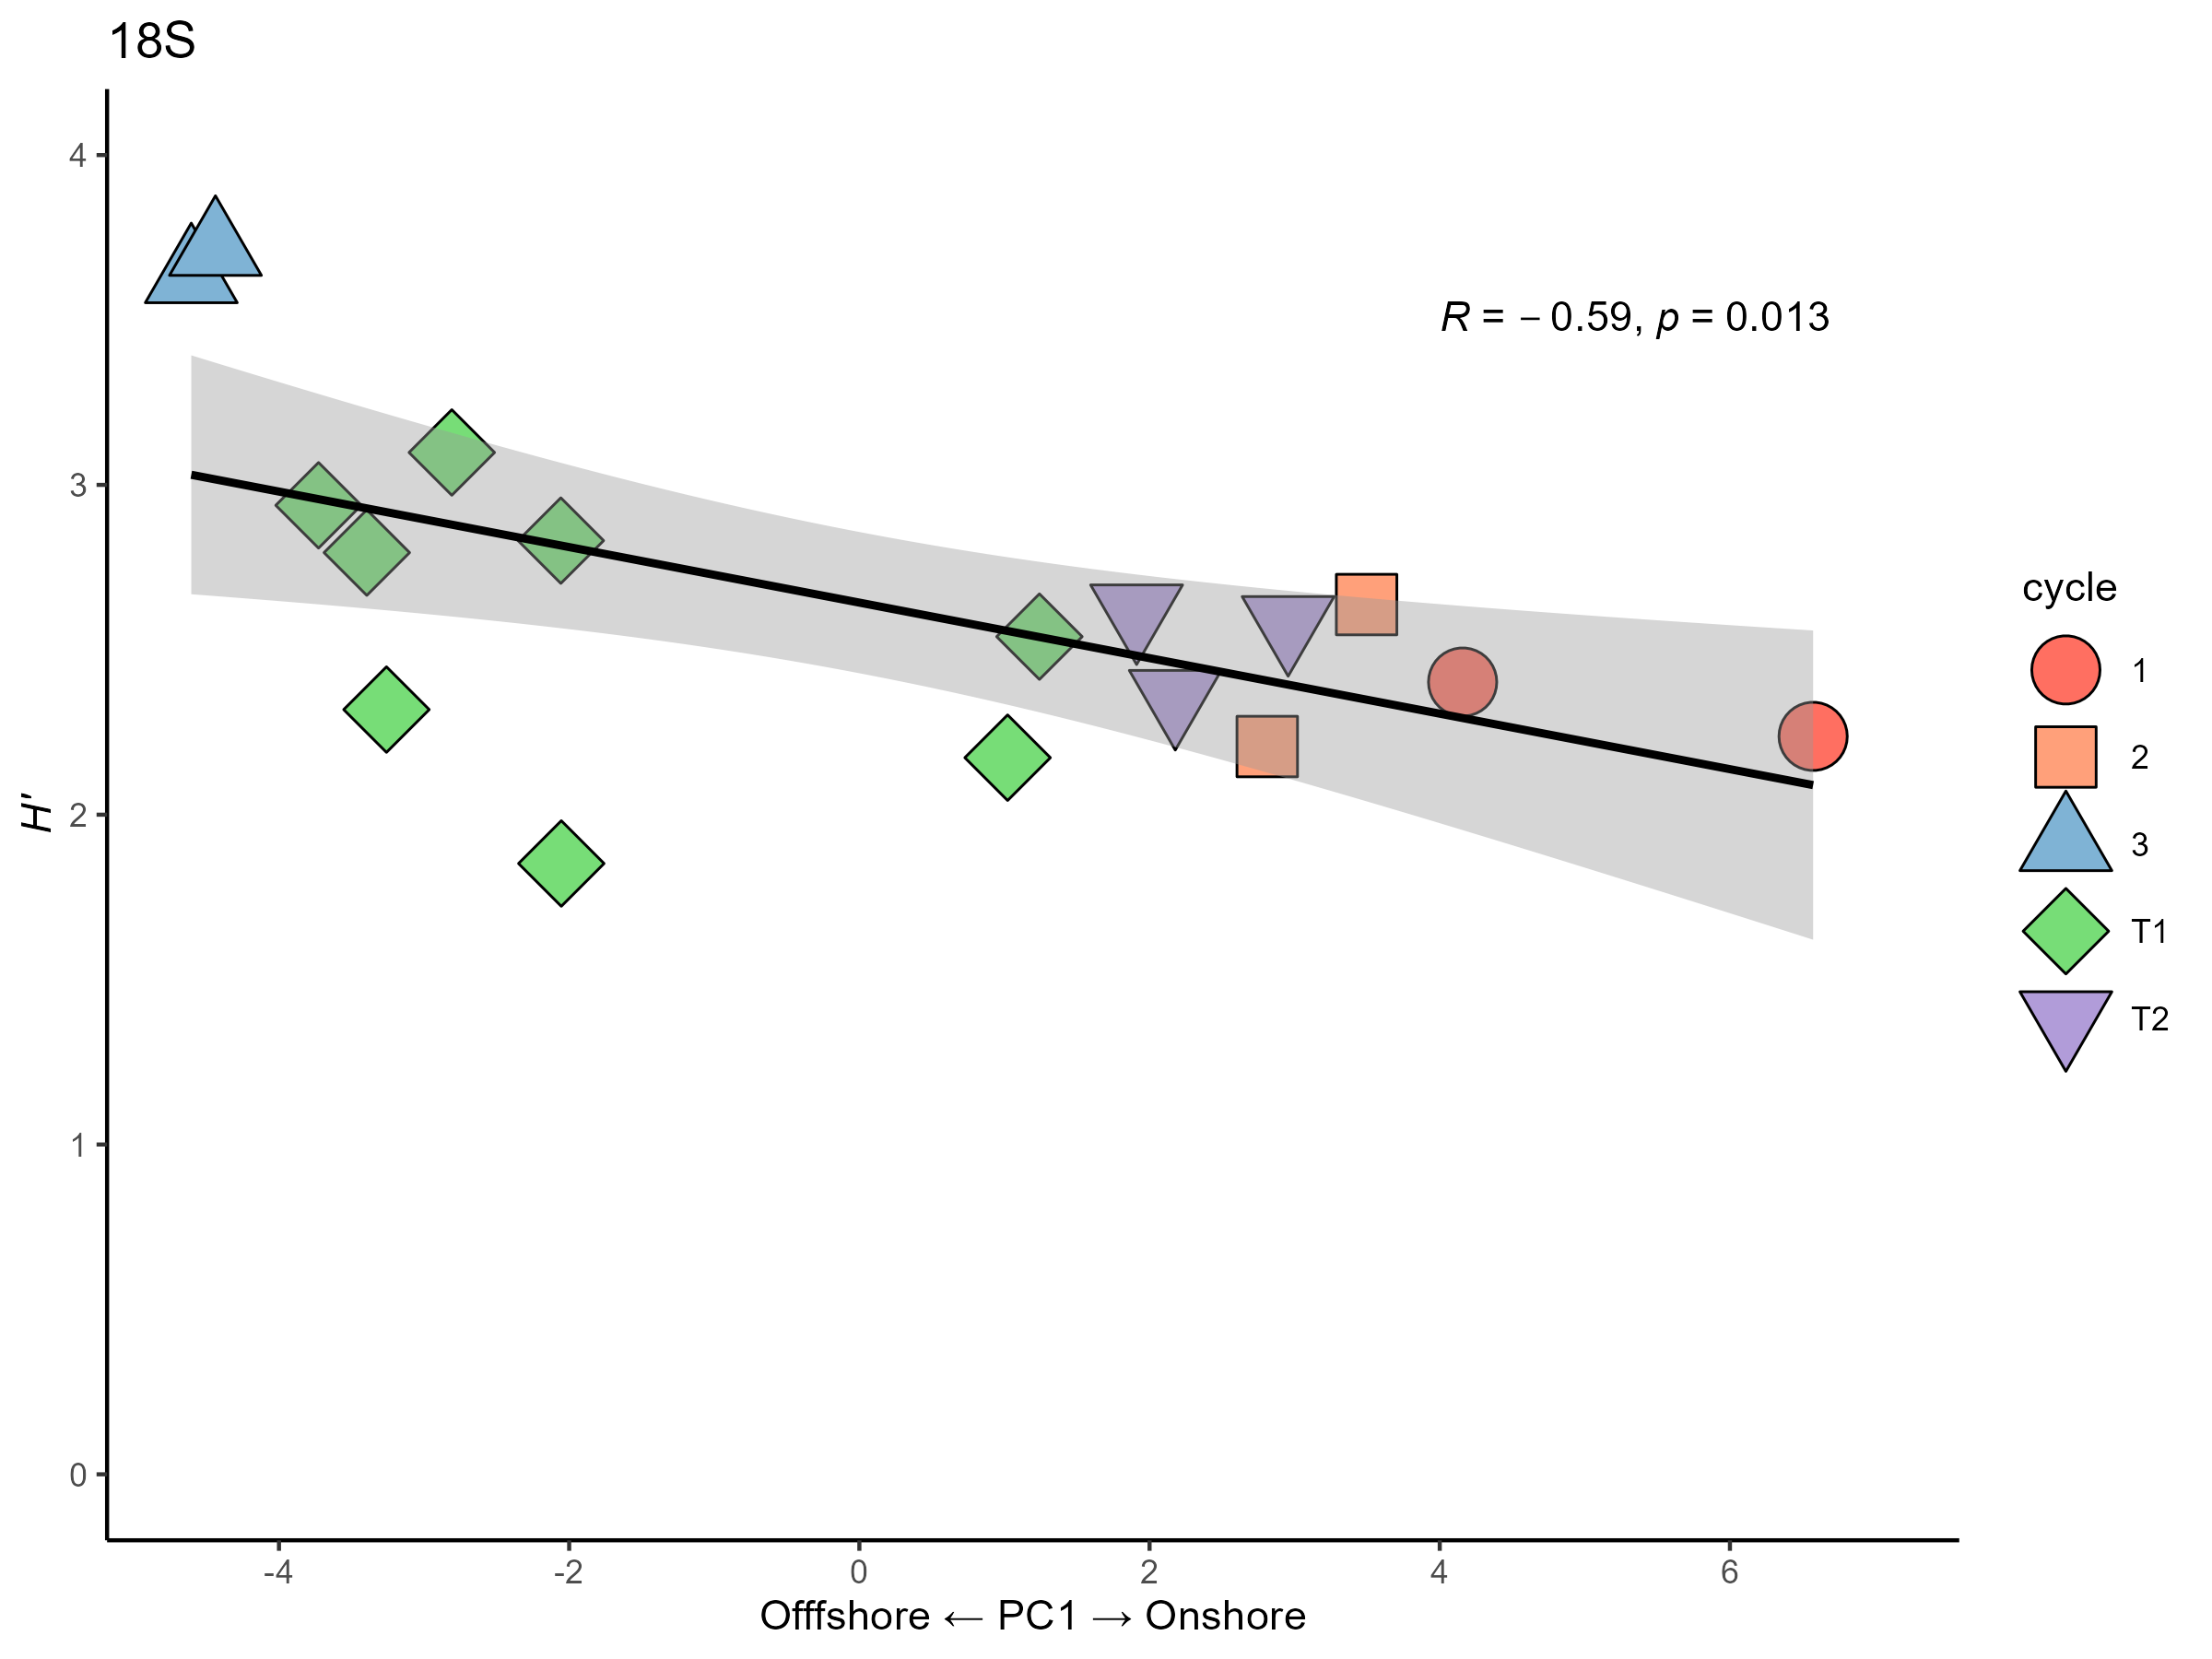
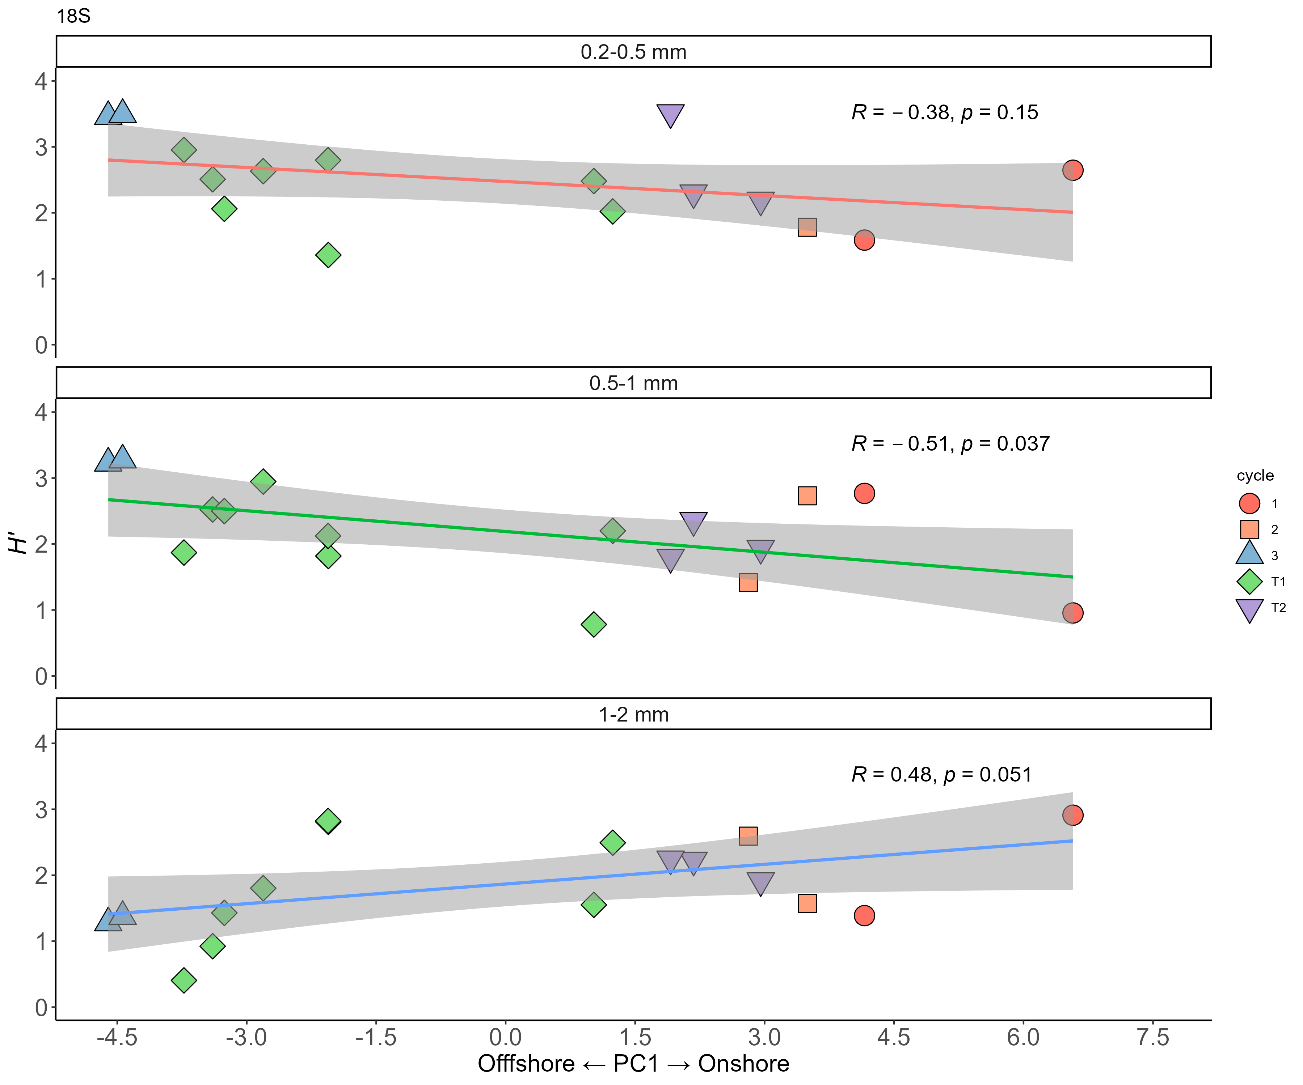
COI
18S

Slide 7
Q3: Community Composition

Slide 8
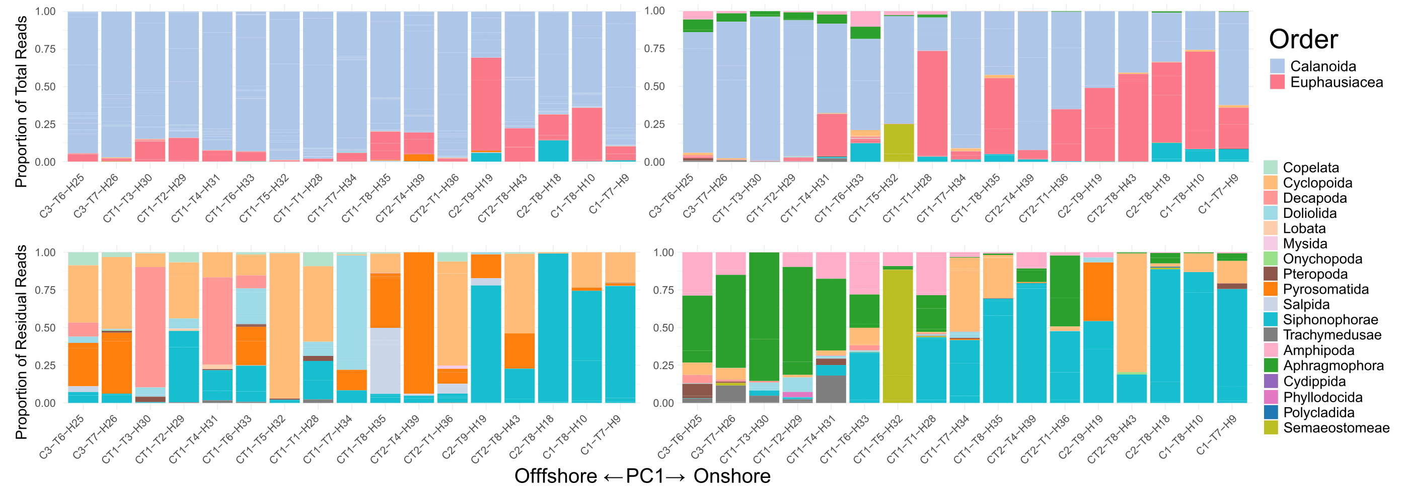
Stacked Barplots (Order)
COI
18S

Slide 9
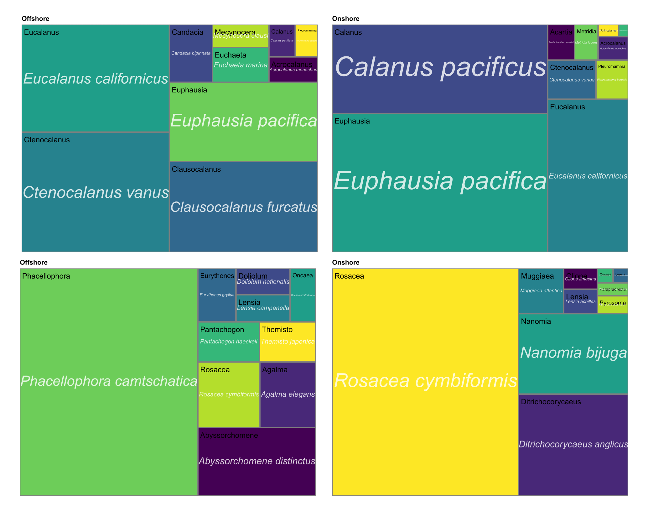
COI

Slide 10
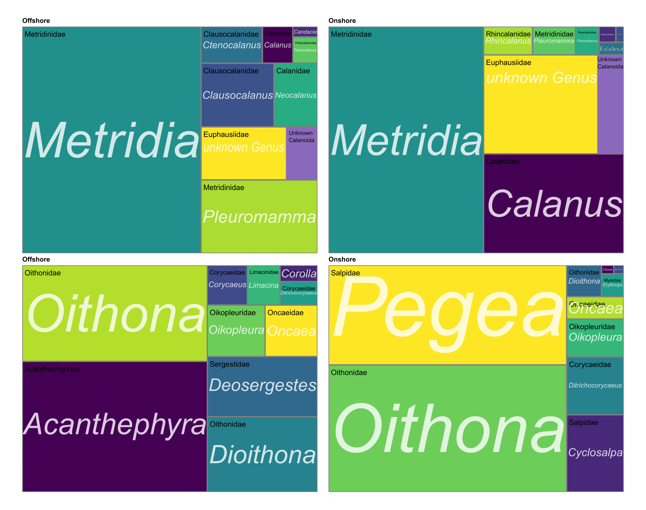
18S

Slide 11
Q4: Zooplankton Taxon and Size-specific relationships with Environmental Properties

Slide 12
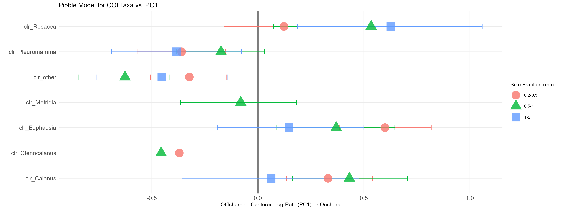
Q3: Patterns with Environment (Raw COI)

Slide 13
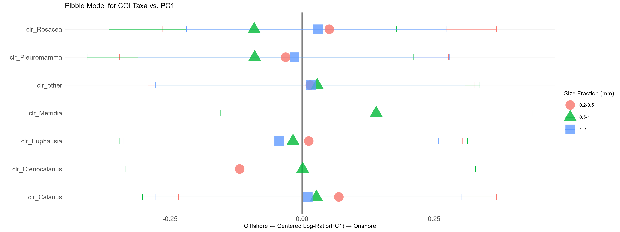
Q3: Patterns with Environment (Raw COI)

Slide 14
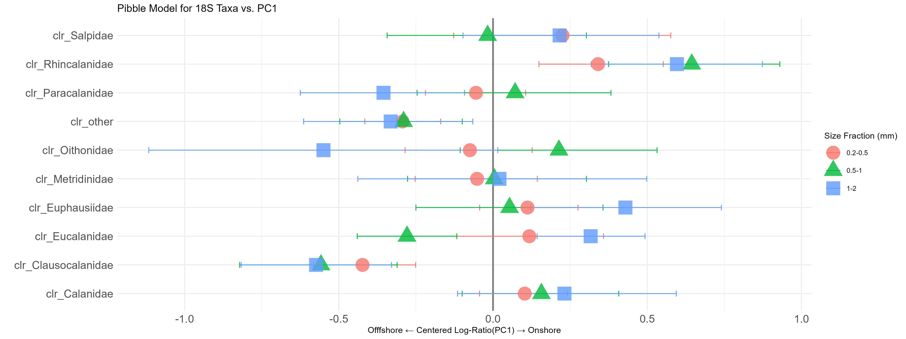

Slide 15
Q5: Variable PCR Experiment, Zooscan, and Comparison of Estimates of Zooplankton Abundance

Slide 16
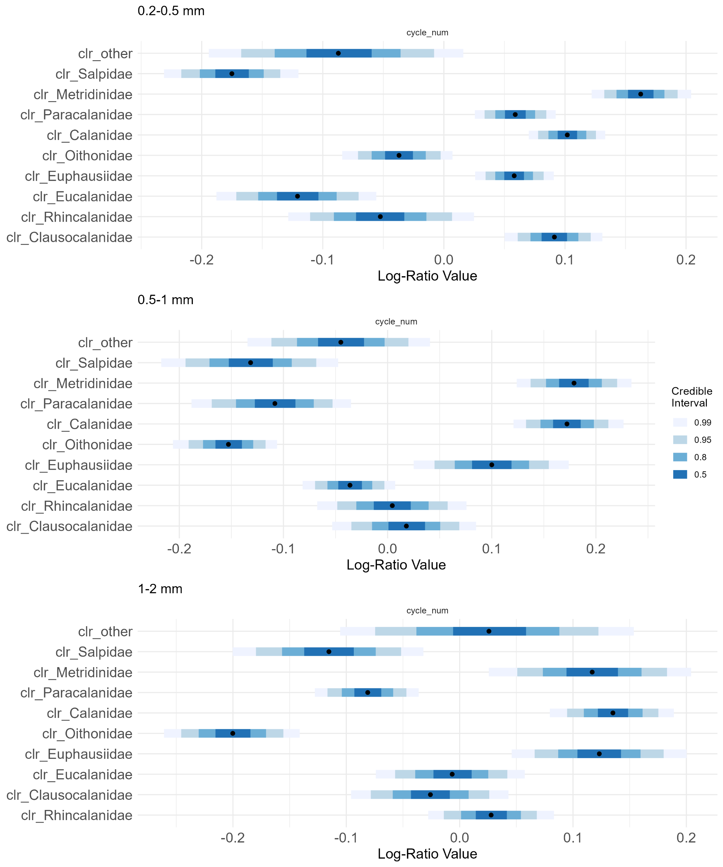
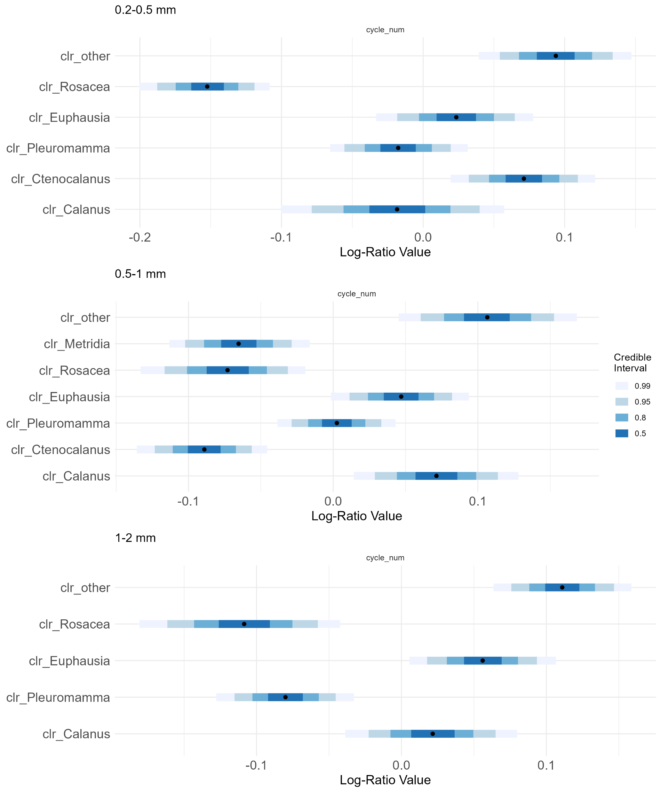
Fido Amplification Efficiencies (Supplemental)

Slide 17
Fido Amplification Efficiencies (Supplemental)

Slide 18
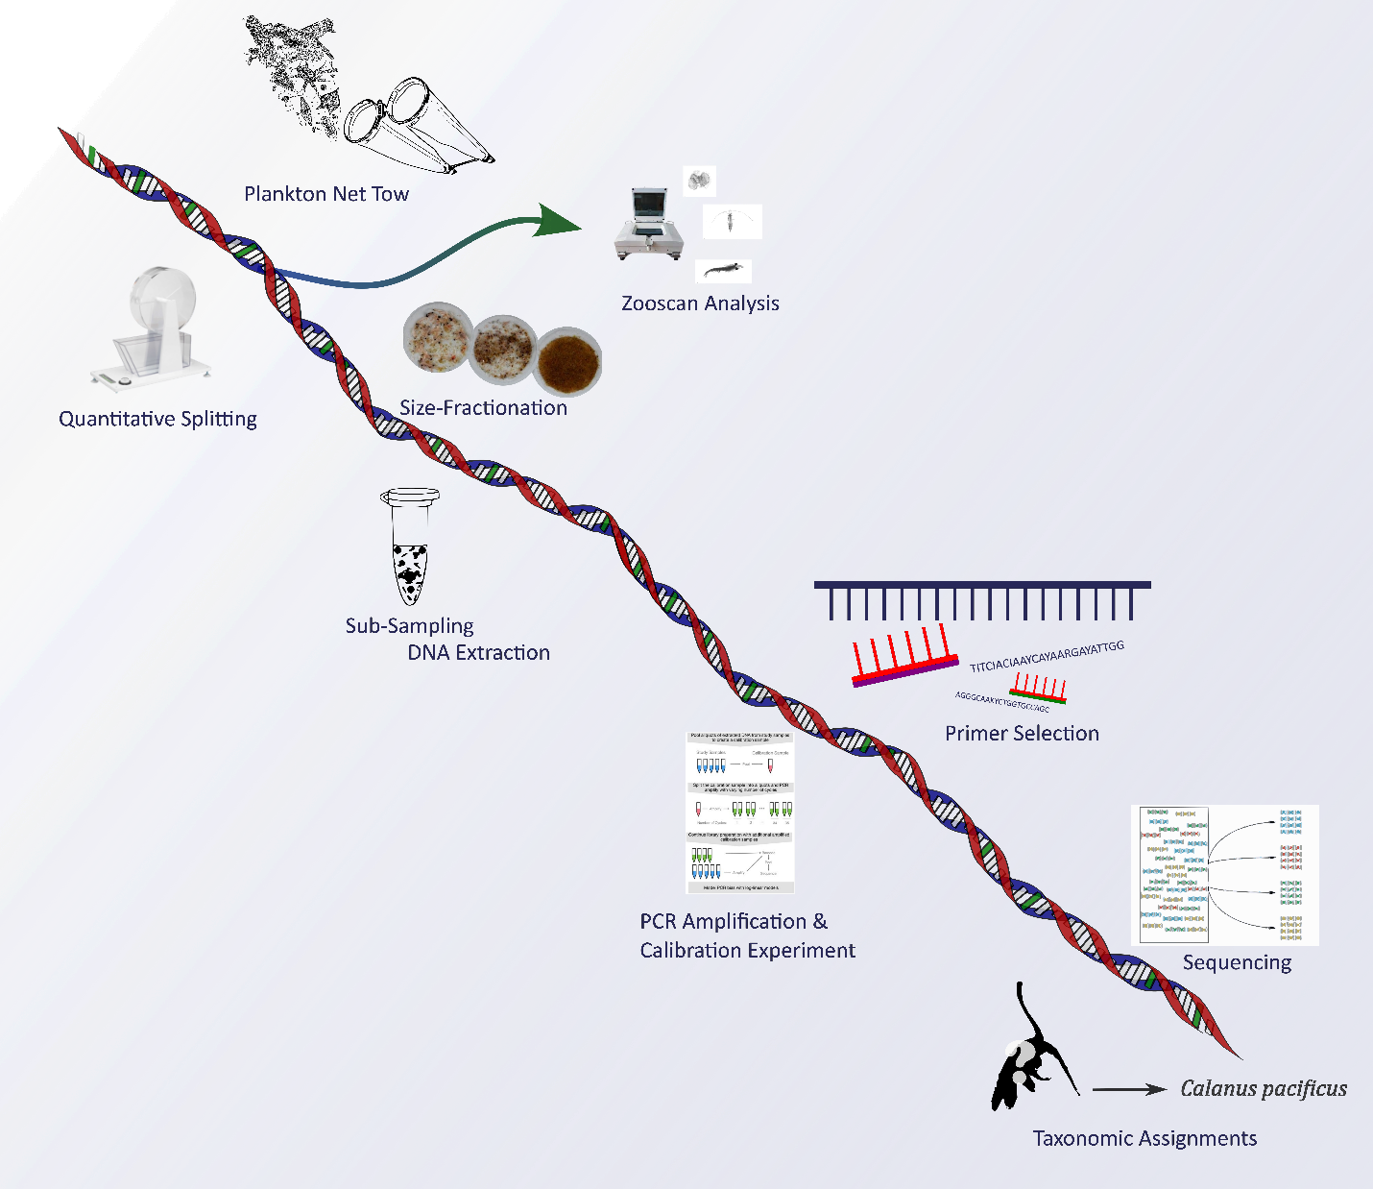

Slide 19
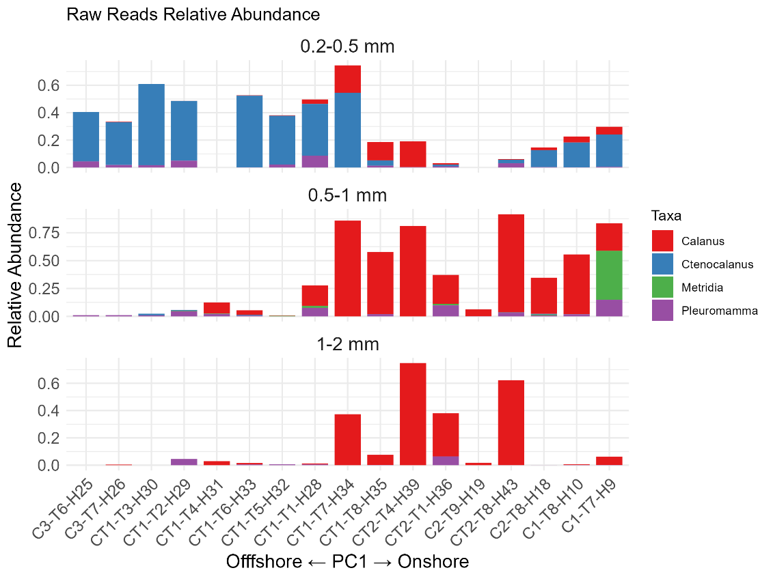
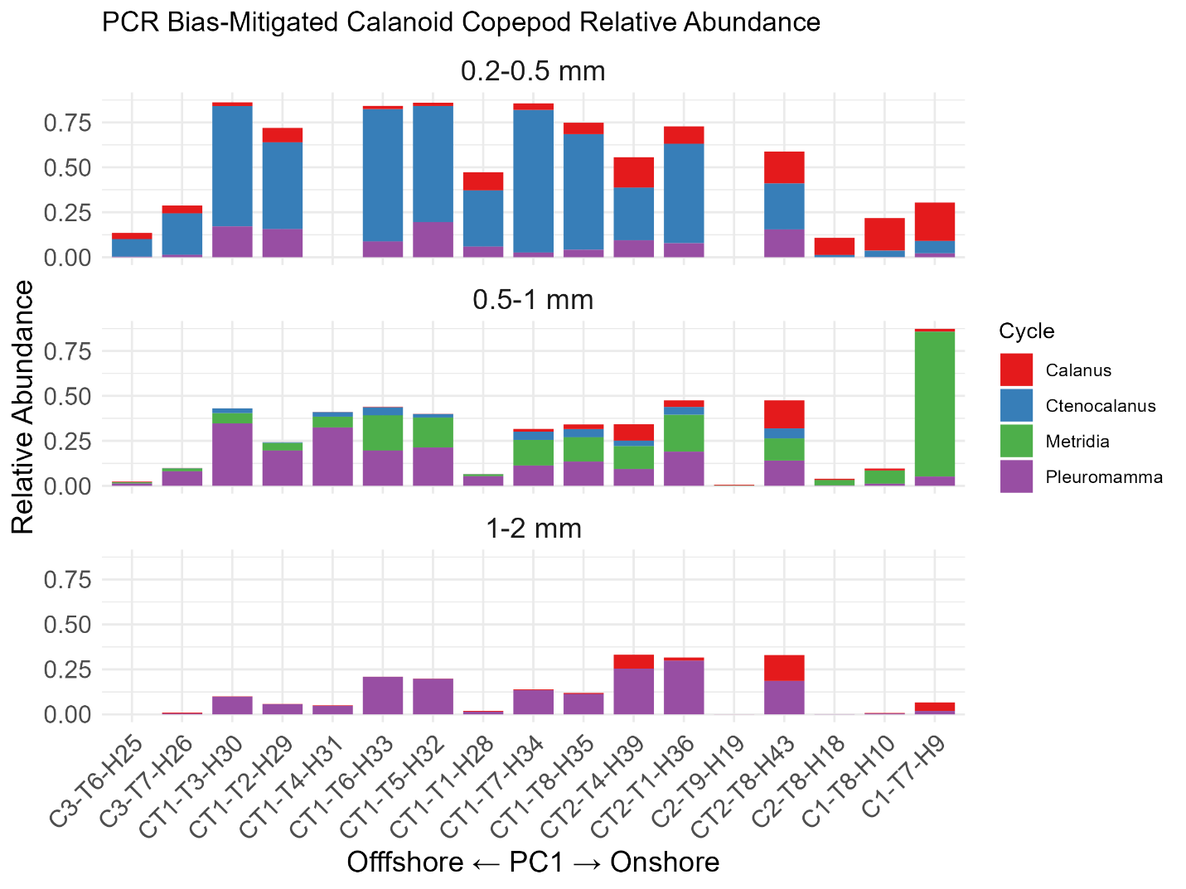
Q5

Slide 20
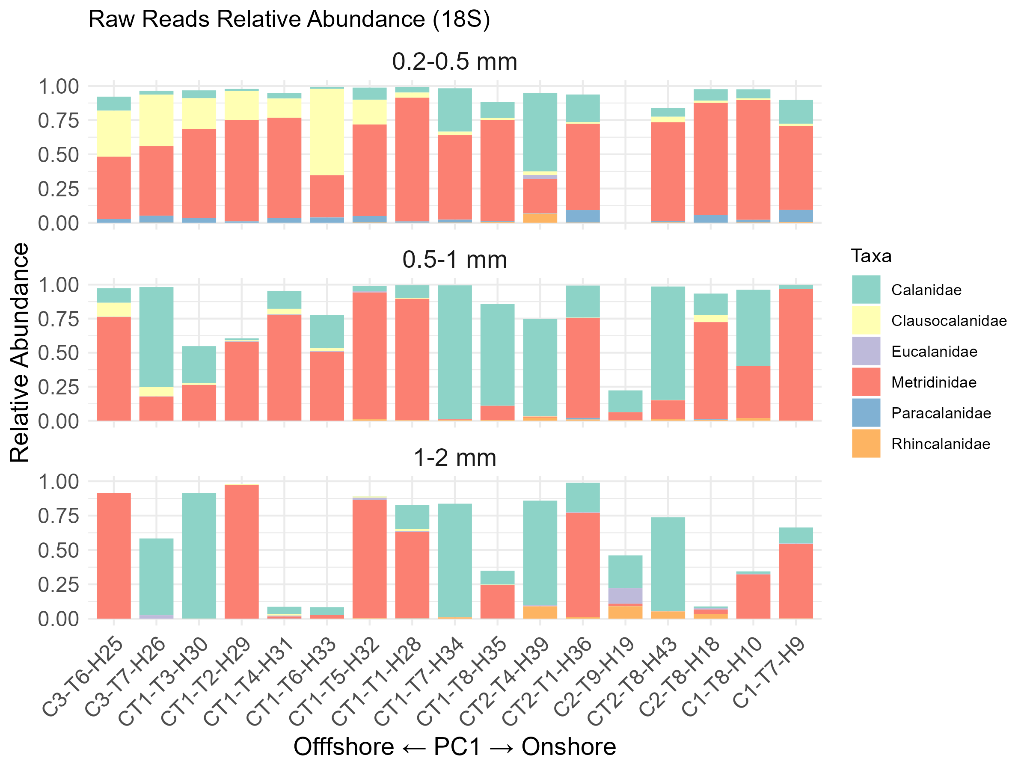

Slide 21
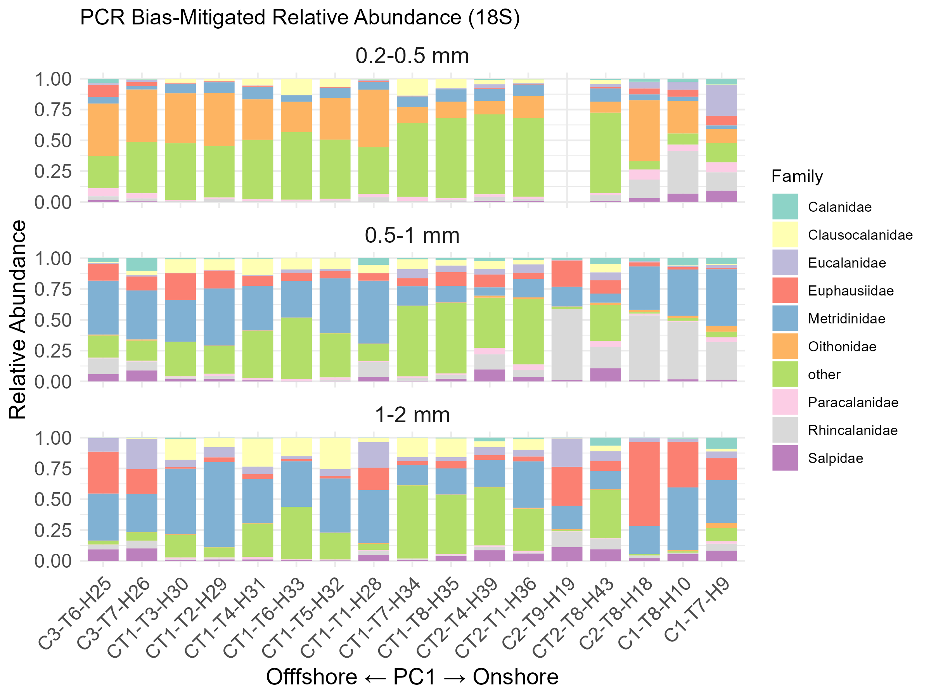

Slide 22
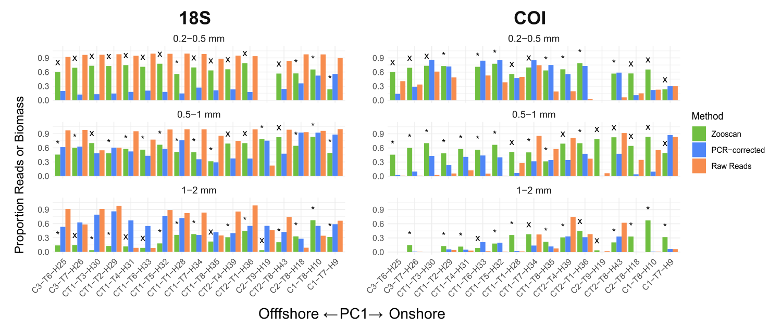
Zoo-PB, PCR-RA, RRA

Slide 23
Zoo-RA, PCR-RA, RRA

Slide 24
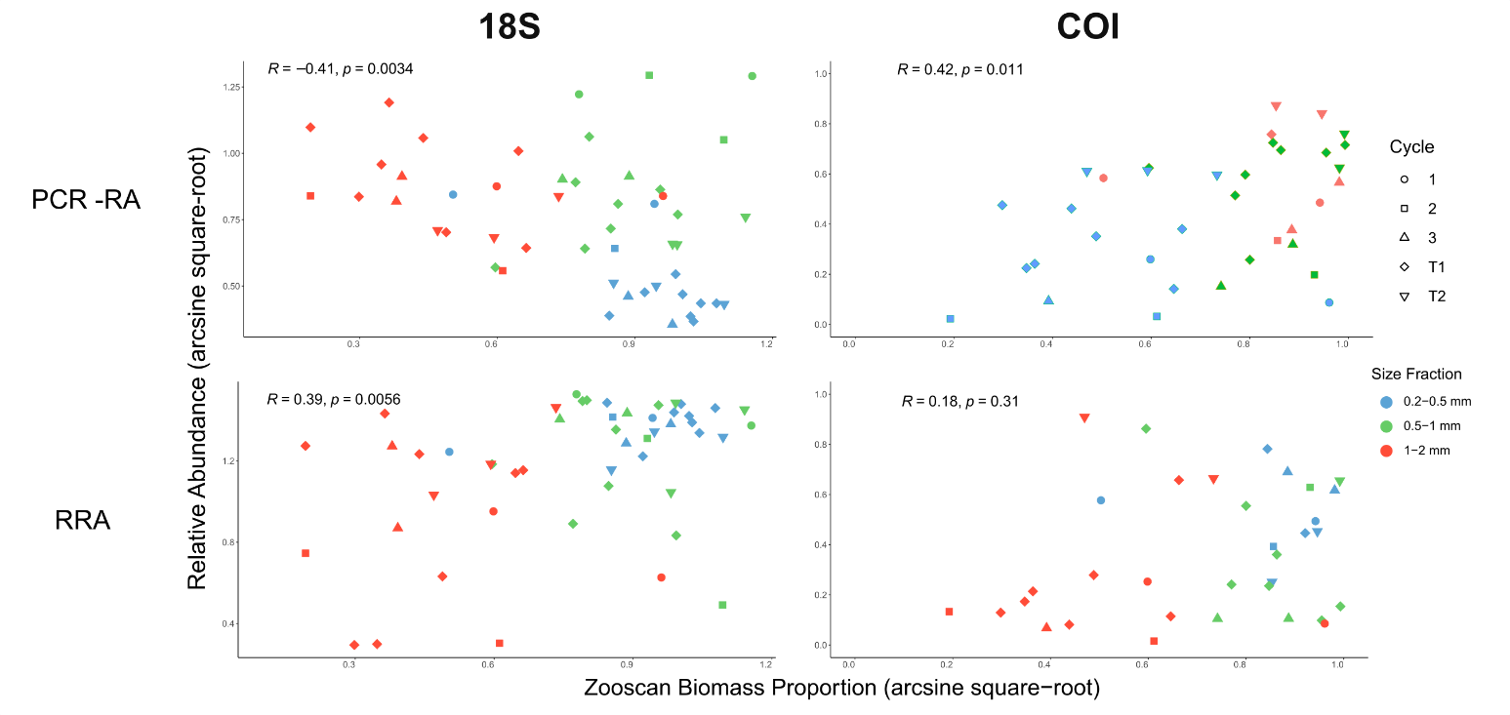

Slide 25
Correlations
 |  | RRA vs. Zooscan Biomass Proportion |  | PCR Corrected vs. Zooscan Biomass Proportion
 |  | 18s | COI | 18s | COI
 |  | R | R | R | R
Strata
All |  | 0.39, 0.0056 | 0.41*** | 0.42 0.011 | 0.18 0.31
Cycle | 1
 | 2
 | 3
 | T1
 | T2
Size Fraction | 0.2-0.5 mm
 | 0.5-1 mm
 | 1-2 mm
Onshore/Offshore | Onshore
 | Offshore

Slide 26
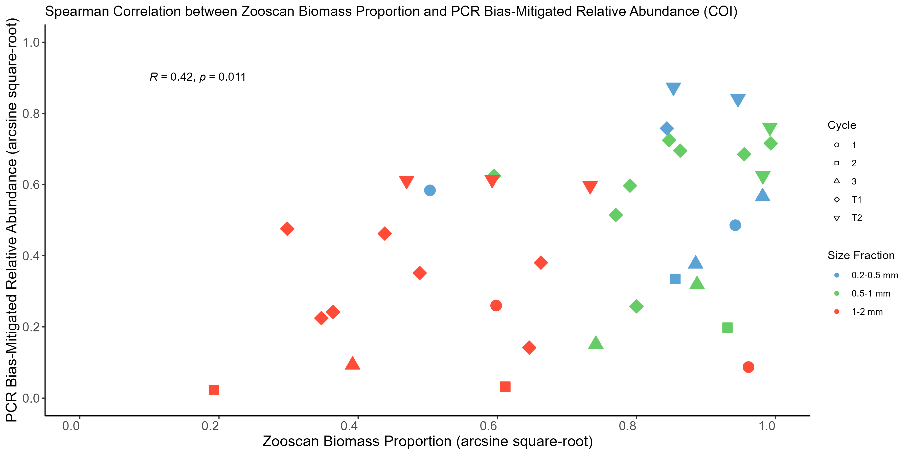
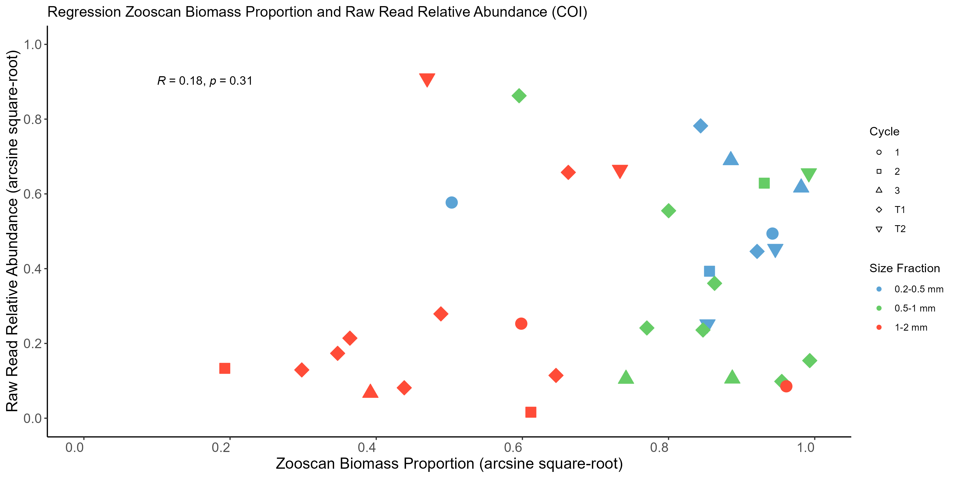
COI-all

Slide 27
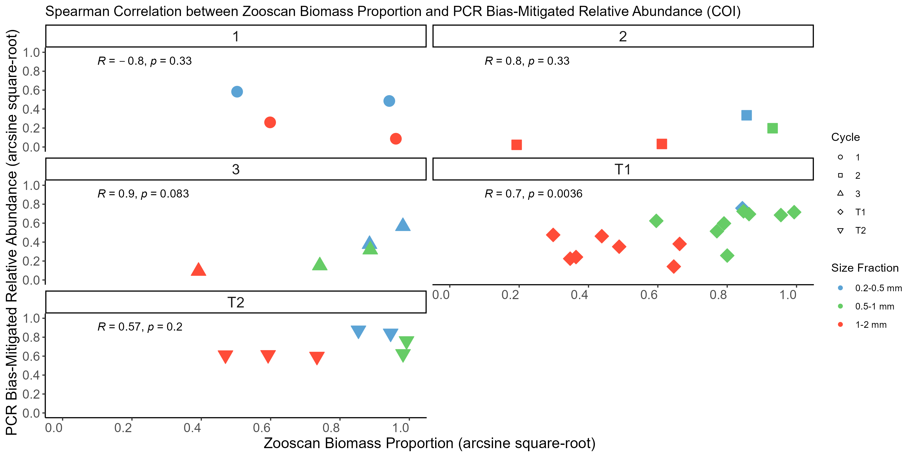
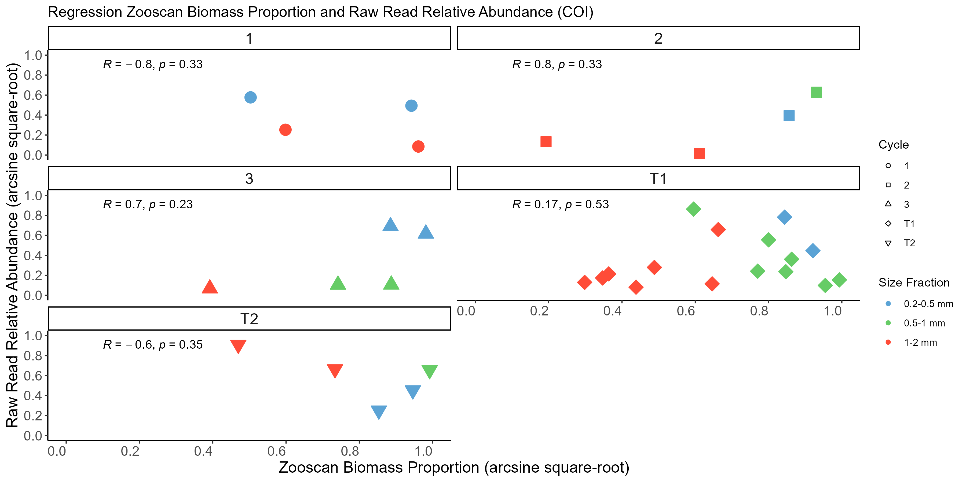
COI-cycle

Slide 28
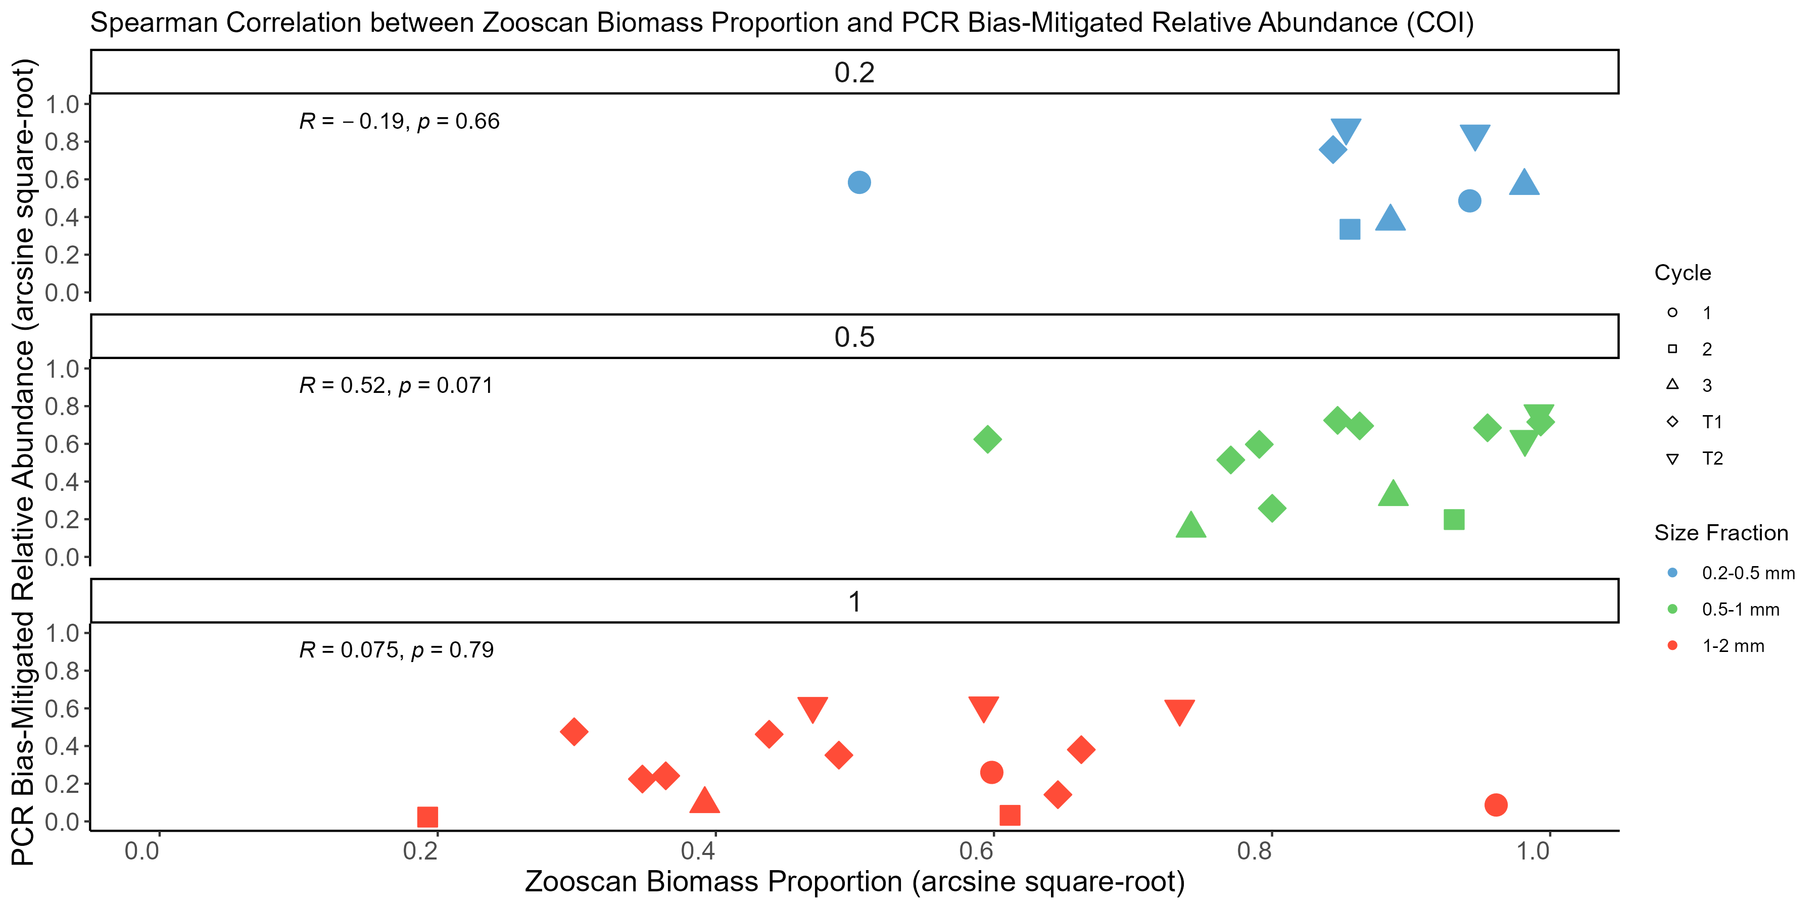
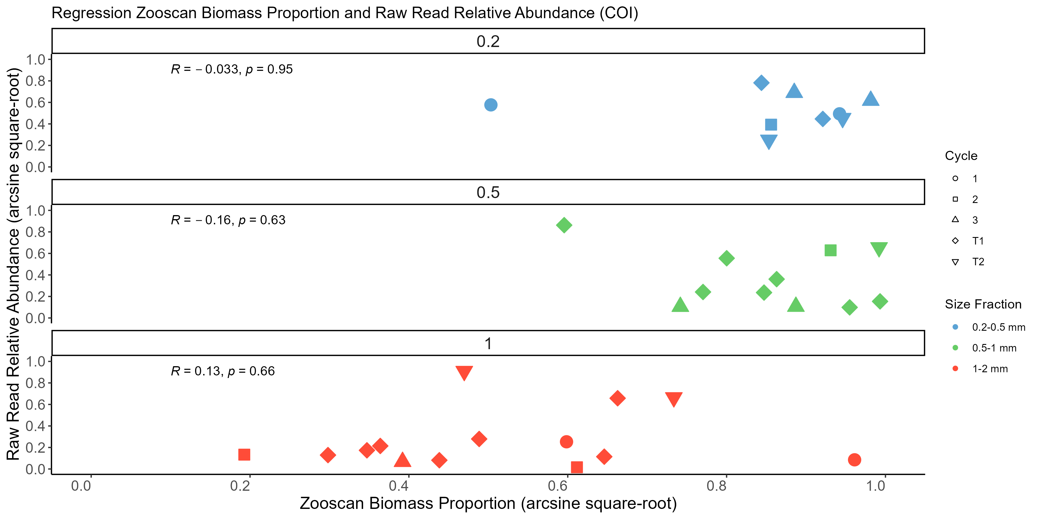
COI-size

Slide 29
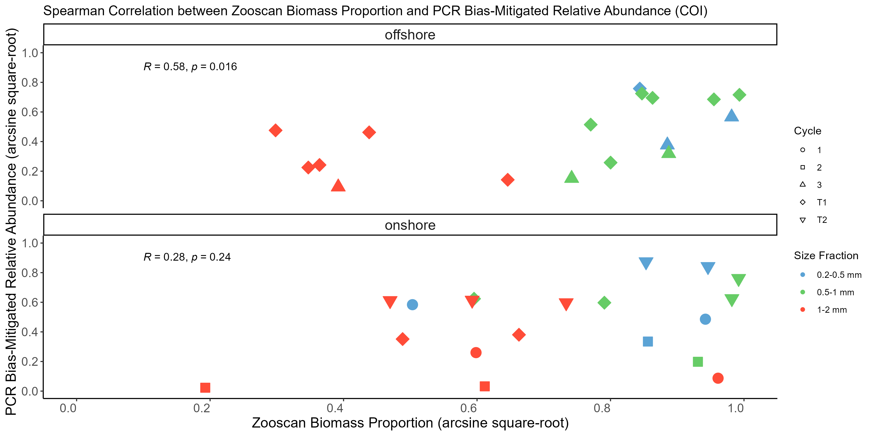
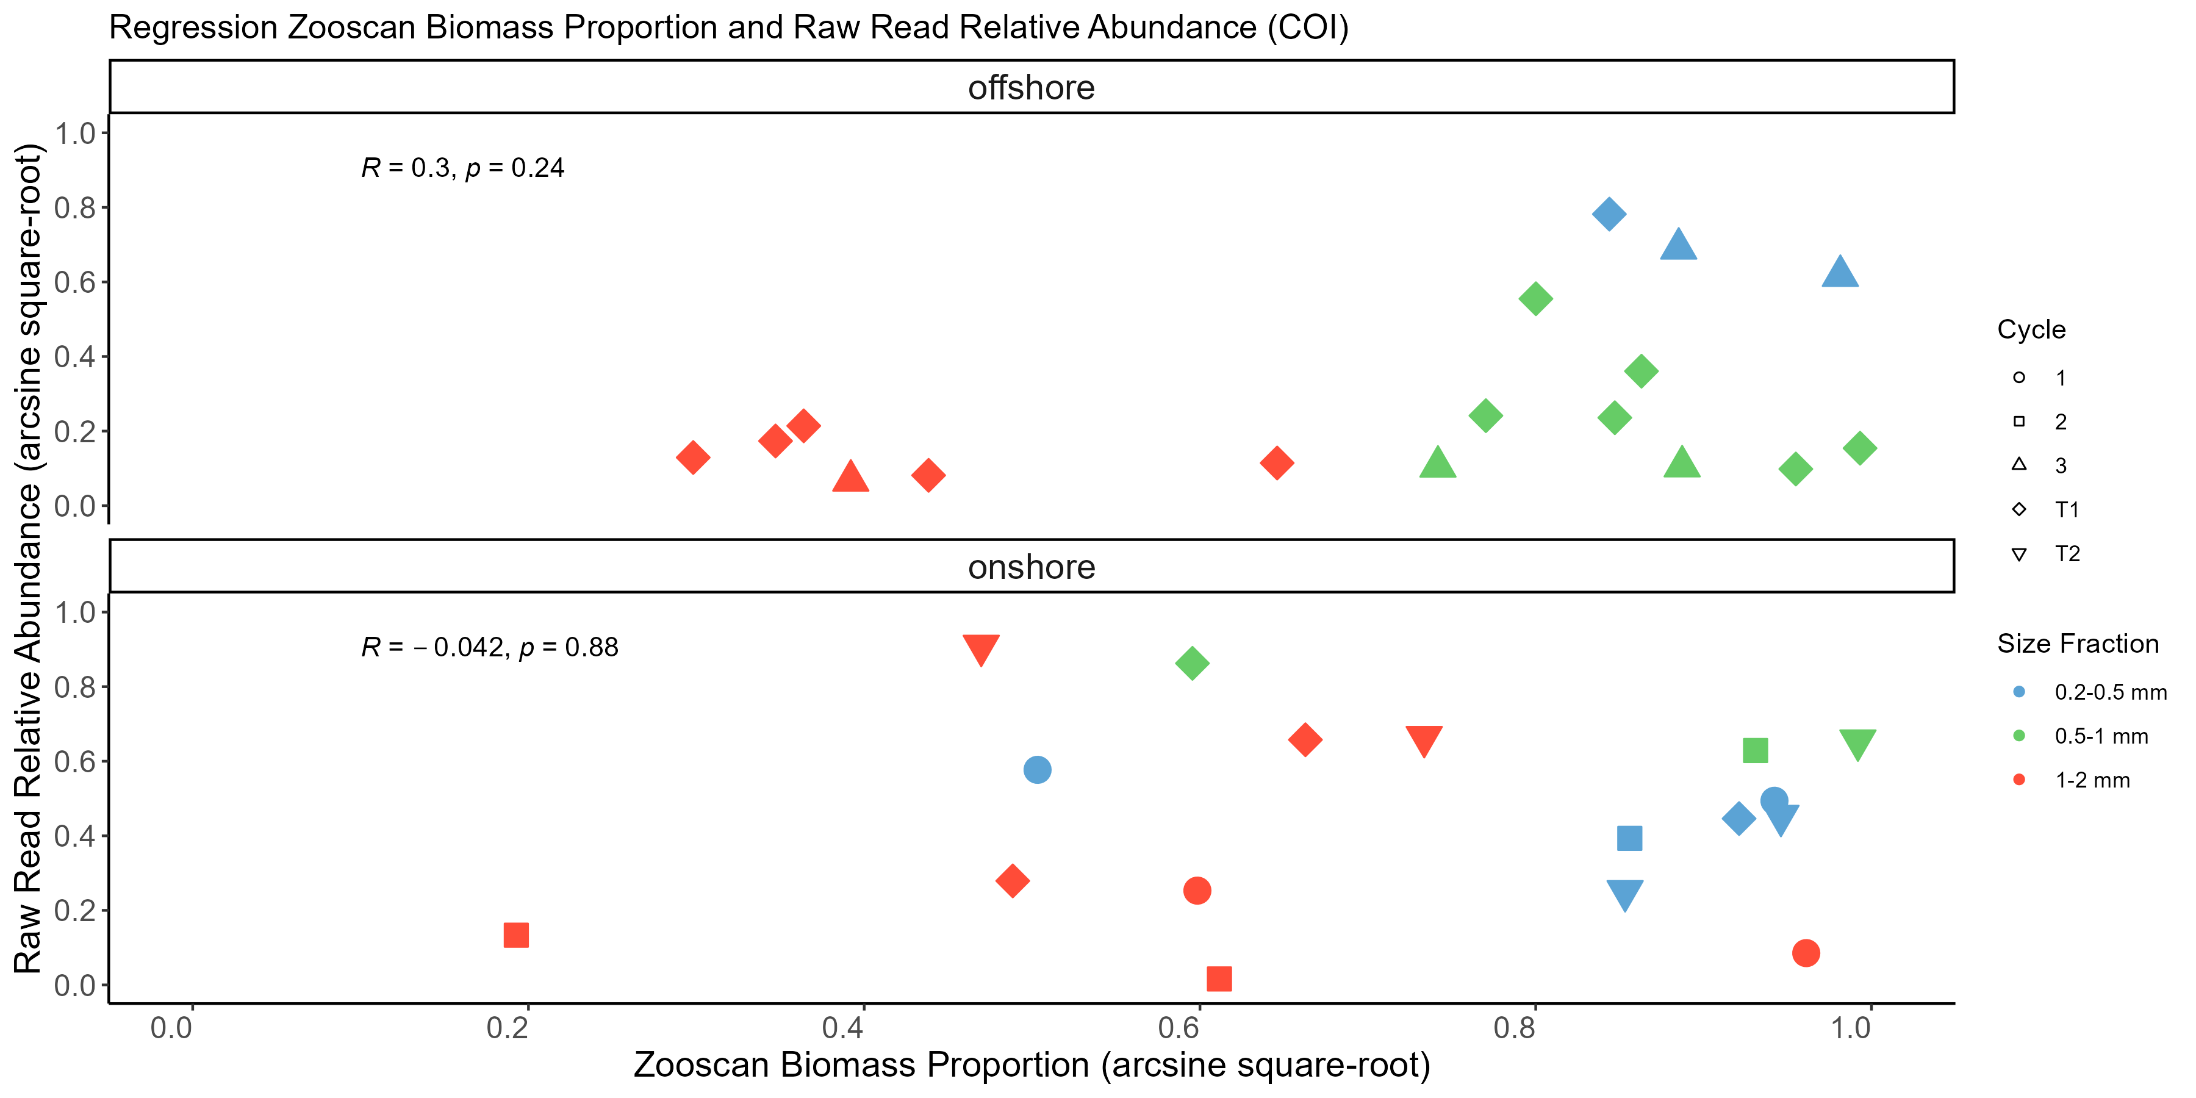
COI Cluster

Slide 30
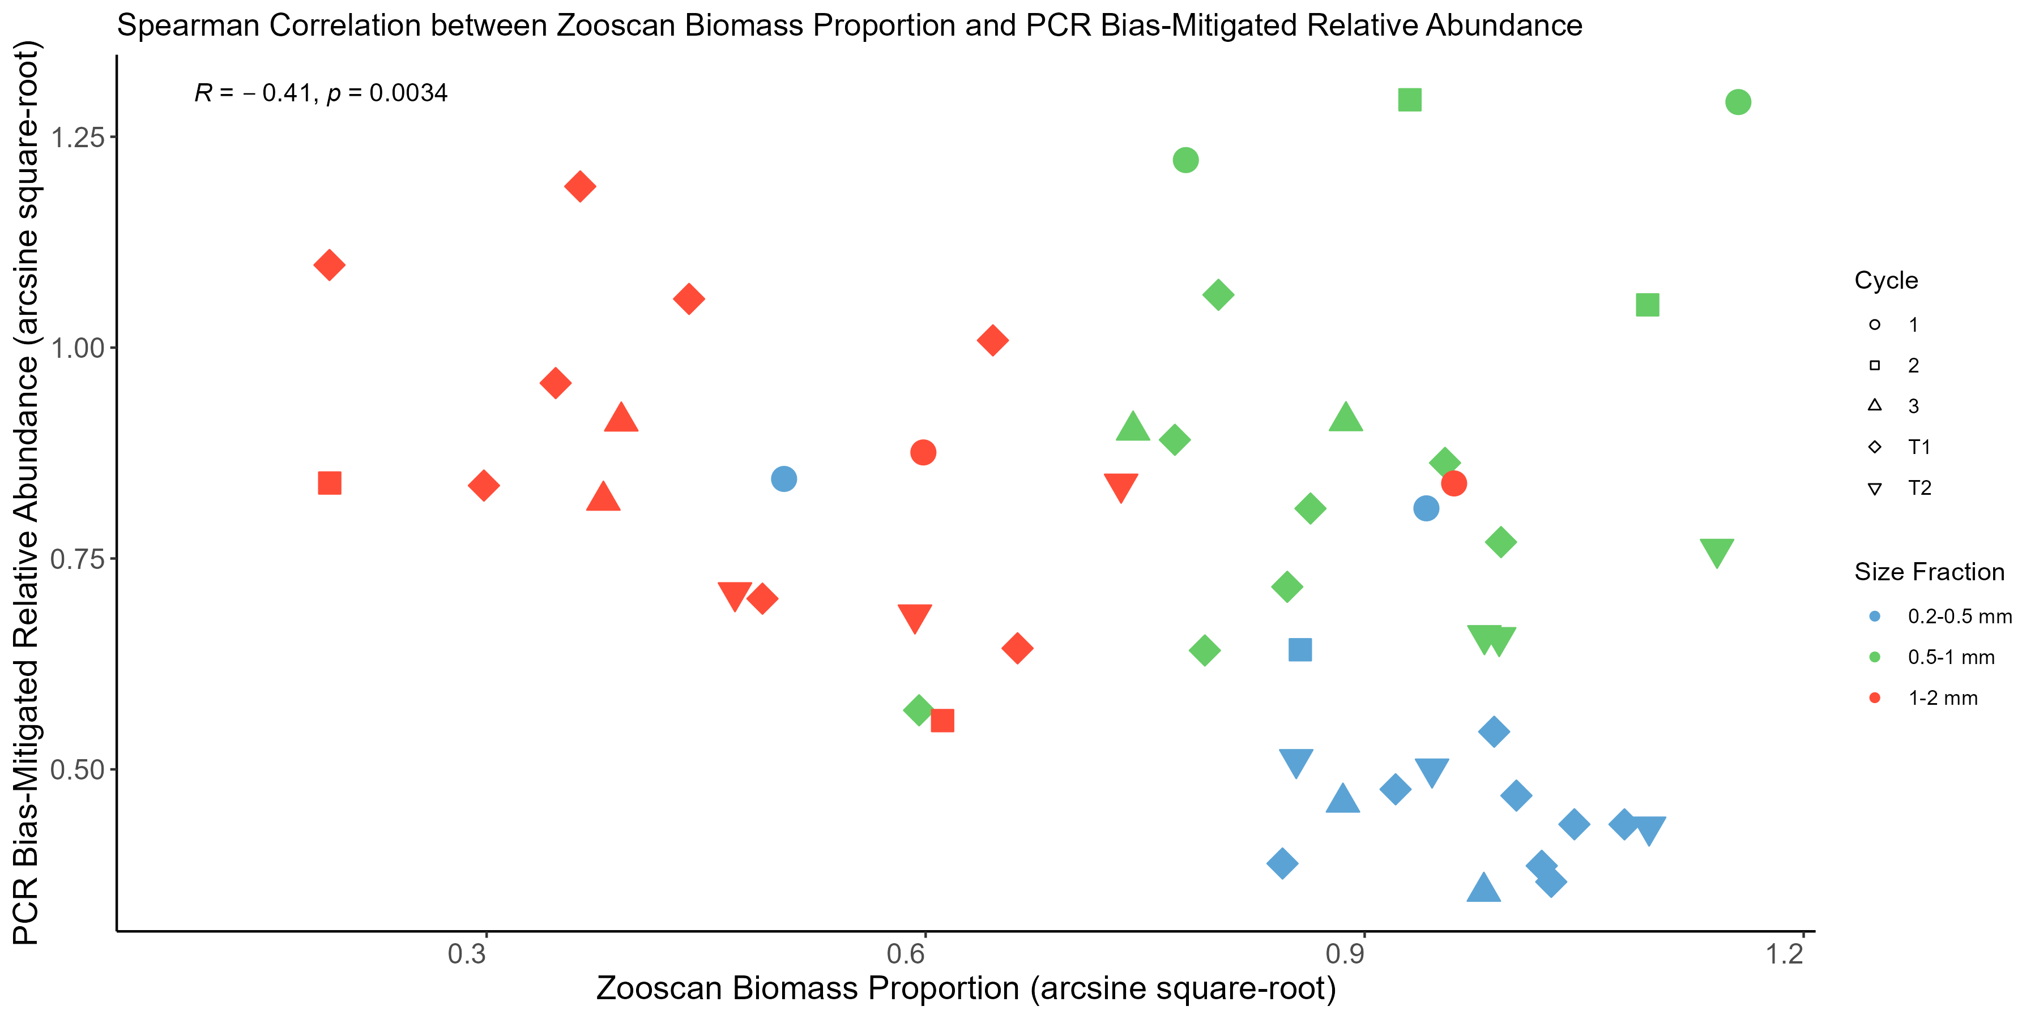
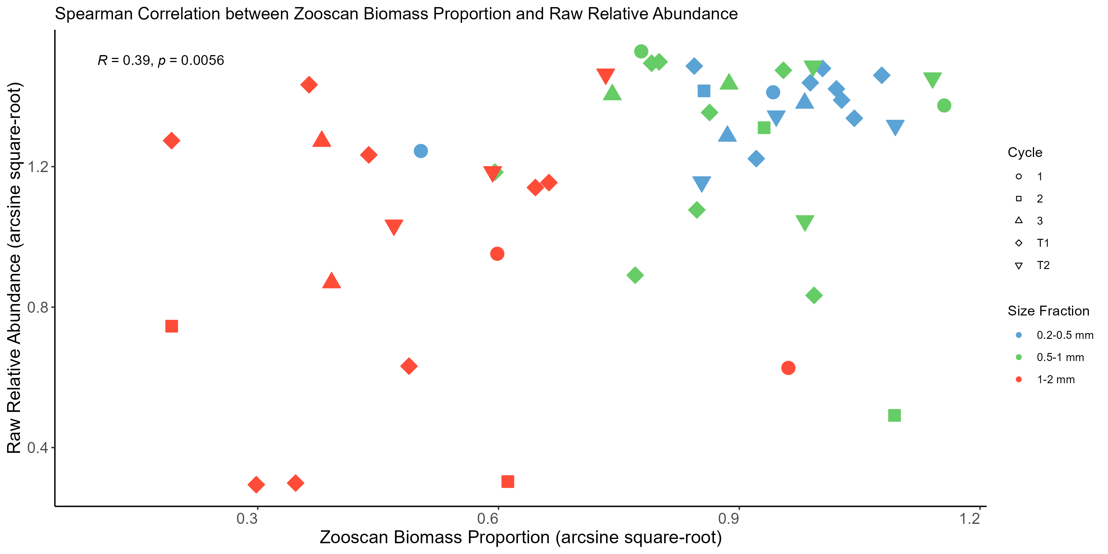
18S-all

Slide 31
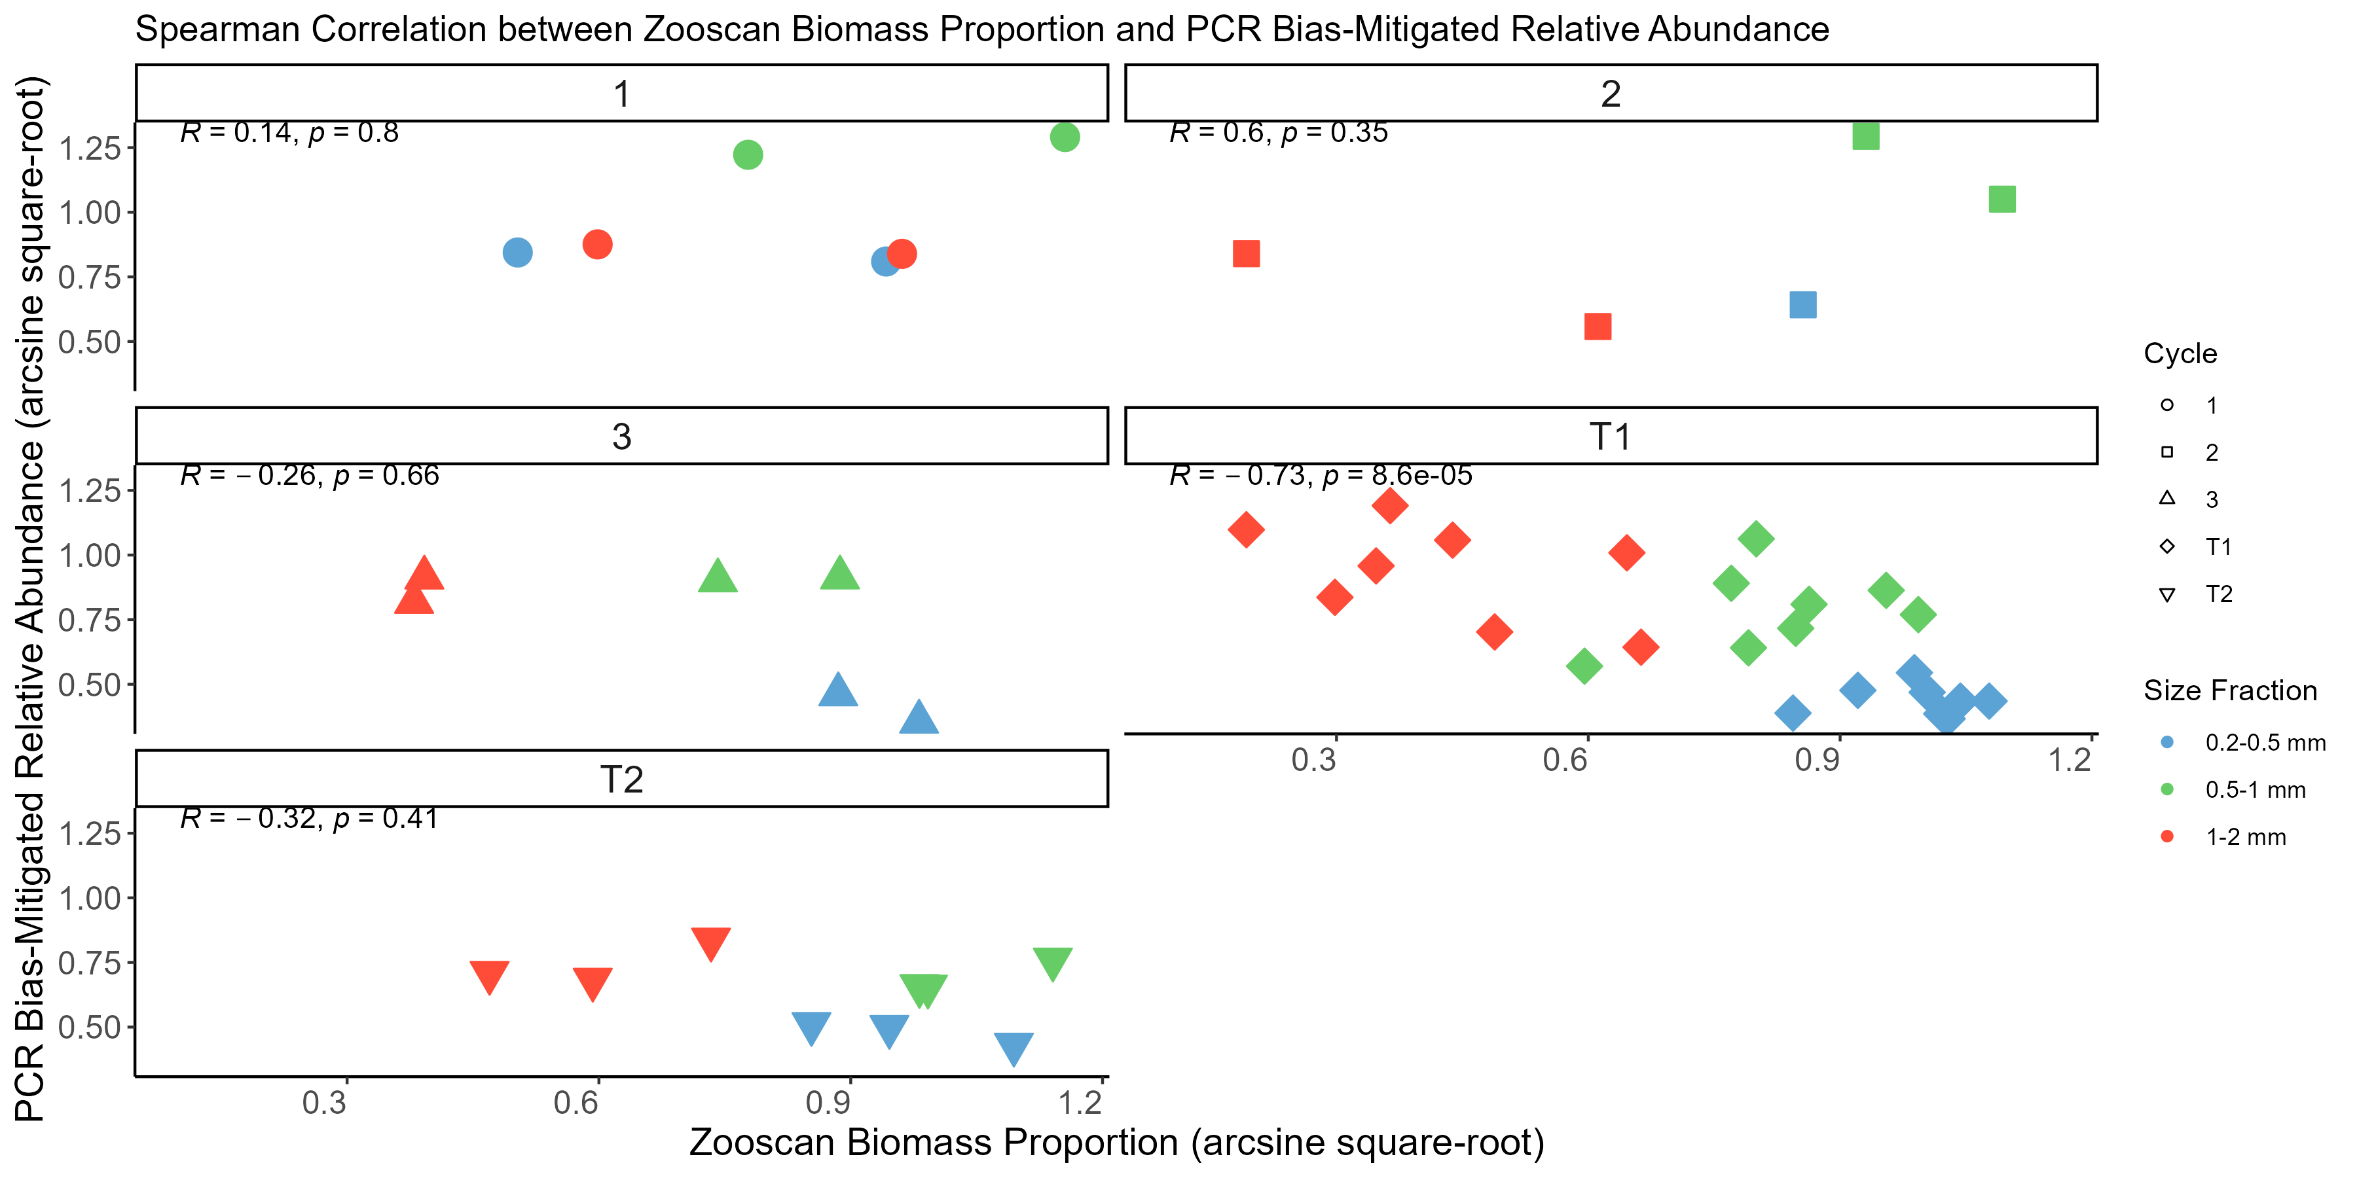
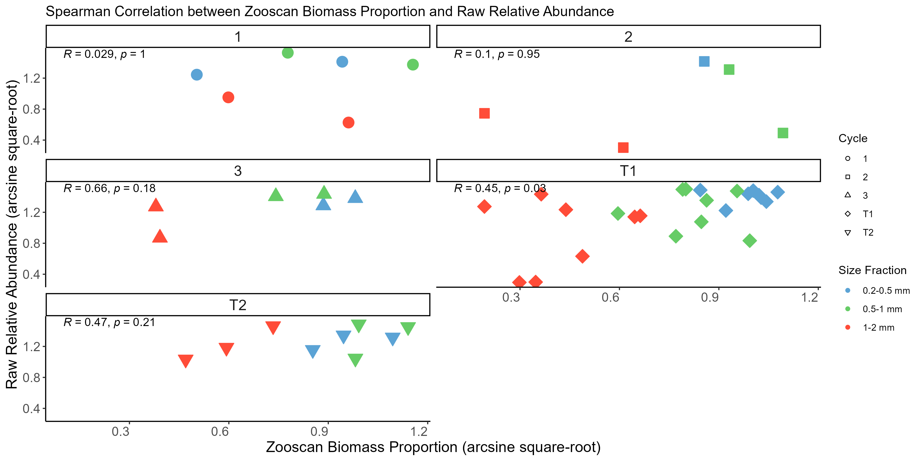
18S-cycle

Slide 32
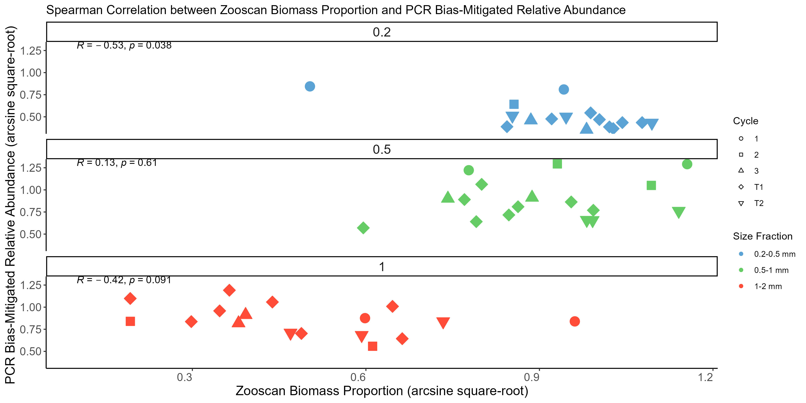
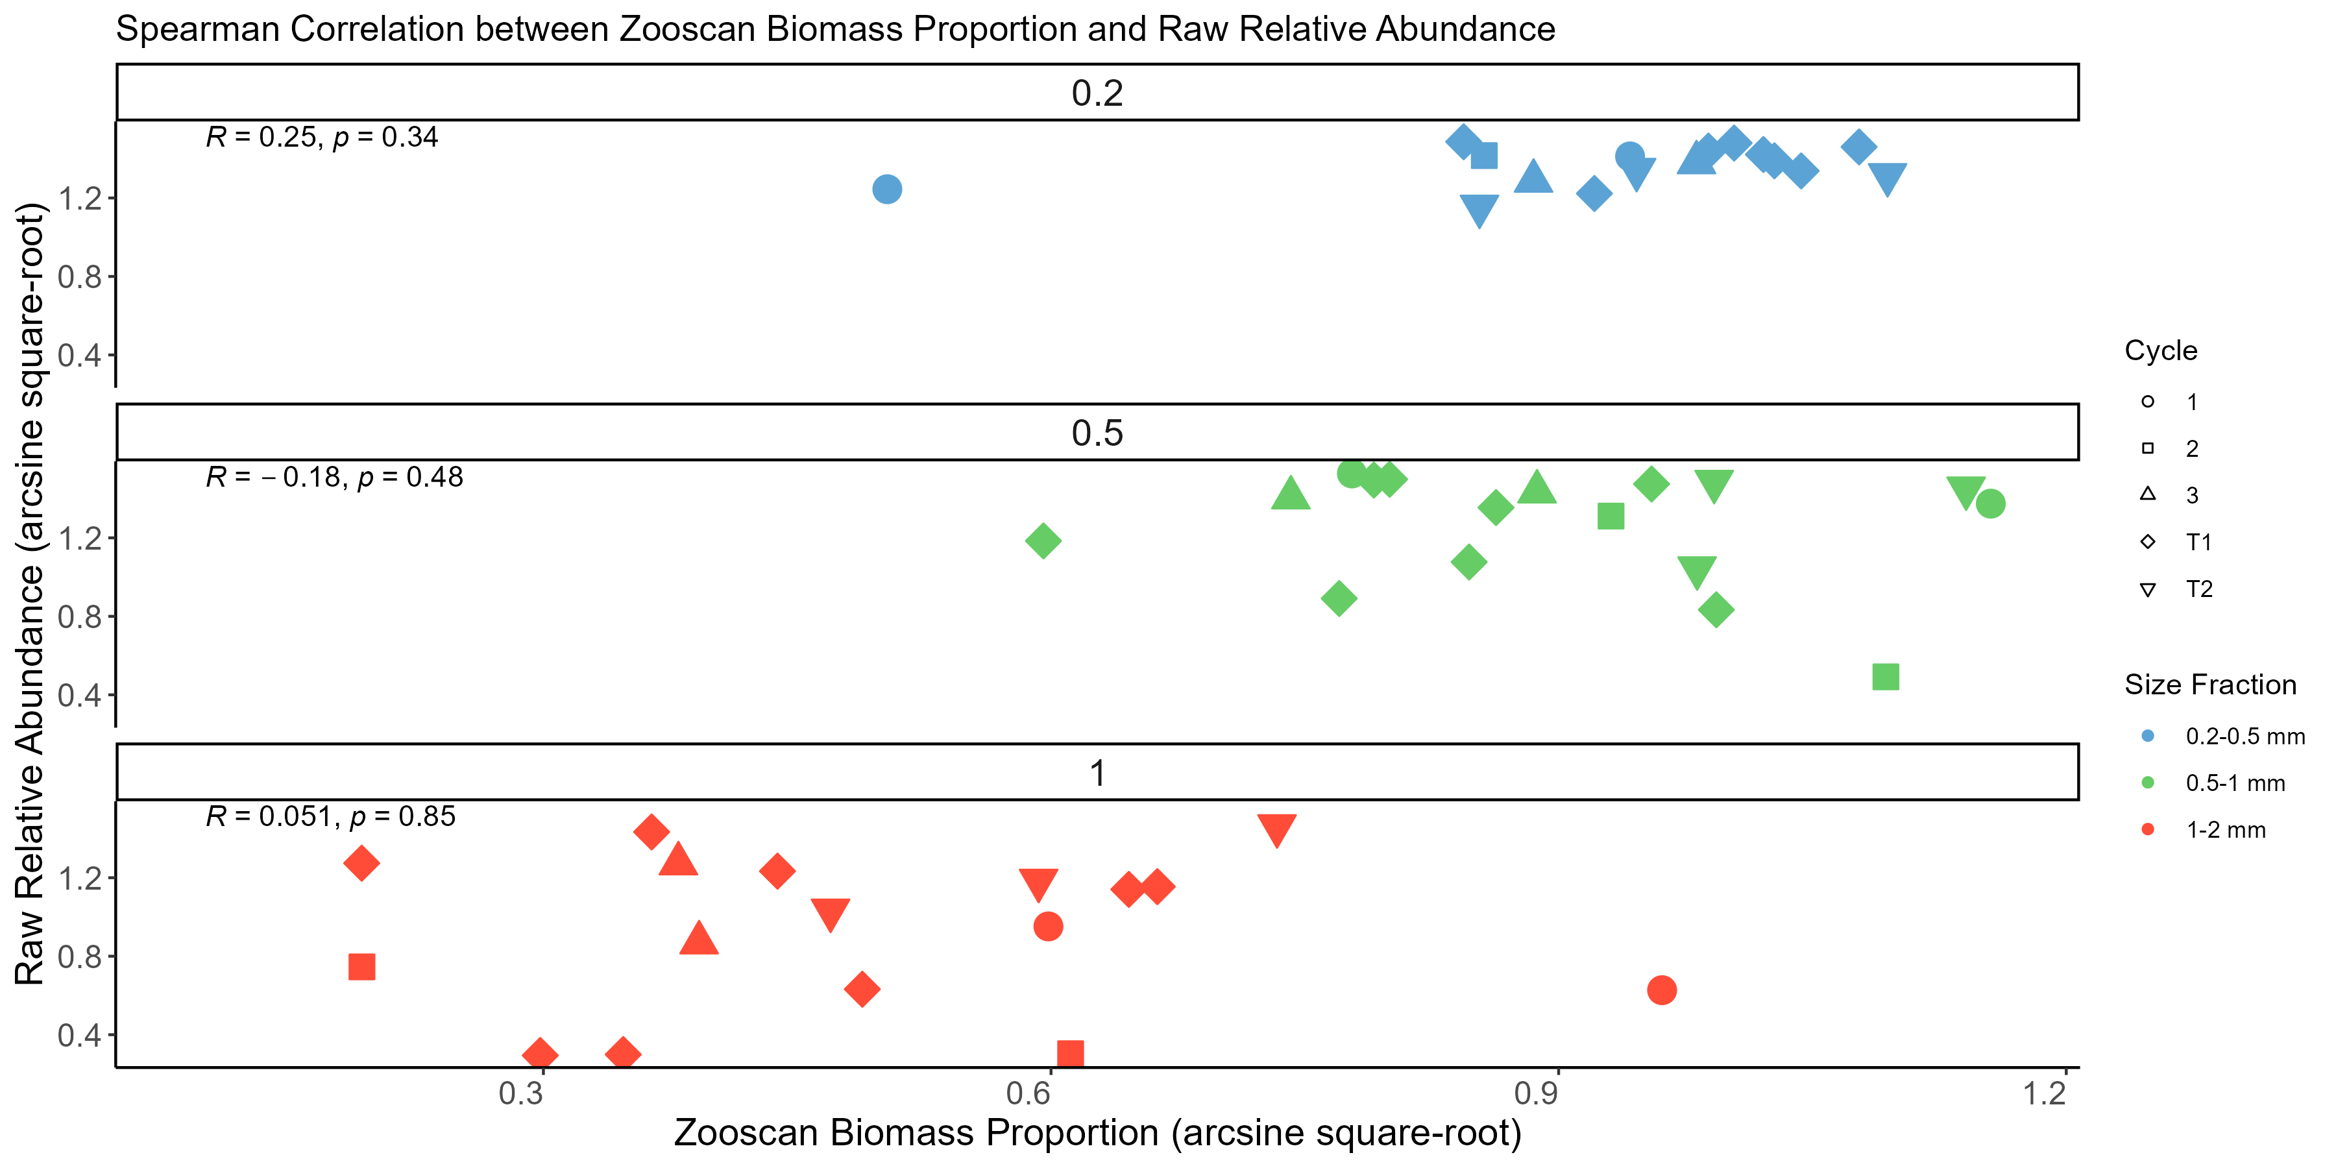
18S-size

Slide 33
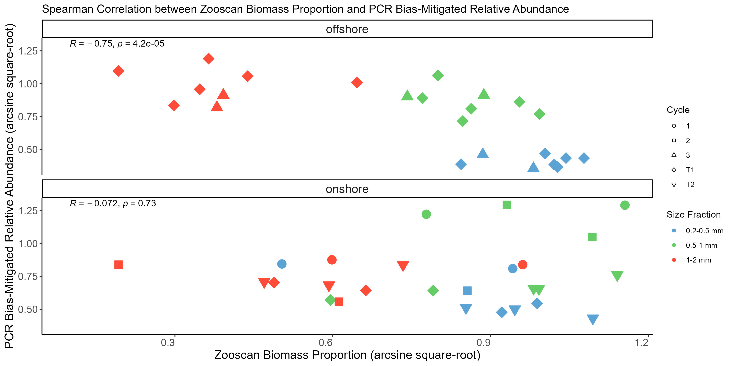
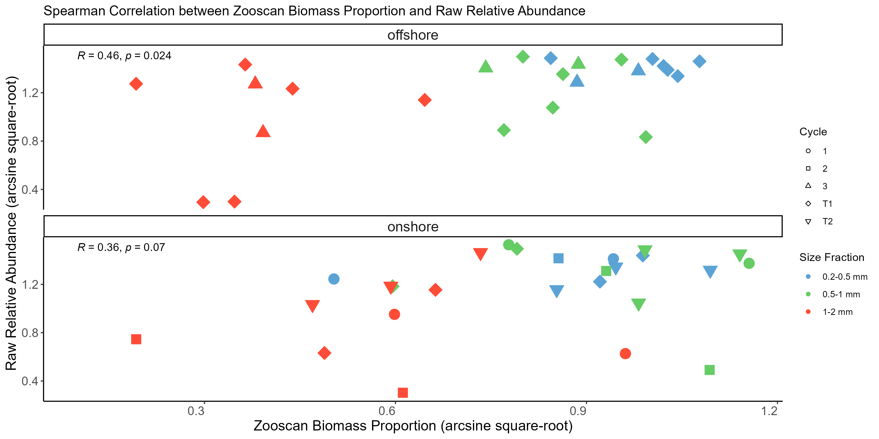
18S Cluster

Slide 34
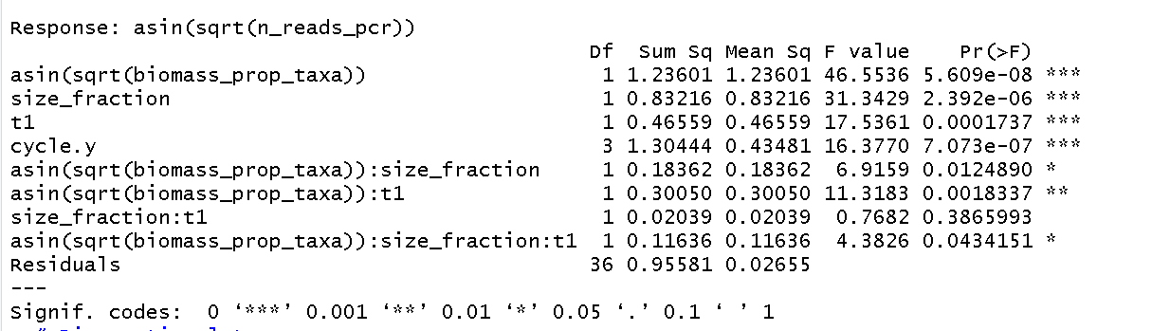
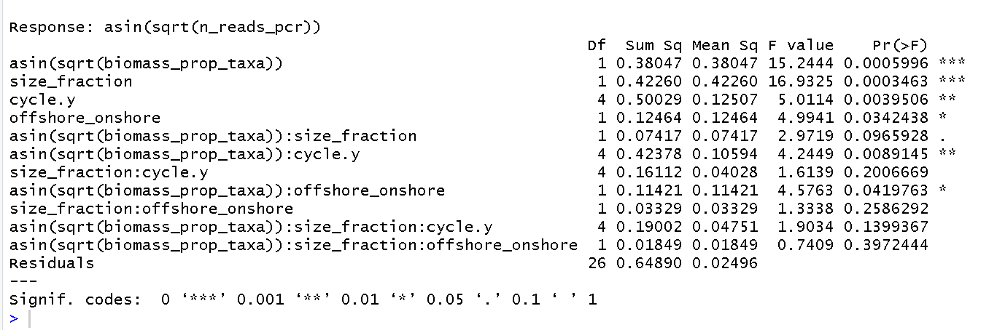
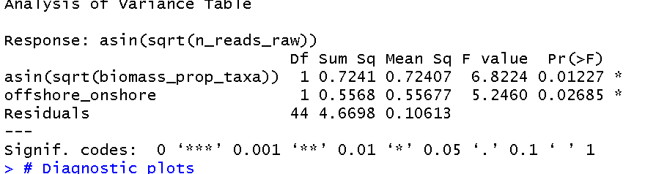
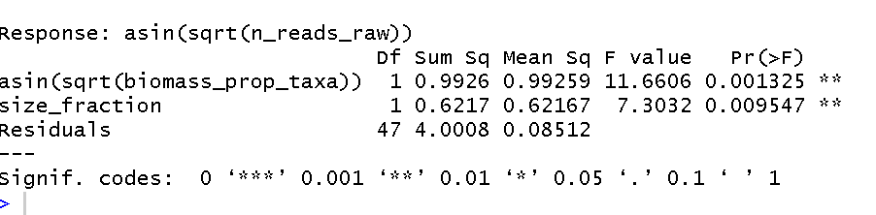
ANCOVA Table
COI
18S

