Slide 1

Acknowledging
Alerts
Unix Team

Slide 2
Presentation Outline
Nutshell
Alert Notification Flow
Channels of Nagios Notification
Acknowledging email alert
Acknowledged email alert
Acknowledging SMS alert
Acknowledged SMS alert
Q and A

Slide 3











What to do when a Nagios alert is received in your email/mobile phone?
Acknowledge
so that the team is aware that a team member is already working on the issue
Reply to the email alert
Forward SMS alert to Nagios
Notes:
Explain the topic in a nutshell (bottomline)

Slide 4




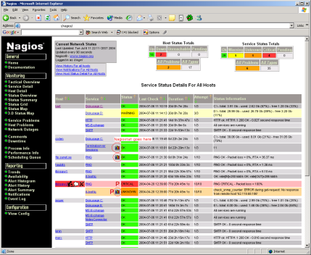





Alert Notification Flow
Notifications for production services are sent to specific groups through SMS
All notification displays on the Nagios web interface
During business hours
(7:00 am – 7:00 pm)
Alert notification displays on the Nagios web interface
Receives system alerts through active monitoring or passive checks
and sent through email
Receives alert acknowledgement
Acknowledge alerts so that the team is aware that a team member is already working on the issue
Notes:
Flow of Nagios alerts notification

Slide 5
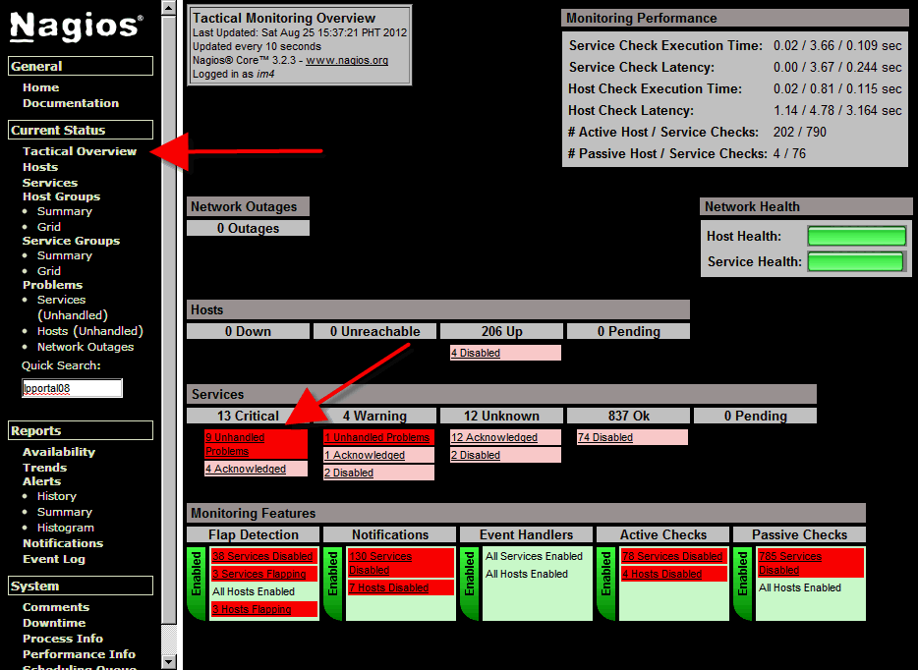





Three channels of Nagios Notification
email
Web interface
email
SMS
SMS
Notes:
Show the breakdown of the topics – Intro to Nagios (How it works?), Function Nagios relevant to the topic, Web interface, Email alert (acknowledging ) SMS alert (acknowledging)

Slide 6
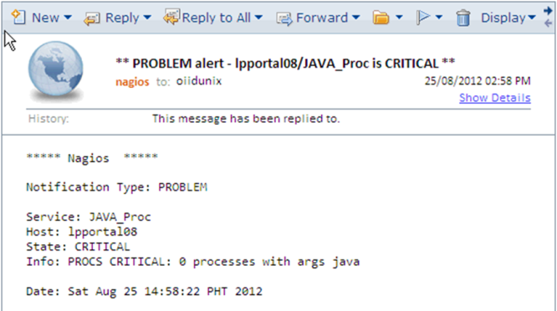
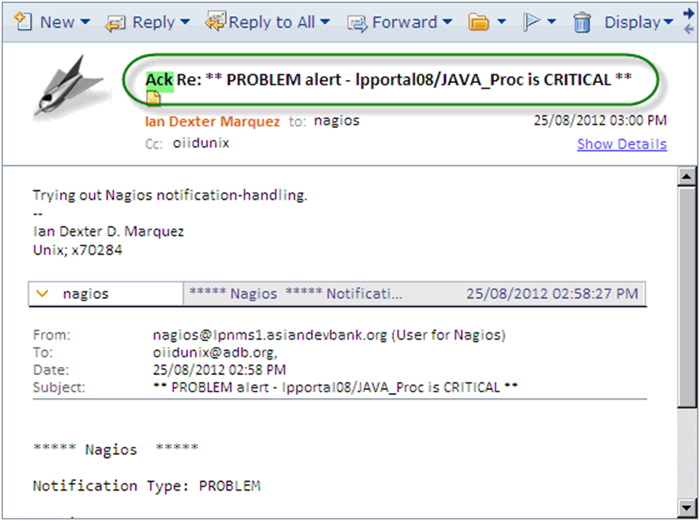


Acknowledging email alert
**PROBLEM alert - lpportal08/JAVA_Proc is CRITICAL **
nagios to oiidunix 25/08/2012 02:58PM
Show details
***** Nagios *****
Service: JAVA_Proc
Host: lpportal08
Sate: CRITICAL
Info: PROCS CRITICAL: 0 processess with args java
Date: Sat Aug 25 14:58:22 PHT 2012
a. Reply to the email
b. Insert ACK to the subject line.
ACK Re: **PROBLEM alert - lpportal08/JAVA_Proc is CRITICAL **
Ian Dexter Marquez to nagios 25/08/2012 02:58PM
Cc: oiidunix Show details
________________________________________________________________________
- -
Ian Dexter D. Marquez
Unix; x70284
To:
Cc:
Bcc:
Subject:
Trying out Nagios notification-handling
- -
Ian Dexter D. Marquez
Unix; x70284
nagios
ACK
Re: **PROBLEM alert – lpportal08/JAVA_Proc is CRITICAL
Notes:
Email alert and how to acknowledge

Slide 7
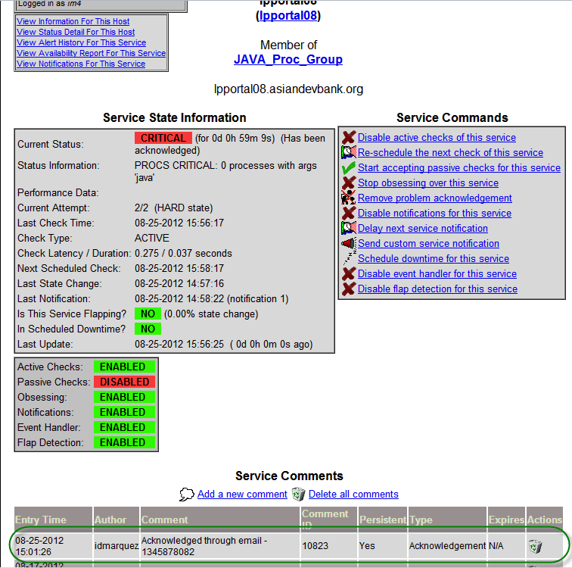

Acknowledged email alert
a. Alert acknowledgement is received and available in the Nagios web interface
b. Alert acknowledgement is received via email
**ACKNOWLEDGEMENT alert - lpportal08/JAVA_Proc is CRITICAL **
nagios to oiidunix 25/08/2012 02:58PM
Show details
________________________________________________________________________
Notification Type: ACKNOWLEDGEMENT
Service: JAVA_Proc
HostL lpportal08
State: CRITICAL
Notes:
Email alert and how to acknowledge

Slide 8
Acknowledging SMS alert
a. Forward the message to the mobile number of the SMS gateway – 09285043259
b. Insert ACK on the first line
Unix ADB
+6392850443259
KO: lppportal/JAVA_Proc
: nagios@lpnms1
Stage: CRITICAL
Info: PROCS CRITICAL: 0 process with args java:
Time: Sat Aug 25 15:01:26 PHT 2012=
KO: lppportal/JAVA_Proc
From: nagios@lpnms1
Stage: CRITICAL
Info: PROCS CRITICAL: 0 process with args java:
Time: Sat Aug 25 15:01:26 PHT 2012=
Unix ADB
+6392850443259
Unix ADB
+6392850443259
ACK KO: lppportal/JAVA_Proc
To: nagios@lpnms1
Stage: CRITICAL
Info: PROCS CRITICAL: 0 process with args java:
Time: Sat Aug 25 15:01:26 PHT 2012=
c. Change the From keyword to To
ACK
From
To
Notes:
SMS alert and how to acknowledge

Slide 9
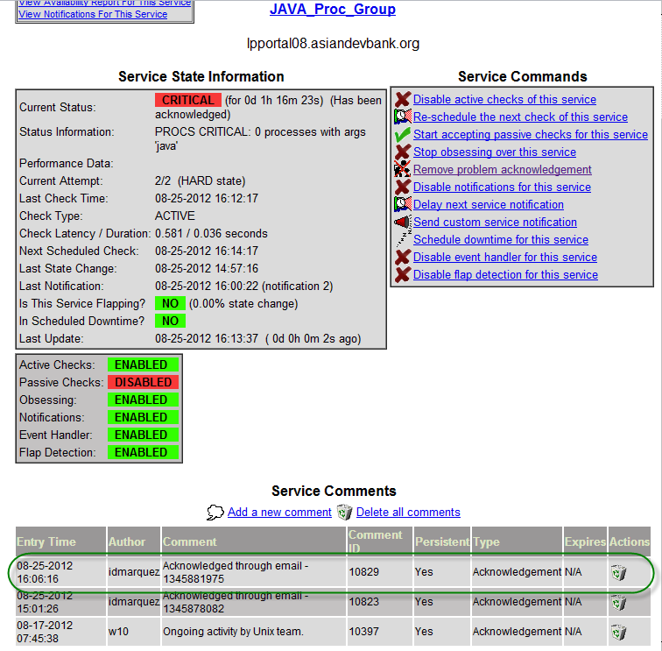
Acknowledged SMS alert
a. Alert acknowledgement is received and available in the Nagios web interface
b. Alert acknowledgement is received via SMS
KO: lppportal/JAVA_Proc
From: nagios@lpnms1
Stage: CRITICAL
Type: ACKNOWLEDGEMENT
Info: PROCS CRITICAL: 0 process with args java:
Time: Sat Aug 25 15:01:26 PHT 2012=
Unix ADB
+6392850443259
Notes:
Email alert and how to acknowledge

Slide 10
Acknowledging
Alerts
Q and A
Thank you
Unix Team

