Slide 1

Project 4 - Group 03
Awesome Anime Answers
Our Anime Recommender

Slide 2





Our Goal:
Our Team
To use Machine Learning and the K-nearest neighbor algorithm to build a model to read a broad dataset and recommend new animes to users based on their preferences.
Daniel Purrier
Carlos Ruiz
Steven Madden
Amar Patil

Slide 3
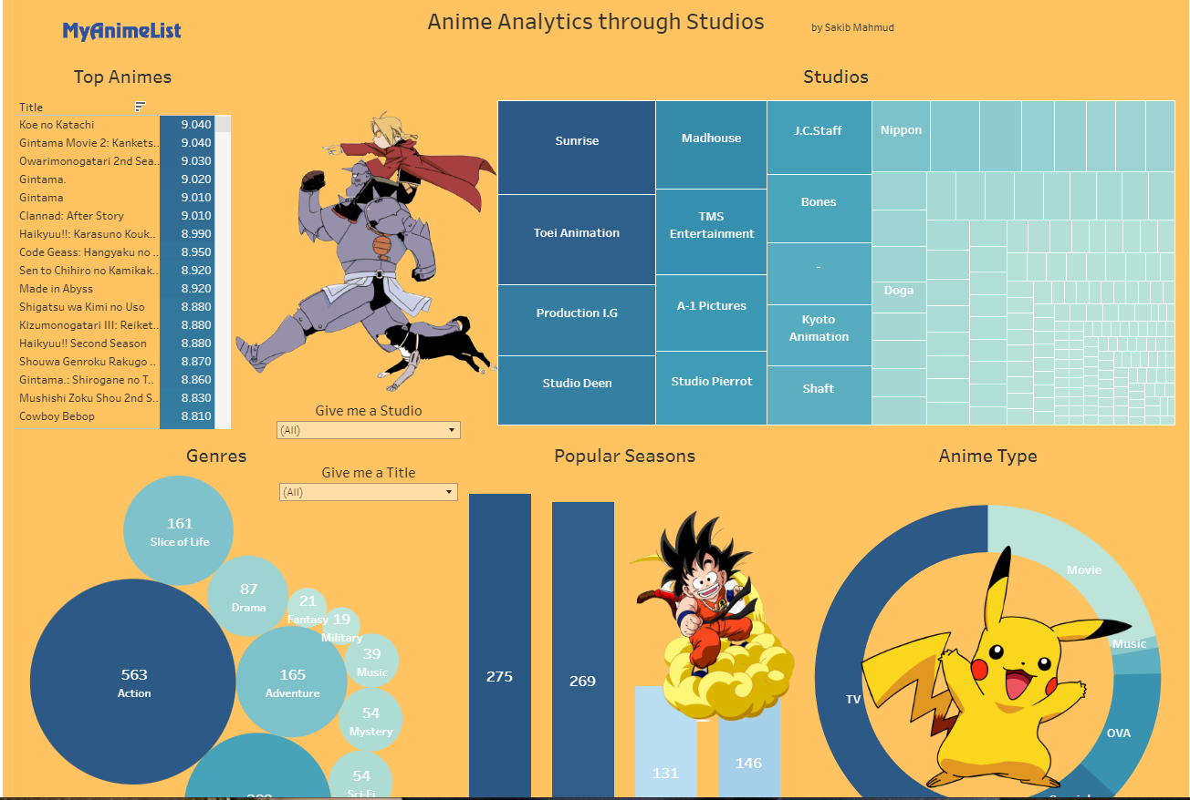
Our Inspiration
Anime is an incredibly popular form of entertainment. In the U.S. alone, approximately 72% of the population watches some form of anime.* However, with so many choices of titles and genres, it can be overwhelming for someone new to Anime or even an Anime veteran to find new shows and movies they might like. After finding other recommenders and our own team’s enthusiasm for Anime, we thought it would be fun to build our own anime recommender.
*According to a 2024 servy by https://worldpopulationreview.com/country-rankings/anime-popularity-by-country
https://public.tableau.com/app/profile/sakib.mahmud1560/viz/AnimeAnalyticsthroughStudios/AnimeAnalyticsDashboard

Slide 4
Data and cleaning
We started by choosing our dataset,
https://www.kaggle.com/datasets/CooperUnion/anime-recommendations-database
based on file size, number of rows, and perceived amount of cleaning necessary. We estimated we might only lose around 3.5% of rows when cleaning was done.
We started by reading in our dataset looking at its shape and searching for nulls.
Since the impact of dropping null values is less than 1% in genre and type columns, we can drop all rows with null values. We lost another 2.5% when we found entries in the episode column contained non-numeric values.
We found some strange symbols in some of the names, so we removed them. Then it was a matter of taking all the unique entries in the genre and type columns and turning them into their own Boolean columns, and then dropping the genre and type columns.
Once done, we dropped just a few more columns, when realized several genre columns were of an 18+ plus variety, so we decided to drop them.
And no Alex, we’re not telling you which ones we dropped.

Slide 5
Machine Learning
Since we are building a recommender we knew we would use k-nearest neighbor. Let’s explain why:
Primary Components of a recommender System
1. Candidate generation
In this first state, the system starts from huge dataset and generates a smaller subset of data. Example in Youtube reduces large amount of videos down to hundreds or thousands. This is first stage of Recommendation. There are two common candidate generation approaches:
Content-based Filtering
Uses similarity between items to recommend items similar to what user likes
Ex: if User watches dog videos, then the system can recommend cute animals videos to that user.
Collaborative Filtering
Recommends items based on the behavior or preferences of similar users.
Ex: If used A is similar to user B, and user B likes video 1, then it recommends A

Slide 6
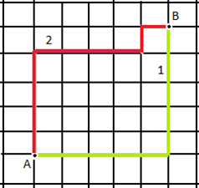
2. Scoring
This model scores and ranks the candidates in order to select the set of items (on the order of 10) to display to the user. This is subset of Candidate generation
3. Re-ranking
This is final ranking which takes into account dislikes or likes of newer content. Re-ranking helps to ensure diversity, freshness and fairness.
To determine the degree of similarity, most recommendation systems rely on one or more of the following:
1. Manhattan
Also, know as city block distance, or taxicab geometry wherein the distance is measured between two data points in Grid-like path. As shown below. Mainly used where high dimensionality in the data.

Slide 7
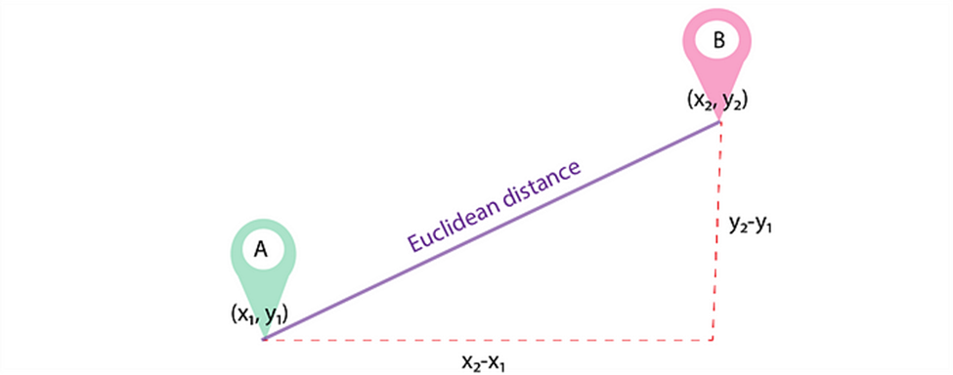
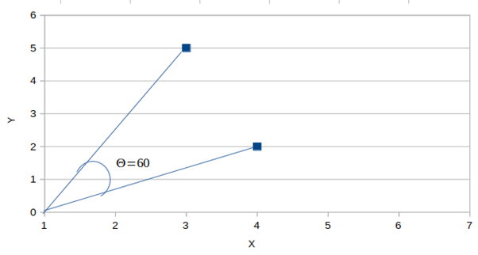
2. Euclidean
This is the shortest distance between 2 data points in the plane. Mainly used for the smaller dimensionality problems.
3. Cosine Distance
Also known as Cosine Similarity is used to find similarities between two data points. Cosine similarity is given by Cos θ, and cosine distance is 1- Cos θ. Mainly used in the Collaborative Filtering based recommender systems to offer future recommendations

Slide 8



Imported Modules
Import pandas
Import numpy
Import pickle
Pre-Processing
from sklearn.preprocessing import StandardScaler, OneHotEncoder, OrdinalEncoder
from sklearn.pipeline import Pipeline
from sklearn.compose import ColumnTransformer
from sklearn.impute import SimpleImputer
from sklearn.neighbors import NearestNeighbors

Slide 9
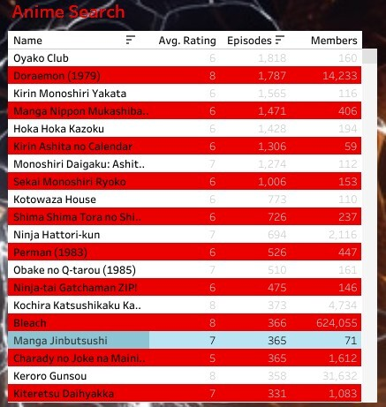
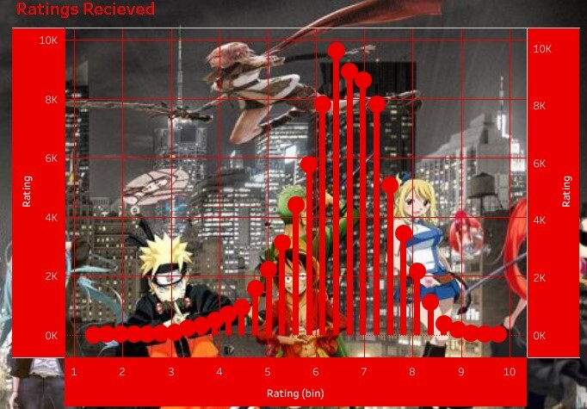
Visualizations Examples

Slide 10

Live Demo
https://aidecisions.pythonanywhere.com/

Slide 11
Conclusions
With more than two thirds of the population of the United States enjoying some kind of anime, a recommender may be a useful tool for finding new shows and movies to watch amid the wide variety available. Hopefully a project like this can take some of the guesswork out of finding new entertainment.
Limitations/Bias
The Dataset was last updated 8 years ago, meaning it contained no recent animes
The companion rating dataset was too large to use for the scope of the project
Fewer categories (ie: year, studio) than other similar datasets
You must know at least one anime for it to work
Future Work
Further refining of the nearest neighbors to yield stronger results
Added search functionality
Added image results to show cover art of recommended animes
Optimize the recommender for people who have no experience with anime

Slide 12
Work Cited
worldpopulationreview.com/country-rankings/anime-popularity-by-country
2024 Anime statistics
public.tableau.com/app/profile/sakib.mahmud1560/viz/AnimeAnalyticsthroughStudios/AnimeAnalyticsDashboard
Visualization inspiration
www.kaggle.com/datasets/CooperUnion/anime-recommendations-database/data
Dataset
git.bootcampcontent.com/boot-camp-consortium-east-coast/DATA-PT-EAST-APRIL-041524/-/tree/main/01-Lesson-Plans/23-Project-4-Week-1/3/BOOOTH_RECOMMENDER_EXAMPLE?ref_type=heads
Instructor project example
select2.org/data-sources/ajax
makitweb.com/loading-data-remotely-in-select2-with-ajax/
Referenced for drop down elements in the HTML

