Slide 1
Distributed project
6-Distributed Systems
Justin Lauwerens, Ward Goossens & Willem Van der Elst

Slide 2
Outline
Namingserver
Discovery
Replication
Agents
GUI

Slide 3
Namingserver

Slide 4
Namingserver
CustomHashmap => ConcurrentSkipListMap
Ordered
Multiple entries at the same time possible
Hashing %

Slide 5
Discovery

Slide 6
general
UDP & Json
RequestHandler responds to messages received

Slide 7
Bootstrap & Discovery
Multicast Hello message
Response nameserver: node count message (unicast)
Node gets nameserver ip
If only node sets next and previous node to itself
Response nodes: potential update of previous of next node
If updated => respond with message to update their next and or previous (unicast)

Slide 8
Shutdown
Close folderWatcher & replicaManager
Bye message
Unicast to nameserver, previous & next node
Response nodes: update previous/next to the senders previous/next
Response nameserver: remove node

Slide 9
Failure
Node detects failure on other node
Unicast failure message to nameserver
Response nameserver:
Remove the failed node
Send failedinfo message containing the failed node’s next and previous => detector of failure
Detector of failure send updateNext/ updatePrevious message to received next and previous

Slide 10
Replication

Slide 11
general
FolderWatcher using java.nio.file (local files)
Continiously scans the designated folder for:
New files
Updates
Removals
ReplicaManager (replicated files)
TCP file transfer
UDP file removal

Slide 12
Starting
Scan designated folder
Send all files to correct nodes
Update replicaLocations Hashmap

Slide 13
Update
File updated:
Resend updated file
Update replicaLocations
File deleted:
Use replicaLocations to get the location
UDP unicast DeleteFile message to location
Update replicaLocations

Slide 14
Shutdown
Folderwatcher: Go over al replicas in replicalocations
UDP unicast DeleteFile message
ReplicaManager:
Move replicated files to previous node
Unless previous node = local file host => UDP RequestPreviousPrevious message

Slide 15
Agents

Slide 16
general
Most requirements already implemented node based
Refactoring to get the other requirements
Node and nameserver => Device interface

Slide 17
Failure agent
Ping neigbours at regular intervals
Failure mechanism as already discussed

Slide 18
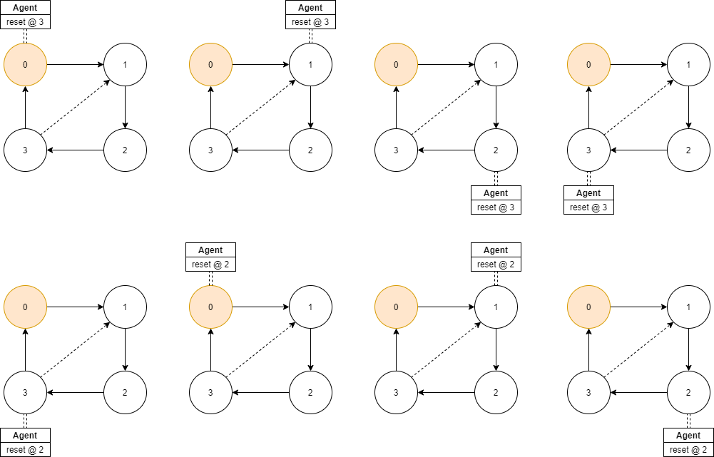
Synchronization agent
If on node:
Get replicas => add if absent
Update file locks
Clear if on reset node
Send to next device
UDP unicast Agentwrapper message

Slide 19
GUI

Slide 20
GUI

