Slide 1
Cape Fear Collective DS Technical Screen
Dante Haywood November 25, 2020

Slide 2

About me
Data Scientist new to Wilmington.
Looking to build cool stuff!
Favorite Thanksgiving dish: Mac & cheese.
Previous work experience: Deloitte, Accenture, MGR Foundation, Fundación Pro Vivienda Social, The Heinz Endowments
Education: Carnegie Mellon, BS Economics & Statistics ’13
dante.haywood@gmail.com
dantehaywood.com

Slide 3
Outline
Assignment Overview
What is a food desert?
Data Exploration
Provided data overview.
Summary statistics and graphs.
Model Building
Multivariate analysis.
Modelling workflow.
Model Evaluation
ROC curves.
Tradeoffs.
Assumptions, Limitations, & Next Steps
Special considerations.

Slide 4
Assignment Overview
Explore the provided data to understand the problem of food deserts in North Carolina and New Hanover County.
Join data sets to create a clean df with one row per tract.
Prepare visualizations and insights (at least 3) to illustrate interesting findings from the data.
Build a predictive model with a binary output (1 if food desert, else 0).
Organize findings into an hour-long presentation (saving 15 minutes for questions and discussion, so 45 minutes of content). Your audience will come from a spectrum of data literacy and data comfort.

Slide 5
What is a food desert?
Food desert definitions are generally vague.
The USDA Economic Research Service designates food deserts with a rules-based model.²
Factors include: Food store locations, population, vehicle availability, poverty, store access.
Designation performed in 2010 and improved upon in 2017 with enhanced data matching.
Food Desert
“… areas where people have limited access to a variety of healthy and affordable food.”¹

Slide 6
Food Desert Implications
Myriads of problems are associated with food deserts including:
Obesity
Malnutrition
Poor nutritional preferences
Hindered child development
Research focuses on four main areas:
Finding food deserts
Determining causes of food deserts
Health effects of food deserts
Reversing food desertification
Challenges
Groceries cannot be forced to enter neighborhoods.
Individuals may not make healthier choices, if available.
Symptomatic of and correlated with other socio-economic issues.

Slide 7
Data
Five datasets provided:
food.desert – Binary classification of food deserts, poverty rates, and median household income.
population – County population over time.
ruca.usda – RUCA codes, tract population, and Census tract land area.
stores – The number of grocery stores, supercenters, convenience stores, and specialty food stores.
vehicles – The number of cars per household.
The data are aggregated to different geographic levels:
Food desert designation for 2010 are included, but this designation was improved upon by the USDA in 2017². This analysis will focus solely on the 2017 designation.
Geographic Level
County | Census Tract
pop | food.desert
stores | ruca.usda
 | vehicles
Note

Slide 8
Data Exploration & Statistics
100
2,195
368 (16.8%)
NC Counties
Census Tracts
2017 Food Desert Tracts
6 / 45
83
72
New Hanover Food Desert Tracts
Counties with at Least 1 Food Desert
Counties with at Least 1 More Food Desert Tract 2010-2017

Slide 9
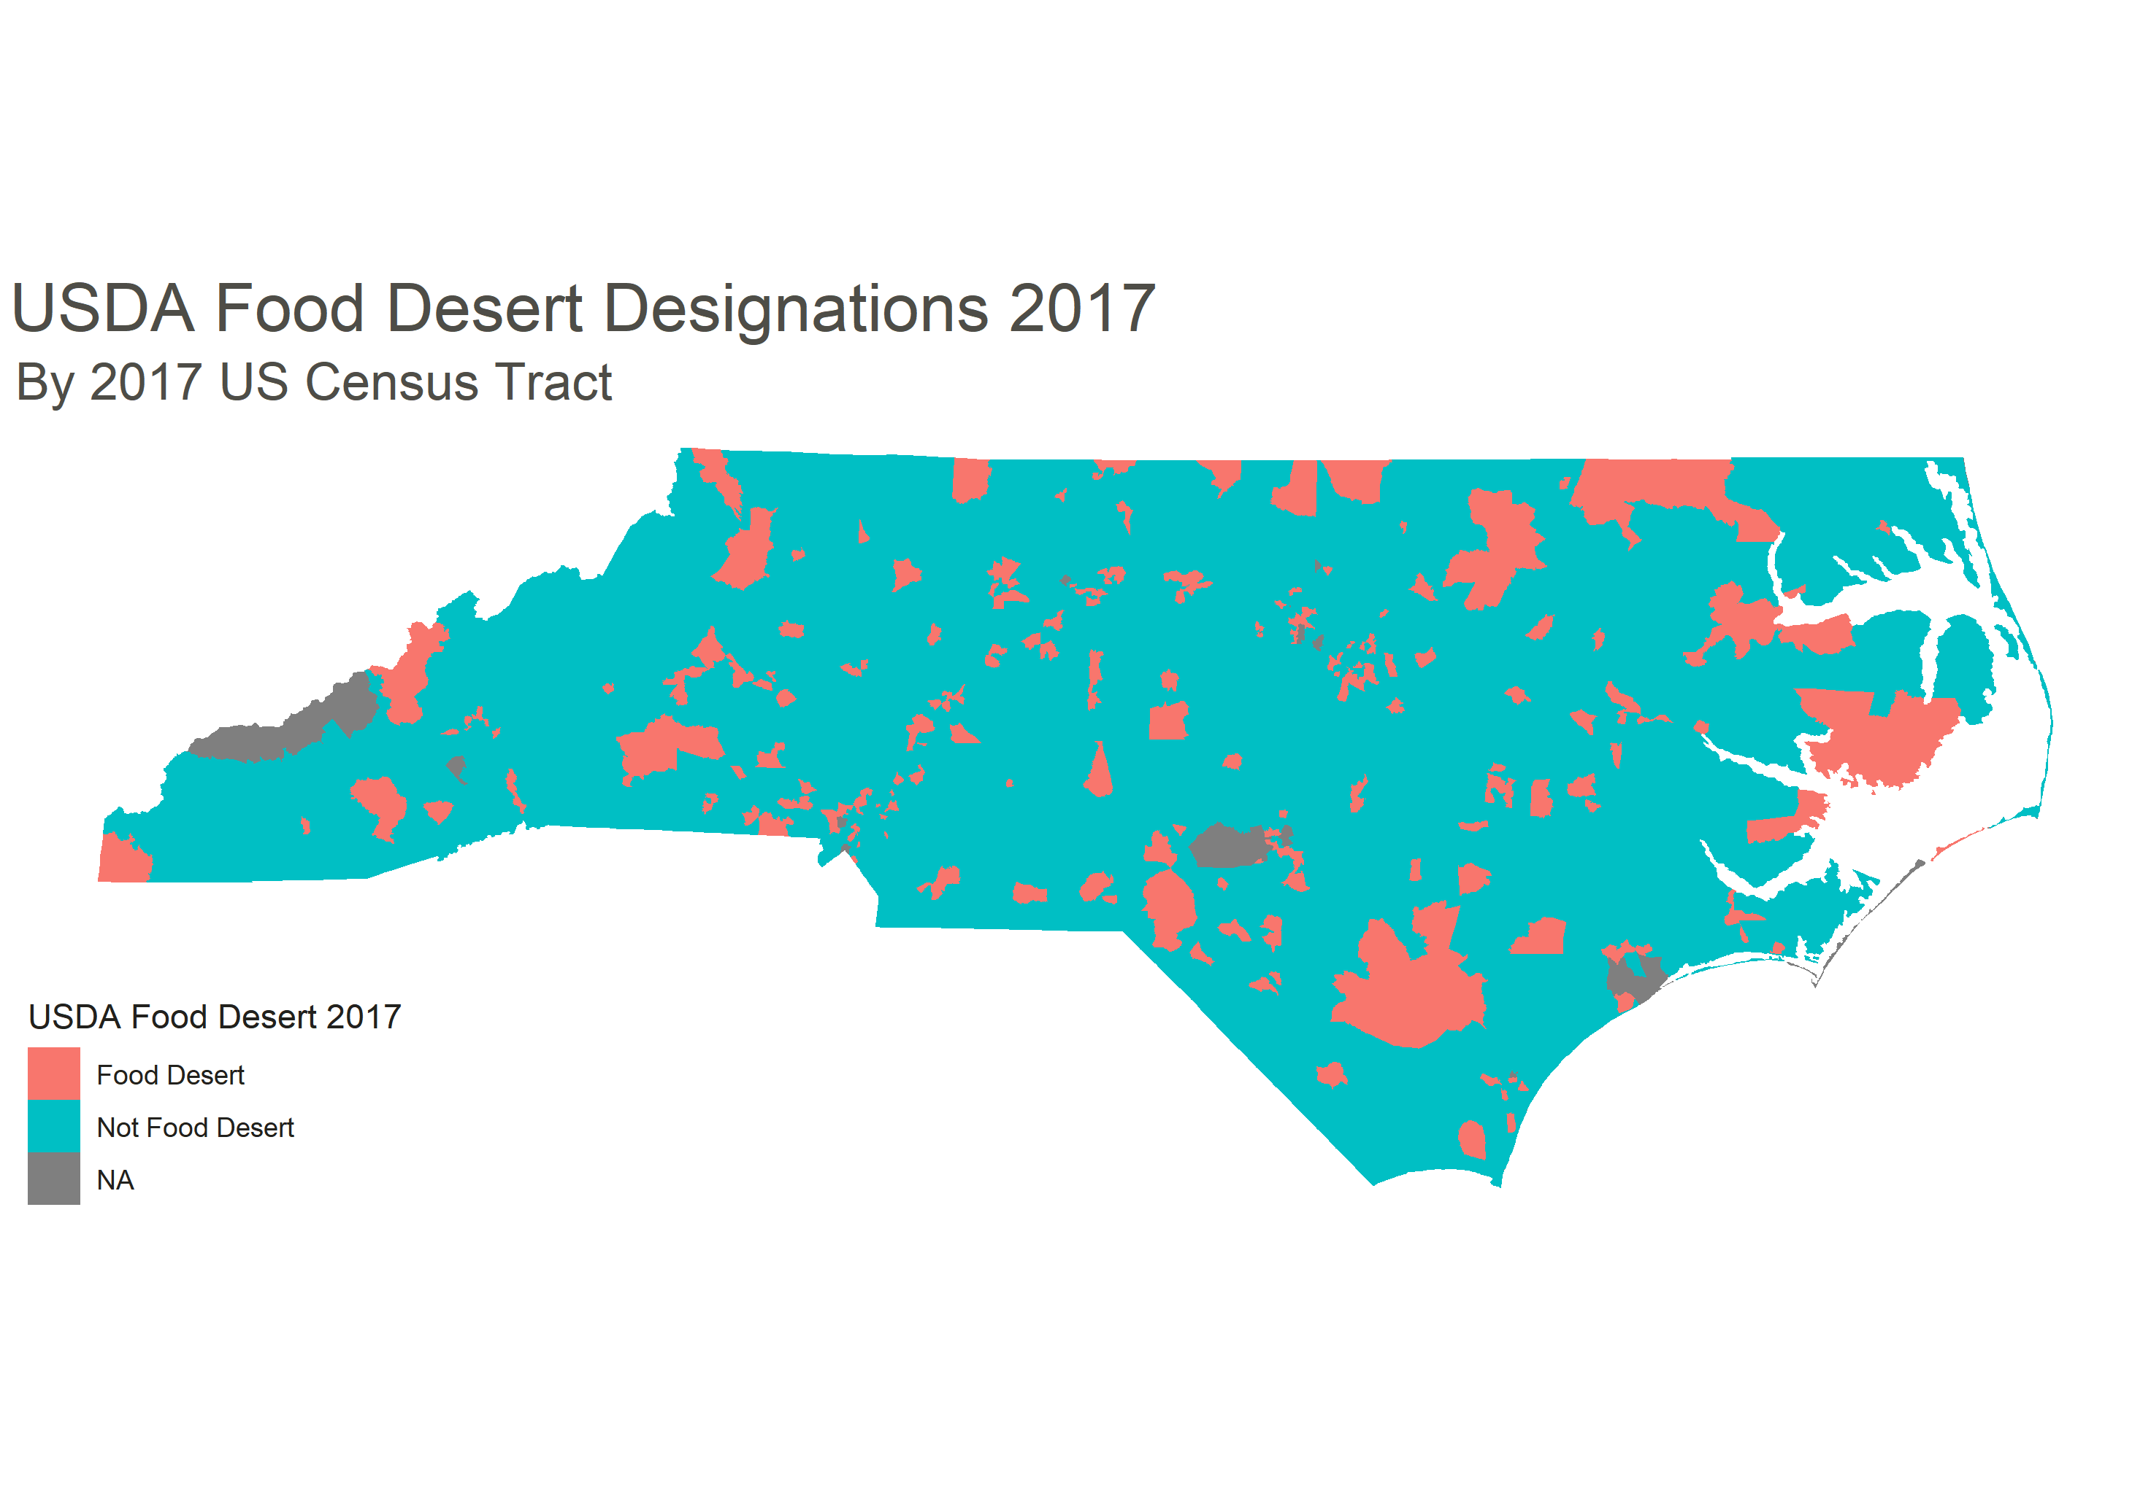
USDA Food Desert Designations 2017³

Slide 10
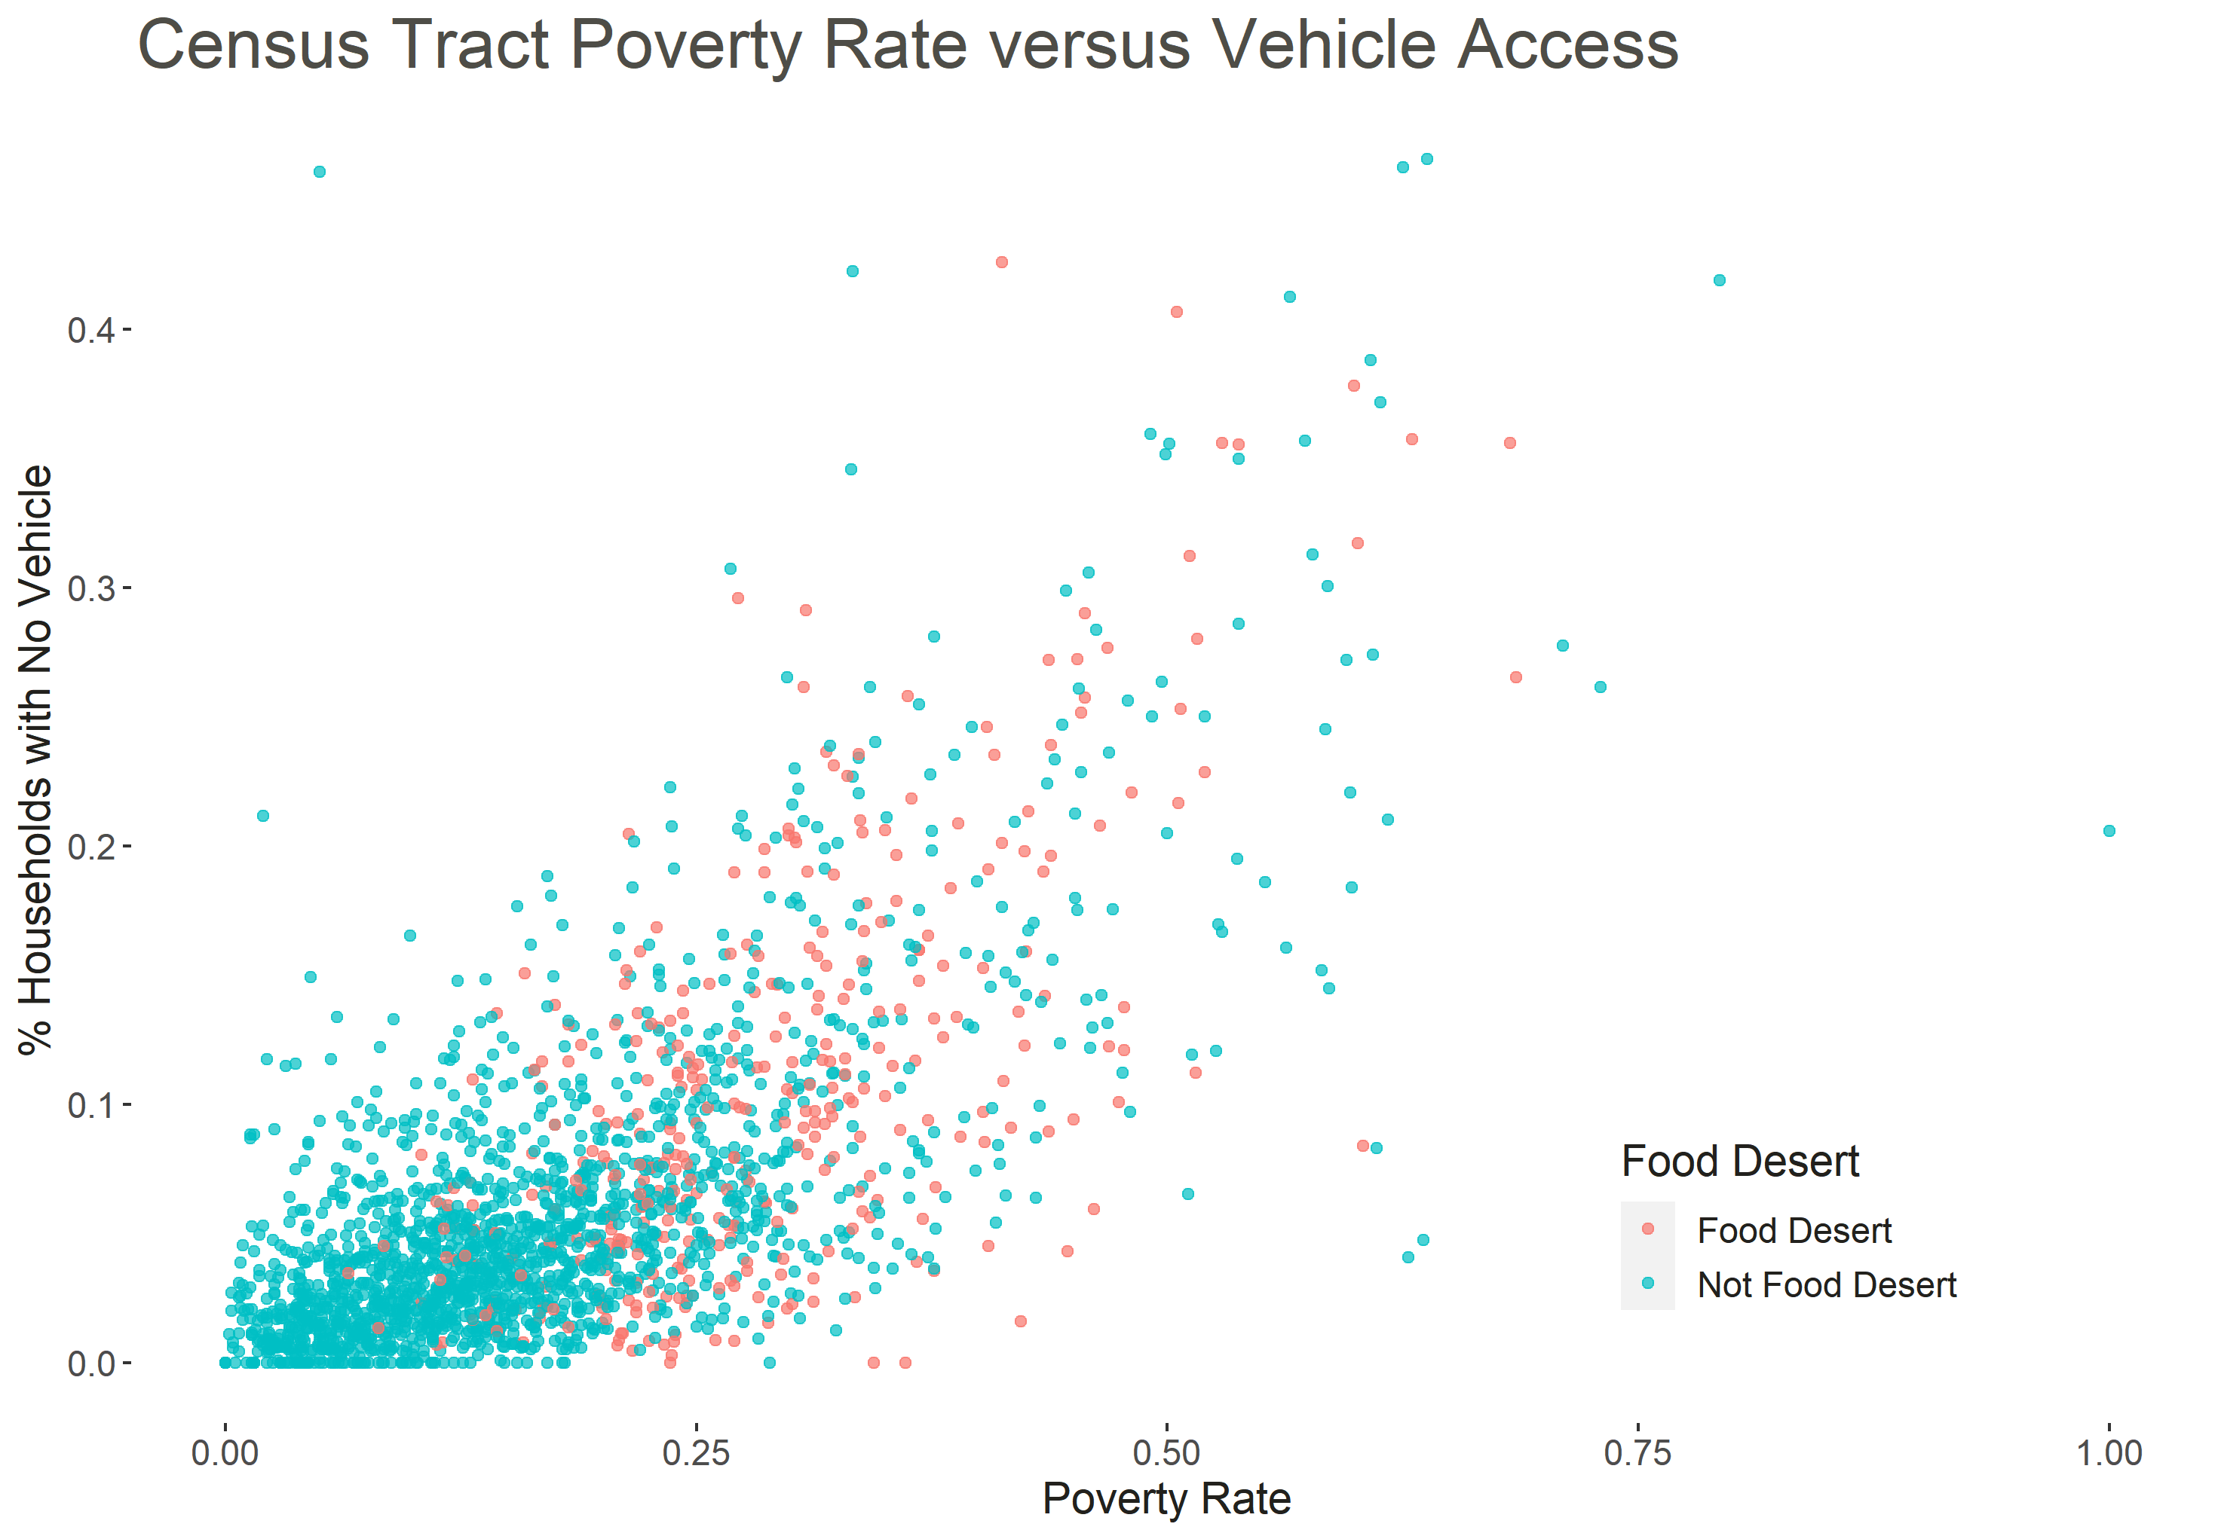
Economic Injustice: Income
As listed in [2], poverty is correlated with the percentage of households without access to a vehicle.
North Carolina tract data demonstrates a correlation of r = 0.7 between graphed variables.
Food deserts become more common when >25% of a census tract lives in poverty and >10% have no access to a vehicle.
These two variables alone cannot perfectly define food deserts, so variation exists.

Slide 11
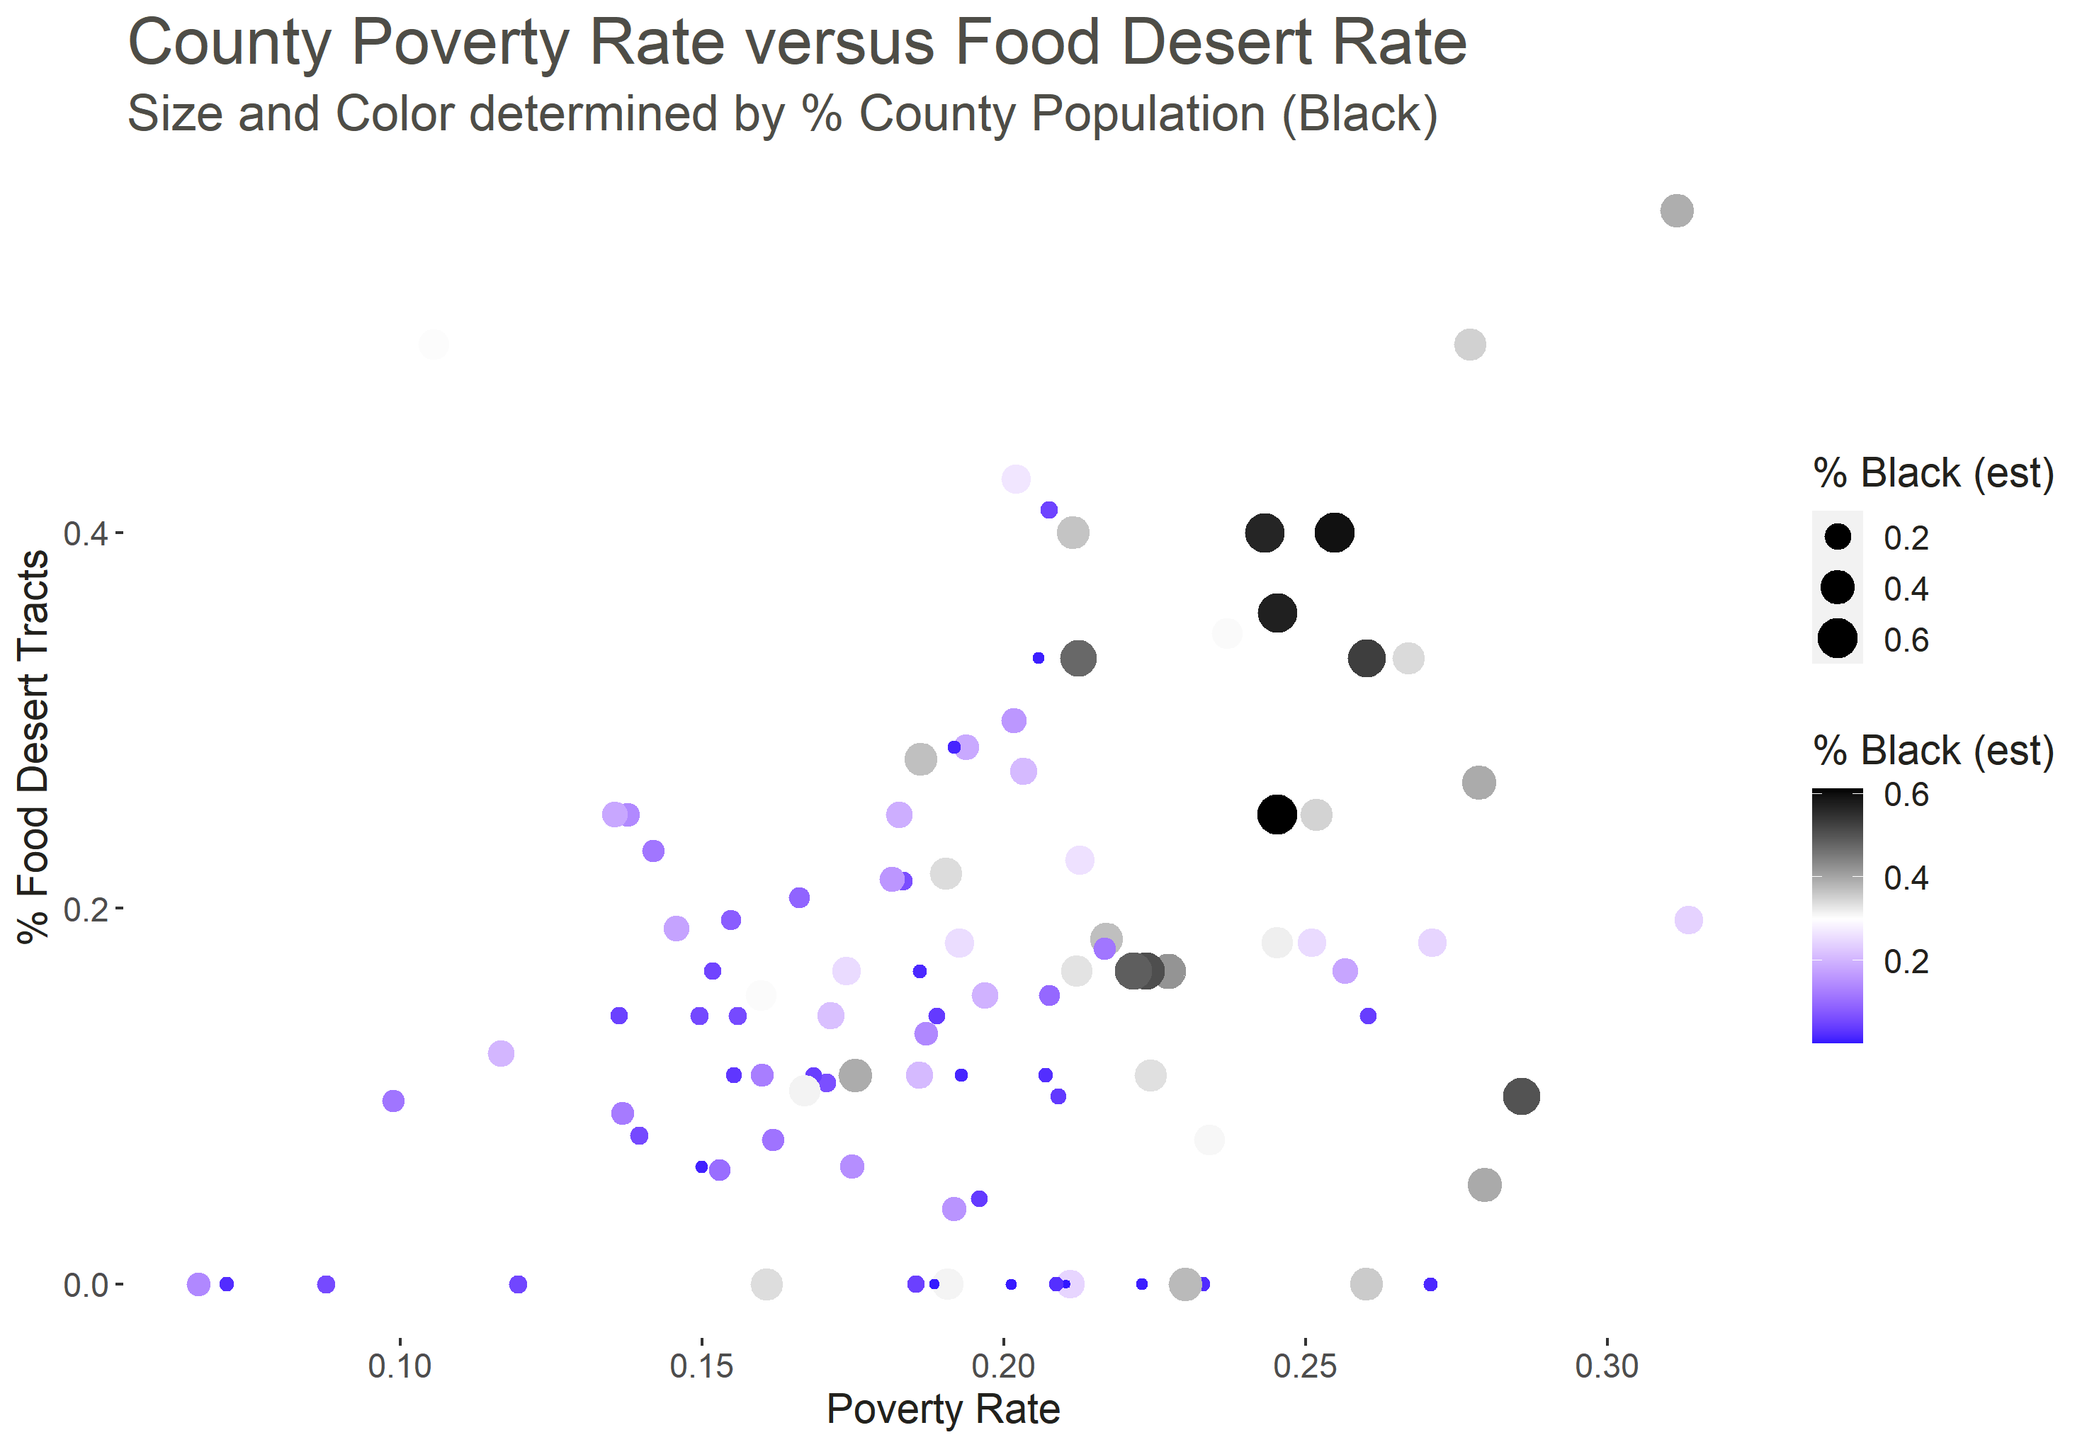
Economic Injustice: Race
Research debates the effect of race on food desertification¹.
North Carolina has a mix of food desert counties between whites and blacks. However, some of the blackest counties have the highest percentage of food desert tracts and vice-versa.
Including race metrics into model can cause algorithmic bias. Correlation does not equal causation.
Percentages are affected by the total number of tracts in a county.
Note

Slide 12
Modelling Food Desert Designations
1. Multivariate Analysis
2. Feature Selection
2. Compare Models
3. Finalize Model
Evaluate variables’ predictive capability with graphs and summary statistics.
Goal: Inform the overall modelling process (effect direction, effect size, multicollinearity).
Algorithmically evaluate variables’ capability with predictive models.
Goal: Shortened list of variables with proven prediction power alone and in the presence of other variables.
Define predictive model structures with the shortened list of variables.
Goal: Determine a model structure with the best predictive capability.
Validate model, evaluate its performance, and perform prediction.
Goal: A final model for predicting food deserts in NC.

Slide 13
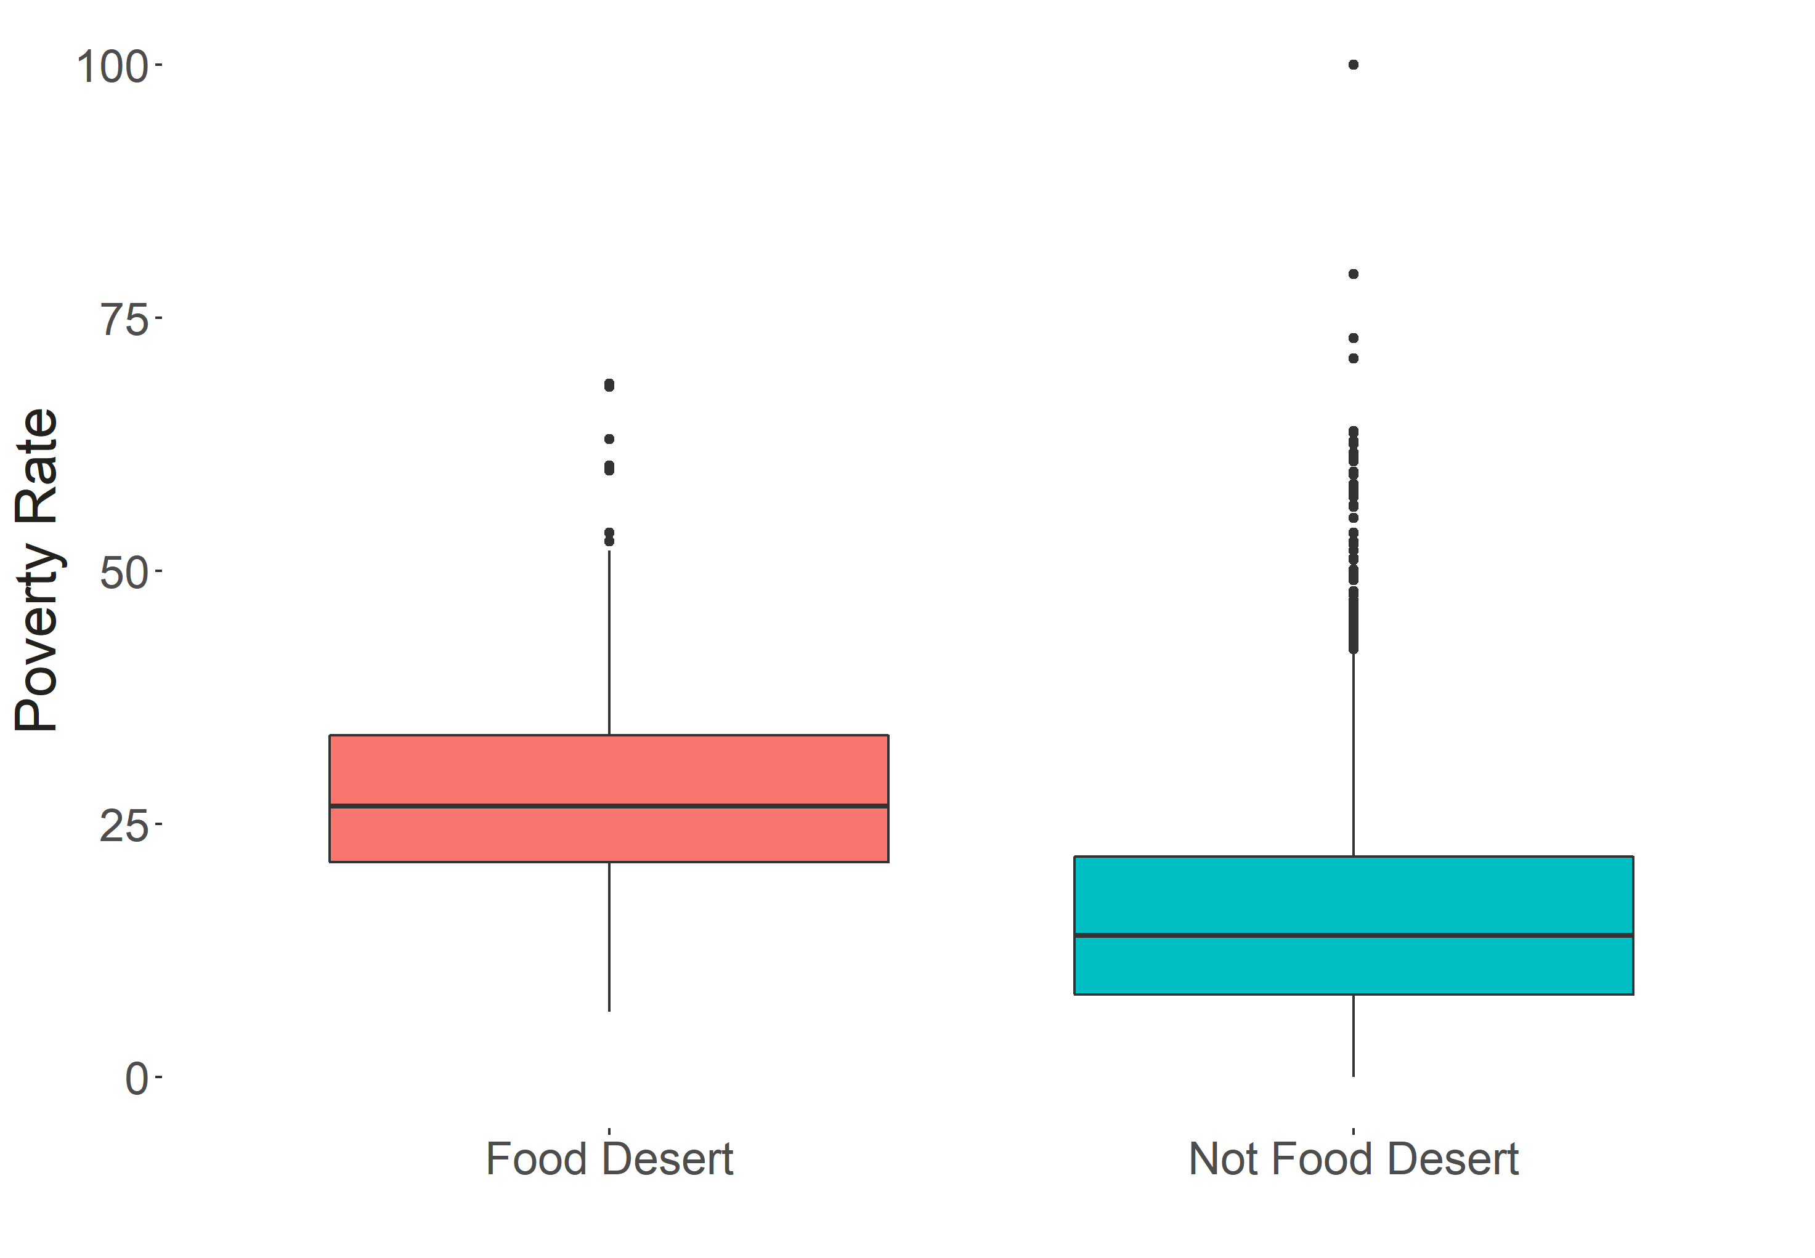
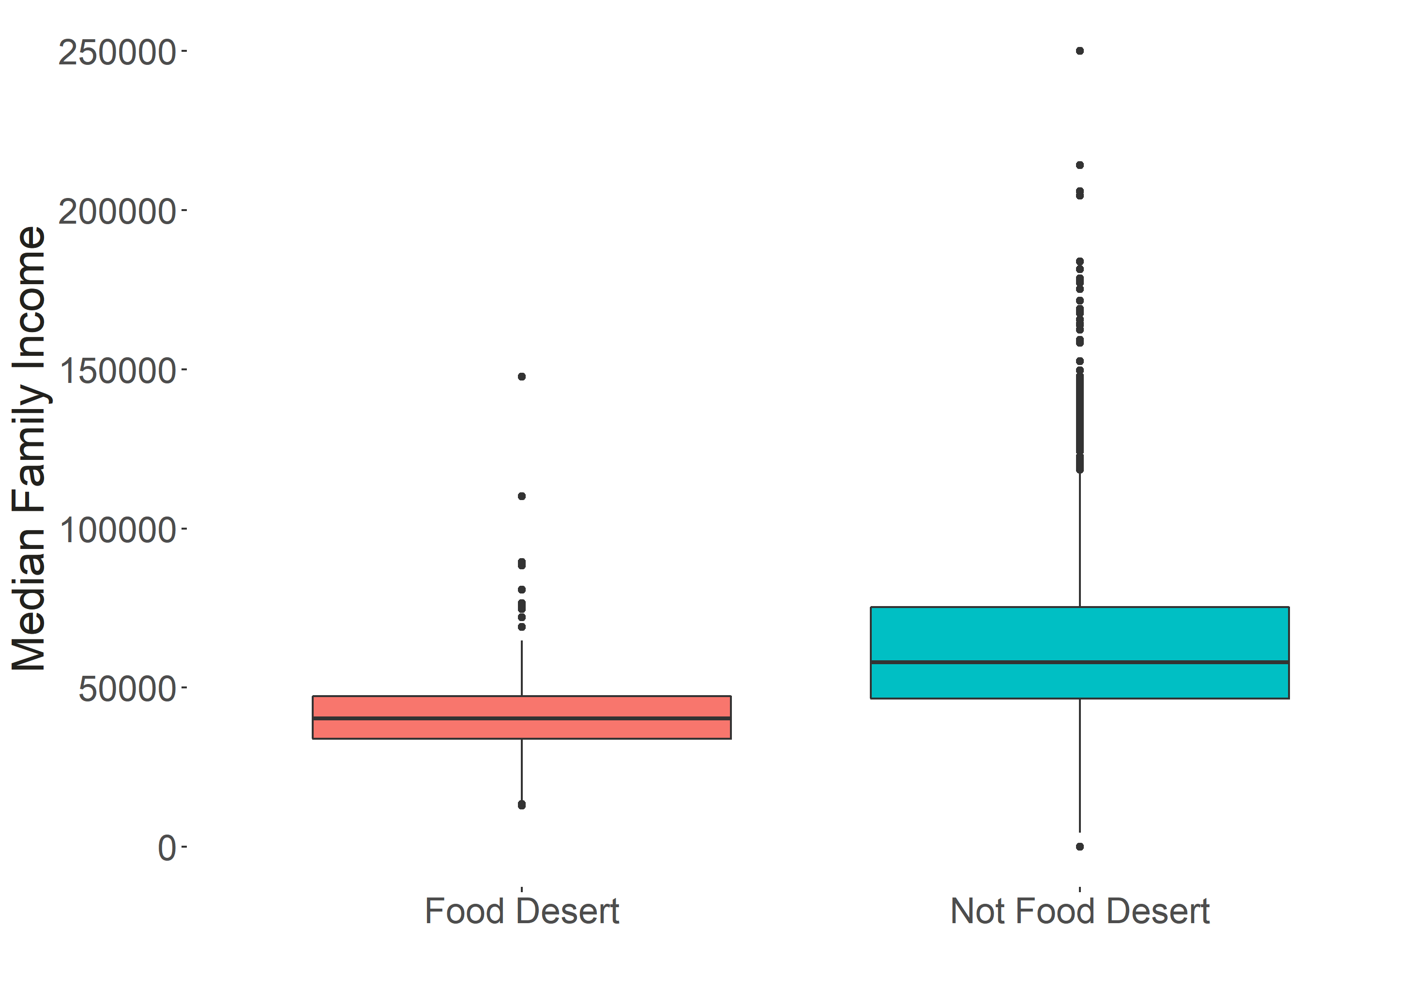
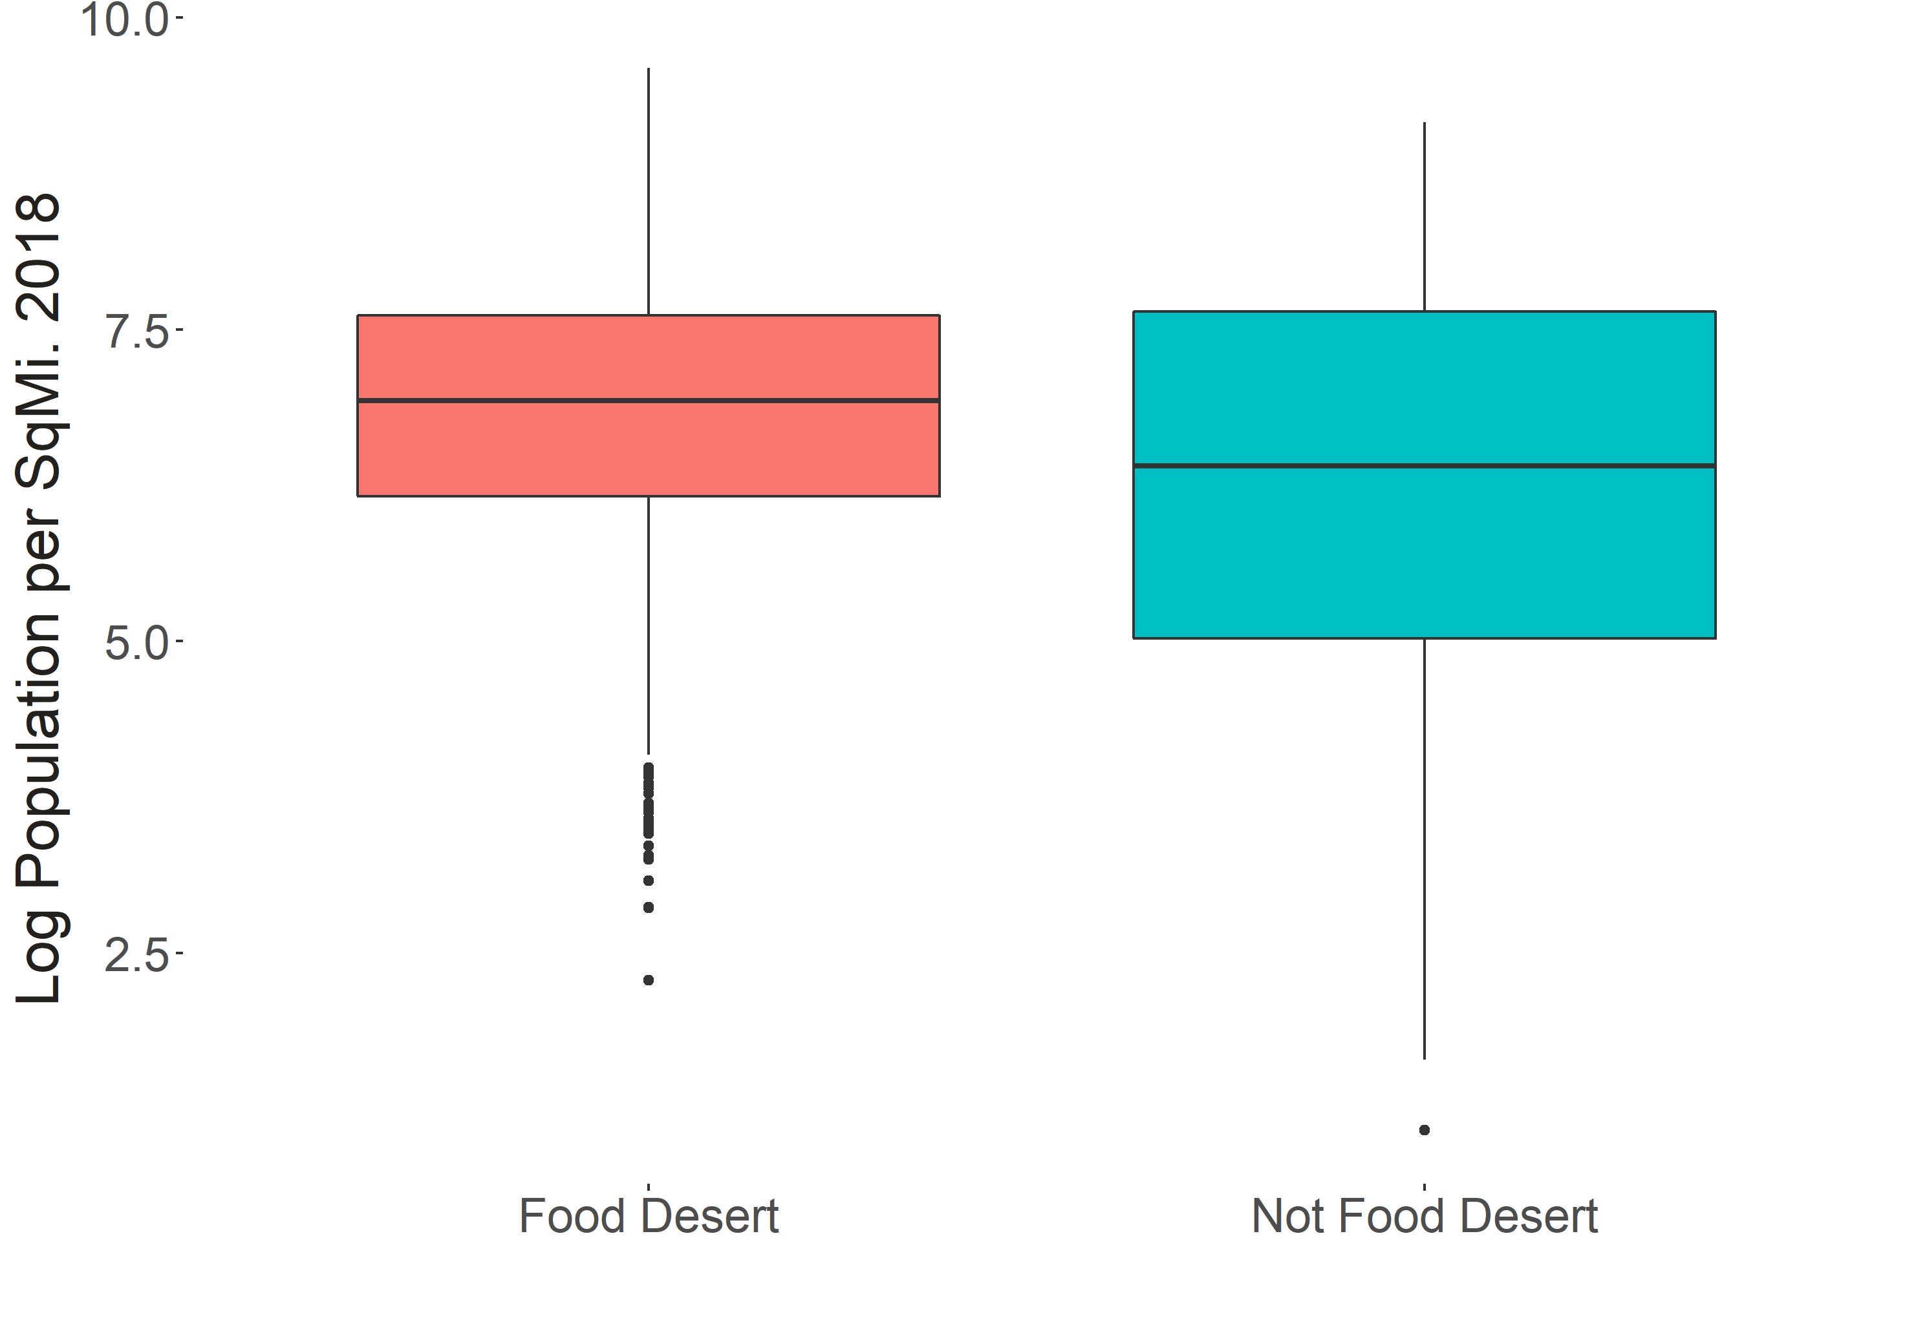
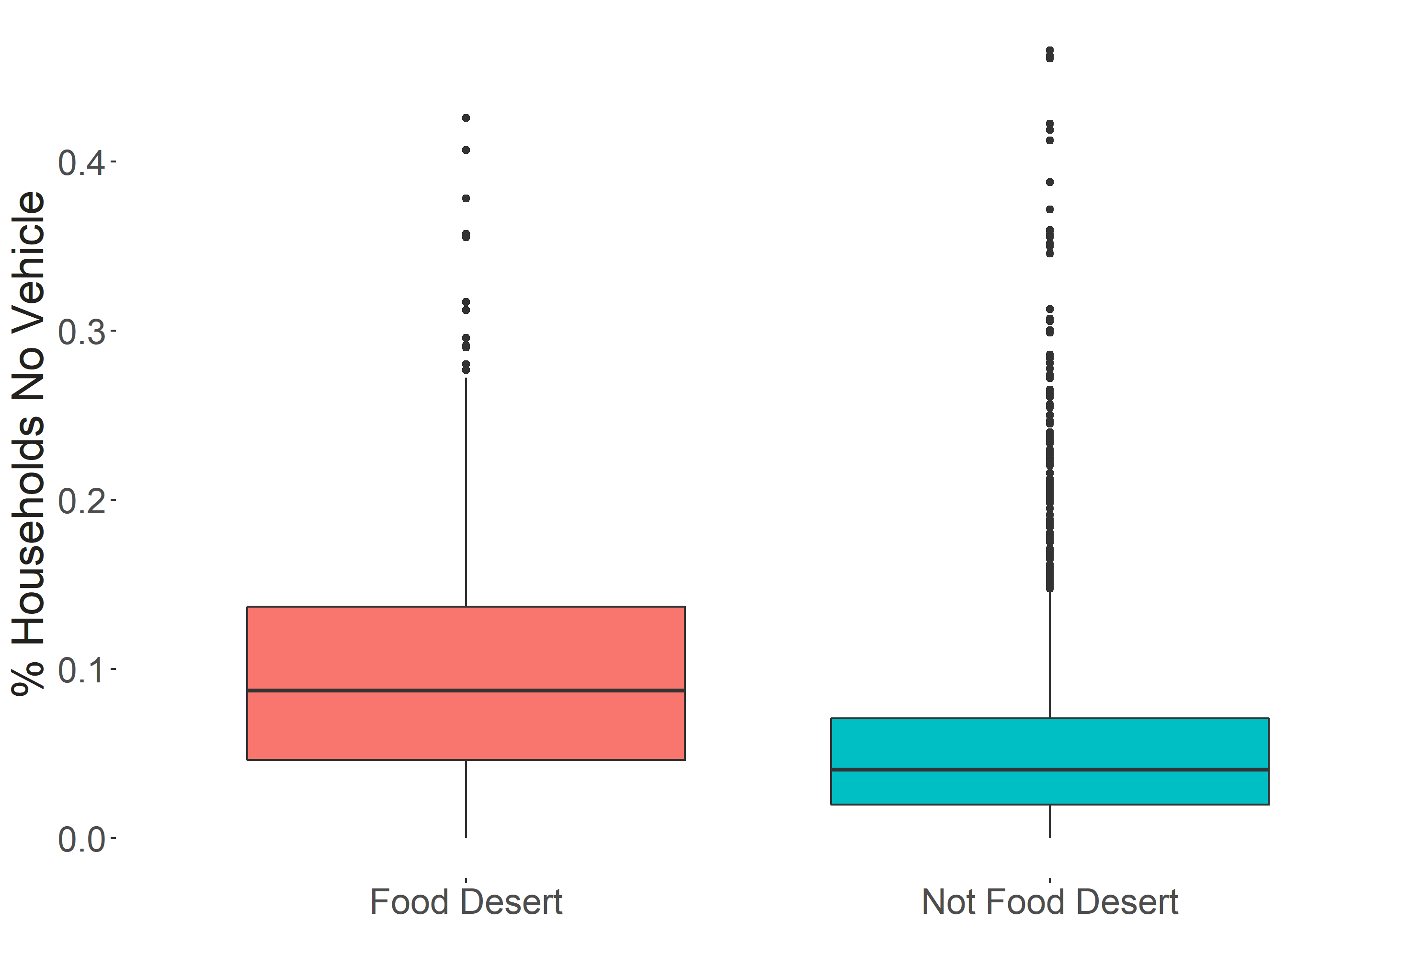
Multivariate Analysis
Multivariate analysis finds differentiators for food deserts.
Four variables shine as differentiators of food deserts:
Poverty rate
Median Family Income
Log Population per Sqmi. 2018 (generated)
% Households No Vehicle
These variables end up carrying through into the final model.
Six variables were generated by combining variables from the given set. This helps find hidden relationships in the data.

Slide 14
Variable Selection
Multiple feature selection processes were performed.
Ten variables selected for final model.
Univariate Logistic Regression
Build a univariate logistic regression for each potential predictor i.e. P(food_desert) = logit(B₀ + B₁x).
Gather the variables’ coefficients and significance level in univariate models.
Filter the selected variables on significance level.
Random Forest Gini Importance
Build bootstrapped decision trees, aggregate their predictions and the average decrease in Gini (G) impurity metric where G = sum(i=1:k, p_{k} * (1 – p_{k})); p_{k} = percent of correct predictions after split for class k.
A larger mean decrease in the Gini metric for a variable indicates more importance to the prediction.
Filter the selected variables on importance.
Manual Selection
Remove variable combinations that are not compatible for interpretation.
For example, Census tract area and county area. Tract area is more specific and relevant to making predictions at the tract level.

Slide 15
Variables Selected
food.desert$medianfamilyincome Median family income of census tract. food.desert$povertyrate Share of the tract population living with income at or below the federal poverty thresholds for family size. ruca.usda$land_area_square_miles_2010 Estimate of land area of tract 2010. log_pop_per_sqmi_est_2018 Generated feature. The natural logarithm of 2018 tract population density (people / square mile). log(vehicles$population2018 / ruca.usda$land_area_square_miles_2010) vehicles$population2018 : Estimate of tract population from 2018 American Community Survey. vehicles$pct_hhold_2plus_veh Estimated percentage of households in tract with 2 or more vehicles. vehicles$pct_hhold_no_veh Estimated percentage of households in tract with no vehicle. | ruca.usda$primary_ruca_code_2010 Primary Rural-Urban Commuting Area 2010 (See “Appendix 3: RUCA Code Definitions" for further description). convs14_per_1k_capita Generated feature. The 2014 estimated number of convenience stores per 1,000 people in county. (food.desert$population_estimate_2014 / 1e3) / stores$ convs14 food.desert$population_estimate_2014 : Estimate of county population from 2014 American Community Survey. stores$convs14: Count of convenience stores in county 2014. groc14_per_1k_capita Generated feature. The 2014 estimated number of grocery stores per 1,000 people in county. (food.desert$population_estimate_2014 / 1e3) / stores$groc14 stores$groc14: Count of grocery stores in county 2014. mean_change_pop Generated feature. The average year-over-year change in population for a tract between 2010 and 2016. mean(sum(i = 2011:2016, population.population_estimate_[i] – population.population_estimate_[i – 1]))
Legend
dataset$variable

Slide 16
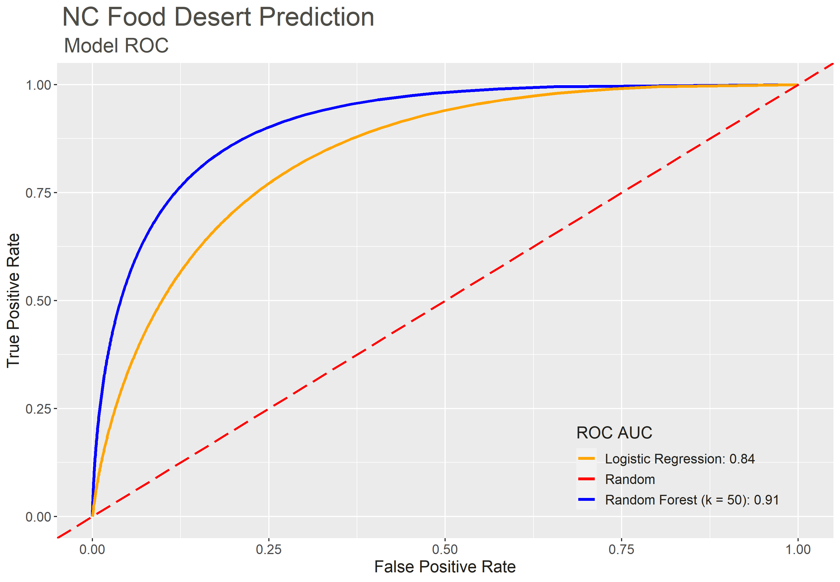
Model Comparison: ROC
X-axis: False Positive Rate: The percent of tracts incorrectly predicted as a food desert (“false alarm”).
Y-axis: True Positive Rate: The percent of tracts correctly predicted as a food desert.
The area under the curve (AUC) for the Random Forest (k = 50) is 0.91, signaling strong performance on the test set.
Random Forest (k = 50) recalls >50% of the food deserts within the first 10% of the data. This indicates it is doing very well at giving food deserts high scores.
Real-world performance is not guaranteed.
Note

Slide 17
Model Comparison: Tradeoffs
Model Comparison
Logistic Regression | Random Forest
Variable effects on food desert designation are interpretable. Coefficients give the direction and magnitude. | Somewhat interpretable. A single decision tree is interpretable.
Only finds linear relationships, so non-linear information will not be used without more tweaking. | USDA food desert designations are rule based and a decision tree will find those rules.
Performance could improve. | Performance is already excellent.

Slide 18
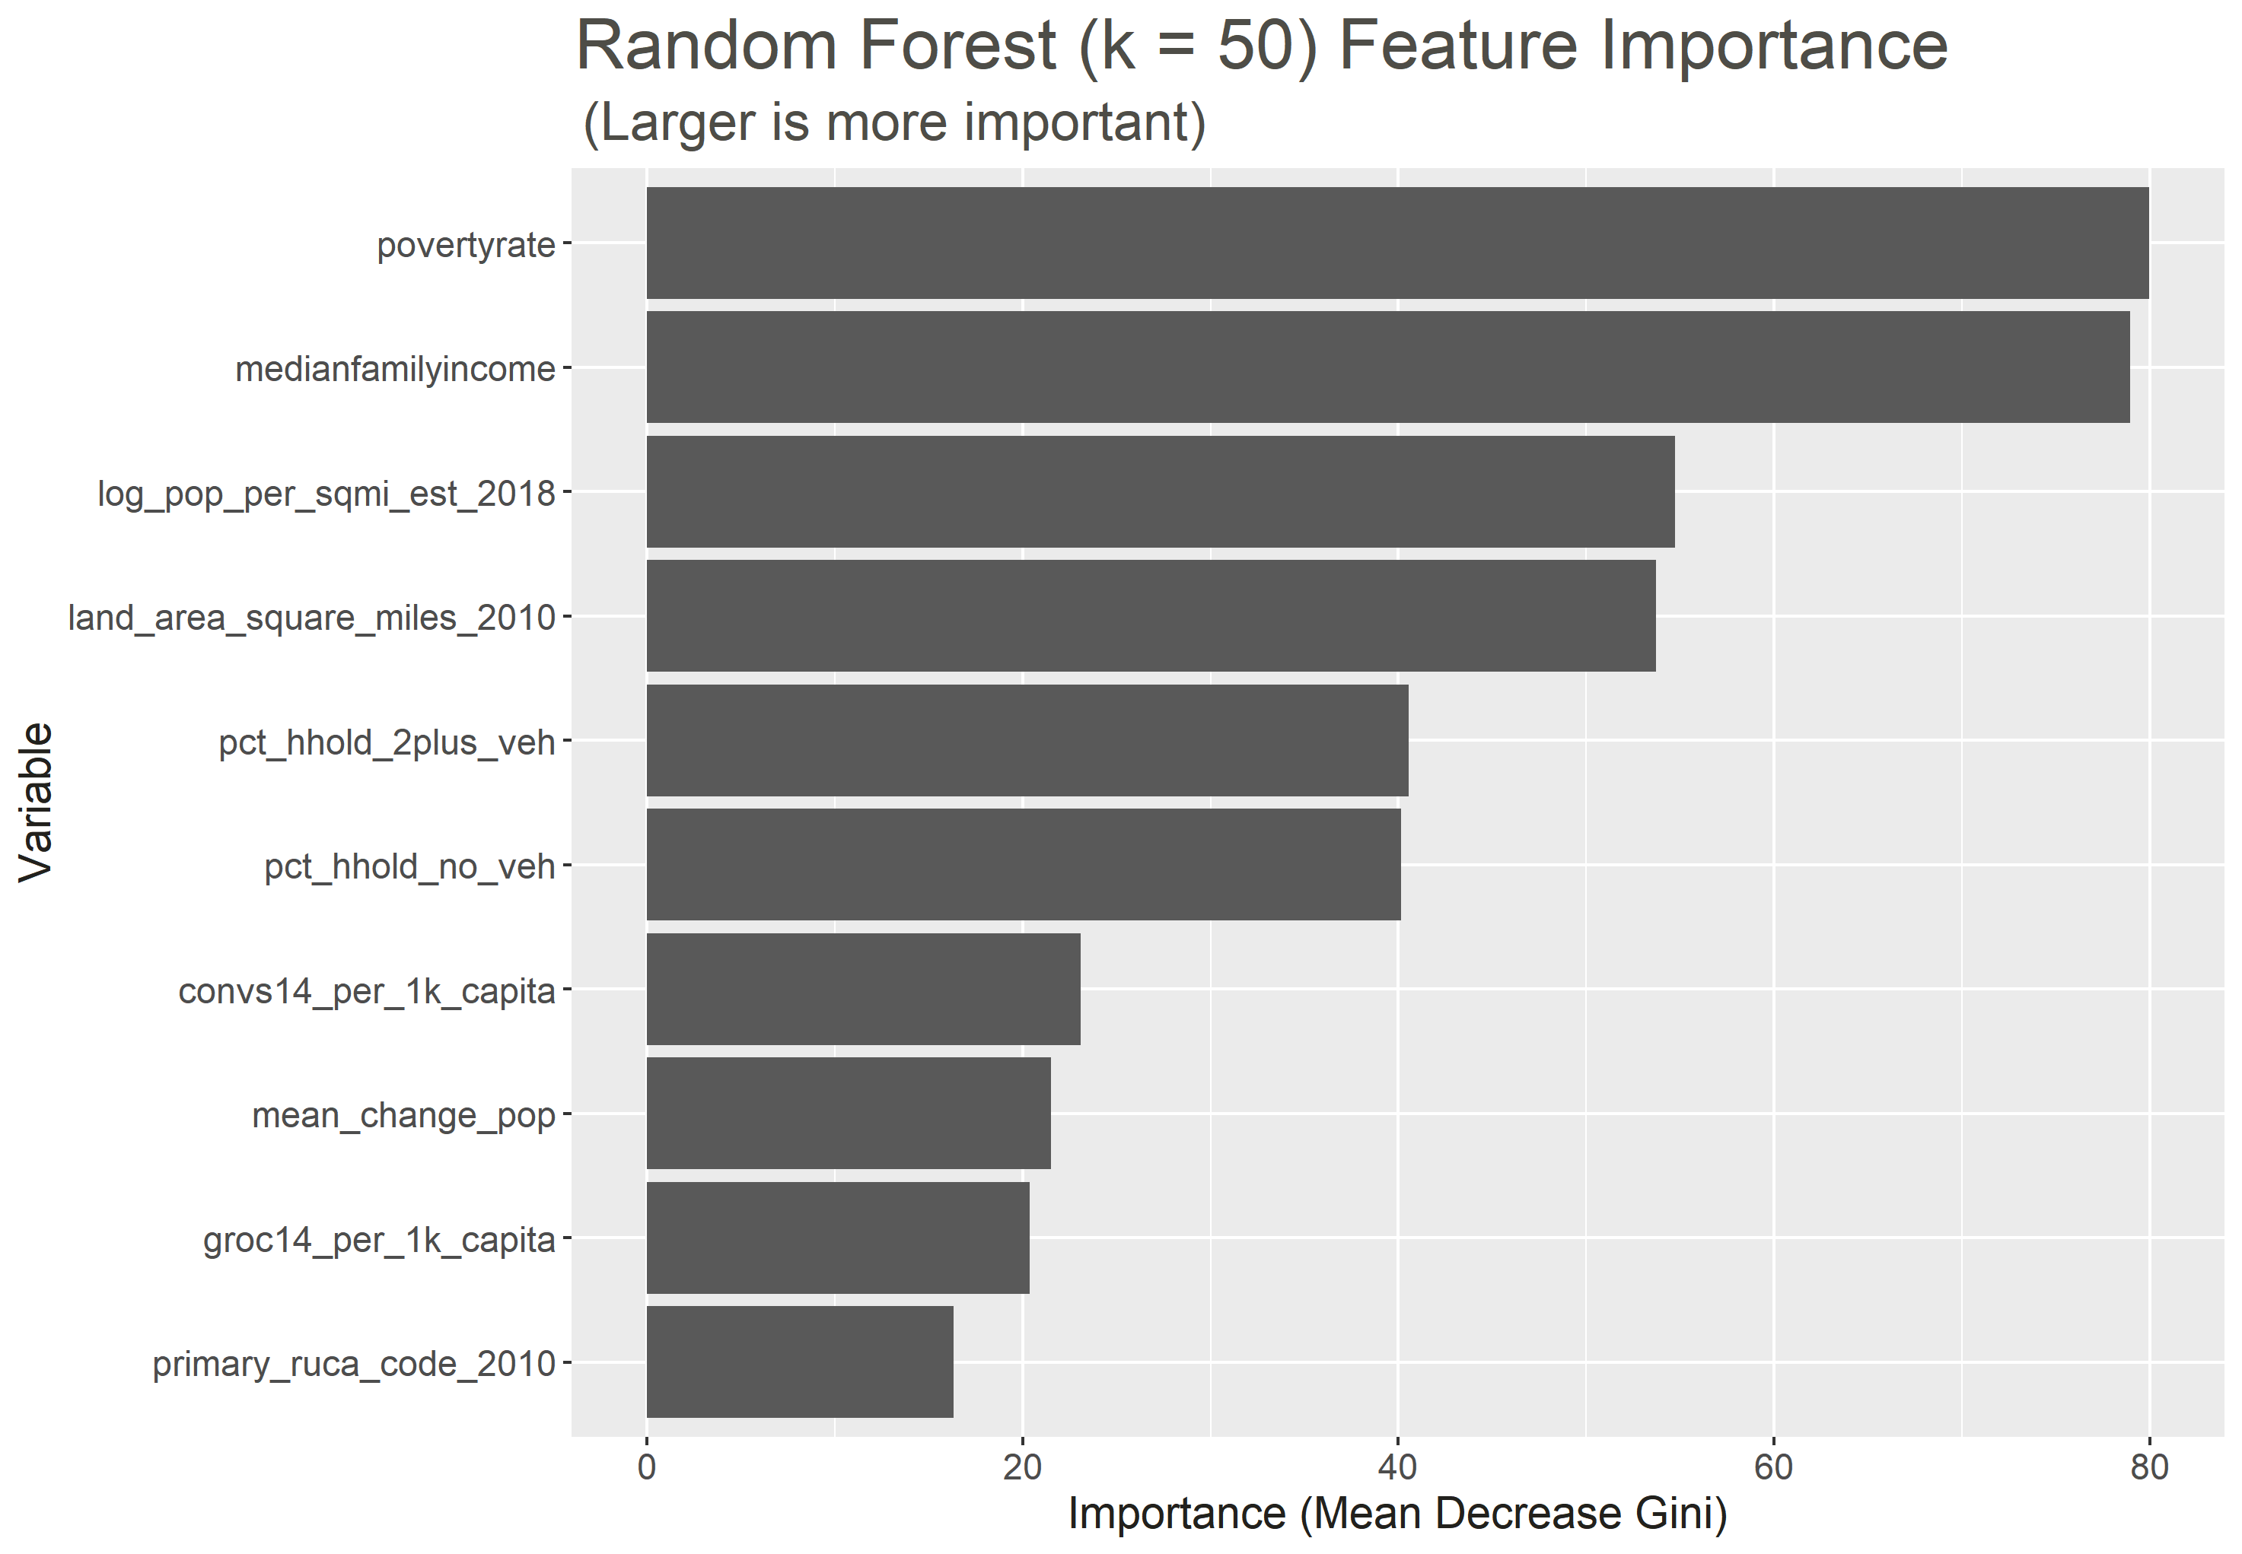
Variable Importance
The same four variables visualized in boxplots during multivariate analysis are selected with high importance.
Vehicle access and poverty are both listed by the USDA² as being a factor to food desert designation.
Importance value is relative to other variables. The importance magnitude is not comparable across models.
Correlated variables have similar importance.

Slide 19
Assumptions, Limitations, & Next Steps
Assumptions
Data is presented as-is.
Changes to Census tracts over the years is not detrimental to model and analysis.
Limitations
Geographic level of data is not even. Tract-level data would be best for interpretation.
Some data are not up to date. Census data is old.
Evaluating variables from different years can have confounding effects.
Having the number of grocery/supercenter/convenience/specialty stores at the tract level may help prediction.
One week turnaround.
Next Steps
Validate code.
Tweak model parameters.
Add more predictive model types.
Estimate model uncertainty.
New Hanover deep dive.

Slide 20
Appendices
Appendix 1: Logistical Model Specifications
Appendix 2: Prediction Overview
Appendix 3: RUCA Code Definitions

Slide 21
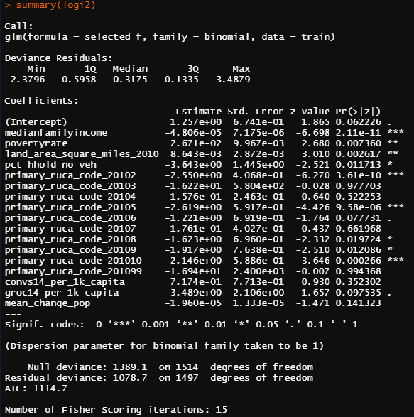
Appendix 1: Logistic Model Specifications

Slide 22
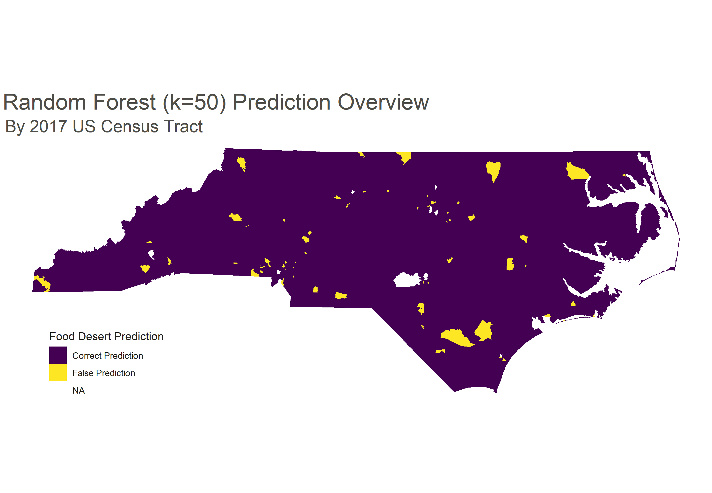
Appendix 2: Prediction Overview³
72 / 367 (19.6%) training Census tracts are incorrectly predicted with the final random forest model. Given the class imbalance (16.8%), the model could increase its performance with a looser threshold on the number of votes or probability needed to call a prediction.

Slide 23
Appendix 3: RUCA Code Definitions
Primary RUCA Codes, 2010
1 Metropolitan area core: primary flow within an urbanized area (UA)
2 Metropolitan area high commuting: primary flow 30% or more to a UA
3 Metropolitan area low commuting: primary flow 10% to 30% to a UA
4 Micropolitan area core: primary flow within an Urban Cluster of 10,000 to 49,999 (large UC)
5 Micropolitan high commuting: primary flow 30% or more to a large UC
6 Micropolitan low commuting: primary flow 10% to 30% to a large UC
7 Small town core: primary flow within an Urban Cluster of 2,500 to 9,999 (small UC)
8 Small town high commuting: primary flow 30% or more to a small UC
9 Small town low commuting: primary flow 10% to 30% to a small UC
10 Rural areas: primary flow to a tract outside a UA or UC
99 Not coded: Census tract has zero population and no rural-urban identifier information

