Slide 1

Enrichment Budget
Optimizer
A Genetic Algorithm for Lead Allocation
Enrique Perezalonso | IFSA CS38-09 | April 2026

Slide 2

The Problem
Hermes SDR Pipeline
Hermes scrapes leads from Google Places (FL brokerages, insurance, finance), enriches each via Gemini Flash LLM, and sends personalized cold emails.
The bottleneck:
Each enrichment costs ~$0.002 and 30% of leads fail (no email found). With a tight daily budget, FIFO ordering wastes money on low-value leads.
Core Question
Given N leads with estimated values and costs, and a fixed daily budget B, which subset should we enrich to maximize total expected value?
$0.002
per enrichment call
~30%
of leads fail enrichment
200
leads in daily pool

Slide 3
0/1 Knapsack Problem
Knapsack | Enrichment Optimizer
Item | A prospected lead
Weight cᵢ | Enrichment cost in dollars
Value vᵢ | Expected value (deal size × reply probability)
Capacity B | Daily enrichment budget
xᵢ ∈ {0,1} | Enrich this lead or skip it
NP-Complete
For 200 leads there are 2²⁰⁰ ≈ 1.6×10⁶⁰ possible subsets — more than atoms in the observable universe.
Two Standard Approaches
Dynamic Programming
Greedy Heuristic
Exact optimum in O(N·B) — pseudo-polynomial. Works when B is small.
Sort by value/cost ratio, fill top-down. O(N log N). Fast but can be arbitrarily bad.

Slide 4


Estimating Lead Value
vᵢ = deal_sizeᵢ × P(replyᵢ)
Expected revenue from enriching and contacting the lead
Deal Size
Reply Probability
$5,000 if employees ≥ 50
$3,000 otherwise
Logistic model with hand-tuned coefficients calibrated to Hermes's observed 5–40% reply rates (mean ~18%).
Features: Google rating (+0.6), log reviews (+0.3), has website (+0.4), is real estate (+0.2)
Coefficients are hand-tuned priors, not learned — will be replaced by a trained model once enough closed deals exist.

Slide 5
The Genetic Algorithm
Chromosome
Defaults
200 bits — bit i = 1 means "enrich lead i"
Fitness = Σvᵢ for selected leads
Overbudget penalty: fitness × 0.01
Population: 50 | Generations: 100
Tournament size: 3 | Elitism: 2
Crossover: 0.8 | Mutation: 0.02
One Generation
1
2
3
4
Elitism
Tournament
Selection
Uniform
Crossover
Mutate &
Repair
Top 2 chromosomes pass unchanged
Sample 3, keep fittest (×2 for parents)
Coin flip per bit, rate 0.8
2% bit-flip; drop low-ratio leads if overbudget

Slide 6

Three Solvers Compared
Greedy
Dynamic Programming
Genetic Algorithm
O(N log N) ~15 lines
O(N · B) ~40 lines
O(G · P · N) ~180 lines
How it works
How it works
How it works
Sort leads by value/cost ratio. Walk down the list, if a lead fits in the remaining budget, take it. Never backtrack.
Build a 2D table of (lead, capacity) pairs. At each cell, decide: take this lead or skip it? Backtrack to reconstruct the solution.
Evolve a population of bit-string solutions over 100 generations using selection, crossover, mutation, and budget repair.
Guarantee
Guarantee
Guarantee
No optimality guarantee in general, but often near-optimal when costs are small relative to budget.
Exact optimum. Provably correct. Fast when B is small.
No formal guarantee, but reaches 99.86% of optimum. Flexible: fitness function can encode any objective.
200 leads: < 0.001s
200 leads: 0.21s
200 leads: 0.15s

Slide 7

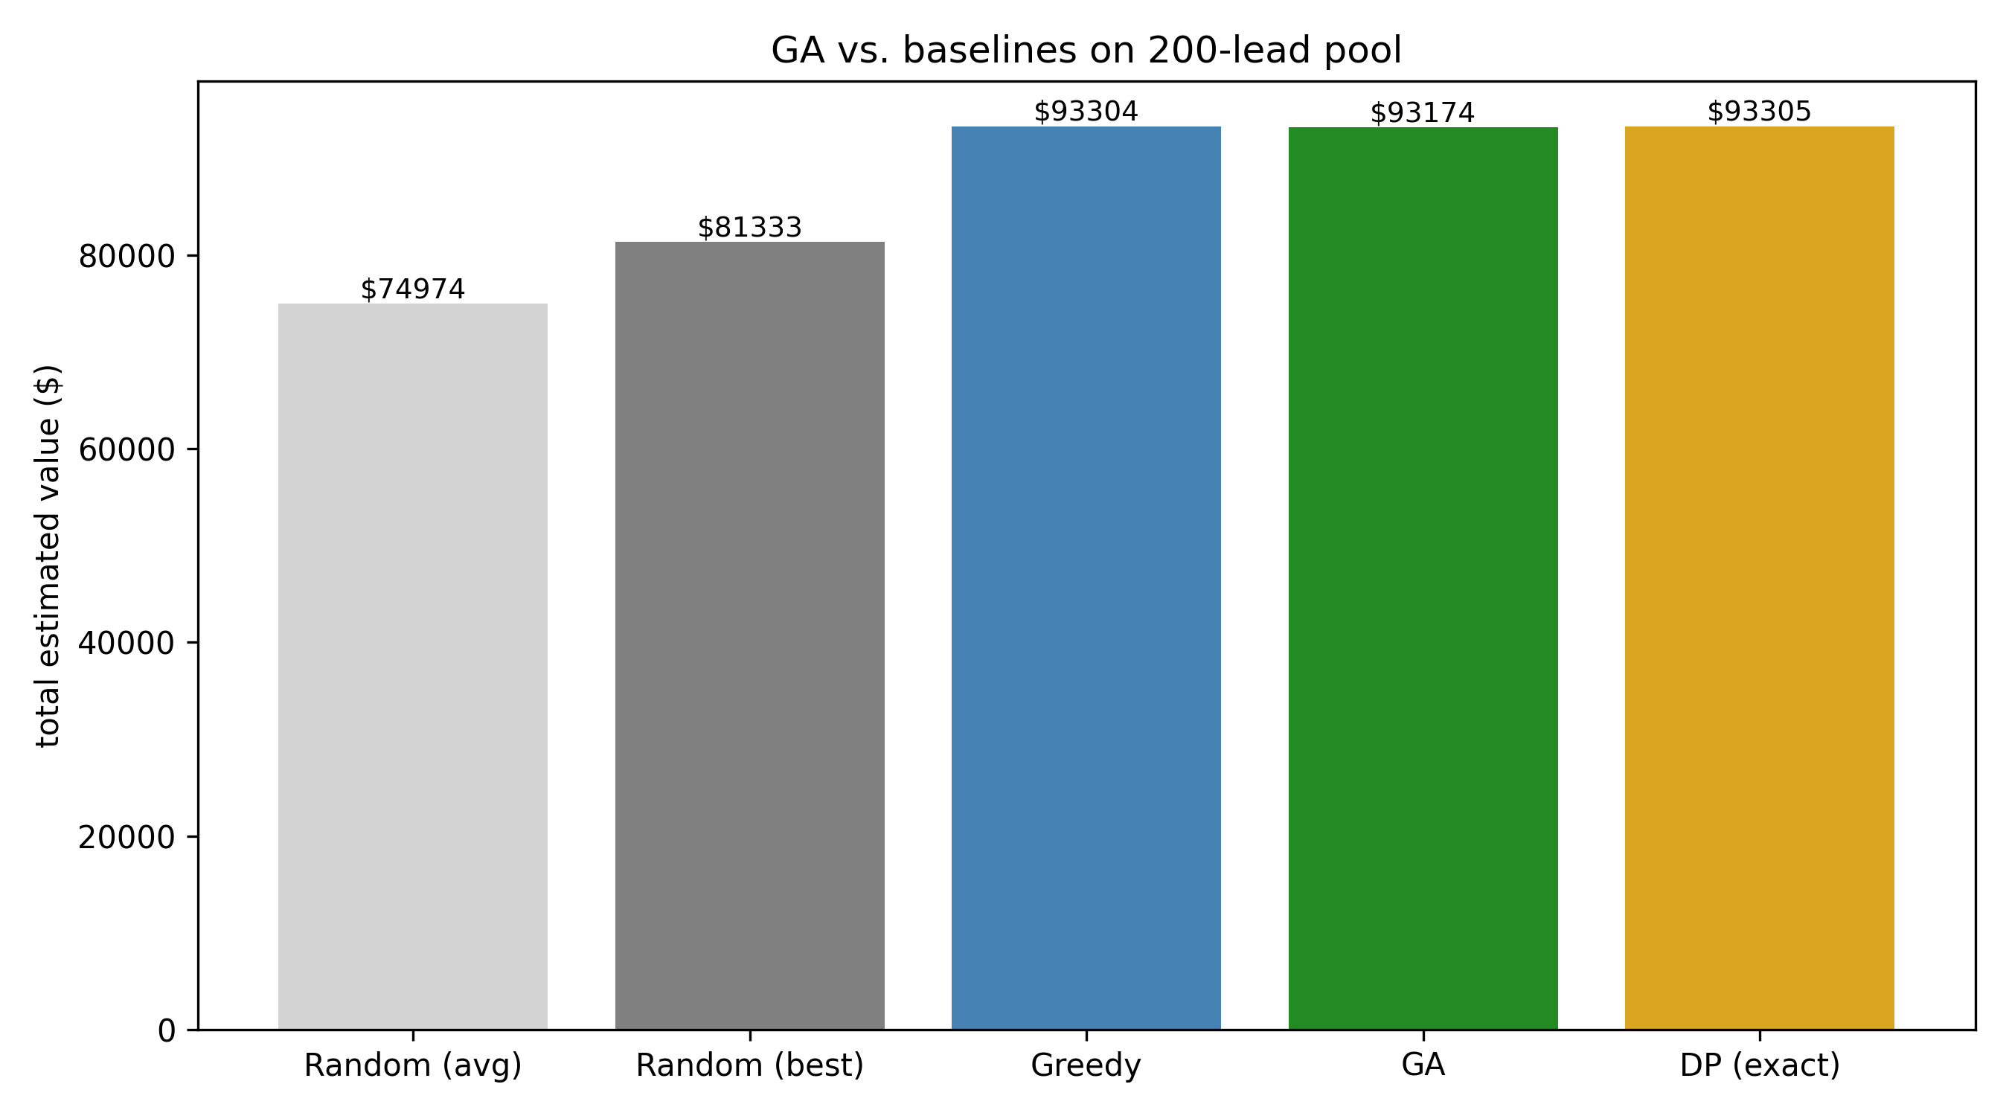
Results: GA vs. Baselines
200-lead pool | Budget = $0.2142 (60% of total pool cost) | Seed 42
Method | Value | % Opt.
Random (avg) | $74,974 | 80.4%
Random (best) | $81,333 | 87.2%
Greedy | $93,304 | 99.99%
GA | $93,174 | 99.86%
DP (exact) | $93,305 | 100.00%
99.86%
of exact optimum
reached by GA
Figure 1

Slide 8
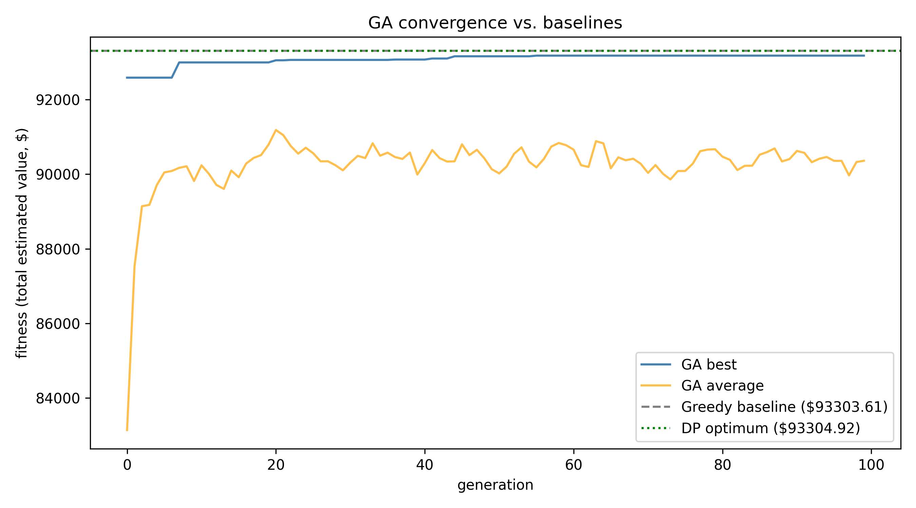
GA Convergence
Key Observations
Best fitness rises sharply in the first few generations, then plateaus near the DP optimum.
Population average is noisier — mutation perturbs non-elite members.
Warm start matters: 20% of initial population seeded from greedy solution with random bit flips.
Figure 2

Slide 9

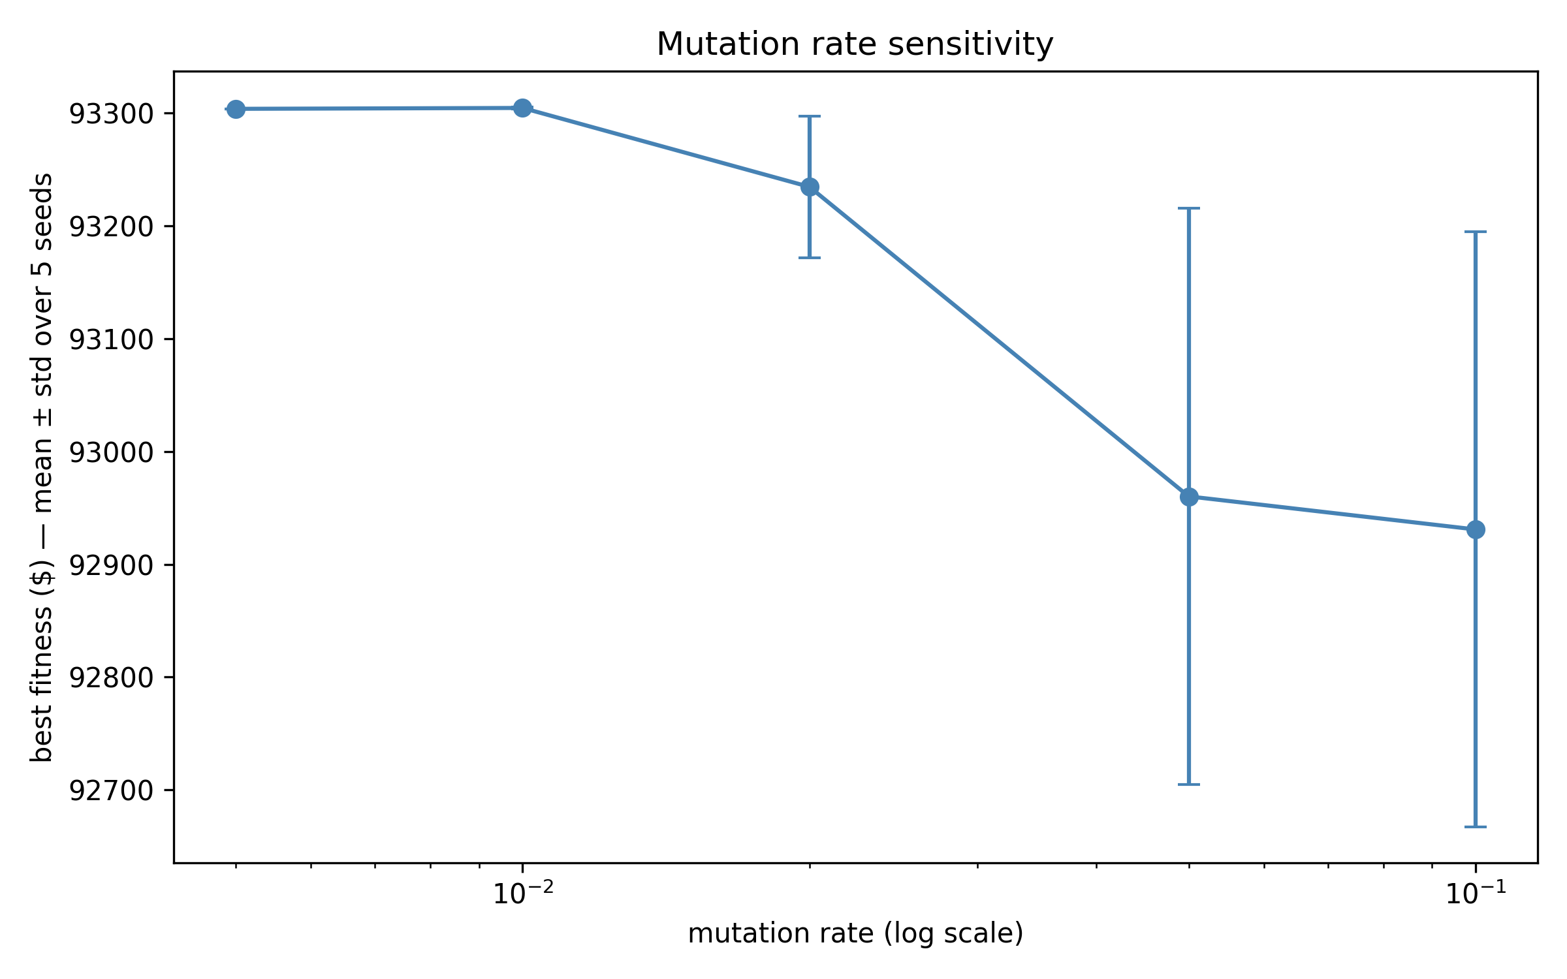
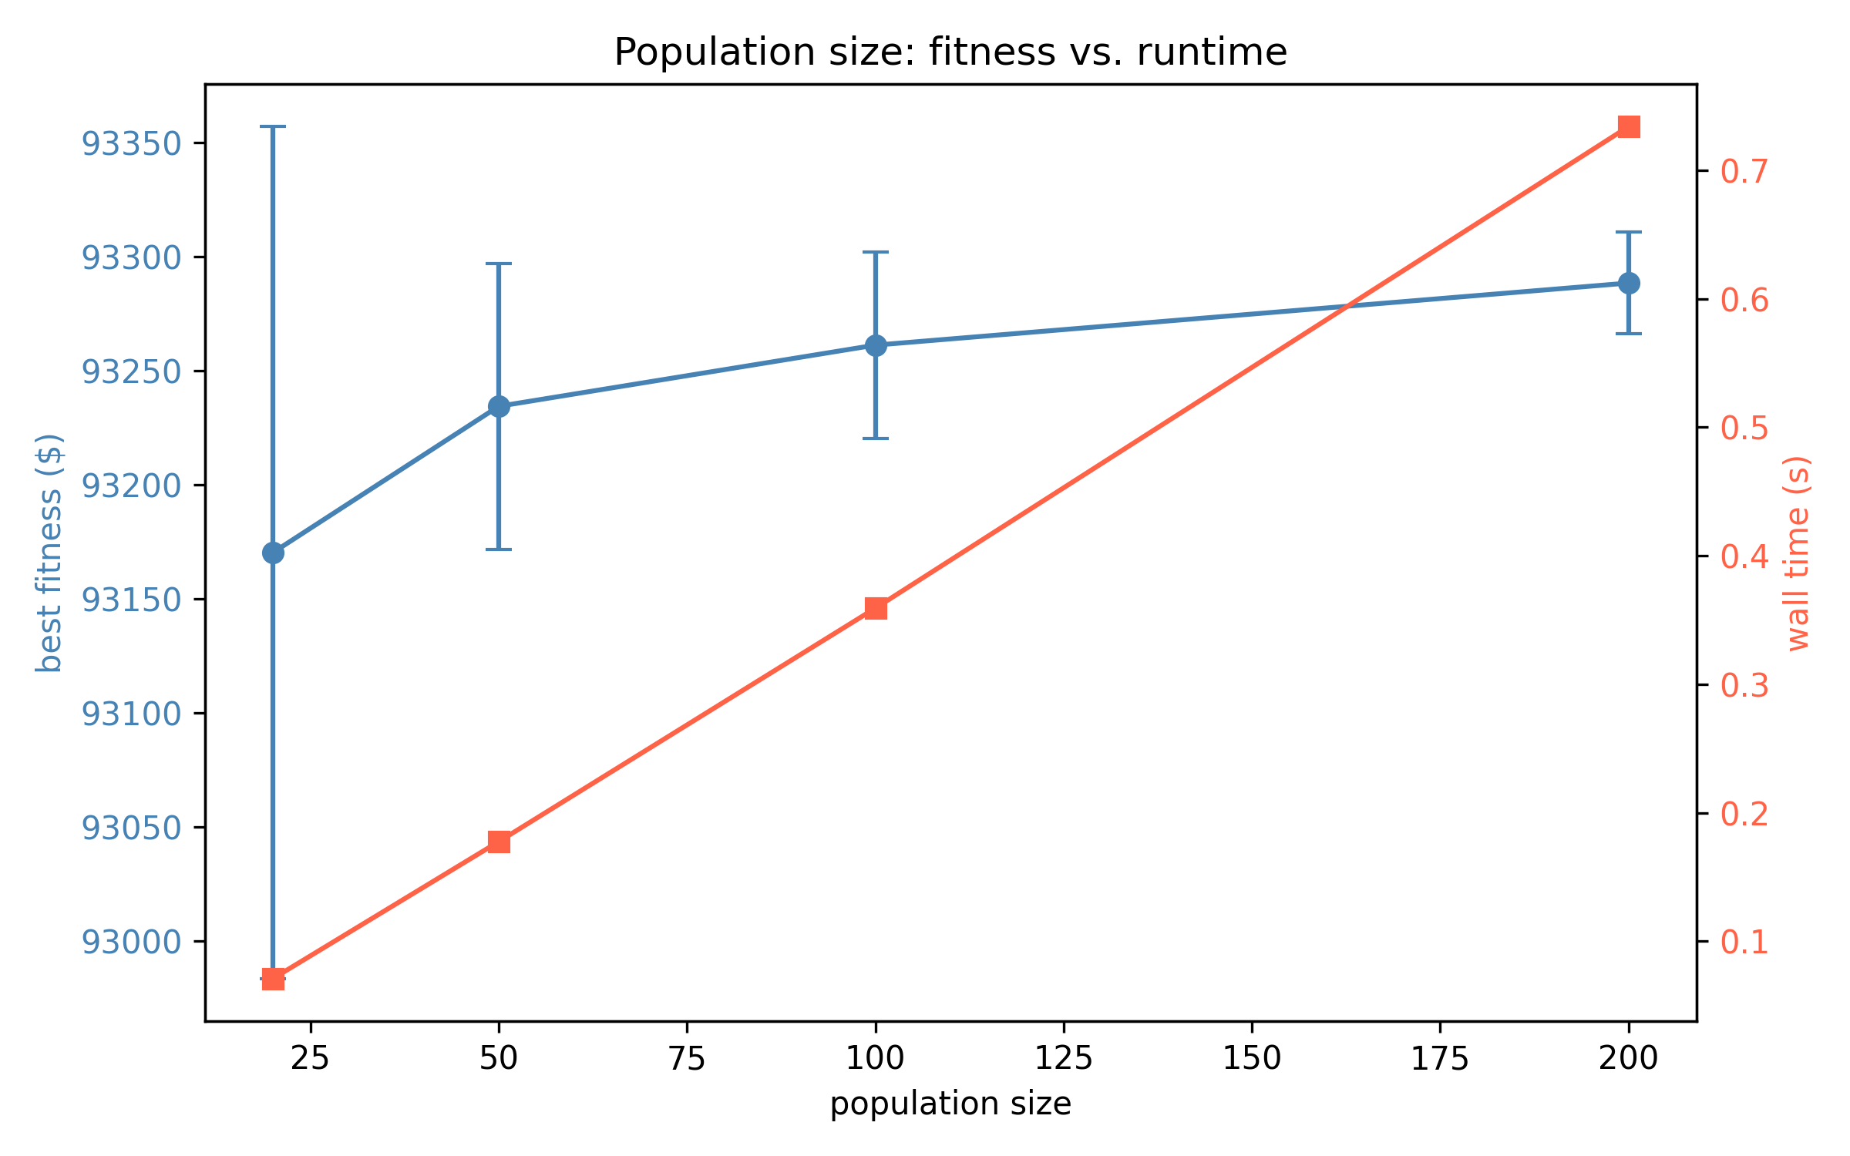
Parameter Sensitivity
Figure 3: Mutation Rate Sensitivity
Figure 4: Population Size vs. Runtime
Less is more
More is better (linear cost)
Lower mutation (1–2%) hits DP optimum on every seed. High mutation destroys good solutions faster than it finds new ones.
Doubling population doubles runtime but modestly improves mean fitness. Pop = 200 reaches exact optimum on 2 of 5 seeds.

Slide 10
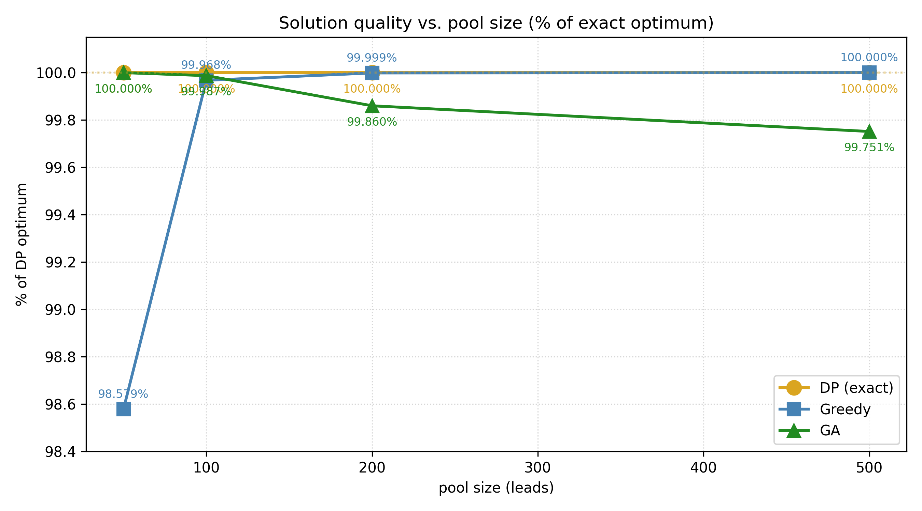
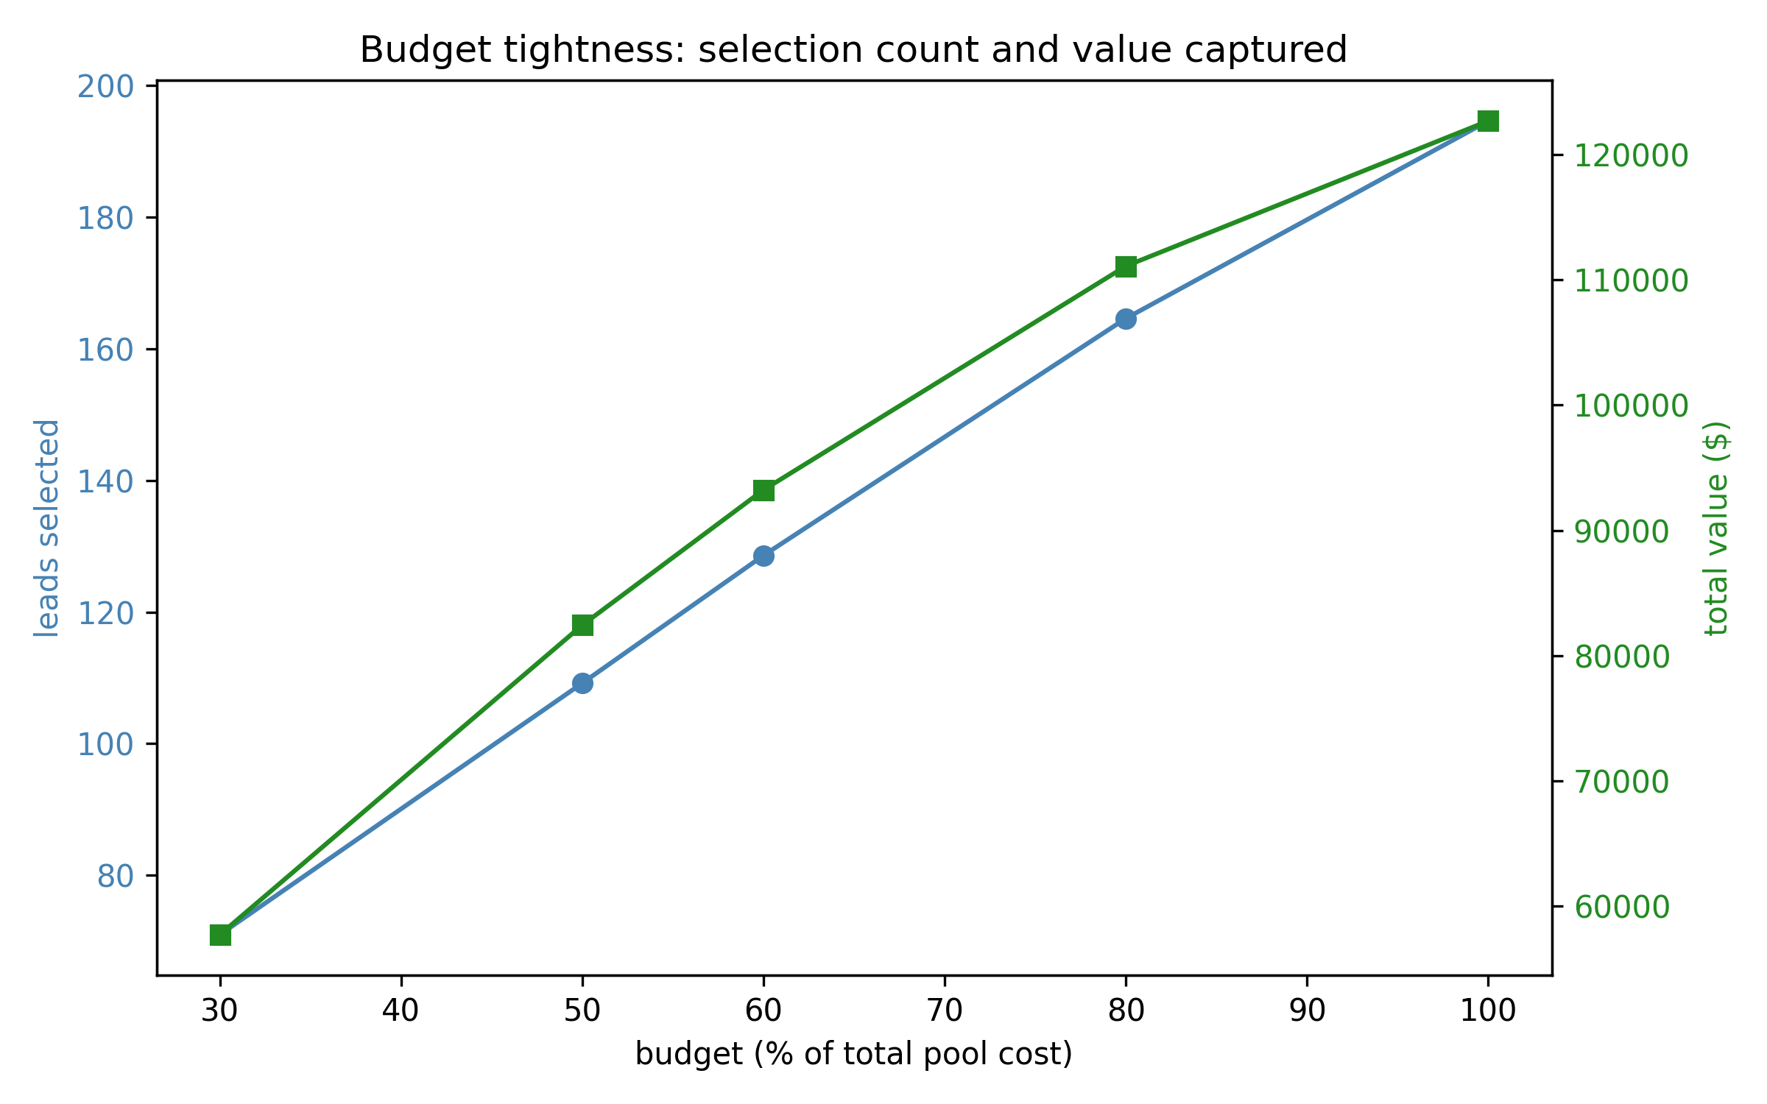
Scaling & Budget Analysis
Figure 5: Solution Quality vs. Pool Size
Figure 7: Budget Tightness
Scaling Findings
Pool | Greedy | GA | DP | DP Time
50 | $21,983 | $22,300 | $22,300 | 0.01s
100 | $47,848 | $47,857 | $47,863 | 0.05s
200 | $93,304 | $93,174 | $93,305 | 0.21s
500 | $233,548 | $232,968 | $233,548 | 1.36s
At N=50, GA beats greedy by 1.4% and ties DP exactly. At N=500, greedy ties DP. GA is most valuable when the knapsack is genuinely combinatorial.

Slide 11
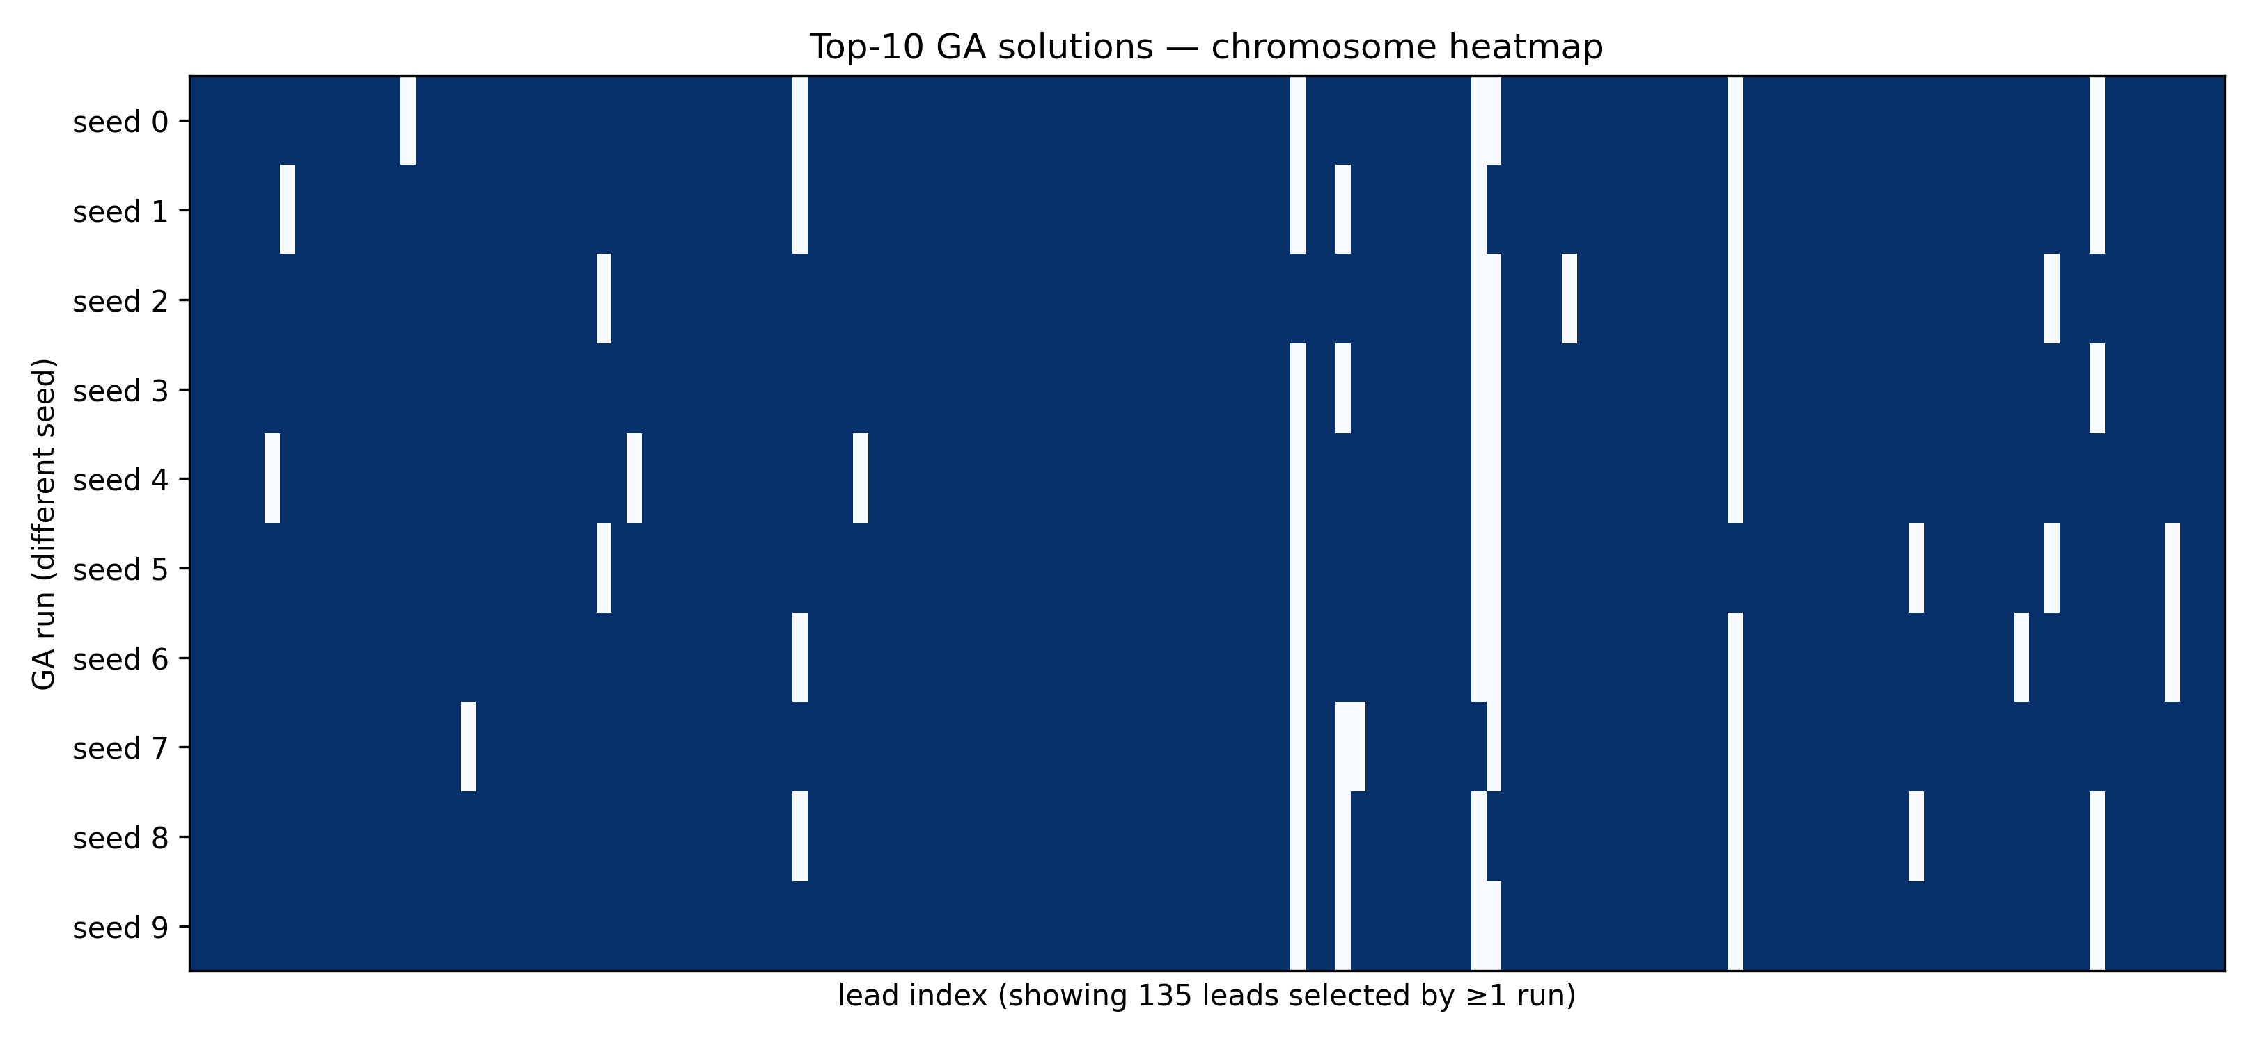
Chromosome Diversity
Figure 8: Top-10 GA solutions across 10 seeds
Most columns are solid blue: all 10 runs agree those leads should be enriched. Speckled columns are borderline leads at the budget frontier. This is the expected behavior — high agreement on obvious picks, disagreement only on marginal ones.

Slide 12

Discussion
Why Greedy Ties DP Here
Why the GA Still Matters
1. Costs are small and bunched
Only three cost tiers ($0.001, $0.002, $0.003), all tiny relative to the $0.2142 budget. Greedy rarely gets "stuck."
2. Many items, loose budget
Budget fits 128 of 200 items (64%). When most items are taken anyway, the problem approaches fractional knapsack where greedy is optimal.
DP requires the objective to be a sum of independent per-item values under a single linear constraint.
The GA's fitness function is just Python.
Any constraint or interaction can be added in a few lines — diversity across business types, city concentration penalties, pairwise lead reinforcement, etc.
Methodological lesson: when an exact baseline is affordable, build it.

Slide 13

From Reflex to Utility Agent
BEFORE
AFTER
Simple Reflex Agent
Utility-Based Agent
→
Single rule: "if lead status = new, queue it."
No reasoning about which lead is better.
FIFO ordering — first in, first enriched.
Assigns each lead a utility (expected value).
Computes budget-constrained allocation.
Maximizes total utility — not just order.
Limitations & Future Work
Synthetic Values
Single-Day Horizon
Small Pool Size
Hand-tuned priors, not learned from real reply data — will swap in trained model
Each day is independent; a multi-day stochastic framing would be more accurate
200 leads — larger pools (10K+) would let the GA differentiate on runtime

Slide 14
Thank You
Enrichment Budget Optimizer • Genetic Algorithm for Lead Allocation
Enrique Perezalonso | perezalonsoenrique@gmail.com

