Slide 1
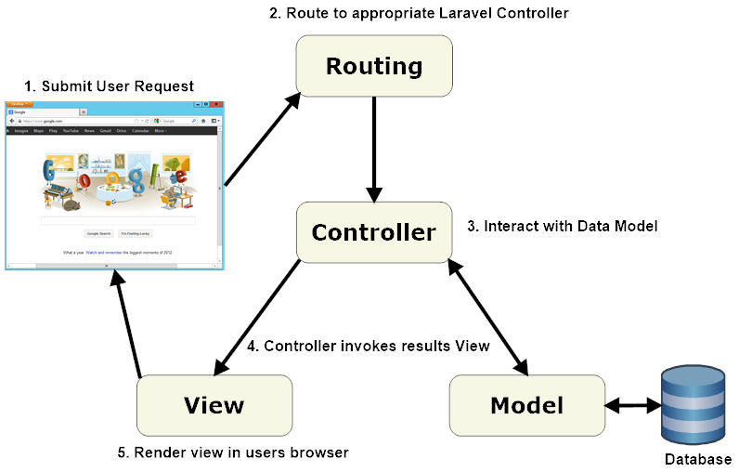

Slide 2
Tipos de Rutas
Route::put('foo/bar', function () { // }); Route::delete('foo/bar', function () { // });
Route::get('/', function () { return 'Hello World'; }); Route::post('foo/bar', function () { return 'Hello World'; });

Slide 3
Rutas con multiples verbos
Route::match(['get', 'post'], '/', function () { return 'Hello World'; });

Slide 4
Para cualquier petición
Route::any('foo', function () { return 'Hello World'; });

Slide 5
Pasando parametros
Route::get('user/{id}', function ($id) { return 'User '.$id; });
Route::get('posts/{post}/comments/{comment}', function ($postId, $commentId) { // });
Route::get('user/{name?}', function ($name = null) { return $name; });
Route::get('user/{name?}', function ($name = 'John') { return $name; });

Slide 6
Routes Gruop
Route::group(['prefix' => 'admin'], function () { Route::get('users', function () { // Matches The "/admin/users" URL }); });

