Slide 1
capability building
Chengdu QA Community
And then a subhead that can run long to add some background flavor or prosaic flourish.

Slide 2

our journey
Define QA
skills
Define levels
of skills
Set 3 month
goal
Regular online
sharing
Self evaluate
Offline learning
Re-evaluate

Slide 3


Generate QA cAPABILITY skills
Fundamental Technics | Automation
Test Method | Test Case Design
Test Strategy | Test Technics
Requirement Analyse | Business Knowledge
Communication | Process Improve

Slide 4
cAPABILITY skills deep dive
Fundamental Technics
Web
Technics
DB & SQL
Network
Gradle
Maven
Junit
WebService
Javascript
XML&JSON
Linux
Application Server
Cloud

Slide 5

cAPABILITY skills deep dive
Coding
Automation
Strategy
Toolset
e.g. Selenium,
Jbehave
Automation
Framework
Design
Refactor &
Case manage
Notes:
Coding: Programming logic, best practices, OO, TTD, unit testing.
Knowledge of different automation tools and frameworks, includes mocking, stubbing, integration testing, etc. Includes use of DOM objects

Slide 6
cAPABILITY skills deep dive
Unit Test
/TDD
Component/
Integration
Test
Regression
Test
Test Method
System Test
Alpha&Beta

Slide 7
cAPABILITY skills deep dive
Test Case Design
Boundary
Value
Equivalence
Class
Decision
Table
State Transition
Diagrams
User Scenario
Error Guessing
Statement
Coverage
Branch
Coverage
Path
Coverage

Slide 8
cAPABILITY skills deep dive
Test Levels
Test Schedule
Test Tools
Test Strategy
Test Priority
Test Approach

Slide 9
cAPABILITY skills deep dive
Test Technics
Security
Testing
Performance
Testing
Web
Testing
Mobile
Testing
Usability
Testing
Compatibility
Testing
Localisation
Testing
Exploratory
Testing
Embedded
Testing
Notes:
Exploratory testing: Exploratory testing execution, use of different methodologies to test end-to-end flows, user journeys, etc.
Usability testing: Work with UX/BA/PO to define usability requirements. Includes A/B Testing, User Acceptance Testing sessions, etc.
Performance testing: Definition of performance requirements with PO/BAs based on data. Knowledge about performance testing tools. Planning/execution on different kinds of performance testing (stress, load, soak, peak).
Security testing: Planning and execution of security testing (authentication, authorisation, confidentiality, integrity, etc) Includes knowledge about different tools and methods (eg. penetration testing, vulnerability scan tools)

Slide 10
cAPABILITY skills deep dive
Requirement Analyse
Requirement
understand
Requirement
clarify
Write AC
Specific
as QA
Business Knowledge (e.g. Insurance)
Life Insurance
PI
CI

Slide 11
cAPABILITY skills deep dive
Logical thinking
Ask questions
Listen to
others
Communication
Team work
Express idea
Notes:
Communication: Ability to collate and present thoughts in coherent manner. Also requires use of external tools to communicate complex ideas. This includes both verbal and non-verbal communication.
Questioning: The ability to ask a variety of questions for a given context to withdraw pertinent, rich information from our clients. Continuously sustain an ongoing curiosity in things. Why certain processes exist? What is their purpose? How could we make it better?
Negotiation: Ability to mediate divergent views and positions, resolve points of difference, and arrive at agreed course of action. Ability to create and foster open feedback atmosphere.
Problem solving: Ability to distill a complex problem to quantifiable solutions. To understand the root causes to ensure the solutions are appropriate.

Slide 12
cAPABILITY skills deep dive
Agile
DevOps
Scrum/Kanban
/XP
Process Improve
Risk Manage
Bug Analyse
Notes:
Related to the overall processes on the project. Thinking about the big picture and how the product quality is affected by the processes, improving project practices to improve quality.
Risk management: Analysis of risks and formulation of action plans to manage risks. Tracking impact of issues in the project and in the test strategy.
DevOps: Includes continuous delivery, continuous integration. Use of techniques to improve feedback from automated tests (eg.: reporting, parallelization, grid)
Use of different metrics and data to improve project processes and overall quality. Includes estimation, defect metrics, output, throughput, lead time, cycle time, kickbacks, root cause analysis, etc.

Slide 13
Define levels of skills
Level 1 - Want to Learn
Express interest. I am interested in this, I hear it before but not sure how to do. May have theoretical knowledge.
Level 2 - Beginner
I understand it but I do not have related work experience. Knowledge is practical but limited. Have played around a little but haven’t gone into depths. Don’t assign me in a project by myself.
Level 3 - Moderate
I work on it and I've gone into some depth. I can explain it to others clearly. I'm comfortable beginning to teach others. I can influence at my peer level and with folks I'm teaching; I'm starting to understand how to influence with the client.
Level 4 - Experienced
I can lead a team to work on it. Comfortable in the environment and can teach others at different skill levels and in different project situations. Can influence people in a less complex environment.
Level 5 - Expert
I can provide consult service to client on this topic. I can get in big and complex accounts and teach others. Size, complexity, and political issues don't matter. I can teach others to teach. Give me the hardest problem and I feel fine doing it

Slide 14
evaluation
1. Evaluate the test technics.
e.g. Security test (2) / Performance test (3) / Usability test (3) / etc..
2. Generate the spider graph
3. Generate the rate of test technics. E.g. 3.5
4. Continuously evaluate the other matrix then generate the overall rate
for all technics
5. Define the 3 month learning goal

Slide 15
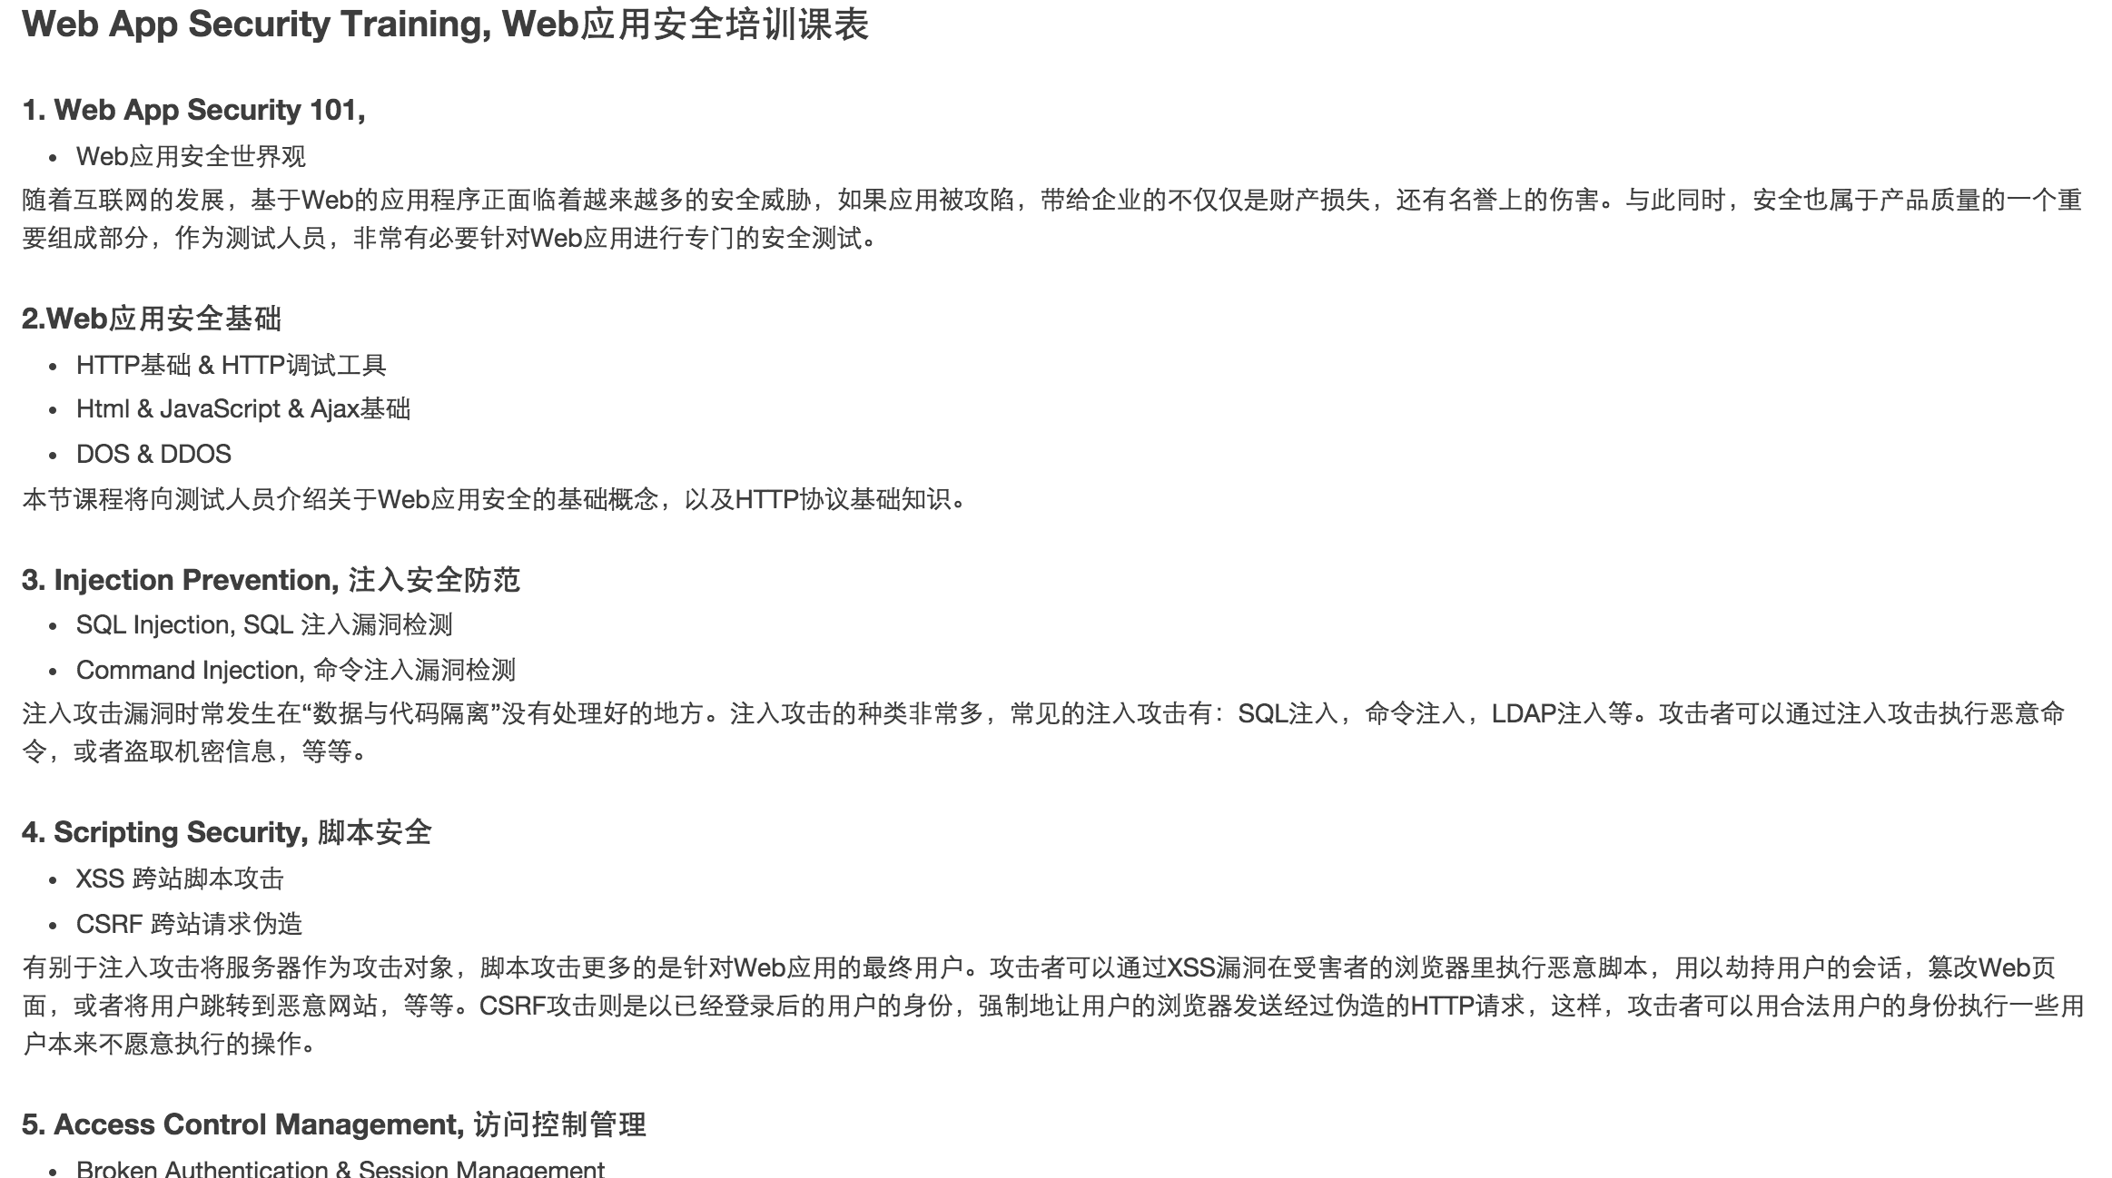
Learning phase
Generate course/practice list and use Github to manage knowledge base
Course example:

Slide 16
THANK YOU
For questions or suggestions:
Go to Brand Hub
https://my.thoughtworks.com/groups/brand

