Slide 1
Adaptive Hybrid Retrieval-Augmented Generation
Optimizing the computational cost-performance trade-off
via learned query routing
Dante Wesslund · KTH EECS · 22 October 2026
Supervisors: Arvid Eriksson (KTH), Peng Zhang (Ericsson)
Examiner: Pawel Herman · In collaboration with Ericsson
Notes:
[0:00 to 0:30]
Hello everyone. Before I start, can everyone see the title slide?
My name is Dante Wesslund, and this is my master's thesis, Adaptive Hybrid Retrieval-Augmented Generation, done at Ericsson. Thank you to my supervisors, Arvid Eriksson at KTH and Peng Zhang at Ericsson, and to my examiner Pawel Herman.
In one sentence: can a small, cheap classifier look at a question and decide, before any retrieval runs, whether the cheap or the expensive retrieval mode is needed, and does that save real cost?

Slide 2
Graph-enhanced retrieval answers harder questions, but every query pays for it
Naive vector search only
10.9 s
mean time per query
≈3,500
model tokens per query*
Mix vector + knowledge graph
24.4 s
mean time per query
≈17,900
model tokens per query*
2.2×
time
5.2×
tokens
Yet Mix was needed on only 327 of 2,000 judged questions (16%). On 959 (48%), Naive was already enough.
Times: all 193 test questions. *Tokens: per-mode means over 15 instrumented queries (prompt, output and reasoning tokens).
Notes:
[0:30 to 1:30]
Retrieval-augmented generation grounds a language model in documents. The cheapest form is vector search: embed the question and fetch the most similar chunks. In LightRAG that is the Naive mode.
Graph-enhanced retrieval adds an entity-relation graph, so the system can connect facts that live in different documents. That is LightRAG's Mix mode, and it helps on multi-hop questions.
But it is expensive. In my runs Mix takes 24.4 seconds per query against 10.9 for Naive, about 2.2 times longer, and it uses roughly 5 times as many model tokens.
And here is the key observation: of the 2,000 questions I judged, Mix was needed on only 327, about one in six. On almost half, 959, Naive was already enough. So a system that always runs Mix pays the graph premium on every question, but it changes the outcome on only about one in six.
(The token numbers come from a 15-query instrumented subset. I return to that at the end.)

Slide 3
Some questions need the graph, most do not
Q Which film came out first, The Love Route or Engal Aasan?
Q When was the director of film Private Hell 36 born?
Gold answer: The Love Route
Gold answer: October 26, 1912
correct
Naive: “…The Love Route came out significantly earlier than Engal Aasan.” (1915 vs 2009)
not enough
Naive: “…was directed by Don Siegel. However, the provided documents do not contain information regarding Don Siegel's birth date.”
correct
Mix: “…The Love Route was released significantly earlier than Engal Aasan.”
correct
Mix: “…Donald Siegel was born on October 26, 1912.”
Label: naive_enough → route to Naive
Label: mix_required → route to Mix
Real questions and answers from the 2WikiMultihopQA runs (abridged). Comparison question left, two-hop compositional question right.
Notes:
[1:30 to 2:40]
Two real examples from my runs make the difference concrete.
On the left: which film came out first, The Love Route or Engal Aasan? Each film has its own document with a release date, vector search fetches both, and both modes answer correctly. Mix adds nothing here, so the label is naive_enough and the right decision is the cheap mode.
On the right: when was the director of Private Hell 36 born? This is a two-hop question. Vector search finds the film's page and even names the director, Don Siegel, but his birth date is in a different document that does not look similar to the question. Naive gives up. Mix's graph context links the film to the director entity, and it answers correctly: October 26, 1912. Here the expensive mode is needed.
The whole thesis is about telling these two situations apart from the question alone.

Slide 4
The idea: let a cheap classifier pick the mode from the question, before retrieval runs
−42%
mean time per query vs. always running Mix
Naive
low cost
Router
small classifier,
no LLM call
Question
−63%
estimated model tokens per query
Mix
high cost
≈92%
of always-Mix's judged-correct answers kept*
Trained on labels that say which mode was enough for each question (next section).
ModernBERT router on 193 test questions. *Assumes Mix is correct wherever Naive was.
Notes:
[2:40 to 3:40]
So the idea is to put a router in front of retrieval. It reads only the question, no retrieved text and no language-model call, and sends it to Naive or Mix.
The router is trained on labels that record, for every question, which mode was actually enough. I will show how those labels are made in a moment.
Here is where we end up, so you know what to listen for. My best router, a fine-tuned ModernBERT, cuts mean time per query by 42 percent compared with always running Mix, cuts estimated model tokens by 63 percent, and keeps about 92 percent of the answers that always-Mix gets right, under an assumption I will make explicit.
The rest of the talk is about how solid those numbers are.

Slide 5
Can a lightweight classifier pick the cheapest sufficient retrieval mode?
Within one fixed Hybrid RAG setting (LightRAG, Naive vs. Mix), how well can a query-only classifier predict the minimum sufficient retrieval mode, and what does routing with it save?
Sub-question 1
Prediction
How does a fine-tuned ModernBERT classifier compare to a TF-IDF baseline and a question-type heuristic in predicting the label?
Sub-question 2
Cost
How much mean time and model-token cost does routing save compared with always-Mix, and what does it risk in answer quality?
Notes:
[3:40 to 4:25]
Formally, the research question is: within one fixed Hybrid RAG setting, how well can a lightweight query-only classifier predict the minimum sufficient retrieval mode, and what does routing with it save?
Why only the question? Because the point is to decide before any retrieval cost is paid. Anything that inspects retrieved text has already paid for at least one retrieval run.
I split it into two sub-questions. First, prediction: how does a fine-tuned encoder, ModernBERT, compare to a simple TF-IDF baseline, and to a heuristic that uses the benchmark's question type? Second, cost: how much time and model-token cost does routing save relative to always running Mix, and what does it risk in answer quality?

Slide 6
Prior work routes between models or retrieval depth; this thesis routes between vector and graph retrieval
Adaptive-RAG
Jeong et al., 2024
A question-complexity classifier picks no, single-step or multi-step retrieval.
RouterBench
Hu et al., 2024
Routes each query between language models on cost vs. quality.
GraphRAG, LightRAG
Edge et al., 2025; Guo et al., 2025
Graph-enhanced retrieval improves multi-hop answers at higher cost.
This thesis A query-only router choosing between two retrieval modes inside one LightRAG index, trained on judge-derived labels and evaluated with paired statistical tests.
Notes:
[4:25 to 5:10] (shorten to one sentence if running long)
Where does this sit? Adaptive-RAG is the closest precedent: a small classifier estimates question complexity and picks how much retrieval to do. RouterBench frames routing between language models as a cost-quality trade-off. GraphRAG and LightRAG show that graph retrieval helps on multi-hop questions, and also document its cost.
What none of them asks is how to choose between a vector mode and a graph-enhanced mode inside one framework, from the question alone. That is the gap I study, with labels derived by an LLM judge and paired statistical tests on the results.

Slide 7
Method
From benchmark questions to labels and routers
Notes:
[5:10] Moving on to the method: how I turned benchmark questions into training labels, which routers I trained, and how I evaluated them.

Slide 8
Both modes run on every question, and an LLM judge records which one was enough
LABELLING (offline, once)
2,000 questions
2WikiMultihopQA, multi-hop by design
LightRAG index
shared corpus: vector chunks + entity-relation graph
Run both modes
Naive and Mix answers, time per query
LLM-as-a-Judge
compares both answers with the gold answer
LEARNING AND EVALUATION
Binary dataset
1,286 questions: 900 train / 193 val / 193 test
Train routers
TF-IDF + logistic regression; ModernBERT (fine-tuned)
Evaluate
as classifiers and as routing policies on cost
Same Gemini model generates and judges, temperature 0, 5 text chunks per mode; first 2,000 queryable questions of the 2WikiMultihopQA train split, in benchmark order.
Notes:
[5:10 to 6:25]
This is the whole pipeline. I took 2,000 questions from 2WikiMultihopQA, a public benchmark whose questions need several documents by construction. Their documents are indexed once in LightRAG, which builds both the vector index and the entity-relation graph.
Every question is then run through both Naive and Mix, so for each question I have two answers and two execution times.
Then an LLM judge, Gemini, gets the question, the gold answer from the benchmark, and both candidate answers, and decides which mode was enough. Giving it the gold answer turns judging into a constrained comparison rather than open-ended scoring.
This labelling is done once, offline. The bottom row is the learning part: build a binary dataset, train the routers, and evaluate them both as classifiers and as routing policies.

Slide 9
The label is the cheapest mode that was judged sufficient
959 Naive enough
327 Mix
714 Neither correct
2,000 judged questions
Naive answer correct
naive_enough
label 0
1,286 questions
25% Mix required
split 900 / 193 / 193, stratified by question type and label
Naive not enough, Mix correct
mix_required
label 1
Neither correct: routing cannot help
none_enough
excluded
If both modes are correct, the judge is told to choose Naive: the label records the minimum sufficient mode, not the better-looking answer.
Notes:
[6:25 to 7:25]
The judge assigns one of three classes. If Naive's answer is correct, the question is naive_enough. If Naive is not enough but Mix is correct, it is mix_required. If neither is correct, none_enough.
Importantly, when both modes are correct the judge is instructed to choose Naive, so the label is the cheapest mode that was sufficient.
Out of 2000 judged questions, 959 are naive_enough, 327 mix_required, and 714, about a third, are none_enough. Those are excluded from training, because when both modes fail, choosing between them cannot improve the answer. I come back to what that third means at the end.
That leaves 1286 questions, about a quarter of them Mix-required, split into train, validation and test, stratified by question type and label.

Slide 10
Two query-only routers: a lexical baseline and a fine-tuned encoder
TF-IDF + logistic regression
Word and word-pair counts, weighted by rarity
Balanced class weights
Trains in seconds on a CPU
Tests how much of the signal is lexical
Fine-tuned ModernBERT
Pretrained encoder + classification head
Class-balanced loss, early stopping
3 seeds averaged into one ensemble
Trains in hours on a CPU
Both: threshold chosen on validation F1, then frozen. Reference: type-only rule (Mix if the question is compositional); not deployable, since real queries have no type label.
Notes:
[7:25 to 8:25]
I compare two routers that both see only the question text.
The baseline is TF-IDF with logistic regression: it represents a question by its words and word pairs, weighted by how rare they are. It trains in seconds and tells us how much of the routing signal is purely lexical.
The second is ModernBERT, a recent pretrained encoder, fine-tuned with a class-balanced loss and early stopping. I trained it with three random seeds and average their scores into one ensemble, so the result does not hinge on one lucky seed.
For both, the decision threshold is chosen on the validation split and then frozen before touching the test set.
As a reference I also include a rule that sends a question to Mix whenever the benchmark calls it compositional. It cannot be deployed, because real questions have no such label, but it shows how much of the signal is simply question structure.

Slide 11
Each router is evaluated as a classifier and as a routing policy, with paired tests
Classification
AUPRC on mix_required (primary, chance 0.254)
Precision, recall, F1
Routing-label accuracy
Routing policy
Mean routed time (measured)
Model tokens (estimated per mode)
Under-routing: missed Mix call (answer risk)
Over-routing: unneeded Mix call (wasted cost)
Statistics
Same 193 test questions for all routers, so tests are paired
Paired bootstrap 95% intervals
Permutation tests, McNemar
Holm correction (7 metrics)
Notes:
[8:25 to 9:25]
Evaluation has two sides. As classifiers, the main metric is AUPRC on the minority class, mix_required, because the classes are imbalanced; a random router would score 0.254, the share of Mix-required questions. I also report precision, recall, F1 and accuracy.
As routing policies, I simulate what each router would have cost on the test set, using the precomputed answers and times: mean routed time, which is measured for every query, and model tokens, which are estimated from per-mode means. I separate the two kinds of mistakes: under-routing, sending a Mix-needing question to Naive, which risks the answer, and over-routing, sending a Naive-sufficient question to Mix, which only wastes cost.
Because all routers are scored on the same 193 questions, the comparisons are paired: paired bootstrap intervals for differences, permutation tests, McNemar's test on individual routing decisions, and Holm correction for testing seven metrics.

Slide 12
Results
Prediction (sub-question 1), then cost and risk (sub-question 2), then where the signal comes from
Notes:
[9:25] Now the results: first how well the routers predict the label, which is sub-question one; then what routing costs and risks, which is sub-question two; then where the signal comes from.

Slide 13
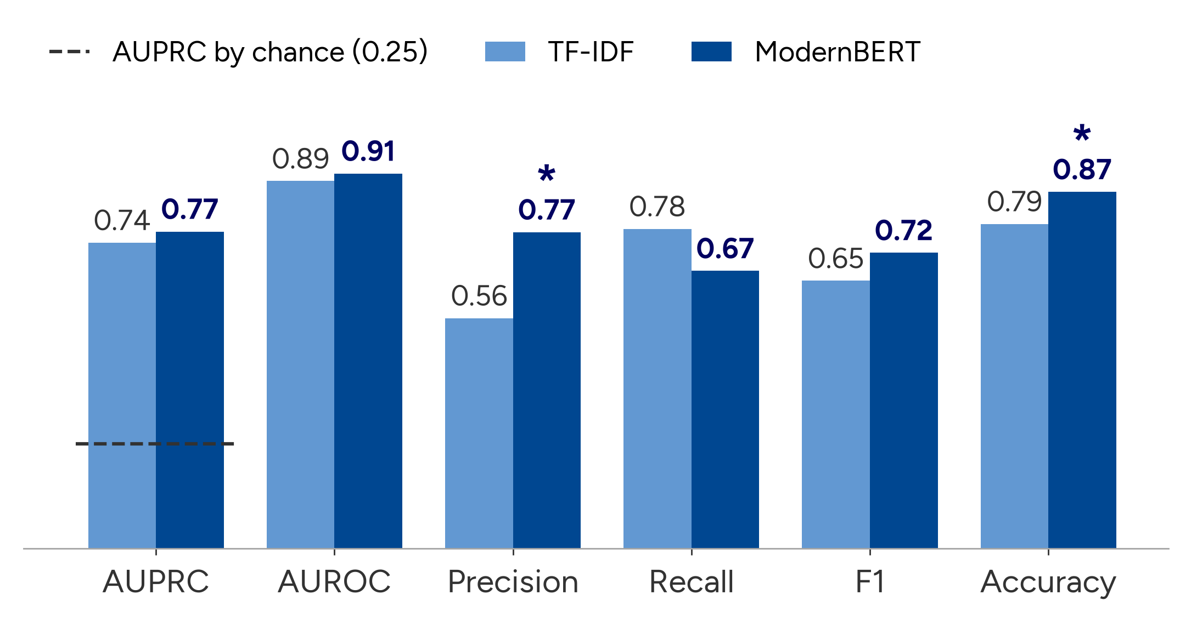
Both routers find Mix-needing questions far above chance, and ModernBERT is more precise
Chance level
AUPRC 0.254
AUROC 0.5
Significant (Holm) *
Precision, accuracy
Recall is lower
0.67 vs 0.78, not significant
Notes:
[9:25 to 10:40]
Here are both routers on the 193 test questions. TF-IDF is light blue, ModernBERT dark blue.
First the good news: both find Mix-needing questions far above chance. AUPRC is 0.74 for TF-IDF and 0.77 for ModernBERT, about three times the chance level of 0.254 shown by the dashed line, and AUROC is around 0.9. So the routing decision is partly predictable from the question alone. That is the first half of the answer to sub-question one.
ModernBERT has the higher point estimate on five of the six metrics. The clearest difference is precision: 0.77 against 0.56. When ModernBERT says Mix, it is usually right.
The exception is recall: TF-IDF catches more of the Mix-needing questions, 0.78 against 0.67, because it sends more questions to Mix.
Which of these differences are real, and which could be noise on 193 questions? That is the next slide.

Slide 14
Paired tests: the precision and accuracy gains are significant; the ranking gains are not resolved
difference [95% interval] Holm p
Precision
+0.209 [+0.115, +0.312]
<0.001
Accuracy
+0.078 [+0.026, +0.130]
0.035
F1
+0.068 [−0.022, +0.155]
0.56
AUPRC
+0.027 [−0.053, +0.105]
1.00
AUROC
+0.018 [−0.009, +0.047]
0.56
Balanced accuracy
+0.018 [−0.043, +0.075]
1.00
Recall
−0.102 [−0.212, +0.000]
0.56
−0.2
−0.1
0
+0.1
+0.2
+0.3
ModernBERT − TF-IDF (right of zero favours ModernBERT)
Reading: ModernBERT is the more selective router. Whether it also ranks questions better cannot be decided with 49 Mix-required test questions.
Notes:
[10:40 to 12:10]
This slide is the statistical core, so let me say how to read it. Each row is one metric. The dot is the difference, ModernBERT minus TF-IDF, and the bar is its 95 percent paired-bootstrap interval. The dashed line is zero: if a bar crosses it, the data cannot tell the two routers apart on that metric. Blue rows are significant after Holm correction for testing seven metrics; grey rows are not.
Precision: plus 0.21, with the whole interval well to the right of zero, Holm-adjusted p below 0.001. Accuracy: plus 0.078, adjusted p 0.035. McNemar's test agrees: ModernBERT gets 21 questions right that TF-IDF gets wrong, and the reverse happens 6 times.
Everything else, F1, AUPRC, AUROC, balanced accuracy, and the lower recall, has an interval that includes zero. I read that as undecided, not as equal: with only 49 Mix-required test questions, differences of a few hundredths in AUPRC cannot be resolved.
So the honest answer to sub-question one is: both routers predict the label well above chance, and ModernBERT is significantly more selective than TF-IDF. I cannot claim it ranks questions better overall.

Slide 15
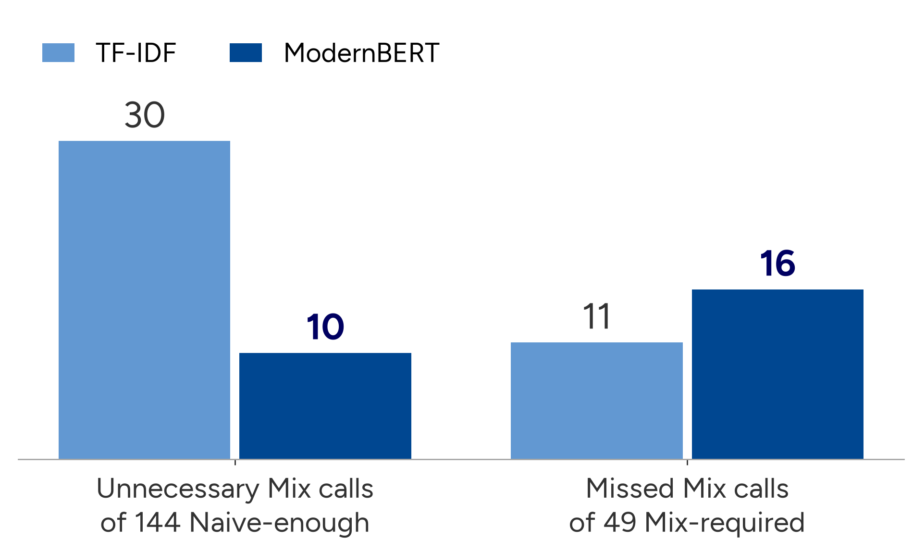
ModernBERT makes a third as many unnecessary Mix calls, at a small cost in missed ones
Over-routing: wasted cost
30 → 10 unnecessary Mix calls
McNemar: 20 vs 0, p < 0.001
Under-routing: answer risk
11 → 16 missed Mix calls
McNemar: 6 vs 1, p = 0.125 (not significant)
Notes:
[12:10 to 13:10]
Translating that into routing decisions. On the left, unnecessary Mix calls: questions where Naive was enough but the router chose Mix. TF-IDF makes 30 of them, ModernBERT 10. That difference is clear: ModernBERT avoids 20 of TF-IDF's mistakes and makes no new ones, McNemar p well below 0.001.
On the right, missed Mix calls, which are the dangerous error because the cheap mode then fails. ModernBERT misses 16, TF-IDF 11. That gap rests on 6 versus 1 questions and is not significant.
So the trade is: far less wasted compute, for a small and statistically unresolved increase in risk. Which side you prefer depends on what a wasted Mix call costs compared with a degraded answer in a given deployment.

Slide 16
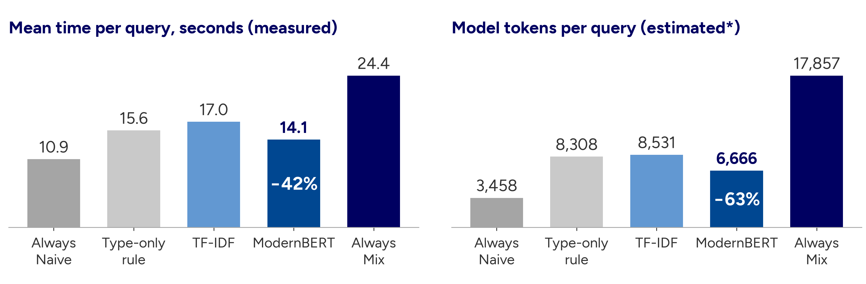
ModernBERT routing cuts mean time by 42% and estimated tokens by 63% compared with always-Mix
ModernBERT vs TF-IDF time: −2.9 s per query, 95% interval [−5.6, −0.9], p = 0.003.
*Tokens: per-mode means from 15 instrumented queries, no interval. The router's own inference time is not included in either chart.
Notes:
[13:10 to 14:25]
Now sub-question two, cost. Left: mean time per query, measured on every test question. Always-Naive takes 10.9 seconds, always-Mix 24.4. TF-IDF routing gets 17.0, ModernBERT 14.1: a 42 percent reduction relative to always-Mix. And the difference between the two routers, about 2.9 seconds per query, is itself significant, p = 0.003.
Right: model tokens per query. ModernBERT routes at about 6,666 tokens against 17,857 for always-Mix, a 63 percent reduction; TF-IDF saves 52 percent. The saving is larger in tokens than in time because Mix adds an extra language-model call and a much larger context, while wall-clock time also includes network latency.
Two caveats I want to be upfront about. The token figures are estimates, from per-mode means measured on 15 queries; the time figures are measured for every query. And the router's own inference time, three encoder passes for the ensemble, is not included. I expect it to be small next to retrieval calls of 11 to 24 seconds, but I did not measure it.

Slide 17
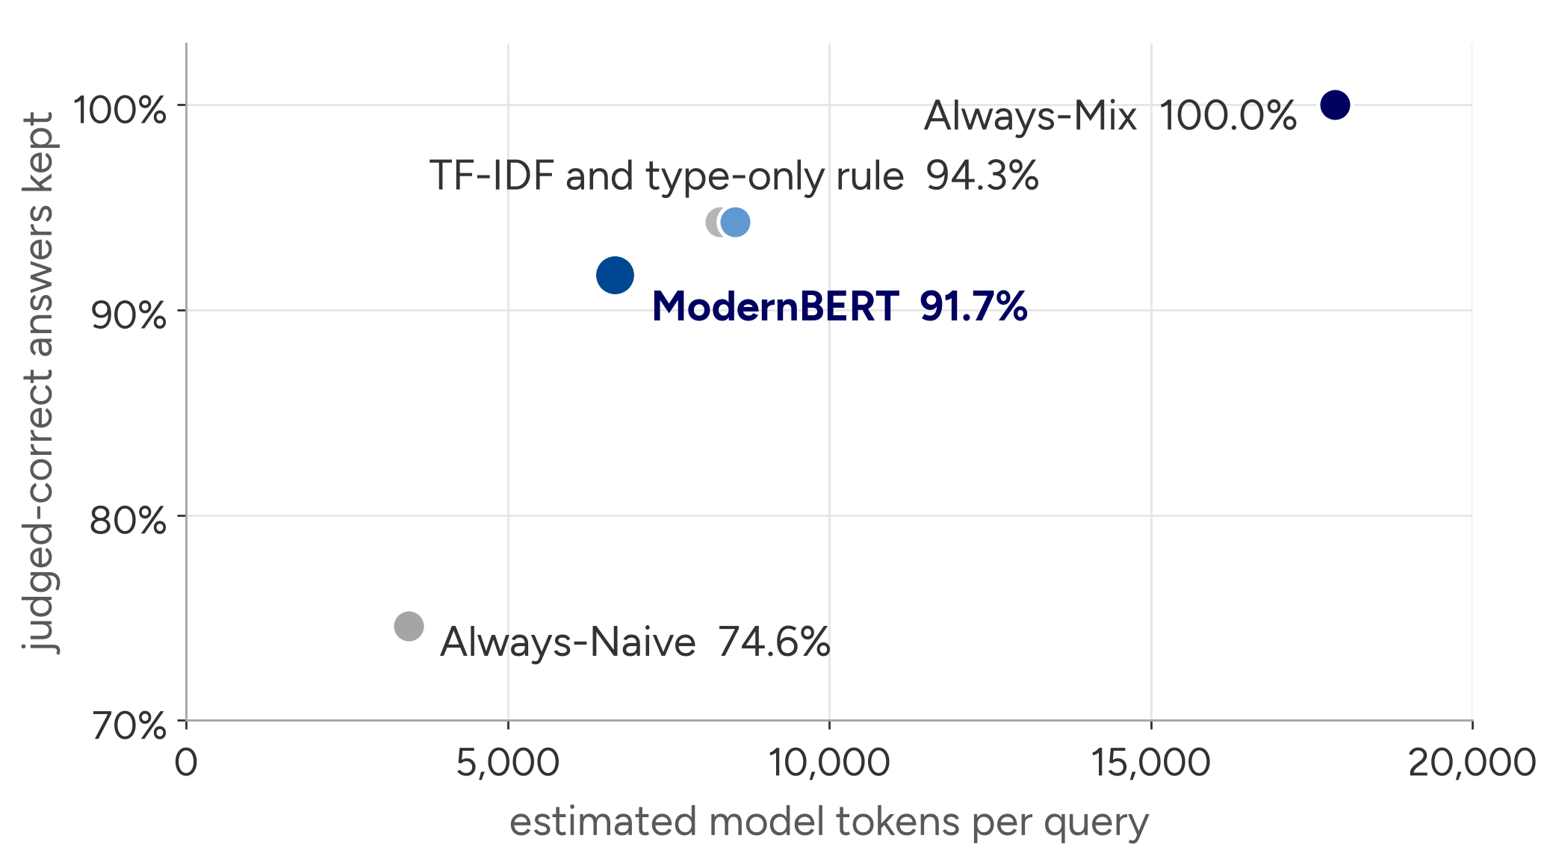
ModernBERT keeps about 92% of judged-correct answers at 37% of always-Mix's tokens
ModernBERT
keeps 91.7% of the answers at 37% of always-Mix's token cost
TF-IDF
keeps 94.3% at 48%
Assumes Mix is correct wherever Naive was, so kept answers = 1 − under-routing. Answers were not re-judged per policy.
Notes:
[14:25 to 15:25]
What does the saving cost in answers? I did not re-judge the answers each policy would pick, so this uses one explicit assumption: that Mix is correct whenever Naive was. Then the only way a policy can lose an answer is by under-routing, and the share of always-Mix's correct answers it keeps is one minus the under-routing rate.
Plotted against estimated tokens: always-Naive is cheapest but keeps only 74.6 percent. ModernBERT keeps 91.7 percent at 37 percent of always-Mix's token cost. TF-IDF and the type-only rule keep 94.3 percent at about half the cost.
So ModernBERT gives up about eight points of answers, 91.7 against 100, in exchange for cutting almost two thirds of the estimated token cost. And remember from slide 15 that the difference between the two routers in missed Mix calls is not significant, whereas the difference in time is.

Slide 18
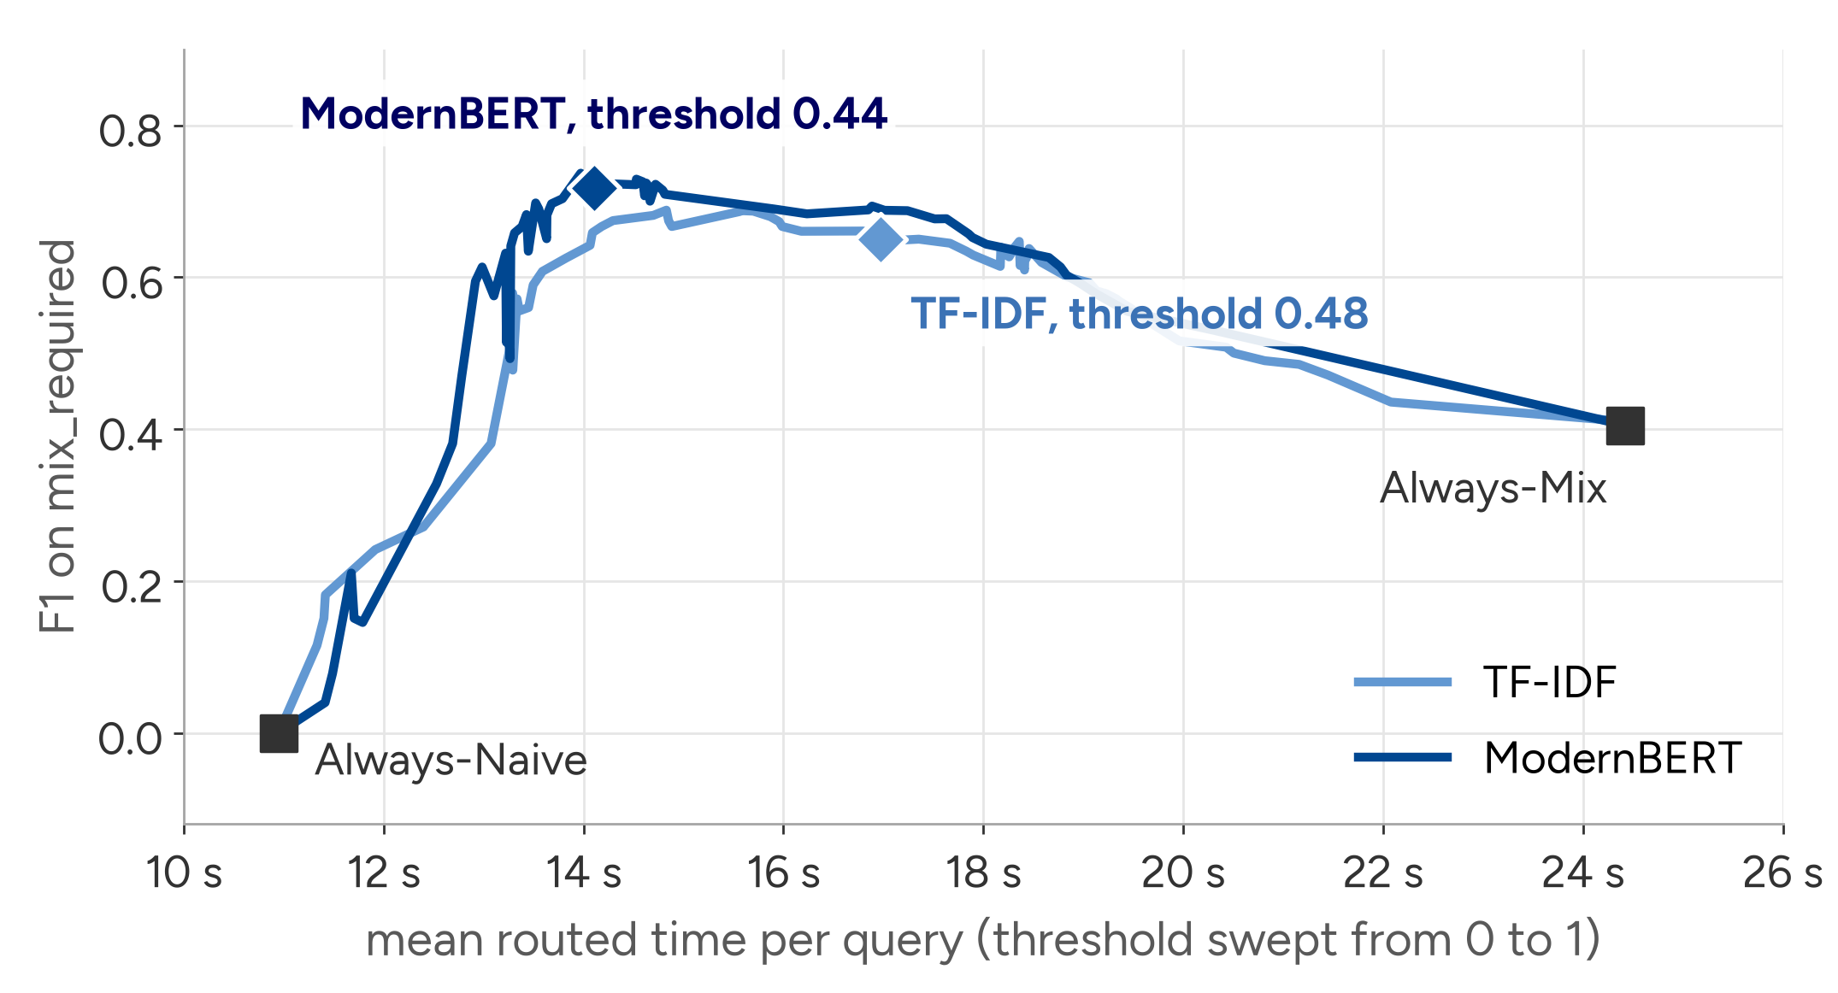
The threshold is a cost dial, and both chosen operating points sit well above the static policies
Reading the curve
Each point is one threshold; lowering it sends more questions to Mix.
ModernBERT's chosen threshold sits near its peak; TF-IDF's is a few hundredths below its own (0.65 vs 0.69).
In deployment the threshold sets the cost.
Notes:
[15:25 to 16:25] (shorten to one sentence if running long)
Routing is not one fixed point. Each router has a threshold, and sweeping it from 0 to 1 traces a curve from always-Mix on the right to always-Naive on the left. The y-axis is F1 on the Mix-required class, the x-axis mean routed time.
Over a broad middle range both routers sit well above always-Mix: higher routing F1 at much lower time. At the low-time end, below about 13 seconds, F1 falls under always-Mix's, because the router then sends almost everything to Naive.
The diamonds are the thresholds chosen on validation. ModernBERT's, 0.44, sits near its peak. TF-IDF's, 0.48, is a few hundredths below the best point on its own curve. The plateau is broad, so the choice is not brittle.
Practically, the threshold is a dial a deployment can turn to match its own cost of a wasted Mix call against a missed one.

Slide 19
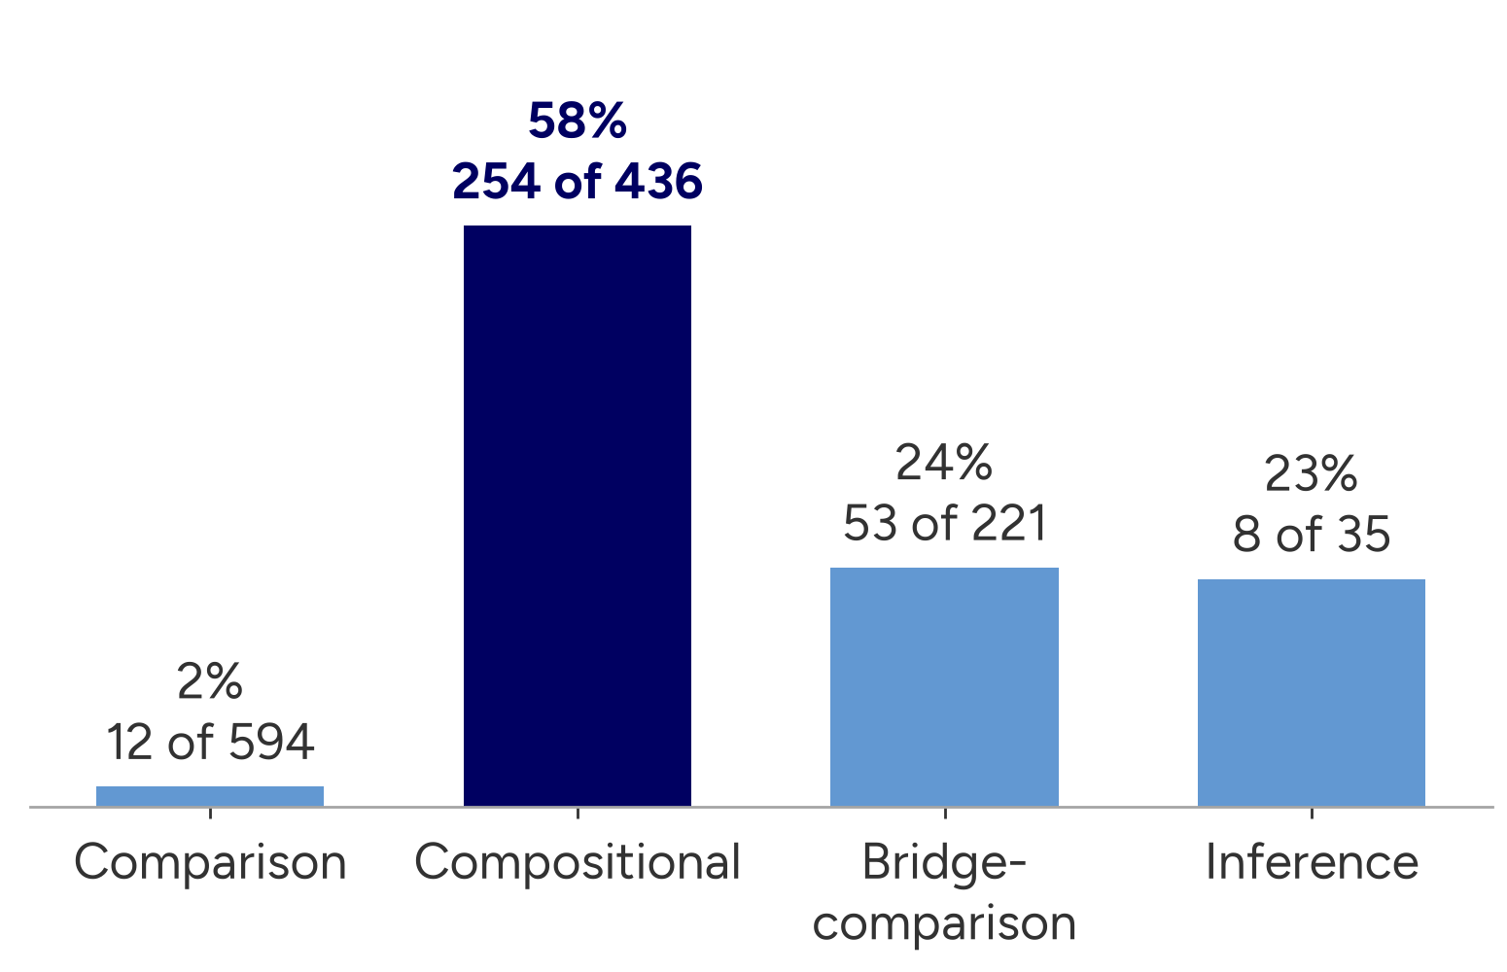
Much of the signal is question structure: compositional questions are the ones that usually need Mix
Mix-required rate by question type (all 1,286 labelled questions)
Type-only rule
F1 0.67, using the benchmark's type label, which real queries do not have
ModernBERT vs the rule (text only)
Precision 0.77 vs 0.58 (Holm p = 0.002); accuracy higher only before correction
Within compositional questions
ModernBERT precision 0.78 vs TF-IDF 0.64 (p = 0.003, exploratory)
Weak spot: bridge-comparison
ModernBERT finds 1 of 8 Mix-required questions (backup 26)
Notes:
[16:25 to 17:40]
Where does the signal come from? This chart shows how often each benchmark question type needs Mix. Comparison questions almost never do, 12 of 594. Compositional questions, like the Private Hell 36 example, need it 58 percent of the time, and they make up 254 of the 327 Mix-required questions.
That is why the type-only rule is strong: Mix for compositional, Naive otherwise, reaches F1 0.67. But it uses a label that real queries do not have.
ModernBERT, reading only the text, is significantly more precise than that rule. Its accuracy advantage holds only before multiple-testing correction, and TF-IDF does not beat the rule on anything. Within compositional questions, ModernBERT's precision advantage over TF-IDF is also significant, as an exploratory test.
And there is a clear weak spot: on bridge-comparison questions ModernBERT finds only 1 of 8 Mix-required ones.
So I read the router as learning question structure from phrasing, plus some precision on top. Useful, but part of the signal is benchmark-specific, which matters for transfer.

Slide 20
What this means for a deployment like Ericsson's
Cheap to run, tunable
No language-model call at query time; the threshold sets the cost. Trains in hours on a CPU. Labels cost one run of both modes plus the judge per training question.
Validate on the target workload
Part of the signal is benchmark structure. Real queries need their own labels: a small human-labelled set or a judge that does not rely on gold answers.
Routing cannot fix everything
36% of the questions failed in both modes. They need a better answering pipeline or a fallback, not a better router.
Notes:
[17:40 to 18:40] (shorten to one sentence if running long)
What does this mean in practice, for example at Ericsson where the corpus is internal technical documentation?
First, the router is cheap to run and tunable: no language-model call at query time, and the threshold sets where you sit on the cost curve. It is not free to set up, though: every training label requires running both modes and the judge once.
Second, it must be validated on the target workload. Part of what it learned is the structure of this benchmark. Internal documentation has no gold answers, so labelling would need a small human-labelled set or a different judging protocol.
Third, routing has a ceiling: 36 percent of the questions failed in both modes. For those, choosing between Naive and Mix cannot help; they need a better end-to-end pipeline.
One ethical point: a router can serve some kinds of question systematically worse. Here ModernBERT sent 7 of the 8 Mix-required bridge-comparison questions to Naive, so a deployment should monitor quality per question segment, not only on average. On sustainability: fewer Mix calls mean fewer tokens and less time, which should lower energy use, although I did not measure energy.

Slide 21
Limitations, and what would remove them
Limitation
Next step
Labels come from an LLM judge, using the same Gemini model that wrote the answers; no human check
Hand-validate a sample; re-judge with a second model family
Token cost estimated from 15 instrumented queries
Log tokens for every query
One benchmark (chosen partly for label balance), one framework, row-random split
Template-grouped split; HotpotQA, MuSiQue; other frameworks
193 test questions (49 Mix-required) cannot resolve small ranking differences
A test set 5 to 20 times larger
Kept answers assume Mix is correct wherever Naive was
Re-judge the answer each policy picks
Notes:
[18:40 to 19:40]
I want to be explicit about the limits.
The labels come from an LLM judge, and the same Gemini model both wrote and judged the answers, with no human check. Giving the judge the gold answer reduces the risk, but shared bias is possible; the fix is a hand-validated sample and a second judge from another model family.
Token costs come from 15 instrumented queries, so they are preliminary; the fix is logging tokens for every query.
It is one benchmark, chosen partly because it gave a balanced label split, one framework, and a split that is random by row, so similar question templates appear on both sides.
193 test questions with 49 positives cannot resolve small ranking differences.
And the kept-answers figure rests on an assumption that re-judging each policy's answers would remove.
What these do not change: the time saving is measured on every test query, and the precision gain is significant on the labels as defined. What they limit is how far the numbers transfer.

Slide 22
Conclusions
Contributions
Prediction (sub-question 1). From the question alone, both routers find Mix-needing questions at about 3× chance. ModernBERT is significantly more precise than TF-IDF (0.77 vs 0.56) and than the type-only rule; ranking gains are unresolved.
Cost (sub-question 2). ModernBERT routing cuts mean time by 42% and estimated tokens by 63% versus always-Mix, keeping about 92% of judged-correct answers (assuming Mix is correct wherever Naive was).
Scope. One benchmark, one framework, LLM-judged labels: validate on the target workload before deployment.
A study of query-only routing between a vector and a graph-enhanced retrieval mode within one RAG framework
A judge-labelled routing dataset and an open, reproducible pipeline
Evidence, from paired tests, that the encoder's gain lies in precision and therefore in cost
Thank you. Questions are welcome.
github.com/Dantecool02/Thesis_ericsson
Notes:
[19:40 to 20:40] Leave this slide up during the questions.
To conclude, and to answer the two sub-questions directly.
One, prediction: from the question alone, both routers find Mix-needing questions at about three times chance. ModernBERT is significantly more precise than TF-IDF and than the type-only rule; whether it ranks questions better is unresolved at this test size.
Two, cost: routing with ModernBERT cuts mean time by 42 percent and estimated tokens by 63 percent compared with always running Mix, while keeping about 92 percent of judged-correct answers under the stated assumption.
Concretely, my part of the work was to design the labelling protocol, run both modes on all 2,000 questions, build the dataset, train both routers and do the statistical analysis; Ericsson provided the problem setting and supervision. [Check this sentence is accurate before the talk.]
The contributions are the study itself, a judge-labelled routing dataset with an open and reproducible pipeline, and the evidence that the encoder's advantage lies in precision, which is exactly what translates into cost.
Thank you, I am happy to take questions.

Slide 23
Backup slides
24 Full statistics table
25 Seed stability
26 Per question type
27 Cost and errors per policy
28 Dataset composition
29 Judge prompt
30 PR and ROC curves
31 Statistical power
32 Query-only vs Naive-first cascade
33 Configuration
34 Use of generative AI
Type the slide number in Keynote and press Return to jump
Notes:
Backup section. Jump here by slide number when a question needs the detail (type the number and press Return in Keynote).

Slide 24
Backup: full classification comparison with intervals and paired tests
Metric | TF-IDF [95% CI] | ModernBERT [95% CI] | Difference [95% paired CI] | p | Holm p
AUPRC | 0.742 [0.610, 0.853] | 0.769 [0.645, 0.889] | +0.027 [−0.053, +0.105] | 0.518 | 1.000
AUROC | 0.892 [0.836, 0.936] | 0.910 [0.865, 0.949] | +0.018 [−0.009, +0.047] | 0.165 | 0.563
Balanced accuracy | 0.784 [0.718, 0.848] | 0.802 [0.730, 0.872] | +0.018 [−0.043, +0.075] | 0.520 | 1.000
Precision (mix) | 0.559 [0.437, 0.681] | 0.767 [0.644, 0.889] | +0.209 [+0.115, +0.312] | <0.001 | <0.001
Recall (mix) | 0.776 [0.650, 0.885] | 0.673 [0.540, 0.809] | −0.102 [−0.212, +0.000] | 0.127 | 0.563
F1 (mix) | 0.650 [0.547, 0.740] | 0.717 [0.607, 0.810] | +0.068 [−0.022, +0.155] | 0.113 | 0.563
Accuracy | 0.788 [0.731, 0.845] | 0.865 [0.819, 0.912] | +0.078 [+0.026, +0.130] | 0.006 | 0.035
n = 193 test questions (49 mix_required). Marginal CIs: 1,000 bootstrap resamples. Paired CIs: 10,000 paired resamples. p: paired permutation test (10,000). Holm over the 7 metrics. DeLong AUROC p = 0.18.
Notes:
Use for: 'Is ModernBERT actually better?' / 'Show me the statistics.' Thesis Table 4.2.

Slide 25
Backup: every ModernBERT seed scores above TF-IDF on the aggregate metrics
Run | Threshold | AUPRC | AUROC | Bal. acc. | Precision | Recall | F1 | Accuracy
Seed 7 | 0.36 | 0.754 | 0.895 | 0.791 | 0.648 | 0.714 | 0.680 | 0.829
Seed 13 | 0.42 | 0.783 | 0.915 | 0.792 | 0.762 | 0.653 | 0.703 | 0.860
Seed 42 | 0.24 | 0.771 | 0.915 | 0.812 | 0.692 | 0.735 | 0.713 | 0.850
Sample std | – | 0.015 | 0.011 | 0.012 | 0.057 | 0.042 | 0.017 | 0.016
Ensemble | 0.44 | 0.769 | 0.910 | 0.802 | 0.767 | 0.673 | 0.717 | 0.865
TF-IDF | 0.48 | 0.742 | 0.892 | 0.784 | 0.559 | 0.776 | 0.650 | 0.788
Point estimates. Aggregate metrics vary little across seeds; precision and recall vary more because each seed selects its own validation threshold. The ensemble costs three encoder forward passes per query.
Notes:
Use for: 'Why an ensemble?' / 'Is it a lucky seed?' Thesis Table 4.5.

Slide 26
Backup: per-question-type results on the test set
Slice | n | n mix | Router | AUPRC | Precision | Recall | F1 | Accuracy
Comparison | 90 | 2 | TF-IDF | 0.277 | 0.000 | 0.000 | 0.000 | 0.978
 |  |  | ModernBERT | 0.140 | 0.000 | 0.000 | 0.000 | 0.978
Compositional | 65 | 38 | TF-IDF | 0.814 | 0.636 | 0.921 | 0.753 | 0.646
 |  |  | ModernBERT | 0.834 | 0.780 | 0.842 | 0.810 | 0.769
Bridge-comparison | 33 | 8 | TF-IDF | 0.418 | 0.273 | 0.375 | 0.316 | 0.606
 |  |  | ModernBERT | 0.396 | 0.500 | 0.125 | 0.200 | 0.758
Inference | 5 | 1 | TF-IDF | 0.333 | 0.000 | 0.000 | 0.000 | 0.400
 |  |  | ModernBERT | 0.500 | 0.000 | 0.000 | 0.000 | 0.800
Exploratory, unadjusted tests on compositional and bridge-comparison only: just compositional precision differs significantly (p = 0.003). Comparison and inference have too few Mix-required questions to test.
Notes:
Use for: 'Is the router just learning the question type?' / per-slice questions / bridge-comparison weakness. Thesis Table 4.4.

Slide 27
Backup: routed cost and routing errors per policy
Policy | To Mix | Mean time (s) | Est. tokens | Token saving | Missed Mix | Extra Mix | Kept answers*
Always-Naive | 0.0% | 10.95 | 3,458 | 80.6% | 49 (0.254) | 0 (0.000) | 74.6%
Type-only rule | 33.7% | 15.59 | 8,308 | 53.5% | 11 (0.057) | 27 (0.140) | 94.3%
TF-IDF | 35.2% | 16.98 | 8,531 | 52.2% | 11 (0.057) | 30 (0.155) | 94.3%
ModernBERT | 22.3% | 14.11 | 6,666 | 62.7% | 16 (0.083) | 10 (0.052) | 91.7%
Always-Mix | 100.0% | 24.42 | 17,857 | 0.0% | 0 (0.000) | 144 (0.746) | 100.0%
Time: measured per query. Tokens: per-mode means from 15 instrumented queries (3,458 Naive, 17,857 Mix; prompt, output and reasoning tokens; embeddings excluded). Missed Mix = under-routing, Extra Mix = over-routing. *Kept answers = 1 − under-routing, assuming Mix is correct wherever Naive was.
Notes:
Use for: token-estimate questions, under/over-routing, answer-retention assumption. Thesis Table 4.3.

Slide 28
Backup: dataset composition by split and question type
Split | Total | Comparison | Compositional | Bridge-comparison | Inference
Train | 900 | 415 (8 mix) | 305 (178 mix) | 155 (37 mix) | 25 (6 mix)
Validation | 193 | 89 (2 mix) | 66 (38 mix) | 33 (8 mix) | 5 (1 mix)
Test | 193 | 90 (2 mix) | 65 (38 mix) | 33 (8 mix) | 5 (1 mix)
Overall | 1,286 | 594 (12 mix) | 436 (254 mix) | 221 (53 mix) | 35 (8 mix)
Label flow: 2,000 judged → 959 naive_enough, 327 mix_required, 714 none_enough (excluded) → 1,286 binary.
Query set: first 2,000 of the 2,279 queryable questions of the 2WikiMultihopQA train split, in benchmark order. Split jointly stratified by question type and label.
Notes:
Use for: 'Why exclude none_enough?' / 'How were questions selected?' Thesis Tables 3.1-3.2.

Slide 29
Backup: the judge sees the gold answer and must return the minimum sufficient label
Labels defined in the prompt (quoted)
naive_enough: the Naive answer was already enough to answer the question correctly.
mix_required: the Naive answer was not enough, but the Mix answer provided more context that led to a correct answer.
none_enough: neither answer was enough.
Key rules (9 in total)
Use the ground-truth answer to judge correctness when it is provided. A longer answer is not better just because it is longer.
If both Naive and Mix are correct, choose naive_enough.
Treat explicit admissions of missing information and obvious error messages as not enough.
Model gemini-3-flash-preview, temperature 0, one fixed prompt for all 2,000 questions. Full system and user prompt verbatim in thesis Appendix B.
Notes:
Use for: 'Can you trust the labels?' Answer: judged supervision, not ground truth; the gold answer makes it a constrained comparison; same-model bias not measured; next step is human validation and a second judge family.

Slide 30
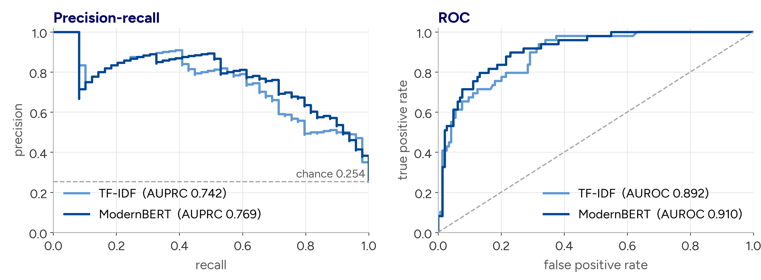
Backup: precision-recall and ROC curves on the test set
Notes:
Use for: ranking quality questions. AUPRC 0.742 vs 0.769; AUROC 0.892 vs 0.910; neither difference significant.

Slide 31
Backup: why the ranking differences stay undecided
Metric | Observed difference | Min. detectable difference (80% power, α = 0.05) | Test set needed
AUROC | +0.018 | ≈ 0.04 | ≈ 5× larger
Balanced accuracy | +0.018 | ≈ 0.08 | ≈ 21× larger
AUPRC | +0.027 | ≈ 0.11 | ≈ 17× larger
F1 (mix) | +0.068 | ≈ 0.13 | ≈ 4× larger
Derived from the paired-bootstrap standard errors on 193 test questions (49 Mix-required). A non-significant result here means undecided, not equal. Required size scales with (detectable / observed)².
Notes:
Use for: 'Is 193 test queries enough?' / 'Why not cross-validation?' (the fixed split kept threshold selection clean; CV is a fair suggestion for future work). Thesis Section 5.6.5.

Slide 32
Backup: even a perfect Naive-first cascade costs more time than query-only routing
Policy | Mean time per query | Est. tokens per query | Kept answers* | Wait for Mix-needing questions
ModernBERT router (query-only) | 14.1 s | 6,666 | 91.7% | 31 s (Mix only)
Perfect cascade: Naive first, escalate exactly the Mix-required | 19.5 s | 7,992 | 100% | 59 s (Naive, then Mix)
Always-Mix | 24.4 s | 17,857 | 100% | 24 s
A cascade pays for Naive on every question, and its escalated questions pay for both modes. The perfect cascade is the cheapest possible full-recall cascade; a real one needs an imperfect failure detector, so it would cost more or keep fewer answers.
Estimate from the per-query times and per-mode token means on the 193 test questions; not part of the thesis. *Kept answers under the same assumption as slide 17. Mix-needing wait: mean over the questions each policy sends to Mix.
Notes:
Use for: 'Why not run Naive first and escalate when it fails?' Answer: even a perfect cascade averages 19.5 s per query vs 14.1 s for the query-only router, and the Mix-needing questions wait about 59 s because they pay for both modes. A cascade would recover answers the router misses, so it is a different point on the trade-off, and combining both (route first, escalate on admitted failure) is natural future work. Clearly say this is a back-of-the-envelope estimate, not a thesis result.

Slide 33
Backup: experimental configuration
Component | Setting
Generator and judge | gemini-3-flash-preview, temperature 0
Embeddings | gemini-embedding-001 (768-dim)
LightRAG | v1.4.10; chunks 1,200 tokens, overlap 100; Naive top_k = chunk_top_k = 5; Mix chunk_top_k = 5 (graph retrieval at LightRAG defaults)
TF-IDF router | uni- and bigrams, min df 2, 20k features; logistic regression, C = 1.0, balanced weights
ModernBERT router | ModernBERT-base, max 128 tokens, lr 2e-5, batch 16, up to 8 epochs, early stopping on validation F1
Seeds and thresholds | seeds 7, 13, 42; thresholds from validation F1 (TF-IDF 0.48, ensemble 0.44)
Code and data | github.com/Dantecool02/Thesis_ericsson, tag examiner-revision (labels, splits, outputs in results/)
Notes:
Use for configuration questions. Thesis Appendix B.

Slide 34
Backup: use of generative AI tools
OpenAI Codex and Anthropic Claude Code were used in an advisory role, as discussion partners:
discussing phrasing and implementation alternatives, and debugging
preparing the revisions after supervisor and examiner feedback, and this presentation
The research question, design, experiments, analyses and conclusions are my own; every reported number was checked against the logs and output files.
Thesis Section 5.7, Use of generative AI tools. The Gemini model inside the pipeline is part of the method, not of this disclosure.
Notes:
Use for: questions about AI assistance. Keep it factual and brief.

