Slide 1

HACKING THE USB WORLD
WITH FACEDANCER
ENUMERATION AND THE CONTROL ENDPOINT
KATE TEMKIN & DOMINIC SPILL

Slide 2
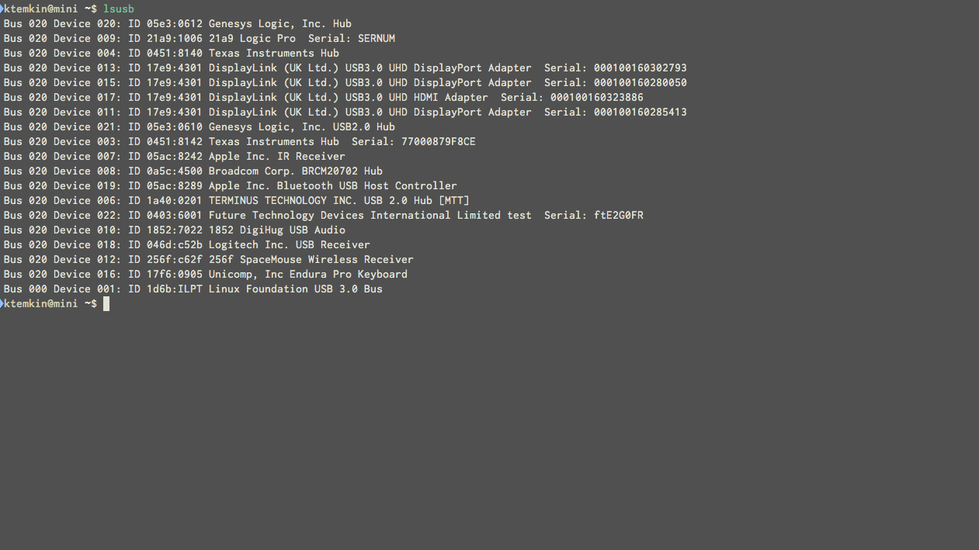
enumeration allows devices to be identified and paired with the correct drivers automatically
ENUMERATION

Slide 3
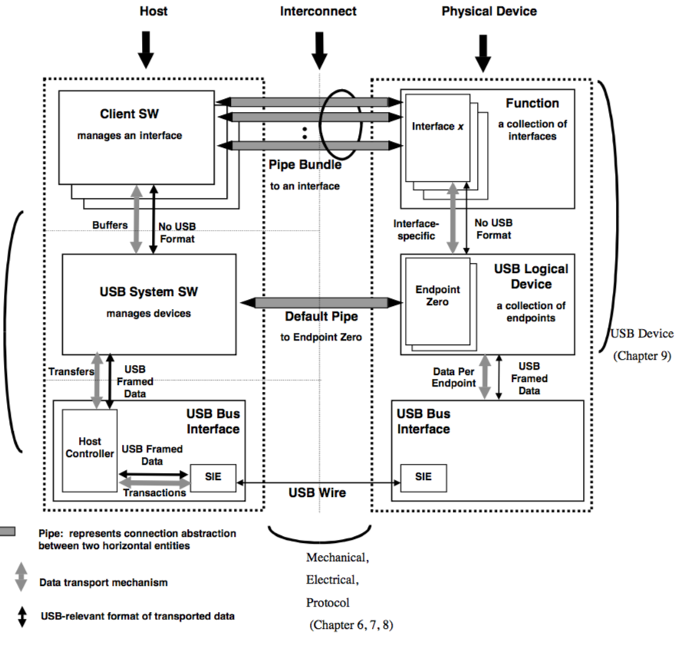
to support enumeration, every USB device must support a standard protocol on EP0
this protocol involves our first formal type of transfer: usb control requests

Slide 4
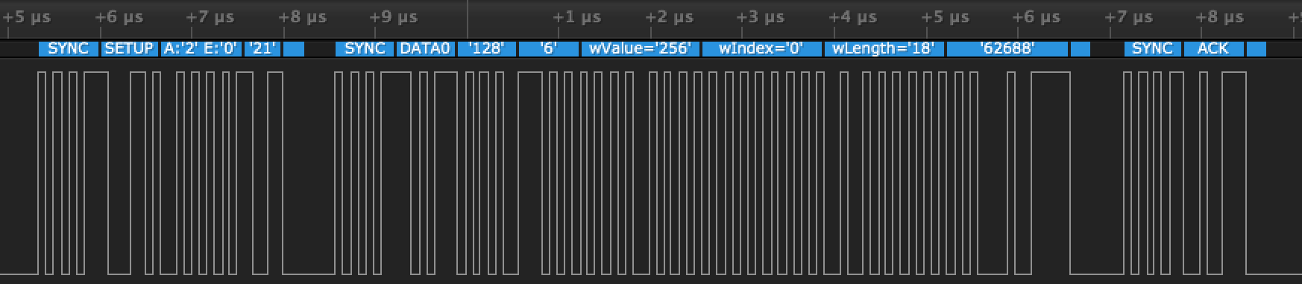
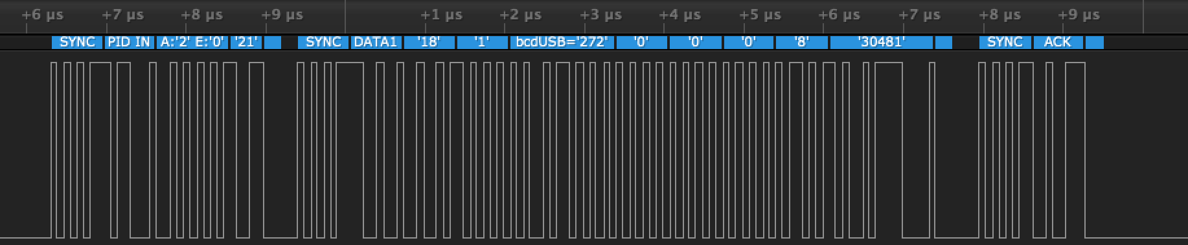
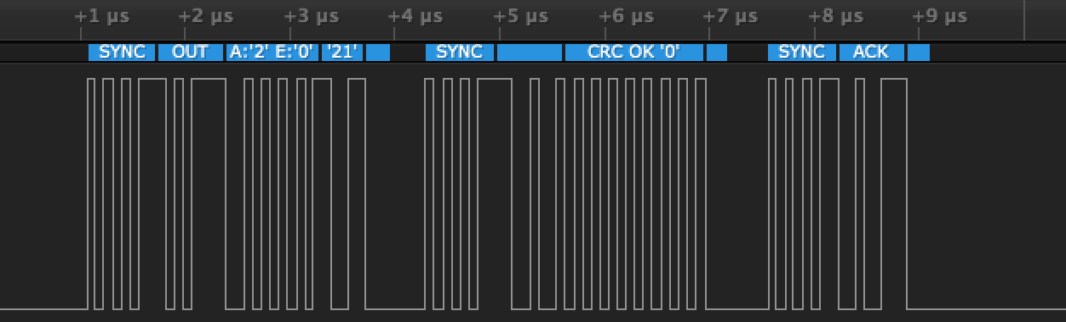
each control transfer is made up of a number of transactions…
…which form a simple command-and-response protocol.

Slide 5
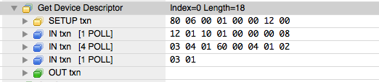
It’s often helpful to think of these transactions at a higher level of abstraction…

Slide 6
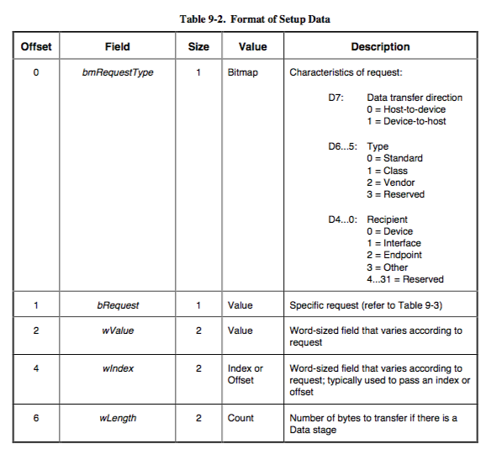
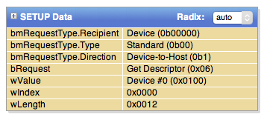
SETUP STAGE
Each control transfer begins with a setup stage describing the transactions to be performed.

Slide 7
If a device doesn’t support a given request,
it can STALL the setup stage by issuing a STALL handshake instead of an ACK.
SETUP STAGE

Slide 8
If the request has a non-zero length, the transfer has a data stage compromised of one or more IN or OUT data transactions.
The data stage ends when a short packet is received– that is, a packet less than the maximum packet size. (i.e. 8 bytes for LS, 64 bytes for FS)
DATA STAGE
If the device isn’t ready for the data stage, it can NAK to buy time to become ready.

Slide 9
Each control transfer ends with a status stage, which confirms both sides agree that a transaction completed correctly.
The status stage is always in the direction opposite the last transaction, to ensure both sides have a chance to ACK.
STATUS STAGE

Slide 10
CONTROL REQUESTS
The setup stage of a control transfer describes the type of request, the size and direction of the request’s data stage, and provides arguments.
The USB specification requires all devices to support a number of standard control requests, which are used for enumeration and configuration.

Slide 11
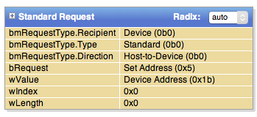

SET_ADDRESS REQUESTS
Every device starts with an address of zero.
A set-address request is one of the first requests commonly issued to a device, and assigns it an address for future communications.
This request has a length of zero, and thus no data stage. It communicates only via setup arguments:
value = address to be assigned

Slide 12
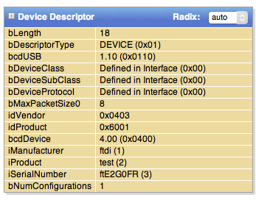
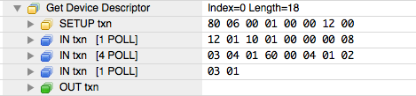
GET_DESCRIPTOR REQUESTS
A primary goal in enumeration is to allow USB devices to self-describe. Accordingly, devices can provide summaries of themselves and their functions called descriptors.
There are a multitude of descriptors a device can provide. Some examples:
device descriptors provide a high-level overview of the device
string descriptors contain strings that are referenced elsewhere

Slide 13
DEVICE DESCRIPTORS
The device descriptor provides everything a host needs to get an idea of who the device is:
Vendor ID
Product ID
Device ‘class’ in formation
References to string names.
Max size of packets on the control endpoint.

