Slide 1

HACKING THE USB WORLD
WITH FACEDANCER
INTERFACES, ENDPOINTS, AND TRANSFERS
KATE TEMKIN & DOMINIC SPILL
Notes:
These are the speaker notes for Opening Closed Systems With GlitchKit. We’ve included these with our uploaded slides so you can make better sense of the mostly-picture slides if you don’t have time to watch the recorded version or you want a text reference.

Slide 2
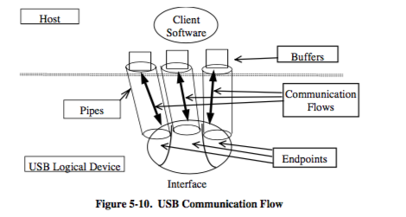
ENDPOINTS
Most USB devices use a number of communication channels, which are described in terms of their endpoints.
Endpoints both help to provide conceptual channels and help the host to schedule packets.
All diagrams from the USB 2.0 specification.

Slide 3
ENDPOINT TYPES
Type | Purpose
Control | Communications channel used for standard communications and simple packetized back-and-forth. Used for initial device discovery and setup. Only transport that also specifies a packet format. EP0 is always a control endpoint.
Bulk | Transport for shipping bytes ‘in bulk’. Bulk endpoints tend to be assigned the leftover bandwidth on the bus.
Interrupt | Transport for short bursts of latency-sensitive data. Used in cases that are similar to when you’d trigger an interrupt (e.g. keyboard keypress state).
Isochronous | Transport for data that grows “stale” if not delivered quickly— such as video frames from a camera.

Slide 4
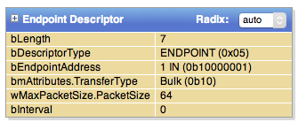
ENDPOINT DESCRIPTORS
With the exception of the control endpoint, which is always present, each endpoint is described by an endpoint descriptor.
The descriptor contains the endpoint’s vital statistics, including its address and type. Note that the endpoint’s direction is encoded in its address.
The MSB of the endpoint number specifies its address.
0x81 = endpoint one IN
0x80 = endpoint one OUT

Slide 5
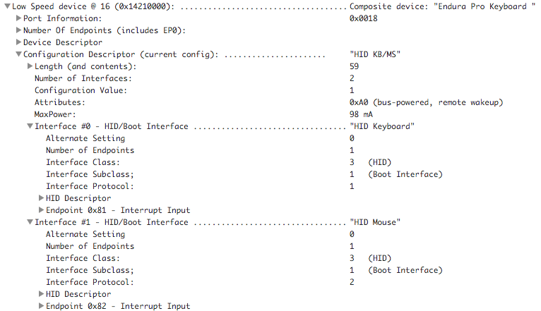
INTERFACES
USB devices can present more than one logical function– for example, a device can be both a keyboard and mouse.
To help organize endpoints, and to allow the host to use multiple drivers, endpoints are organized into interfaces based on function.

Slide 6
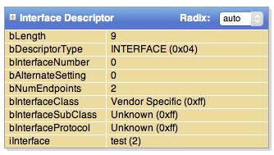
INTERFACE DESCRIPTORS
Each interface is described by an interface descriptor, which describes the grouping for the logical function.
Interfaces can contain a description of the device’s class, allowing the host to figure out if it has drivers for an individual interface.

Slide 7
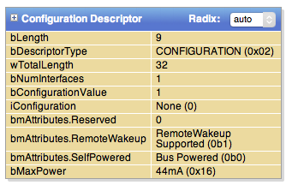
CONFIGURATION DESCRIPTORS
A device can opt to provide multiple collection of interfaces, and allow the host to switch between those. These collections are known as configurations, and are described using a configuration descriptor.
Each configuration provides a summary of its expected power consumption, allowing hosts to select configurations that match power requirements.
This is rarely used.

Slide 8
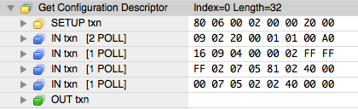
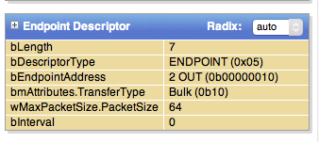
GETTING CONFIGURATION DESCRIPTORS
A GET_DESCRIPTOR can read a configuration and all of its ‘subordinate’ descriptors at once, if the length requested is long enough.

Slide 9
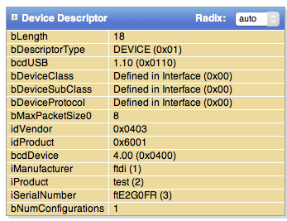
SCOPING OUT A DEVICE
The device descriptor contains the number of configurations present, which can then be used to issue a GET_DESCRIPTOR for each configuration.

Slide 10
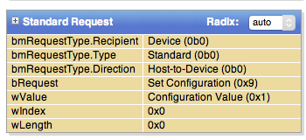

SET_CONFIGURATION REQUESTS
Before any endpoints other than EP0 can be used, a configuration must be selected using a SET_CONFIGURATION request. Setting configuration zero marks the device as unconfigured.

Slide 11
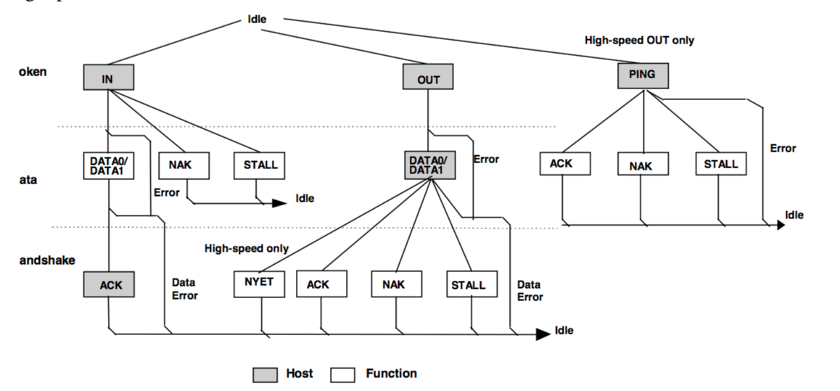
T
D
H
BULK TRANSACTIONS
All diagrams from the USB 2.0 specification.
Notes:
Points:
Access has to be multiplexed

Slide 12
Field | Value
Length | 256
Address | 0x1000
Field | Value
Length | 192
Address | 0x1040
Field | Value
Length | 128
Address | 0x1080
Field | Value
Length | 64
Address | 0x10C0
Field | Value
Length | 0
Address | 0x1100
a transfer issues transactions containing
maximum size packets until we run out of data
… at which point a short packet is issued.
TRANSFERS

Slide 13
Field | Value
Length | 256
Address | 0x1000
Field | Value
Length | 192
Address | 0x1040
Field | Value
Length | 128
Address | 0x1080
Field | Value
Length | 64
Address | 0x10C0
Field | Value
Length | 0
Address | 0x1100
Usually, both device and host controllers automate breaking transfers into transactions.
This has some interesting security consequences.
TRANSFERS

