Slide 1

HACKING THE USB WORLD
WITH FACEDANCER
A WHIRLWIND TOUR OF USB
Notes:
These are the speaker notes for Opening Closed Systems With GlitchKit. We’ve included these with our uploaded slides so you can make better sense of the mostly-picture slides if you don’t have time to watch the recorded version or you want a text reference.

Slide 2

WELCOME TO HS.T!
Quick vitals:
Training runs 9:00am – 5:30 pm
Talks at lunch
Approximate schedule on CTF system
Course materials:
all documents on https://usb.ktemkin.com
lab kits & live USB images being distributed
all challenges on the course website (or on the live USB if the internet fails)

Slide 3

SO, WHO are YOU?
Katherine/Kate Temkin (@ktemkin):
founder, Insomnia Security
Nintendo Switch inspector
glitch witch & open-source-tool-builder
educational (reverse) engineer
occasional engineering streamer

Slide 4
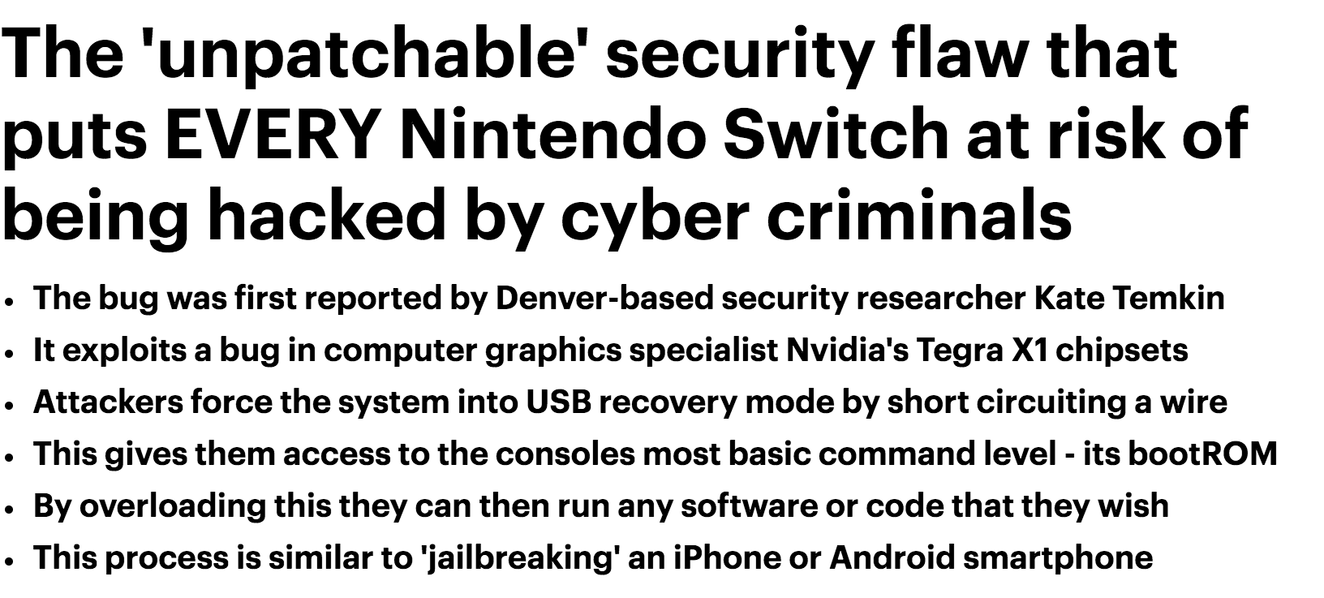



Notes:
And we’ve got some really interesting devices whose software stacks have been hardened to all hell

Slide 5
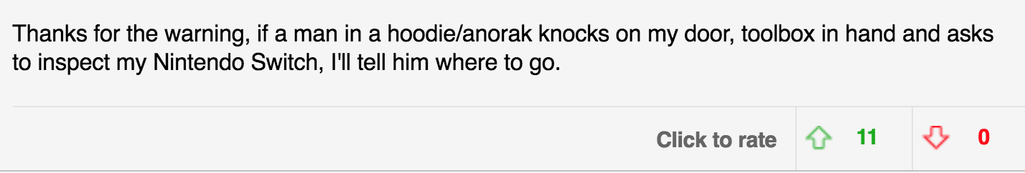
Notes:
And we’ve got some really interesting devices whose software stacks have been hardened to all hell

Slide 6
SO, WHO are YOU?
Michael Ossmann (@michaelossmann):
Apparently also Dominic, now

Slide 7
The universal serial bus
Resources:
http://www.beyondlogic.org/usbnutshell/
USB Complete, 5th Edition (ISBN: 1931448280)
USB specs: http://www.usb.org/developers/docs/usb20_docs/
Ultra-high-level:
current specification: 3.1; 2.0 is commonly still used
most of the ‘security surface’ is still on USB 2; we cover it exclusively
four current speeds: low, high, full, and super
multiple types of connectors in multiple sizes: {mini, micro} A, B, AB, C

Slide 8
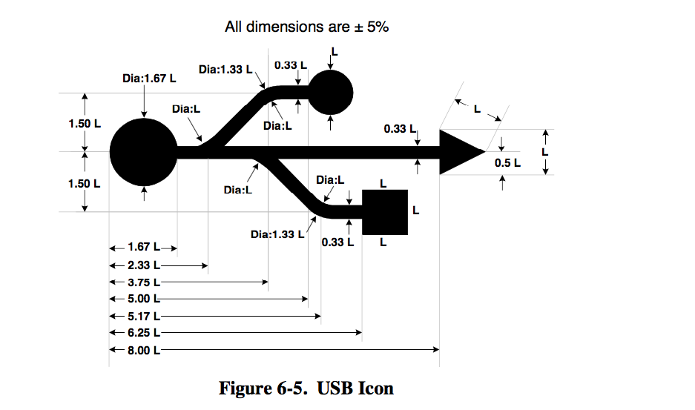
USB SPECS: SOURCE OF ALL KNOWLEDGE
spec violation
full of important information about USB and, uh, also diagrams like this one
nothing like some spec violation to start off a Monday
left: from USB spec
right: from this course

Slide 9
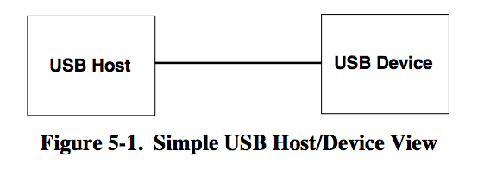
actual diagram from the USB specification
[probably not simplified enough]
the device faces upstream, and responds (only) when the host makes requests of it
the host faces downstream, provides power, and does most of the heavy lifting
PHYSICAL LAYER // USB 2.0
All diagrams from the USB 2.0 specification.
Notes:
Points:
Access has to be multiplexed

Slide 10
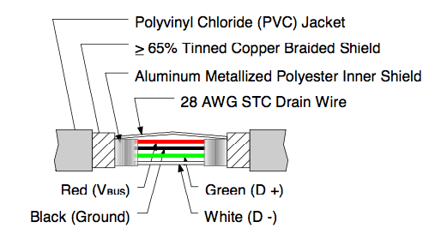
all communications occur over a single differential pair— essentially a single signal over two wires
a limited amount of power (5V @ 500mA) is also provided from host to device
PHYSICAL LAYER // USB 2.0
All diagrams from the USB 2.0 specification.
Notes:
Points:
Access has to be multiplexed

Slide 11
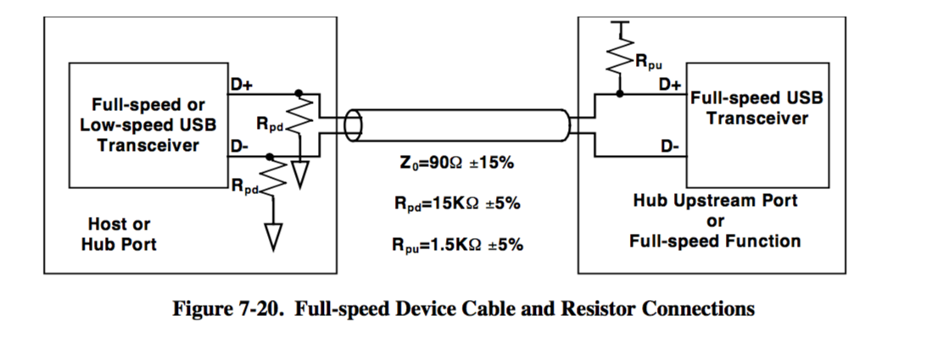
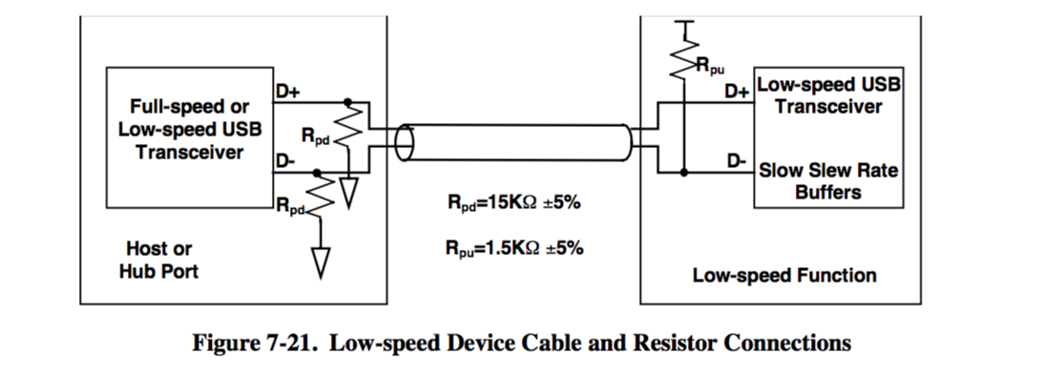
a pull-up resistor indicates the presence of a USB device
the location of the resistor indicates if the device is low speed or full/high

Slide 12
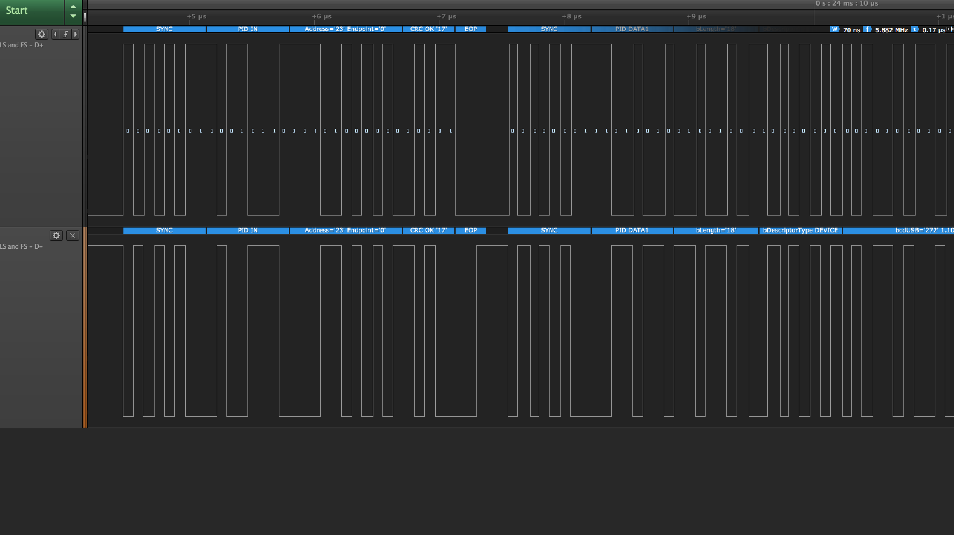
USB SIGNALING
Single differential pair: signals (almost) always inverse of each other
Half-duplex by necessity– only one participant controls the lines

Slide 13
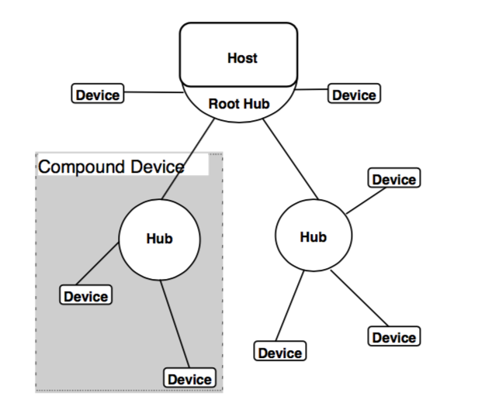
usb is designed to allow communications with more than one device simultaneously
devices, in turn can communicate more than one data stream at once, emulating multiple logical connections
PHYSICAL LAYER // USB 2.0
All diagrams from the USB 2.0 specification.
Notes:
Points:
Access has to be multiplexed

Slide 14
SHARING THE LINES
Each communication is directed at a particular device and endpoint
The host decides who gets to talk, and when
Devices only “speak when spoken to”

Slide 15
SHARING THE LINES
Each device is assigned an address, and listens for packets directed to it
Each device can accept multiple endpoints, which allow communications to be functionally grouped

Slide 16
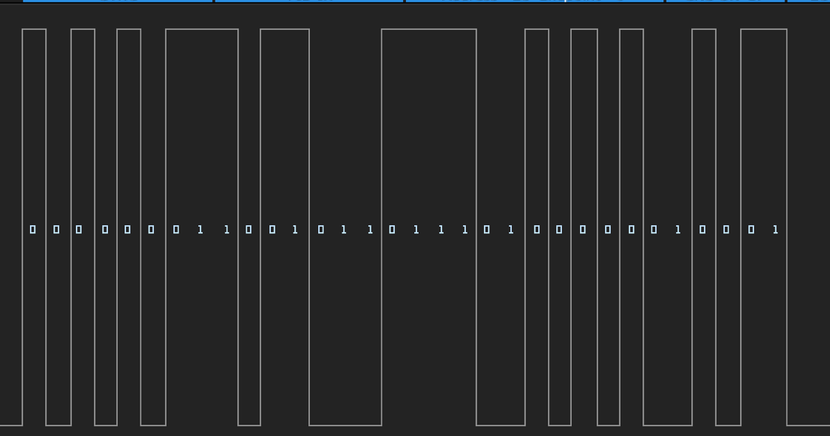
USB PACKETS
The ‘atoms’ that make up USB communications
Always contain a packet ID (PID) that specifies the packet type

Slide 17
TOKEN PACKETS
Start each USB communication.
Specify the direction of the communication, the device that should be listening, and the endpoint the device should route the packet to.
OUT and SETUP tokens indicate that data is about to be sent to the device.
IN tokens temporarily ‘give’ the bus to a given device, allowing it to speak.

Slide 18
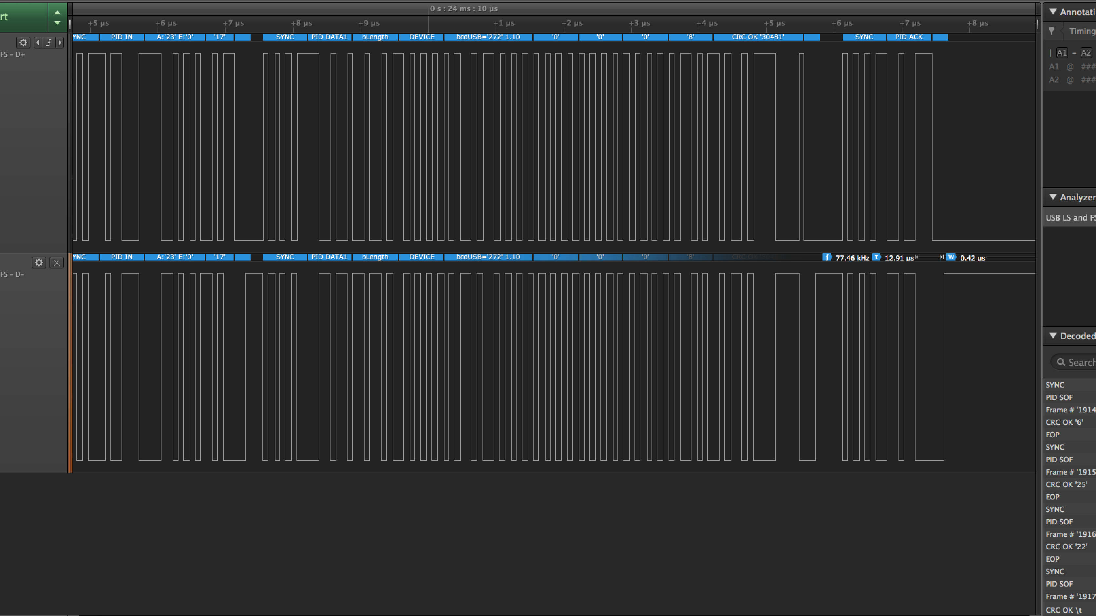
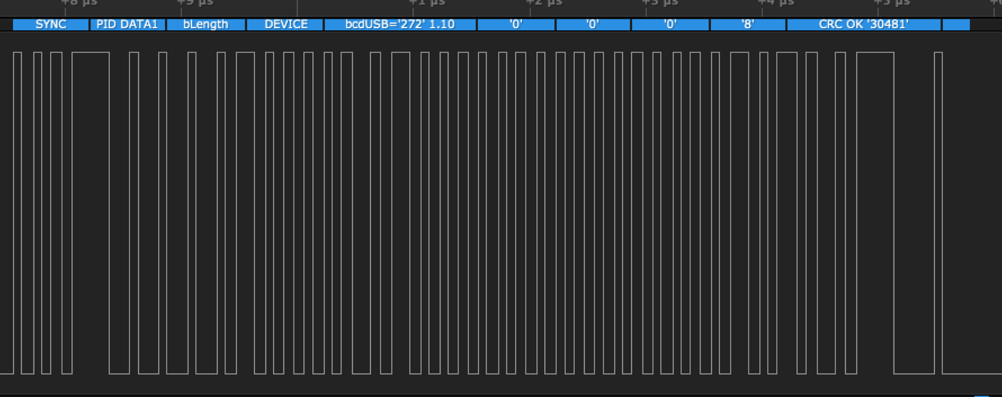
DATA PACKETS
Follow an IN/OUT/SETUP token.
Can originate from the device, following an IN token.
Carry the actual USB data.
Tokens typically alternate between DATA0 and DATA1, providing some protection against missed packets.
Contain simple CRC16 error checking.

Slide 19
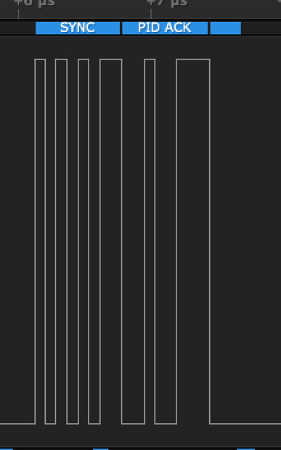
HANDSHAKE PACKETS
Used to indicate the status of a communication.
Three main types, indicated by PID:
ACK- “communication successful”
NAK- “not successful; retry”
STALL- “not supported; don’t retry”

Slide 20
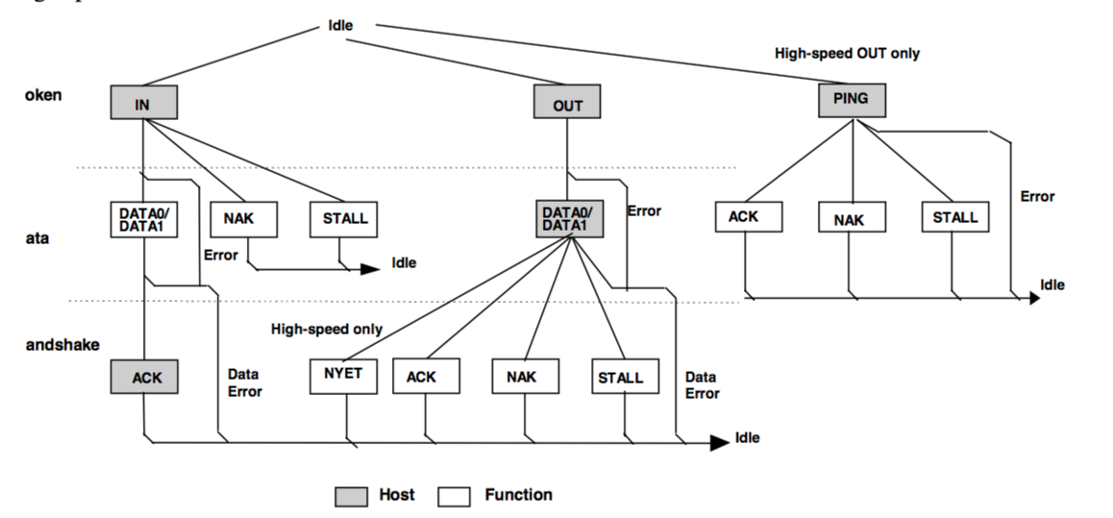
T
D
H
USB TRANSACTIONS
All diagrams from the USB 2.0 specification.
Notes:
Points:
Access has to be multiplexed

Slide 21
each transaction starts with a token packet that contains direction and destination information
T
if data is ready, a data packet is sent that contains the data;
otherwise, a NAK or STALL handshake packet is sent
D
H
if data was transmitted, the other side responds with an ACK or NAK packet
USB TRANSACTIONS
All diagrams from the USB 2.0 specification.
Notes:
Points:
Access has to be multiplexed

Slide 22
Field | Value
Length | 256
Address | 0x1000
Field | Value
Length | 192
Address | 0x1040
Field | Value
Length | 128
Address | 0x1080
Field | Value
Length | 64
Address | 0x10C0
Field | Value
Length | 0
Address | 0x1100
multiple transactions can be chained,
creating a USB transfer
USB TRANSFERS

Slide 23
Field | Value
Length | 256
Address | 0x1000
Field | Value
Length | 192
Address | 0x1040
Field | Value
Length | 128
Address | 0x1080
Field | Value
Length | 64
Address | 0x10C0
Field | Value
Length | 0
Address | 0x1100
most hosts keep track of transfer state,
so a transfer looks like a single operation to software
USB TRANSFERS

Slide 24
Field | Value
Length | 256
Address | 0x1000
Field | Value
Length | 192
Address | 0x1040
Field | Value
Length | 128
Address | 0x1080
Field | Value
Length | 64
Address | 0x10C0
Field | Value
Length | 0
Address | 0x1100
transfers continue until a short packet;
similar to null terminated protocols
USB TRANSFERS

