Slide 1
RISK ASSESSMENT FOR AIRCRAFT BUSINESS EXPANSION
Overview
Our company is expanding into new industries to diversify its portfolio. They are interested in purchasing and operating airplanes for commercial and private enterprises, but do not know anything about the potential risks of aircraft. My task is to determine which aircraft are the lowest risk for the company. This project will use data science techniques to analyze the NTSB aviation accident dataset up to Feb 2021 to identify the safest options for the company to start this new business endeavor

Slide 2
Business Understanding
Specifically, the company is interested in purchasing and operating airplanes for commercial and private enterprises, but do not know anything about the potential risks of aircraft. For the company to make effective decision on the business, the following business questions should be answered:
What are the trends in aviation accidents over time?
What are the trends in Injuries Due to Aviation Accidents Over Time?
Do weather conditions influence accidents?
Are there specific aircraft models that are involved in more accidents?
Is there a correlation between the number of engines and number of accidents?
Is there a relationship between the purpose of the plane and the number of accidents?
Which countries or locations experience the highest number of aviation accidents?

Slide 3
Data Understanding
The dataset, sourced from the National Transportation Safety Board (NTSB), contains 88,889 records of civil aviation accidents spanning from 1962 to 2023. It includes 31 attributes, covering accident details such as date, location, aircraft make/model, injury severity, weather conditions, and phase of flight. While rich in insights, the dataset has missing values in key fields like latitude/longitude, aircraft category, and injury counts, which may impact analysis. The data provides an opportunity to explore accident trends, risk factors, human and operational influences, and regulatory impacts, helping to enhance aviation safety and decision-making.

Slide 4
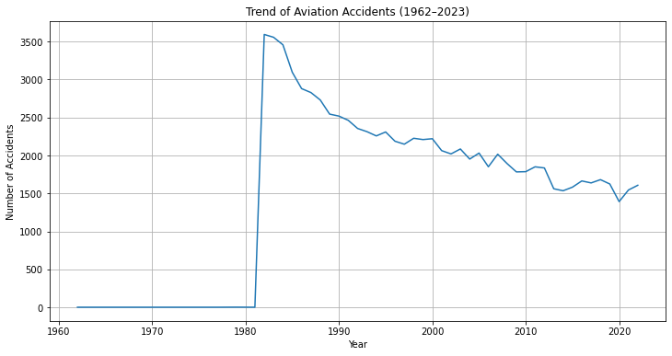
Data Analysis
This section will display the results of answering the business questions.
What are the trends in aviation accidents over time?
We can observe that there has been an overall drop of aviation accidents from 1982 to the year 2023. In the year 1982 we had the highest record of aviation accidents and 2020 having the lowest as the current lowest aviation accident recorded. From the year 1963 to 1981 we had the lowest aviation accidents recorded.

Slide 5
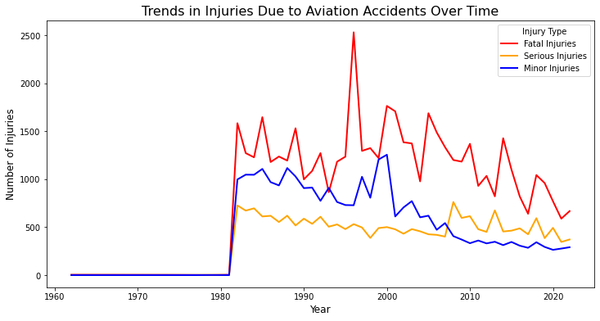
2. What are the trends in Injuries Due to Aviation Accidents Over Time?
From the line plot we can observe that we have high records of fatal accidents followed by the minor injuries and finally serious injuries until the year 2008 where serious injuries are higher than minor injuries untill the year 2023.

Slide 6
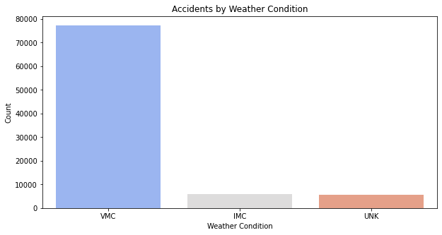
3. Do weather conditions influence accidents?
It turns out that accidents are mainly experienced during visual meteorological conditions (VMC) compared to instrument meteorological conditions (IMC) which might seem counterintuitive as one might expect more accidents in poorer visibility conditions

Slide 7
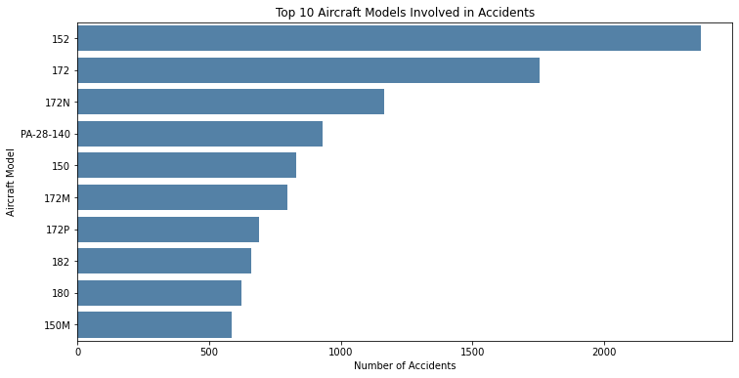
4. Are there specific aircraft models that are involved in more accidents?
The aircraft model 152 has the highest accident count, with just over 2000 accidents. This is significantly higher than any other model listed on the graph. Followed by model 172 with accidents over 1500 recorded. This shows that models with high accident records like 152, 172 and 172N are likely to be in an accident compared to other models.

Slide 8
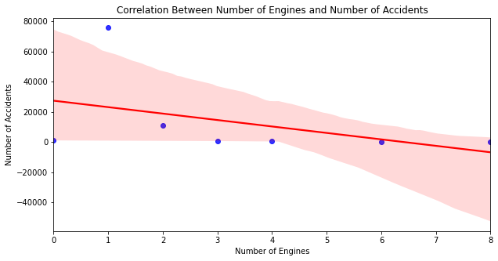
5. Is there a correlation between the number of engines and number of accidents?
We can also observe that Correlation between Number of accidents and Number of engines is a weak negative correlation of -0.42925333836 hence does not influence the number of accidents.

Slide 9
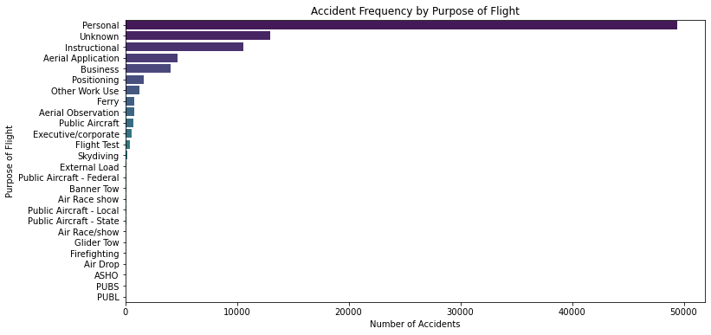
6. Is there a relationship between the purpose of the plane and the number of accidents?
From this visualization we can observe that personal flights have the highest record of number of accidents of over 4000.
For the other purposes of flight each has a records of less than 2000 with flight test with the least.

Slide 10
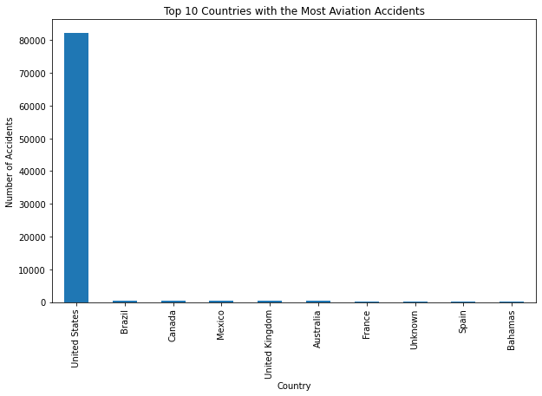
7. Which countries or locations experience the highest number of aviation accidents?
As seen from the visualization above, the United states is the most dominant country in our dataset with over 90% of data.

Slide 11
Recommendation
Based on the findings above, I would recommend:
Prioritize Aircraft Maintenance and Inspection. Since personal-purpose flights have the highest accident records, likely due to poor maintenance, invest in strict and frequent maintenance schedules.
Choose Aircraft Models with Strong Safety Records. The Cessna 152 has the highest accident count, possibly due to design flaws. Conduct a thorough risk assessment of aircraft models before purchasing or leasing. Opt for models with better safety features and lower accident rates.
Train Pilots and Crew on Safety Best Practices. Even though most accidents happen in Visual Meteorological Conditions (VMC), pilot error is still a significant factor and Simulate adverse weather conditions training even for VMC scenarios to improve situational awareness.
Focus on Route and Air Traffic Analysis. Since most accidents occur in the United States, analyze high-risk areas and plan routes strategically to avoid congested airspaces. Utilize advanced GIS and geospatial analytics to map accident-prone zones and create safer flight paths.
Invest in Multi-Engine Aircraft for Enhanced Safety. Analysis shows that aircraft with fewer engines tend to have higher injury counts. If possible, invest in multi-engine aircraft, especially for longer and high-risk routes, to increase redundancy and minimize risks in case of engine failure.
Improve Data-Driven Safety Measures. Use historical accident data to predict high-risk factors and integrate AI-powered risk assessment tools.
Consider Insurance and Safety Protocols Given the accident trends, ensure comprehensive insurance coverage for aircraft, passengers, and crew.

Slide 12
Conclusion
Our analysis of aviation accident data highlights key risk factors that must be addressed before starting the aviation business. While aviation safety has improved over the years, factors such as aircraft model choice, purpose of the aircraft maintenance practices, pilot training, and flight conditions play a critical role in accident prevention. By implementing data-driven safety measures, investing in well-maintained multi-engine aircraft, and adhering to strict operational standards, we can mitigate risks and enhance flight safety. These insights will guide strategic decisions to ensure a safe and sustainable aviation operatio

Slide 13
THANK YOU
I welcome any questions
Reach out on
Gmail: dantonkipngeno1@gmail.com
LinkedIn: Danton kipngeno

