Slide 1
AWS Sagemaker

Slide 2
What is sagemaker
A machine learning platform for developing, training and deploying models on AWS.
Integrated with various other AWS services (s3, ec2, etc.)
Some of the services,
Processing (preprocessing jobs) : Read training data from s3 (or others, possibly), pre-process and output to s3.
Training (Training jobs, Algorithms, Hyperparameter tuning jobs)
Inference (Deploying a model, deploying an endpoint for model, etc.)
And others (Notebooks, Labelling jobs, Foundation models, etc.)
Notes:
Notes for presentation:
1. What is sagemaker, what is a domain, and how can people collaborate in Sagemaker.
2. Different services provided in Sagemaker.
3. Different libraries provided in Sagemaker.
4. Different ways of deploying a model in Sagemaker.
5. What is the general setup when deploying a model with Sagemaker.
6. Deploying a model using s3 and model artifacts.
Demo
7. Deploying a model using a docker container.
Demo
8. Different ways of inferencing
9. Training a model in Sagemaker using docker container and training data stored in s3, and finally deploying it to an endpoint.
10. An example workflow for training and deploying the model on Sagemaker (for a Kaggle competition, a more complex model than the simple one)
Demo
11. Questions and review

Slide 3
A simple machine learning model
A model trained on the diabetes dataset.
A simple sklearn linear regression model.
Train script run through.

Slide 4
Scenarios
Deploying a pretrained model and host an inference endpoint using Sagemaker docker image.
Using a custom docker images for inference.
Training model in Sagemaker, hosting an inference endpoint using custom docker images and deploying for inference.
Training data stored in S3
Notes:
A pretrained model being deployed on Sagemaker.
Setup for a pretrained model deployed on a custom docker container
A model trained and deployed on Sagemaker itself

Slide 5
1. Deploying a pretrained model
Train the model (locally)
Extract the model artifacts (using joblib /pickle python library or some other library)
Create inference script
Specify how to load model (model_fn)
Specify how to read inference input (input_fn)
Specify how to predict (predict_fn)
Specify how to return output (output_fn)
Create final model artifact (model.joblb + inference.py = model.tar.gz)
Notes:
How is the model artifact configured (inference.py)
Dump the model artifacts, store them in s3
Loading a prebuilt image (Explain why an image is necessary)

Slide 6
Upload the final artifact to an S3 bucket.
Specify docker image used for running the model
To allow inference for models, they should be executed inside of a docker container.
Sagemaker provides images for popular frameworks (Sagemaker, Pytorch, Tensorflow, etc)
Create an endpoint configuration
Create endpoint

Slide 7
7. Endpoint configuration
A configuration for an endpoint specifying,
The models (multiple models can be hosted on the same endpoint) used by endpoint
The instance (machine) to run the model and endpoint
Endpoint type (Realtime or serverless)

Slide 8
Run through and python SDK deployment

Slide 9
2. Using a custom docker image for model deployment
Two possible ways to handle deployment to an endpoint,
Have the trained model inside of the container
Have the trained model artifact (model.joblib) in an S3 bucket and handle loading the model in the inference script.
Dockerfile run through
Notes:
AWS provides their own docker images.
We can use our own images if we want
Push the image to ecr and create your model
The image must have a server built in it and should expose port 8080 (In this case a flask server)
The server should have 2 endpoints, /ping and /invocations

Slide 10
Inference setup for custom container
The container must have a server running (e.g: Flask, FastAPI)
The server startup should be done through a file called ‘serve’
Sagemaker runs ‘docker exec <container_name> serve’ when deployed for inference
The container should expose port 8080
The server should have two endpoints
/ping: A GET endpoint which acts as a health check for the model and endpoint. Sagemaker uses this to see if the endpoint and model initializes properly.
/invocations: A POST endpoint which is used to do the inference and sending the response

Slide 11
Upload the docker container to Amazon ECR
Create a model which uses the ECR repository as inference image
Follow the usual endpoint creation process (create endpoint configuration and endpoint)

Slide 12
Code walkthrough

Slide 13
3. Training a model (in Sagemaker) and deploying an endpoint
The Dockerfile remains unchanged
Sagemaker suggests using two separate images for training and inference (here we are only using one for simplicity)
Load the training data (diabetes.csv) into a S3 bucket
Upload the docker image to ECR (training and inference images)
Create a training job in Sagemaker,
Notes:
Must have an (separate) image for training and inference.
The input data must be stored in s3 (or some other storage)
The model will be output to an s3 bucket
The output model can be set up with an endpoint and deployed

Slide 14
Sagemaker training job
A training job is an instance used for training a model using an aws machine
Entrypoint in the docker image for training,
Docker exec <containername> train
How to set up a training job,
Specify training image
Specify the compute instance (what machine it runs on)
Hyper parameters (Key value pair)
Input data configurations (Channels)
Model output location (e.g: S3 bucket URI)
Notes:
Channel:

Slide 15
Behind the scenes
Sagemaker will mount the following directories,
Model output location: S3 prefix -> /opt/ml/model/
Writing to /opt/ml/model/ will store it in the bucket prefix
Hyperparameters: The key value pairs -> /opt/ml/input/config/hyperparameters.json
Channels: Suppose a channel is set for an S3 prefix,
S3 prefix -> /opt/ml/data/<channel_name>

Slide 16
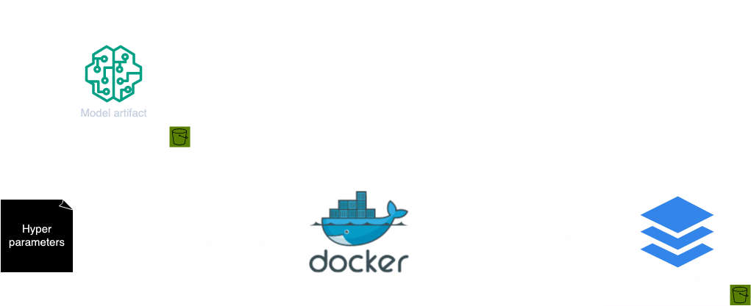

Slide 17
Train script walkthrough

Slide 18
After training
We have the model saved in a S3 prefix
Register it as a model in Sagemaker
Attach the image used for inference (can be the same image provided it has a script called ‘serve’)
Follow the previously mentioned procedure to deploy the model to an endpoint
Notes:
Channels
Output configuration (s3 bucket)
How the above two gets mounted into the container

Slide 19
Inference image
The Dockerfile remains same
Or if you want different dockerfiles, only install dependencies for the server
The inference script/server (serve) will have to load the model from the mounted S3 bucket
When specifying model artifacts with an inference image, the model artifacts are available at /opt/ml/model/ (in an uncompressed form)

Slide 20
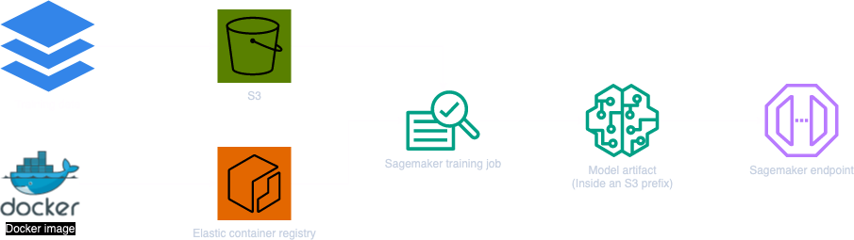

Slide 21
Walkthrough
Notes:
How the s3 object from training gets mounted into the image for inference

Slide 22
Other services

