Slide 1
TOR and Ricochet

Slide 2
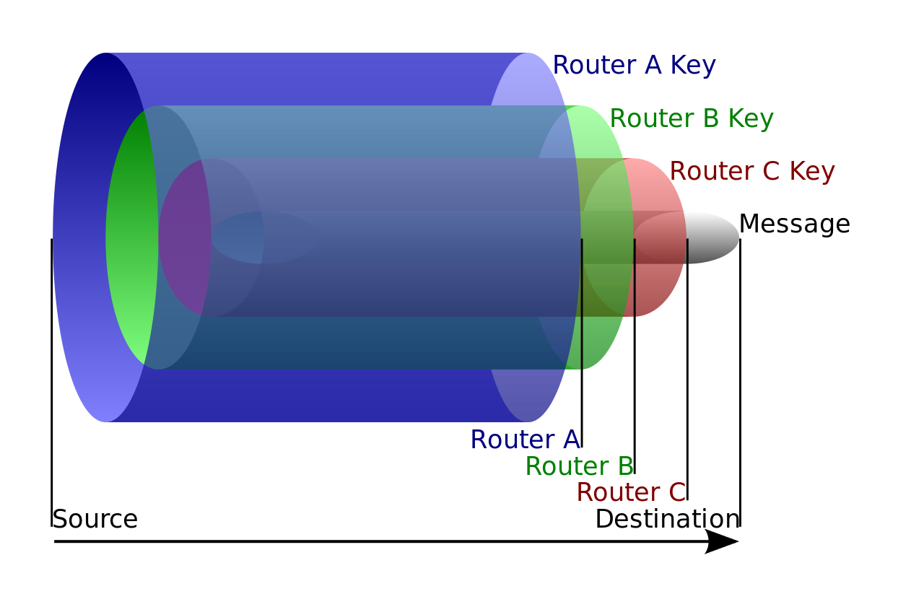
Onion routing
Traffic passes through several random relays (onion routers)
Packets have multi-layer encryption like an onion
Each onion router removes a layer
Routers only know what the previous router and what are next router are
Last hop is unencrypted (unless HTTPS is used)
By ​English Wikipedia user HANtwister, CC BY-SA 3.0, https://commons.wikimedia.org/w/index.php?curid=4567044

Slide 3



Onion routing
Can be used to view ordinary (non-onion service) sites
Tor instance acts as a proxy
Each router removes a layer of encryption and forwards to the next router
  The last hop to the server is unencrypted
On the return journey the routers add a layer of encryption

Slide 4
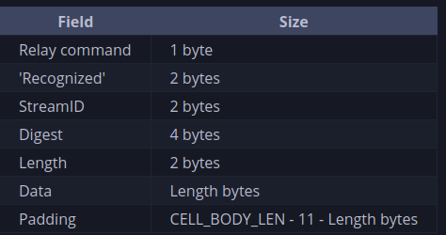
Onion routing – creating the connection
The circuit is created by extending a chain
Symmetric keys are exchanged using the Diffie–Hellman key exchange algorithm
The onion routers remember the previous and next routers
Each router removes a layer of encryption and forwards to the next router
  The last hop to the server is unencrypted
On the return journey the routers add a layer of encryption
Structure of an unencrypted relay cell
https://spec.torproject.org/tor-spec/relay-cells.html

Slide 5
Onion services

