Slide 1
NAT, UDP hole punching, WebRTC

Slide 2
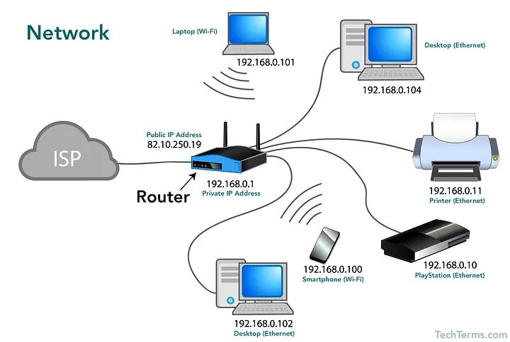
Network Address Translation (NAT)
Only ~4.3 billion IPv4 address
IPv6 is dumb or something idk why people don’t use it
The solution:
  All devices on a local network have the same public IP address
  Router must forward traffic to devices on the network
https://medium.com/yavar/nat-network-address-translation-2e5bd3c550f9

Slide 3
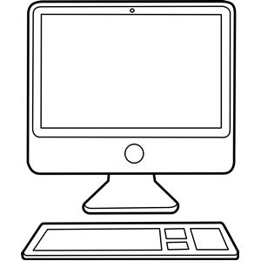

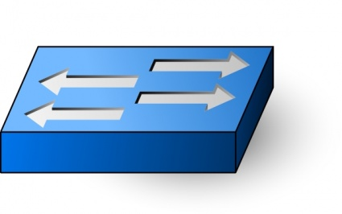
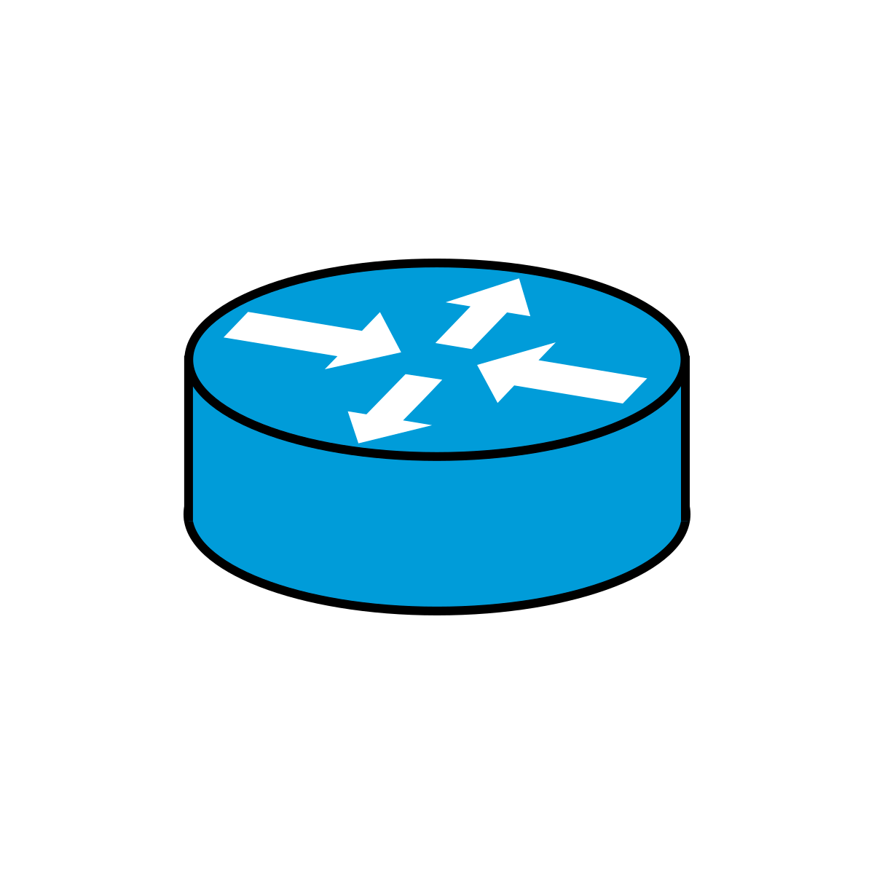
Network configuration
192.168.1.100
192.168.1.254
(default gateway)
86.21.122.203
216.58.204.78
192.168.1.101
Switch
Home router
Google server
ISP router
192.168.1.102
Packets to 192.168.1.* go to the device directly
Everything else is sent to the default gateway for forwarding

Slide 4

Source 192.168.1.100:34064
Destination 216.58.204.78:80
192.168.1.100
192.168.1.254
(default gateway)
86.21.122.203
216.58.204.78
192.168.1.101
Switch
Home router
Google server
ISP router
192.168.1.102

Slide 5
Inside local | Inside global | Outside global
192.168.1.100:34064 | 86.21.122.203:34064 | 216.58.204.78:80
192.168.1.100
192.168.1.254
(default gateway)
86.21.122.203
216.58.204.78
192.168.1.101
Switch
Home router
Google server
ISP router
Source 192.168.1.100:34064
Destination 216.58.204.78:80
192.168.1.102

Slide 6
Inside local | Inside global | Outside global
192.168.1.100:34064 | 86.21.122.203:34064 | 216.58.204.78:80
192.168.1.100
192.168.1.254
(default gateway)
86.21.122.203
216.58.204.78
192.168.1.101
Switch
Home router
Google server
ISP router
Source 86.21.122.203:34064
Destination 216.58.204.78:80
192.168.1.102

Slide 7
Inside local | Inside global | Outside global
192.168.1.100:34064 | 86.21.122.203:34064 | 216.58.204.78:80
192.168.1.100
192.168.1.254
(default gateway)
86.21.122.203
216.58.204.78
192.168.1.101
Switch
Home router
Google server
ISP router
Source 86.21.122.203:34064
Destination 216.58.204.78:80
192.168.1.102

Slide 8
Inside local | Inside global | Outside global
192.168.1.100:34064 | 86.21.122.203:34064 | 216.58.204.78:80
192.168.1.100
192.168.1.254
(default gateway)
86.21.122.203
216.58.204.78
192.168.1.101
Switch
Home router
Google server
ISP router
Server replies...
192.168.1.102

Slide 9
Inside local | Inside global | Outside global
192.168.1.100:34064 | 86.21.122.203:34064 | 216.58.204.78:80
192.168.1.100
192.168.1.254
(default gateway)
86.21.122.203
216.58.204.78
192.168.1.101
Switch
Home router
Google server
ISP router
Source 216.58.204.78:80
Destination 86.21.122.203:34064
192.168.1.102

Slide 10
Inside local | Inside global | Outside global
192.168.1.100:34064 | 86.21.122.203:34064 | 216.58.204.78:80
192.168.1.100
192.168.1.254
(default gateway)
86.21.122.203
216.58.204.78
192.168.1.101
Switch
Home router
Google server
ISP router
Source 216.58.204.78:80
Destination 86.21.122.203:34064
192.168.1.102

Slide 11
Inside local | Inside global | Outside global
192.168.1.100:34064 | 86.21.122.203:34064 | 216.58.204.78:80
192.168.1.100
192.168.1.254
(default gateway)
86.21.122.203
216.58.204.78
192.168.1.101
Switch
Home router
Google server
ISP router
Source 216.58.204.78:80
Destination 192.168.1.100:34064
192.168.1.102

Slide 12
Source 216.58.204.78:80
Destination 192.168.1.100:34064
Inside local | Inside global | Outside global
192.168.1.100:34064 | 86.21.122.203:34064 | 216.58.204.78:80
192.168.1.100
192.168.1.254
(default gateway)
86.21.122.203
216.58.204.78
192.168.1.101
Switch
Home router
Google server
ISP router
192.168.1.102

Slide 13
Network Address Translation (NAT)
If two computers are using the same inside local port number, they will need to be mapped to different inside global ports
Inside local | Inside global | Outside global
192.168.1.100:34064 | 86.21.122.203:34064 | 216.58.204.78:80
192.168.1.101:34064 | 86.21.122.203:12453 | 216.58.204.78:80
192.168.1.100
192.168.1.101
Some routers change ports by default
In general completely up to the router how it wants to map ports

Slide 14
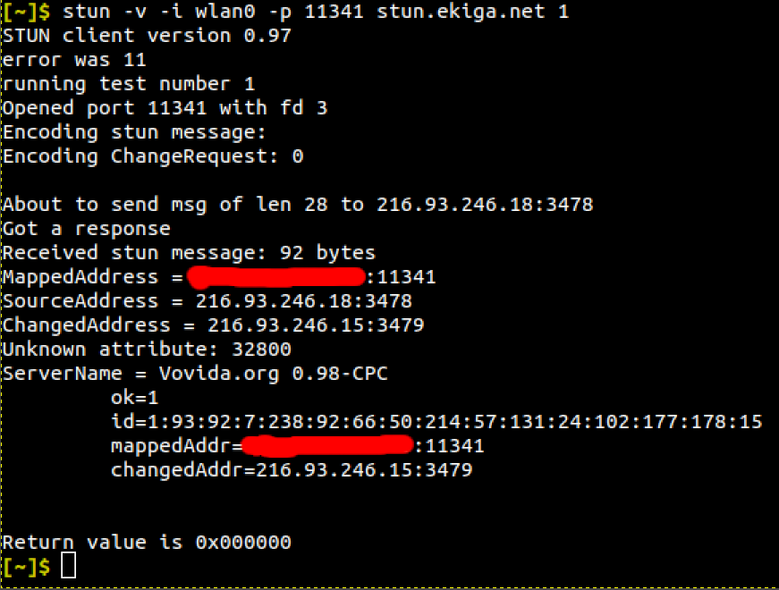
Session Traversal Utilities for NAT (STUN)
wlan0 network interface
Source port
Verbose mode
Test number
A protocol to work out how the router is translating a source address
Send a UDP packet to a STUN server (e.g. stun.ekiga.net)
STUN server replies with what it saw for the source IP and port
What the IP and port were mapped to

Slide 15
UDP Hole Punching
How can we create a peer-to-peer connection with all this NAT stuff????
A solution: UDP hole punching

Slide 16
  Make a request to a STUN server to find the mapped address
  Send mapped address to peer by any method
  Both peers send UDP packets from their source port to the other’s mapped address
Port 1234
Port 1234
Network 1
Network 2
86.21.122.203
101.4.54.32
192.168.1.101
10.5.0.10
Router NAT table for network 1
STUN server
Router NAT table for network 2
Inside local | Inside global
192.168.1.100:34064 | 86.21.122.203:34064
Inside local | Inside global
192.168.1.100:34064 | 86.21.122.203:34064

Slide 17
  Make a request to a STUN server to find the mapped address
  Send mapped address to peer
  Both peers send UDP packets from their source port to the other’s mapped address
The STUN server’s response said 86.21.122.203:4321
The STUN server’s response said 201.4.54.32:1234
Network 1
Network 2
86.21.122.203
201.4.54.32
192.168.1.101
10.5.0.10
216.93.246.18
(stun.ekiga.net)
Router NAT table for network 1
STUN server
Router NAT table for network 2
Inside local | Inside global | Outside global
192.168.1.101:1234 | 86.21.122.203:4321 | 216.93.246.18:3478
 |  | 86.21.122.203:4321
Inside local | Inside global | Outside global
10.5.0.10:1234 | 201.4.54.32:1234 | 216.93.246.18:3478

Slide 18
  Make a request to a STUN server to find the mapped address
  Send mapped address to peer
  Both peers send UDP packets from their source port to the other’s mapped address
I’ll send it by carrier pigeon
I’ll phone them
Network 1
Network 2
86.21.122.203
201.4.54.32
192.168.1.101
10.5.0.10
216.93.246.18
(stun.ekiga.net)
Router NAT table for network 1
STUN server
Router NAT table for network 2
Inside local | Inside global | Outside global
192.168.1.101:1234 | 86.21.122.203:4321 | 216.93.246.18:3478
Inside local | Inside global | Outside global
10.5.0.10:1234 | 201.4.54.32:1234 | 216.93.246.18:3478

Slide 19
  Make a request to a STUN server to find the mapped address
  Send mapped address to peer
  Both peers send UDP packets from their source port to the other’s mapped address
Source port: 1234
Destination:
201.4.54.32:1234
Source port: 1234
Destination:
86.21.122.203:4321
Network 1
Network 2
86.21.122.203
201.4.54.32
192.168.1.101
10.5.0.10
216.93.246.18
(stun.ekiga.net)
Router NAT table for network 1
STUN server
Router NAT table for network 2
Inside local | Inside global | Outside global
192.168.1.101:1234 | 86.21.122.203:4321 | 216.93.246.18:3478
192.168.1.101:1234 | 86.21.122.203:4321 | 201.4.54.32:1234
Inside local | Inside global | Outside global
10.5.0.10:1234 | 201.4.54.32:1234 | 216.93.246.18:3478
10.5.0.10:1234 | 201.4.54.32:1234 | 86.21.122.203:4321
Hope that the mapped address is the same!
Hope that the mapped address is the same!

Slide 20
Problems
Packets must be sent periodically so that the NAT table entry does not surpass its TTL
Have to coordinate creating the connection somehow
Uses UDP – fast but unreliable
Doesn’t work with all NAT translation methods...

Slide 21
NAT translation methods
Full cone
  Addresses are mapped predictably
(Address-)restricted cone
  Addresses are mapped predictably
  Only accept packets from IPs to which I have already sent a packet
Port-restricted cone
  Addresses are mapped predictably
  Only accept packets from sockets (IP+port) to which I have already sent a packet
Symmetric
  Addresses are mapped differently depending on the destination
  Not possible to do UDP hole punching on these networks.

Slide 22
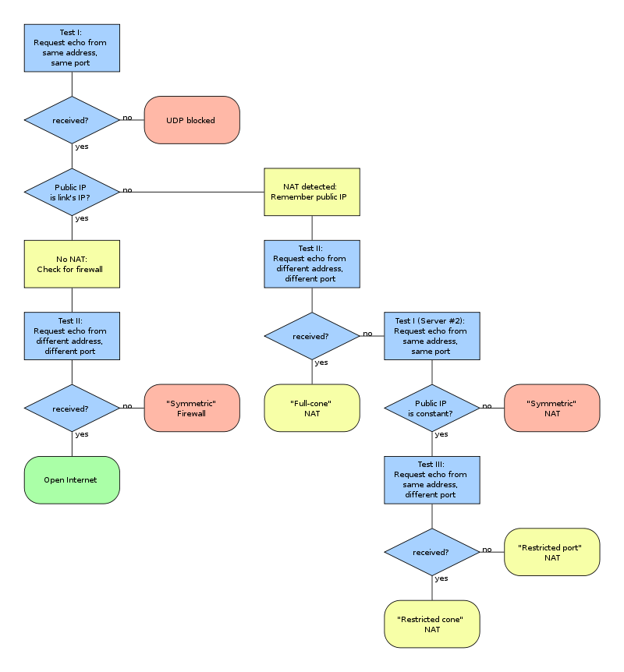
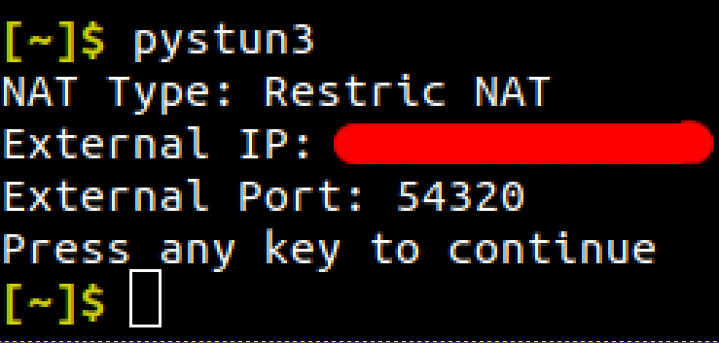
NAT translation methods
NAT translation method can be determined using this flowchart
pystun3 (a pip package) can do this (https://github.com/talkiq/pystun3)
By Christoph Sommer - Own work, CC BY-SA 3.0, https://commons.wikimedia.org/w/index.php?curid=1337756

Slide 23

WebRTC – a protocol that basically does all of this
“Web Real-Time Communication”
Built into all modern browsers
Makes requests to STUN servers
Does UDP hole punching
Can create connections through relay servers instead if a peer connection is not possible
Can make ordered UDP connections
Multiple uses (in addition to creating a standard peer-to-peer socket)
  Audio and video conferencing, screen sharing, file exchange...

Slide 24
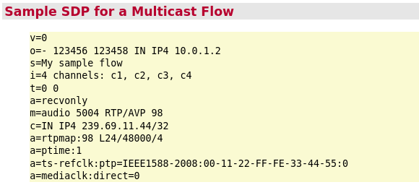
WebRTC – how it works
Peer A wants to initiate a peer connection to peer B
Peer A creates a Session Description Profile (SDP)
  Contains information about codecs used, etc
This SDP is the offer
Peer A sends the offer to peer B (via a third party)
Peer B creates an SDP answer and sends it back to peer A
Peers A and B also exchange Internet Connectivity Establishment (ICE) candidates
  Can refer to open ports on the local network, hole-punched UDP sockets, relay servers…
The ICE candidates are tested in priority order until a connection is made
  Local connections first, then UDP hole punching, then relays
https://dev.audinate.com/GA/ddm/userguide/1.1/webhelp/content/appendix/sample_sdp_specification.htm

Slide 25
Signalling
Before the peer connection is created the SDPs and ICE candidates must be exchanged
This process is called signalling
Typically done using an external server to forward the data using WebSockets
SDPs and ICE candidates sent via a signalling server
WebSocket
Signalling server
WebSocket
P2p WebRTC connection established
WebRTC does not define any specific protocol for signalling

