Slide 1



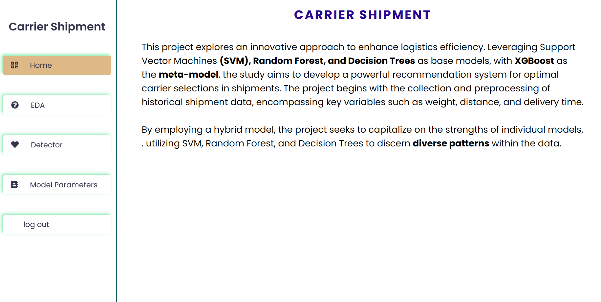
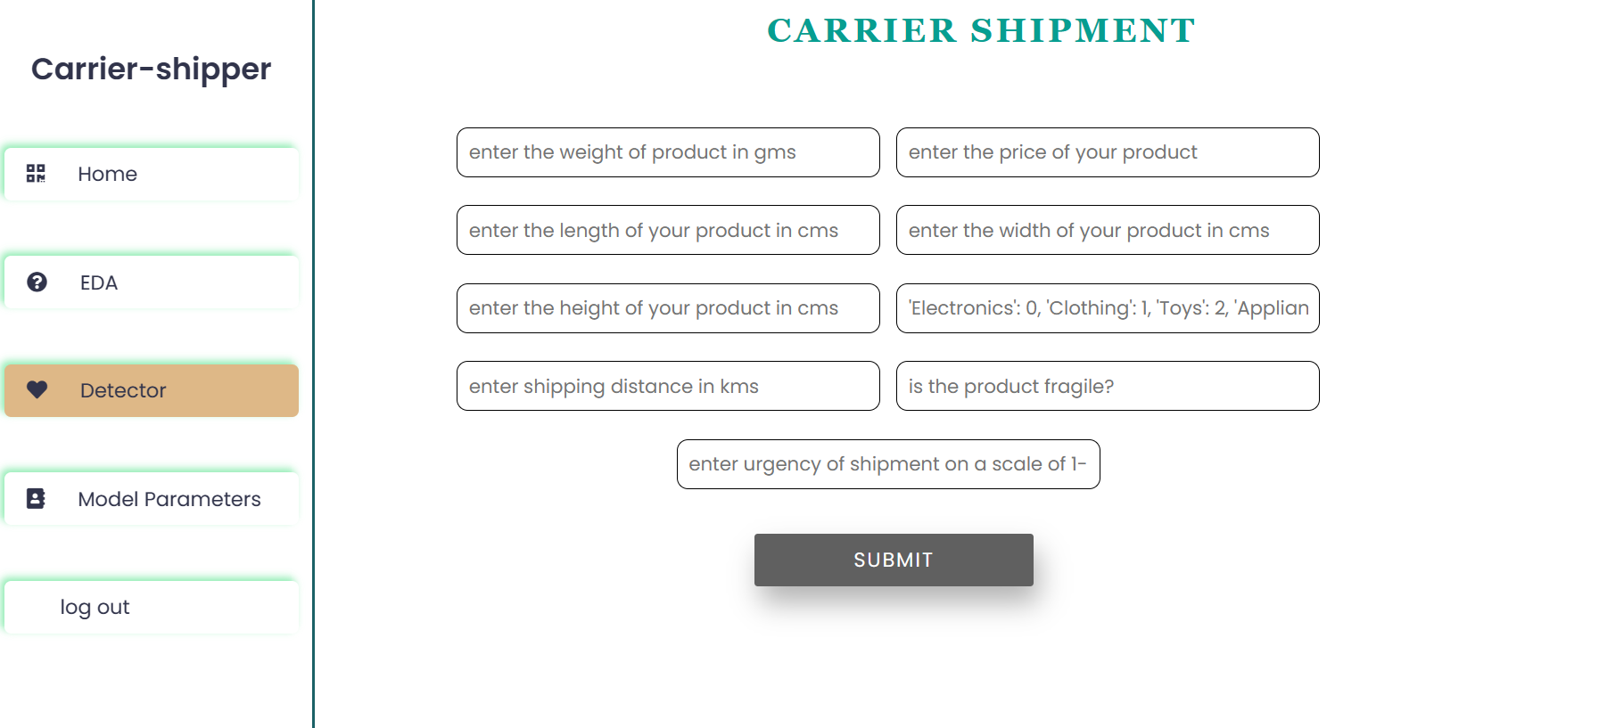
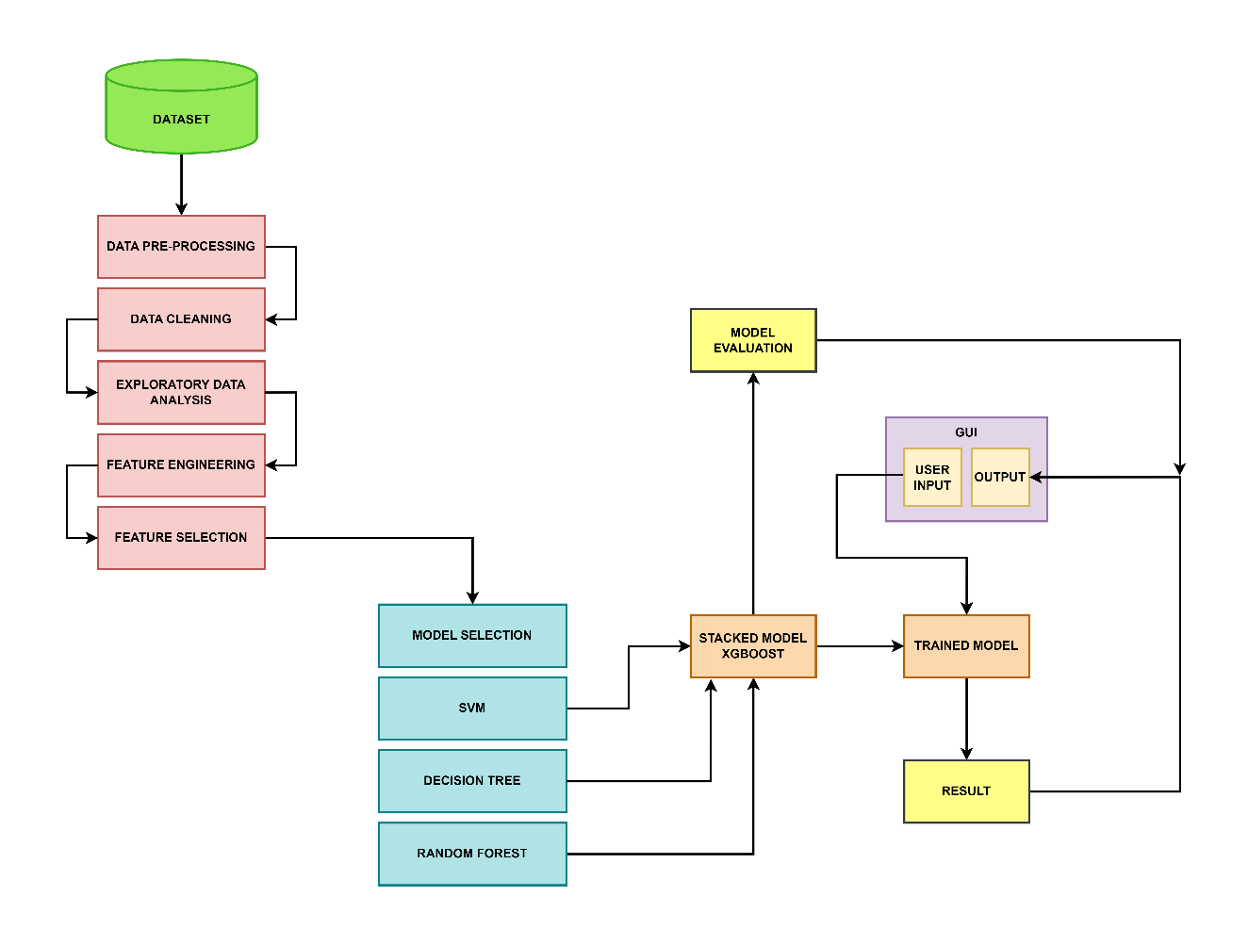
SAI VIDYA INSTITUTE OF TECHNOLOGY
Department of Computer Science & Engineering
Accredited by NBA, New Delhi, NAAC- “A” Grade
Project Exhibition - 2024
A Smart Recommendation System for Carrier-Shipper Matching using Multilabel Classification
Aastha Prasad(1VA20CS001), S G Dhanush Kumar(1VA20CS043),
Sharan S(1VA20CS049), Danush V S(1VA20CS069)
Department Of CSE, VIII SEM, Sai Vidya Institute Of Technology, Bengaluru-560064
Introduction
Results
The "Smart Recommendation System for Carrier Shipping Matching" is a sophisticated solution designed to streamline the process of selecting the optimal shipping carrier for each package.
Leveraging a combination of historical data, real-time tracking and advanced machine learning techniques, this system aims to provide users with accurate and data-driven carrier recommendations that align with their specific shipping requirements.
Problem Statement
Conclusion And Future Studies
Design and implement an intelligent recommendation system that can efficiently match carriers (freight transportation providers) with shippers (companies or individuals looking to ship goods) based on their specific needs, preferences, and operational constraints. The system should take into account various parameters, such as cargo type, delivery timeline, geographical location, carrier capacity and pricing
Innovation and Significance:
Our Smart Recommendation System introduces innovative solutions to the complex task of Carrier-Shipper Matching.
It significantly enhances efficiency, reduces costs and optimizes resource allocation.
Data-Driven Decision Making:
We have demonstrated the power of data-driven decision-making, which allows for real-time adjustments and proactive problem-solving. As a Future work we want to improve the architecture with the current reviews and other real time values for better results.
System Architecture
System Architecture
Acknowledgements
We express our special in-depth gratitude, sincere gratitude to our Guide Dr. Dr. Tejashwini N Associate Professor, Dr. Varun E, Associate Professor Sai Vidya Institute Of Technology, Bengaluru, for his constant support in completing the project.

