Slide 1
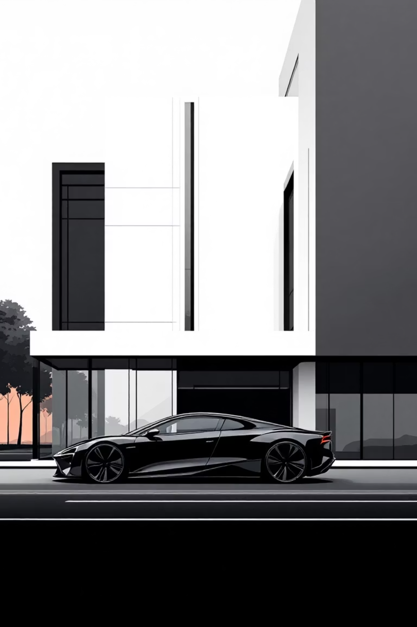
Car Rental MERN Project
Enterprise-Ready Full Stack Web Application
Member 1 - Shashi Vamshi
Member 2 – Dhanush
Member 3 – Pavani
Member 4 - Krishnapriya
Member 5 - Pravalika

Slide 2
Project Introduction
The Car Rental MERN Project is a scalable full-stack web application designed to digitize and streamline the car rental process for both customers and administrators. The system replaces manual and time-consuming rental procedures with an automated, transparent, and efficient online platform.
Problem it Solves:
How It Is Different:
Traditional car rental systems suffer from manual booking processes, limited vehicle visibility, and inefficient management.
This application provides secure authentication, role-based access control, and centralized administration through a modern web interface.

Slide 3
Technology Stack & Core Functionalities
Technology Stack:
Core Functionalities:
Frontend: React.js for UI, Redux for state management, React Router for navigation
Secure user registration and login
Vehicle listing and search
Backend: Node.js with Express.js for RESTful APIs
Car booking with date selection
Database: MongoDB with Mongoose
Admin dashboard for vehicle and booking management
Role-based access for users and administrators

Slide 4

System Workflow & Architecture
Users interact with the application through a responsive React-based frontend
User actions trigger to manage application state
Frontend communicates with backend REST APIs via HTTP requests
Backend processes requests, applies business logic, and interacts with MongoDB
Responses are returned to the frontend, dynamically updating the UI

Slide 5
System Capabilities & Limitations
What the System Can Do:
What the System Cannot Do (Current Version):
Enable secure user authentication
Allow users to browse and book vehicles
Offline booking support
Manage vehicles, users, and bookings via admin panel
Advanced analytics and reporting
Maintain booking history and real-time updates
Native mobile application support

Slide 6
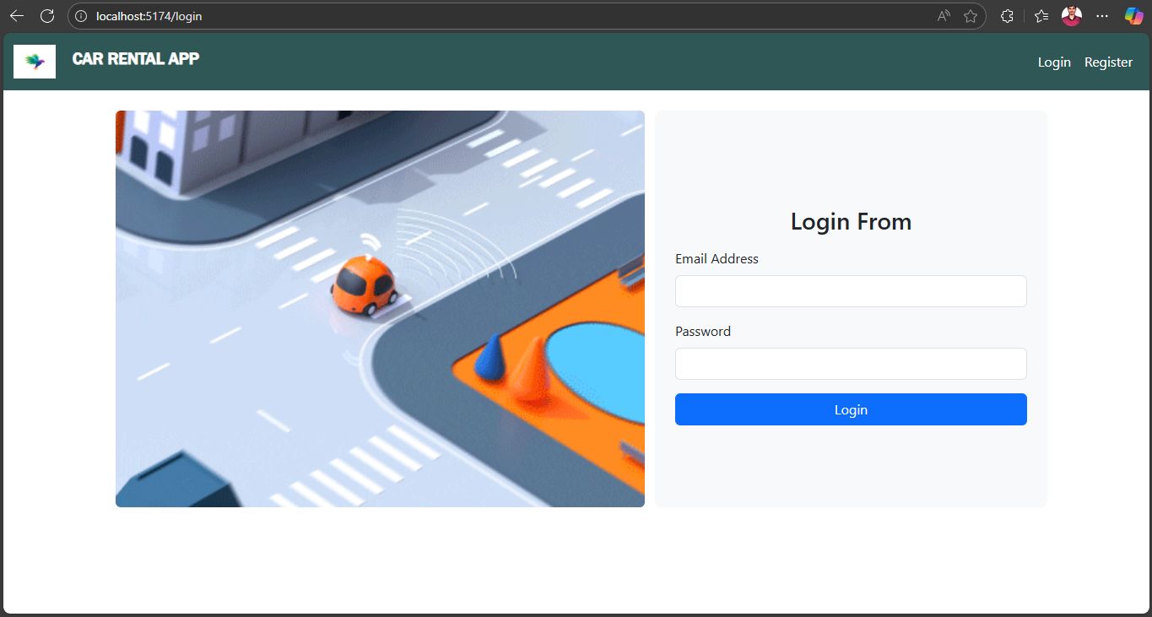
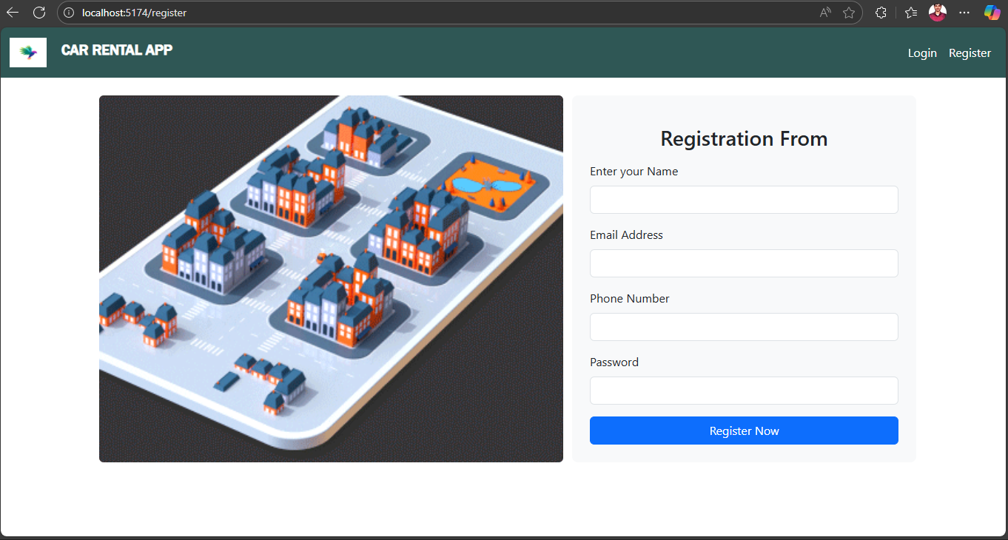
Client​

Slide 7
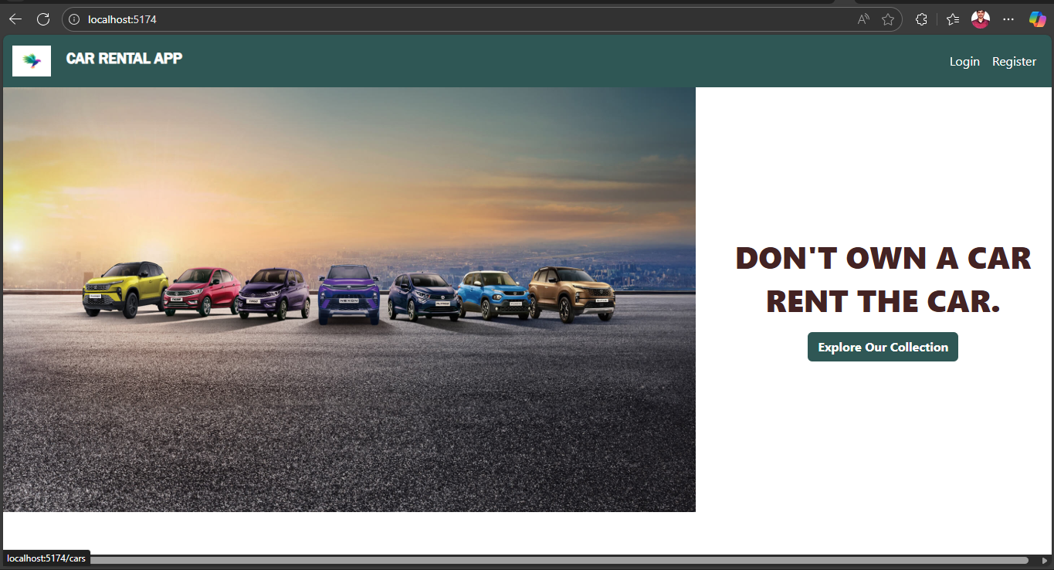
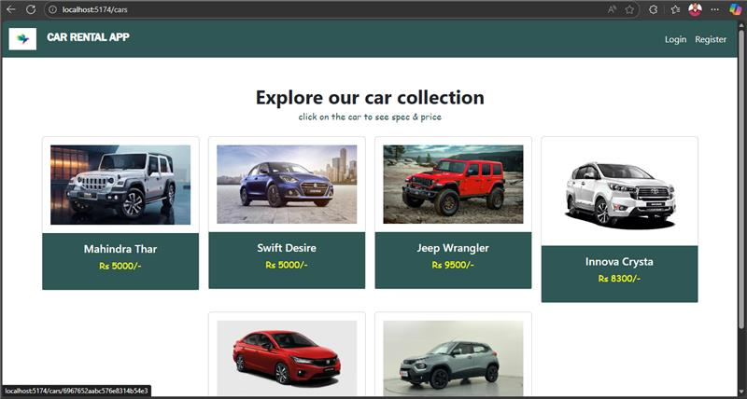
Client

Slide 8
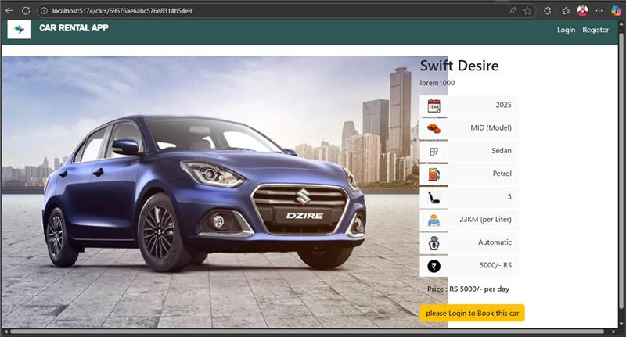
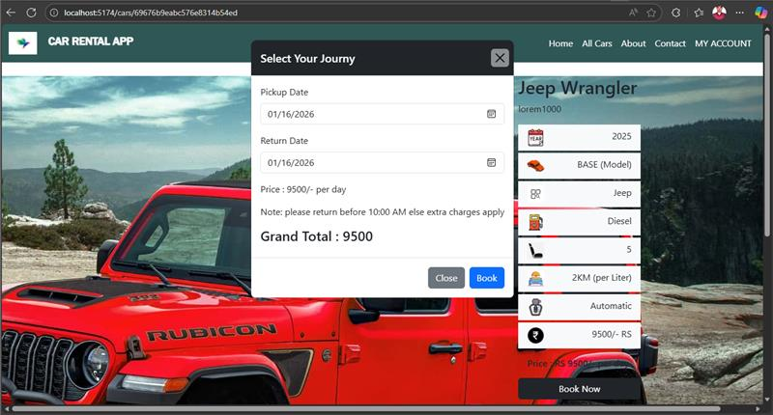
Client​

Slide 9
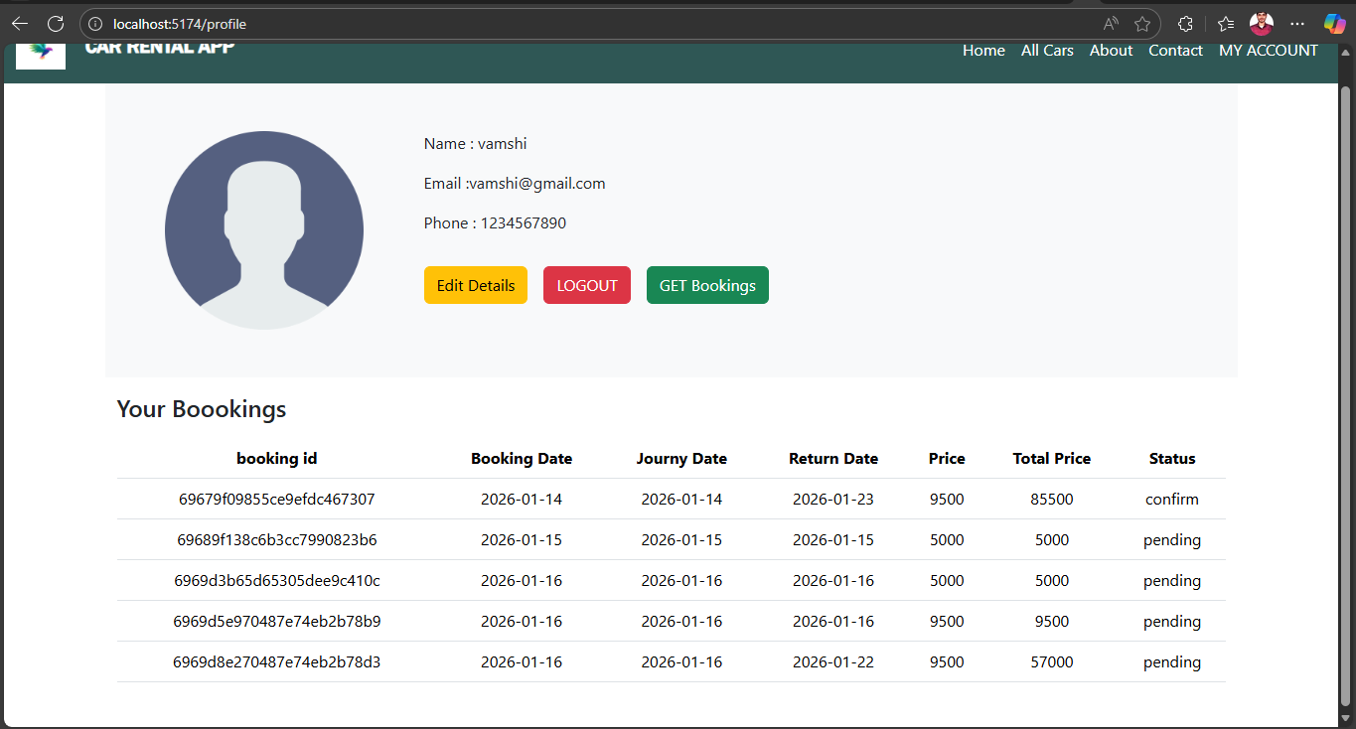
Client​​
​

Slide 10
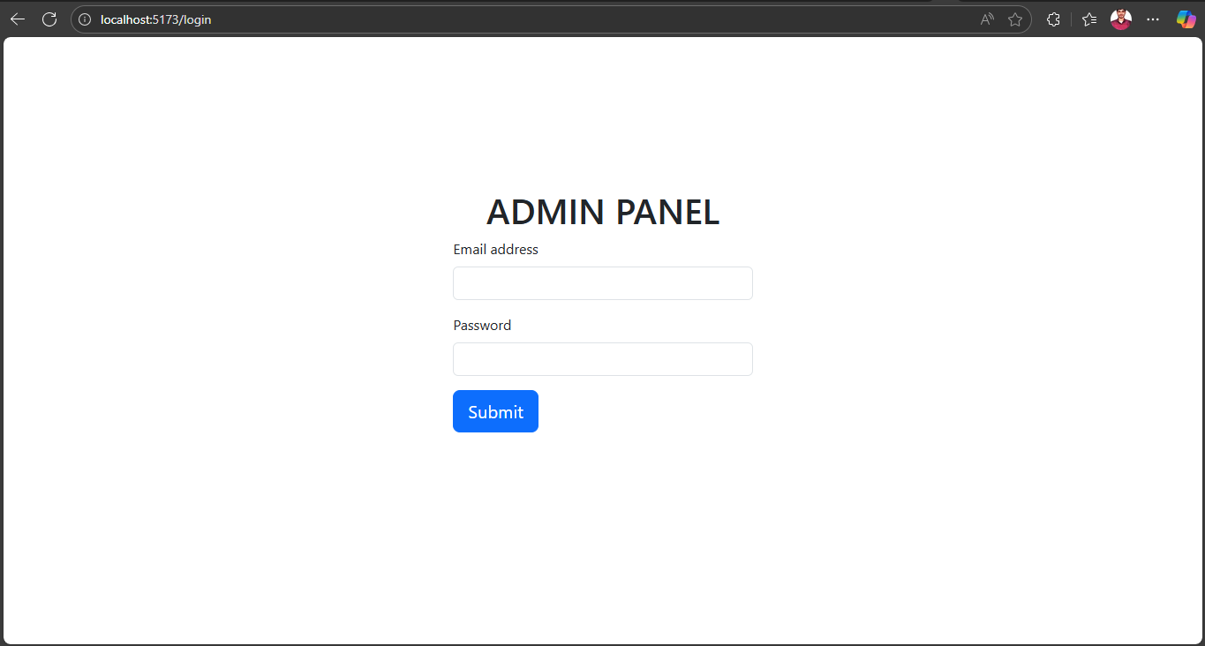
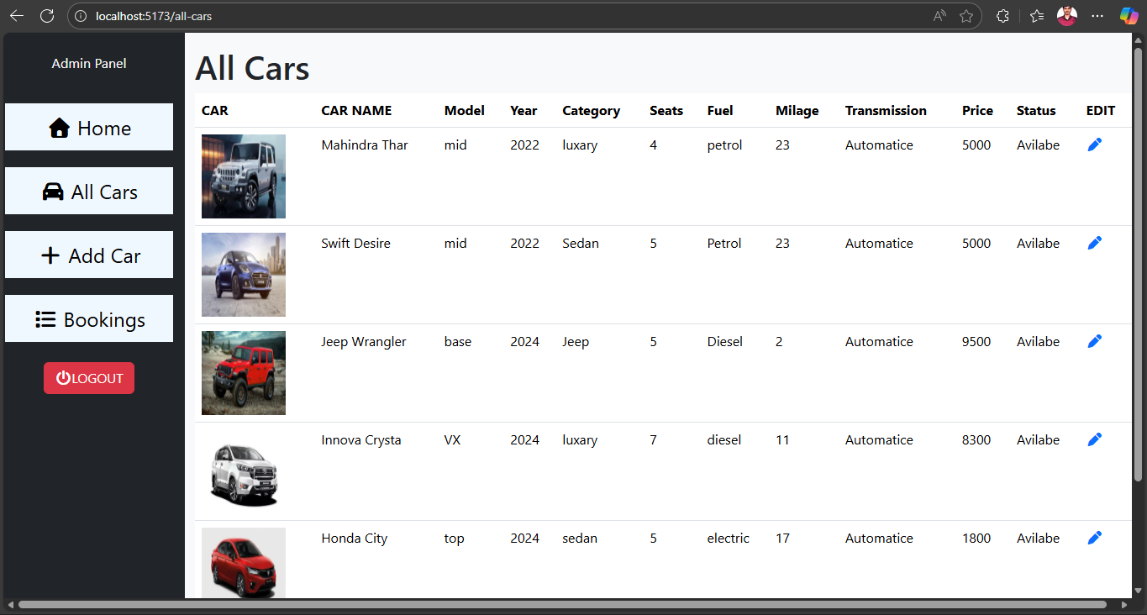
Admin

Slide 11
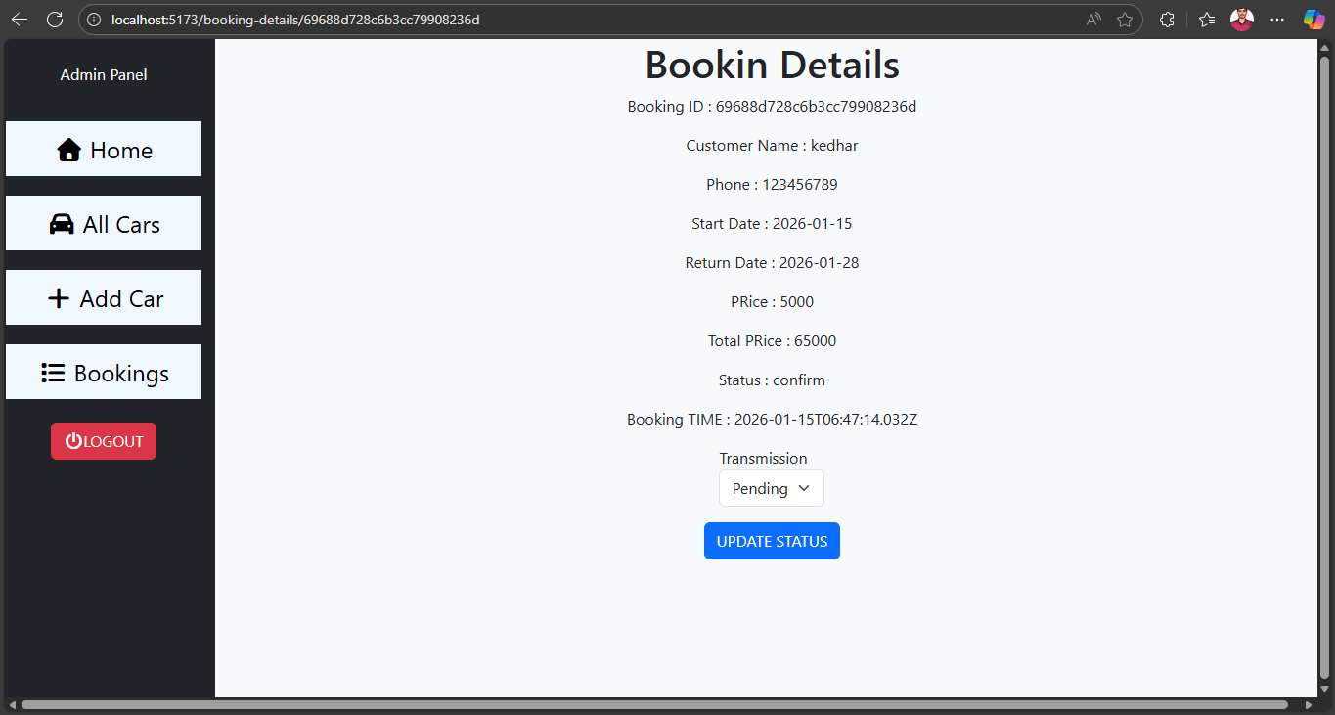
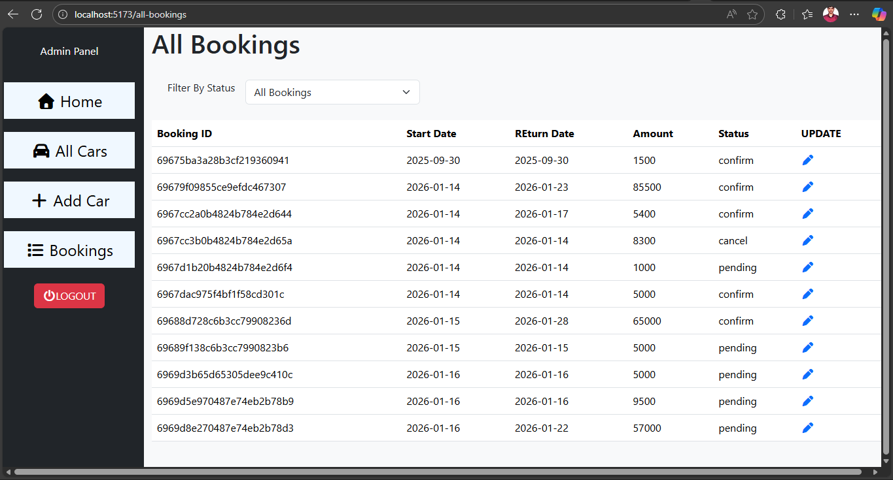

Slide 12

Future Enhancements
Mobile application development using React Native
AI-based vehicle recommendation and pricing optimization
Email and SMS notification system
Advanced analytics and reporting dashboards

