Slide 1

YENEPOYA INSTITUTE OF TECHNOLOGY
NH-13, Thodar, Moodbidri, Mangalore, Karnataka 574225
Department of Information Science & Engineering
Project Presentation on
SAFELDA
(Safe Fall Detection and Protection for Aged People)
Under the guidance:
Dr. Pradeep Udupa
Associate Prof. & HOD
Team Members:
Danvitha D - 4DM21IS012
Pradhvini M P - 4DM21IS042
Rachel Jacob Fernandes - 4DM21IS043
Thripada P - 4DM21IS058

Slide 2
CONTENTS:
Abstract 03
Introduction 04
Literature Survey 05-06
Platform Used 07-08
Problem Statement and solution 09
System proposed 10
System Implementation 11
Snapshots 12
Result 13

Slide 3
Abstract:
SAFELDA addresses the critical issue of fall-related injuries among elderly individuals by combining cutting-edge IoT technology with advanced safety features.
The system’s wearable device continuously monitors the user’s movements, and in the event of a fall, it automatically triggers an alert that is sent to caregivers or family members, along with the GPS location of the incident.
Through its combination of real-time monitoring, personalized detection, and physical protection, SAFELDA offers a comprehensive solution to one of the most pressing safety issues faced by the elderly population.

Slide 4
Introduction:
SAFELDA is an IoT-based wearable aimed at ensuring the safety of elderly individuals.
Detects falls and sends immediate alerts with GPS location to caregivers.
Features a protective airbag mechanism that inflates to reduce injury upon a fall.
Uses machine learning for personalized fall detection, reducing false alarms.
This project not only aims to safeguard the elderly from the physical impact of falls but also provides peace of mind for caregivers and family members through its comprehensive monitoring and alert system.
Reduces injury risk with an airbag mechanism and customizes fall detection using machine learning.

Slide 5
Literature Survey:
IoT Based Fall Detection System for Elderly/Physically Challenged People:
Fall is the one of the leading problems among elderly and physically challenged people. Fall detection is the major challenge in public health care domain.
Disadvantages:
Complexity: Any failure or errors in the software or hardware, power cut will cost serious troubles & made us uncomfortable.
Privacy/Security: While device provide extensive data activity and wellness, numerous tests demonstrates that the information isn't 100% precise and not by any means 80% once in a while.

Slide 6
2. Fall Detection System using XG Boost and IoT:
This project aims to design and implement a fall detection system for the elders using machine learning techniques and Internet-of-Things (IoT).
A robust fall detection system monitors the fall and alerts caregivers, hence alleviating their burden and diminishes the workload on resource constrained healthcare systems.
The main issue with fall detection systems is false alarms (situation where the system mistakenly thinks a fall has happened when it hasn’t).

Slide 7
Platform Used:
Hardware Requirements:
ESP32 Microcontroller(ESP32 DEVKIT V1):
Memory: 4MB Flash, 520KB SRAM.
I/O Pins: At least 10 GPIOs (for interfacing with QR scanner and motor).
Accelerometer (ADXL345 or MPU6050):
Detects rapid changes in movement, orientation, and acceleration to determine falls.
Gyroscope (MPU6050 or LSM6DS3):
Helps differentiate between regular movements and sudden falls by tracking angular velocity
Heart Rate Sensor- Pulse Oximeter (MAX30100 or MAX30102):
Monitors the user’s heart rate before and after a fall to detect possible health risks.

Slide 8
Mini Airbag System (Custom-made):
Deploys automatically when a fall is detected.
Uses a micro gas inflator (CO₂ cartridge) for rapid inflation.
Software Requirements:
Features:
Fall Alerts: Receive instant notifications.
GPS Tracking: View real-time location of the elderly person.
Health Monitoring: Display heart rate, body temperature, and activity data.
User Authentication: Secure login for caregivers.
Settings Panel: Adjust fall detection sensitivity and notification preferences.

Slide 9
Problem Statement And Solution Strategy:
Problem Statement:
High risk of fall-related injuries among elderly individuals, leading to severe health complications.
Exiting fall detection systems have high false alarm rates and lack real-time responsiveness.
Solution:
IoT-based wearable device with sensors for accurate fall detection.
Real time alerts with GPS location and an automatic airbag deployment system to minimize injuries.
Cloud storage for real-time data access.

Slide 10
System Proposed :
Components:
ESP32 microcontroller for processing,
Accelerometer detects rapid changes in movement and acceleration to determine falls.
Heart Rate Sensor Monitors the user’s heart rate before and after a fall to detect possible health risks.
Mobile application.
User Benefits:
Health Monitoring.
Enhanced safety.
Instant Emergency Alerts.

Slide 11
System Implementation:
HARDWARE SETUP:
The system begins with assembling the wearable device, which includes an ESP32 microcontroller, an accelerometer, a gyroscope, heart rate and temperature sensors, a GPS module, and an airbag deployment mechanism.
These components are integrated onto a compact PCB to ensure efficiency and portability. The sensors continuously collect real-time motion and health data, which is processed locally by the ESP32 before transmitting it to the cloud.
SOFTWARE SETUP:
The emergency alert system is integrated with third-party services (SMS gateways, voice call APIs, etc.) to send notifications to caregivers when a fall is detected.
The cloud server is developed using platforms such as Firebase, AWS, or a custom Node.js backend.

Slide 12
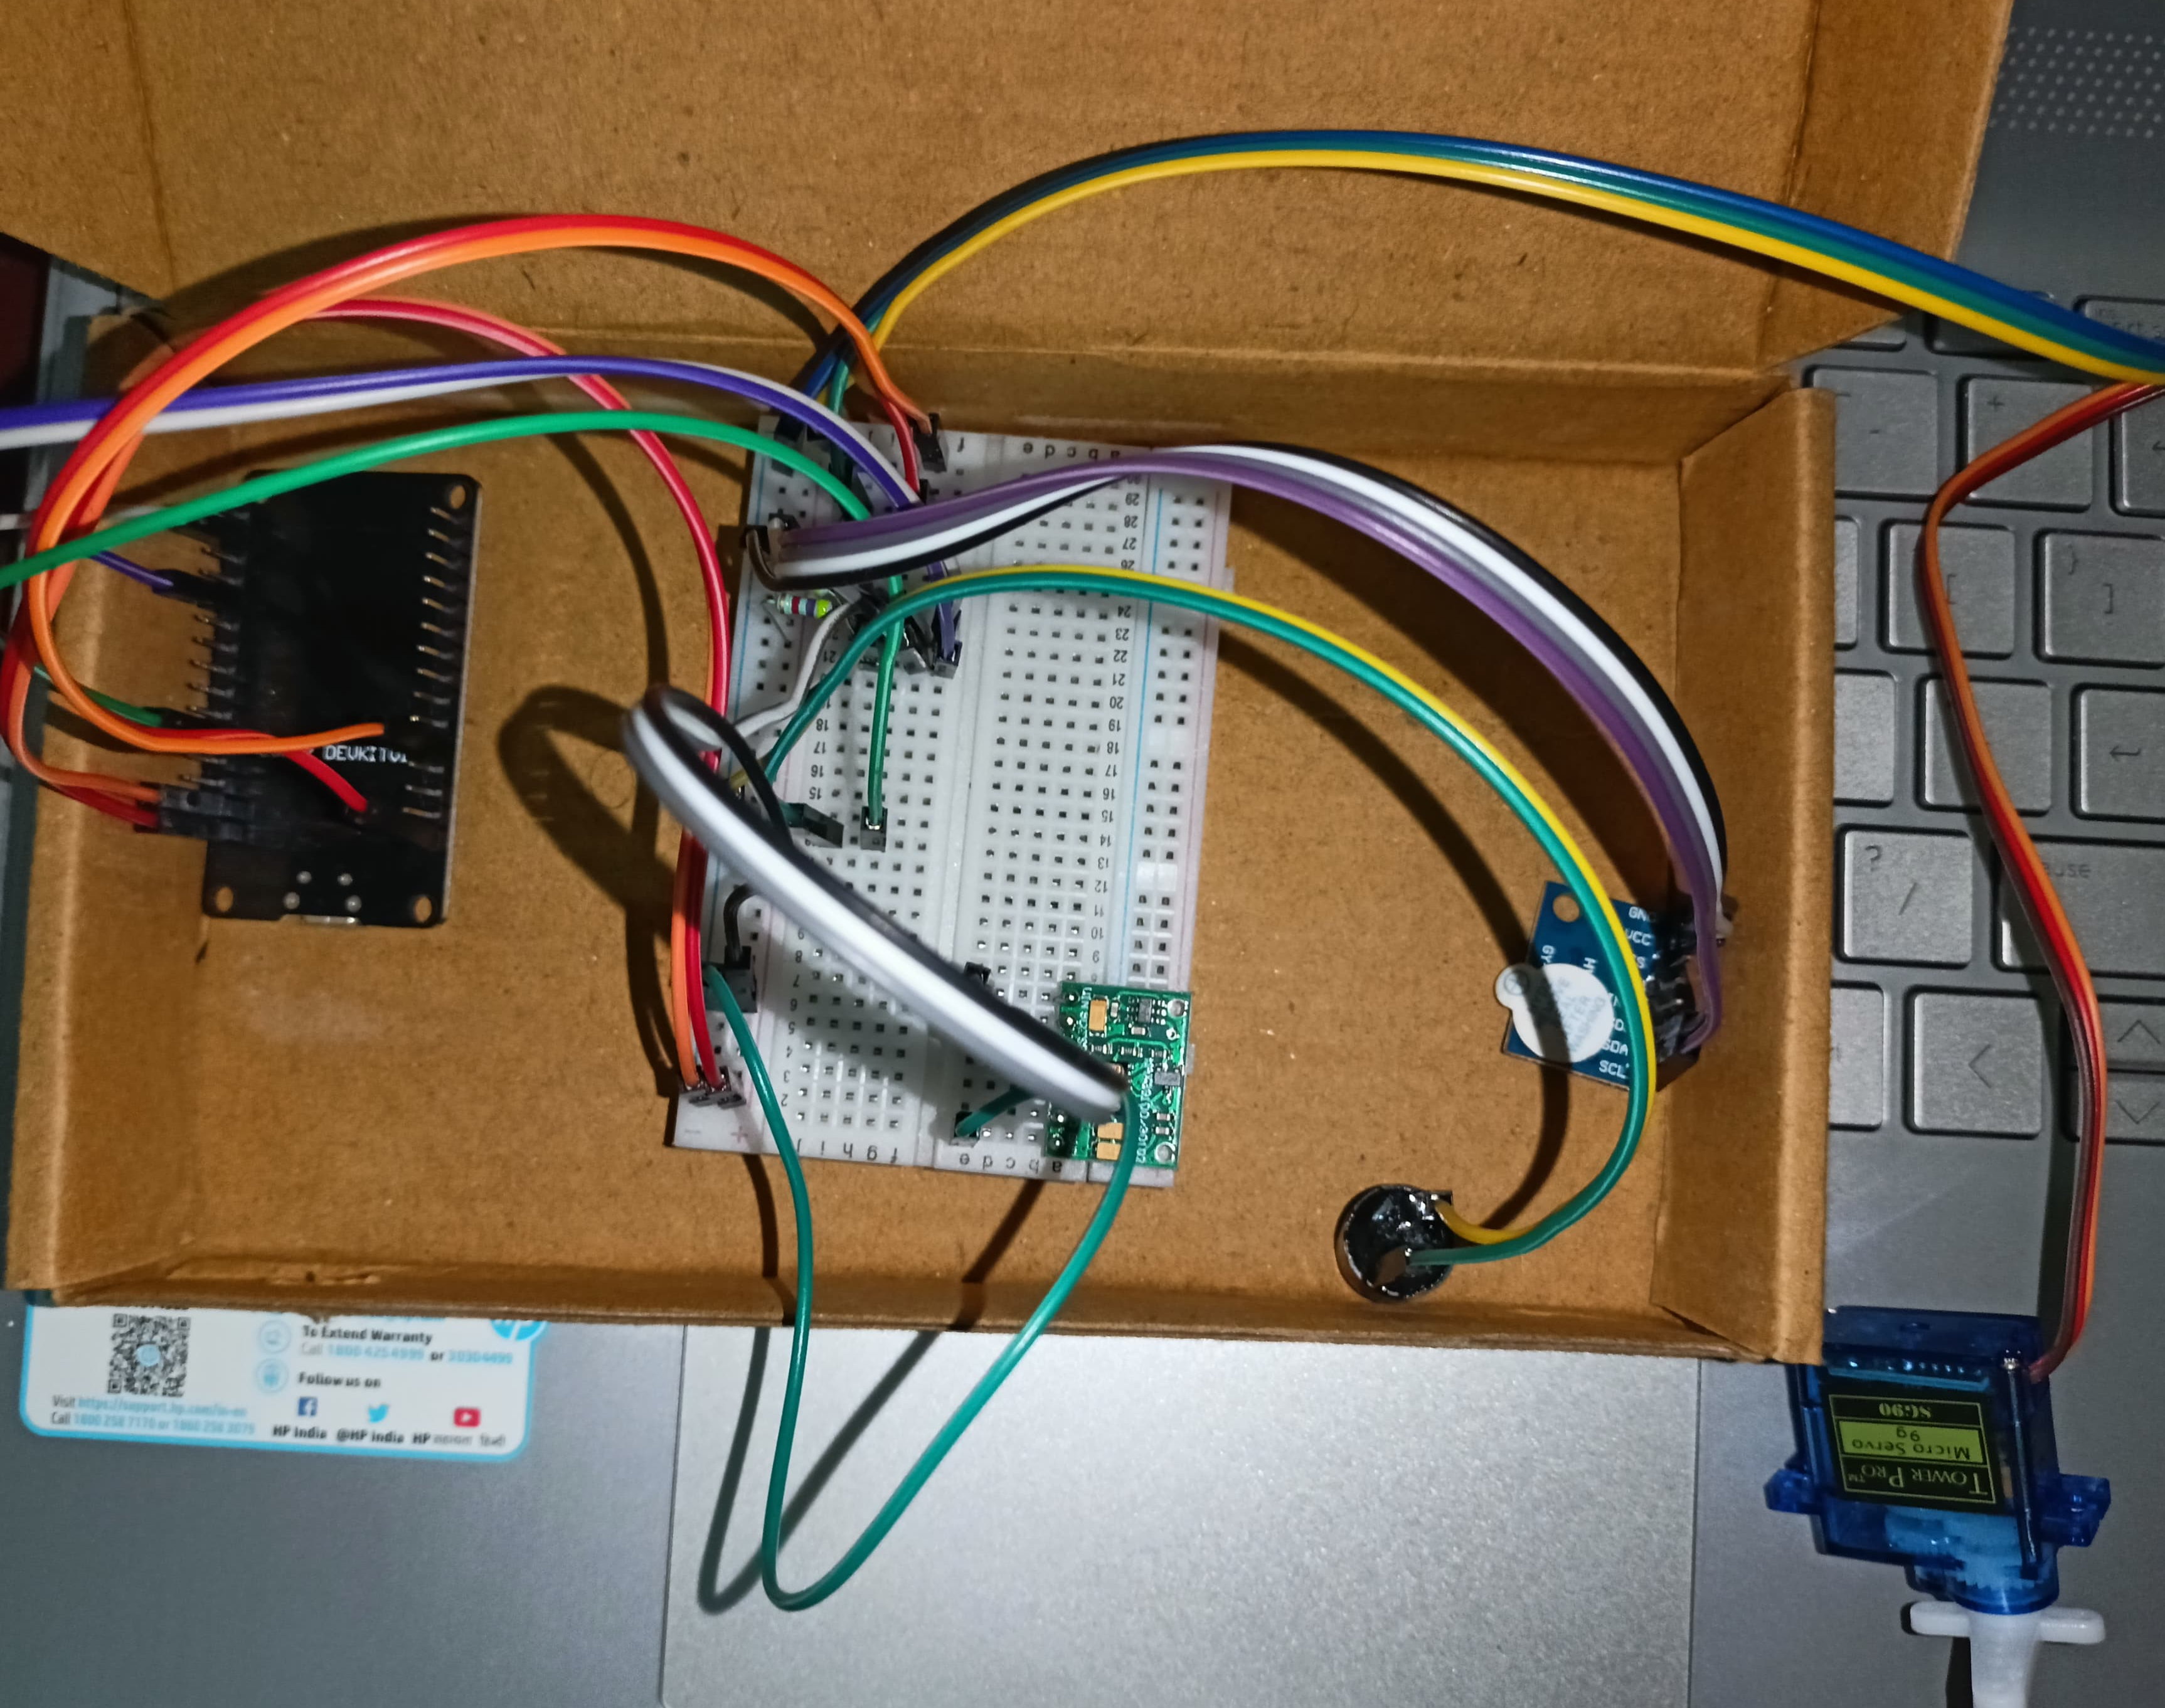
SNAPSHOTS:

Slide 13
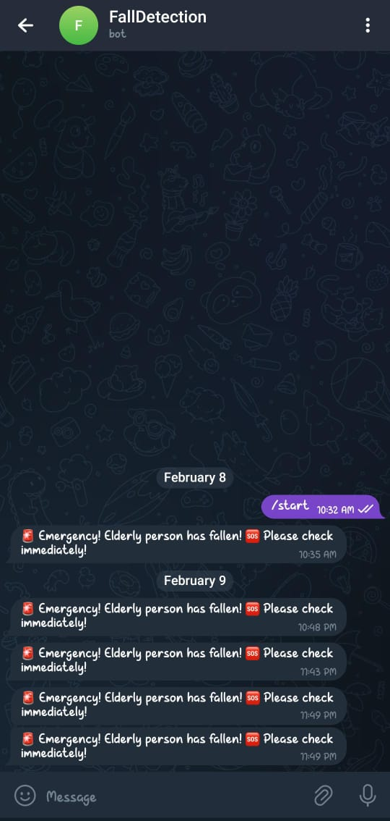

Slide 14
Result:
The IoT-based Fall Detection System for elderly people represents a significant step forward in enhancing the safety and well-being of elderly individuals
With thorough software and hardware testing to ensure reliability and performance, this system has the potential to greatly improve the quality of life for elderly individuals while providing peace of mind to their families and caregivers
The successful implementation of this project could pave the way for further innovations in healthcare technology, especially in the context of aging populations.

Slide 15
THANK YOU

