Slide 1
Is Happy Hour Truly “Happy”?
Project 1
Wuyan Xu, Dan Rapp, Yevgeniy Khmelnitskiy, Charlie Essi

Slide 2
Question
Does drinking alcohol make you happy?
What type of alcohol?
How do you define “Happiness”?
What other variables might have a coorelation with overall happiness?
How many of you drink alcohol?
Do you think there is a coorelation between your happiness and alcohol consumption?

Slide 3
Hypothesis
H₀ = Countries that consume more alcohol per capita have a higher level of happiness compared to countries who consume less alcohol per capita.
H₁ = Countries that consume more alcohol per capita do not have a higher level of happiness compared to countries who consume less alcohol per capita.

Slide 4
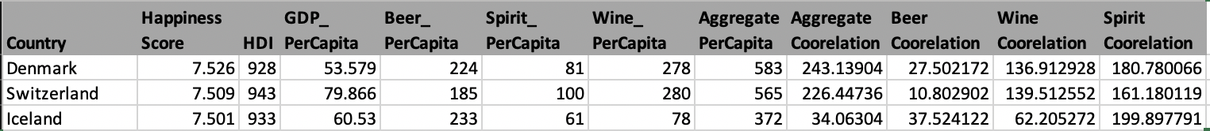
Where is the data?
Sources:
Kaggle Data
Human Development Index by United Nations Development Program
GDP Data
Alcohol Consumption per Capita
Data Cleanup and Resolution
Country Conflicts
The GDP Per capita seems skewed in countries with low population
Variables
Notes:
Happiness Score
A metric measured in 2016 by asking the sampled people the question: "How would you rate your happiness on a scale of 0 to 10 where 10 is the happiest"
Data Cleanup and Resolution
When searching for countries lat and long via api, there were some issues when searching countries due to using the right search function e.g. Georgia is a state and a country
The GDP values appear interesting, since the gdp values are higher with the African countries when it is assumed they are poorer
The Human Development Index (HDI) is a summary measure of average achievement in key dimensions of human development: a long and healthy life, being knowledgeable and have a decent standard of living. The HDI is the geometric mean of normalized indices for each of the three dimensions.
The Gross Domestic Product measures the value of economic activity within a country. Strictly defined, GDP is the sum of the market values, or prices, of all final goods and services produced in an economy during a period of time.
Per Capita for each person; in relation to people taken individually.

Slide 5
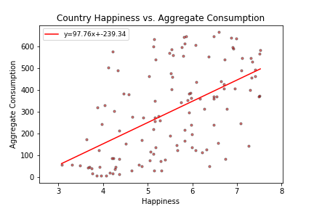
Max Consumption: Czech Republic, 665
Min Consumption: Comoros, 5
Max Happiness: Denmark, 7.526/10
Min Happiness: Syria, 3.069/10
Correlation Coefficient: .3

Slide 6
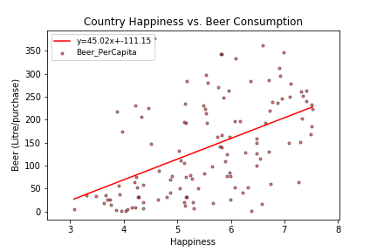
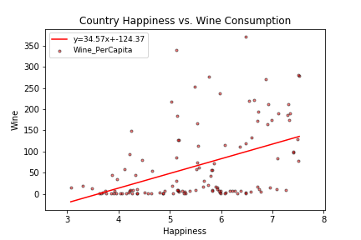
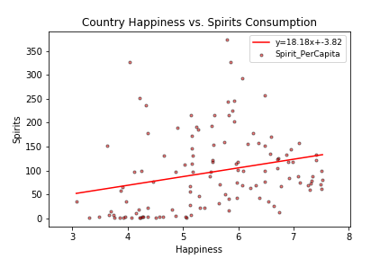
Alcohol Type | Correlation Coefficient (r²)
Beer | .243
Wine | .066
Spirits | .203

Slide 7
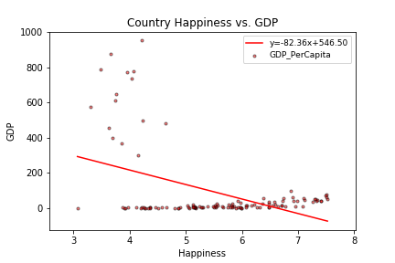
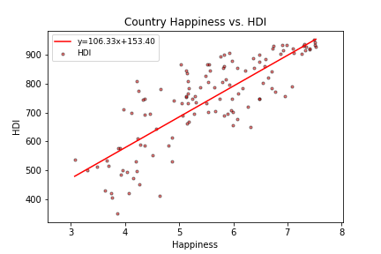
Correlation Coefficient: .2
Strongest Correlation: Spain, 4.109
Weakest Correlation: Senegal, 754.077
Correlation Coefficient: .2
Strongest Correlation: Norway, .338
Weakest Correlation: Sierra Leone, 233.240

Slide 8
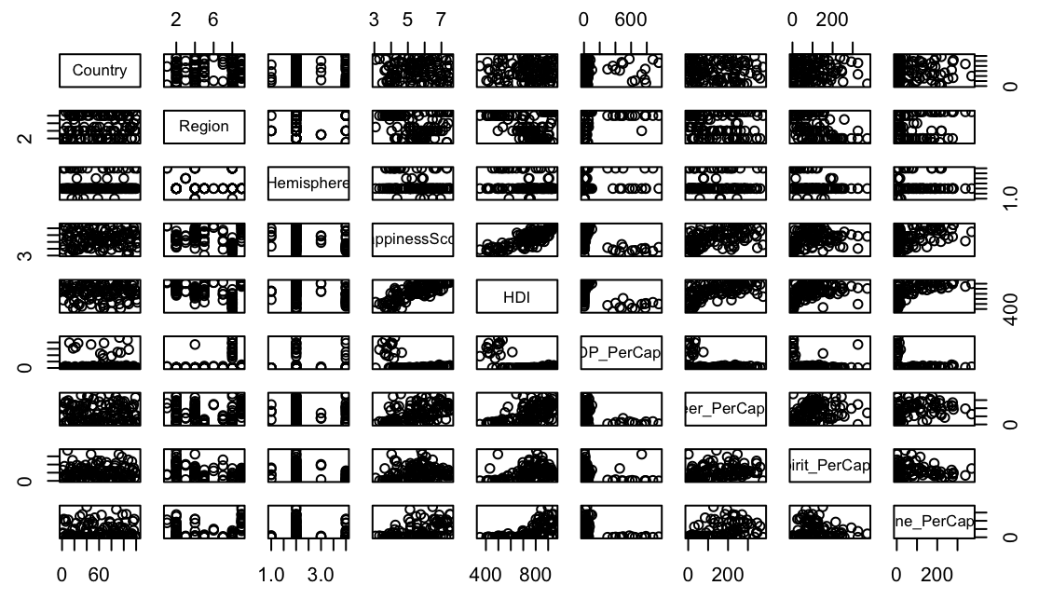
Multiple Linear Regression

Slide 9
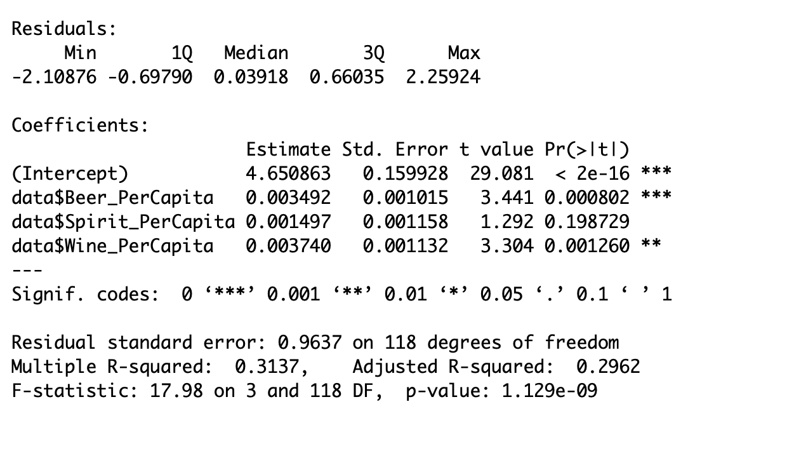
Multiple Linear Regression Results

Slide 10
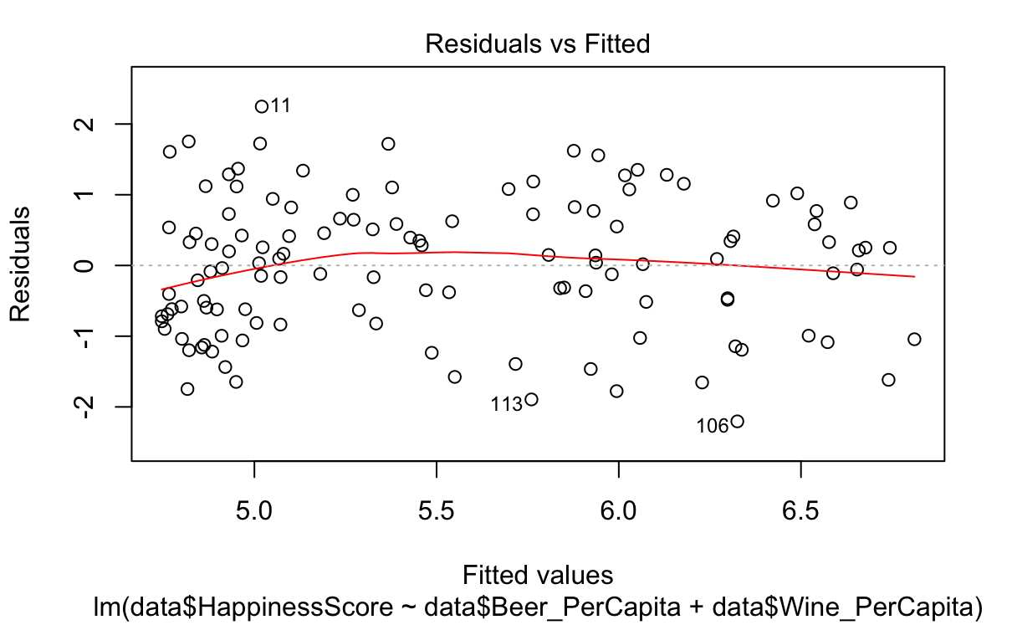
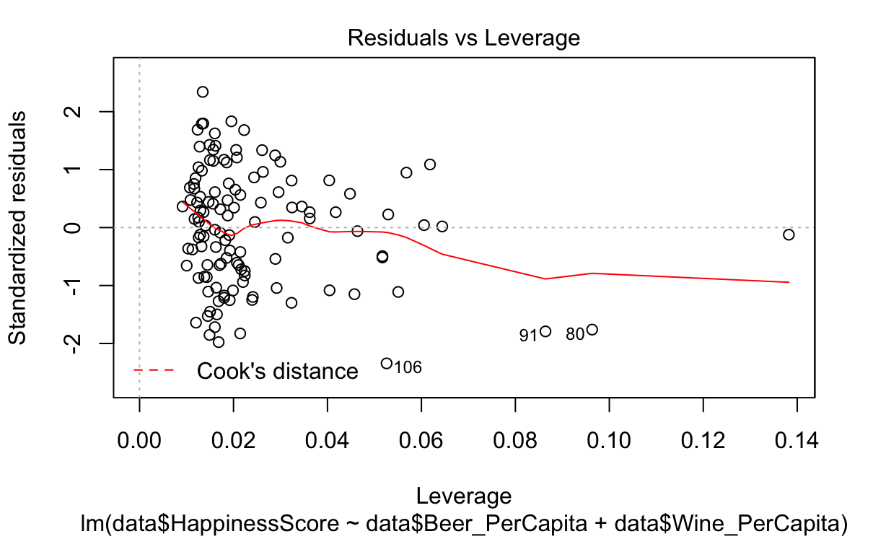
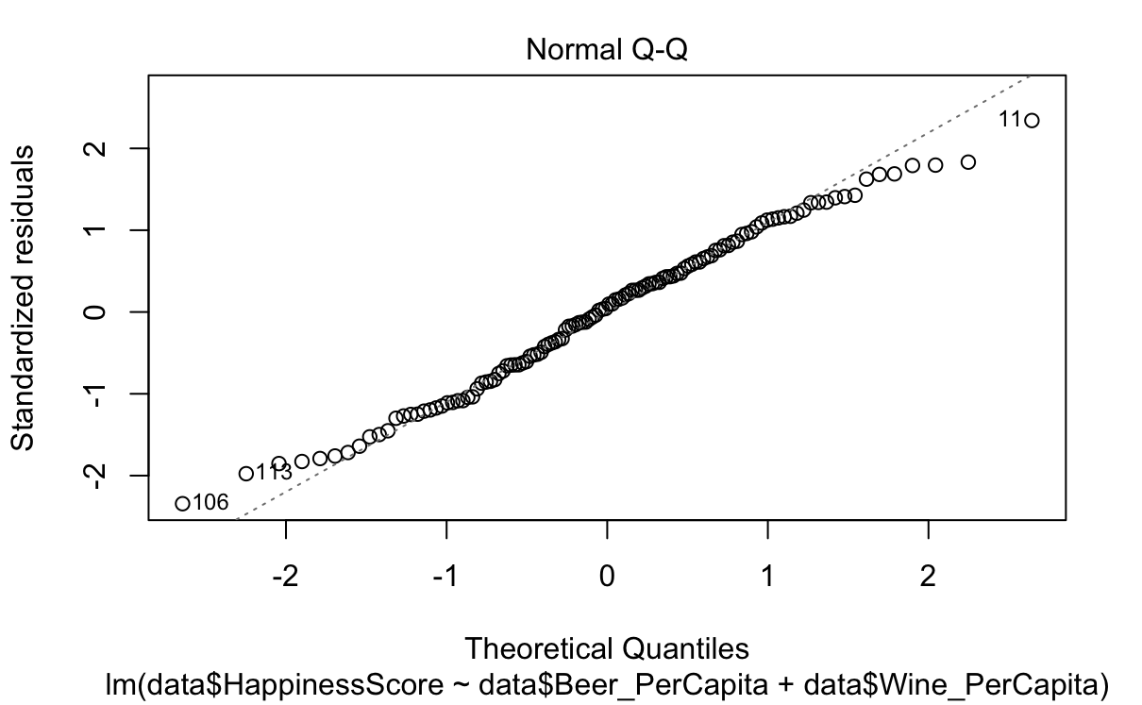
Multiple Linear Regression Results

Slide 11
Correlation by Geography
Heatmap Demonstration

Slide 12
Conclusion and Post Mortem
REJECT null hypothesis and accept
Countries that consume more alcohol per capita do not have a higher level of happiness compared to countries who consume less alcohol per capita.
Better option
HDI v Happiness
Difficulties
Further Studies?

Slide 13
Questions?
Thank you

Slide 14
Sources
Kaggle Data
GDP
Per Capita Consumption
Country Set
Human Development Index (HDI)
World Happiness Report

